Slide 1








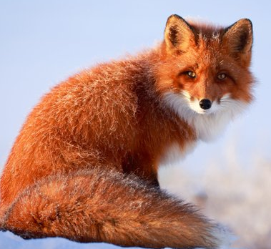
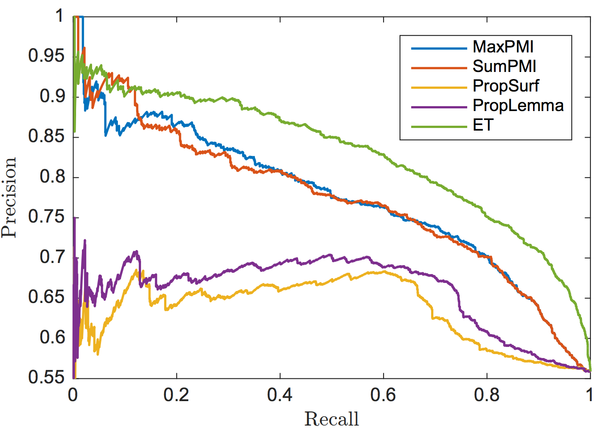
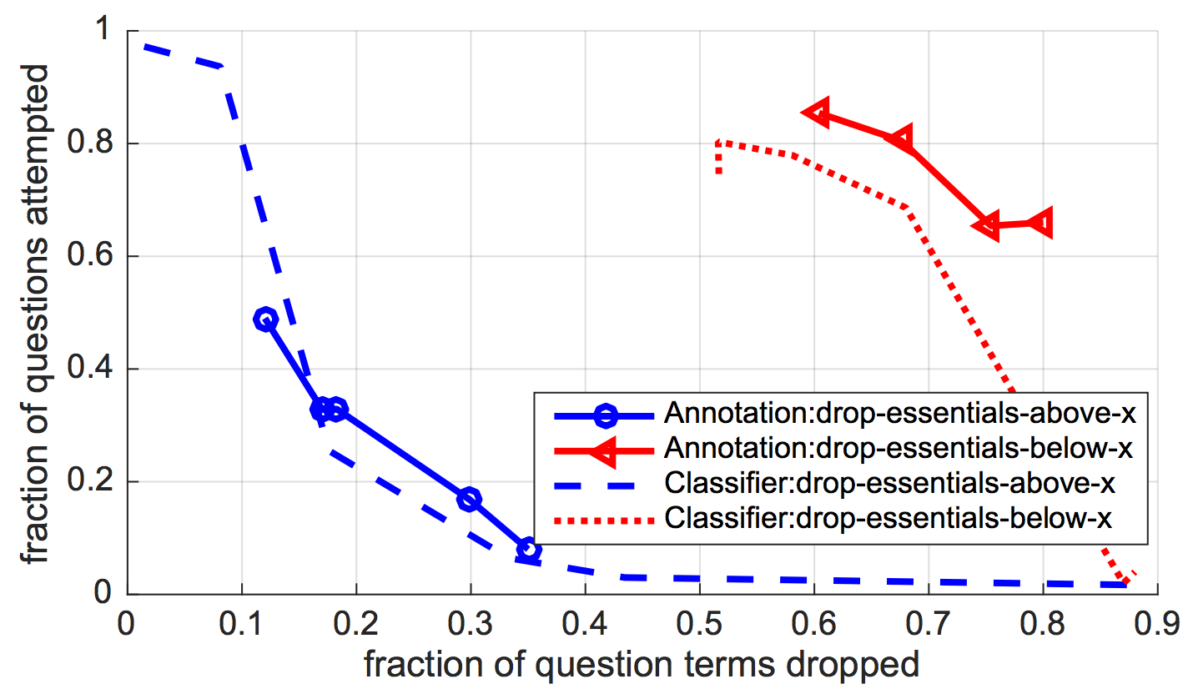
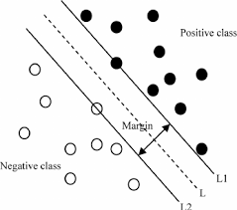


Learning What is Essential in Questions Daniel Khashabi* Tushar Khot^ Ashish Sabharwal^ Dan Roth*
^
*
Challenge for QA systems: Is a word in a question important, redundant, or distracting?
An animal grows thicker hair as a season changes. This adaptation helps to _______. (A) find food (B) keep warmer (C) grow stronger (D) scape from predators
Essentiality in Questions
State-of-the-art Essentiality classifier: F1 = 0.8, MAP = 0.9
Important for humans!
Dataset | Baseline | With ET
Regents | 59.11 | 60.85
AI2Public | 57.90 | 59.10
RegtsPertd | 61.84 | 66.84
Up to 5% increase in end-to-end QA performance
2K annotated questions 19K annotated terms

