Slide 1


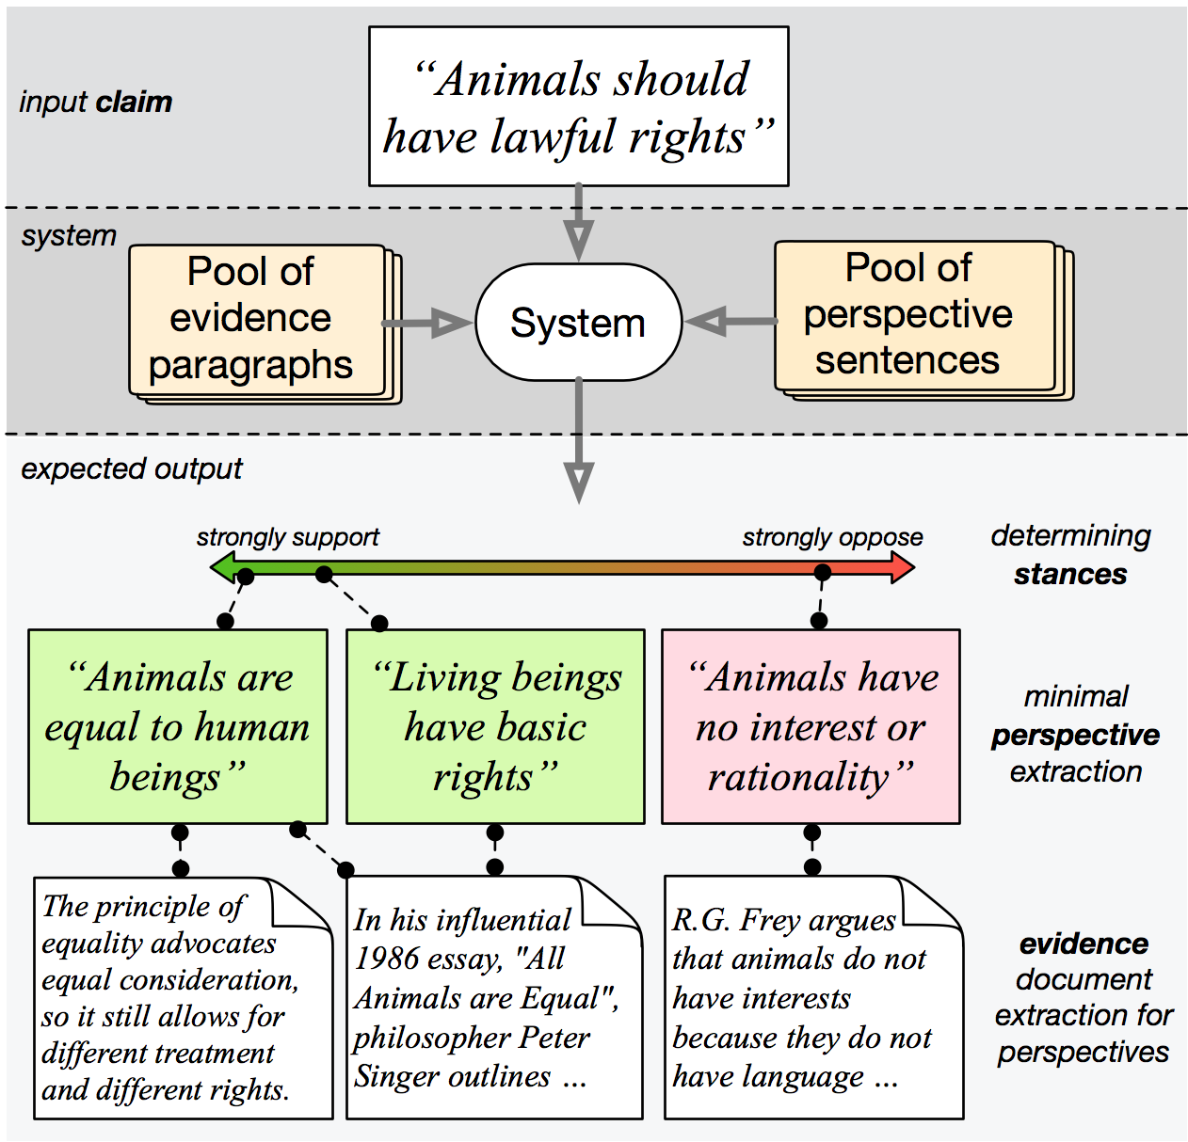
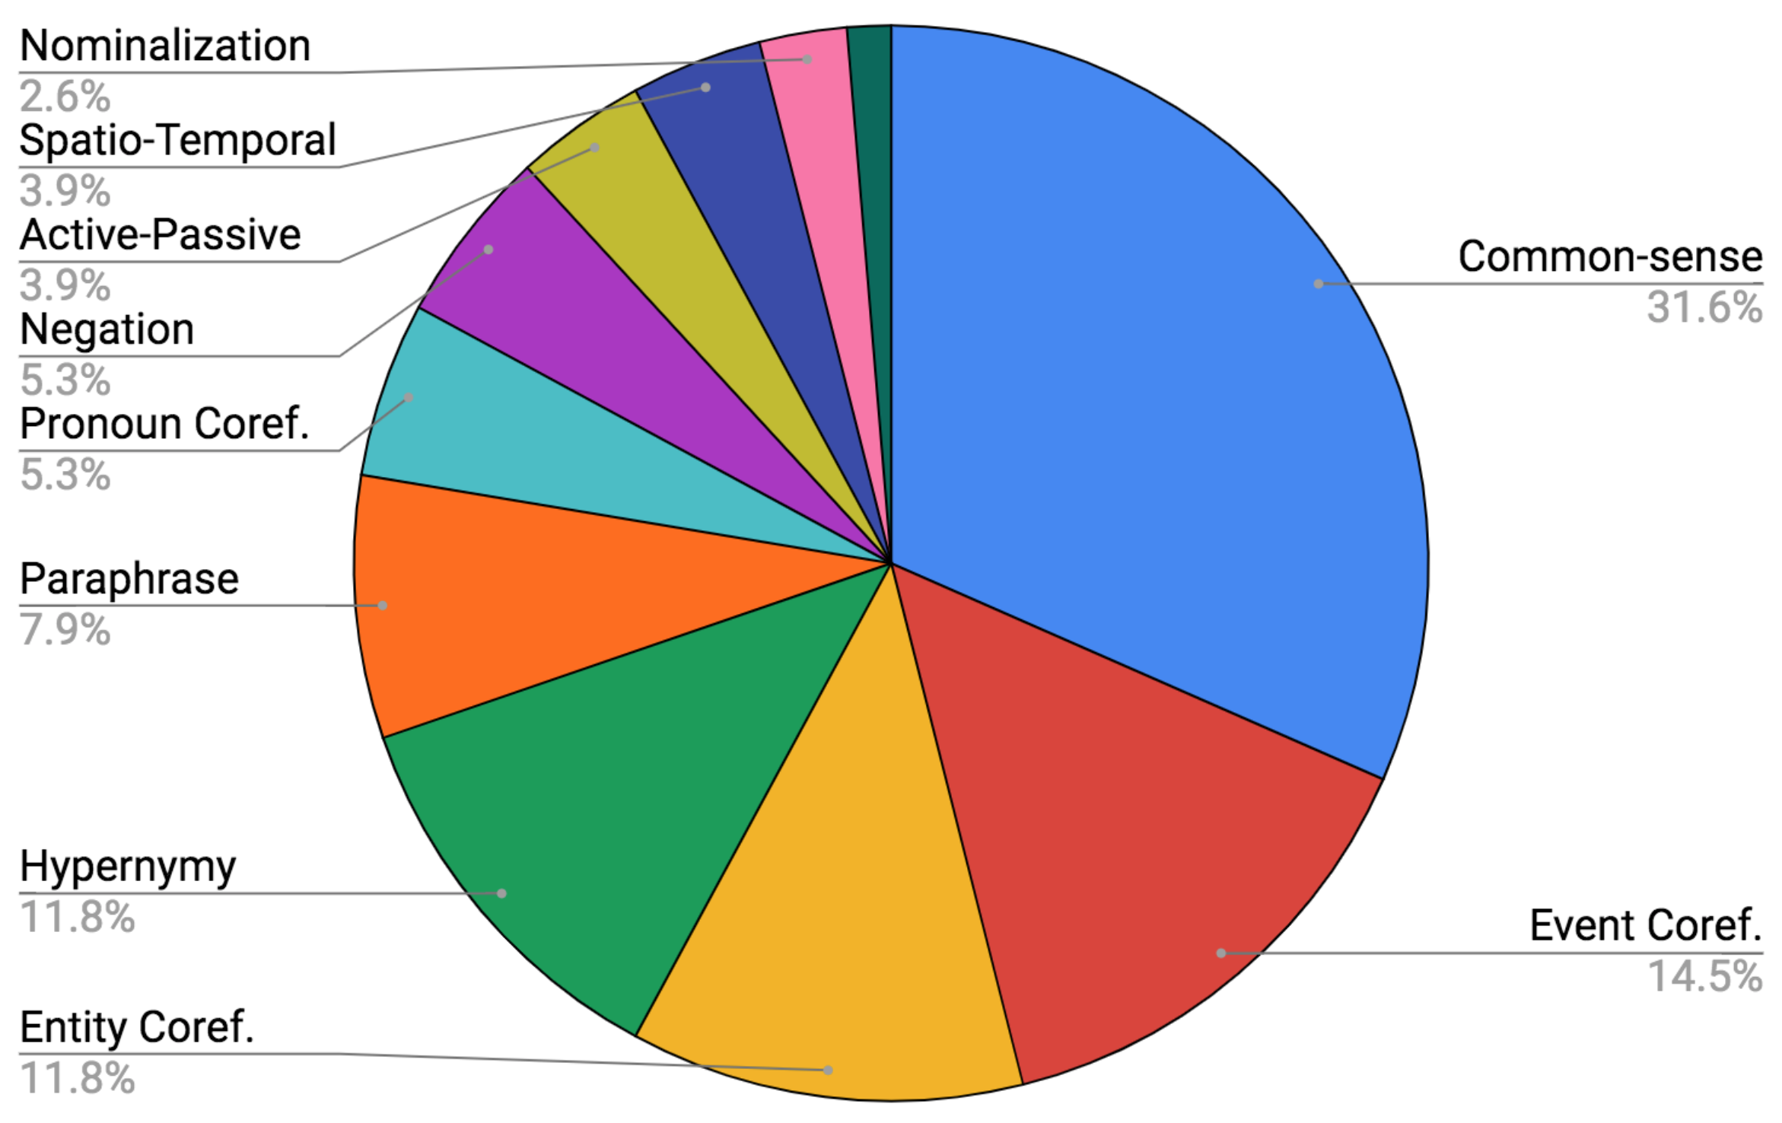
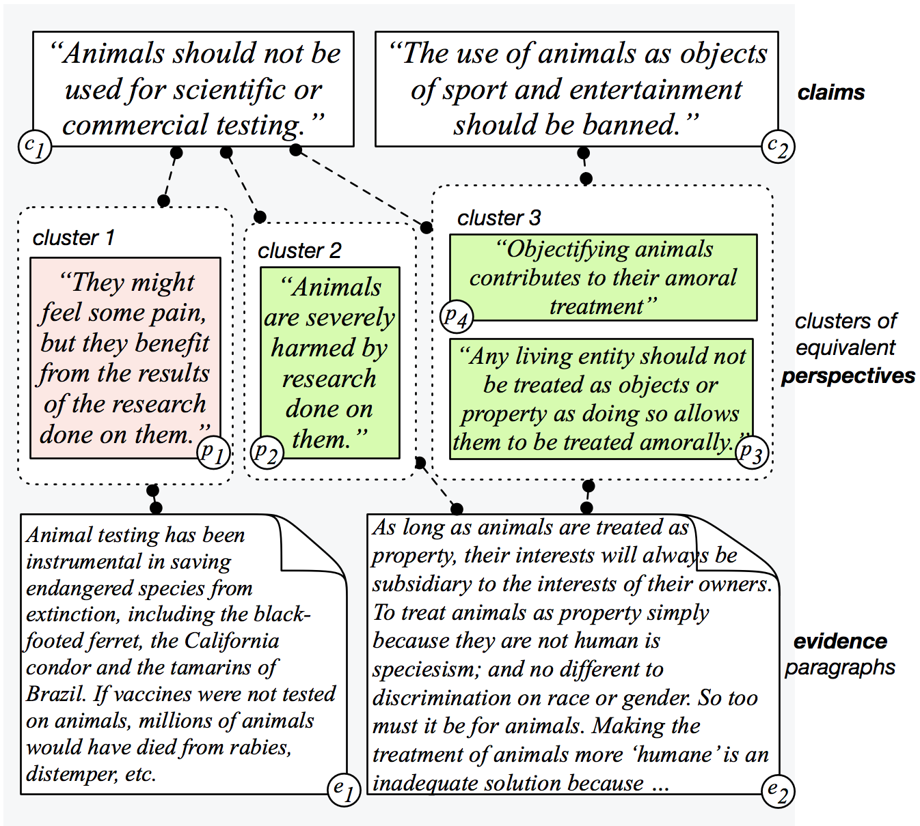
Seeing Things from a Different Angle:
Discovering Diverse Perspectives about Claims
Sihao Chen, Daniel Khashabi, Wenpeng Yin, Chris Callison-Burch, Dan Roth
University of Pennsylvania
1. Motivation
2. Task Definition
4. Challenges
Many controversial claims don’t have a single correct answer. To respond to such claims, one needs to understand the arguments with respect to the claims from different perspectives.
Take the following claim as example, “Animal should have lawful rights.”
There exist many ways to respond to the claim. These responses form a spectrum of perspectives, each taking a supporting/opposing stance with respect to the claim.
Ideally one should find an automatic way of discovering and identifying such perspectives, along with supporting evidence paragraphs.
To facilitate research in this direction, we propose the task of Substantiated Perspective Discovery, along with a large-scale, human annotated dataset PERSPECTRUM.
Given an input claim, a system is expected to find relevant arguments, or perspectives with their stance & evidence. We break down the task into foursubtasks
T1: Find all relevant perspectives to the input claim
T2: Identify the stance of each perspective
T3: Identify if two perspectives are equivalent under the same claim
T4: Extract evidence to substantiate the perspectives
5. Baseline & Results
Always “Positive”: Always predict “positive” on Stance classification task
IR: Information Retrieval Baseline
IR + BERT: Perspective Stance Classification
Human: Human Performance
Dataset Statistics
 | Always “Positive” | IR | (IR +) BERT | Hum.
T1 Relevance | - | 40.0 | 50.8 | 72.5
T2 Stance | 68.0 | - | 70.8 | 90.9
T3 Equivalence | - | 36.5 | 63.7 | 83.7
T4 Evidence | - | 46.8 | 55.7 | 60.7
Overall | 12.8 |  | 17.5 | 40.0
907
controversial claims
11,164
arguments, or perspectives
8,092
evidence paragraphs
3. Dataset Collection
13
topics, incl. politics, culture, health, etc.
Initial/Seed
Data Collection
Relevance + Stance Verification
Generate Perspectives
Collect Web Perspectives
Second Round Quality-Check
Evidence
Verification
There is a considerable gap between the performances of baselines and humans.
We collect ~1k claims,
~8k perspectives and
~8k evidence paragraphs from:
idebate.com, debatewise.org,
procon.org.
For every claim, ask mturkers to label each perspective with one of the five labels:
support, oppose, mildly-support, mildly-oppose,
not-a-valid-perspective
We ask mturkers to determine if two perspectives are equivalent relative to a claim
We ask mturkers to do another round of verification.
We use Bing search to retrieve similar perspectives.
We ask mturkers to verify their validity and stance, and only keep the invalid perspectives.
An expert annotator goes over all annotations and adds missing perspectives shared between two similar claims.
For each claim/perspective pair, we ask mturkers whether each candidate evidence paragraph provides enough support.
For more details & dataset download
Visit: http://cogcomp.org/perspectrum
Acknowledgements
This work was supported in part by US DARPA under contract HR0011-15-2-0025 and a gift from Google

