Slide 1
Optimization A focus on evolutionary optimization and its applications
Introduction to
Daniel Khashabi (d.khashabi@gmail.com)
Amirkabir University of Technology, School of Electrical Engineering
October 20, 2010

Slide 2
Lecture Overview:
Optimization and its necessity.
Classes of optimizations problems.
Evolutionary optimization.
Historical overview.
How it works?!
Several Applications of EO.
Examples.

Slide 3


Optimization
A simple function:
- Remember derivation in math(I) course!
- The goal: finding maximum and minimum
- Best answer: Global max/min
General Form Definition:
Find set which maximizes function

Slide 4
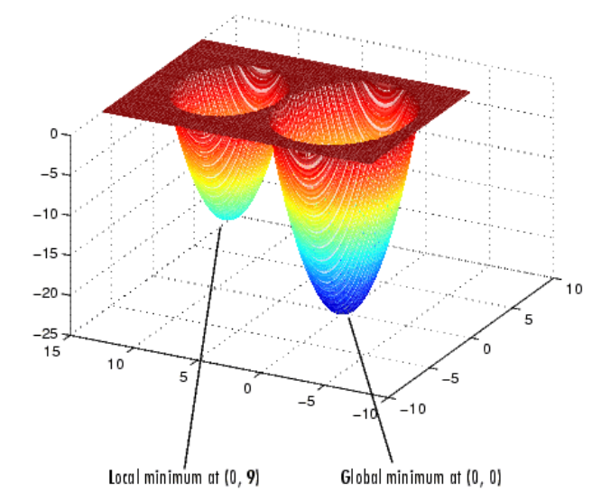
Local vs. Global; a BIG challenge!
This an important challenge !
[Optimization with Genetic Algorithm/Direct Search Toolbox : Ed Hall]

Slide 5
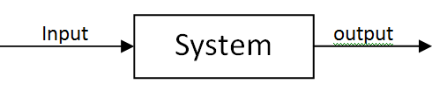
Necessity of Optimization
Every engineering design can be assumed as a black-box :
e.g. a robot, an antenna, a machine, a network, a program , …
Aim is to design black-box with
enough performance
least cost! ➔ Optimization !

Slide 6
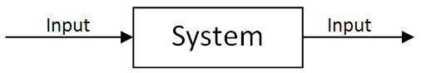
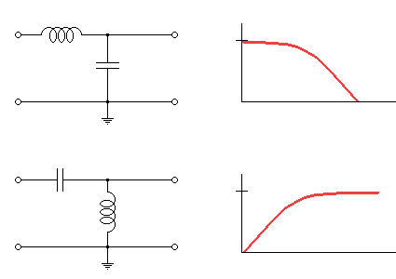
Necessity of Optimization
Some engineering design examples:
Analog Filter design:
Goal: to find a minimal arrangement of elements which gives us
desired frequency
response!
Elements:
Self inductor
Capacitor
Resistor
...
Parameters:
Arrangement of elements makes the frequency response.

Slide 7
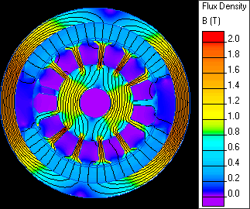
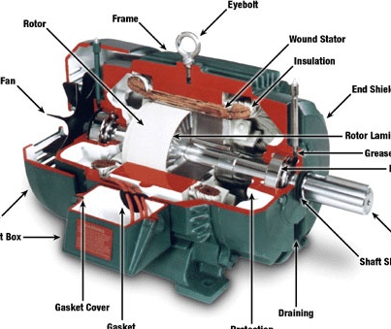
Necessity of Optimization
Some engineering design examples:
Electrical machine design:
Goal: design a motor which has best performance(Low loss)
How?
Changing internal structure of a motor(say dc motor)
Performance should be modeled
As a function!
Elements:
Number of commutator
Direction/number of
compensating windings
…
-> Design parameters

Slide 8
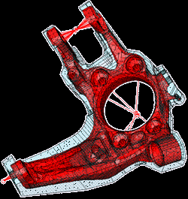
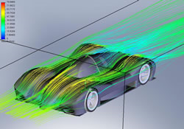
Necessity of Optimization
Every engineering design needs to be optimized!
This is the world of optimization:
Electrical machine design
Robotics
Circuit design
Antenna design
Telecommunication Routing
….
Other fields:
Structure design e.g.
Automotive design:

Slide 9
Optimization Methods
There are lots of optimization methods:
Gradient Methods.
Linear Programming.
Quadratic Programming.
…
Evolutionary Methods!
key that specifies which “method of optimization” is suitable for our challenge is characteristics of problem, i.e. complexity of problem:
Number of variables.
Constraints of variables.
Structure of function: Linearity, Quadratic or completely non-linear.
Derivability of function.
…

Slide 10
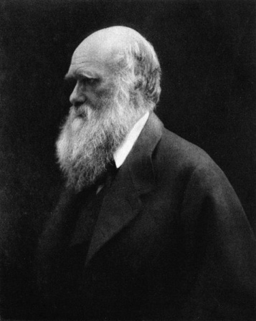
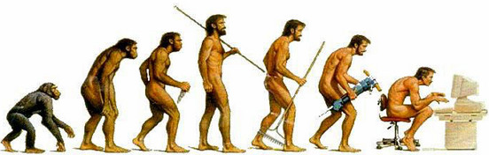
EO: Historical Overview
Inspired from Darwin's “Evolution Theory”.
Evolution of human generation during time by mutation and crossover(breeding)
Betters(Fitter) have more chance to survive
This causes generations tend to better characteristics!
Evolutionary Optimization/Genetic algorithms
Rapidly growing area of artificial intelligence.
Evolves solutions!
[http://daily.swarthmore.edu/static/uploads/by_date/2009/02/19/evolution.jpg]
[Charles Darwin: 1809-1882 : http://en.wikipedia.org/wiki/Charles_Darwin]

Slide 11

Evolutionary Optimization
A way to employ evolution in solutions
Optimization
Based of variation and selection
by understanding the adaptive processes of natural systems
Search for ?!
Find a better solution to a problem in a large space.
What is a better solution?
A good solution is specified by “Fitness Function”!
A “Fitness Function” is a function that shows how answers are desirable !
E.g. performance of a machine, gain of a circuit, ….
[http://science.kukuchew.com/wp-content/uploads/2008/05/explosm-evolution-t-shirt.jpg]

Slide 12
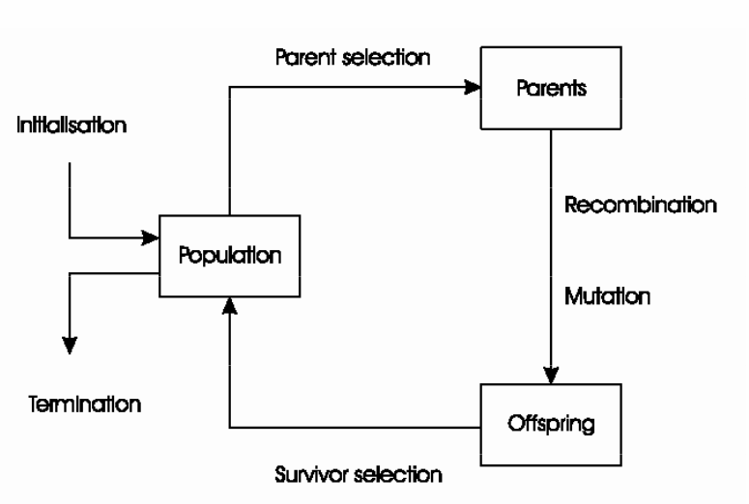
EO: How it works?
Solution of problem is formed by -> “Population”
Population consists of -> individuals.
Every population is parent generation for next generation.
Solutions are evolved in every generation. How?!
Crossover and mutation
Individuals that are more fitter -> more chance to survive!
Fitness in population grows gradually, as generations pass.
This is called “Evolution”!
[“Evolutionary Algorithms”: S.N.Razavi]

Slide 13

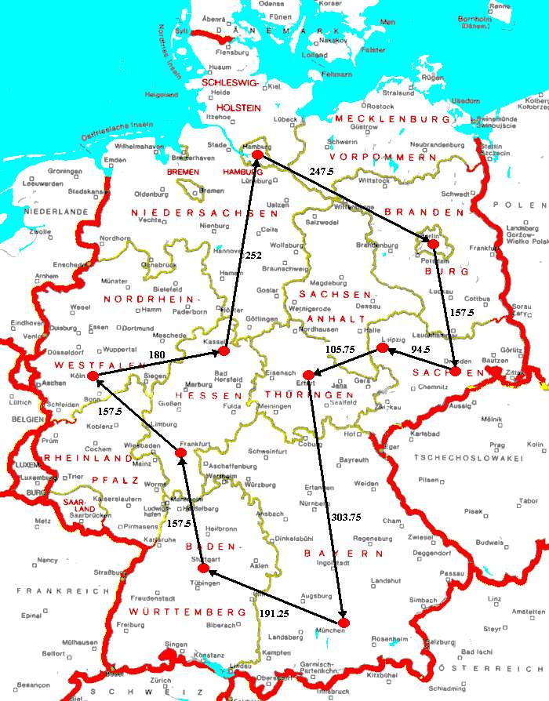
Traveling Salesman Problem(TSP)
A single salesman travels to cities and completes the route by
returning to the city he started from.
Each city is visited by the salesman exactly once.
Find a sequence of cities with a minimal travelled distance. Encoding: Chromosome describes the order of cities, in which the salesman will visit them
[Genetic Algorithms: A Tutorial: W.Wliliams]
[http://www.informatik.uni-leipzig.de/~meiler/Schuelerseiten.dir/TBlaszkiewitz/GermanyLRoute.jpg]

Slide 14

Traveling Salesman Problem(TSP)

Slide 15
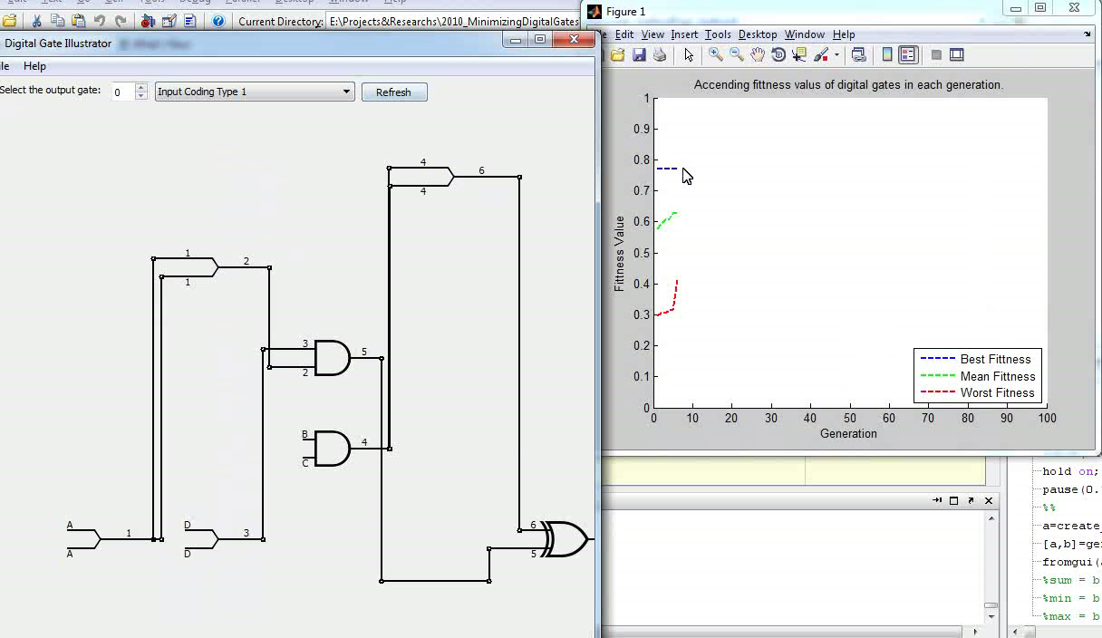
Evolvable Hardware
How to Evolve a Hardware ?! “Design and Optimizing a digital combinational logic circuit using GA.”
Example Run:
[“Design and Optimizing Digital Combinational Gates”: M.Moosavi, D.Khashabi]

Slide 16
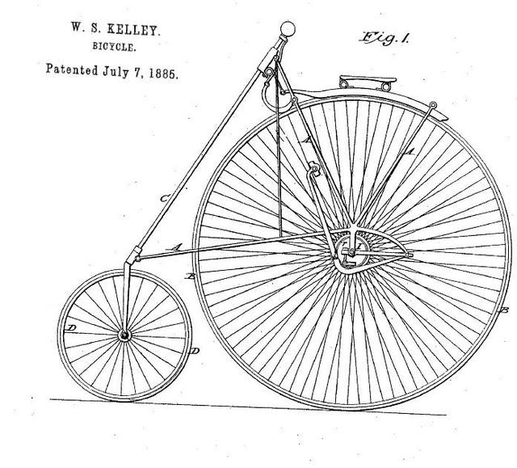
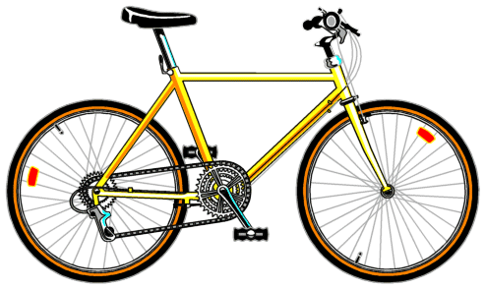
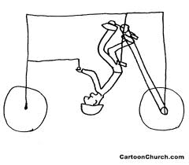
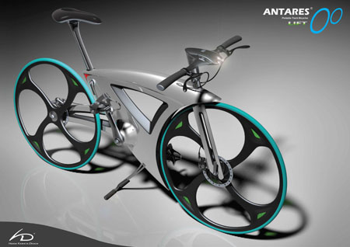
Evolving a Bicycle!
Which one is better?!

Slide 17
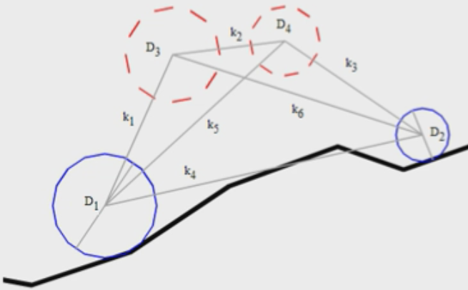
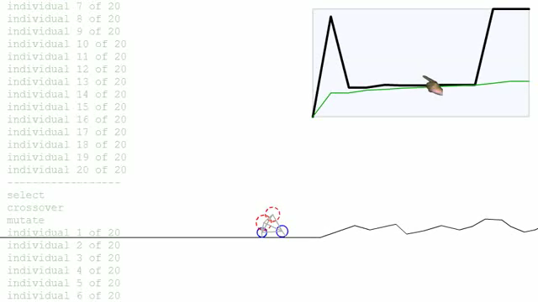
Evolving a Bicycle!
Goal: evolves a machine that is able to traverse most distance!
Parameters:
Wheel and mass diameter
Springs length and stiffness

Slide 18
Applications of Evolutionary Optimization
in a nutshell !
Control
Gas pipeline, pole balancing, Robot motion planning and obstacle avoidance …
Design Problems
Semiconductor Design, Aircraft Design, Keyboard configuration, Resource Allocation(e.g. electrical power networks.)
Signal Processing:
Filter design
Automatic Programming
Genetic Programming
…

Slide 19
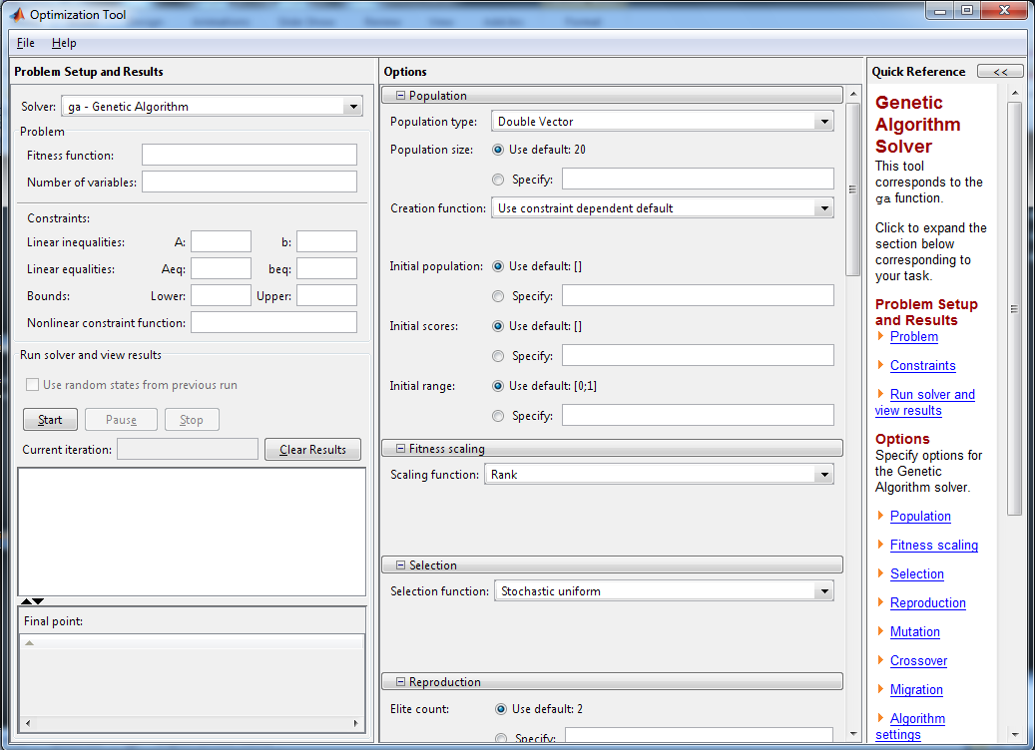
Use MATLAB!
Optimization Toolbox:
optimtool
Genetic Algorithm Toolbox:
gatool

Slide 20
Summery
Optimization and …
its necessity
Evolutionary optimization
Historical foundation
Procedure
Several examples and applications.

Slide 21
Question?
Thanks!

Slide 22
References:
[1] Wikipedia.com
[2] K.Kiani, Presentation: “Genetic Algorithms” .
[3] W.Wliliams, Presentation: “Genetic Algorithms:A Tutorial”.
[4] S.N.Razavi, Presentation: “Evolutionary Algorithms”.
[5] M.Moosavi, D.Khashabi, “Designing and Optimizing Digital Combinational Logic Circuits”, Iranian Student Conference of Electrical Engineering, August-2010.

