Slide 1

Evolutionary Optimization With focus on genetic algorithm and regarding applications
Introduction to
In memory of Caro Lucas,
Valuable Iranian Scientist
Danial Khashabi (d.khashabi@gmail.com)
Amirkabir University of Technology, School of Electrical Engineering
July 22, 2010

Slide 2
Lecture Overview:
Evolutionary optimization.
What is EO in general.
Genetic Algorithms.
Overview of search methods.
Some examples of evolutionary optimization for getting perception!
Brief history of Digital Genetics.
Introducing genetic algorithm members.
Steps for solving a problem using genetic algorithm, a detailed view.
A review on genetic algorithm.
Introducing applications of GA.
Some examples:
Optimizing a one-variable function.
Optimizing a two-variable function.
Traveling Salesman problem(TSP).
Evolving hardware using GA.

Slide 3
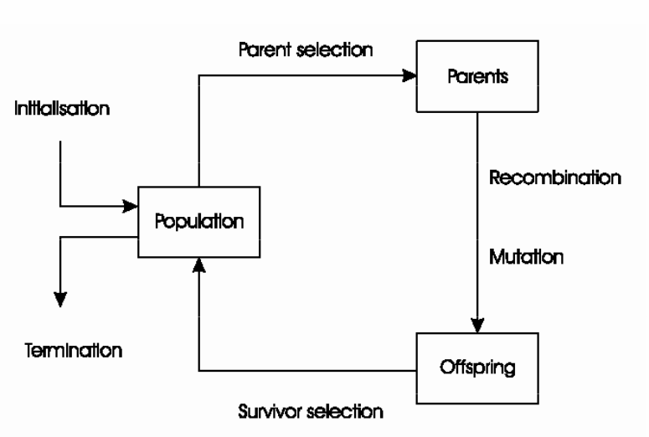
Evolutionary Optimization
Solution for problem is formed by “Population”
Population consists of individuals.
Individuals that are more fitter, have more chance to survive!
Solutions are evolved in every generation.
Every population is parent generation for next generation.
Fitness in population grows gradually, as generations pass.
This is called “Evolution”!
[“Evolutionary Algorithms”: S.N.Razavi]

Slide 4
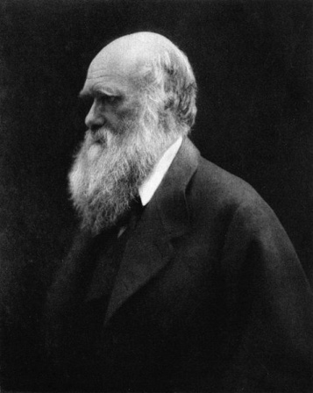
What is EO in general?
It’s a branch of Computation Theory in Computer Science?
So why an engineer needs to know about EO?
It is an optimization method and it can be applied to bunch of problems!
It is inspired from Darwin's “Evolution Theory”.
Genetic algorithms are a part of evolutionary computing, which is a rapidly growing area of artificial intelligence.
[Charles Darwin: 1809-1882 : http://en.wikipedia.org/wiki/Charles_Darwin]

Slide 5
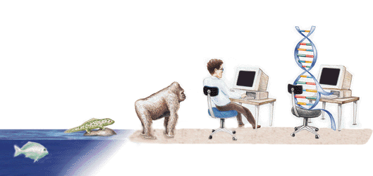
Genetic Algorithm
A way to employ evolution in solutions
Why evolution?!
Man computational problems require searching through a large possibilities for solutions.
Search and Optimization
Based of variation and selection
by understanding the adaptive processes of natural systems
Search for ?!
Find a better solution to a problem in a large space.
What is a better solution?
A good solution is specified by “Fitness Function”!
[http://media.brainz.org/uploads/2009/02/genetic-algorithms.jpg]

Slide 6
Overview of Search Methods
You are here !
[Genetic Algorithms: A Tutorial: W.Wliliams]

Slide 7
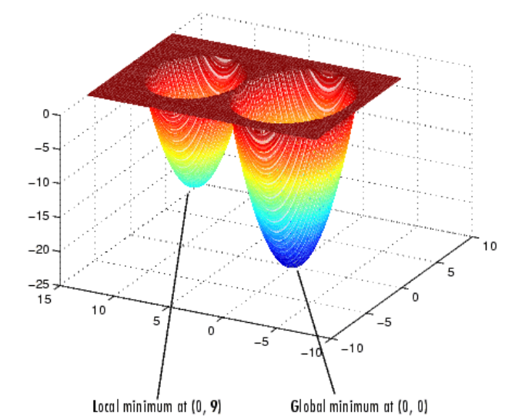
Local vs. Global; a BIG challenge!
This an important challenge !
[Optimization with Genetic Algorithm/Direct Search Toolbox : Ed Hall]

Slide 8
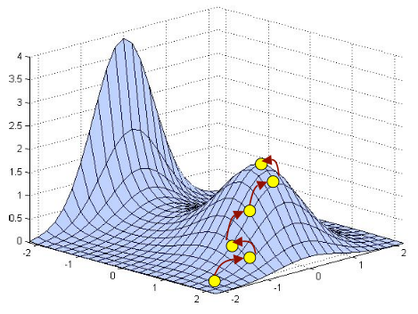
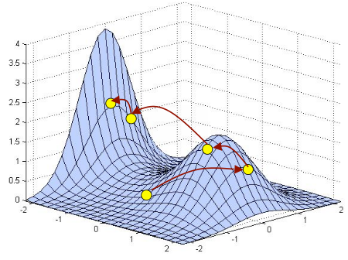
GA vs. Some other search methods
Search methods:
Aggressive methods(e.g. Simulated Annealing)
Can be trapped in local minima
Initial position is important
Non-Aggressive methods(e.g. GA)
Traces Global minima
Can not guarantee discovery of hilltop
[Genetic Algorithms: A.Dix, M.Sifalakis]

Slide 9
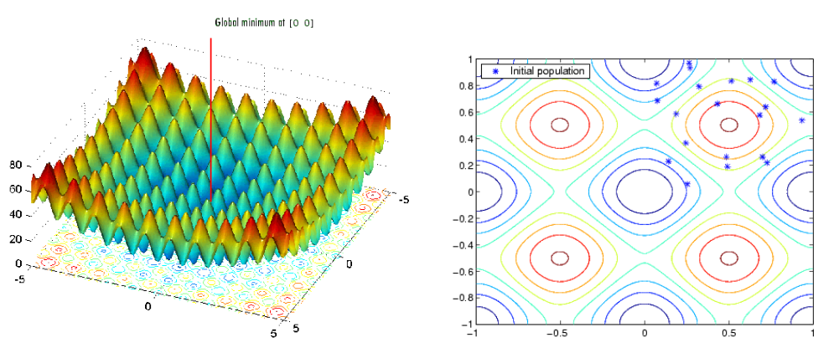
One example !
[Optimization with Genetic Algorithm/Direct Search Toolbox, E.Hall]

Slide 10
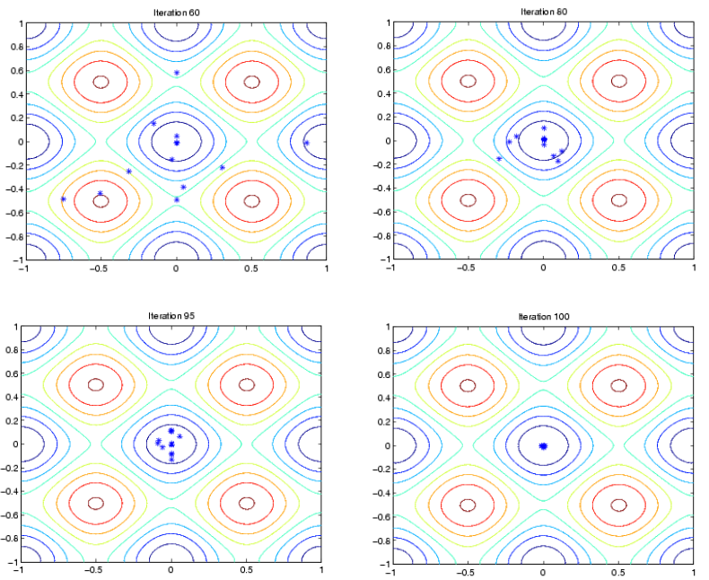
One example !
[Optimization with Genetic Algorithm/Direct Search Toolbox, E.Hall]

Slide 11
Brief History
Evolutionary computing
was introduced in the 1960s
by I. Rechenberg
in his work "Evolution strategies"
Genetic Algorithms (GAs)
invented by John Holland
This lead to Holland's book "Adaption in Natural and Artificial Systems" published in 1975.
Genetic Programming?!
In 1992 John Koza has used genetic algorithm to evolve programs to perform certain tasks. He called his method "genetic programming" (GP).

Slide 12
Genetic Algorithm
A chromosome is a string representation of a candidate solution to a problem.
Bin(0/1) 101000111010111010111
Decimal(0-9) 345304539475330394537
Alfa(A-Z) ABBCBDCCCBBDBAAABCA
Hex(0-F): 982234BA68AB23634FDD
The genes are single or subset of digits at specific locations in the chromosome string:
Bin 0101000100100111101
An Allele is possible values a gene can take; e.g. 1/0 for binary.
Gene

Slide 13
Solving a Problem using GA Step 1: Encoding
We need to encode the problem in a proper manner.
Solutions are coded as “chromosomes”
Algorithm only understands numbers.
Improper coding may result inefficient solutions.
Some times a new method of coding may result in new methods and solutions.
It’s a kind of Heuristic.
Encoding depends on the problem heavily.
This could be:
String of real numbers.
String of 1 and 0(binary coding)
This is the most common coding.
This is a simple encoding and also powerful and fast.
Chromosome A | 101100101100101011100101
Chromosome B | 111111100000110000011111

Slide 14
Solving a Problem using GA Step 1: Encoding
Example1:
Example2:
Solution for 23, ' 6+5*4/2+1' would be represented like so:
0110 1010 0101 1100 0100 1101 0010 1010 0001
6 + 5 * 4 / 2 + 1
These genes are all strung together to form the chromosome:
011010100101110001001101001010100001
The possible genes 1110 & 1111 will remain unused and will be
ignored by the algorithm if encountered.
A Sample Chromosome
1
0
1
1
0
1
0
0
0
1
0
1
1
Size
Shape
Speed
Decimal | Binary Coded Decimal(BCD)
0 | 0000
1 | 0001
2 | 0010
3 | 0011
4 | 0100
5 | 0101
6 | 0110
7 | 0111
8 | 1000
9 | 1001
+ | 1010
- | 1011
* | 1100
/ | 1101
[Genetic Algorithms: Dr.K.Kiani]

Slide 15
Solving a Problem using GA Step 1: Encoding
Example:
Every encoding needs a decoding(After Optimization)
Expected coding is :
number -> operator -> number -> operator
We may encounter some conditions that is not predicted based on encoding algorithm:
The best encoding is which:
Probability of encountering an undefined condition is low
By means of least bits it represents the most information
It covers whole search space!
We must define a rule how to deal with unexpected conditions.
By the above rule we can interpret above chromosome as:
2 + 7
0010 1010 0011 1100 0101 1010 0110 2 + 3 * 5 + 6
=30
1000 1100 0011 1101 0011 1010 0010 8 * 3 / 3 + 2
=10
0010 0010 1010 1110 1011 0111 0010 2 2 + n/a - 7 2
[Genetic Algorithms: Dr.K.Kiani]

Slide 16
Solving a Problem using GA Step 1: Encoding
Direct value encoding for real numbers:
In the value encoding, every chromosome is a sequence of some values
Example of Problem: Finding weights for a neural network
The problem: A neural network is given with defined architecture. Find weights between neurons in the neural network to get the desired output from the network.
Encoding: Real values in chromosomes represent weights in the neural network.
Chromosome A | 1.2324 5.3243 0.4556 2.3293 2.4545
Chromosome C | (back), (back), (right), (forward), (left)
[Genetic Algorithms: Dr.K.Kiani]

Slide 17
Solving a Problem using GA Step 2: GA Operators
Crossover(Recombination):
Operate on selected parent chromosomes to create new offspring
decomposes two distinct solutions (chromosomes) and then randomly mixes their parts to form novel solutions (chromosomes)
Mutation:
A surprisingly small role is played by mutation.
Randomly changes the offspring.
This creates diversity in search space.
Prevent falling of all solutions into a local optimum.
Most mutations are damaging rather than beneficial.
therefore, rates must be low to avoid the destruction of species.

Slide 18
Solving a Problem using GA Step 2: GA Operators
Crossover:
Example(Single Point Crossover)
Example(Two- Point Crossover)
Example(Simple Arithmetic Crossover)
Parents :
Pick random gene (k) after this point mix values
Random
Parent1
1010000000
Offspring1
1011011111
Parent2
1011011111
Offspring2
1010000000
Random
Parent1
1010000000
Offspring1
1011000000
Parent2
1011011111
Offspring2
1010011111
Parent 1:
0.1 | 0.2 | 0.3 | 0.4 | 0.5 | 0.6 | 0.7 | 0.8 | 0.9
Parent 2:
0.3 | 0.1 | 0.4 | 0.5 | 0.3 | 0.2 | 0.6 | 0.6 | 0.3
Offspring 1:
0.1 | 0.2 | 0.3 | 0.4 | 0.5 | 0.6 | 0.7 | 0.6 | 0.4
Offspring 2:
0.3 | 0.1 | 0.4 | 0.5 | 0.3 | 0.2 | 0.6 | 0.8 | 0.8
[Genetic Algorithms: Dr.K.Kiani]

Slide 19
Solving a Problem using GA Step 2: GA Operators
Mutation:
Example:
Example( Order Changing Mutation):
two numbers are selected and exchanged
Example(Adding Mutation)
a small number (for real value encoding) is added to (subtracted from) selected values
mutated
Random
Parent
1010000000
Offspring
1010000100
(1 2 3 4 5 6 8 9 7) => (1 8 3 4 5 6 2 9 7)
(1.29 5.68 2.86 4.11 5.55) => (1.29 5.68 2.73 4.22 5.55)
[Genetic Algorithms: Dr.K.Kiani]

Slide 20
Solving a Problem using GA Step 3: Start Optimization!
Lets have a look on optimization process:
A random population of chromosomes are generated.(Initial Population)
Repeat {
The fitness function is applied to each chromosome.(Evaluation)
Selection is applied in a favorable manner.(Selection)
Crossover is applied on pairs to generate new population.
Mutation is applied to some offspring.
}
Generating Initial Generation:
Most of time it’s random
Initial population must be diverse

Slide 21
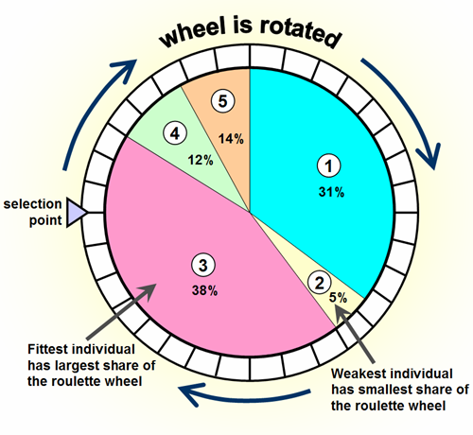
Solving a Problem using GA Step 3: Selection(Reproduction)
New generation is produced based on generation’s fitness value.
Must make sure that fittest chromosomes are propagated to the next generation.
One popular selection: Roulette-wheel selection method:
Every individual has a probability(chance) to be selected proportional proportional to its fitness value.
So better individuals(more fitted individuals) have more chance to be selected!
Even less fitted solutions have chance to be selected !
This is a good characteristic !
Causes more diversity on population.
As a result algorithm avoids of trapping in local minimum.
[http://www.edc.ncl.ac.uk/assets/hilite_graphics/rhjan07g02.png]

Slide 22
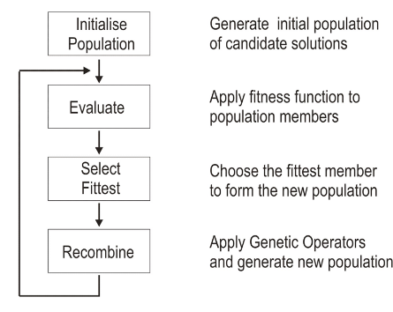
Solving a Problem using GA A Review on Algorithm:
[Genetic Algorithms: A.Dix, M.Sifalakis]

Slide 23
A Review on Characteristics:
Stochastic
Used for -> hard problems
Maintains -> population
Every Solution -> chromosome
Reproduction -> new population
Better solutions -> more chance of survival

Slide 24
Let see an examples!: one variable function(Slide1)
Optimizing a one variable function:
If
The goal is to
Because function is determined explicitly its possible to determine maximum of function by gradient:
Numerical result:
[Genetic Algorithms: Dr.K.Kiani]

Slide 25
Let see an examples!: one variable function(Slide2)
Lets again review:
What we exactly need to find maximum of a one variable function:
Find a proper encoding for solutions
A proper GA operator algorithms(Mutation and Crossover).
A proper selection method.
Now we are going to discuss each one:
Encoding:
Goal to encode real numbers [-1,2] using binary string: 111010….01
I assume this corresponding:
The length of chromosome depends on required precision.
If I need N digit of accuracy in real numbers space: (Say N is 6)
If I don’t care decimal point, I have:
So by having a 22-digit length string it is possible to compute a rang of real numbers with 6-precision, specifically [-1,2]
For finding corresponding real number from binary string, if chromosome is
000 ... 0
-1
111 ... 1
2

Slide 26
Let see an examples!: one variable function(Slide3)
Example of a chromosome:
For simplicity, we use simplest(one-point) crossover and mutation methods.
Fitness Function:
It is clear that a clear that a chromosome with higher f(x) is better!
So we can assume that: where x is real part of chromosome.
E.g:
Chromosome: 1000101110110101000111
[Genetic Algorithms: Dr.K.Kiani]

Slide 27
Let see an examples!: one variable function(Slide4)
For simplicity, we use simplest(one-point) crossover and mutation methods.
Mutation:
Crossover:
[Genetic Algorithms: Dr.K.Kiani]

Slide 28
Let see an examples!: one variable function(Slide5)
Results:
If populationSize = 50
P_crossover = 0.25
P_mutation = 0.01
Note about improvement of best answer.
After 150 generations:
Remember result from explicit method:
Generation number | Fitness function
1 | 1.441942
6 | 2.250003
8 | 2.250283
9 | 2.250284
10 | 2.250363
12 | 2.328077
39 | 2.344251
40 | 2.345087
51 | 2.738930
99 | 2.849246
137 | 2.850217
145 | 2.850227
[Genetic Algorithms: Dr.K.Kiani]

Slide 29
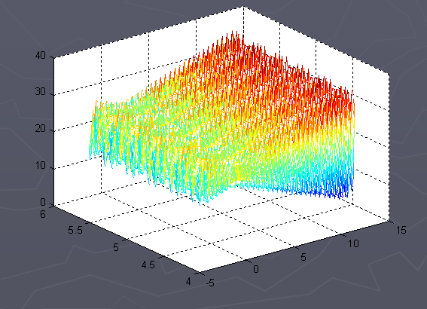
Another examples! A 2-variable function(Slide1)
If
Again we need to decode x1 and x2 like previous example.
As mentioned number of digits in chromosomes depends on desired precision.
[Genetic Algorithms: Dr.K.Kiani]

Slide 30
Another examples! A 2-variable function(Slide2)
Domain of x1 is 12.1-(-3)=15.1
4 digits of precision:
So we need 18-length bit string for representing x1
Doman of x2 is 5.8-4.1=1.7
4 digits of precision:
So we need 15-length bit string for representing x2
We can assume that out chromosome has length 15+18=33
Example chromosome: 010001001011010000111110010100010
If we want to decode? E.g.: above chromosome.
So above chromosome corresponds to (x₁, x₂)= (1.052426,5.755330)
And the fitness value for this point is: f(1.052426,5.755330) = 20.252640
[Genetic Algorithms: Dr.K.Kiani]

Slide 31
Another examples! A 2-variable function(Slide3)
Initial Population:
populationSize = 20
Generated randomly:
[Genetic Algorithms: Dr.K.Kiani]

Slide 32
Another examples! A 2-variable function(Slide4)
Evaluating by fitness fun:
It is clear, that the chromosome v₁₅ is the strongest one, and the chromosome v₂ the weakest.
[Genetic Algorithms: Dr.K.Kiani]

Slide 33
Another examples! A 2-variable function(Slide5)
We can use simplest mutation and crossover methods
By considering a selection method it is easy to calculate the solution.
Its on your own to calculate the result!
Have a look at Matlab’s GA toolbox
Just type: gatool

Slide 34
Some Important Applications of GA
Economics
Biding Strategies, stock trends
Social Systems
Numerical and Combinatorial Optimization
Job-shop scheduling, Traveling salesman problem(TSP)
Automatic Programming
Genetic Programming
Machine Learning
Classification, NN training and designing,
Control
Gas pipeline, pole balancing, missile evasion
Design Problems
Semiconductor Design, Aircraft Design, Keyboard configuration, Communication networks, Resource Allocation(e.g. electrical power networks.)
Robotics:
Trajectory Planning
Signal Processing:
Filter design

Slide 35
Traveling Salesman Problem(TSP)
A single salesman travels to each of the cities and completes the route by returning to the city he started from.
There are cities and given distances between them.
Each city is visited by the salesman exactly once.
Find a sequence of cities with a minimal travelled distance. Encoding: Chromosome describes the order of cities, in which the salesman will visit them
[Genetic Algorithms: A Tutorial: W.Wliliams]

Slide 36
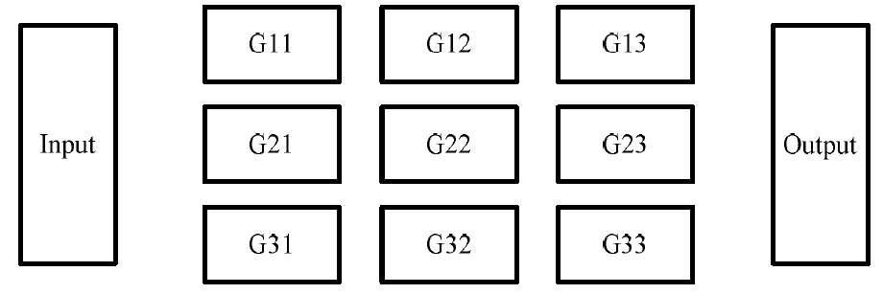
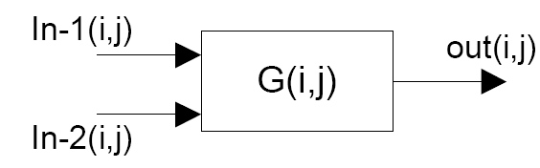
Evolvable Hardware(1)
How to Evolve a Hardware ?! “Design and Optimizing a digital combinational logic circuit using GA.”
It is important to have a proper encoding.
Assume that your gate are placed on such sheet(Gate-Matrix)
And each gate is like this(Gate-Characteristic):
Each gate get its input from previous levels: in-1(I,j) in-2(I,j).
Output is connected to a gate: out(I,j).
G(i,j) is position of gate in gate matrix.
Its possible to use several gate types, e.g. : {AND, OR, XOR, NOR, NAND}.
The only limit is that gate-matrix be a complete set, i.e. it is possible to make any circuit by the use of that set.
By designing a suitable encoding we can design an algorithm for designing a combinational circuit.
[“Design and Optimizing Digital Combinational Gates”: M.Moosavi, D.Khashabi]

Slide 37
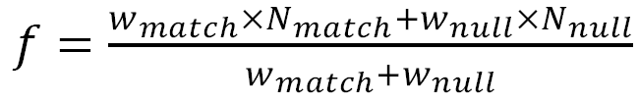
Evolvable Hardware(2)
Fitness Function: What is the best circuit?
Difference between truth table and output of circuit must be minimum(Zero is desirable)
Minimum number of gates is desired.
A weighted fitness function:
N-match is number of output that match truth table.
N-Null is number of Null gates .
W-match is weight(importance) of having true output results.
W-Null is weight(importance) of having minimum gates.
Most of times W-match/W-null = 10 is a desirable value.
Its important that output be same as truth table even though circuit isn't an optimized one!
[“Design and Optimizing Digital Combinational Gates”: M.Moosavi, D.Khashabi]

Slide 38

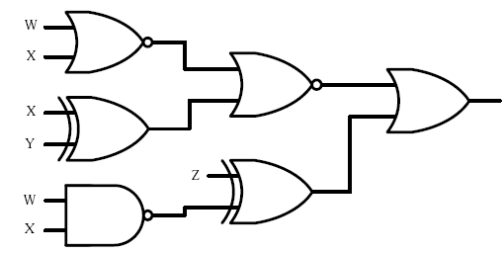
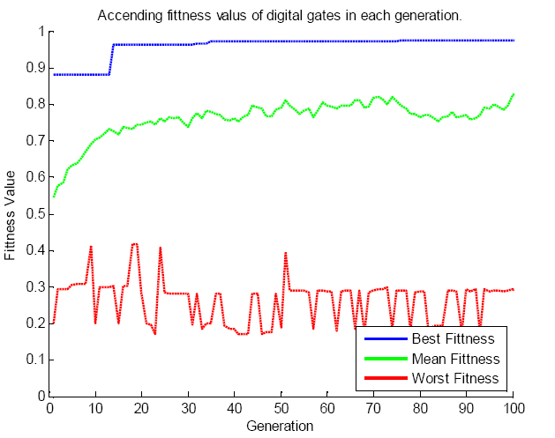
Evolvable Hardware(3)
An example of results:
If
Evolved hardware:
Fitness-value plot:
[“Design and Optimizing Digital Combinational Gates”: M.Moosavi, D.Khashabi]

Slide 39
Question?
Thanks!

Slide 40
App: References:
[1] K.Kiani, Presentation: “Genetic Algorithms” .
[2] A.Dix, M.Sifalakis, Presentation: “Genetic Algorithms”.
[3] W.Wliliams, Presentation: “Genetic Algorithms:A Tutorial”.
[4] S.N.Razavi, Presentation: “Evolutionary Algorithms”.
[5] E.Hall, Presentation: “Optimization with Genetic Algorithm/Direct Search Toolbox”
[6] M.Moosavi, D.Khashabi, “Designing and Optimizing Digital Combinational Logic Circuits”, ISCEE-2010(Submitted!).

