Slide 1

Emergent phenomena in large-scale LLMs
Daniel Khashabi
Notes:
Thank you for having me! It's an honor to be here.

Slide 2
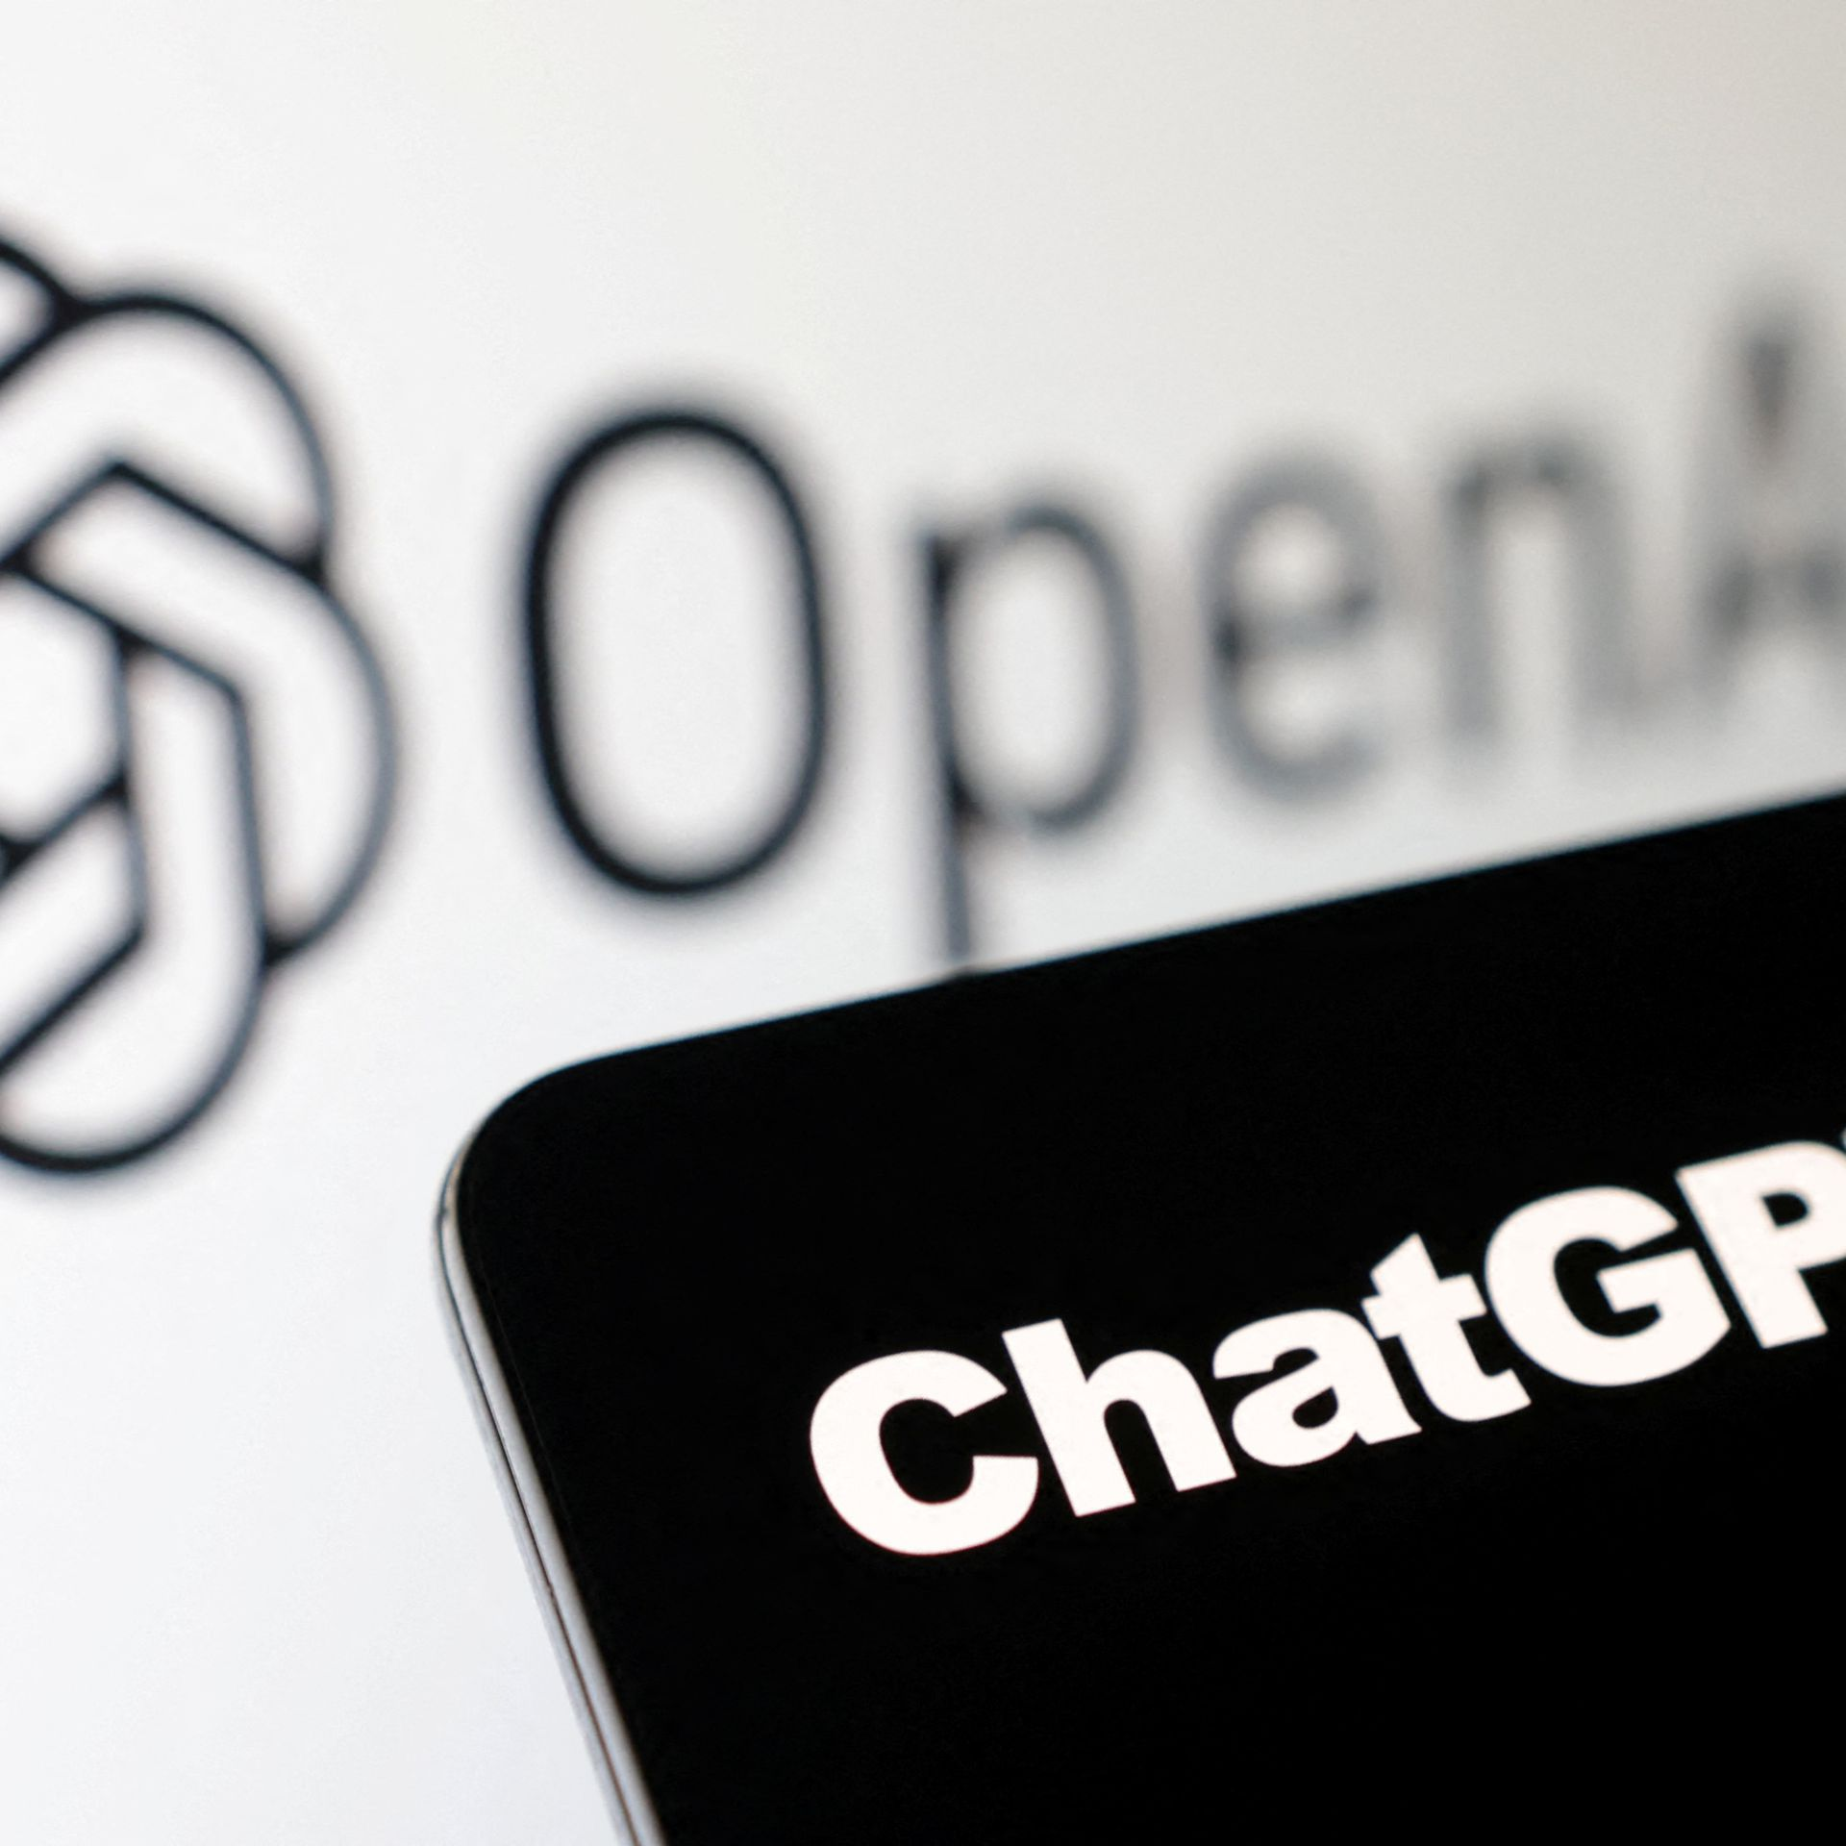


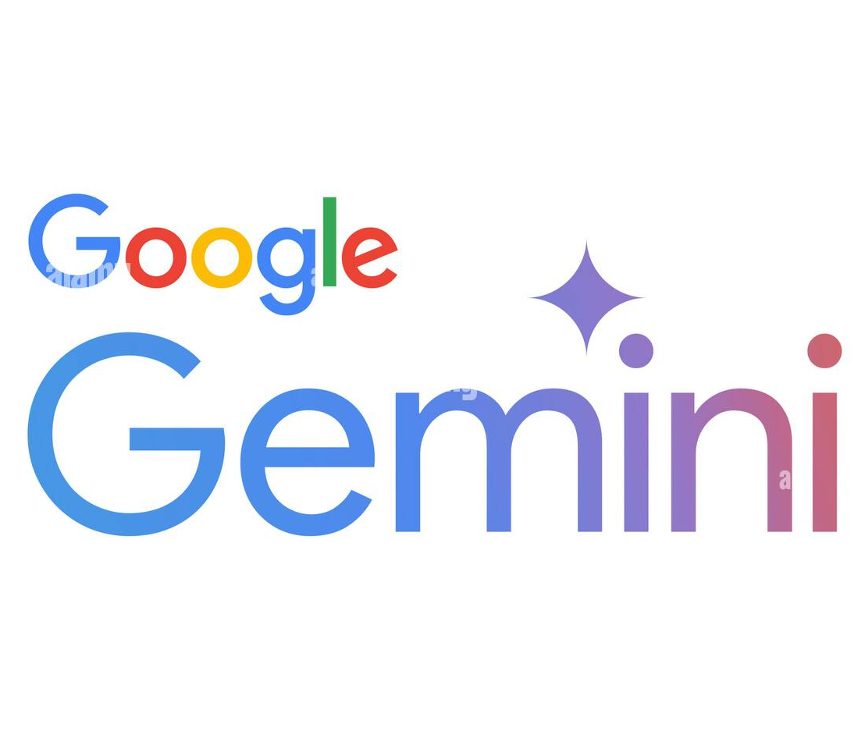
The success we dreamed of
Language models that reason
across many tasks that were once considered aspirational.
Notes:
We are at a point where we dreamed of a few years ago.
We now have language models that reason across ...

Slide 3
How do these models work?
Notes:
So the progress is real.
The question now is: how [the hell] did we get here, and can we do better?

Slide 4
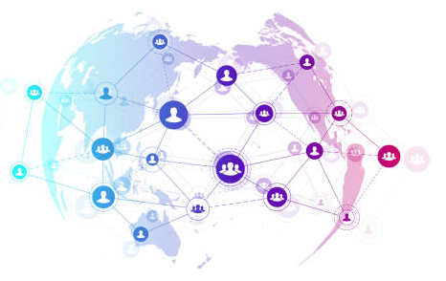
Learning ~ Compression + Replication
Examples of the World
New Instances
🤖
Notes:
then a few more photos

Slide 5
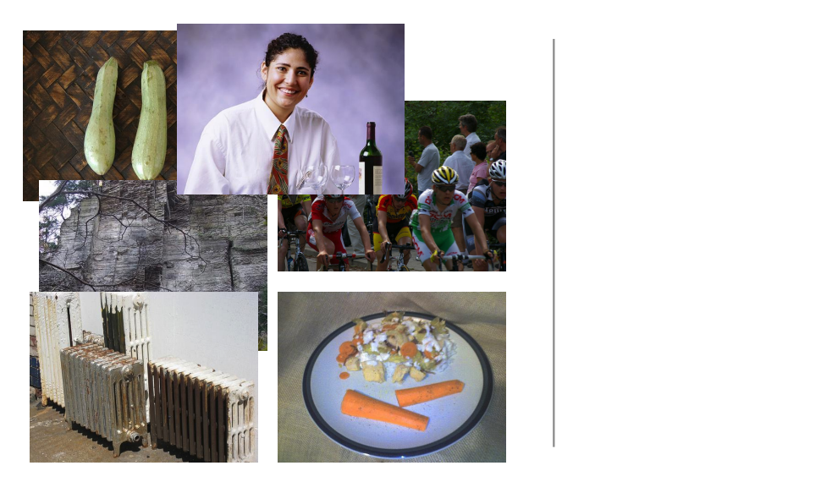
Learning ~ Compression + Replication
Examples of the World
New Instances
🤖
Notes:
then a few more photos

Slide 6
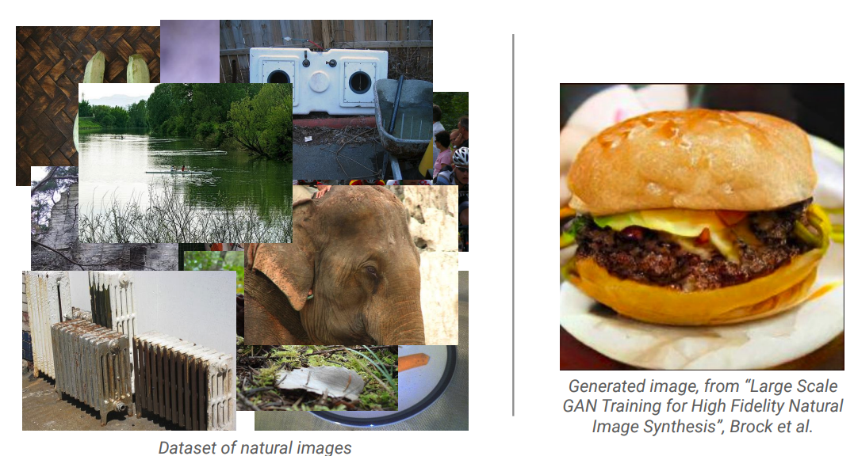
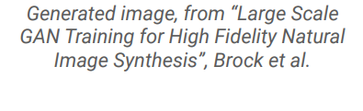
Learning ~ Compression + Replication
Examples of the World
New Instances
🤖
Notes:
then a few more photos

Slide 7
Learning ~ Compression + Replication
== lemon
The lemon (Citrus limon) is a species of small evergreen trees in the flowering plant family Rutaceae, native to Asia, primarily Northeast India (Assam), Northern Myanmar or China.[2] The tree's ellipsoidal yellow fruit is used for culinary and non-culinary purposes throughout the world, primarily for its juice, which has both culinary and cleaning uses.[2] The pulp and rind are also used in cooking and baking. ….
== wheelbarrow
A wheelbarrow is a small hand-propelled vehicle, usually with just one wheel, designed to be pushed and guided by a single person using two handles at the rear, or by a sail to push the ancient wheelbarrow by wind. The term "wheelbarrow" is made of two words: "wheel" and "barrow." "Barrow" is a derivation of the Old English "barew" which was a device used for carrying loads. The wheelbarrow is designed to …..
== wings over kansas
wings over kansas is the second studio album by jason ammons, john bolster and mo rosato. the album debuted at number one on the billboard 200, selling 35,000 copies in it first week at the time. it was the second highest selling album to debut at the billboard top 50 and the third highest selling album to debut at the top heatseekers, with 26,000 copies sold. this is the supremes album earning the nickname …
== treaty of paris (1763)
the treaty of paris, also known as the treaty of 1763, was signed on 10 february 1763 by the kingdoms of great britain, france and spain, with portugal in agreement, after great britain's victory over france and spain during the seven years' war.
the signing of the treaty formally ended the seven years' war, known as the french and indian war in the north american theatre, ….
Examples of the World
New Instances
🤖
Notes:
then a few more photos

Slide 8
Learning ~ Compression + Replication
Are predictive models of the world.
Examples of the World
New Instances
🤖
Notes:
Generation is not just the product of AI, it is what fuels it.

Slide 9
Learning ~ Compression + Replication
Are predictive models of the world.
Are learned from unlabeled data.
Examples of the World
New Instances
🤖
Notes:
Generation is not just the product of AI, it is what fuels it.

Slide 10
Learning ~ Compression + Replication
Are predictive models of the world.
Are learned from unlabeled
data
Examples of the World
New Instances
🤖
Notes:
Generation is not just the product of AI, it is what fuels it.

Slide 11
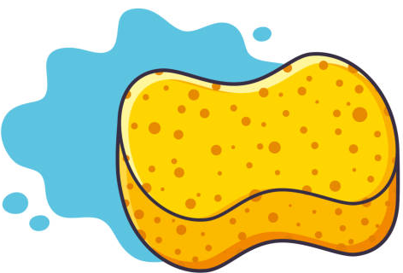
AI Models ~ Sponges
Examples of the World
New Instances
🤖
Notes:
Generation is not just the product of AI, it is what fuels it.

Slide 12
AI Models ~ Sponges
Examples of the World
New Instances
Notes:
Generation is not just the product of AI, it is what fuels it.

Slide 13
AI Models ~ Sponges
Examples of the World
New Instances
Notes:
Generation is not just the product of AI, it is what fuels it.

Slide 14
Scaling up AI Models Makes it Better
Examples of the World
New Instances
🤖
Notes:
Generation is not just the product of AI, it is what fuels it.

Slide 15

Today: Emergent phenomena
What is happening inside language models?
What do we mean by “emergent phenomena”?
What do we understand about it?
What does the future hold?
Notes:
So the core claim of this talk is simple:
Scaling laws -- while powerful -- they obscure ... [read]
To understand how LLMs behave, and why they succeed or fail, [read]

Slide 16
Today: Emergent phenomena
What is happening inside language models?
What do we mean by “emergent phenomena”?
What do we understand about it?
What does the future hold?
Notes:
So the core claim of this talk is simple:
Scaling laws -- while powerful -- they obscure ... [read]
To understand how LLMs behave, and why they succeed or fail, [read]

Slide 17
Recipe: (1) Pre-training
Pre-training := Next-Token Prediction
Modern LLMs are pre-trained on many-trillions of tokens.
  For comparison, if you read 1 book per week, you’d need 50,000 years to cover a comparable amount of text!!!
Johns Hopkins University is in _______.
LM
Baltimore
Bengio et al. ‘04, Peters et al. ‘18, Raffel et al. ‘20, Brown et al. ’20, many others
Notes:
... how did we get here?
Let's to a quick review of our current reasoning stack.
It should not be a surprise to this audience that, the most crucial step is training next-token prediction models on massive amounts of data.
The model memorizes facts and statistical structure of language.
This is the foundation, that is then goes through post-training

Slide 18
Recipe: (2) Post-training
“Aligning” LMs to respect our intents embedded in instructions.
We won’t talk about this ☹
Among others: Mishra et al. 2022; Sanh et al. 2022; Chung et al. 2022, … .
Notes:
… to align them … [read]
This is done through techniques such as …

Slide 19
Recipe: (2) Post-training
“Aligning” LMs to respect our intents embedded in instructions.
  Supervised Fine-tuning (SFT/behavior cloning) with labeled data.
Summarize this article ...
Summary: …
Explain ”space elevators”
to a 6-year-old.
LM
Imagine a normal elevator that you ride to space …
Answer the question: …
Answer: 320 °F
Cross-Task Generalization via Natural Language Crowdsourcing Instructions.
Mishra, Khashabi, Baral and Hajishirzi. ACL 2021 🥇Ai2 Lasting Impact Award!🥇
Among others: Sanh et al. 2022; Chung et al. 2022, … .
Notes:
… to align them … [read]
This is done through techniques such as …

Slide 20
Recipe: (2) Post-training
“Aligning” LMs to respect our intents embedded in instructions.
  Supervised Fine-tuning (SFT/behavior cloning) with labeled data.
  Reinforcement Learning on preference data or verifiers.
Explain ”space elevators” to a 6-year-old.
LM
It is basically ….
R
Christiano et al. 2017; Stiennon et al. 2020; Ouyang et al., 2022; many others
Notes:
Or Reinforcement learning to teach models using human preference data or verifiers.

Slide 21
Scaling Recipe: The whole thing
Almost all the reasoning models follow this recipe:
Pre-training
Post-training
Notes:
Putting these pieces together, gives us the canonical recipe used for training modern reasoning LLMs:
Large-scale pre-training following by post-hoc alignment.
And of course, one alternate repeat this process multiple times.
This simple recipe is what has given us the remarkable successes we have witnessed in the past few years.

Slide 22
Demo time: a pre-trained model
https://gist.github.com/danyaljj/3ac2f34651d6d9dd4b422daa09dd282a
Pre-training
Post-training

Slide 23
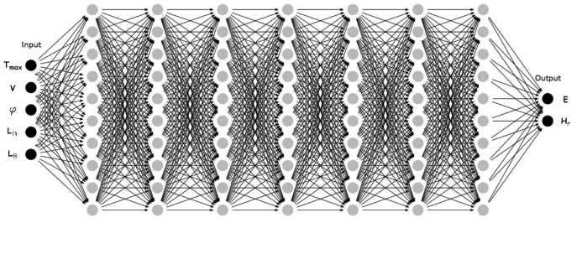

Our overnight success was
70 years in the making!
Since 1950’s
Neural Networks
Since 1940’s
(GPUs 1990’s)
Since 1980’s
Massive Data
Fast Computers

Slide 24
Today: Emergent phenomena
Today: Emergent phenomena
What is happening inside language models?
What do we mean by “emergent phenomena”?
What do we understand about it?
What does the future hold?
Notes:
So the core claim of this talk is simple:
Scaling laws -- while powerful -- they obscure ... [read]
To understand how LLMs behave, and why they succeed or fail, [read]

Slide 25
Today: Emergent phenomena
Today: Emergent phenomena
What is happening inside language models?
What do we mean by “emergent phenomena”?
What do we understand about it?
What does the future hold?
Notes:
So the core claim of this talk is simple:
Scaling laws -- while powerful -- they obscure ... [read]
To understand how LLMs behave, and why they succeed or fail, [read]

Slide 26
What is “Scaling” pre-training LLMs?
Compute
“Scaling” models is not one thing. There are various axes.
Larger model size
  But model params may be under-utilized.
More data
  But more data might not necessarily contain more information (e.g., duplications)
More compute
  But unnecessary computation may be wasted.
Scale means all the above: effective compression of information
  Requires model capacity
  Requires large, rich data
  Requires compute
# data
# model params

Slide 27
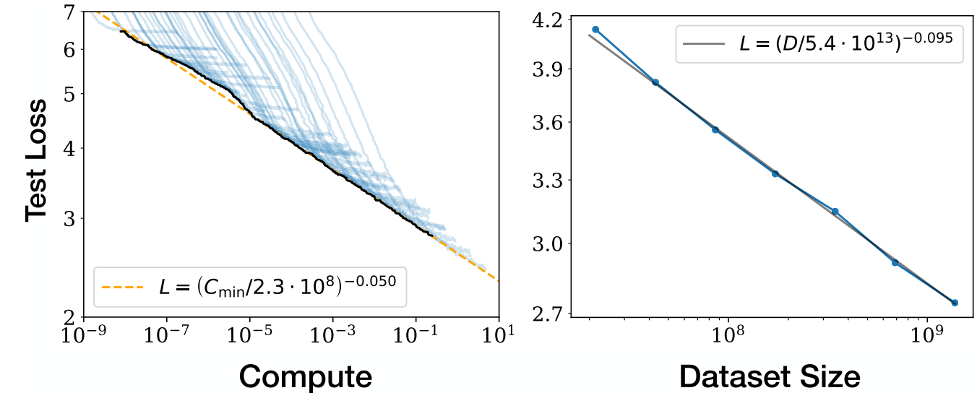
Pre-training: Effect of scale
Kaplan et al. 2020; among others
More data and compute ⇒ better results.
Notes:
Perhaps nothing better captures the progress of modern AI than the scaling laws.
The idea is deceptively simple:
Basically, with more compute and data, the models become better.
At first glance, this is extremely good news.
Industry loved this because it offered a predictable path forward.
Invest in data, invest in compute, and performance improves.
Compared to open-ended research bets, this is much less riskier.
Despite all this, ….

Slide 28
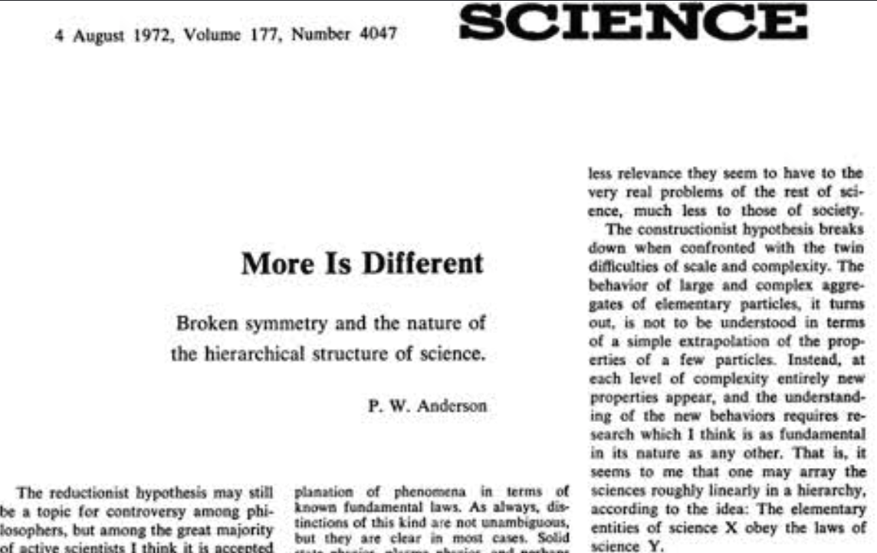
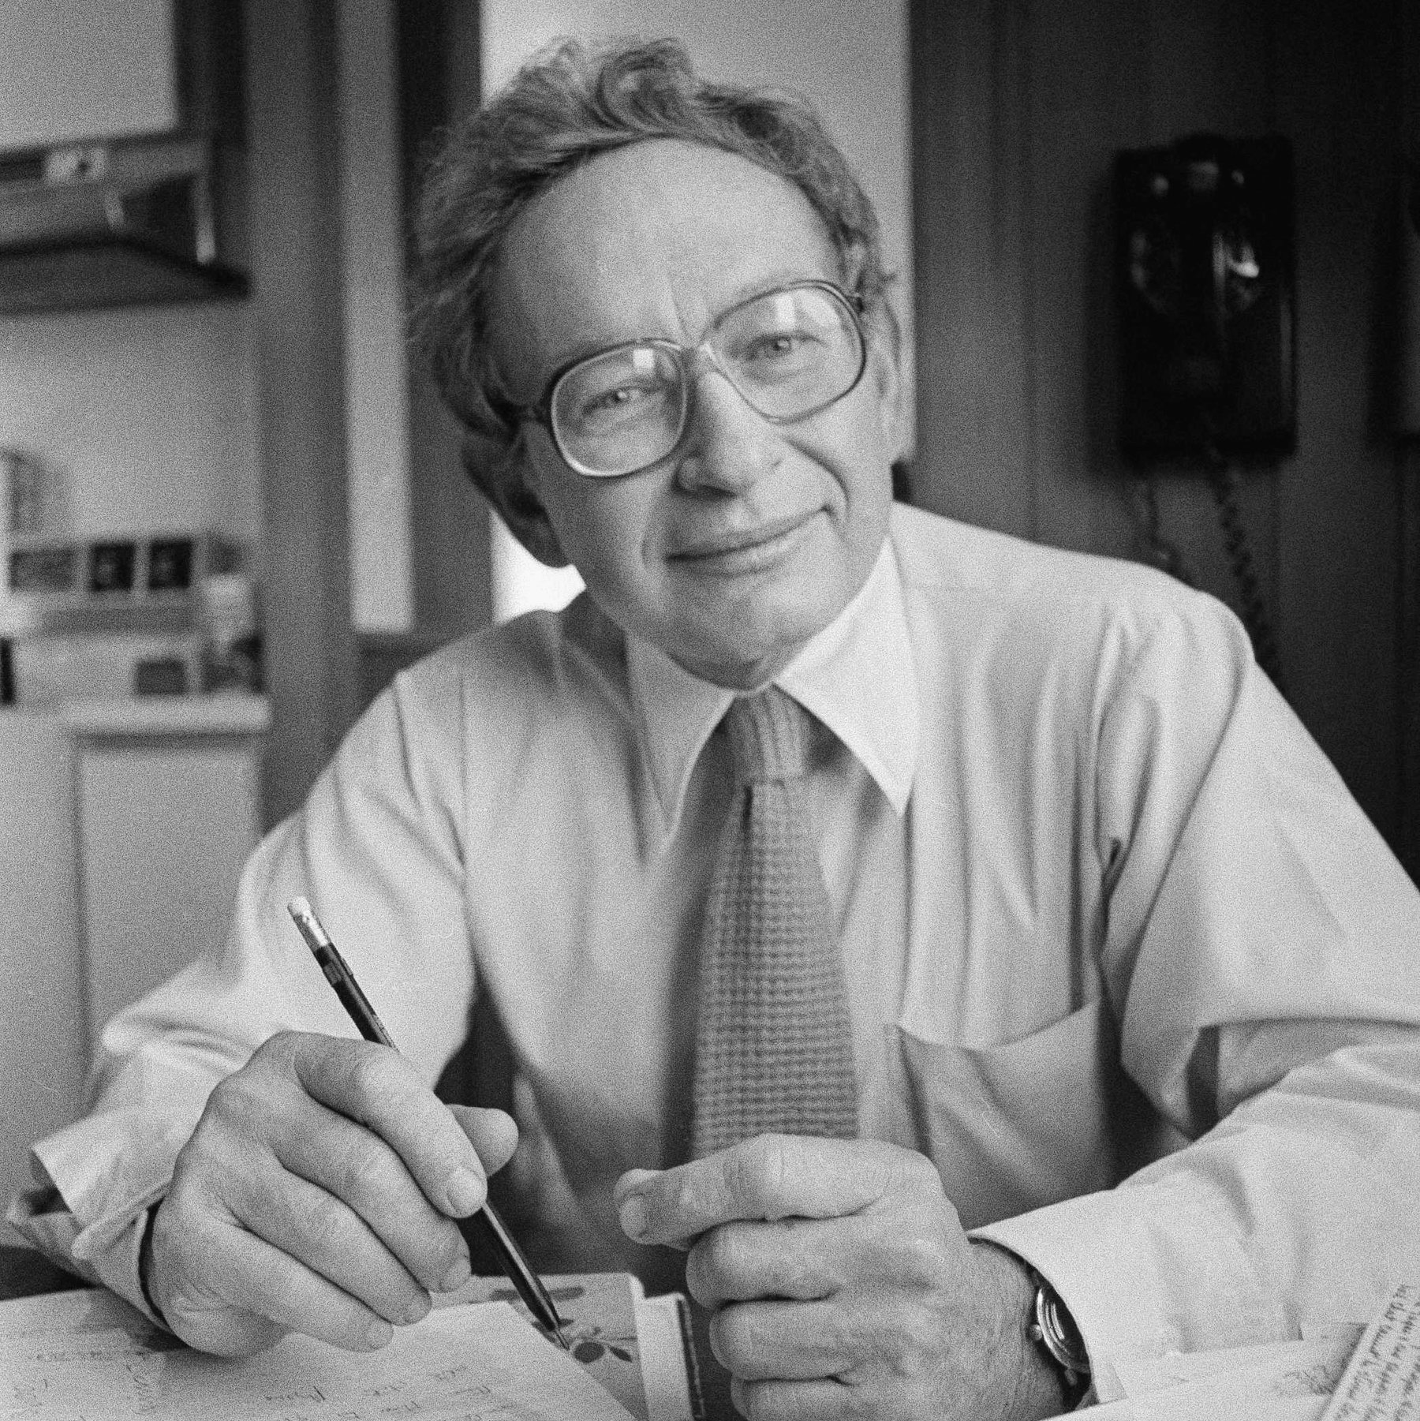
More of the same produces something qualitative different
Anderson ’72 argued that complex systems can behave in ways that can't be understood by the laws that govern their microscopic parts.
He argued that new properties appear at each level of complexity.

Slide 29
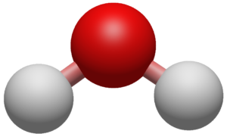

“More is Different”: Examples
No single molecule is wet.
When you put billions of them together, they’re wet.
Although chemistry is subject to the laws of physics, we can’t (easily) infer chemistry from our knowledge of physics.

Slide 30

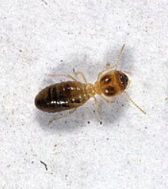
“More is Different”: Examples
No ants have grand plans. (to our knowledge)
Their colony builds cathedrals.

Slide 31
Why does this matter?
Unpredictability:
  Testing a smaller model doesn’t tell you what the larger model can do.
Safety implications:
  Standard pre-deployment testing assumes you know what to test for.
  Emergent abilities violate that assumption.
You can’t test what you don’t know.

Slide 32
Today: Emergent phenomena
Today: Emergent phenomena
What is happening inside language models?
What do we mean by “emergent phenomena”?
What do we understand about it?
What does the future hold?
Notes:
So the core claim of this talk is simple:
Scaling laws -- while powerful -- they obscure ... [read]
To understand how LLMs behave, and why they succeed or fail, [read]

Slide 33
Today: Emergent phenomena
Today: Emergent phenomena
What is happening inside language models?
What do we mean by “emergent phenomena”?
What do we understand about it?
What does the future hold?
Notes:
So the core claim of this talk is simple:
Scaling laws -- while powerful -- they obscure ... [read]
To understand how LLMs behave, and why they succeed or fail, [read]

Slide 34
A working example
Notes:
Let me first clearly define what we mean by in-context learning.
- We give the model a few examples — say, university acronyms mapped to cities — and then ask it to complete a new one.
There are no parameter updates, no gradient steps, no task-specific training—just inference from context.
This behavior — which we now call in-context learning — amounts to .... .
Because of its simplicity and generality, …[read]

Slide 35
A working example
Input: NYU
Notes:
Let me first clearly define what we mean by in-context learning.
- We give the model a few examples — say, university acronyms mapped to cities — and then ask it to complete a new one.
There are no parameter updates, no gradient steps, no task-specific training—just inference from context.
This behavior — which we now call in-context learning — amounts to .... .
Because of its simplicity and generality, …[read]

Slide 36
A working example
Input: NYU Output: NYC
Notes:
Let me first clearly define what we mean by in-context learning.
- We give the model a few examples — say, university acronyms mapped to cities — and then ask it to complete a new one.
There are no parameter updates, no gradient steps, no task-specific training—just inference from context.
This behavior — which we now call in-context learning — amounts to .... .
Because of its simplicity and generality, …[read]

Slide 37
A working example
Input: NYU Output: NYC
Input: UMD
Notes:
Let me first clearly define what we mean by in-context learning.
- We give the model a few examples — say, university acronyms mapped to cities — and then ask it to complete a new one.
There are no parameter updates, no gradient steps, no task-specific training—just inference from context.
This behavior — which we now call in-context learning — amounts to .... .
Because of its simplicity and generality, …[read]

Slide 38
A working example
Input: NYU Output: NYC
Input: UMD Output: DC
Notes:
Let me first clearly define what we mean by in-context learning.
- We give the model a few examples — say, university acronyms mapped to cities — and then ask it to complete a new one.
There are no parameter updates, no gradient steps, no task-specific training—just inference from context.
This behavior — which we now call in-context learning — amounts to .... .
Because of its simplicity and generality, …[read]

Slide 39
A working example
Input: NYU Output: NYC
Input: UMD Output: DC
Input: JHU
Notes:
Let me first clearly define what we mean by in-context learning.
- We give the model a few examples — say, university acronyms mapped to cities — and then ask it to complete a new one.
There are no parameter updates, no gradient steps, no task-specific training—just inference from context.
This behavior — which we now call in-context learning — amounts to .... .
Because of its simplicity and generality, …[read]

Slide 40
A working example
Input: NYU Output: NYC
Input: UMD Output: DC
Input: JHU Output:
Notes:
Let me first clearly define what we mean by in-context learning.
- We give the model a few examples — say, university acronyms mapped to cities — and then ask it to complete a new one.
There are no parameter updates, no gradient steps, no task-specific training—just inference from context.
This behavior — which we now call in-context learning — amounts to .... .
Because of its simplicity and generality, …[read]

Slide 41
In-Context Learning
ICL := learning to imitate the implicit pattern described by few examples provided in the context.
This is very interesting since we didn’t explicitly train our models to show this ability!! (it emerged from large-scale pre-training).
The models infer the patterns from their input.
Input: NYU Output: NYC
Input: UMD Output: DC
Input: JHU Output:
LM
Baltimore
Originally coined by Brown et al., 2020
Notes:
Let me first clearly define what we mean by in-context learning.
- We give the model a few examples — say, university acronyms mapped to cities — and then ask it to complete a new one.
There are no parameter updates, no gradient steps, no task-specific training—just inference from context.
This behavior — which we now call in-context learning — amounts to .... .
Because of its simplicity and generality, …[read]

Slide 42
Demo time: ICL
https://gist.github.com/danyaljj/3ac2f34651d6d9dd4b422daa09dd282a

Slide 43
Wait — this shouldn't work
We only trained the model to predict the next token
We never showed it "here are examples, learn the pattern"
Yet at scale, it just… does
No gradient updates. No fine-tuning. Just prompting.
Notes:
And that brings us to a big open questions: … [read]
For years — going back at least to GPT-2 — …. [read]
The implicit assumption has been: [ … read]

Slide 44
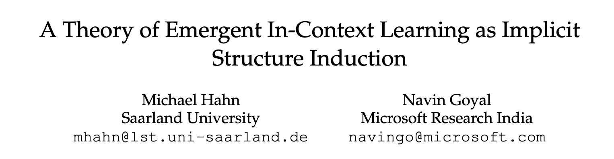
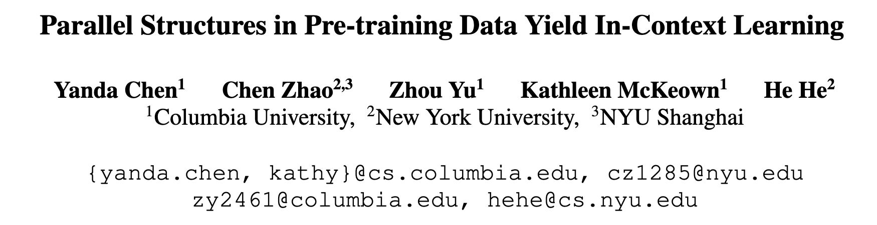
The big open question:
Why (and When) does ICL emerge?
For years, the organic emergence ICL (from 'next-token' training) is deeply tied to human language.
Perhaps human language has specific properties that yields ICL.
  Compositionality, abstraction, parallel patterns, etc.
Notes:
And that brings us to a big open questions: … [read]
For years — going back at least to GPT-2 — …. [read]
The implicit assumption has been: [ … read]

Slide 45
The big open question:
Why (and When) does ICL emerge?
For years, the organic emergence ICL (from 'next-token' training) is deeply tied to human language.
But … is it really about human language specifically?
Research question: Is ICL a [human] language-specific phenomenon?
Notes:
But… [read]
We can ask fundamental questions here: … [read]
or is it a more general computational principle that [human] language happens to expose particularly well?
That's our research question. And to answer it, …

Slide 46

Human vs. Genetic Language
Human language
The computer science department at JHU is known for ...
Genomic language
ATTACCCCGATTGCTATGCCTGAGAAGCTATTATGCCTGAGAAGCTAT ...
Similar: Both are symbolic, short- and long-range dependencies.
Different: Vocabularies, interpretability, evolutionary path.
Genomic Next-Token Predictors are In-Context Learners.
Beslow, Mishra, Revsine, Schatz, Liu, Khashabi. TMLR. 2026.
Notes:
To answer this, my students (Nathan) conduct a controlled comparison comparing the emergence of ICL on two modalities: human language and genomic language.
These two languages are different in many ways:
their vocabulary,
how we interpret them: human language obviously our language communication and genomic sequences have no human-readable semantics;
and their evolutionary path. One emerged from human cognition and communication. The other from billions of years of natural selection.
But they’re also similar in some structural form. Both are long symbolic sequences, and they both encode short- and long-range dependencies.
So maybe if we train separate LMs on these languages, they will share some traits.

Slide 47
ICL on Human vs. Genetic Language
Hypothesis: If ICL appears in both settings,
it must reflect a more general computational mechanism.
Qwen3
Human language
LM
The computer ___
These models are trained on similar scale (compute x data)!
Genomic language
GM
ATTACCCCG ___
Evo2
Genomic Next-Token Predictors are In-Context Learners.
Beslow, Mishra, Revsine, Schatz, Liu, Khashabi. TMLR. 2026.
Notes:
Specifically, found two languages models:
On the top, we have a standard language model trained on human text.
On the bottom, we have a genomic model trained on DNA sequences.
Crucially, these models are trained at a comparable scale — similar compute and data budgets.
This allows us to explore an interesting hypothesis: …

Slide 48
What task should we use for evaluation?
Qwen3
LM
input1 -> Output1 SEP
input2 -> Output2 SEP
input3 -> Output3 SEP
Input4 -> ?
?
GM
Evo2
Genomic Next-Token Predictors are In-Context Learners.
Beslow, Mishra, Revsine, Schatz, Liu, Khashabi. TMLR. 2026.
Notes:
But it’s actually unclear how we can compare these models fairly?

Slide 49
What task should we use for evaluation?
Qwen3
We defined 100 reasoning tasks
based on bitstrings
LM
10100000 -> 00000101 SEP
11100011 -> 11000111 SEP
11001110 -> 01110011 SEP
11000000 -> ?
GM
Various functions: Bitwise NOT, Reverse, etc.
But we need to express the same underlying task in a language each model understands.
Evo2
Genomic Next-Token Predictors are In-Context Learners.
Beslow, Mishra, Revsine, Schatz, Liu, Khashabi. TMLR. 2026.
Notes:
We did what many computer scientists would do:
we defined a family of simple reasoning tasks over bitstrings — e.g. reversal, bitwise operations, and structured transformations.
The challenge, of course, is that our genomic model doesn’t natively speaks “bitstrings.”
So we need to ..

Slide 50
What task should we use for evaluation?
Qwen3
Replace “1” with “3”
Replace “0” with “4”
Replace “SEP” with “6”
Drop “->”
LM
34344444444443436333444333344433363344333443334433633444444
10100000 -> 00000101 SEP
11100011 -> 11000111 SEP
11001110 -> 01110011 SEP
11000000 -> ?
Replace “1” with “T”
Replace “0” with “A”
Replace “SEP” with “G”
Drop “->”
TATAAAAAAAAAATATGTTTAAATTTTAAATTTGTTAATTTAATTTAATTGTTAAAAAA
GM
Evo2
Genomic Next-Token Predictors are In-Context Learners.
Beslow, Mishra, Revsine, Schatz, Liu, Khashabi. TMLR. 2026.
Notes:
For each model, we define a mapping/codebook from bits to their tokens.
For the genomic model, it maps the bits to nucleotide sequences — A, T, C, and G.
For consistency, we do the same for the language model: we map bits into digits.
Importantly, this transformation does not change the task logic --- only the surface representation does.
This allows us to probe two different models on the same problem.

Slide 51
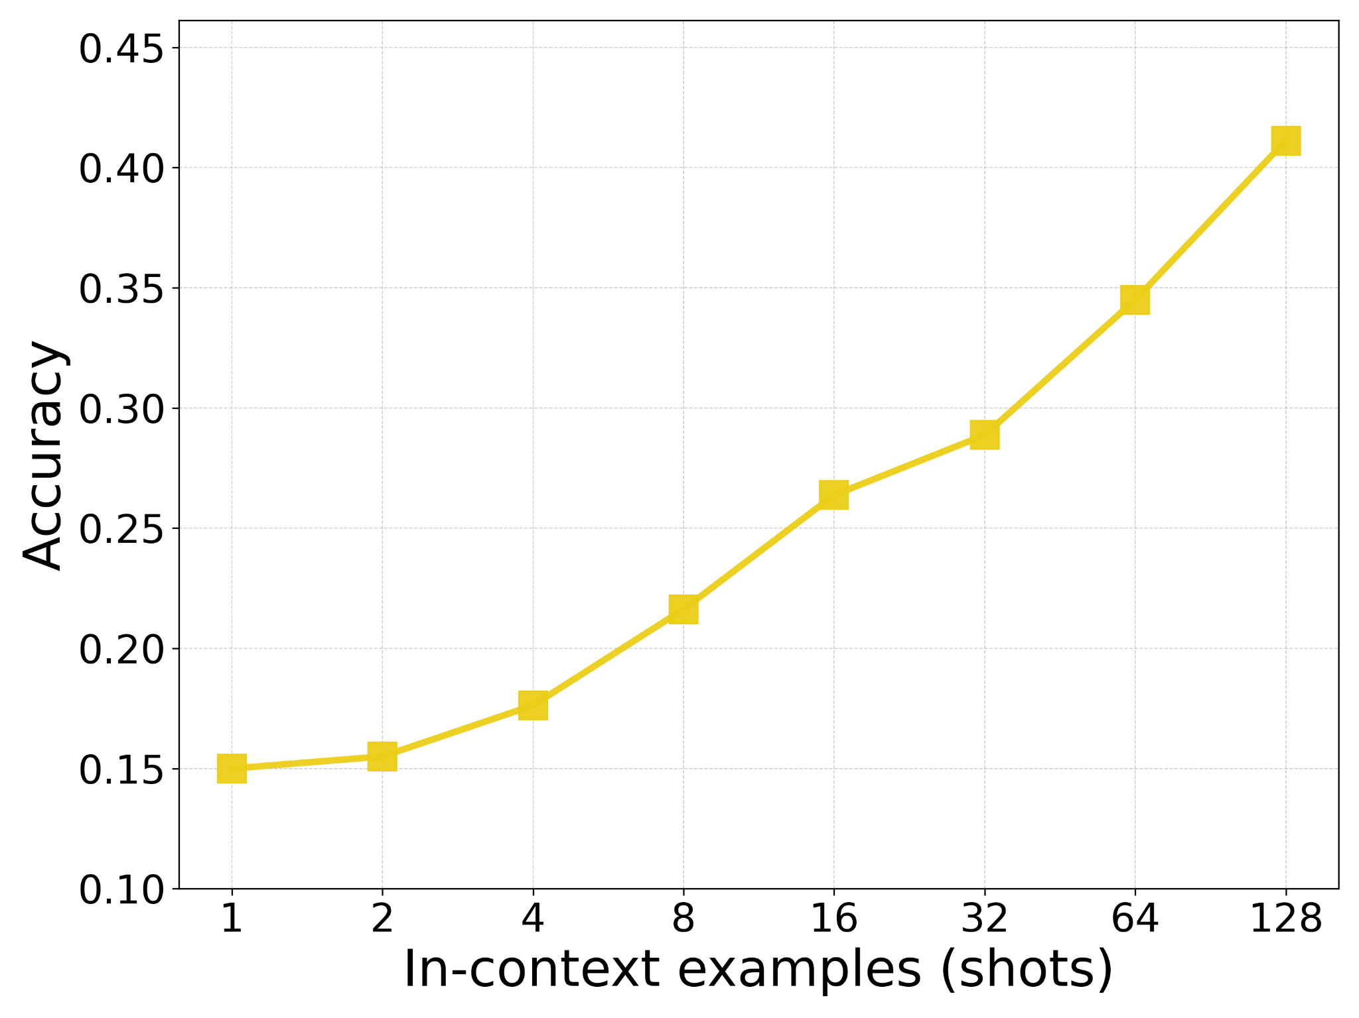
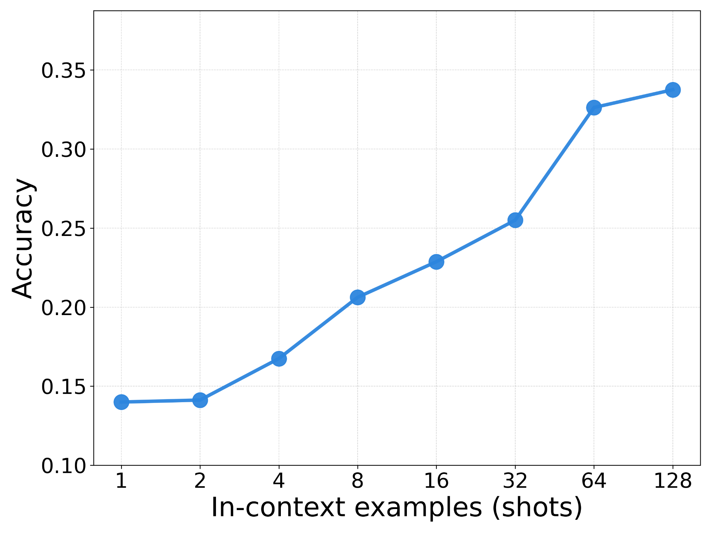
Genomic Models are In-Context Learners
Evo2-40B
Qwen3-14B
Both models exhibit log-linear gains in pattern induction
as the number of in-context demonstrations increases.
Genomic Next-Token Predictors are In-Context Learners.
Beslow, Mishra, Revsine, Schatz, Liu, Khashabi. TMLR. 2026.
Notes:
Let’s start on the right. This is Qwen3, a standard language model.
As we increase the number of in-context examples, accuracy improves steadily.
This is exactly what we expect and is well documented that now we now take it for granted.
Now look at the left. This is Evo2, a genomic model trained on DNA sequences, not human language.
There is no natural notion of words, syntax, or semantics here — [now show it] and yet we see the same qualitative behavior.
As we add more in-context demonstrations, the model’s accuracy improves.
In conclusion, …
To our knowledge, this is the first evidence of emergent in-context learning in non–human-language symbolic sequences.
ICL arising in genomic models trained purely on DNA, with no linguistic supervision at all.

Slide 52
Summary
x
Next-nucleotide predictors are in-context learners.
Emergent ICL is clearly not tied to human language.
ICL is a consequence of large
autoregressive training on rich distribution.
x
x
Notes:
So, we have established that …

Slide 53
How about other modalities?
What other data can yield ICL? And what’s common in them?
✓ Human language
Today I’m presenting …
✓ DNA sequences
T A T A A A A A A A T A T G T T T …
M
? Brain signals
12, 15, 18, 14, 10, 8, 11, 17, 22,…
? Time series
18934, 18951, 18920, 18885, …
? Protein sequences
M A S M T G G Q Q M G S H ...
Notes:
This leads to interesting questions:
….
One can also ask questions about the nature of computational reasoning.
We’ve shown that ICL exhibits shared behavior in both language and genomics models. The two aren’t identical, but they clearly overlap. This naturally raises the question: [read]

Slide 54
10100010
00011000
10100010SEP
00011000SEP
① Sample
an abstract
IN-CONTEXT
EXEMPLARS
⋮
⋮
TEST INPUT
(QUERY)
10000100
????????
Convergent Emergence of In-Context Learning Across Modalities. Beslow et al. arXiv 2026.

Slide 55


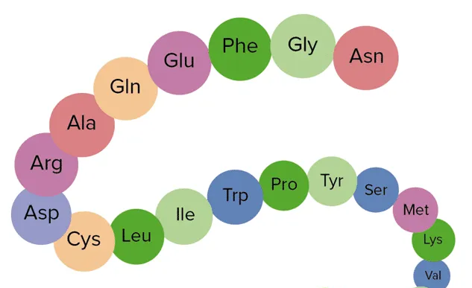


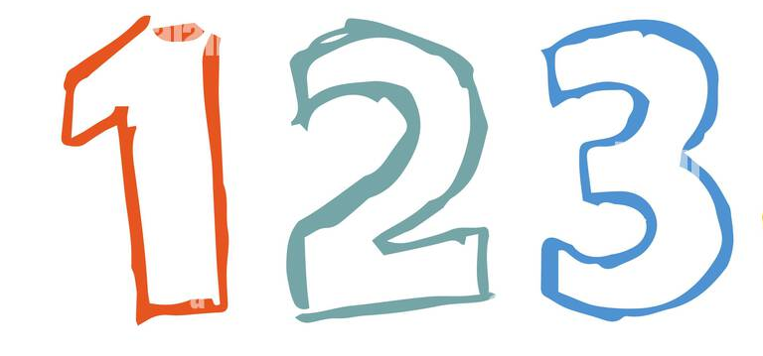
10100010
00011000
10100010SEP
00011000SEP
IN-CONTEXT
EXEMPLARS
① Sample
an abstract
⋮
⋮
TEST INPUT
(QUERY)
10000100
????????
Language
(digits)
Genome
(nucleotides)
Protein
(amino acids)
Integer sequence
(digits)
Image
(pixels)
Time series
(half-sine lobes)
0 ⇒
1 ⇒
SEP ⇒
0 ⇒
1 ⇒
SEP ⇒
② Form encoding codebook
0 ⇒ 4
1 ⇒ 9
SEP ⇒ 2
0 ⇒ T
1 ⇒ G
SEP ⇒ C
0 ⇒ N
1 ⇒ P
SEP ⇒ I
0 ⇒ 6
1 ⇒ 7
SEP ⇒ ,
94944494
44499444
94444944
GTGTTTGT
TTTGGTTT
GTTTTGTT
PNPNNNPN
TTTGGTTT
PNNNNPNN
76766676
66677666
76666766
76766676
66677666
????????
③ Encoding ICL prompts for each modality
767666667
666776666
766667666
2
2
C
C
I
I
I
I
94944494
44499444
????????
GTGTTTGT
TTTGGTTT
????????
PNPNNNPN
TTTGGTTT
????????
,
,
,
666666666
666666666
666666666
76766666
66776666
76666766
666666666
666666666
666666666
⋮
⋮
⋮
⋮
⋮
⋮
⋮
⋮
⋮
⋮
⋮
⋮
?
?
?
?
?
?
?
?
????????
Evo2
ProGen2
TimesFM 2.5
Qwen3
NextTerm
ImageGPT
Convergent Emergence of In-Context Learning Across Modalities. Beslow et al. arXiv 2026.

Slide 56
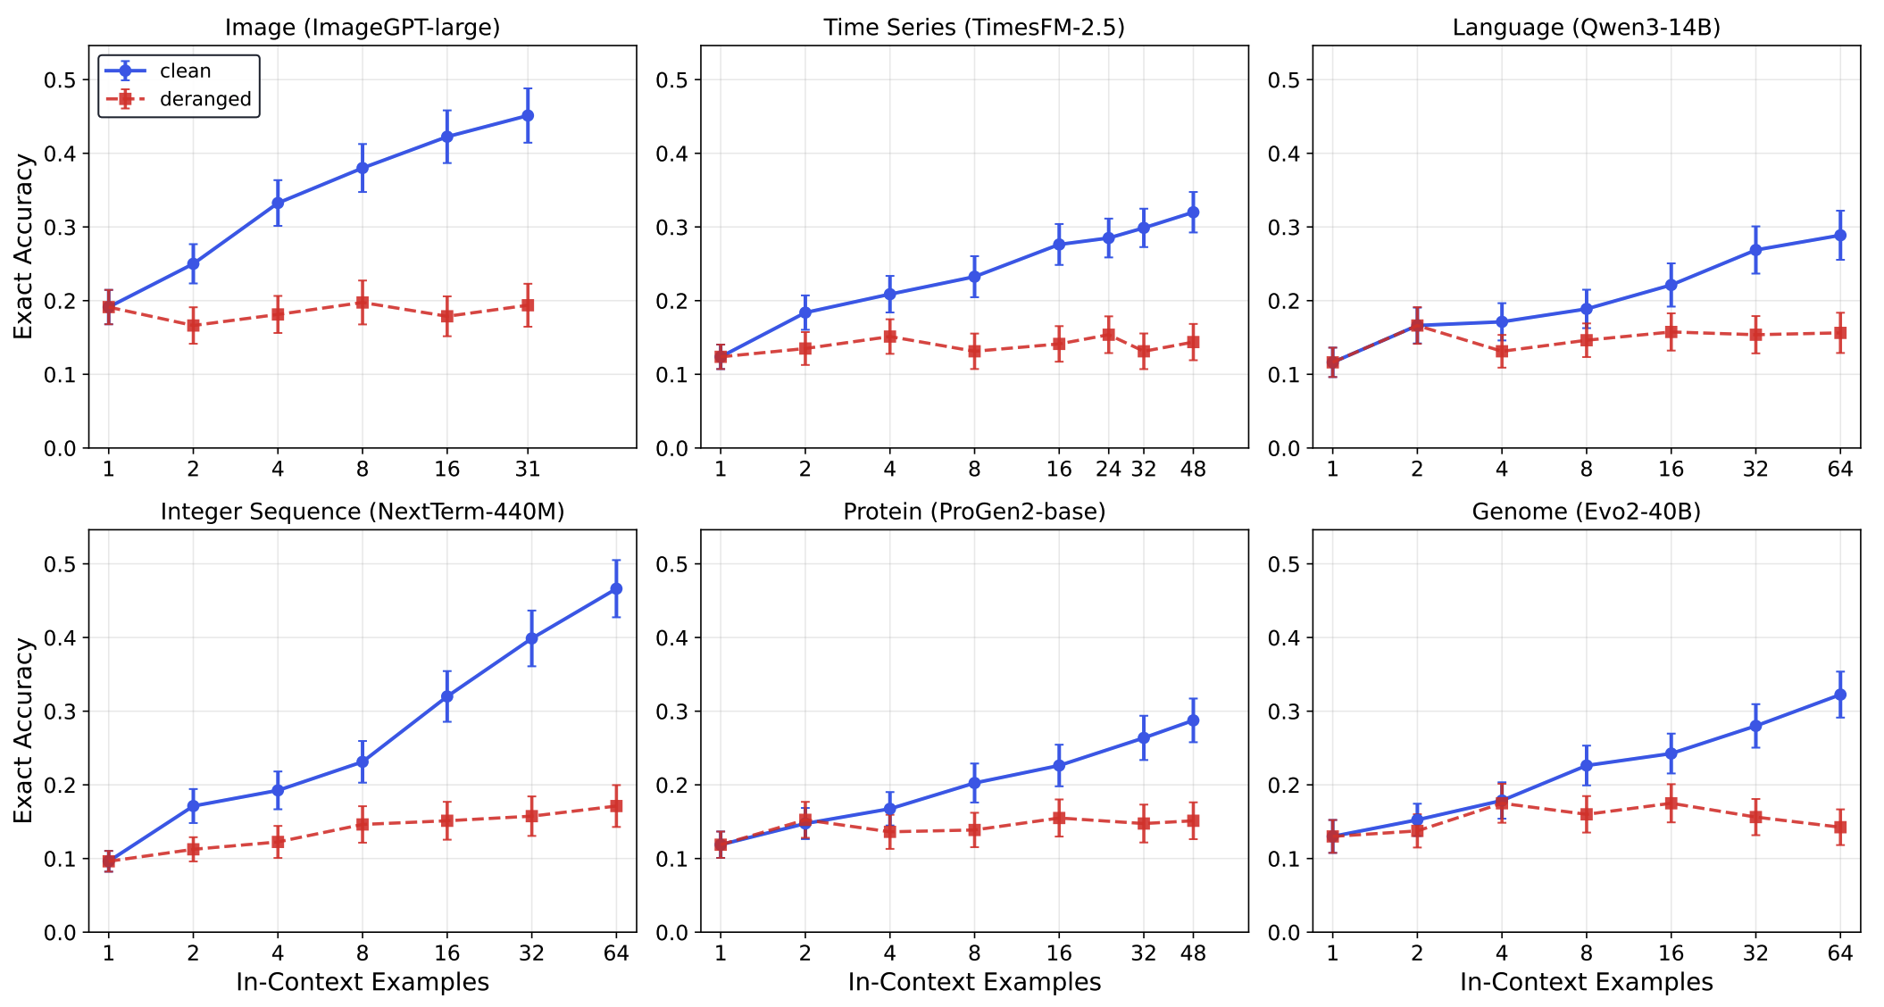
Convergent Emergence of In-Context Learning Across Modalities. Beslow et al. arXiv 2026.

Slide 57
Summary
x
Most next-token predictors trained on natural data
are in-context learners..
Convergent In-Context Induction Hypothesis:
  ICL is a consequence of next-token prediction:
  it organically emerges in any modality with rich data, and
  its realizations share a common substrate across modalities
ICL in
Modality A
ICL in
Modality B
x
ICL in
Modality C
Notes:
So, we have established that …

Slide 58
Open Questions
If reasoning arises without human-interpretable tokens, what does that say about the nature of “reasoning”?
Is it possible one can learn to reason (say in human lang) by
learning from other modalities?
Notes:
This leads to interesting questions:
….
One can also ask questions about the nature of computational reasoning.
We’ve shown that ICL exhibits shared behavior in both language and genomics models. The two aren’t identical, but they clearly overlap. This naturally raises the question: [read]

Slide 59
Other emergent phenomena we didn’t cover
Generalization to unseen task instructions
[Mishra et al. 2021 among others]
Inference-time reasoning: models improving their responses with more inference-time thinking
  [DeepSeek-R1, among others]
Cross-lingual transfer: capabilities learned in English appear in low-resource languages

Slide 60
Today: Emergent phenomena
Today: Emergent phenomena
What is happening inside language models?
What do we mean by “emergent phenomena”?
What do we understand about it?
What does the future hold?
Notes:
So the core claim of this talk is simple:
Scaling laws -- while powerful -- they obscure ... [read]
To understand how LLMs behave, and why they succeed or fail, [read]

Slide 61
Today: Emergent phenomena
Today: Emergent phenomena
What is happening inside language models?
What do we mean by “emergent phenomena”?
What do we understand about it?
What does the future hold?
Notes:
So the core claim of this talk is simple:
Scaling laws -- while powerful -- they obscure ... [read]
To understand how LLMs behave, and why they succeed or fail, [read]

Slide 62
How far will we be able to scale?
Is “scaling” here to stay?

Slide 63
Someone: “we won’t have enough compute”
For:
  There is simply not enough compute available.
  Even if we have the compute (in theory), scaling the compute will be quite costly.
Against:
  Computing infrastructure continue to progress at a rapid pace.
    E.g. renewables, space data centers, inference hardware, etc.
  The economy of scale will just work out.
    With more usage, cost per unit will be cheaper.

Slide 64
Someone: “we won’t have enough data”
For:
  Existing LLMs are severely data hungry. There is simply not much enough data in the world.
  And you don’t need just any data; you want data on challenging and rare problems (e.g., hard math and engineering problems).
Against:
  There is massive amount of untapped data in the world.
  As we deploy AI in more applications, allowing continuous stream of fresh data.

Slide 65
How far will we be able to scale?
Is “scaling” here to stay?

Slide 66
Putting things together
Emergence is real: Large-scale pre-training on simple objectives lead to capabilities that appear at scale.
In-context learning is a prominent manifestation of emergence.
  Not specific to human language.
It is important to understand emergence: It is not just an academic endeavor. It is how a foundation of how we form trustworthy AI.

