Slide 1

AnaloBench: Benchmarking the Identification of Abstract and Long-context Analogies
Xiao Ye, Andrew Wang,
Jacob Choi, Yining Lu, Shreya Sharma, Lingfeng Shen, Vijay Tiyyala,
Nicholas Andrews, Daniel Khashabi
Notes:
Hi I'm Andrew and I'll be presenting our work on AnaloBench: Benchmarking the Identification of Abstract and Long-context Analogies

Slide 2
What makes two texts analogous?
The weather finally became pleasant following the stormy week.
As the flame extinguished, it left behind a thin wisp of smoke
⛈️
🔥
Notes:
I’ll start off by posing a question: what makes two texts analogous? Consider these two scenarios.
On the left, we have “The weather finally became pleasant following the stormy week.”
On the right, we have “As the flame extinguished, it left behind a thin wisp of smoke”

Slide 3
What makes two texts analogous?
The weather finally became pleasant following the stormy week.
As the flame extinguished, it left behind a thin wisp of smoke
⛈️
🔥
Analogous?
Notes:
These scenarios are semantically dissimilar (one is talking about “weather improving” and the other is talking about “a flame going out”).
But are they analogous?

Slide 4
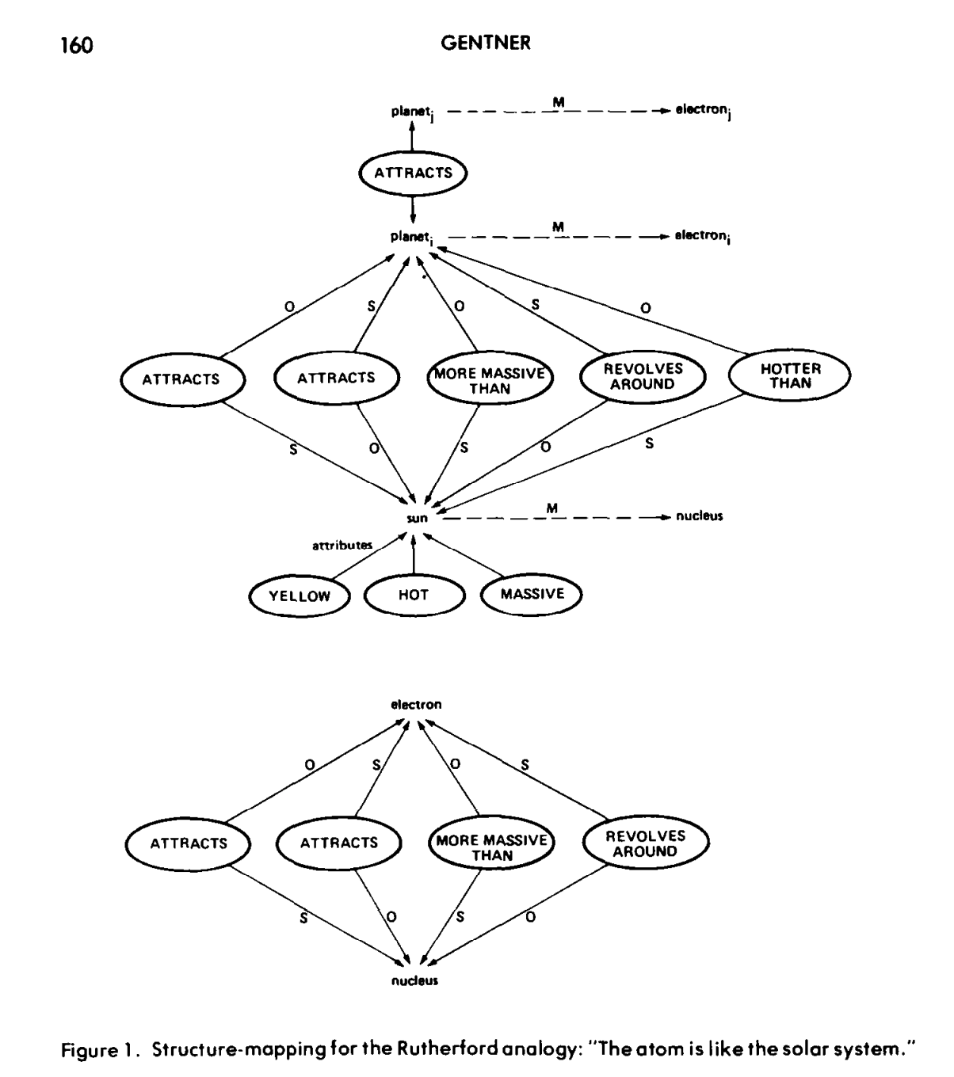
What makes two texts analogous?
Turbulent
⛈️
Storm
Subject
Object
becomes
calmer than
Object
Subject
Pleasant weather
Tranquil
Notes:
Intuitively, when I think about this question, I break each scenario down into components and their relations.
So “the stormy weather becomes pleasant weather”... “Pleasant weather is calmer than stormy weather” … so on and so forth

Slide 5
What makes two texts analogous?
Turbulent
Turbulent
⛈️
🔥
Storm
Flame
Subject
Object
Subject
Object
becomes
calmer than
becomes
calmer than
Object
Subject
Object
Subject
Pleasant weather
Wisp of smoke
Tranquil
Tranquil
Notes:
And we can do the same for the other scenario

Slide 6
What makes two texts analogous?
Turbulent
Turbulent
⛈️
🔥
Storm
Flame
Subject
Object
Subject
Object
becomes
calmer than
becomes
calmer than
Object
Subject
Object
Subject
Pleasant weather
Wisp of smoke
Tranquil
Tranquil
Notes:
We can see that the structure of these relations is quite similar between these two scenarios.

Slide 7
What makes two texts analogous?
Turbulent
Turbulent
⛈️
🔥
Storm
Flame
Structure Mapping Theory:
“An analogy is an assertion that a relational structure that normally applies in one domain can be applied in another domain”
Subject
Object
Subject
Object
becomes
calmer than
becomes
calmer than
Object
Subject
Object
Subject
Pleasant weather
Wisp of smoke
Structure-mapping: A theoretical framework for analogy
Dedre Gentner
Cognitive Science, 1983
Tranquil
Tranquil
Notes:
As it turns out, according to the Structure Mapping Theory proposed by Dedre Gentner, “An analogy is an assertion that a relational structure that normally applies in one domain can be applied in another domain”
This would make these two scenarios analogous, in spite of their surface level semantic differences.

Slide 8
Analogical reasoning in traditional AI systems
Challenge: how to automatically discover relational structures?
1980 — Patrick H Winston. Learning and reasoning by analogy. Communications of the ACM.
1983 — Jaime G Carbonell. Learning by analogy: Formulating and generalizing plans from past experience. In Machine learning.
1984 — Douglas R Hofstadter. The copycat project: An experiment in nondeterminism and creative analogies.
1999 — Roger C Schank. Dynamic memory revisited.
2013 — Tomáš Mikolov, Wen-tau Yih, and Geoffrey Zweig. Linguistic regularities in continuous space word representations. NAACL
Notes:
Because of the difficulty of comparing relational structures automatically,

Slide 9
Analogical reasoning in traditional AI systems
Challenge: how to automatically discover relational structures?
1980 — Patrick H Winston. Learning and reasoning by analogy. Communications of the ACM.
1983 — Jaime G Carbonell. Learning by analogy: Formulating and generalizing plans from past experience. In Machine learning.
1984 — Douglas R Hofstadter. The copycat project: An experiment in nondeterminism and creative analogies.
1999 — Roger C Schank. Dynamic memory revisited.
2013 — Tomáš Mikolov, Wen-tau Yih, and Geoffrey Zweig. Linguistic regularities in continuous space word representations. NAACL
Notes:
for a long time solving analogies remained a challenging objective for AI systems

Slide 10
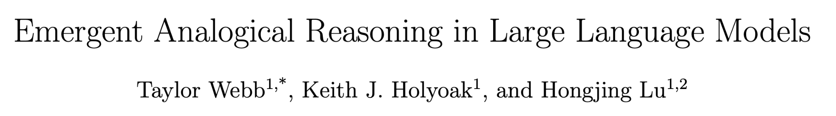
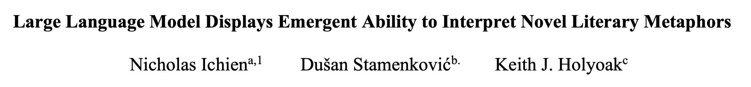
LLMs and analogical reasoning
2023
2024
Emergent Analogical Reasoning in Large Language Models, Webb et al., Nature Human Behavior 2023
Notes:
With the success of LLMs, more recent works have revisited analogical reasoning as a novel frontier for challenging problems.

Slide 11
LLMs and analogical reasoning
“large language models…have acquired an emergent ability to find zero-shot solutions to a broad range of analogy problems”
Emergent Analogical Reasoning in Large Language Models, Webb et al., Nature Human Behavior 2023
Notes:
In particular, Webb et al 2023, concluded that “large language models…have acquired an emergent ability to find zero-shot solutions to a broad range of analogy problems”

Slide 12
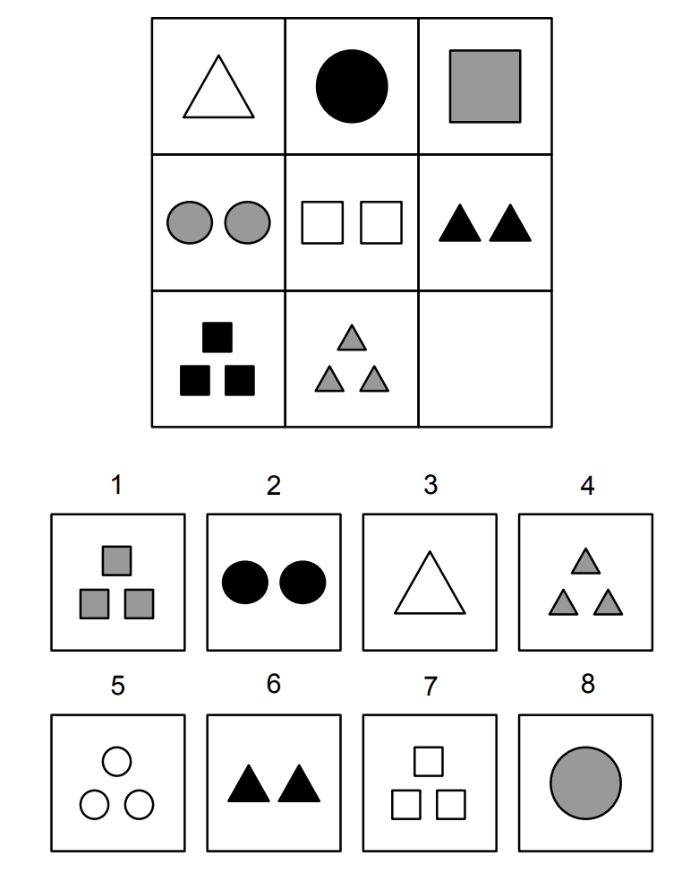
LLMs and analogical reasoning
Emergent Analogical Reasoning in Large Language Models, Webb et al., Nature Human Behavior 2023
Notes:
In their work, they study abstract settings such as “Raven’s Progressive Matrices”,

Slide 13
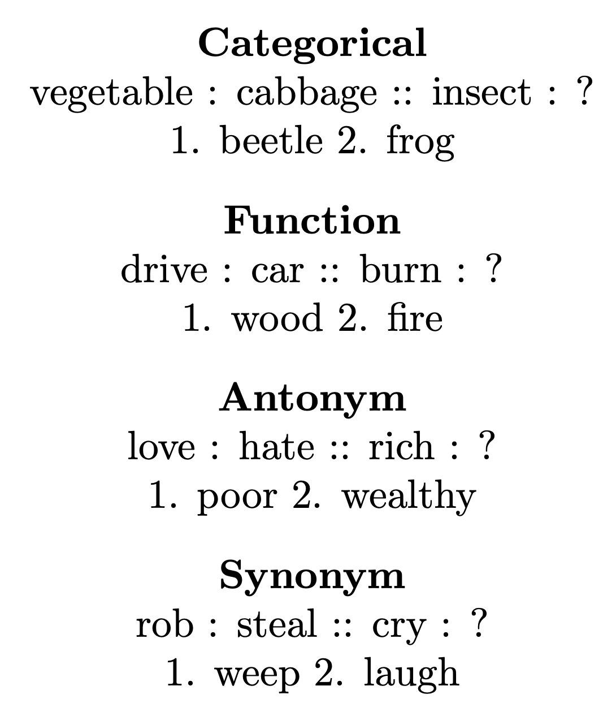
LLMs and analogical reasoning
Emergent Analogical Reasoning in Large Language Models, Webb et al., Nature Human Behavior 2023
Notes:
“lexical analogies”

Slide 14
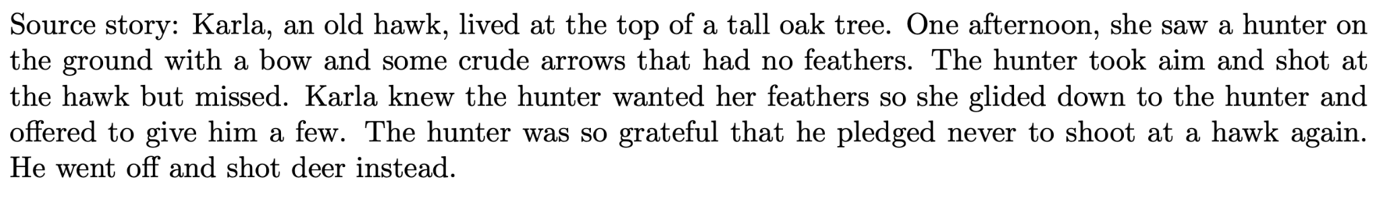
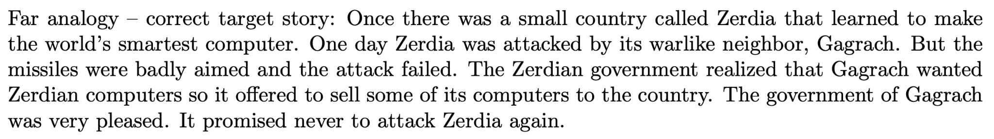
LLMs and analogical reasoning
Emergent Analogical Reasoning in Large Language Models, Webb et al., Nature Human Behavior 2023
Notes:
and a set of 18 short natural language stories

Slide 15
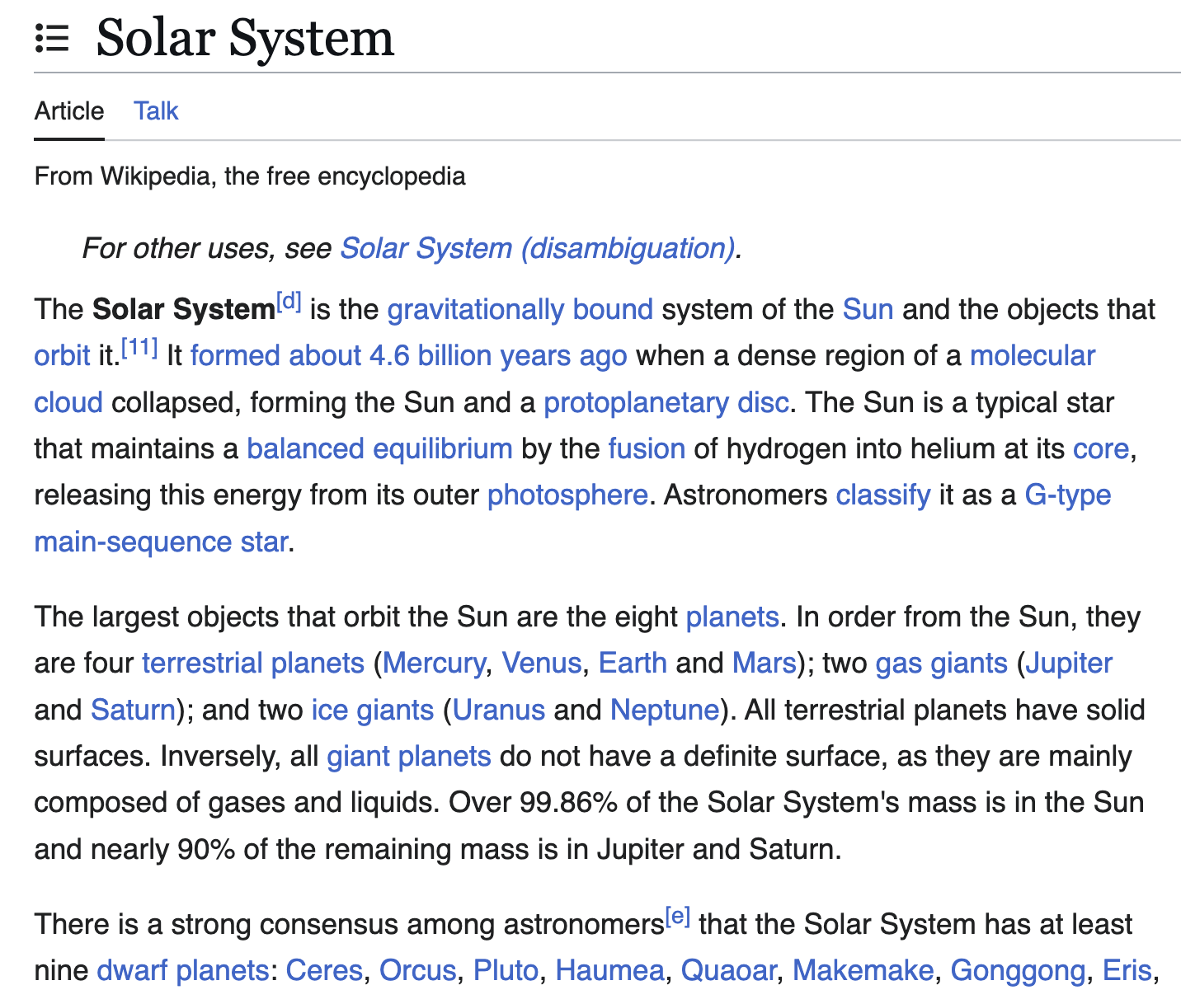
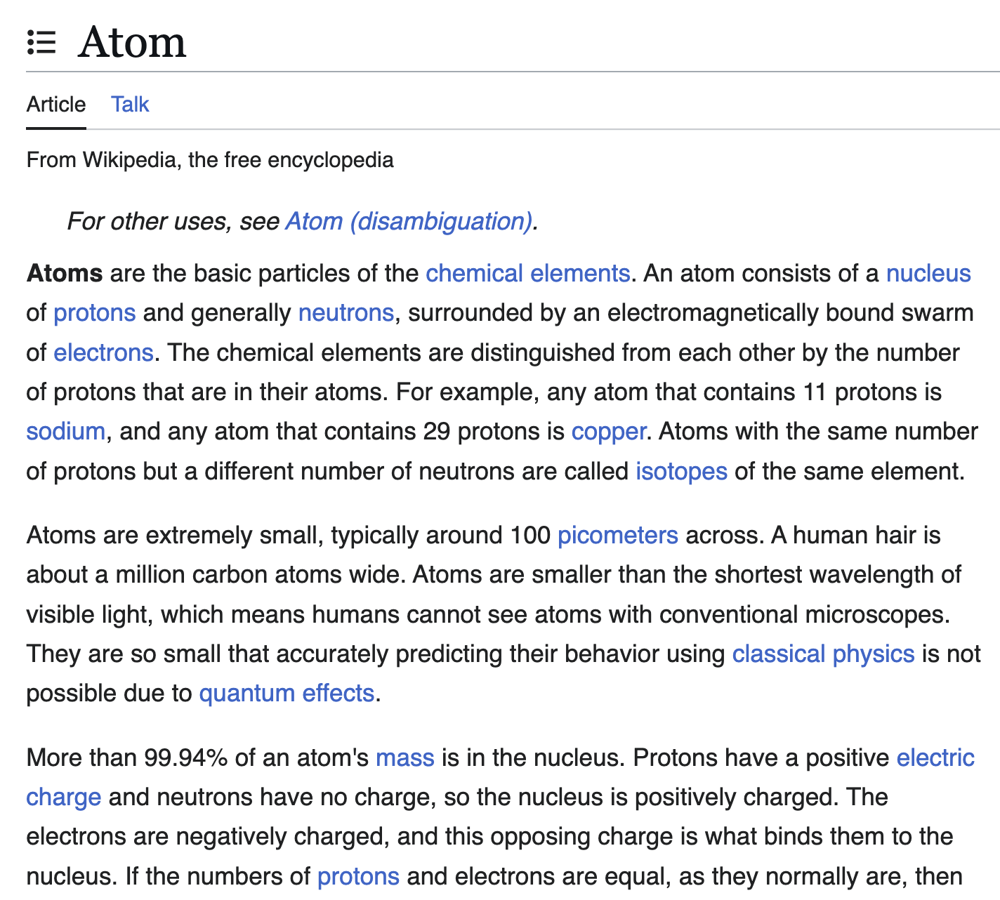
Towards more challenging evaluations
Real world analogy: the solar system is like the atom
Notes:
But analogies in the real world can be far more nuanced and rich.
Something like the assertion “the solar system is like the atom” may seem simple at first,
but really, there is a wealth of information that must be considered to confirm whether the analogy is valid.

Slide 16
Towards more challenging evaluations
Real world analogy: the solar system is like the atom
Are LLMs performant on more challenging analogical reasoning tasks?
Notes:
We are interested in seeing whether these conclusions still hold up when we depart abstract/limited settings for a more realistic setting.

Slide 17
Tasks
Task 1:
Multiple choice
Task 2:
Analogical retrieval
Notes:
We study two ways specific ways of doing this
Both involve giving LLMs a narrative and seeing if it can identify the most analogous narrative from a set of choices.

Slide 18
Dataset creation
340 seed analogies from human annotators
① Analogical Pairs
Sentence A | Sentence B
You can't pour from an empty cup. | A fallen tree cannot provide shade.
You can't pour from an empty cup. | It's hard to love with a broken heart.
He danced off his sugar high then promptly fell asleep. | After letting off his rage he sat down like a lamb.
He danced off his sugar high then promptly fell asleep. | The weather finally became pleasant following the stormy week.
. . . | . . .
Notes:
Before I elaborate on either task, I’ll first explain how we constructed the data we used
To make data for these tasks, we collected a set of 340 analogies from human annotators
We selected JHU students to ensure quality. Previously we had tried crowdsourcing but that yielded poor results

Slide 19
Dataset creation
340 seed analogies from human annotators
① Analogical Pairs
Sentence A | Sentence B
You can't pour from an empty cup. | A fallen tree cannot provide shade.
You can't pour from an empty cup. | It's hard to love with a broken heart.
He danced off his sugar high then promptly fell asleep. | After letting off his rage he sat down like a lamb.
He danced off his sugar high then promptly fell asleep. | The weather finally became pleasant following the stormy week.
. . . | . . .
Each analogy is a pair of analogous sentences
Notes:
Each of our analogies consists of two sentence-long texts that share relational structures.

Slide 20
Dataset creation
340 seed analogies from human annotators
① Analogical Pairs
Sentence A | Sentence B
You can't pour from an empty cup. | A fallen tree cannot provide shade.
You can't pour from an empty cup. | It's hard to love with a broken heart.
He danced off his sugar high then promptly fell asleep. | After letting off his rage he sat down like a lamb.
He danced off his sugar high then promptly fell asleep. | The weather finally became pleasant following the stormy week.
. . . | . . .
annotated to be analogous
pre-existing sentences
Notes:
Our annotation instructions encouraged far analogies (or analogies between semantically dissimilar narratives).
We took common sayings, or dictionary examples of common sayings, and asked annotators to create several analogous texts for each.

Slide 21
Dataset creation
Analogous texts are grouped into clusters
① Analogical Pairs
② Analogical Clusters
Sentence A | Sentence B
You can't pour from an empty cup. | A fallen tree cannot provide shade.
You can't pour from an empty cup. | It's hard to love with a broken heart.
He danced off his sugar high then promptly fell asleep. | After letting off his rage he sat down like a lamb.
He danced off his sugar high then promptly fell asleep. | The weather finally became pleasant following the stormy week.
. . . | . . .
After letting off his rage he sat down like a lamb.
He danced off his sugar high then promptly fell asleep.
The weather finally became pleasant following the stormy week.
You can't pour from an empty cup.
A fallen tree cannot provide shade.
It's hard to love with a broken heart.
...
.
.
.
Notes:
This enabled us to sort the texts into “analogical clusters”, where any pair of texts within a cluster are analogous by transitivity.
The outcome of this process was then further refined by additional human annotators.
More details on the annotation process can be found in the paper.

Slide 22
Tasks
Task 1:
Multiple choice
Task 2:
Analogical retrieval
Notes:
Now that we have our data, I’ll talk about task 1 in more detail

Slide 23
Task 1: Multiple choice
Description: Given a narrative, can LLMs identify the most analogous narrative from a set of 4 choices?
Q: Which of the following is the most analogous sentence to the target sentence?
Target: The weather finally became pleasant following the stormy week.
As the flame extinguished, it left behind a…
All that glitters is not gold.
A fallen tree cannot provide shade.
A succession of waves battered the rock.
Notes:
In task 1, we have a narrative, and we want to see if an LLM can identify the most analogous narrative from a set of 4 choices.
We specifically wanted to explore the effects of increasing task difficulty on language model performance

Slide 24
Task 1: Multiple choice
Description: Given a narrative, can LLMs identify the most analogous sentence from a set of 4 choices?
Q: Which of the following is the most analogous sentence to the target sentence?
Sampled from outside of cluster
Sampled from same cluster
Target: The weather finally became pleasant following the stormy week.
As the flame extinguished, it left behind a…
All that glitters is not gold.
A fallen tree cannot provide shade.
A succession of waves battered the rock.
Notes:
To construct each question in our evaluation, we sample pairs of narratives from a cluster to serve as the intended answer choice,
then sample narratives from the complement of the cluster to serve as negative distractors.

Slide 25
Task 1: Multiple choice
Intuition: analogies between longer narratives are more difficult
Q: Which of the following is the most analogous sentence to the target sentence?
Target: The weather finally became pleasant following the stormy week.
As the flame extinguished, it left behind a…
All that glitters is not gold.
A fallen tree cannot provide shade.
A succession of waves battered the rock.
Notes:
To vary the difficulty of the task, we play around with the length of narratives.

Slide 26
Task 1: Multiple choice
Intuition: analogies between longer narratives are more difficult
Q: Which of the following is the most analogous story to the target story?
Target: For an entire week, the town had been battered by incessant, violent storms. The sky was a relentless shade of charcoal, thunder…
Once upon a time, in a quiet town nestled amidst snow-capped…
In the small town of Baker's Crest, people lived simple lives, mostly…
Once upon a time, a man named Henry lived in a tiny, worn-out house. He…
A stormy morning on the coast revealed an awe-inspiring sight as a …
Notes:
Intuitively, longer narratives means that irrelevant details can obscure the key relational structures to look for, which makes the task more challenging to solve.

Slide 27

Lengthening seed analogies
GPT-4 prompting: Increase length of narratives in analogies to 10 sentences and 30 sentences
Prompt:
Given the following sentence, expand it into a 30 sentence story:
Sentence: The weather finally became pleasant following the stormy week.
For an entire week, the town had been battered by incessant, violent storms. The sky was a relentless shade of charcoal, thunder…
GPT-4
Quality of these extended stories is attested in Appendix C
Notes:
To vary the length of narratives, we take each of the sentence-long texts from the annotation process and extend them to 10 sentence and then 30 sentence narratives
We use GPT-4 to do this by prompting it to rewrite an input text to a given length

Slide 28
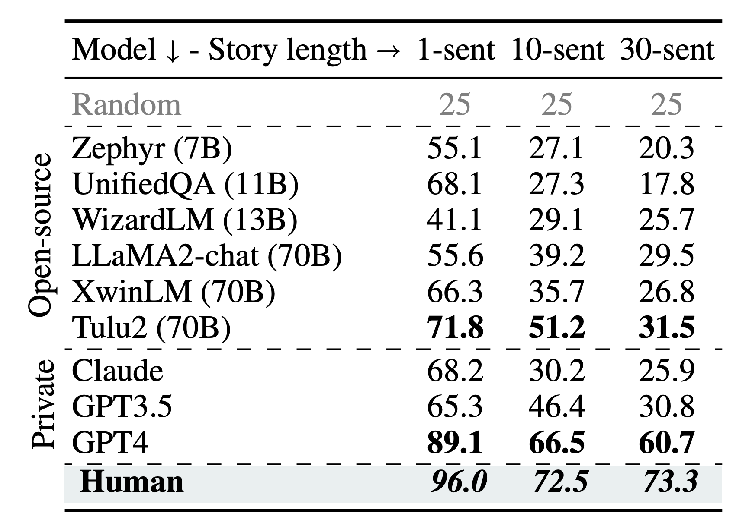
Results
Task Overview: Given a narrative, can LLMs identify the most analogous sentence from a set of 4 choices?
Notes:
We evaluated LLMs on single-sentence, ten-sentence, and thirty-sentence narratives

Slide 29
Results
Task Overview: Given a narrative, can LLMs identify the most analogous sentence from a set of 4 choices?
Human performance is high but decreases with story length
Notes:
We also tested human performance on these settings, and found that they perform well on the simplest setting with single sentences, which suggests that our data collection is generally valid. With longer narratives, the task becomes more challenging, and human performance decreases as expected

Slide 30
Results
Task Overview: Given a narrative, can LLMs identify the most analogous sentence from a set of 4 choices?
LLM performance decrease
is much larger than
human performance decrease
Notes:
We tested a large variety of LLMs on our benchmark.
In general, we found that LLM performance degraded much more relative to human performance.

Slide 31
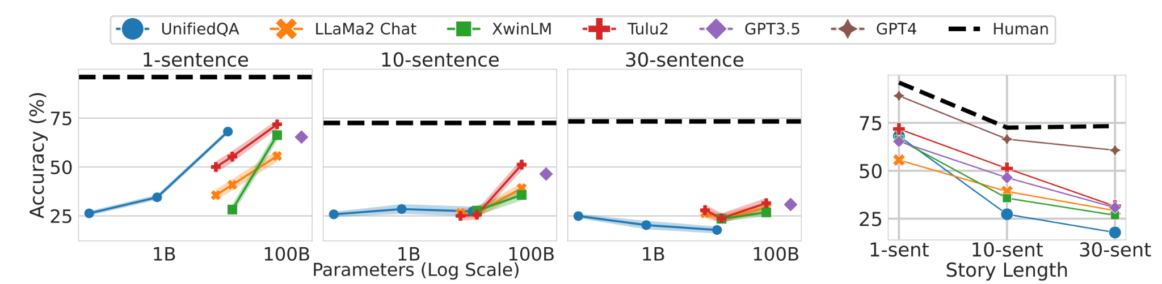
Further analysis - model size
Task Overview: Given a narrative, can LLMs identify the most analogous sentence from a set of 4 choices?
Notes:
We also investigated whether model size can benefit performance.
To do that we looked at model families such as Llama that contain model versions in different sizes

Slide 32
Further analysis - model size
Task Overview: Given a narrative, can LLMs identify the most analogous sentence from a set of 4 choices?
Notes:
We plotted accuracy vs model size for each of the narrative length settings we evaluated

Slide 33
Further analysis - model size
Task Overview: Effect of model size on performance
Performance scales with model size on short narratives
Notes:
We find that on short narratives, model size offers considerable benefit to performance

Slide 34
Further analysis - model size
Task Overview: Effect of model size on performance
Performance DOES NOT scale with model size on long narratives
Notes:
However as narrative length increases, model size stops being beneficial

Slide 35
Tasks
Task 1:
Challenging analogies
Task 2:
Analogical retrieval
Notes:
We’ve shown that on multiple-choice questions, LLMs display poor performance as task difficulty is increased
And that model size also seems to have little impact
In our second task, we use the same data as before, but we increase the set of choices to 200 narratives.

Slide 36
Task 2 - Analogical retrieval
Task Overview: Given a narrative, can LLMs identify the most analogous sentence from a set of 200 choices?
Q: Retrieve the top 10 analogous stories from the sentence bank…
Query
The weather finally became pleasant following the stormy week.
Doc. n
As the flame extinguished, it left behind a thin wisp of smoke
Notes:
The purpose of this task is to study “analogical retrieval,” where a query narrative is used to retrieve the top analogous narratives in a collection.
Analogical retrieval is more akin to how humans identify analogies from a large collection of past experiences, and we wanted to see if LLMs can replicate this ability
To perform retrieval, we enumerate all 200 narrative choices in-context, and prompt the LLM to select the top 10 most analogous stories

Slide 37
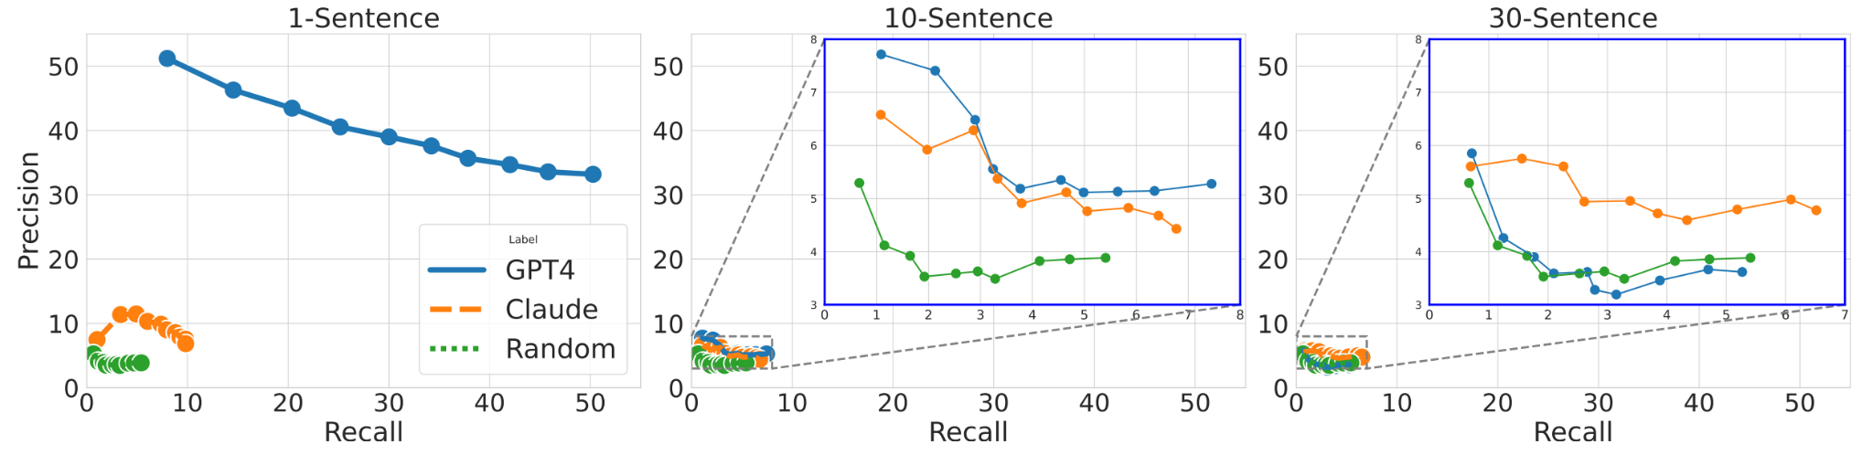
Task 2 - Results
Task Overview: Given a narrative, can LLMs identify the most analogous sentence from a set of 200 choices?
Notes:
Like in the previous task, we perform this experiment on 1-sentence, 10-sentence, and 30-sentence narratives

Slide 38
Task 2 - Results
Task Overview: Given a narrative, can LLMs identify the most analogous sentence from a set of 200 choices?
Notes:
We report the precision vs recall curves on analogical retrieval for each of the narrative lengths

Slide 39
Task 2 - Results
Task Overview: Given a narrative, can LLMs identify the most analogous sentence from a set of 200 choices?
Notes:
We test GPT4 and Claude and add a random-choice baseline for good measure

Slide 40
Task 2 - Results
Task Overview: Given a narrative, can LLMs identify the most analogous sentence from a set of 200 choices?
Some LLMs do well on short narratives
Notes:
We find that on the single-sentence setting, GPT4 is able to perform well whereas Claude is not

Slide 41
Task 2 - Results
Task Overview: Given a narrative, can LLMs identify the most analogous sentence from a set of 200 choices?
All LLMs perform trivially on long narratives
Notes:
But on longer narrative lengths, both models achieve more or less random performance

Slide 42
Conclusion
Are LLMs performant on more challenging analogical reasoning tasks?
Notes:
Now let’s revisit our initial research motivations.
Prior works concluded that LLMs demonstrate emergent zero-shot behavior on simple analogical reasoning tasks
We hypothesized that richer and more complex analogies may still pose a challenge
We tested this in two ways

Slide 43
Conclusion
Are LLMs performant on more challenging analogical reasoning tasks?
Task 1:
Challenging analogies are difficult for LLMs
Human-AI ability gap increases on longer narratives
Notes:
In our first task, we used narrative length to study the effect of analogy complexity.
We found that the human vs AI performance gap increases as narrative length increases

Slide 44
Conclusion
Are LLMs performant on more challenging analogical reasoning tasks?
Task 1:
Challenging analogies are difficult for LLMs
Model size does not help when narratives are long
Notes:
We also found that the benefit of model size diminishes with longer narratives

Slide 45
Conclusion
Are LLMs performant on more challenging analogical reasoning tasks?
Task 1:
Challenging analogies are difficult for LLMs
Task 2:
LLMs perform poorly on analogical retrieval
Performance on longer narratives is trivial
Notes:
In our second task, we studied analogical retrieval
Here we found that performance approaches random as narrative length increases

Slide 46
Conclusion
Are LLMs performant on more challenging analogical reasoning tasks?
Task 1:
Challenging analogies are difficult for LLMs
Task 2:
LLMs perform poorly on analogical retrieval
AnaloBench is challenging for LLMs
Notes:
To answer our question, we show that analogy identification featuring richer and more complicated narratives is still challenging for LLMs
Thank you

