Slide 1




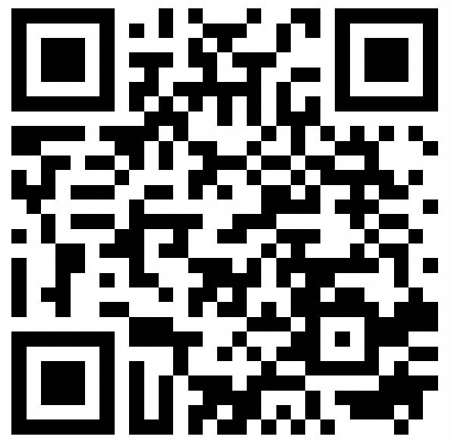





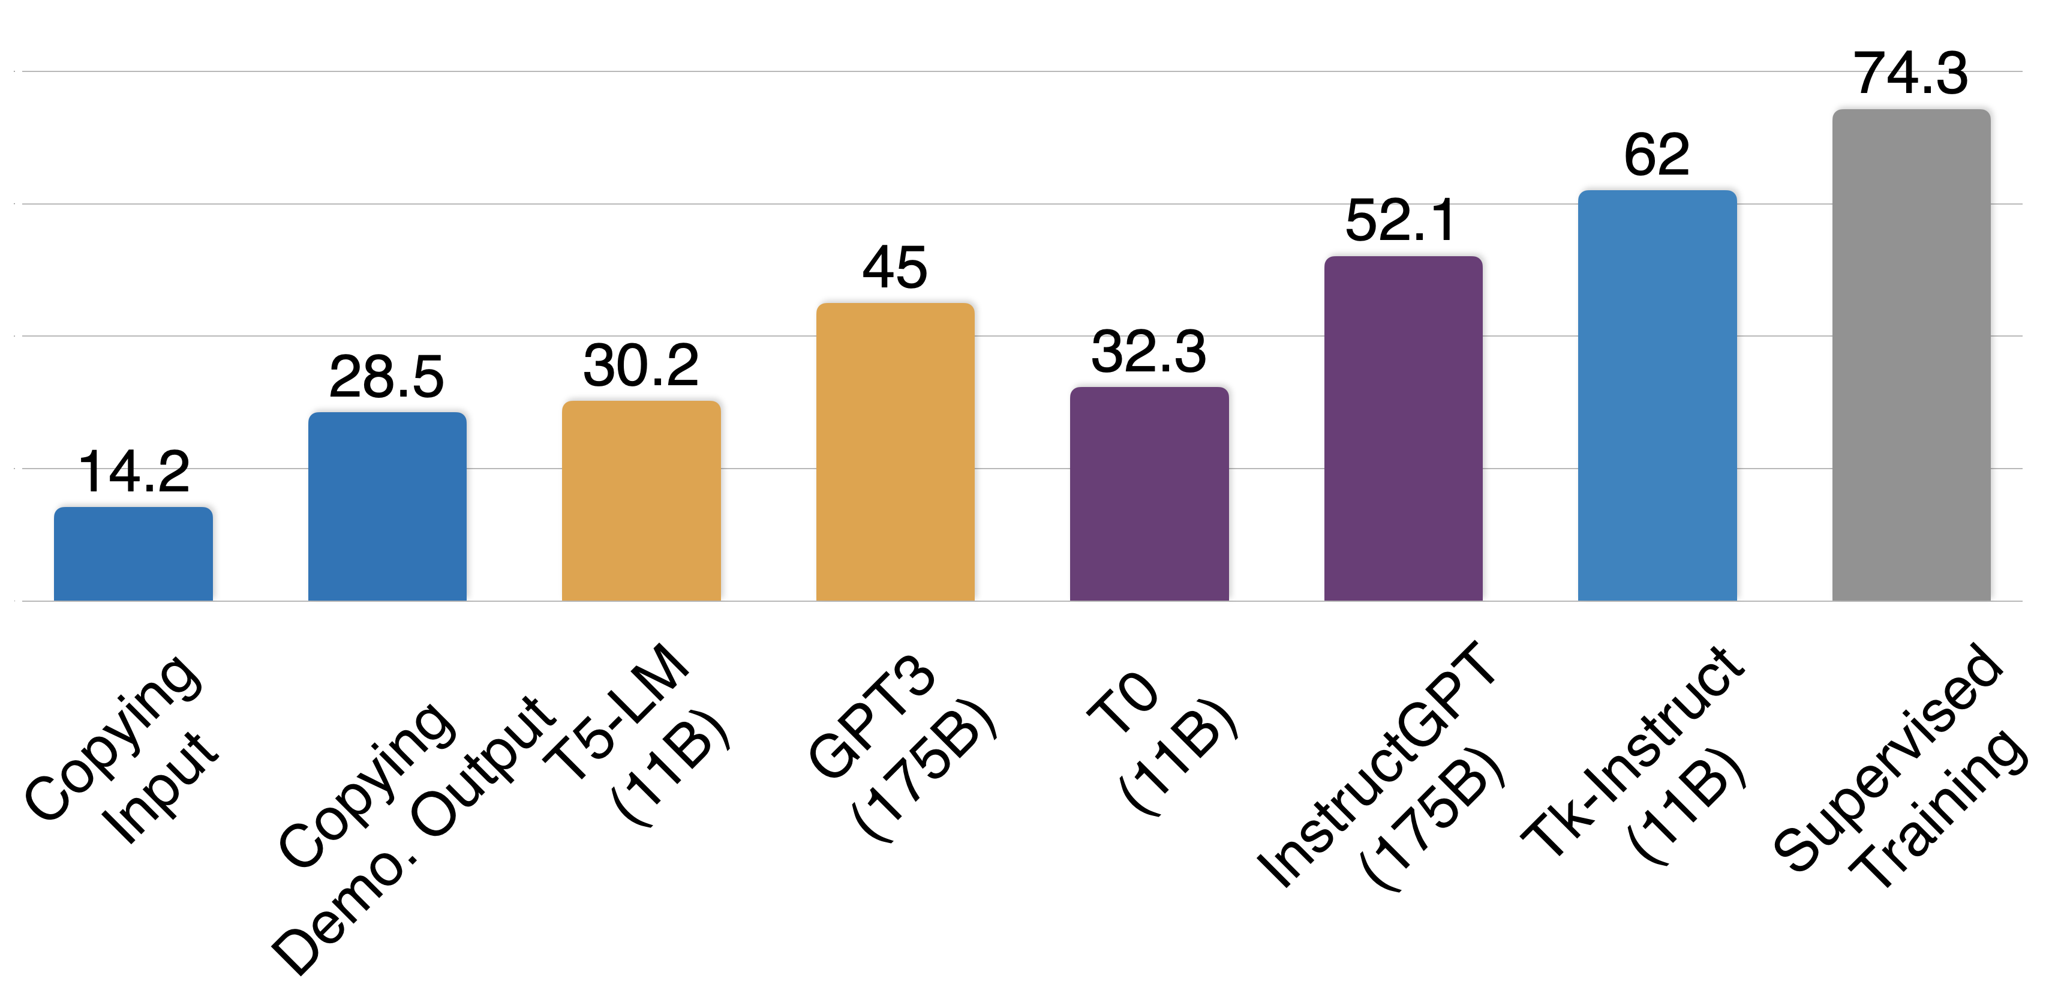
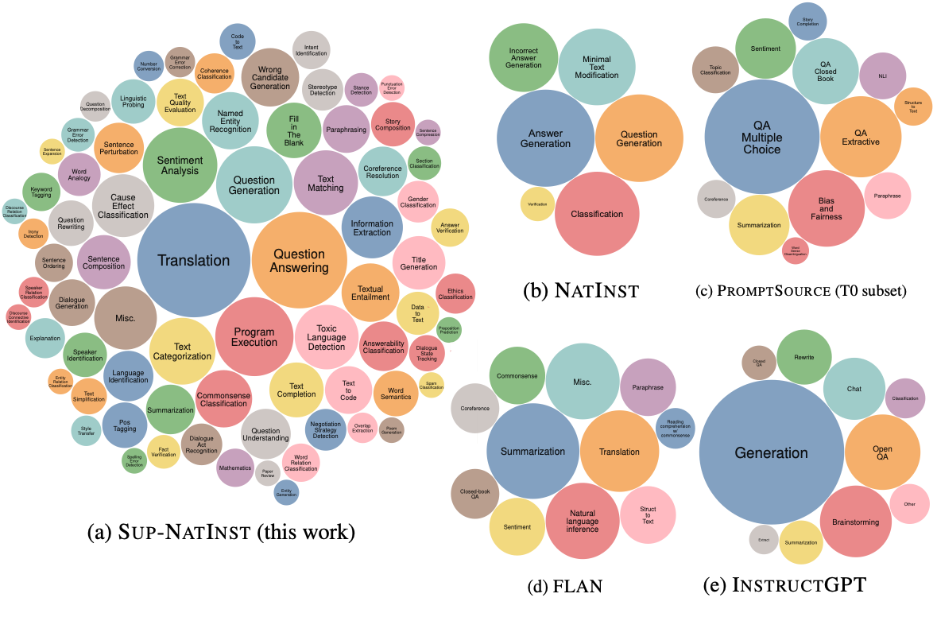
Super-NaturalInstructions: Generalization via Declarative Instructions on 1600+ NLP Tasks
@yizhongwyz
Website
yizhongw@cs.washington.edu
Yizhong Wang*, Swaroop Mishra*, Pegah Alipoormolabashi, Yeganeh Kordi,
Chitta Baral, Yejin Choi, Noah A. Smith, Hannaneh Hajishirzi, Daniel Khashabi, and others
Background
Instructing Example
Task-specific Models
Question Answering
AI
“ the answer is 2022. ”
Sentiment Analysis
AI
“ positive ”
Text Summarization
AI
“ the article tells … ”
General-purpose Model
Question Answering
“ the answer is 2022. ”
Sentiment Analysis
AI
“ positive ”
Text Summarization
“ the article tells … ”
Dialogue Act Recognition
“ order pizza ”
Large pretrained language models can solve various types of tasks by following in-context instructions.
Super-Natural Instructions
Tk-Instruct
We collected a diverse set of 1,616 NLP tasks and annotated their natural language instructions. (see example )
Instruction tuning of T5 model (11B) on our data enables better generalization to unseen tasks than GPT3 (175B ).
How are they collected?
Data was contributed by 88 NLP practitioners from the community.
Instructions were carefully written by these contributors and then reviewed by experts.
Multiple iterations of editing and review were done via GitHub to ensure quality.
Eval setup for cross-task generalization
12 manually picked evaluation categories.
English track: 119 eval tasks, 757 training tasks.
Cross-lingual track: 35 eval tasks, 1271 training tasks.
Why is this dataset unique?
Instructions are declarative and informative!
Diversity: 76 broad categories (see comparison )
Scaling trend of generalization
References:
[1] Mishra et al. “Cross-Task Generalization via Natural Language Crowdsourcing Instructions”. ACL 2022.
[2] Sanh et al. “Multitask Prompted Training Enables Zero-Shot Task Generalization”. ICLR 2022.
[3] Bach et al. “PromptSource: An Integrated Development Environment and Repository for Natural Language Prompts”. ACL 2022.
[4] Wei et. al. “Finetuned Language Models are Zero-Shot Learners.” ICLR 2022.
[5] Ouyang et al. “Training Language Models to Follow Instructions with Human Feedback”. arXiv preprint 2022.
Check our paper for more ablations!
Definition and in-context examples are complementary.
A large number of training instances are not necessary.

