Slide 1

https://github.com/allenai/CommaQA
Hey AI, Can You Solve Complex Tasks by Talking to Agents?
Tushar Khot,
Kyle Richardson,
Daniel Khashabi,
Ashish Sabharwal
Not yet, but we can help
Notes:
Hello everyone, I am Tushar Khot and today I will be presenting our work on learning to communicate with agents. This work was done in collaboration with my colleagues at AI2. In this work, we ask the question: can current AI systems learn to talk with agents to solve more complex tasks. And while they are unable to do so yet, we hope that our proposed dataset can help develop better solutions for this problem.

Slide 2



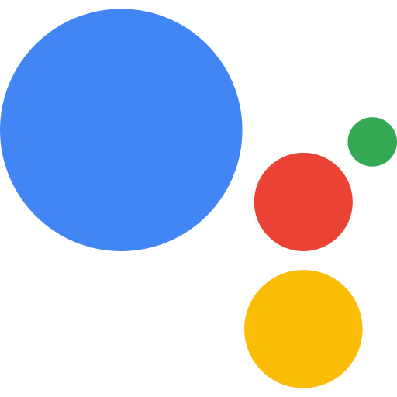



Motivation: Solving Tasks by Talking to Agents
Hey AI, Can you buy me the book series that has the kid with that lightning scar?
1. Solve a complex task by breaking them down into agent’s capabilities
2. Interact with existing agents in their expected and natural language
Can AI systems do the same?
Hey Google, Which book series has a kid with a lightning scar?
Harry Potter
Hey Google, Which are the books in Harry Potter series?
Hey Alexa, Buy Harry Potter and the Sorcerer's Stone
Hey Alexa, Buy Harry Potter and the Sorcerer's Stone
Hey Alexa, Buy Harry Potter and the Sorcerer's Stone
Ordered!
Notes:
So first what do I mean by solving a task by talking with agents? Let’s consider the following scenario: Say someone mentioned a popular book series about a kid with a lightning scar that you should read. You don’t remember the name anymore but would like to buy those books. So you might first ask your Google Assistant, which book series has such a kid and then get the list of books in this series. And now you may use your Alexa assistant to buy each book for you.
Basically you were able to solve a multi-step task by decomposing it into simpler sub-tasks that you know can be solved using existing agents. You interacted with these agents in their natural language without ever relying on any agent internals such as their training data or knowledge bases.
The question in this work is “Can we build AI systems to also do the same task?”

Slide 3
Paper Summary
New Task: Learning to Talk to Agents to Solve Complex Tasks
Green AI: Reuse existing expensive and even proprietary models
Better Long-Term Bet: No need to learn every task from scratch
Interpretability: Naturally modular and interpretable systems
Technical Challenge: Search for solutions by interacting with NL agents
1. Solve a complex task by breaking them down into agent’s capabilities
2. Interact with existing agents in their expected and natural language
Can AI systems do the same?
How can we build AI systems to solve this task?
New Dataset: CommaQA: Communicating with Agents for QA
Synthetic Multi-hop QA Dataset solvable using agents
Challenging for current black-box models and task baselines
Notes:
We formalize this as the task of “learning to talk to agents” . A natural question might be: why should we build such AI systems? By using existing agents, we can reuse the skills of our expensively trained models rather than waste computation on learning them again. We can even use black-box proprietary models behind APIs in this framework. Additionally as the tasks get more complex requiring composition of more and more skills, composing existing agents is a better long-term bet than learning a new monolithic model each time. The resulting systems are also naturally modular and interpretable through the communications with the agents. And at a technical level, this poses an interesting research problem of searching for solutions by communicating in free language with AI agents.
And so “How can we build systems for this task”? Unfortunately current datasets lack sufficiently accurate composable agents, resulting in uncontrollable sources of error. Or have shortcuts exploitable by black-box models negating the need for such skill composition. So we build the first dataset designed for this task, CommaQA. CommaQA is a synthetic multi-hop QA dataset guaranteed to be solvable using our agents. It is challenging for current black-box models as well as task baselines.
Next I will go into more details of the task and the dataset.

Slide 4





Learning to Talk to Agents: Example Task
What is the list of books in LOTR series
Which movies are in the Fast & Furious series
…
Which Harry Potter Book has a car on its cover?
What is the list of books in the Harry Potter series?
Cover of “The Hobbit” book
Poster of the “2 Fast 2 Furious” movie
…
Harry Potter and the Philosopher’s Stone, …
foreach
Cover of the “Harry Potter and the Philosopher’s Stone” book
Cover of the “Harry Potter and the Philosopher’s Stone” book
Is there a truck in ?
Is there a mountain in ?
…
foreach
Is there a car in ?
Is there a car in ?
Yes
No
filter
Harry Potter and the Chamber of Secrets
Notes:
To define the task, lets consider the following scenario with three agents: Google Search, Image Search and a Visual Question answering (or VQA) model and the list of questions that you can ask these agents. Now say you are trying to remember “Which Harry Potter Book had a car on its cover?”. Just based on the sample inputs you know how to get the list of books in this series from Google, then get the book covers for each book in the series from Image Search, and identify which book covers have cars using VQA. You can then filter down to the one book where the VQA answer was “Yes” as your final answer.

Slide 5






Learning to Talk to Agents: Task Definition
Given:
Should NOT rely on:
Agents
Training Data of the Agents
What is the list of books in LOTR series …
Cover of “The Hobbit” book
…
Is there a truck in ?
…
Millions of egs
GPT-3
??
Examples of Valid Inputs
Agents Internal Knowledge
Which Harry Potter Book has a car on its cover? => Harry Potter and the Chamber of Secrets
Complex Task Supervision
Is it okay to play chess at 3 AM? => Yes
??
GPT-3
To Do:
Conversation Supervision
Learn to solve the complex task by talking to agents
This is not a standard QA task – to answer the question a system must communicate with the agents
Notes:
Basically, you were able to answer this question using just the three agents and some examples of their valid input. Additionally to be able to train a system, we assume access to the complex task’s training data too. And what we would like to do given these inputs is to build a system that can learn to use the agents in a similar manner as shown before. Note that unlike standard QA datasets, the system has to communicate with the agents to answer the questions.
For generality of the task, What we assume to not have access to:
Training data of the agents. First the agents might have been trained on millions of examples and retraining on them would be wasteful. And in cases of Google and Alexa, we don’t even have access to the training data
Secondly the agent’s internal knowledge is also often not available or hard to materialize when saved within the model’s parameters.
Finally the complex task may only have label supervision and no supervision on valid conversations with the agents. This is more of an issue of annotation cost and less about the infeasibility of obtaining such annotations.

Slide 6
CommaQA Dataset: Communicating with Agents for QA
Multi-hop QA Dataset designed for the learning to talk task
Agents: Single-hop QA over different modalities
Three different styles of multi-hop reasoning:
CommaQA-I
Implicit Decomposition
TextQA
KBQA
What objects does Apple make?
…
What is IPhone a type of?
…
What objects has Steve Jobs likely used? => [“Cell Phone”, …”]
What awards have the actors of the Oscar-winning movies received? => [“Oscar”, …”]
CommaQA-E
Explicit Decomposition
TextQA
TableQA
Inspired by OpenBookQA (Mihaylov et al. ‘18), StrategyQA (Geva et al. ‘21)
What awards has Sian Heder won?
Who acted in Godfather?
…
What awards has Beyoncé won?
Which movies have won Oscar?
…
CommaQA-N
Numeric Decomposition
TextQA
MathQA
What awards have the actors of the Oscar-winning movies received? => [“Oscar”, …”]
What was the length of javelin throws by Michael Shey ?
…
What is the maximum value in [35.0, 15.0, 25.0]?
…
What awards have the actors of the Oscar-winning movies received? => [“Oscar”, …”]
What was the gap between the longest javelin throws from USA and Ireland? => 2.0
What awards have the actors of the Oscar-winning movies received? => [“Oscar”, …”]
Inspired by HotpotQA (Yang et al. ‘18), MusiQue (Trivedi et al. ‘21)
Inspired by DROP (Dua et al. ‘19)
Notes:
Given this new task, we developed a new synthetic dataset CommaQA to enable progress on this task. CommaQA is posed as a multi-hop QA dataset with each agent as a single-hop QA model. We have three different style of questions inspired by prior datasets that form three different sub-datasets. CommaQA-E where the solution approach is explicitly described in the question, e.g. “What awards have the actors of the Oscar-winning movies received? “. The model still has to figure out how to communicate with the agents and which agents have the answer. Very briefly the other two datasets are: CommaQA-I where the solution approach is implicit in the question and CommaQA-N that requires numeric reasoning. Note that while inspired by reading comprehension or open-domain QA datasets, CommaQA is a dataset for learning to talk to agents with no RC context or corpora.

Slide 7
CommaQA Dataset: Key Properties
No conflicts with world knowledge -- Replace entities with made-up words, e.g., What awards have the actors of the Glag-winning movies received?
Needs dynamic interaction with agents -- Different agents may have the answer in each context
Needs handling of structured answers from agents -- Introduce novel executable operators for NL questions over list/dict answers
Fast and noise-free agents for quick progress -- Agents implemented as fast Python functions (instead of LMs)
Auxiliary supervision as stepping-stones -- Provide rich annotations on the KB, textual facts, decompositions
TextQA
TableQA
What awards has Sian Heder won?
What awards has Beyoncé won?
foreach
Is there a car in ?
Is there a car in ?
Notes:
The resulting CommaQA Dataset has some key properties.
We avoid any conflicts with the world knowledge by using novel made-up nouns.
We ensure that system needs to interact with the agents to find the right solution strategy by varying the agents that can answer a sub-question, e.g., the awards won by a person might be answerable by a TextQA agent or a TableQA agent.
Since complex questions often require reasoning over lists or dictionaries as we also show in our example, our dataset is designed to require reasoning over such structures. We additionally introduce new operators that can execute NL questions over such data structures.
Finally to ensure repaid experimentation, we implement agents as fast and accurate symbolic python functions. We provide auxiliary data such as the KB and conversation supervision both as stepping stones and for oracle upper-bounds

Slide 8
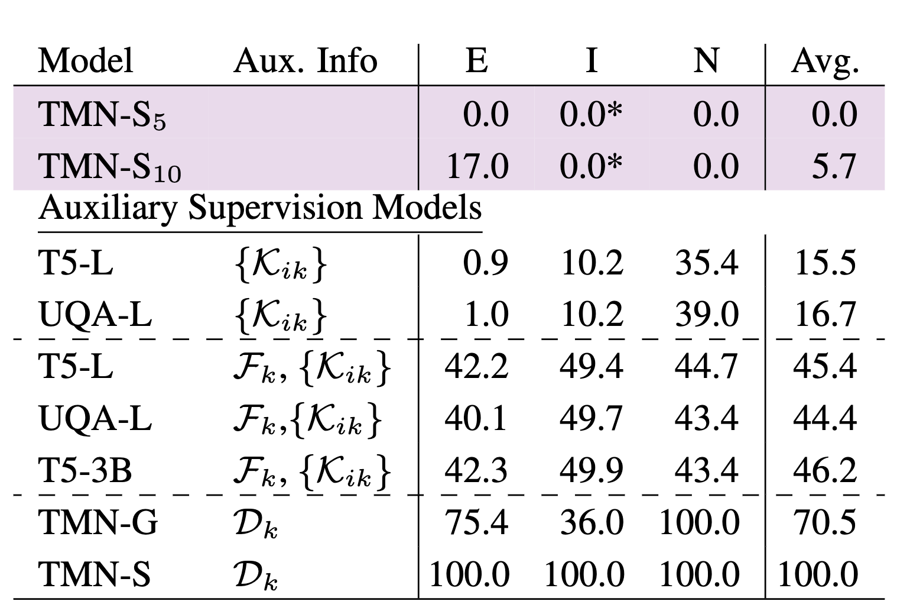


Results
More details in the paper
Unsolved using the current baselines that talk to agents
Black-box models struggle even when given access to the agent’s private knowledge
Oracle
KB
But solvable by training on conversation supervision (oracle upper bound)
Oracle
TMN: Khot et al, ‘21
T5: Raffel et al. ‘20
UQA: Khashabi et al. ‘20
Notes:
I will describe the experiment results on CommaQA very briefly next. We show that current task baselines are unable to solve this task, even though the upper-bound for such methods is 100% by training on the conversation supervision. However black-box models, even in the oracle setting of having all the agent’s knowledge, find this task to be challenging. Beyond this IID setting, we also provide a compositional generalization test split described in the paper.

Slide 9
Conclusion
Rather than learning a new model for each task, can we learn to use existing models/agents? ➔ Proposed Learning to Talk to Agents Task
How do we study this problem and develop methods for this task without other confounding factors ? ➔ Proposed CommaQA Dataset
Future Research Directions:
Use semantics of the question in the search
Reward-based approaches
Please come to our poster for more details!
Code/Data/Paper: https://github.com/allenai/CommaQA
Questions? Email us: {tushark,kyler,danielk,ashishs}@allenai.org
Notes:
In conclusion, in this work we present the task of learning to talk to agents as a better way to build models for new complex tasks. We provide a new synthetic dataset CommaQA that can allow researchers to focus on this extremely challenging problem without confounding issues. Finally, we hope that the community works on developing new methods for this task, e.g. using question semantics and rewards.
Please come to our poster or refer to our paper and code at the link below. And if you have any questions, please feel free to reach out to us!Thank you.

Slide 10
UNUSED SLIDES
UNUSED SLIDES

Slide 11
CommaQA: Communicating with Agents for QA
Synthetic QA Dataset designed for the learning to communicate task
Three different styles of multi-hop reasoning:
Explicit: What awards have the actors of the Oscar-winning movies received?
Implicit: What objects has Aristotle likely used?
Numeric: What was the gap between the longest javelin throws from USA and Ireland?
Different world context per question using novel entities
No cheating via memorization; no conflicts with world knowledge
Different agents with the answer in each world context
Non-deterministic execution; need to interact with agents to find the answer
Controlled dataset with rich auxiliary supervision as stepping stones
Fast and Accurate Agents; Fact and Decomposition supervision
Glag
Lidus
Vexa
Riften
Notes:
To make progress on this task, we provide a new synthetic dataset phrased as a multi-hop QA dataset. We have three different style of questions that form three different datasets. Explicit-where the solution approach is clear but the model still has to figure out the agent communication, implicit where the solution approach is not clear and the model has communicate with the agents and use common-sense to infer the solution and finally a dataset with simple numeric reasoning.
To ensure no memorization, each question has their own world context with made up entities to prevent conflict
Just like in real world, where some information may be in tables, some in text and some in images, our dataset also varies the agents that can provide answer to a sub-question requiring agent interaction even when explicitly described
Finally due to the controlled synthetic nature of our dataset, we are able to provide fact and accurate agents so that researchers can directly focus on the task of learning to communicate. Additionally we provide auxiliary data to serve as stepping stones and evaluate ideal-case baselines

Slide 12
Learning to Communicate with Agents
Necessary Inputs:
Not always available! But useful as stepping stones
Agents
Auxiliary Data:
Training Data of the Agents
Internal Knowledge Resources of the Agents
Sample solution strategies to solve complex questions
What does running a mixer produce?
Is it okay to make noise early in the morning?
Examples of Valid Inputs
What does running a mixer produce?
Is it okay to make noise early in the morning?
Is it okay to play a copper serpent at 3 AM? => No
Training Data
Is it okay to play chess at 3 AM? => Yes

Slide 13
Can you buy me the book series that has the kid with that lightning scar?
1. Solved a task by breaking them down into sub-tasks
2. Interacted with existing agents in natural language
Can we build AI systems to do the same?
Which book series has a kid with a lightning scar?
Harry Potter
What are the books in Harry Potter series?
Hey Alexa, Buy Harry Potter and the Sorcerer's Stone
Hey Alexa, Buy Harry Potter and the Sorcerer's Stone
Hey Alexa, Buy Harry Potter and the Sorcerer's Stone
Ordered!

Slide 14
Motivation: Solve Tasks by using Agents
TODO: Add text + animation

