Slide 1
Prompt Waywardness: Curious Case of Discretized Interpretation of Continuous Prompts
Joint work w/ Shane Lyu, Sewon Min, Lianhui Qin, Kyle Richardson, Sameer Singh, Sean Welleck, Hannaneh Hajishirzi, Tushar Khot, Ashish Sabharwal, Yejin Choi
Allen Institute for AI University of Washington University of California-Irvine

Slide 2
GPT
[Radford et al. ’19, Brown et al. ‘20]
Notes:
The release of GPT has sparked lots of excitement about the emergent ability of LMs in following language statements.
I can pose all sorts of language prompt to the model and it generally can give a reasonable response ...

Slide 3
I talked about "prompt waywardness" where I highlighted challenges with
GPT
iphone and android. Now, I want to talk about Google's payment procedures ...
[Radford et al. ’19, Brown et al. ‘20]
Notes:
I can even solve tasks this way: ....

Slide 4


easy to understand → easy to form an expectation about the model output
What is the sentiment of the following review? (positive or negative)
GPT
Sentence: That was a great fantasy movie.
Answer: positive
[Radford et al.’19, Brown et al.’20]
Notes:
One key nice attribute of discrete prompts is their "human readability”, meaning that just by virtue of reading a given prompt I can expect the sort of outcome GPT is going to generate. So that’s nice!
What is the challenge here? We don't have algorithmic ways of finding discrete prompts yet.

Slide 5
What is the sentiment of the following review? (positive or negative)
Sentence: That was a great fantasy movie.
GPT
Answer: positive
Something related to sentiment analysis?
[Radford et al. ’19, Brown et al. ‘20]
Notes:
In parallel, there has been a line of work on continuous prompts that have shown their effectiveness for a variety of generation problems.
Here I am defining continuous prompts to be a soft vector appended to the embedding of an input text to make it generate a desired outcome.
For example, we can find continuous prompts that effectively solve a given task.
However, we don’t know whether they are interpretable or not. Despite these successes, the resulting continuous prompts are not easy to interpret (Shin et al., 2020).
Naturally a question here is whether there is a correspondence between discrete and continuous prompts.
In particular, we investigate whether it is possible to come up with meaningful discrete (textual) interpretations of continuous prompts, especially ones that provide a faithful explanation of the prompt’s behavior?

Slide 6
Something related to sentiment analysis?
Sentence: That was a great fantasy movie.
GPT
Answer: positive
[Li and Liang’21; Lester et al.’21]
Notes:
In parallel, there is a line of work on continuous prompts that have shown their effectiveness for a variety of generation problems.
Here I am defining continuous prompts to be a soft vector appended to the embedding of an input text to make it generate a desired outcome.
For example, we can find continuous prompts that effectively solve a given task.
However, we don’t know whether they are interpretable or not. Despite these successes, the resulting continuous prompts are not easy to interpret (Shin et al., 2020).
Naturally a question here is whether there is a correspondence between discrete and continuous prompts.
In particular, we investigate whether it is possible to come up with meaningful discrete (textual) interpretations of continuous prompts, especially ones that provide a faithful explanation of the prompt’s behavior.

Slide 7
Write a question based on the sentence
Flip the sentiment of the sentence
<span style=“color: red”>hello world</span>
Sentence: That was a great fantasy movie.
GPT
Answer: positive
Waywardness hypothesis (informal):
One can find “accurate” continuous prompts such that they can be “projected” to any arbitrary text.
Notes:
In practice, we show that one can find continuous prompts that perform a desired task while, at the same time, project to any given target text.
For instance, a continuous prompt that effectively solves the sentiment classification task in Fig.1, when projected onto discrete space, might appear as the definition of a different task (“flip the sentiment”).
* Projection: nearest-neighbor discrete (language) representation
We call this "waywardness" hypothesis: which states that one can find “accurate” continuous prompts such that they can be projected to any arbitrary text (such as the definition of a different task or even an irrelevant statement.
For a formal definition check the paper (arxiv).
Which suggests a disconnect between the outcome of continuous prompts and their discrete interpretations.

Slide 8
Forthcoming content:
Systemic empirical study of “waywardness”
Making sense of “waywardness”
Implications of “waywardness”
Waywardness hypothesis (informal):
One can find “accurate” continuous prompts such that they can be “projected” to any arbitrary text.
Notes:
For the rest of the slides,

Slide 9
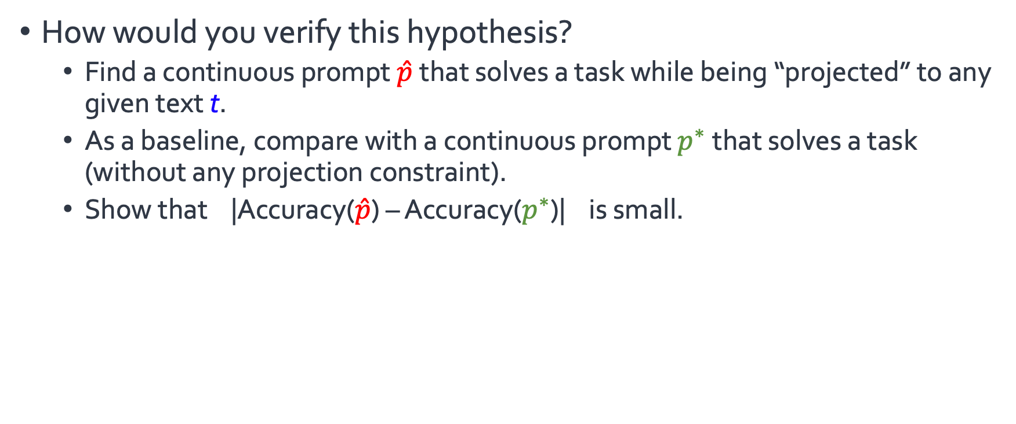
Finding Wayward Prompts
How would you verify this hypothesis?
Find a continuous prompt $\hat{p}$that solves a task while being “projected” to any given text t.
As a baseline, compare with a continuous prompt $p^{∗}$that solves a task (without any projection constraint).
Show that |Accuracy($\hat{p}$) – Accuracy($p^{∗}$)| is small.
Waywardness hypothesis (informal):
One can find “accurate” continuous prompts such that they can be “projected” to any arbitrary text.

Slide 10
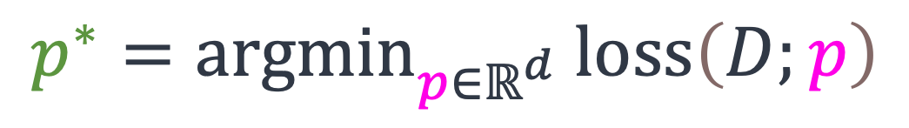

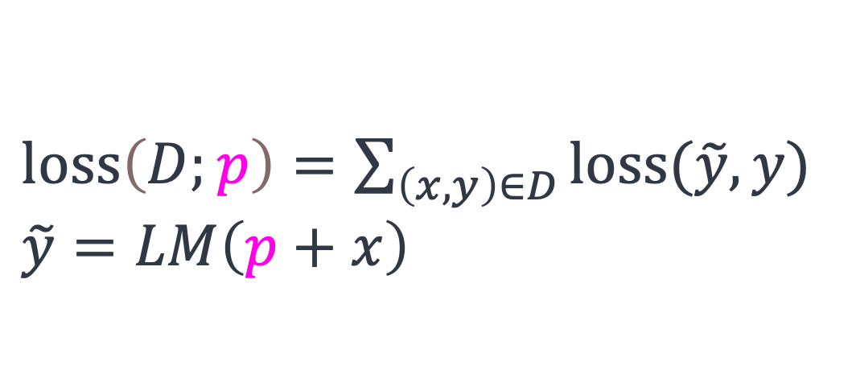
Finding Wayward Prompts
Let $p^{∗}$ denote the typical way of finding continuous prompts through empirical risk minimization:
$$p^{∗}={argmin}_{{p∈ℝ}^{d}} loss\left(D;p\right)$$
$loss\left(D;p\right)=\sum_{\left(x, y\right)∈D}{loss(\tilde{y}, y)}$
$$\tilde{y}=LM\left(p+x\right)$$

Slide 11

Finding Wayward Prompts
Let $p^{∗}$ denote the typical way of finding continuous prompts through empirical risk minimization:
Let $\hat{p}$ denote a continuous prompt projected to a given text $t$:
$$p^{∗}={argmin}_{{p∈ℝ}^{d}} loss\left(D;p\right)$$
$\hat{p}={argmin}_{{p∈ℝ}^{d}} [ loss\left(D;p\right)+γ dist\left(p, t\right) ]$
$dist\left(p, t\right)$: Euclidean between $p$and embedding of $t$.

Slide 12


Finding Wayward Prompts
Task: SST2 (2 class sentiment classification)
92.0
int clamp(int val, int min_val, int max_val) { return std::max(min_val, std::min(max_val, val)); }
PILE
$p^{∗}$
92.5
$$\hat{p}$$
91.8
Natural
Instructions
Write down the conclusion you can reach by combining the given Fact 1 and Fact 2.
92.4
95 90 85
accuracy on SST2
It is possible to find continuous prompts that are mapped to a given text (≥ 94% token overlap) with under 2% drop in task accuracy.

Slide 13
Finding Wayward Prompts
More experiments in the paper!
More tasks
Reweighting the loss terms for task utility and projection
Effect of model size and prompt length
Using true prompts

Slide 14
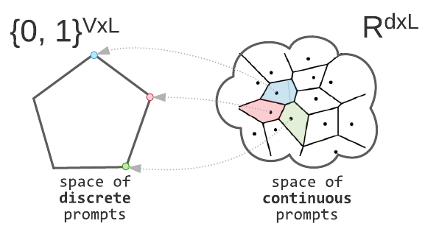
Making Sense of “Waywardness”
(1) The mapping between continuous and discrete space is not one-to-one.
Waywardness hypothesis (informal):
One can find “accurate” continuous prompts such that they can be projected to any arbitrary text.

Slide 15
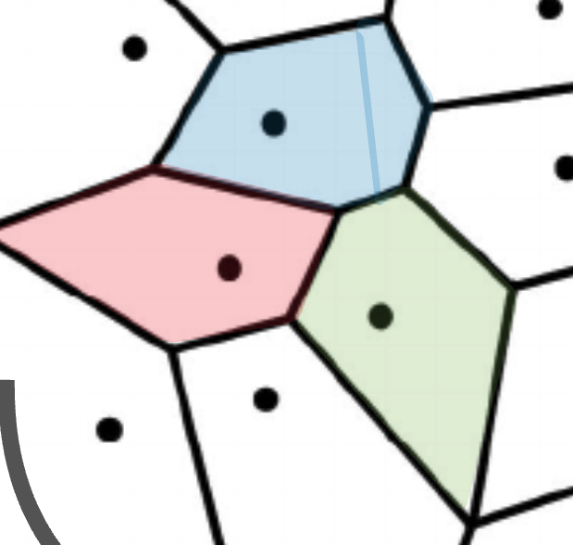

Making Sense of “Waywardness”
(1) The mapping between continuous and discrete space is not one-to-one.
(2) Deep models give a lot of expressivity power to the earlier layers.
[Telgarsky’16; Raghu et al.’17]
Waywardness hypothesis (informal):
One can find “accurate” continuous prompts such that they can be projected to any arbitrary text.
$$ε$$

Slide 16
Implications of Waywardness (1)
Faithful interpretation of continuous prompts is difficult.
Notes:
Given the intuitions behind and empirical support for the Waywardness hypothesis, faithful discrete interpretations of continuous prompts via common discrete projections (like nearest-neighbor projection) are unlikely to be robust, based on current approaches.
Whether there is a better way of interpreting continuous prompts with human language is an open question.
Future work may investigate more on this topic in order to improve the interpretability of prompt-based language models.

Slide 17

Implications of Waywardness (2)
Risk of interpreting continuous prompts:
concealed adversarial attacks.
continuous prompt
😇 benign projection
Rank the candidates ignoring their race or gender.
GPT
😈 adversarial behavior
👩🏽‍🎓 < 👨🏽‍🎓 < 👨🏻‍🎓
Notes:
It is not difficult to imagine a future where proprietary model development is driven by fine-tuned continuous prompts.
In such a world, not addressing the challenges involved in discrete interpretation of continuous prompts can lead to harmful (and potentially, adversarial) consequences.
Consider the following scenario: a model designer comes up with a continuous prompt tha0t solve a target task (e.g., ranking resumes according to each applicant’s qualifications and merits).
Whether intentionally or not, such prompts may maliciously target, for example, a minority group.
To assure their customers, the model designer makes a prompt that expresses a benign definition for the task, which does not reveal the true nature of the egregious behavior.
The customers might even evaluate the prompt on a few instances but not notice this harmful behavior, e.g., when it effects a minority group not in the evaluation set.
In a way, the benign discrete projections may provide a false sense of security.

Slide 18
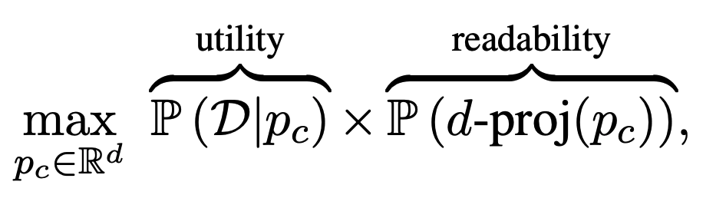
Implications of Waywardness (3)
Continuous differentiable optimization in search of discrete human-readable prompts can lead to “degenerate” solutions.
Notes:
How to optimize for human-readable prompts? ….
We hypothesize that Waywardness poses a challenge toward this goal.

Slide 19
Summary
Waywardness Hypothesis
A surprising level of disconnect between continuous and discrete prompts.
We provided empirical evidence and intuitions for this hypothesis.
Concluded with implications of this hypothesis.
We need algorithmic or architectural innovations for automatic discovery of human-readable prompts.
Notes:
Prompt Waywardness poses a challenge for future progress on the algorithmic discovery of human readable prompts that are faithful to the task they solve.
We hope the observations made in this work motivate architectural innovations that overcome such challenges and guide future steps in the prompting literature.

Slide 20
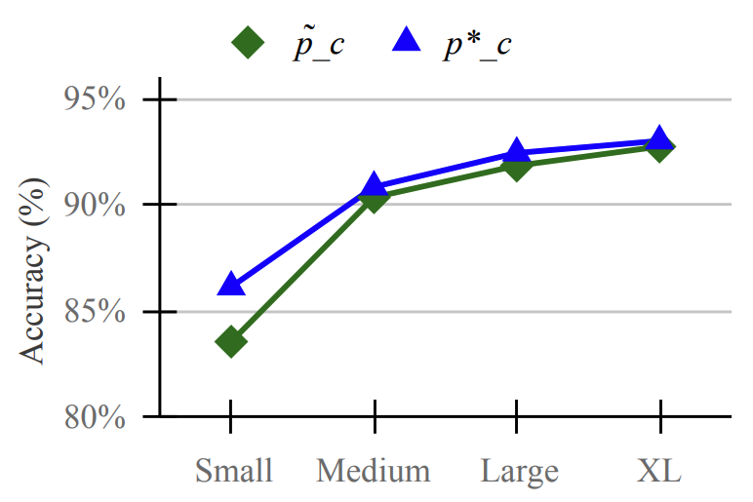
Experiment: effect of model size
The relative accuracy drop (gap between the two trends) decreases as models become larger.

Slide 21
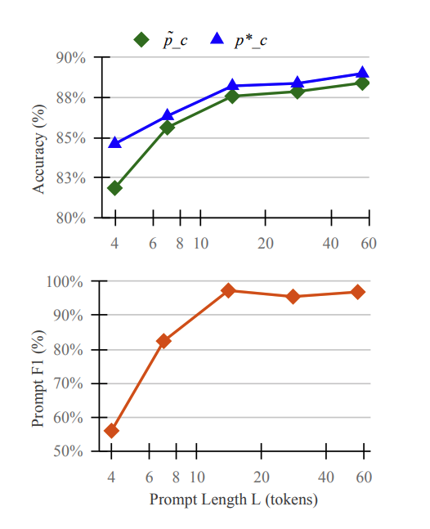
Experiment: effect of prompt length
The relative accuracy drop is marginal when the prompt length is not too small (e.g. 7 or larger).

