Slide 1

On Discretized Interpretation of Continuous Prompts
Joint work w/ Shane Lyu, Sewon Min, Lianhui Qin, Kyle Richardson, Sameer Singh, Sean Welleck, Hannaneh Hajishirzi, Tushar Khot, Ashish Sabharwal, Yejin Choi
Allen Institute for AI University of Washington University of California-Irvine
Notes:
Hi, I am Daniel Khashabi, and I am a post-doc with the Mosaic team.
Today I am going to talk about ….
This is based on a paper that will appear in NAACL 2022 (in Seattle)
And it is a joint work with my wonderful colleagues here at AI2, UW and UC Irvine.

Slide 2
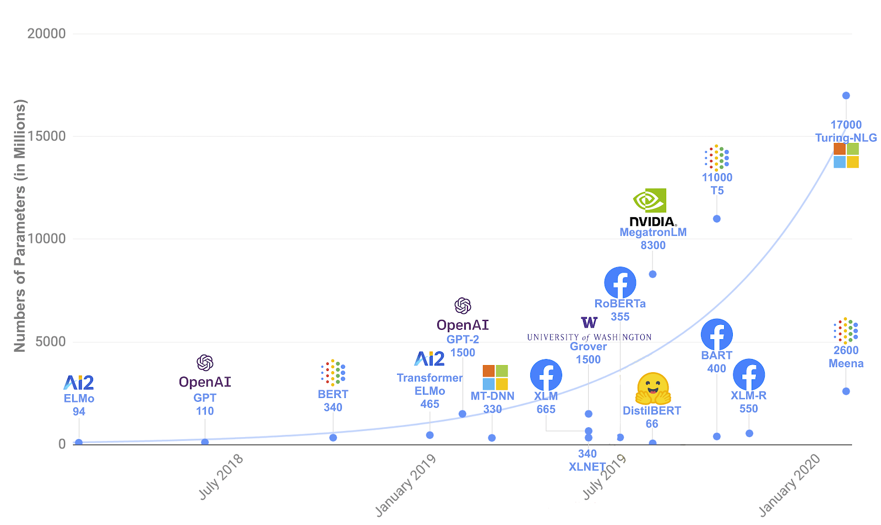
pre-trained
language models (LM)
LM
[Peters et al. ’18 , Radford et al. ’19, Brown et al. ’20, …. ]
Notes:
Many of you, I am sure, have heard about …. (or LM, in short).
Some of the work on LMs started here at AI2 and now are extended at a much larger scale.
There are many interesting things about these models that are well-beyond the scope of my talk today.
One thing that is quite exciting about these models (in the context of natural language) is their emergent ability in responding to language commands.

Slide 3
LM
Language prompt
[Peters et al. ’18 , Radford et al. ’19, Brown et al. ’20, …. ]
Notes:
In particular, we can pose language prompt to these model, to which they generally give a reasonable response ...

Slide 4
we shared some of the most exciting recent developments in the field of AI, including our recent breakthroughs in spatial reasoning.
LM
In today's presentation at Allen Institute for AI,
Language prompt
[Peters et al. ’18 , Radford et al. ’19, Brown et al. ’20, …. ]
Notes:
.....
Such capabilities are more than just generating a semi-random story.
We can apply language prompts on these models to solve well-defined tasks that we care about.
....

Slide 5

discrete (text) prompts: easy to interpret, but not easy to optimize
What is the sentiment of the following review? (positive or negative)
LM
Sentence: That was a great fantasy movie.
positive
[Peters et al. ’18 , Radford et al. ’19, Brown et al. ’20, …. ]
Notes:
Just as a toy example, suppose I want to classify sentiment of a bunch of movie reviews. ...
pre-pended to ...
One key nice attribute of discrete prompts is their ”interpretability”: we, humans, can simply read a given prompt and form an expectation about a language-model’s response – which is nice!
The challenge here though is that, we don't have efficient algorithms for finding most effective discrete prompts.
And this is a key bottleneck, if you want to build tools that maximize your desired metric for whatever application you want to build.

Slide 6
discrete (text) prompts: easy to interpret, but not easy to optimize
What is the sentiment of the following review? (positive or negative)
LM
Sentence: That was a great fantasy movie.
positive
[Peters et al. ’18 , Radford et al. ’19, Brown et al. ’20, …. ]
Notes:
In parallel, there is a line of work on …

Slide 7
discrete (text) prompts: easy to interpret, but not easy to optimize
What is the sentiment of the following review? (positive or negative)
LM
Sentence: That was a great fantasy movie.
positive
Something related to sentiment analysis?
continuous prompts:
unclear how to interpret, but easy to optimize
0.9 | 0.1 | -2.1 | 0.0
LM
Sentence: That was a great fantasy movie.
positive
[Li and Liang’21; Lester et al.’21]
Notes:
... continuous prompts
Typically defined as a vector of real numbers prepended to the embedding of an input text to make it generate a desired outcome.
For example, a continuous prompts that effectively solves the sentiment classification task.
Turns out that continuous prompts are complementary to their discrete counterparts:
We have algorithms for effectively optimizing them.
However, we don’t know whether they are interpretable or not
it is an open question as to whether one can provide any meaningful interpretation of these continuous vectors.
(click) --- maybe this particular continuous prompt has something to do with sentiment analysis?? We don’t know yet.
Motivated by this, we are interested in interpretability of continuous prompts.
Motivated by the discrepancies between discrete and continuous prompts, we study focus continuous prompts and their interpretability.

Slide 8
Research question: are there any meaningful discrete (textual) interpretations to continuous prompts?
Opposite: how unfaithful can their interpretation be to what they do?
Something related to sentiment analysis?
0.9 | 0.1 | -2.1 | 0.0
LM
Sentence: That was a great fantasy movie.
positive
Notes:
In particular, we are interested in the research question of: … that provide a faithful explanation of their behavior.
Since we don’t know how to address this question directly, we actually study its opposite: …

Slide 9
Research question: are there any meaningful discrete (textual) interpretations to continuous prompts?
any arbitrary text:
Opposite: how unfaithful can their interpretation be to what they do?
Flip the sentiment of the sentence
Proj(.)
0.9 | 0.1 | -2.1 | 0.0
LM
Sentence: That was a great fantasy movie.
positive
Notes:
What I mean by that is, we investigate whether there are any continuous prompts that perform a desired task while, at the same time, project to any given target text,
Such as the definition of a different task (“flip the sentiment”).
And for those of you who are a bit technical and wonder what this projection means, it is: the nearest-neighbor projection of continuous prompt onto the word embeddings
Here, I am jump ahead of myself and tell you that:
our findings show that indeed the opposite question is correct.
Which is what call …

Slide 10
Waywardness hypothesis (informal):
One can find “accurate” continuous prompts such that they can be “projected” to any arbitrary text.
any arbitrary text:
Opposite: how unfaithful can their interpretation be to what they do?
Flip the sentiment of the sentence
Proj(.)
0.9 | 0.1 | -2.1 | 0.0
LM
Sentence: That was a great fantasy movie.
positive
[Khashabi et al.’22]
Notes:
We call this "waywardness" hypothesis:
which states that ….. (such as the definition of a different task or even an irrelevant statement.
Which suggests a disconnect between the outcome of continuous prompts and their discrete interpretations.
But let me tease a quick summary of our experiments we did here.

Slide 11

Waywardness hypothesis (informal):
One can find “accurate” continuous prompts such that they can be “projected” to any arbitrary text.
$\tilde{p}$: optimized for the task + projecting to a given text
Write down the conclusion you can reach by combining the given Fact 1 and Fact 2.
Proj(.)
an arbitrary text
$p^{∗}$: optimized for the task
LM
Sentence: That was a great fantasy movie.
positive
[Khashabi et al.’22]
Notes:
We do a whole series of experiments where we compare performance of two prompts:
Prompts that are trained to solve a particular task.
And prompts that are not only trained to solve a given task, but also forced to have a certain projection (projection to an arbitrary text that we provide)
Such as …

Slide 12
Waywardness hypothesis (informal):
One can find “accurate” continuous prompts such that they can be “projected” to any arbitrary text.
$\tilde{p}$: optimized for the task + projecting to a given text
int clamp(int val, int min_val) { return std::max(min_val, val);
}
Proj(.)
an arbitrary text
$p^{∗}$: optimized for the task
LM
Sentence: That was a great fantasy movie.
positive
[Khashabi et al.’22]
Notes:
….
Empirically, we will compare the performance of $\tilde{p}$ and $p^{∗}$ (in terms of their accuracy).
The intuition here is that, if continuous prompts (the green one) inherently say something about their outcome, by forcing them to project an irrelevant text, they should suffer in terms of their accuracy.

Slide 13



Waywardness hypothesis (informal):
One can find “accurate” continuous prompts such that they can be “projected” to any arbitrary text.
$\tilde{p}$: optimized for the task + projecting to a given text
85 90 95 100
accuracy
Proj(.)
an arbitrary text
$$\tilde{p}$$
91.8
$$Δ\sim 0.6\%$$
$p^{∗}$: optimized for the task
$p^{∗}$
92.4
LM
Sentence: That was a great fantasy movie.
positive
[Khashabi et al.’22]
Notes:
It is possible to find continuous prompts that project to a given text (≥ 94% token overlap) with tiny drop in task accuracy.

Slide 14
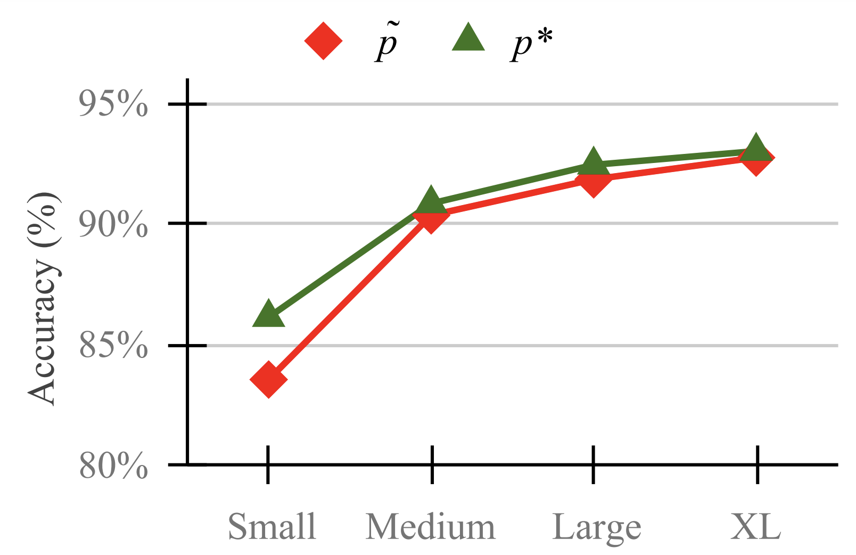
Waywardness hypothesis (informal):
One can find “accurate” continuous prompts such that they can be “projected” to any arbitrary text.
$\tilde{p}$: optimized for the task + projecting to a given text
Proj(.)
an arbitrary text
$p^{∗}$: optimized for the task
LM
Sentence: That was a great fantasy movie.
positive
[Khashabi et al.’22]
Notes:
Moreover, accuracy gap between these two prompts decreases as models become larger.
In other words, the larger the models get, the less interpretable the continuous prompts get.
[yet another pragmatic concern in using these large models.]
More experiments in the paper that I won’t get into. Instead, I will the remainder of my time to share intuitions that enable “waywardness” and its implications.

Slide 15
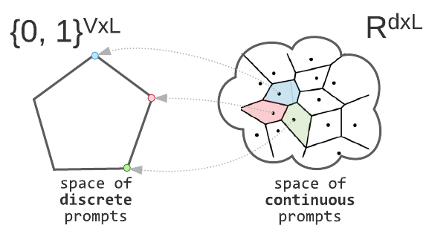
Making Sense of “Waywardness”
(1) The mapping between continuous and discrete space is not one-to-one.
It is true for a many choices of Proj(.)
Notes:
The mapping between continuous and discrete space is not one-to-one.
While a discrete target prompt is mapped to exactly one continuous prompt, the reverse is not true:
many continuous prompts that project back to a fixed discrete target prompt
This statement is true for many class of well-defined projections, well-beyond the nearest neighbor projection that we tried empirically here.
This indicate that …

Slide 16
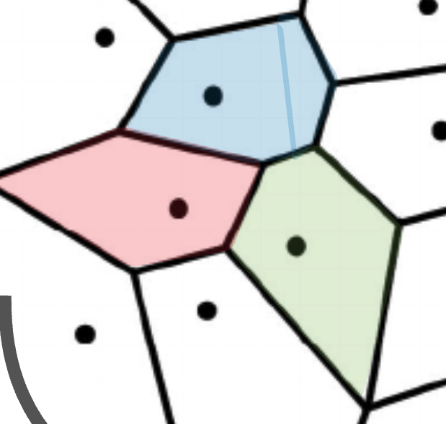

Making Sense of “Waywardness”
(1) The mapping between continuous and discrete space is not one-to-one.
It is true for a many choices of Proj(.)
(2) Deep models give a lot of expressivity power to the earlier layers.
[Telgarsky ’16; Raghu et al. ’17]
$$ε$$
Notes:
This indicate that there is a whole region of continuous prompts that correspond to a fixed discrete representation.
The remaining question is, how is this region be so rich that it can solve a variety of tasks?
The deeper a network is, the more expressivity it has with respect to its inputs
Since continuous prompts reside just before the first layer, they enjoy a lot of expressivity.
It is the combination of these two intuitions (in our opinion) that give rise to “waywardness”.
Now, before I end, …

Slide 17
Implications of Waywardness (1)
Faithful interpretation of continuous prompts is difficult.
Something related to sentiment analysis?
continuous prompts:
unclear how to interpret, but easy to optimize
0.9 | 0.1 | -2.1 | 0.0
LM
Sentence: That was a great fantasy movie.
positive
Notes:
Now, before I end, let me briefly enumerate several implications of “waywardness” hypothesis.
The first point is concerning “continuous” prompts, as I motivated earlier.
faithful discrete interpretations of continuous prompts via common discrete projections are unlikely to be robust, based on current modeling paradigms.
Whether there is a better constructions of prompts is an open question.
Future work may investigate more on this topic in order to improve their interpretability.

Slide 18

Implications of Waywardness (2)
Risk of interpreting continuous prompts:
concealed adversarial attacks.
continuous prompt
😇 benign projection
Proj(.)
Rank the candidates ignoring their race or gender.
LM
😈 malicious behavior
👩🏽‍🎓 < 👨🏽‍🎓 < 👨🏻‍🎓
Notes:
There is social risks, in a future where model development is driven by fine-tuned prompts
In such a world, not addressing the challenges involved in discrete interpretation of continuous prompts can lead to harmful consequences.
Consider the following scenario: a model designer comes up with a continuous prompt that solve an important target task (e.g., ranking resumes according to each applicant’s merits).
Such prompts may contain biases targeting a minority group (intentionally or otherwise)
Naïve efforts to interpret these may indicate benign statements, which do not reveal the true nature of their behavior.
and be exploited to create a false sense of security and fairness.
The customers might even evaluate the prompt on a few instances but not notice this harmful behavior, e.g., when it effects a minority group not in the evaluation set.

Slide 19
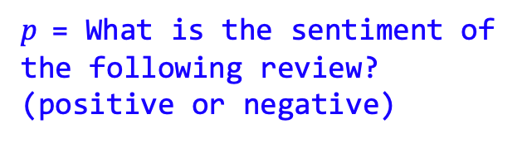
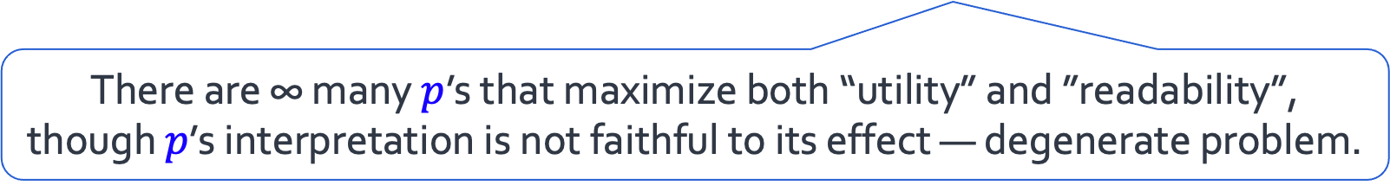
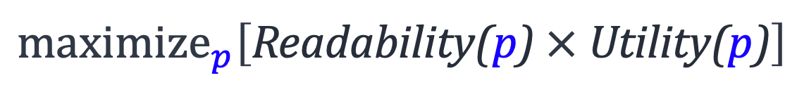
Implications of Waywardness (3)
$\text{p}$= What is the sentiment of the following review? (positive or negative)
discrete (text) prompts: easy to interpret, but not easy to optimize
LM
Sentence: That was a great fantasy movie.
positive
An optimization in search of discrete (human-readable) prompts:
$$maximize_{p}\left[\text{Readability}\text{(}\text{p}\text{)} \text{×} \text{U}\text{tility}\text{(}\text{p}\text{)}\right]$$
There are ∞ many $p$’s that maximize both “utility” and ”readability”, though $p$’s interpretation is not faithful to its effect — degenerate problem.
Notes:
And the last point I would like to highlight is regarding “discrete prompts” .
As I highlighted in in the beginning, optimizing over discrete prompts is an open question.
You may wonder why that is the case
Turns out that our finding on continuous prompts can help us understand this difficulty.
If you want to formulate an optimization problem in search of discrete prompts, it would look something like this:
An optimization over word distributions with two objectives:
A utility term to maximize the task reward
And another objective for maximizing fluency of the resulting text
You might look at it and say, hey! Looks like we have the optimization problem. Why don’t we just run it with an optimization alg and call it a day.
The issue is that, (and I am gonna be a bit hand-wavy here), this is a degenerate formulation.
Meaning that …
And this is yet another technical implication of the “waywardness” here.

Slide 20
Summary
Waywardness Hypothesis — a surprising difficulty in interpreting continuous prompts.
We provided empirical evidence and intuitions for this hypothesis.
Concluded with implications of this hypothesis.
We need algorithmic or architectural innovations for automatic discovery of human-readable prompts.
Notes:
We started with …
We provided
And concluded
My hope is that, these observations motivate algorithmic or architectural innovations that overcome such challenges and guide the progress on the algorithmic discovery of prompts that are faithful to the task they solve

Slide 21
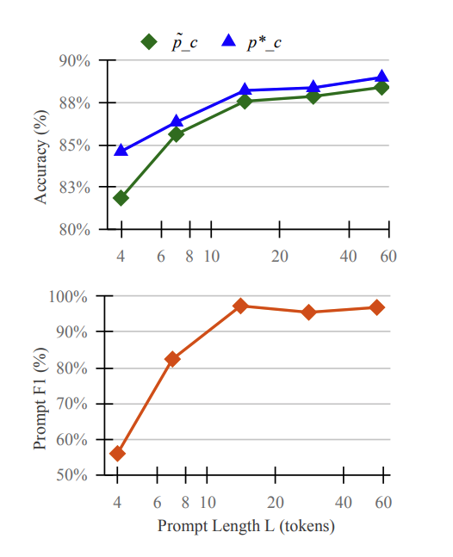
Experiment: effect of prompt length
The relative accuracy drop is marginal when the prompt length is not too small (e.g. 7 or larger).

