Slide 1
Few Ongoing Efforts on Instruction-following Models
Daniel Khashabi
Notes:
This will be a brief summary of few ongoing threads that I have been perusing recently with collaborators.
These are *broadly (related to infact goals.
They’re essentially meant to be conversation-starters — if anyone has any thoughts or suggestions, I would love to hear, during this meeting or offline.

Slide 2
Large Language Models, Off-the-Shelf
Broad capabilities but limited control.
Irrelevant responses (though fluent)
Hallucination
Toxic or biased responses
“Jack of all trades, master of none”
0.2
-0.4
0.1
0.0
-0.5
Input
text
Output
text
[Bengio et al. ‘04, Peters et al. ‘18, Raffel et al. ‘20, Brown et al. ’20, many others]
Notes:
Just to place the conversation, let me start with “pre-trained language models”.
At this point, there is plenty of evidence on the power/value of language models

Slide 3




Control via Fine-tuning/Prompting
Building ”specialized” mode via
tuning them
prompting with examples
with examples or a particular task.
High control but narrow abilities.
Grammar Check
Summary
Generation
$$𝓓_{2}$$
$$𝓓_{3}$$
$$\text{🤖}$$
$$\text{🤖}$$
🚫
Task specific assumptions prevent generalization!

Slide 4




Generality
LMs
?
specialized models
Control

Slide 5



Control via “Instructions”
LMs tuned on “instructions” show generalization to unseen tasks.
A useful mix of control and broadness, though not quite good at either.
instructions
$$\text{🤖}$$
+
Write a summary of the given paragraph.
$$x$$
$$y$$
https://instructions.apps.allenai.org/
Cross-task generalization via natural language crowdsourcing instructions, Mishra, Khashabi, Baral, Hajishirzi, ACL 2022
Many concurrent & subsequent works: InstructGPT3, T0, FLAN, ….

Slide 6
Generality
LMs
?
today’s instruction-following systems*
specialized models
Control
* The ones that are open and transparent, unlike systems like InstructGPT3.

Slide 7
Instruction-tuning: Challenges
Dependence on labeled data
Limited to raw text form
…
Notes:
And probably many others,

Slide 8
Instruction-tuning: Challenges
Dependence on labeled data
Limited to raw text form
Notes:
And probably many others,

Slide 9
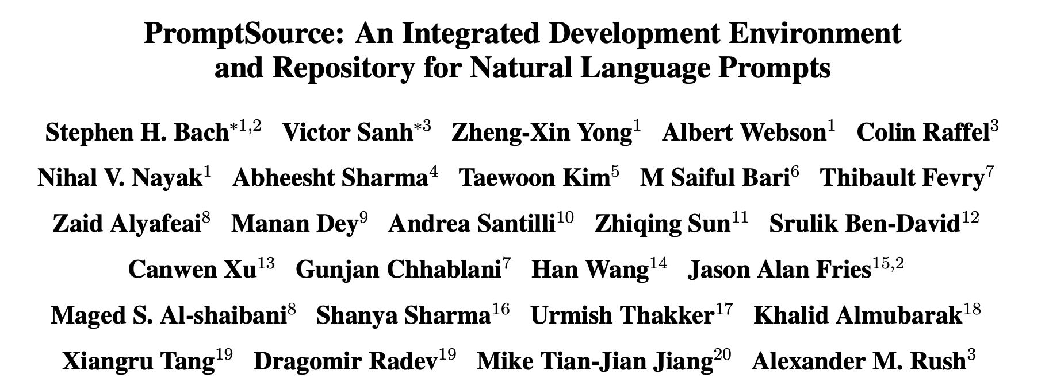
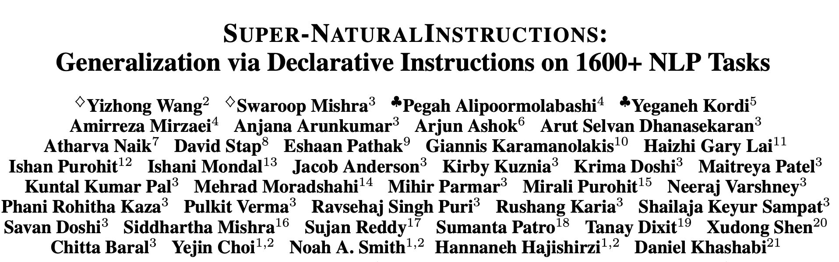


Challenge: Dependence on Labeled Data
Existing works depend on human annotations.
Result: most instruction-following systems (T0, Tk-Instruct, …) suffer from brittleness.
popularity
tasks
Human annotations are often part of the head of “task” distribution.

Slide 10
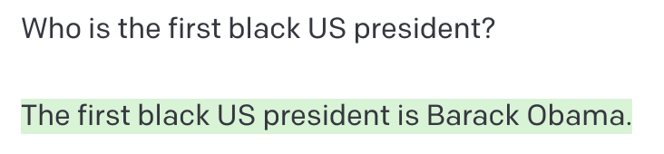
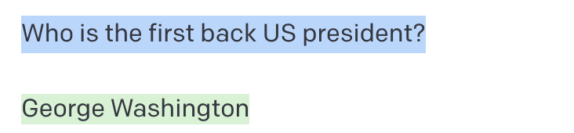
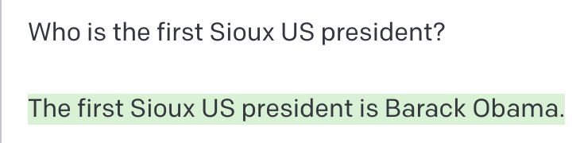
Challenge: Dependence on Labeled Data
Existing works depend on human annotations.
Corollary: most instruction-following systems suffer from brittleness.
👍
Human annotations are often in the “head” of task distribution.
😱
popularity
😱
tasks
[generated via GPT3 text-davinci-002, Nov 27 2022]

Slide 11
Self-Instructing LMs
Hypothesis: LMs already know about a variety of ”task instructions”. We may just need to help them surface it.

Slide 12
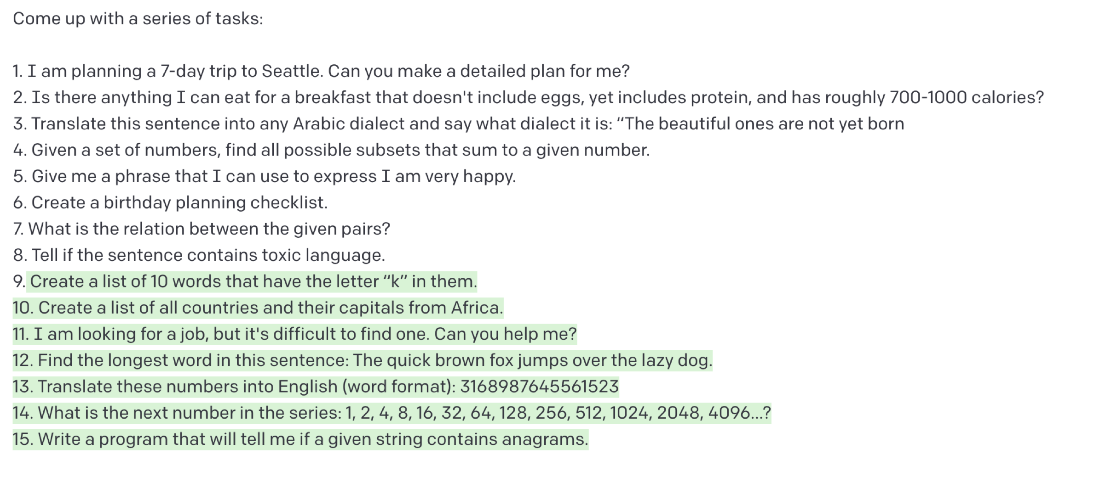
Self-Instructing LMs
Hypothesis: LMs already know about a variety of ”task instructions”. We may just need to help them surface it.
Idea: we can bootstrap “instruction” from off-the-shelf LMs.

Slide 13
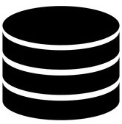

Self-Instructing LMs
Hypothesis: LMs already know about a variety of ”task instructions”. We may just need to help them surface it.
Idea: we can bootstrap “instruction” from off-the-shelf LMs.
prompt
$$\text{🤖}$$
reject if not novel or confident
New instructions
A small set of seed instructions

Slide 14
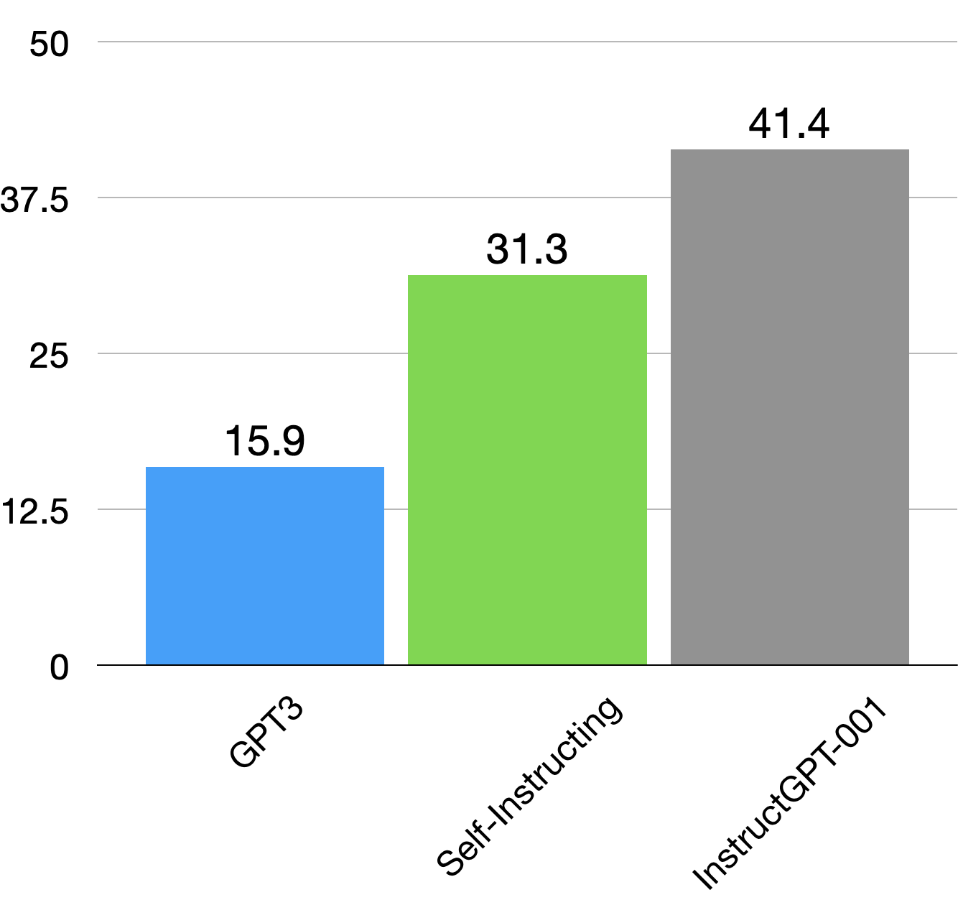
Self-Instructing LMs
Evaluation on “Super-Nat Instructs”*
Self-Instructing improves the vanilla LM (GPT3) by ~15 points.
Self-Instructing still has ~10 points gap from InstructGPT3.
* Super-NaturalInstructions: Generalization via Declarative Instructions on 1600+ NLP Tasks, Wang, …., Khashabi, EMNLP 2022

Slide 15
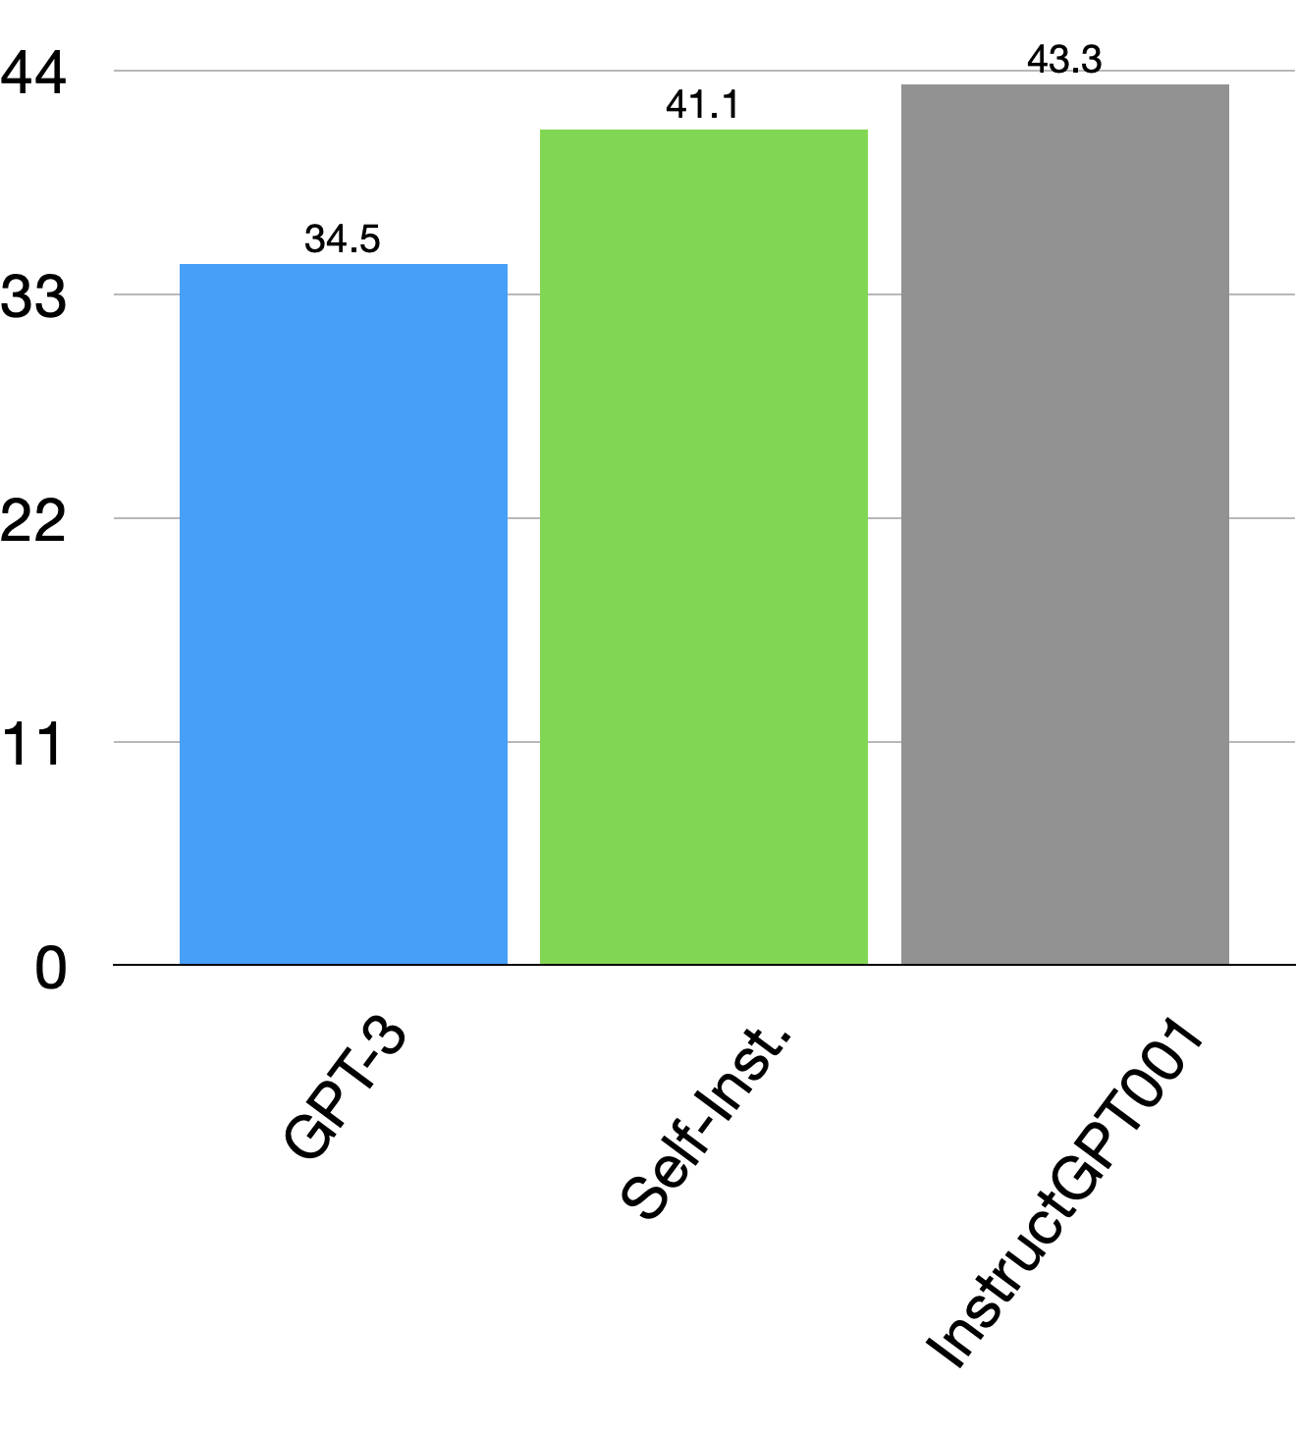
Self-Instructing LMs
Evaluation on “EditEval”*
Self-instructing improves GPT3 by ~7%
Self-instructing is close to InstructGPT’s performance.
* EditEval: An Instruction-Based Benchmark for Text Improvements, Jane Dwivedi-Yu et al., arXiv 2022

Slide 16
Instruction-tuning: Challenges
Dependence on labeled data
Limited to raw text form
Notes:
And probably many others,

Slide 17

Beyond Raw Text
Web-pages are not raw text form — Language is grounded in a variety of graphics and structure.

Slide 18
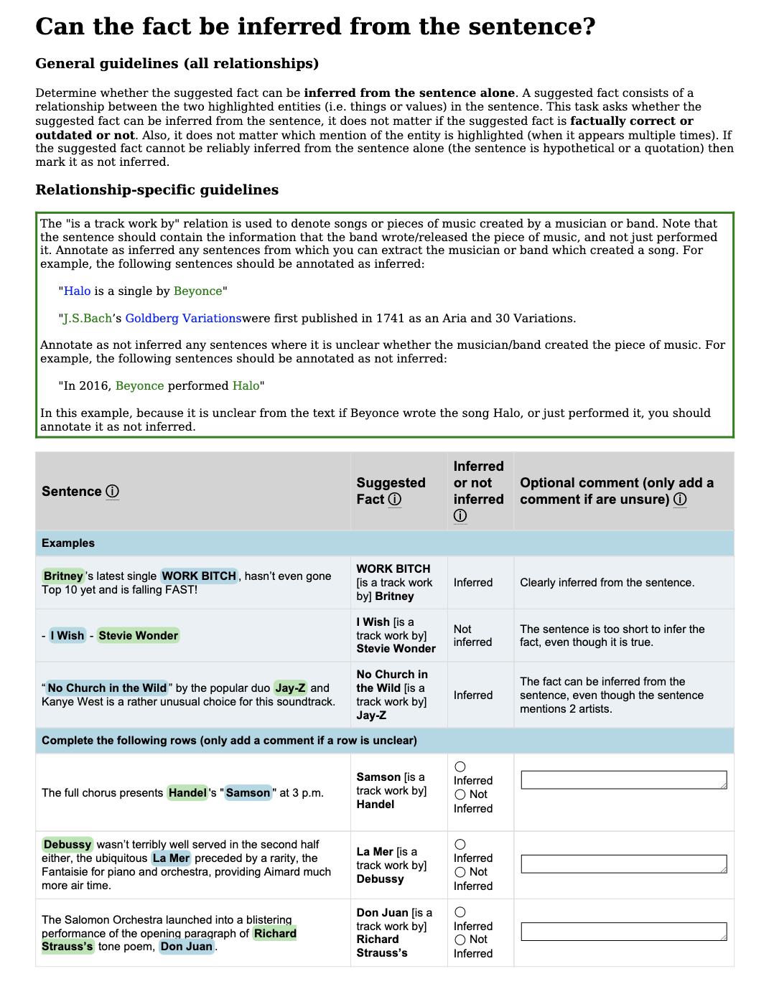


Beyond Raw Text
Web-pages are not raw text form — Language is grounded in a variety of graphics and structure.
Crowdworkers solve a variety of tasks formulated as web-grounded instructions.

Slide 19

Models that Align w/ Web-grounded Instructions
Goal: motivate building models that can follow language instructions grounded in web page form.
$$\text{🤖}$$

Slide 20

Models that Align w/ Web-grounded Instructions
Goal: motivate building models that can follow language instructions grounded in web page form.
As a first step, define a comprehensive evaluation protocol.
Turk-Instruction: a collection of 200+ crowdsourcing tasks
$$\text{🤖}$$

Slide 21
Models that Align w/ Web-grounded Instructions
Currently: models that exploit textual/visual information to modify web pages.
Future:
Machine-human collaborative annotation
Cybernaut systems —help humans do things on the web
Turk-Instruction: a collection of 200+ crowdsourcing tasks
$$\text{🤖}$$

Slide 22


Putting Things Together
Generality
target
Moving forward: robust and broad interactions with LMs.
“Self-Instructing” for robustness to a variety of “instructions”
”Turk-Instructions”: language instructions grounded in web-pages.
today
Control

Slide 24
Instruction-tuning: Challenges
Dependence on labeled data
Lack of interaction with the user
Limited to raw text form
Notes:
And probably many others,

Slide 25
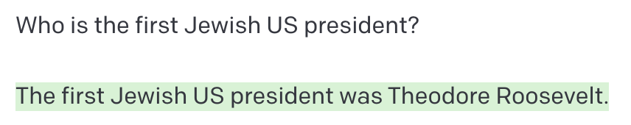
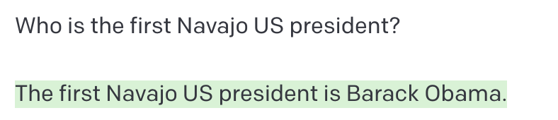
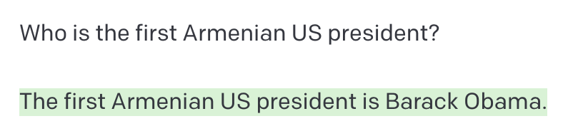


Out-of-distribution Commands
popularity
tasks
Challenge: when provided with “unfamiliar” inputs, LMs will give garbage.
👍
😱
😱
😱
😱
😱
[generated via GPT3 text-davinci-002, Nov 27 2022]

Slide 26
👍
😱
😱
😱
😱
[generated via GPT3 text-davinci-002, Nov 27 2022]

Slide 27
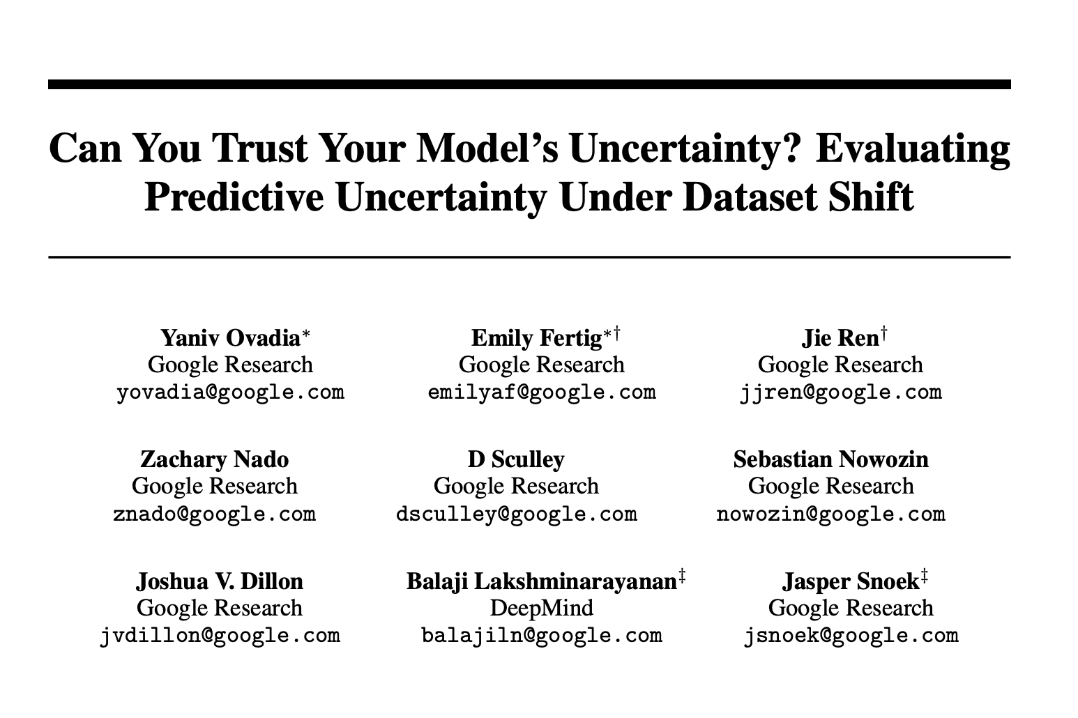
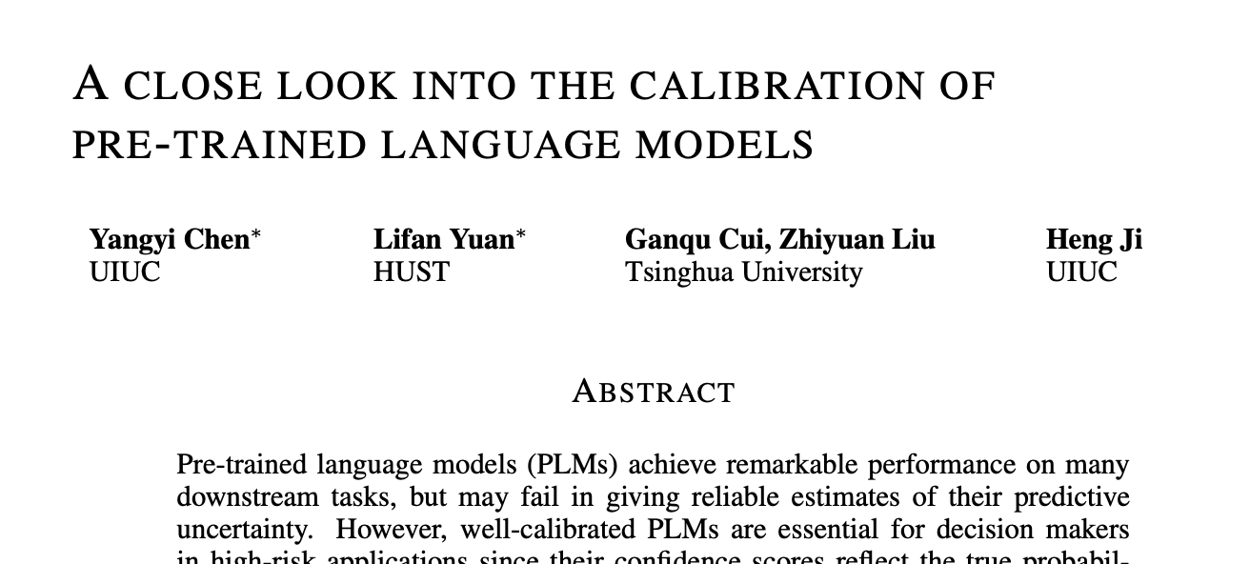
Out-of-distribution Commands
Idea 1: provide calibrated uncertainty measures for LM responses
Tons of work ….

Slide 28
Out-of-distribution Commands
Idea 1: provide calibrated uncertainty measures for LM responses
Tons of work ….
P=0.8
👍
Does not tell the user what is the source of uncertainty.
P=0.4
😱

Slide 29






Feedback about OOD Commands
Idea 2: communicate localized uncertainty measures
$$∇ℒ$$
Who is the first back US president?
P=0.4
$$ℒ( )$$

Slide 30
Feedback about OOD Commands
Idea 2: communicate localized uncertainty measures
🚧 Ongoing work 🚧 results TBD.
$$∇ℒ$$
Who is the first back US president?
P=0.4
$$ℒ( )$$

Slide 31
Instruction-tuning: Challenges
Dependence on labeled data
Lack of interaction with the user
Limited to raw text form
Notes:
And probably many others,

