Slide 1



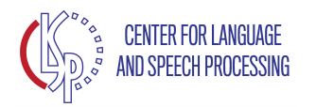

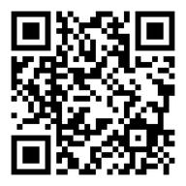

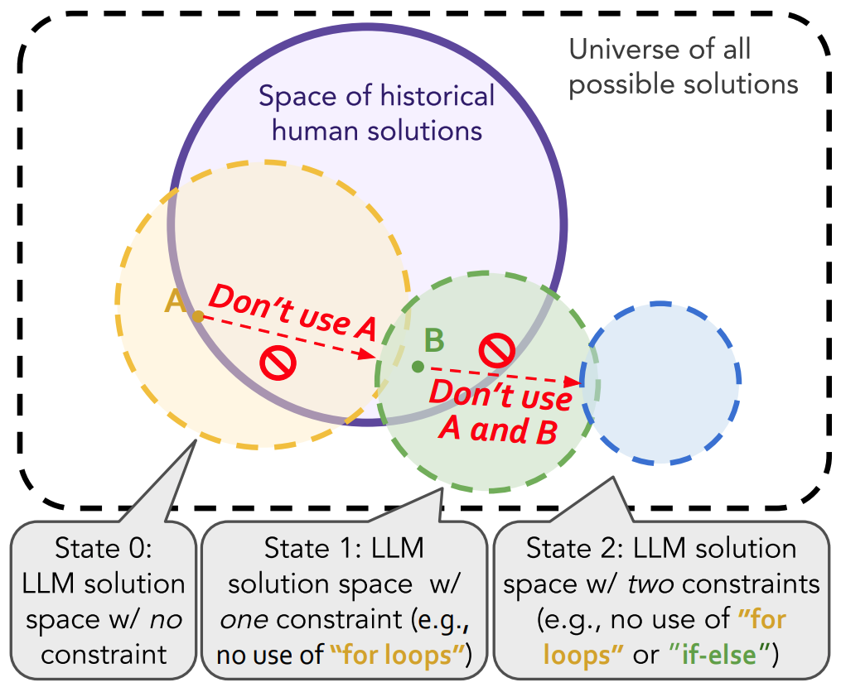
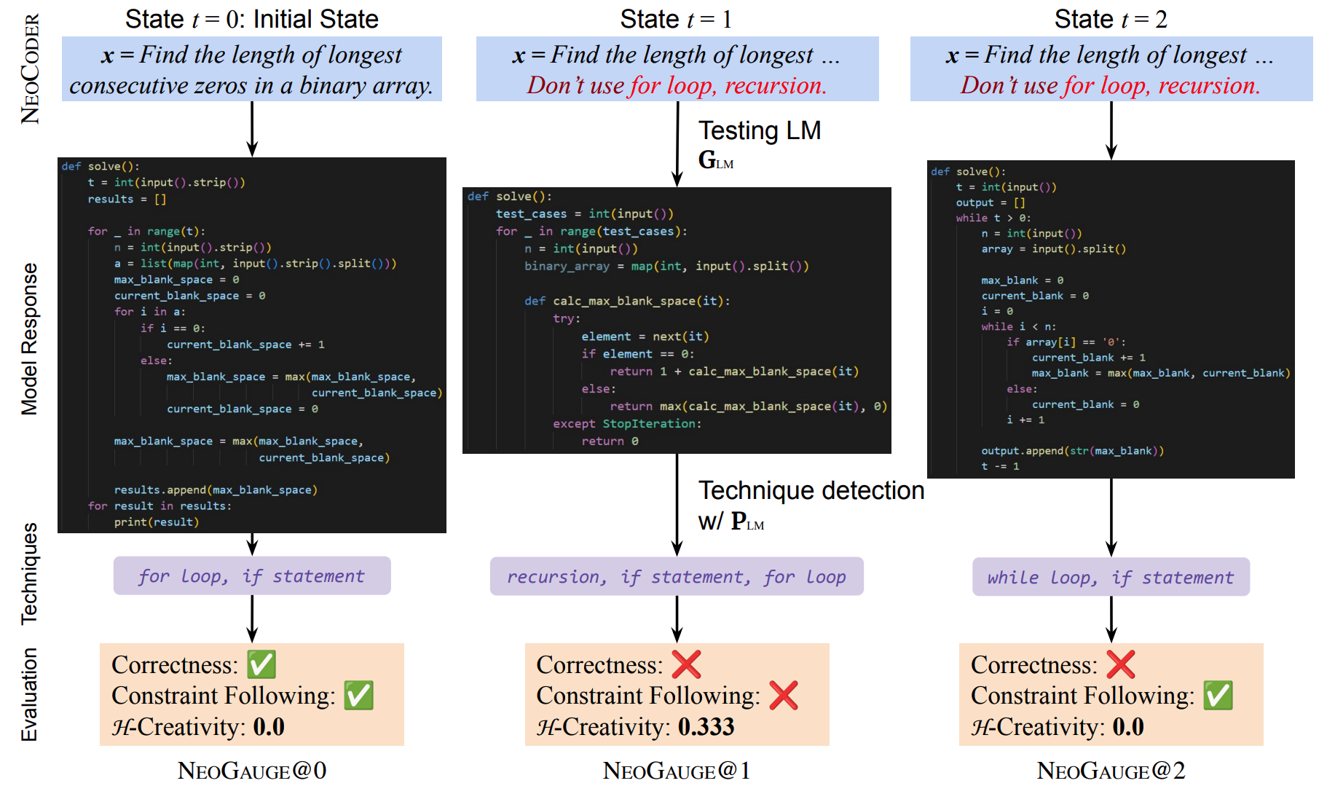
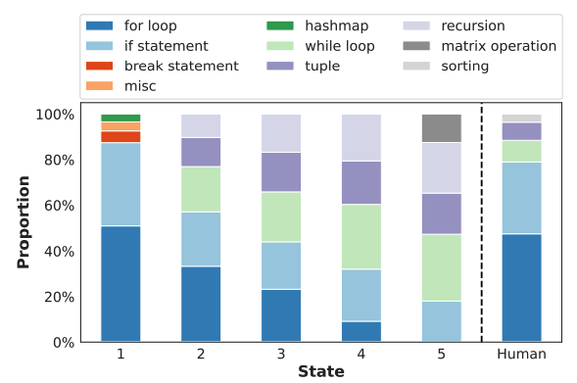
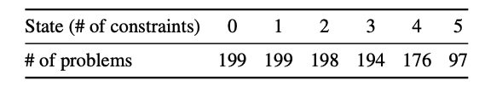
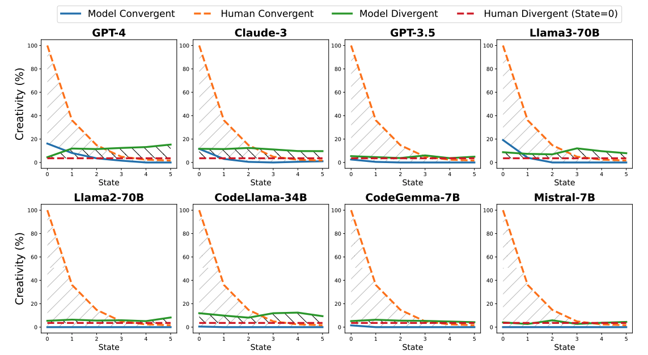
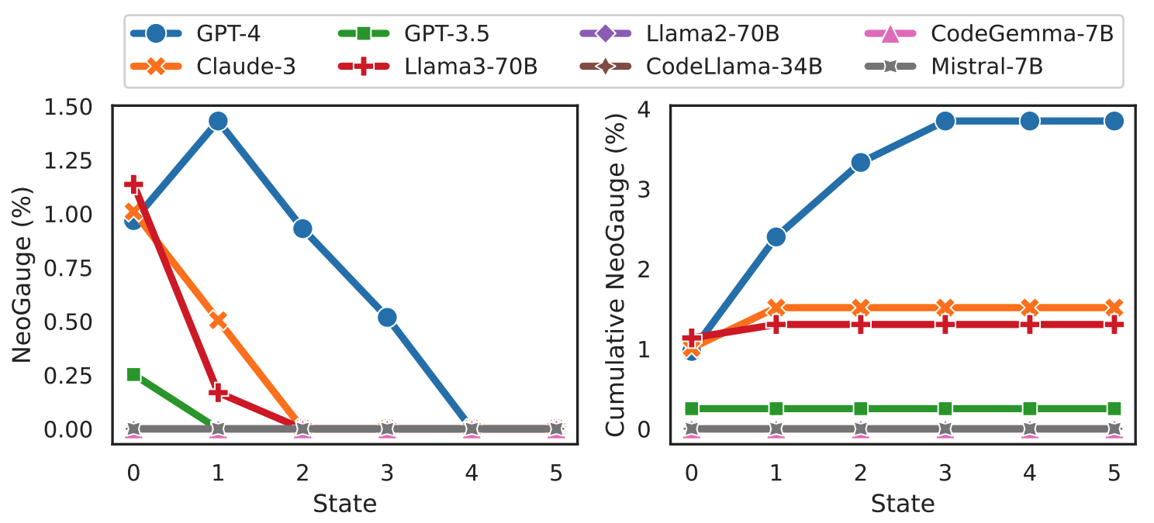
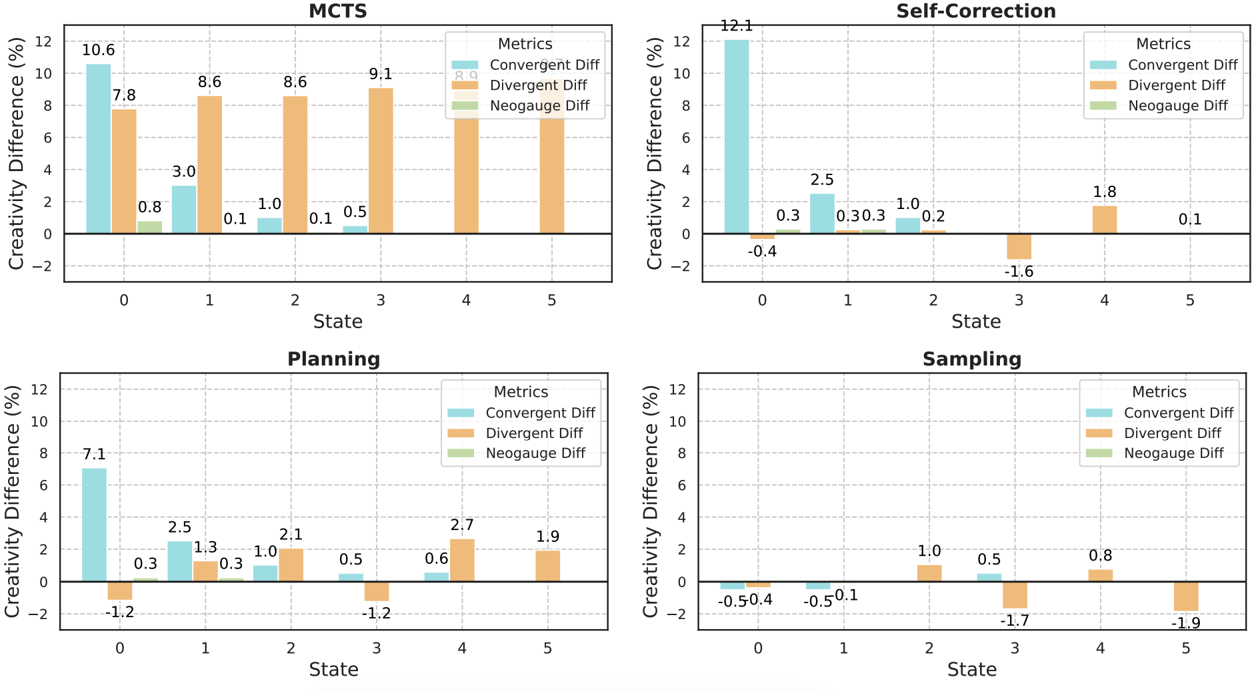
Benchmarking Language Model Creativity:
A Case Study on Code Generation
Yining Lu^{1,2}, Dixuan Wang², Tianjian Li², Dongwei Jiang²,
Sanjeev Khudanpur², Meng Jiang¹, Daniel Khashabi²
¹University of Notre Dame, ²Johns Hopkins University
ArXiv
GitHub
MOTIVATION
!!We define and evaluate LLM creativity for constrained problem-solving setting!!
Creativity evaluation should be on the spectrum of maximal creative solutions.
A unified metric that quantifies both Convergent and Divergent creativity.
Creativity evaluation needs to be state-aware (adaptive to different contexts), and human-grounded (comparing with historical human solutions).
We release a creativity benchmark NeoCoder and a metric NeoGauge that follows the above protocols.
COMPUTING NEOGAUGE
Human-Grounded;
Divergent Creativity
Convergent Creativity
State-Aware
In absense of any constraints, the model defaults to common and accessible techniques, like humans!
NeoGauge@T is a joint probability of being both convergent and divergent creative at state T
RESULTS
Who is more creative: machine or human?
GPT-4 is the most creative LLM thus far
Inference-scaling slightly boosts divergent thinking, with rapidly diminishing returns

