Slide 1


RATIONALYST: Mining Implicit Rationales
for Process Supervision of Reasoning
Dongwei Jiang, Guoxuan Wang, Yining Lu, Andrew Wang, Jingyu Zhang, Chuyu Liu, Benjamin Van Durme, Daniel Khashabi
Notes:
Hello everyone, my name is Dongwei Jiang. Today I'll be presenting RATIONALYST, a novel approach for mining implicit rationales to improve process supervision of reasoning in large language models. This work was conducted by friends and colleagues from Johns Hopkins University and will be presented at ACL 2025

Slide 2



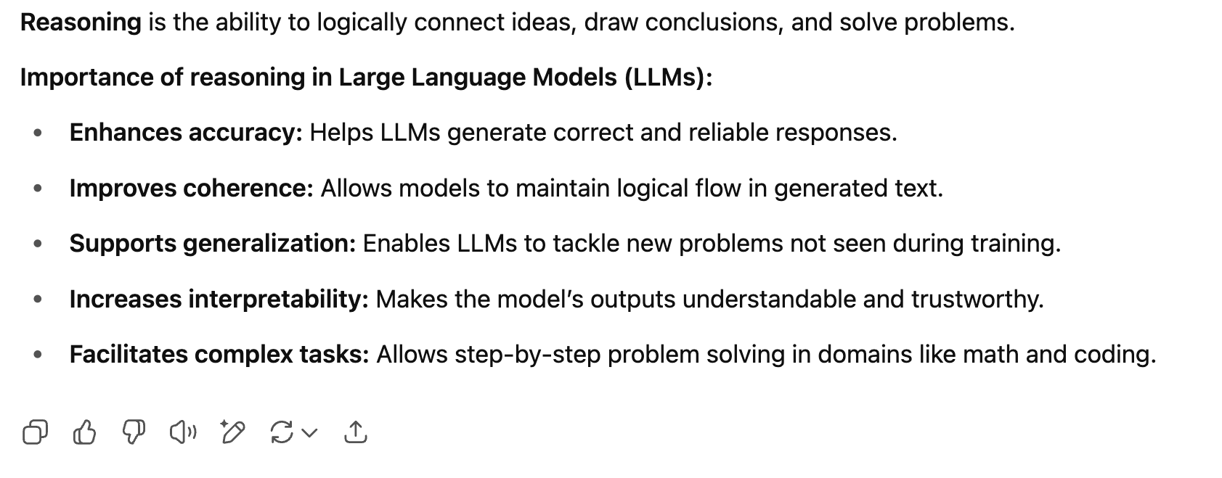
Introduction
https://chat.openai.com/chat
‹#›
Notes:
Let me start by talking about the focus of this paper. So what reasoning is and why it's crucial for LLMs?
Reasoning is the ability to logically connect ideas, draw conclusions, and solve problems step by step.
For large language models, strong reasoning capabilities are essential because it enhances accuracy, improves coherence, supports generalization and increases interpretability

Slide 3
Motivation
A typical document from LLM pre-training data
Problem: LLM reasoning steps are often incomplete
… Harry used magic outside of the school of Hogwarts to inflate Aunt Marge… He is punished to attend a disciplinary hearing at the Ministry of Magic…
Root cause: They mimic logical leaps from their training data
Implicit rationale in the document
When someone breaks the rule, he will be punished!
A question posed to LLM at inference time
Question: A person is caught stealing food from a store to feed their hungry family. What will likely happen to them?
Choices: A: He will be punished B: He will rewarded
Result: Existing LLMs will have difficulty surfacing these implicit statements during the reasoning process, which can lead to flawed conclusions.
Existing LLMs
Let’s think step by step. Since a person is trying to help their family, they will be rewarded for their act!
‹#›
Notes:
So we all know reasoning is important. However, the issue is the reasoning steps current LLMs generate might be incomplete because they mimic logical leaps common in everyday communication that is found in their pre-training data.
Let me illustrate what logical leaps mean with this example from Harry Potter: 'Harry used magic outside of school... He is punished.' The implicit rationale 'When someone breaks the rule, he will be punished' is crucial for understanding the logical connection, but it's left unstated in the original text.
As a result, existing LLMs will have difficulty surfacing these implicit statements during the reasoning process, which can lead to flawed conclusions. To illustrate that, let’s look at LLMs at work, when we ask an LLM about a person stealing food for their family, existing models might focus on the good intentions and conclude they'll be rewarded, missing the crucial implicit rule about societal consequences for breaking laws.

Slide 4

Motivation
A typical document from LLM pre-training data
… Harry used magic outside of the school of Hogwarts to inflate Aunt Marge… He is punished to attend a disciplinary hearing at the Ministry of Magic…
Our solution: RATIONALYST trained on implicit rationales from pre-training data
Implicit rationale in the document
When someone breaks the rule, he will be punished!
How it works: RATIONALYST works by making these implicit rationales explicit and using them to guide the reasoning process at inference time.
A question posed to LLM at inference time
Question: A person is caught stealing food from a store to feed their hungry family. What will likely happen to them?
Choices: A: He will be punished B: He will rewarded
Existing LLMs
Let’s think step by step. Since a person is trying to help their family, they will be rewarded for their act!
Existing LLMs + rationale supervision via RATIONALYST
Let’s think step by step. Although this stealing has good intentions, stealing from a store breaks the rule of society, so it should be punished!
‹#›
Notes:
This is where our approach comes in. Our solution is RATIONALYST, which is a model trained on a vast collection of implicit rationales extracted from pre-training data to provide supervision for reasoning. RATIONALYST works by making these implicit rationales explicit and using them to guide the reasoning process at inference time.
For the example we have, RATIONALYST would help the model generate the complete reasoning: 'Although this stealing has good intentions, stealing from a store breaks the rule of society, so it should be punished!'

Slide 5

RoadMap
How is RATIONALYST actually used during inference
How to mine a dataset of implicit rationales and train RATIONALYST?
Evaluations
‹#›
Notes:
Now that you understand the motivation, let me outline what I'll cover next.
For now, let’s first talk about how is RATIONALYST actually used during inference. I’m going to talk about how to train this model in a bit

Slide 6



Inference-time supervision
Reasoning Trajectory
Question: Michael had 58 golf balls. On Tuesday, he lost 23 golf balls. On Wednesday, he lost 2 more. How many golf balls did he have at the end of Wednesday?
Answer: Michael started with 58 golf balls.
Rationale (R)
RATIONALYST
<BOT> There are two steps in solving the problem. First calculate the golf balls he lost after Tuesday <EOT>
➊
Candidate 1 (C1)
✔
After losing 23 on Tuesday, he had 58 - 23 = 35 golf balls.
P (C1| R) = 0.91
Agent LLM
Candidate 2 (C2)
➌
✗
➋
After losing 23 on Tuesday and Wednesday, he had 58 - 23 = 35 golf balls.
P (C2 | R) = 0.33
‹#›
Notes:
Let's take this math problem about Michael's golf balls from GSM8K as an example. Given the preceding context, which includes the question and partial reasoning trajectory, RATIONALYST first generates an implicit rationale: 'There are two steps in solving the problem. First calculate the golf balls he lost after Tuesday.'
In parallel, our agent LLM, which can be any LLM trying to solve the problem, generates multiple candidate next steps for continuing the reasoning. Here's the key part: we use the rationale R to score how well each candidate C aligns with the guidance provided. The correct step 'After losing 23 on Tuesday, he had 58 - 23 = 35 golf balls' aligns well with the rationale about calculating golf balls lost after Tuesday, so it gets a higher score. We will then select the highest-scoring candidate to continue the reasoning trajectory.

Slide 7
Inference-time supervision cont.
Reasoning Trajectory
Updated Reasoning Trajectory
Question: Michael had 58 golf balls. On Tuesday, he lost 23 golf balls. On Wednesday, he lost 2 more. How many golf balls did he have at the end of Wednesday?
Answer:
Michael started with 58 golf balls.
Question: Michael had 58 golf balls. On Tuesday, he lost 23 golf balls. On Wednesday, he lost 2 more. How many golf balls did he have at the end of Wednesday?
Answer:
Michael started with 58 golf balls. After losing 23 on Tuesday, he had 58 - 23 = 35 golf balls.
Rationale (R)
Rationale (R)
➍
RATIONALYST
<BOT> There are two steps in solving the problem. First calculate the golf balls he lost after Tuesday <EOT>
RATIONALYST
<BOT> Since Michael only has 35 balls, the next calculation should start from 35, not 58.<EOT>
➊
Candidate 1 (C1)
Candidate 1 (C1)
✔
✗
After losing 23 on Tuesday, he had 58 - 23 = 35 golf balls.
After losing 2 more on Wednesday, he had 58 - 2 = 56 golf balls.
P (C1| R) = 0.91
Agent LLM
P (C1| R) = 0.12
Agent LLM
Candidate 2 (C2)
➌
Candidate 2 (C2)
✗
✔
➋
After losing 23 on Tuesday and Wednesday, he had 58 - 23 = 35 golf balls.
After losing 2 more on Wednesday, he had 35 - 2 = 33 golf balls.
P (C2 | R) = 0.33
P (C2 | R) = 0.96
‹#›
Notes:
The process continues iteratively. We update our reasoning trajectory with the correct step. After that, RATIONALYST generates a new rationale given the updated trajectory. RATIONALYST then guides the selection of the next reasoning step. This iterative process ensures that each reasoning step is guided by appropriate implicit rationales, leading to more accurate final answers

Slide 8
RoadMap
How is RATIONALYST actually used during inference
How to mine a dataset of implicit rationales and train RATIONALYST?
Evaluations
‹#›
Notes:
Great! Now that you've seen how RATIONALYST works at inference time, let's dive into the next key question, How to mine a dataset of implicit rationales and train RATIONALYST?

Slide 9


Rationale extraction
Your task is to identify implicit reasoning steps in text - the unstated logical connections that bridge ideas and help predict what comes next. Look for logical leaps where important reasoning steps are assumed but not written out. Add these implicit rationales by writing "<BOT>rationale< EOT >".
Unlabelled Data from
different sources
Filtering via Future
Text Perplexity
Implicit Rationales Extracted by
LLMs from Unlabeled Data
LLM
(LLaMa 3 8B Instruct)
… Harry used magic outside of the school of Hogwarts to inflate Aunt Marge… He is punished to attend a disciplinary hearing at the Ministry of Magic…
… Harry used magic outside of the school of Hogwarts to inflate Aunt Marge… <BOT>When someone breaks the rule, he will be punished<EOT> …
Adding implicit rationale significantly reduces future text perplexity!
Adding implicit rationale has little effect on future text perplexity!
… Harry used magic outside of the school of Hogwarts to inflate Aunt Marge… <BOT>Hogwarts magic is incredibly versatile, capable of a wide range of effects<EOT> …
‹#›
Notes:
Our rationale extraction process uses LLMs to automatically extract implicit rationales from unlabelled data - essentially using one LLM to generate training data for another. We provide a carefully designed prompt shown in the purple box, which instructs the LLM to 'identify implicit reasoning steps in text - the unstated logical connections that bridge ideas and help predict what comes next.' The prompt tells the model to look for logical leaps where important reasoning steps are assumed but not written out, and to add these implicit rationales using the special BOT and EOT tags.
However, since these rationales are generated by LLMs, they can be noisy - we don't know whether they're useful or not. So we add a filtering mechanism based on future text perplexity. We only retain rationales that significantly help predict subsequent text. If adding an implicit rationale reduces the perplexity of predicting future content, we keep it - like the helpful rationale shown here. If a rationale has little effect on prediction, like an irrelevant comment about Hogwarts magic being versatile, we discard it. This filtering ensures we only train on rationales that genuinely capture useful reasoning patterns.

Slide 10
Model training
Input
Output
LLaMa 3 8B Instruct
… Harry used magic outside of the school of Hogwarts to inflate Aunt Marge
When someone breaks the rule, he will be punished
RATIONALYST
‹#›
Notes:
Once we have these high-quality rationales, we use them to train RATIONALYST. As shown in this diagram, the training process is straightforward. We start with LLaMA-3-8B-Instruct as our base model and fine-tune it to become RATIONALYST.
The input is the preceding context, and we teach the model to predict the implicit rationale that should come next. So through the supervised fine-tuning, RATIONALYST learns the pattern: 'given this context, what implicit reasoning step is missing?'

Slide 11
RoadMap
How is RATIONALYST actually used during inference
How to mine a dataset of implicit rationales and train RATIONALYST?
Evaluations
‹#›
Notes:
Now that we understand how to extract and filter rationales, let's move to our evaluation...

Slide 12
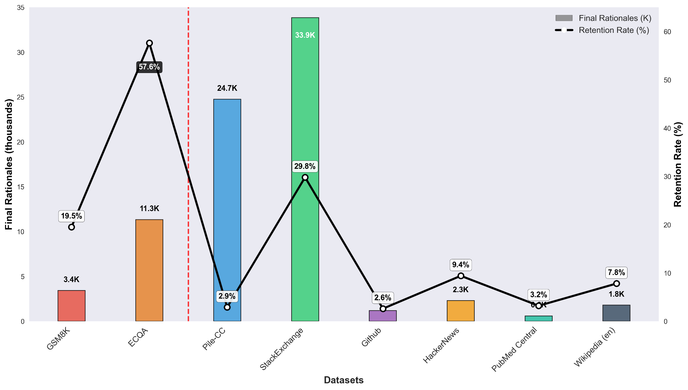
Results of our large-scale rationale extraction
StackExchange has highest retention among web data (Q&A format helps reasoning)
High-quality reasoning datasets yield ~14K rationales with better retention rates
Web-scale data contributes ~65K rationales despite lower retention rates due to massive scale
‹#›
Notes:
Here are our extraction results across different datasets. We applied our rationale extraction process to two main types of data sources. First, we used existing reasoning datasets like GSM8K and ECQA, which already contain structured reasoning examples. Second, we used web-scale data from The Pile, which includes various subdomains like StackExchange, GitHub, and others.
The line chart shows the percentage of rationales retained after filtering across different datasets. We can see significant variation in retention rates (which quantifies the % of rationales upon the perplexity-based filtering that I discussion in the rationale extraction part)- reasoning datasets like ECQA retain 57.6% of generated rationales, while GSM8K retains 19.5%. For The Pile subdomains, we see much lower retention rates, with StackExchange at 29.8% being the highest due to its question-answer format that naturally contains more reasoning content, while most other domains like Pile-CC retain only 2.9% of rationales.
The bar chart shows our final dataset composition: we extracted approximately 79K total rationales, with about 14K from reasoning datasets and 65K from The Pile. The lower retention rates for most Pile subdomains reflect that web-scale data contains less explicit reasoning content, making rationale extraction more challenging. However, the sheer volume of web data still provides substantial training material for RATIONALYST.

Slide 13
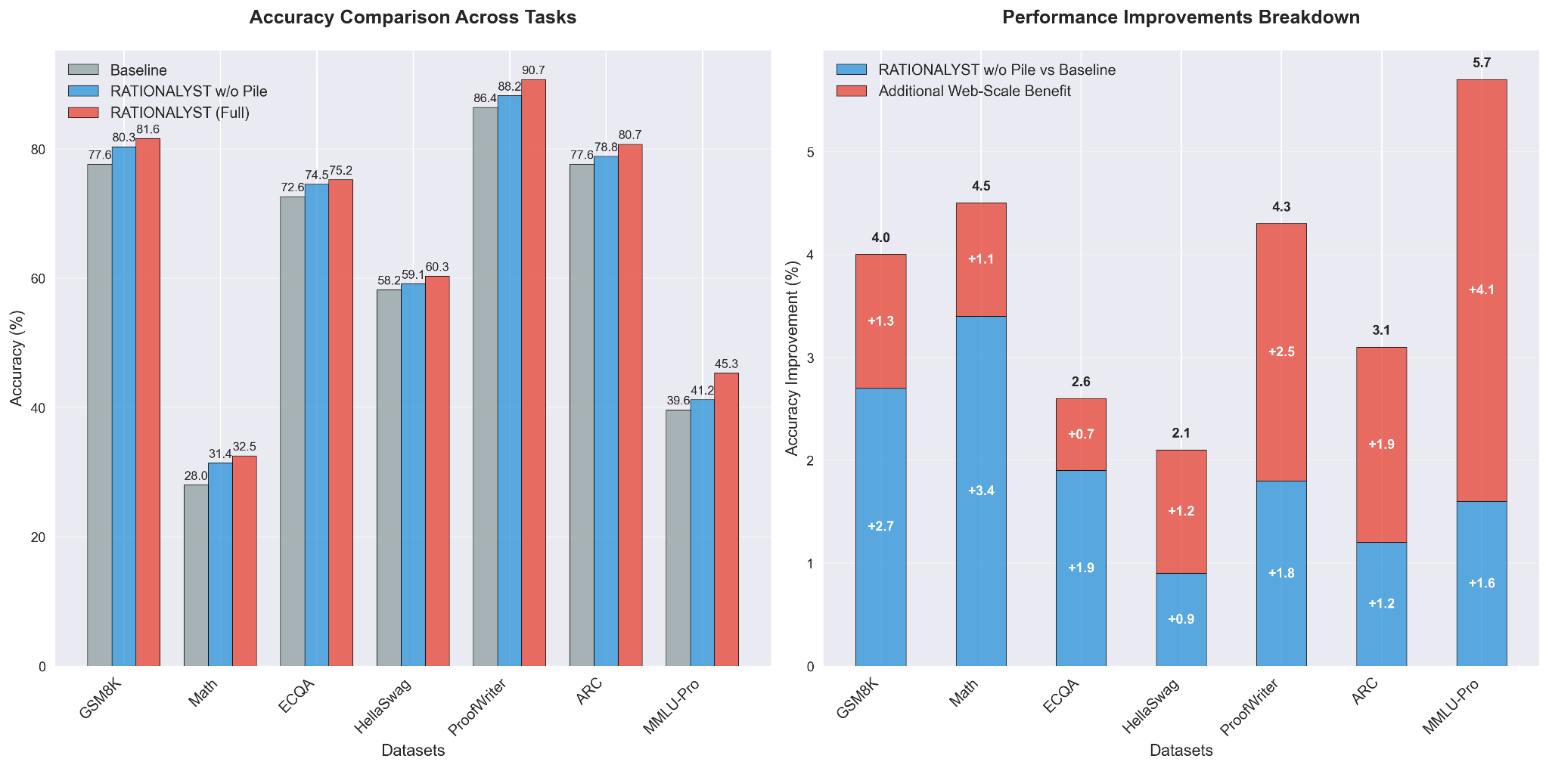
The benefits of adding RATIONALYST
MMLU-Pro shows largest benefit (+5.7% total, +4.1% from web-scale) diverse reasoning helps complex tasks
RATIONALYST provides consistent improvements across all 7 tasks 3.9% average gain)
‹#›
Notes:
We test the benefits of RATIONALYST on seven reasoning datasets. Comparing with the baseline without any supervision, RATIONALYST without The Pile data, and RATIONALYST with full data including The Pile.
The left chart shows across all seven reasoning tasks, adding web-scale rationales consistently improves performance. The right chart breaks down these improvements. The improvements are particularly substantial for MMLU-Pro with a 5.7 point gain. This suggests that the diverse rationales found in web-scale data help the model generalize to various reasoning scenarios

Slide 14
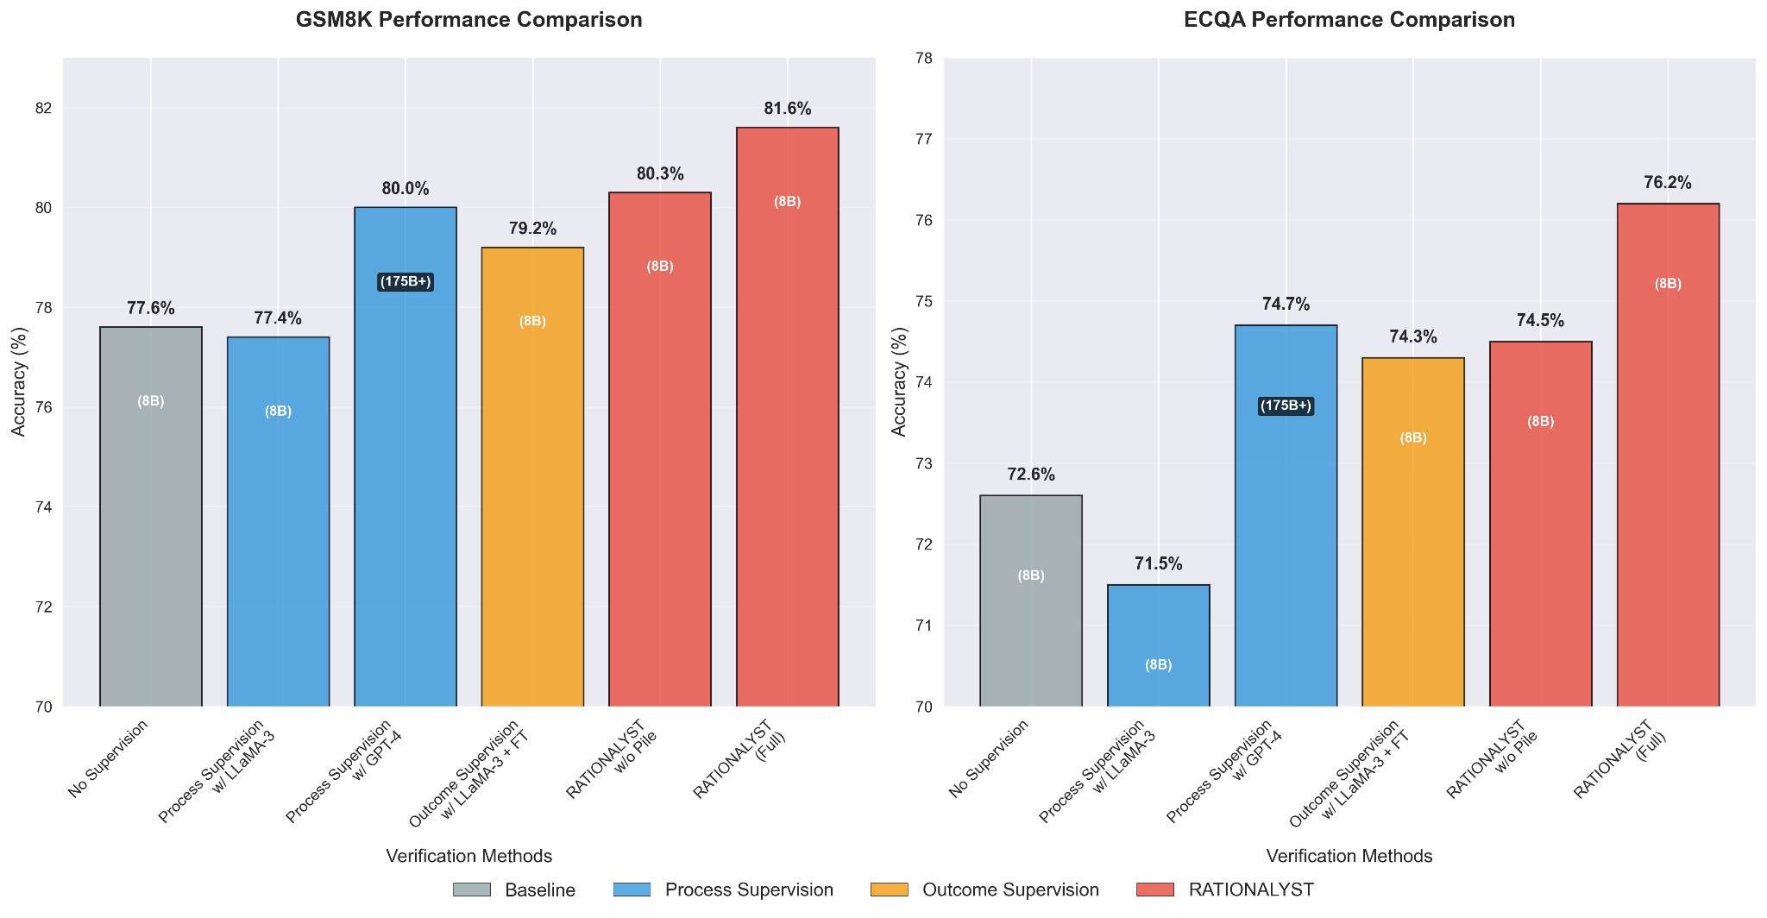
How does Rationalyst compare against other verifiers
RATIONALYST outperforms GPT-4!
RATIONALYST outperforms GPT-4!
‹#›
Notes:
Finally, let's see how Rationalyst compares to other verification methods. First, a quick overview of the approaches: 'No supervision' is our baseline with no verification. 'Process supervision' evaluates each reasoning step during generation. 'Outcome supervision' only checks the final answer. The agent model used here is LLaMa-3-8B.
Looking at GSM8K results: no supervision gets 77.6% accuracy. Process supervision with LLaMA-3-8B actually hurts performance at 77.4%, while GPT-4 reaches 80.0%. Outcome supervision with LLaMa-3-8B trained specifically on the training set achieves 79.2%.
RATIONALYST hits 81.6%, outperforming even GPT-4. We observed similar results on ECQA. This shows our specialized process supervision model beats general verification methods, even with smaller models.

Slide 15
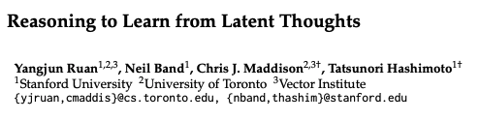
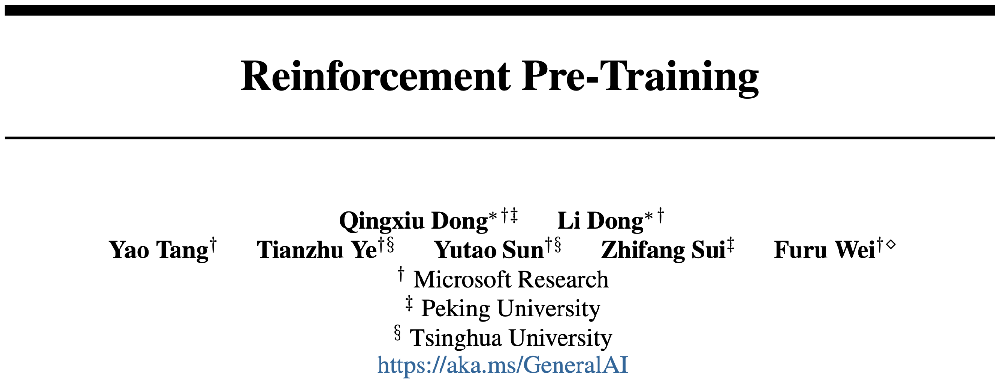
Summary
Motivation: The reasoning steps generated by LLMs might be incomplete because they mimic logical leaps common in everyday communication.
What we did: We extract 79K implicit reasoning steps from unlabeled text, train a specialized rationale generation model called RATIONALYST, and uses it to supervise reasoning at inference time.
What we found: RATIONALYST show +3.9% average improvement across 7 reasoning tasks, outperforming even GPT-4 verification.
Future Work:
Scale up: Use stronger models (GPT-4, LLaMA-70B) and larger datasets
Better integration: Combining RATIONALYST with test-time compute and preference fine-tuning
Parallel Works:
arxiv 2025
arxiv 2025
‹#›
Notes:
Let me summarize our key contributions. Our motivation was that LLMs generate incomplete reasoning steps because they mimic logical leaps from everyday communication. Our solution involved extracting 79K implicit rationales from unlabeled text, training RATIONALYST as a specialized rationale generation model, and using it for process supervision during inference. Our results show an average 3.9% improvement across seven reasoning tasks, outperforming even GPT-4 verification. For future work, we plan to scale up RATIONALYST using stronger models like GPT-4 and LLaMA-70B with larger datasets, and better integration with test-time compute and preference fine-tuning.
We also reference parallel works that explore similar directions that involves rationale extraction from unlabelled datasets

Slide 16
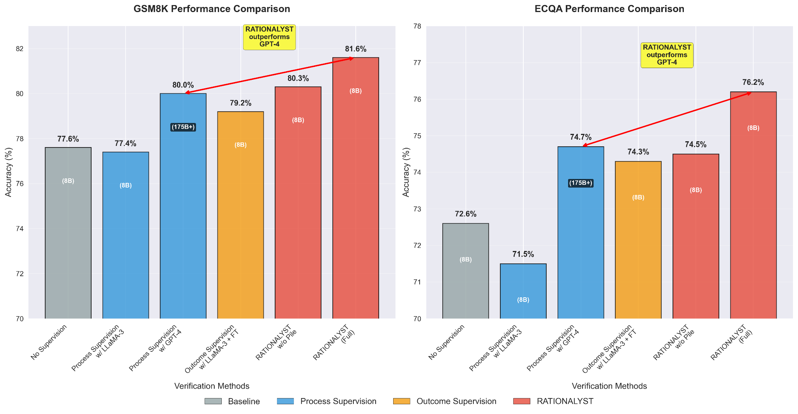
How does Rationalyst compare against other verifiers
Notes:
Now let's see how Rationalyst compares to other verification methods. First, a quick overview of the approaches: 'No supervision' is our baseline with no verification. 'Process supervision' evaluates each reasoning step during generation. 'Outcome supervision' only checks the final answer.
Looking at GSM8K results: no supervision gets 77.6% accuracy. Process supervision with LLaMA-3-8B actually hurts performance at 77.4%, while GPT-4 reaches 80.0%. Outcome supervision achieves 79.2%.
RATIONALYST hits 81.6%, outperforming even GPT-4. Similar results on ECQA. This shows our specialized rationale-based approach beats general verification methods, even with smaller models. The key insight: training specifically for supervision with implicit rationales works better than relying on general reasoning for verification

Slide 17
Future Work
Scaling Up
Use stronger models (LLaMA-3-70B, GPT-4) for better rationale extraction
Train on larger datasets like OpenWebMath
Scale to more reasoning tasks and benchmarks
Technical Improvements
Integrate with test-time compute techniques (beam search, look-ahead)
Add preference tuning (DPO) to distinguish valid/invalid rationales
Combine with existing methods (self-consistency, STEP-BACK prompting)
Research Directions
Study optimal rationale mixing strategies across datasets
Understand what makes rationales effective for reasoning
Investigate rationale transfer across different domains

Slide 18
Roadmap
What to do at inference-time
How to mine a dataset of implicit rationales that are turned explicit?
Training on this data
Evaluations

Slide 19
Using Rationalyst
at inference time

Slide 20
Motivation
Our solution: RATIONALYST trained on implicit rationales from pre-training data
How it works: Provides supervision for reasoning processes
Key benefit: Makes implicit rationales explicit
Outcome: More robust reasoning and conclusions
This is where our approach comes in. Our solution is RATIONALYST, which is trained on a vast collection of implicit rationales extracted from pre-training data to provide supervision for reasoning. RATIONALYST works by making these implicit rationales explicit and using them to guide the reasoning process at inference time.
A typical document from LLM pre-training data
… Harry used magic outside of the school of Hogwarts to inflate Aunt Marge… He is punished to attend a disciplinary hearing at the Ministry of Magic…
Implicit rationale in the document
When someone breaks the rule, he will be punished!
A question posed to LLM at inference time
Question: A person is caught stealing food from a store to feed their hungry family. What will likely happen to them?
Choices: A: He will be punished B: He will rewarded
Existing LLMs
Let’s think step by step. Since a person is trying to help their family, they will be rewarded for their act!
RATIONALYST provides an additional supervision mechanism to guide LLMs’ reasoning processes, resulting in more robust conclusions.
Existing LLMs + rationale supervision via RATIONALYST
Let’s think step by step. Although this stealing has good intentions, stealing from a store breaks the rule of society, so it should be punished!
Notes:
This is where our approach comes in. Our solution is RATIONALYST, which is a model trained on a vast collection of implicit rationales extracted from pre-training data to provide supervision for reasoning. RATIONALYST works by making these implicit rationales explicit and using them to guide the reasoning process at inference time.
For the example we have, RATIONALYST would help the model generate the complete reasoning: 'Although this stealing has good intentions, stealing from a store breaks the rule of society, so it should be punished!'

Slide 21
Motivation
A typical document from LLM pre-training data
The reasoning steps generated by LLMs might be incomplete!
They mimic logical leaps common in everyday communication that’s found in their pre-training data
Underlying rationales are frequently left implicit (unstated).
As a result, existing LLMs trained to mimic web text will have
difficulty surfacing these implicit statements during the reasoning process, which can lead to flawed
conclusions, such as erroneously justifying theft
as a praiseworthy act when done to support one’s
family ( 2 in Figure 1).
… Harry used magic outside of the school of Hogwarts to inflate Aunt Marge… He is punished to attend a disciplinary hearing at the Ministry of Magic…
Implicit rationale in the document
When someone breaks the rule, he will be punished!
A question posed to LLM at inference time
Question: A person is caught stealing food from a store to feed their hungry family. What will likely happen to them?
Choices: A: He will be punished B: He will rewarded
Existing LLMs
Let’s think step by step. Since a person is trying to help their family, they will be rewarded for their act!
Existing LLMs + rationale supervision via RATIONALYST
Let’s think step by step. Although this stealing has good intentions, stealing from a store breaks the rule of society, so it should be punished!

