Slide 1
Can LLMs Generate Tabular Summaries of Science Papers?
Rethinking the Evaluation Protocol
Weiqi Wang, Jiefu Ou,
Yangqiu Song, Benjamin Van Durme, Daniel Khashabi
Under Review at ACL 2025

Slide 2

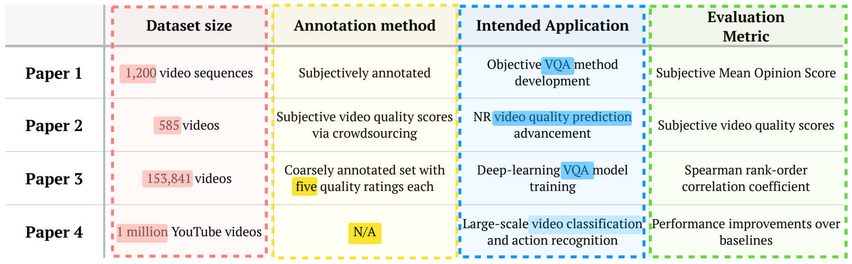





Task: Generating Tabular Summary for Scientific Content
Input: A user prompt seeking scientific information.
Output: A table that summarizes the information/insights extracted from the relevant science papers.
Prompt: Generate a table comparing video dataset papers
Repositories of science: arXiv, Google Scholar, etc.
Potentially
relevant papers
Tabular summary

Slide 3
Why solve this task?
Tables are widely accepted format for scientific content.
  Improves clarity, enables comparisons
Integrating it into our workflow will improve quality and interpretability.
Prompt: Generate a table comparing video dataset papers
Repositories of science: arXiv, Google Scholar, etc.
Potentially
relevant papers
Tabular summary

Slide 4
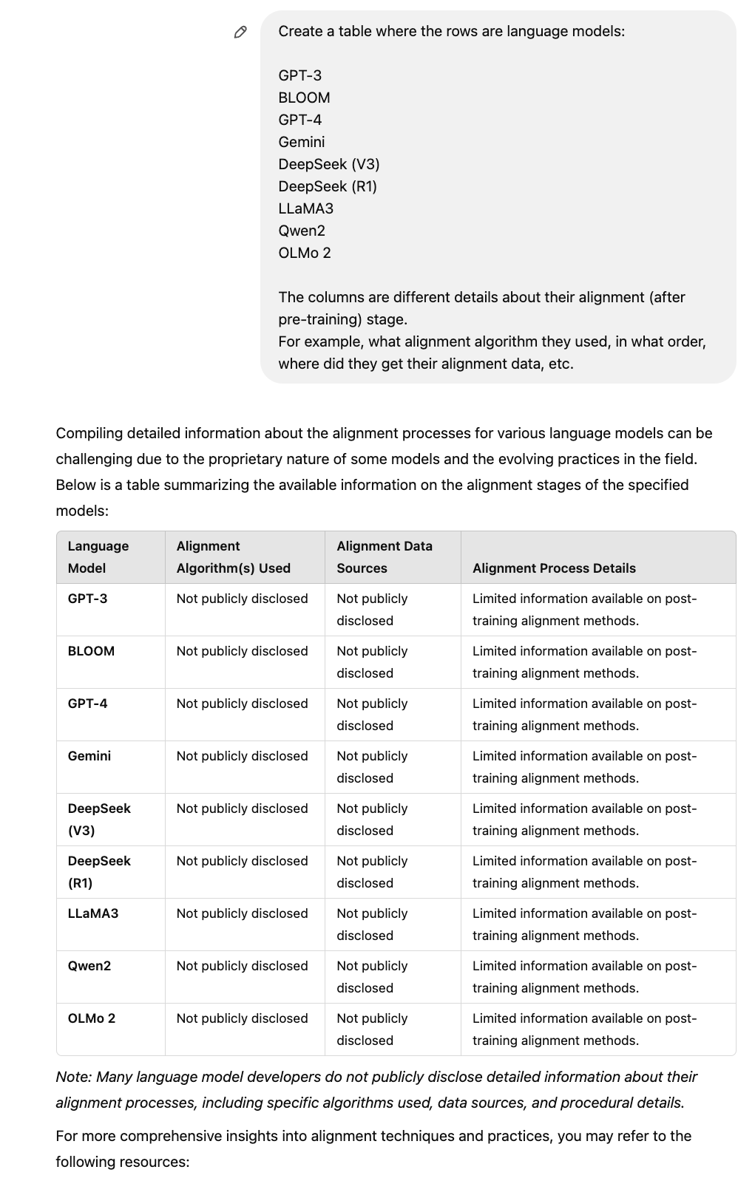
How good is the state-of-the-art at this task?
ChatGPT
Example retrieved on 02/27/2025

Slide 5
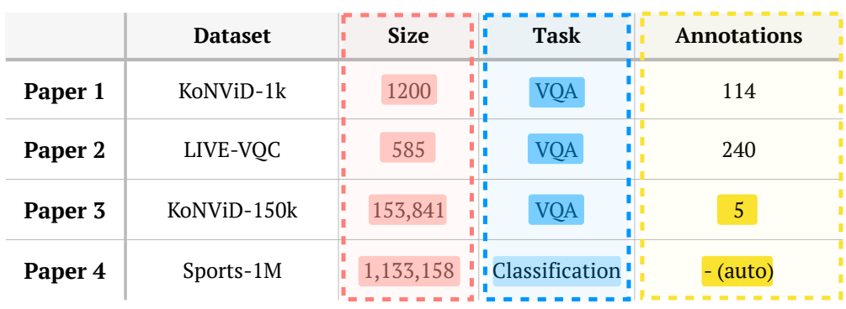
Recent related work: ArxivDigesTables
Newman et al. ArxivDIGESTables: Synthesizing Scientific Literature into Tables using Language Models, EMNLP 2024
Extracted 2.2K tables from existing papers.
The table captions serve as the task prompts.
Rows of the table correspond to individual papers (7K) papers.
We build upon this work by addressing their weaknesses!

Slide 6
Limitations of prior work
The assumption that papers a carefully curated relevant papers are available, is idealistic in realistic scenarios.
Table captions are not appropriate task prompts.
Rely on static embedding and human annotation to evaluate generated tables.

Slide 7

Newman et al. setup:
LLM
processing
Prompt
Well-curated relevant papers (gold papers)
Tabular summary
Our setup:
Prompt
LLM
processing
Repositories of science: arXiv, Google Scholar, etc.
Potentially
relevant papers
Tabular summary
We build a retrieval engine over papers and identify hard negative candidate papers to make evaluation realistic.

Slide 8
Limitations of prior work
The assumption that papers a carefully curated relevant papers are available, is idealistic in realistic scenarios.
Table captions are not appropriate as task prompts.
Rely on static embedding and human annotation to evaluate generated tables.

Slide 9
User Demand vs. Captions
Prompts in prior work [Newman et al.] are table captions.
We replace them with user demand prompts:
  We collect these by careful prompting of LLMs to:
    (1) obtain a more complete prompt while
    (2) avoiding leakage of table schema/values.
Brief and ambiguous
  Comparison of Trajectory and Path Planning Approach
  Generate a table that compares different trajectory and path planning approaches. You can focus on their collision avoidance techniques, benefits, limitations, and applicable scenarios.
Longer and more precise

Slide 10
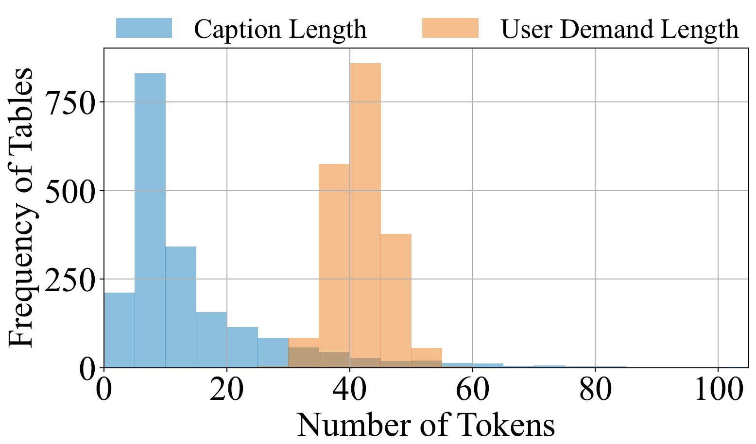
User Demand vs. Captions
Our collected user demands feature longer context, thus including better hints to curate the table.

Slide 11
Limitations of prior work
The assumption that papers a carefully curated relevant papers are available, is idealistic in realistic scenarios.
Table captions are not appropriate as task prompts.
Rely on static embedding and human annotation to evaluate generated tables.

Slide 12
CBFIR Networks | Datasets | Evaluation Metrics | Loss Function
GAN | DARN | Recall@1 | TL, AL
CN-LexNet | Shopping100K | Recall@20 | CL, TL
ResNet-v2 | DeepFashion | Recall@1,10 | BCE Loss
Originally, we have a ground-truth table extracted from a paper
Ground-truth Table
We synthesize QA pairs from the ground-truth table about schema and values
table schema:
Is Dataset included in the table schema?
unary (cell) values:
Is CL, TL the loss function for paper CN-LexNet?
pairwise comparisons:
Is ResNet using more evaluation metrics than GAN?
Then, we ask an LLM to answer these QAs based on the generated table
The ratio of “Correct” indicates the recall.
Correct!
✅
Correct!
✅
Incorrect!
❌
Backbone Model | Losses | Attributes | Datasets
GAN | TL+AL | Shape | DARN Color
CNLexNet | CL+TL | Various | Consumer-to-Shop
ResNet | Landmark | Various | DeepFashion
Then, we have a table that is generated by an LLM
Generated Table

Slide 13
Backbone Model | Losses | Attributes | Datasets
GAN | TL+AL | Shape | DARN Color
CNLexNet | CL+TL | Various | Consumer-to-Shop
ResNet | Landmark | Various | DeepFashion
Similarly, we can reverse the process by starting with the generated table.
Generated Table
Again, we synthesize QAs based on the generated table.
table schema:
Is Attributes included in the table schema?
unary (cell) values:
Is DARN Color used in GAN?
pairwise comparisons:
Is ResNet using fewer losses than GAN?
The ratio of “Correct” indicates the precision.
But answer them using the ground-truth table.
Incorrect!
❌
Incorrect!
❌
Correct!
✅
CBFIR Networks | Datasets | Evaluation Metrics | Loss Function
GAN | DARN | Recall@1 | TL, AL
CN-LexNet | Shopping100K | Recall@20 | CL, TL
ResNet-v2 | DeepFashion | Recall@1,10 | BCE Loss
And answer QAs using our ground-truth table.
Ground-truth Table

Slide 14
Our released data: arXiv2Table
Expanded version of Newman et al. 2024.
Contains
  2.1K user demand prompts
  2.1K tables (inherited from arXivDigestable).
    Dropped few low-quality tables.
  Each prompt comes with it a set of candidate (distractor + gold) papers.
  Evaluation framework based on utilization.
Dataset will be on arXiv on coming weeks!

Slide 15
We also proposed a new approach
An inference-time algorithm that iteratively digests and organizes papers in tabular form.

Slide 16


Prompt
Candidate Paper Retrieval
Batching
Paper Selection and Table Refinement
Based on the current batch of papers, (1) select papers that match the user demand and (2) update the table based on the selected papers.
Two papers in this batch can be included, one column can be inserted. Updating the table:
……
Model | Data | Loss | Title
… | … | … | …
… | … | … | …
… | … | … | …

Slide 17
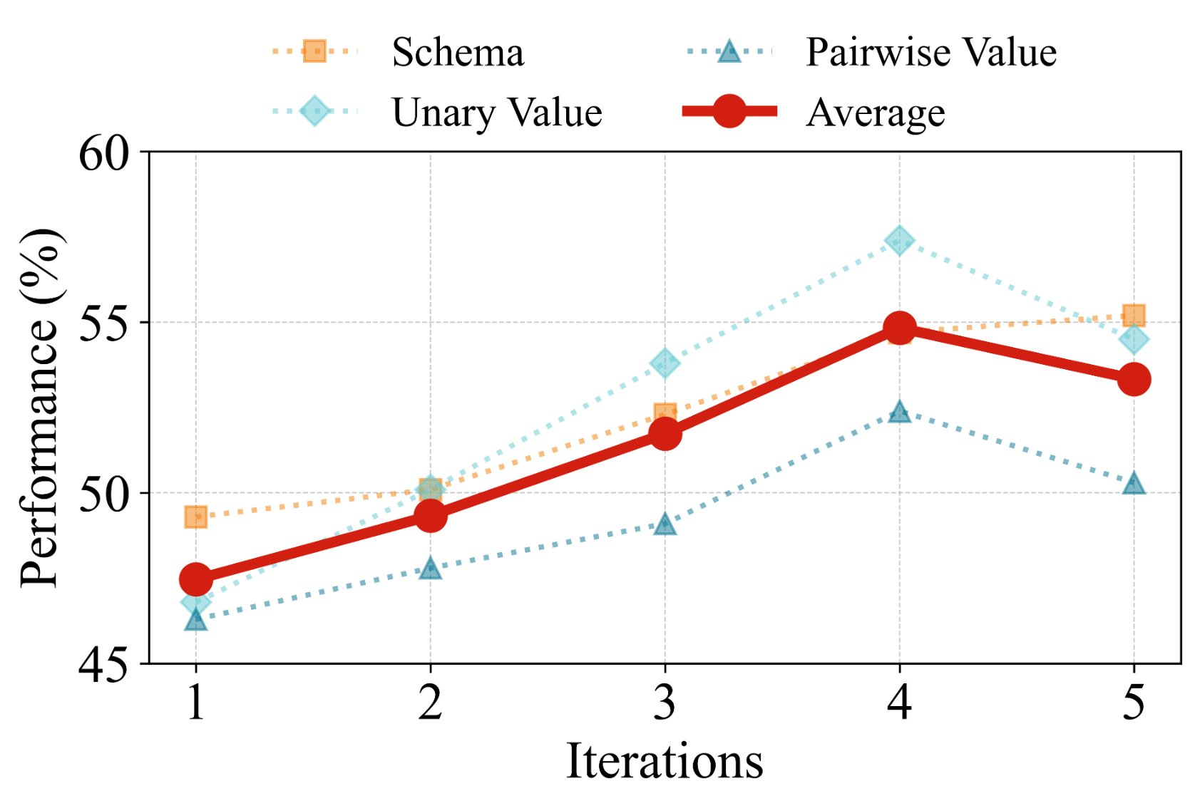
Evaluation vs Number of Iterations
With more iterations, all aspects of the generated tables improves
(up to iter ~4).

Slide 18
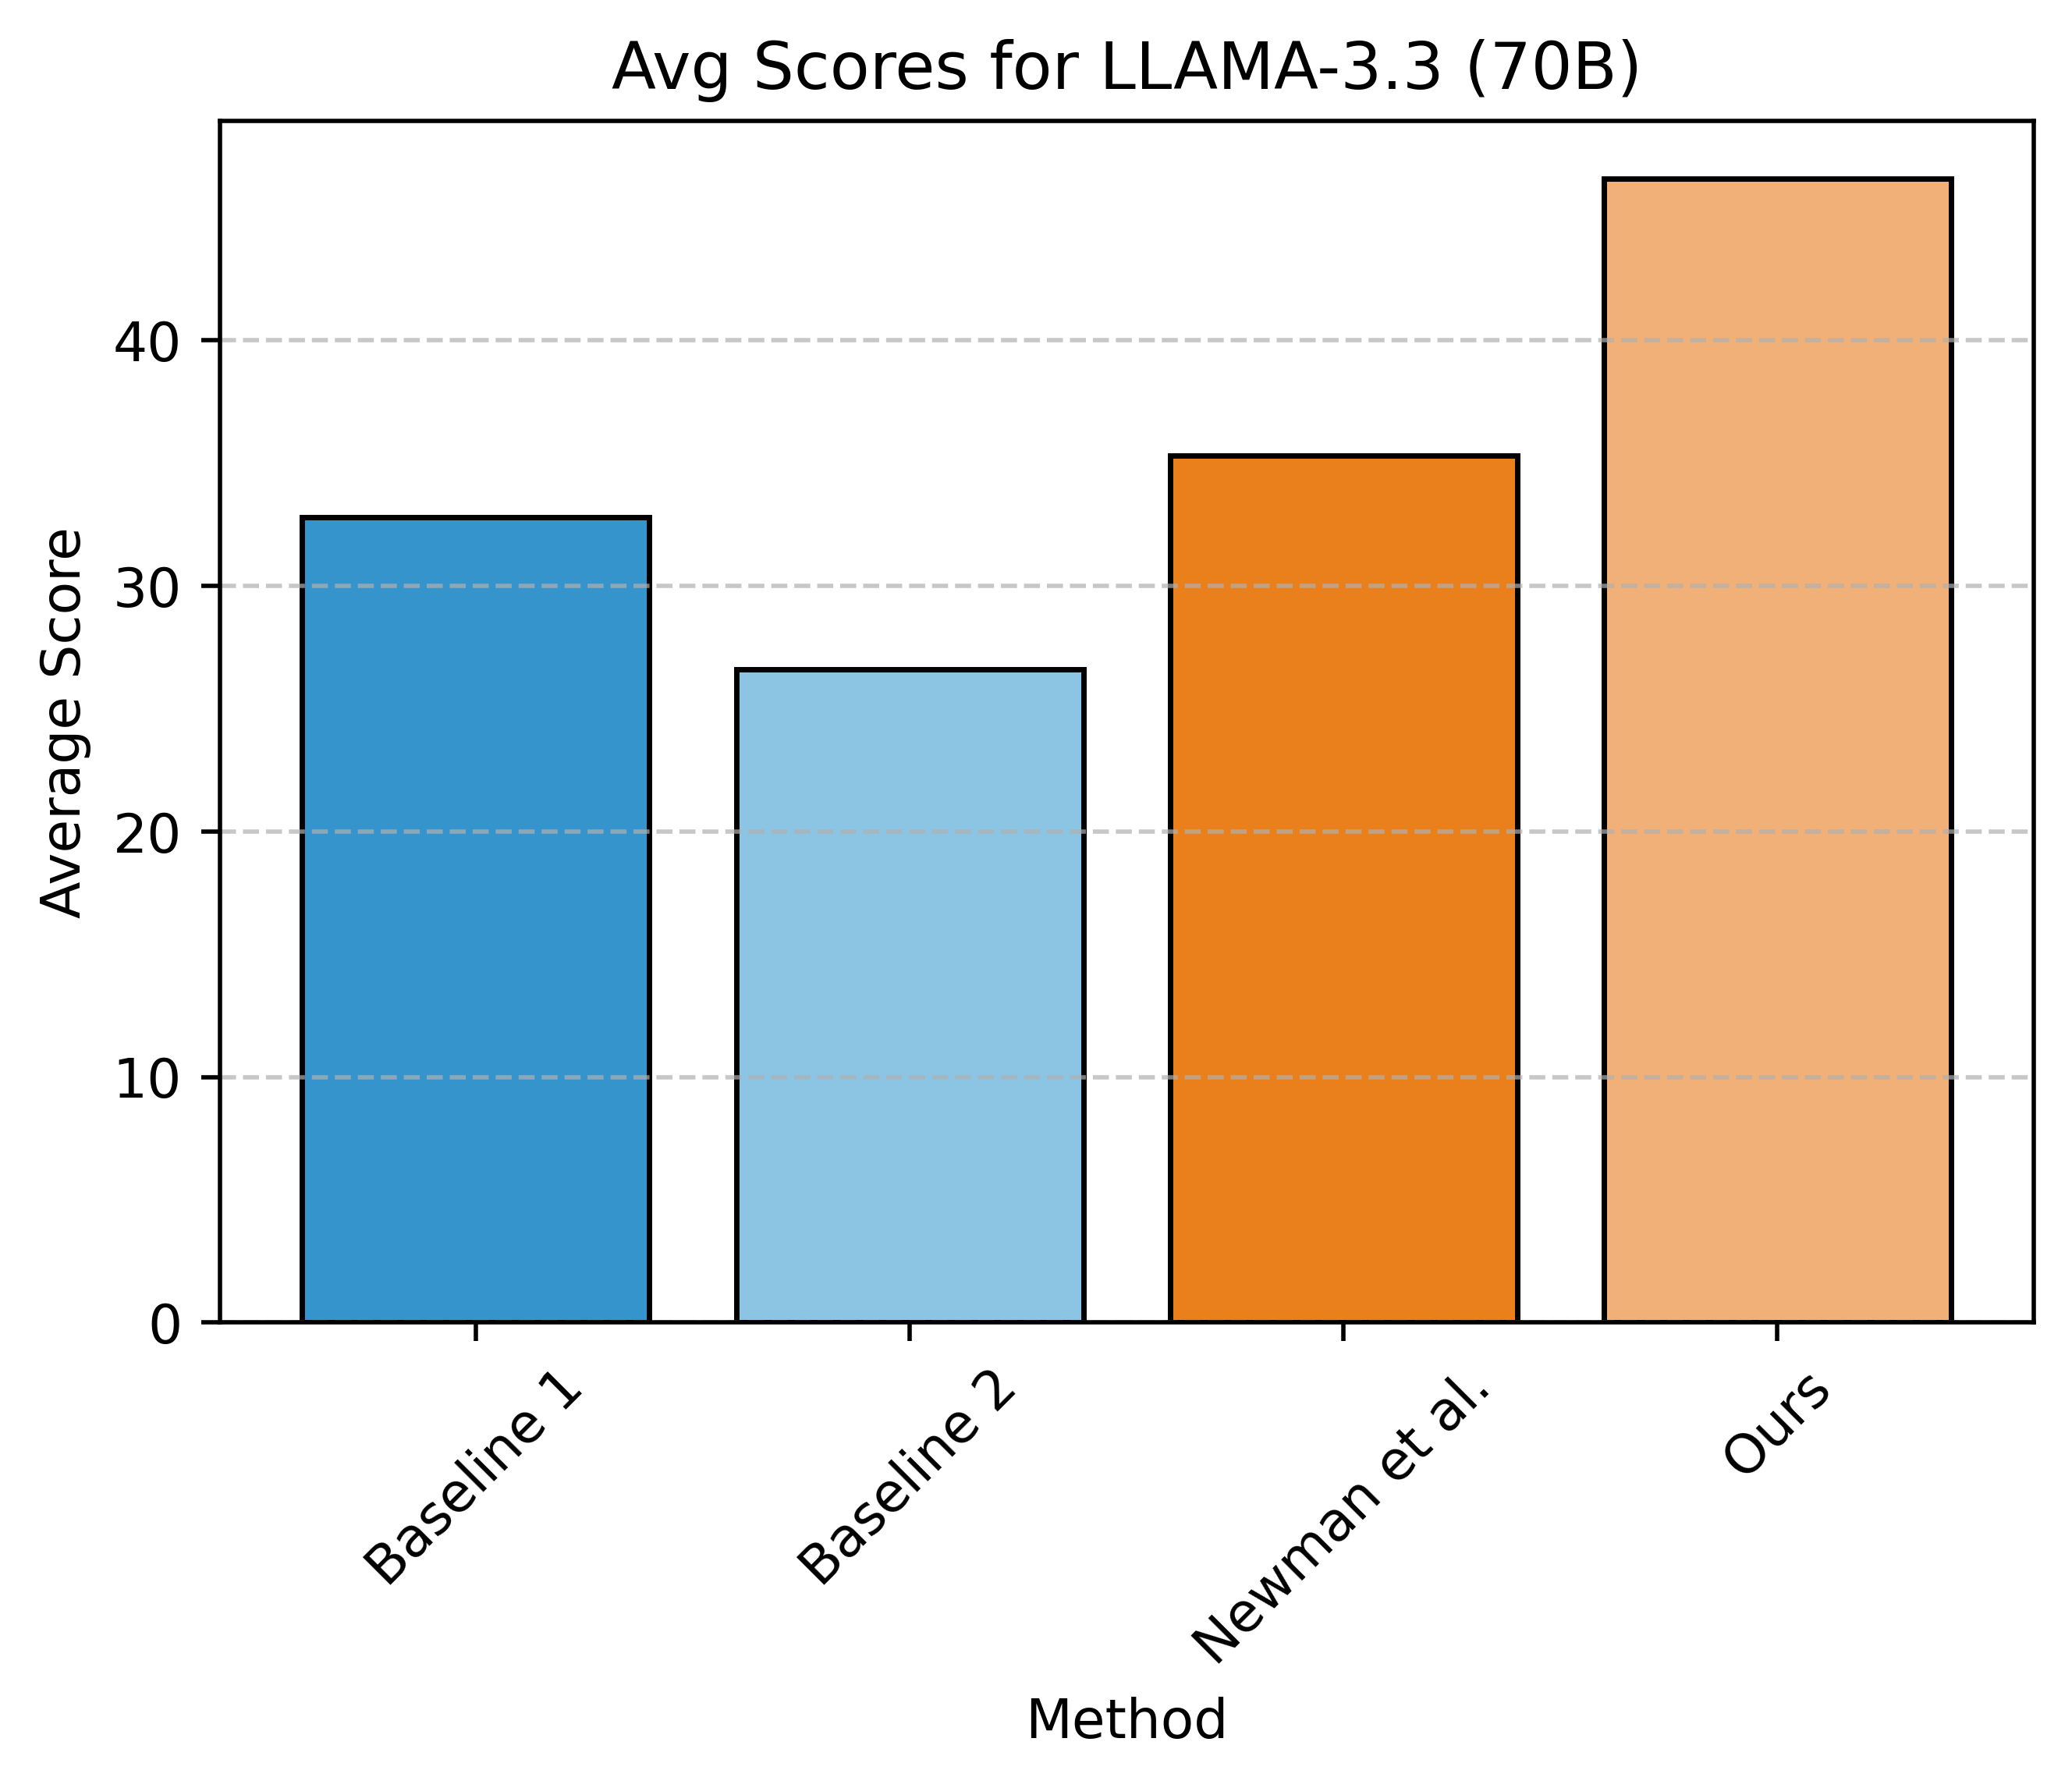
Evaluation of the end-to-end pipeline
Model: Llama 3.3 (70B)
Baseline 1: All papers processed
in one conversation round.
Baseline 2: One-conversation
round per paper.
Newman et al.: Two stages;
define schema in the first round,
then fill in the values.
Our proposed approach outperforms existing results.

Slide 19
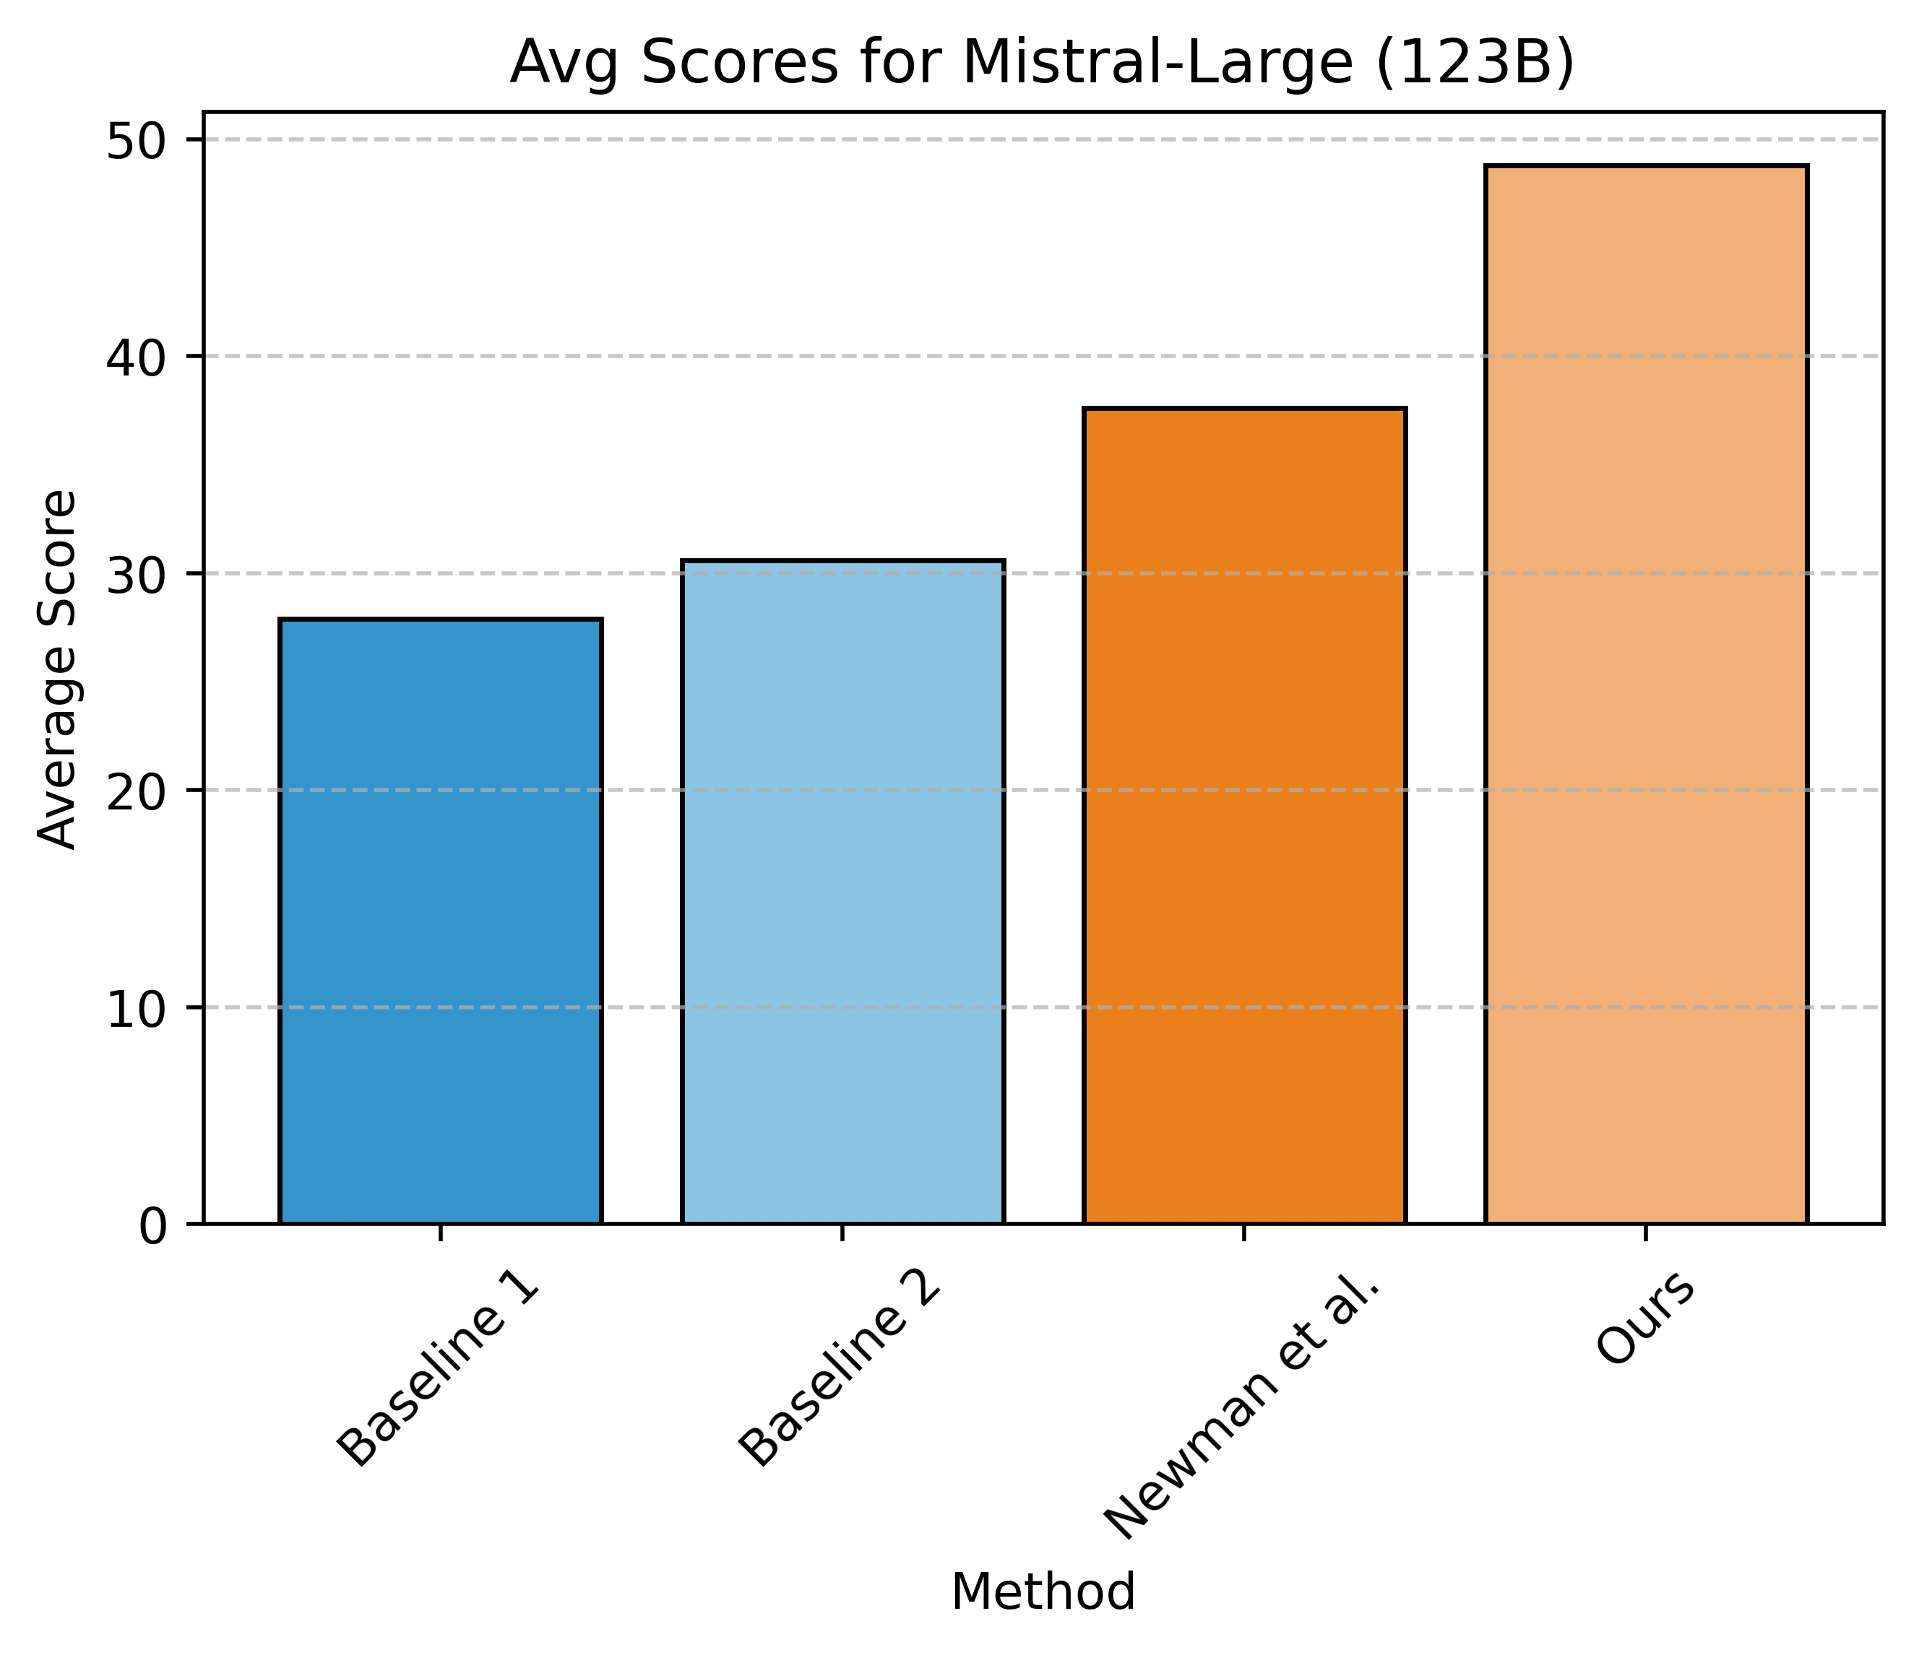
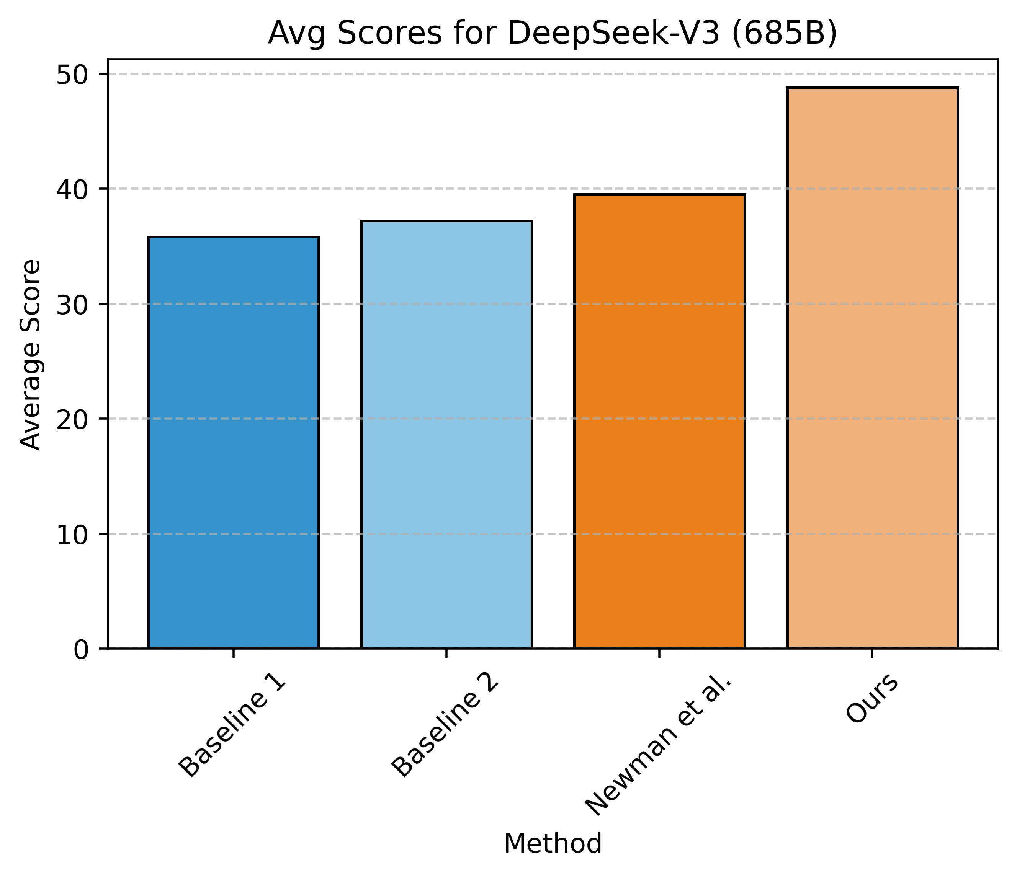
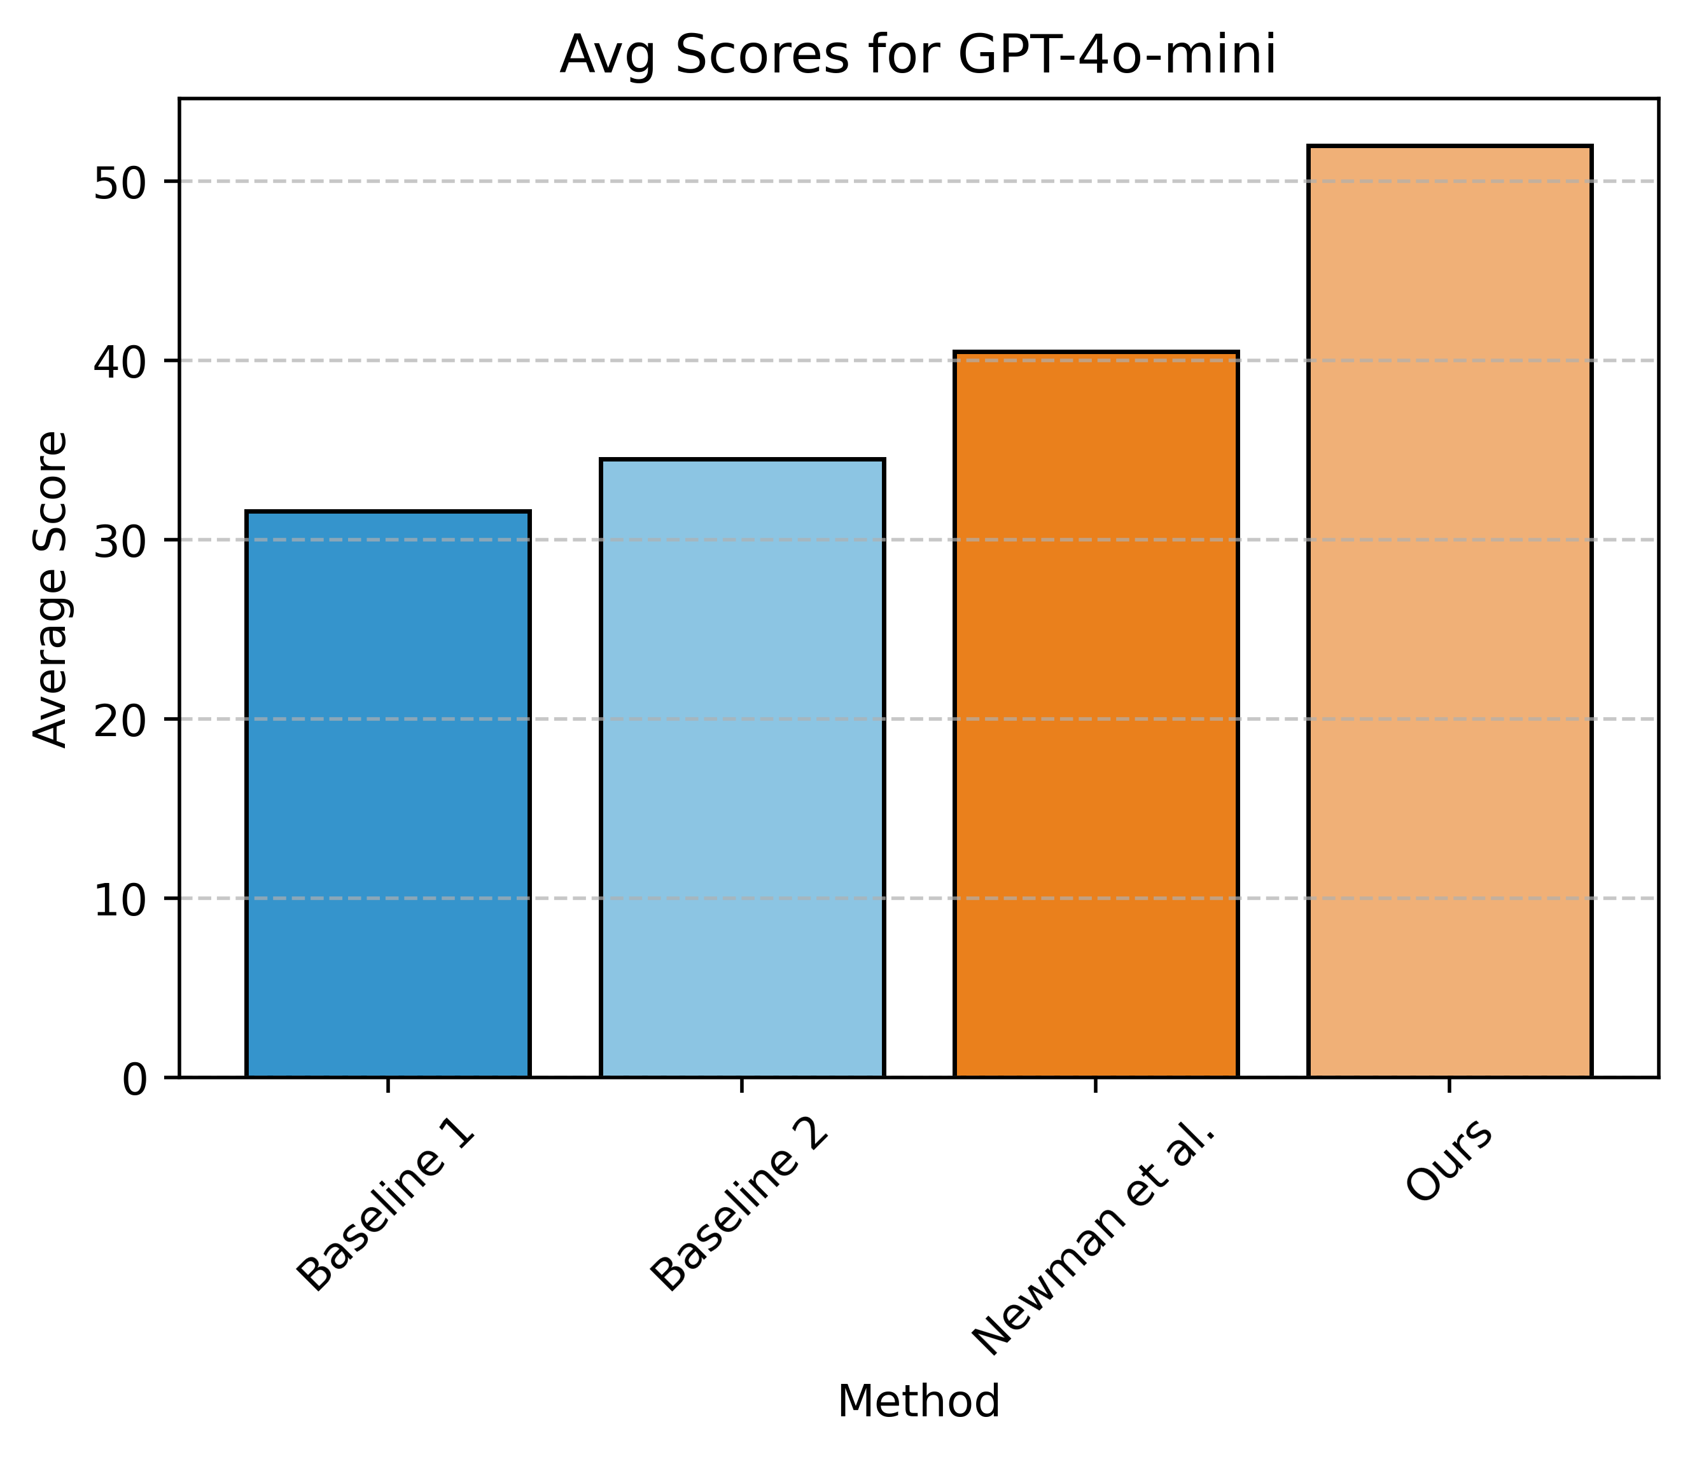
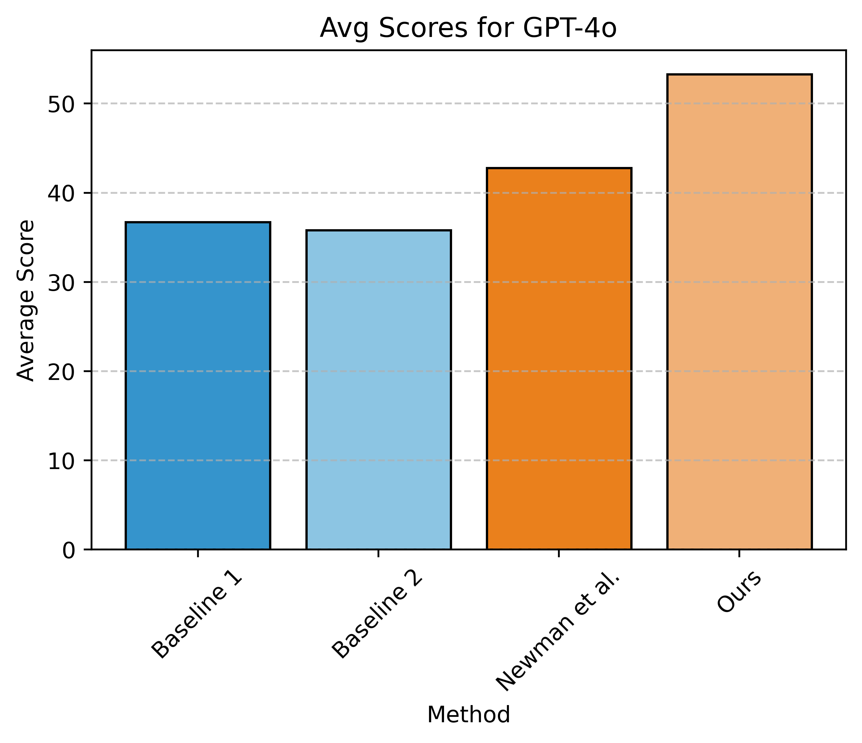
Evaluation of the end-to-end pipeline (other models)
The gains of our approach is consistent across different models.
The task remains challenging for all these approaches.

Slide 20
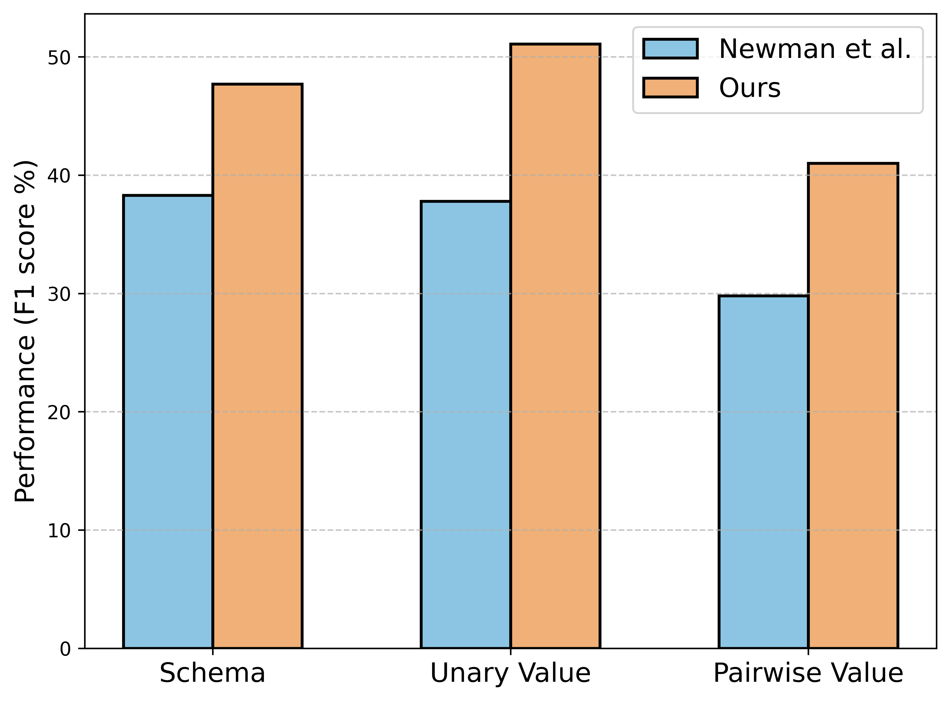
Evaluation of Different Aspects
Different aspects:
  Schema: whether we got the
  right table headings.
  Unary: whether we got the
  cell values.
  Pairwise: whether comparison
  between the cells are found.
Pairwise value comparisons is a more challenging metric than unary values.

Slide 21
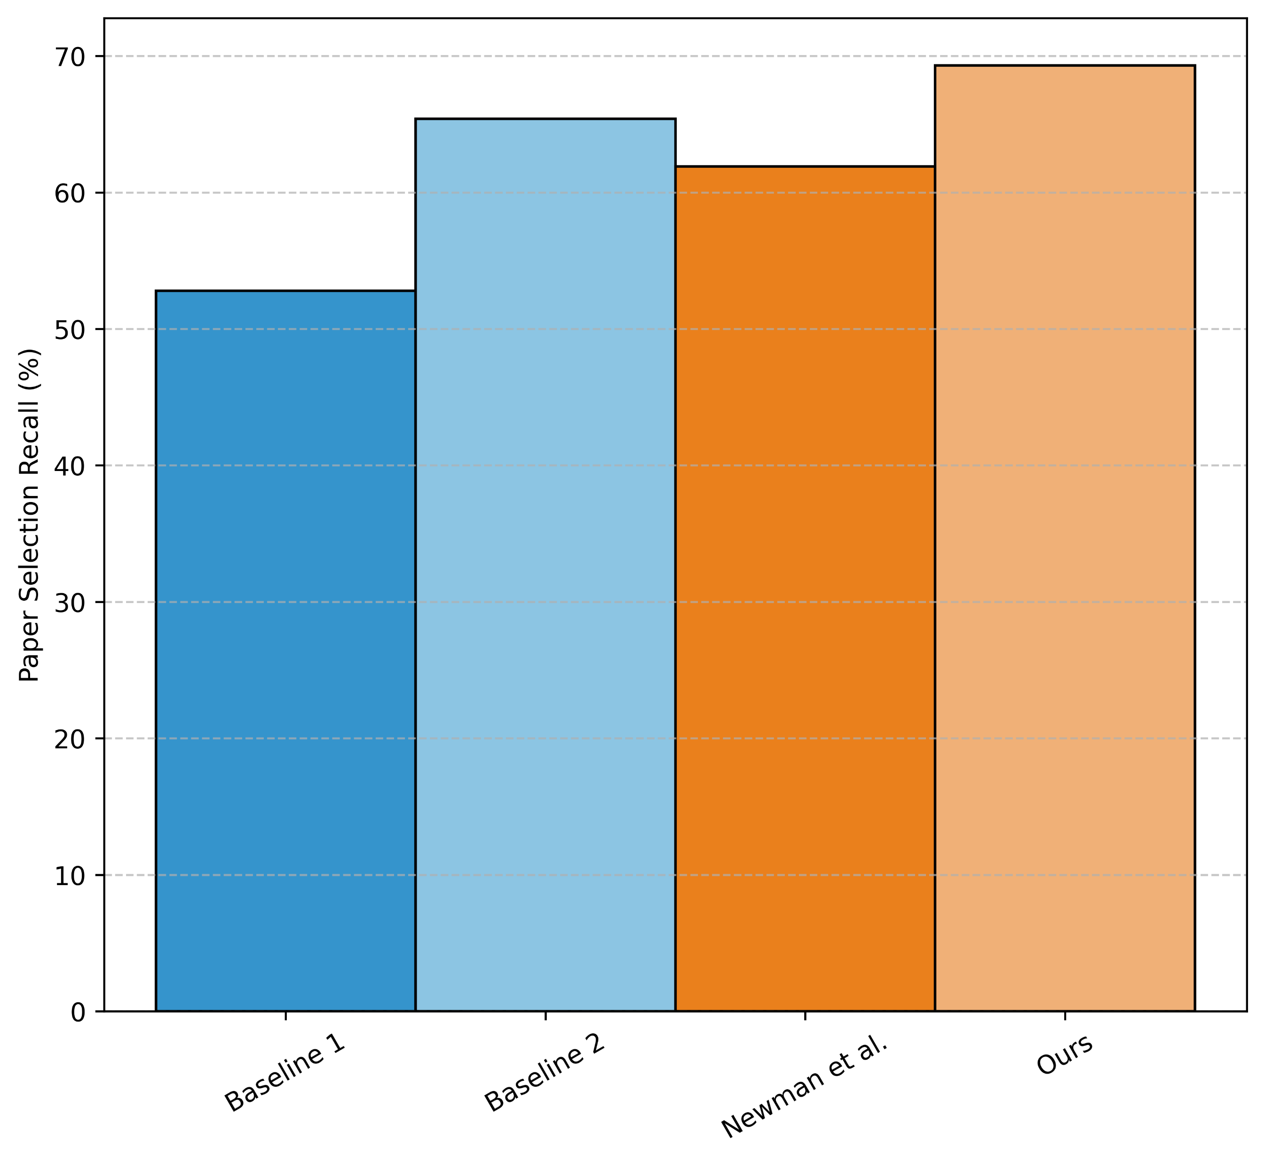
Evaluation of Paper Selection
Selecting relevant papers is difficult for all methods.
Our method is slightly stronger than the best baseline.

Slide 22
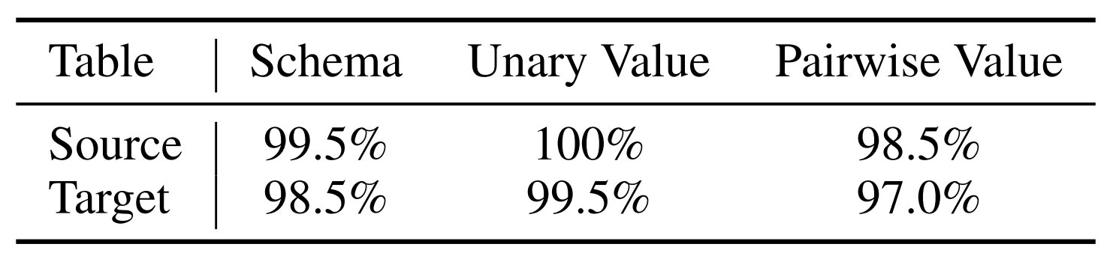
Expert Verification of Our Automatic Evaluation
We annotate a sample of 200 QA pairs to verify that:
  Source: the QA pairs are synthesized correctly from the source table.
  Target: the QA pairs are correctly answered based on the target table.
Our LLM-based evaluation is robust.

Slide 23
Summary and Conclusion
Motivation: A more realistic pipeline for evaluating tabular summarization of science literature.
  Why? Tabular summaries are crucial framework for quickly aggregating and understanding the progress in science.
We introduce arXiv2Table, a framework for evaluating systems for tabular summarization.
We also develop a system to address the challenge posed.
Our benchmark is challenging! Give it a try!! 🚀

