Slide 1
Can LLMs Generate Tabular Summaries of Science Papers?
Rethinking the Evaluation Protocol
Daniel Khashabi
JHU, Assistant Professor
Notes:
Thanks Orion.
Now we're going to switch gears from reasoning to knowledge representation, in particular tabular representation of scientific information which we hope to use without our system.

Slide 2

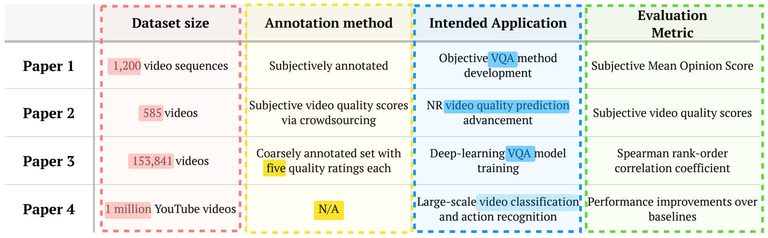





Task: Generating Tabular Summary for Scientific Content
Input: A user prompt seeking scientific information.
Output: A table that summarizes the information/insights extracted from the relevant science papers.
Prompt: Generate a table comparing video datasets
Repositories of science: arXiv, Google Scholar, etc.
Potentially
relevant papers
Tabular summary
Notes:
Let’s start with our task definition. I name the task: ...
The input is a prompt that articulates an information-seeking question by the user.

Slide 3
Why focus on this task?
Tables are widely adopted format for scientific content.
  Improves clarity, enables comparisons
Integrating it into our workflow will improve quality and interpretability.
Prompt: Generate a table comparing video datasets
Repositories of science: arXiv, Google Scholar, etc.
Potentially
relevant papers
Tabular summary
Notes:
Why do we need to solve this task?
- Tables are well-adopted representations for showing scientific content. It's omnipresent in papers because people find it intuitive.
- We believe that using a tabular representation of knowledge (among others) within our system will improve the quality of our system and its interpretability.

Slide 4
what we do, briefly
Develop arXiv2Table, a framework for evaluating this task.
Develop strong system for tackling our benchmark.
Prompt: Generate a table comparing video datasets
Repositories of science: arXiv, Google Scholar, etc.
Potentially
relevant papers
Tabular summary

Slide 5
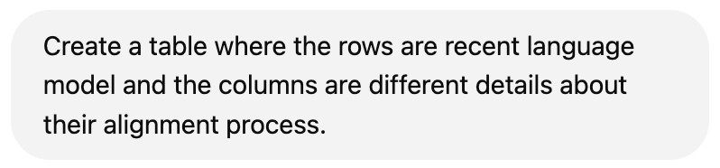
How good is the state-of-the-art at this task?
An easy prompt since it’s extensively discussed in various forms (papers, Twitter, Reddit, etc.)
Language Model | Release | Base | Alignment Algorithm(s) Used | Alignment Data Sources for alignment
GPT-3-instruct | 2020 | GPT-3 | SFT --> RLHF/PPO | Curated datasets with human-labeled prompts and responses
GPT-4 | 2023 | GPT-4 pre-trained? | SFT --> RLHF/PPO | Curated datasets with human-labeled prompts and responses
Gemini | 2023 | Gemini pre-trained? | SFT --> RLHF/PPO | Curated datasets with human-labeled prompts and responses
LLaMA2 | 2023 | LLaMA2 pre-trained | SFT --> RLHF/PPO | Curated datasets with human-labeled prompts and responses
LLaMA3 | 2024 | LLaMA3 pre-trained | Iterate: Rejection sampling -> SFT -> DPO | 10 million human-annotated examples. The alignment process was conducted over multiple rounds, with each round involving the collection of new preference annotations and SFT data.
Alpacha | 2023 | LLAMA 1 | SFT | Self-Instruct, 52,000 input-output pairs
Qwen2.5 | 2024 | Qwen2.5 pre-trained | SFT -> DPO -> GRPO | 1 million samples
Tulu 3 | 2024 | Llama 3.1 | SFT -> DPO -> RLVR | near 1 million samples
DeepSeek (V3) | 2024 | DeepSeek pre-trained | SFT -> GRPO | 1.5 million samples (reasoning + non-reasoning tasks). Reasoning data was generated by specialized models. Non-reasoning data was produced by DeepSeek-V2.5 and validated by human reviewers.
What I manually created
for my course
Notes:
You might be wondering how difficult this task is.
- Here is an example query that a user may be interested in: ...
- What's a good answer to this question: here is what I prepared for my course since I wanted to summarize what has happened in the field and how the practices in alignment are changing. So, a tabular representation is a very natural thing to do.
- And let me emphasize that this is a relatively simple task.
- The answer to this question is available. A ton of papers, blog posts, Reddit. This is easy.
- The headache is going out there, along with identifying all the relevant information.

Slide 6
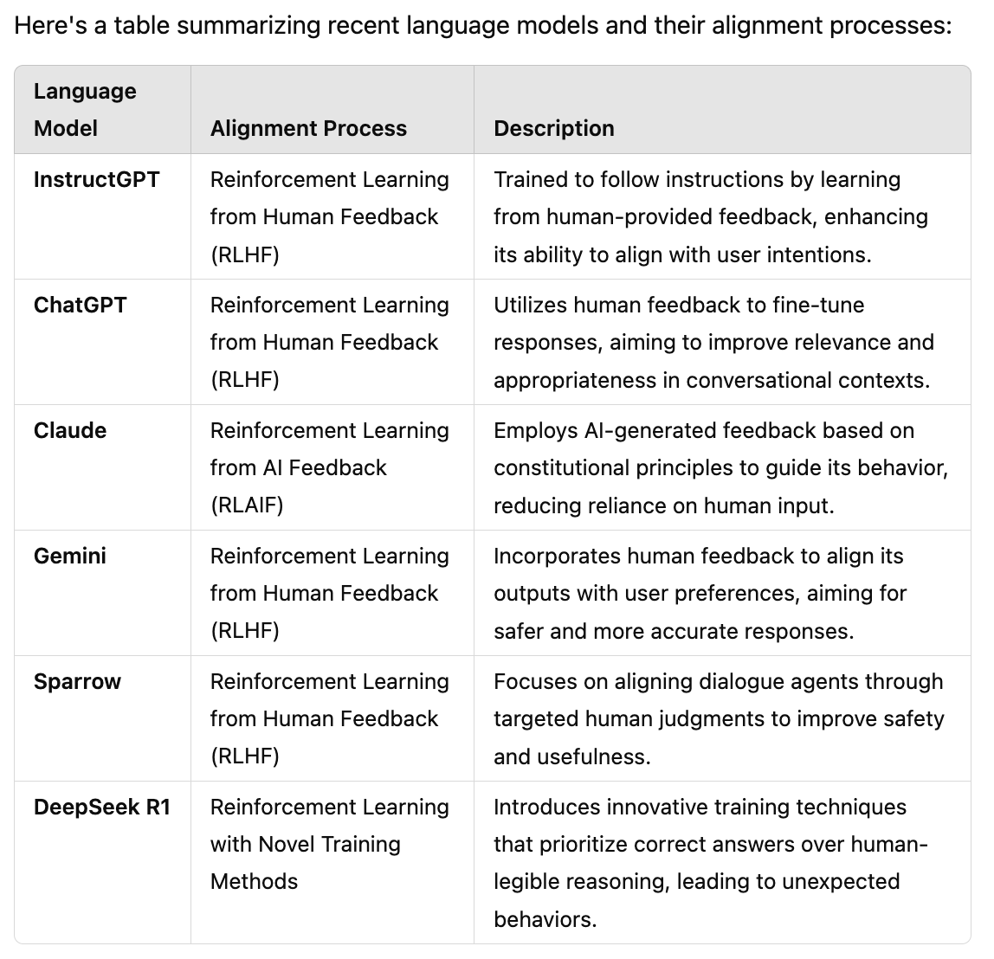
How good is the state-of-the-art at this task?
Not able to identify a meaningful set of column values (table schema)
ChatGPT
A lot of details are missing here!
(many open-source models)
Example retrieved on 02/27/2025
Notes:
Now, how does ChatGPT do on this question? Here is the response.
- An okay set of rows, though missing a lot, but perhaps it's fine.
- The columns, though, are quite incomplete.

Slide 7
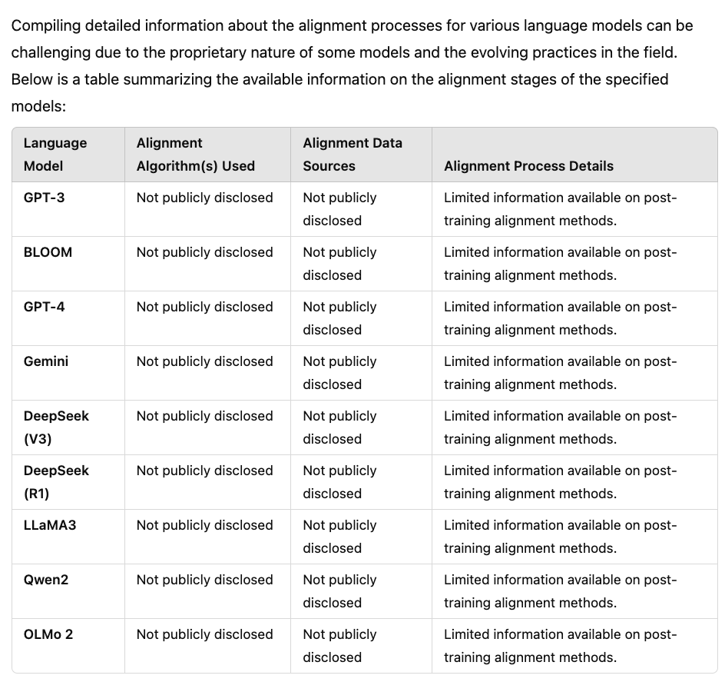
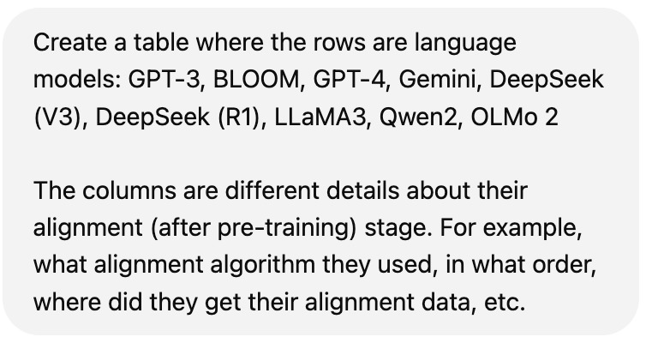
“Perhaps your query is ambiguous/underdefined?”
Better schema
(already given in the prompt) 👍
ChatGPT
There is so much known about these models that are missing!
Example retrieved on 03/13/2025
Notes:
Now, you might say, perhaps you're not being fair to ChatGPT because your prompt is underdefined or perhaps ambiguous.
I don't agree with this but let's be more generous to ChatGPT and offer it more details.
Now, the prompt has more specificity about what rows we want and the kind of columns we're looking for.
Now with this handholding, the table has more rows and has more columns, of course because I said what they're in prompt.
But now the content is not right. Pretty much everything is labeled as "not publicly disclosed," which is not true for most of these models. We know quite a bit about them.
So, the conclusion is that ChatGPT is good as a tabular summarizer of science content.

Slide 8
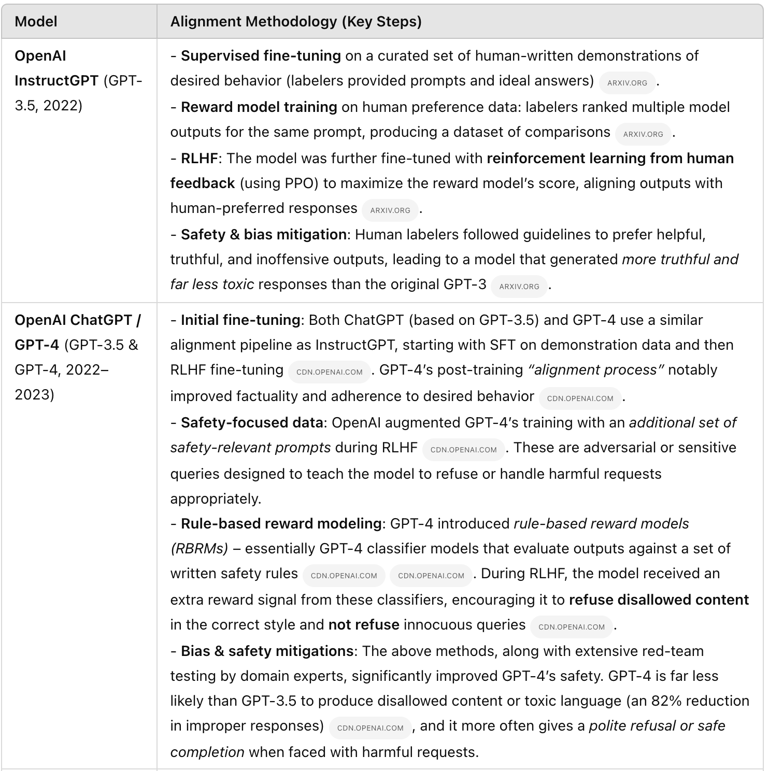
“Wait but did you try OAI ‘Deep Search’???”
ChatGPT Deep Search
(>15 mins)
GPT 3.5 has two rows?
Incorrect information
(precision issues)
Lots of text, not much structure/insight.
Example retrieved on 03/13/2025
Notes:
However, you may use the OpenAI "deep search" feature. And that's a fair question to ask.
I issued my question to ChatGPT DeepSearch. Waited roughly 20 minutes.
And got these results. Evidently more information.
But perhaps too much text, and let's structure. What's the point of using tables if you're going to fill it in with so much text? It's so hard to glean any insights from these results.
Moreover, some information is inaccurate here. The response certain research work from OpenAI (such as rule-based reward modeling), but there is no evidence that they're part of GPT-4's public release. So, these are precision issues.
(and I don't why GPT3 is mentioned in two rows).

Slide 9
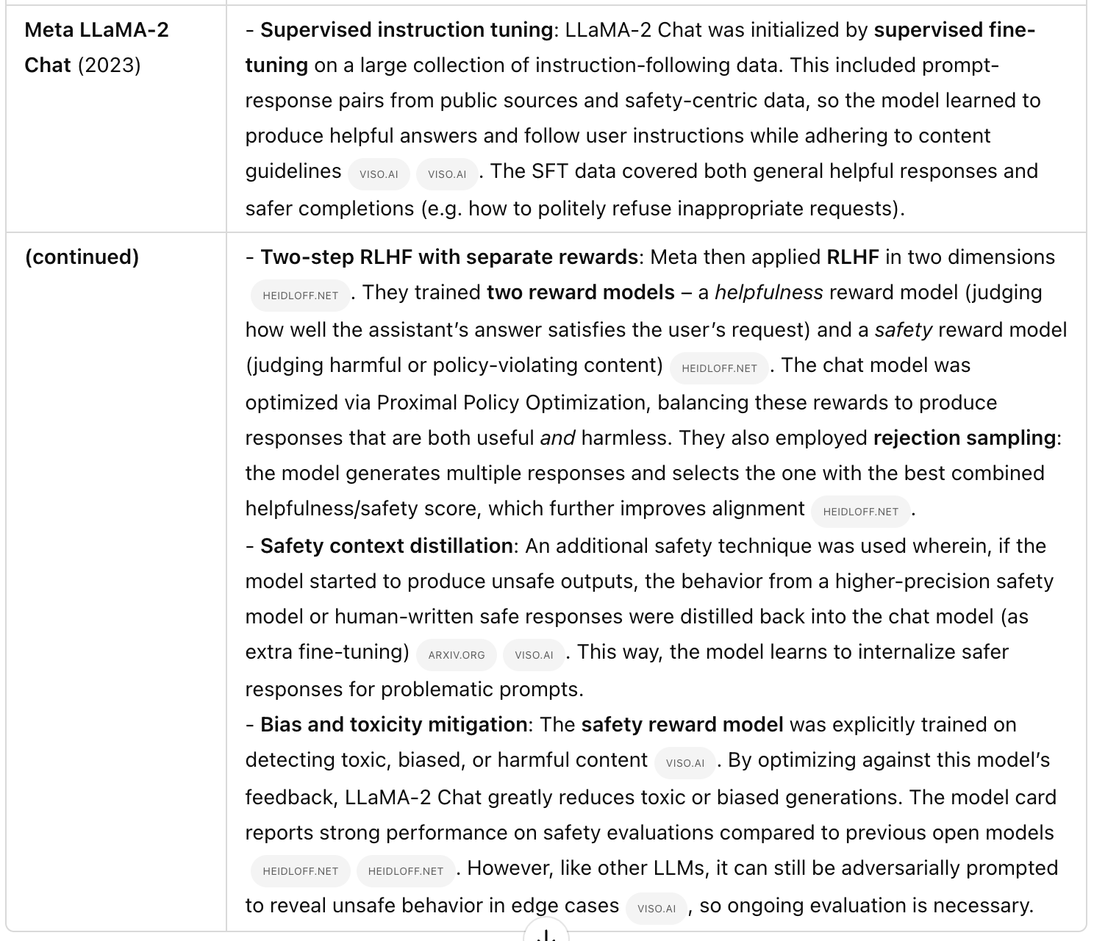
No reference to Llama2 paper itself?
???
ChatGPT Deep Search
(>15 mins)
The table has these models:
GPT-3.5, GPT-4, Claude, Sparrow, LaMDA, LLaMA-2
What about the rest? Recall issue.
Example retrieved on 03/13/2025
Notes:
If I scroll down, you can see results, llama2, but notice that all these citations are to blog posts, not the llama2 paper itself, which shows that the system is not good at identifying important citations, which is crucial for science.
You can also see that the results are missing a lot of important, recent models, which shows the deep search has recall issues as well.
Hopefully by now I have conviced you that even Deep Search does not solve this problem.

Slide 10
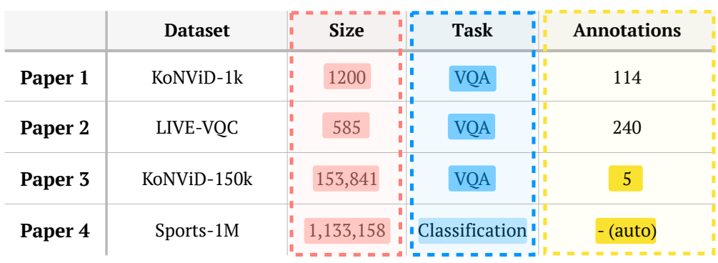
Recent related work: ArxivDigesTables
Newman et al. ArxivDIGESTables: Synthesizing Scientific Literature into Tables using Language Models, EMNLP 2024
Extracted 2.2K tables from existing papers.
The table captions serve as the task prompts.
Rows of the table correspond to individual papers (7K) papers.
We build upon this work by addressing their weaknesses!
Notes:
Before I get to our contribution, I will highlight a recent work that we will build upon.
Specifically, arxivDigestable by Newman et al. released a dataset of tables and captions extracted from existing papers.
Basically, the idea is that we can use table captions as a prompt (input) and try to reconstruct the extracted paper.
We're going to build upon this work and extend it by addressing its weaknesses.

Slide 11
Limitations of prior work
The assumption that papers a carefully curated relevant papers are available.
Table captions are not appropriate task prompts.
Rely on static embedding and human annotation to evaluate generated tables.
Notes:
What are these weaknesses, and how do we improve upon them?

Slide 12

Newman et al. setup:
LLM
processing
Prompt
Too idealistic
Well-curated relevant papers (gold papers)
Tabular summary
Our setup:
Prompt
LLM
processing
Repositories of science: arXiv, Google Scholar, etc.
Potentially
relevant papers
Tabular summary
We build a retrieval engine over papers and identify hard negative candidate papers to make evaluation realistic.
Notes:
To show this visually, their experimental setup assumed that we have access to gold data.
How in reality, as orion discussed earlier, retrieval is difficult. Often there are many distractors.
So, we built a retrieval engine to identify hard negatives and distractor science papers. And augment the evaluation.

Slide 13
Limitations of prior work
The assumption that papers a carefully curated relevant papers are available, is idealistic in realistic scenarios.
Table captions are not appropriate as task prompts.
Rely on static embedding and human annotation to evaluate generated tables.

Slide 14
User Demand vs. Captions
Prompts in prior work [Newman et al.] are table captions.
We replace them with user demand prompts:
  We collect these by careful prompting of LLMs to:
    (1) obtain a more complete prompt while
    (2) avoiding leakage of table schema/values.
Brief and ambiguous
  Comparison of Trajectory and Path Planning Approach
  Generate a table that compares different trajectory and path planning approaches. You can focus on their collision avoidance techniques, benefits, limitations, and applicable scenarios.
Longer and more precise

Slide 15
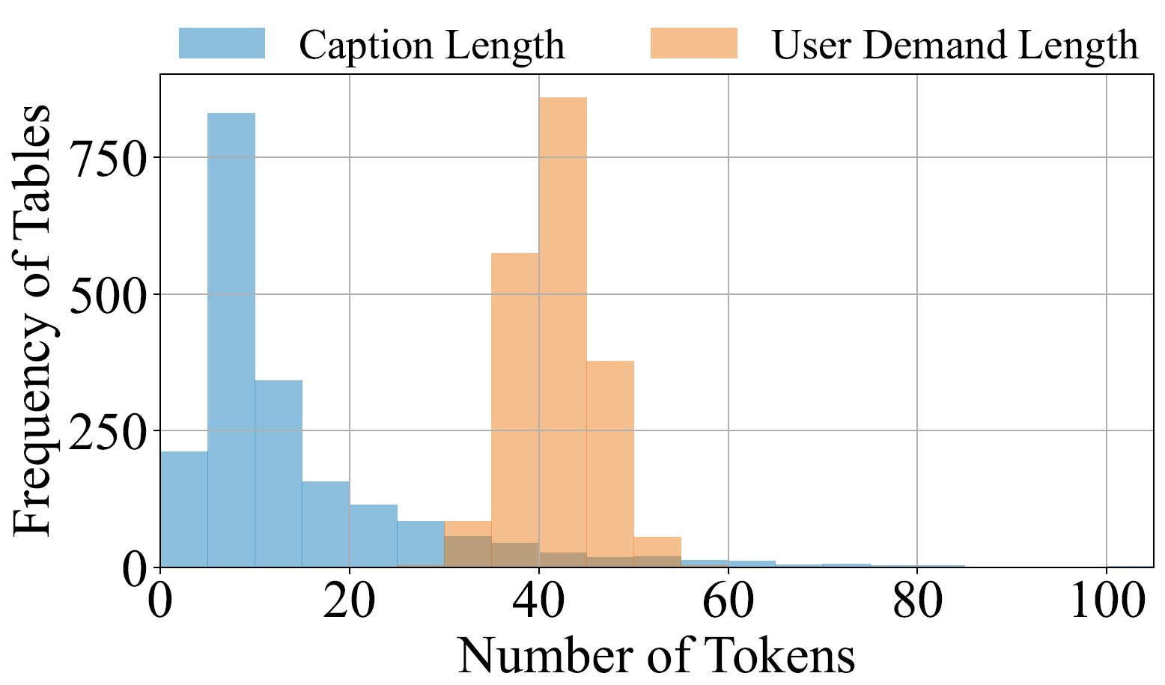
User Demand vs. Captions
Our collected user demands feature longer context, thus including better hints to curate the table.

Slide 16
Limitations of prior work
The assumption that papers a carefully curated relevant papers are available, is idealistic in realistic scenarios.
Table captions are not appropriate as task prompts.
Rely on static embedding and human annotation to evaluate generated tables.

Slide 17
CBFIR Networks | Datasets | Evaluation Metrics | Loss Function
GAN | DARN | Recall@1 | TL, AL
CN-LexNet | Shopping100K | Recall@20 | CL, TL
ResNet-v2 | DeepFashion | Recall@1,10 | BCE Loss
Originally, we have a ground-truth table extracted from a paper
Ground-truth Table
We synthesize QA pairs from the ground-truth table about schema and values
table schema:
Is Dataset included in the table schema?
unary (cell) values:
Is CL, TL the loss function for paper CN-LexNet?
pairwise comparisons:
Is ResNet using more evaluation metrics than GAN?
Then, we ask an LLM to answer these QAs based on the generated table
The ratio of “Correct” indicates the recall.
Correct!
✅
Correct!
✅
Incorrect!
❌
Backbone Model | Losses | Attributes | Datasets
GAN | TL+AL | Shape | DARN Color
CNLexNet | CL+TL | Various | Consumer-to-Shop
ResNet | Landmark | Various | DeepFashion
Then, we have a table that is generated by an LLM
Generated Table

Slide 18
CBFIR Networks | Datasets | Metrics | Loss
GAN | DARN | Recall@1 | TL, AL
CN-LexNet | Shopping100K | Recall@20 | CL, TL
ResNet-v2 | DeepFashion | Recall@1,10 | BCE Loss
Ground-truth Table
table schema:
Is Dataset included in the table schema?
unary (cell) values:
Is CL, TL the loss function for paper CN-LexNet?
pairwise comparisons:
Is ResNet using more evaluation metrics
than GAN?
Questions
The ratio of “correct” indicates the recall.
Correct!
✅
Correct!
✅
Incorrect!
❌
Backbone Model | Losses | Attributes | Datasets
GAN | TL+AL | Shape | DARN Color
CNLexNet | CL+TL | Various | Consumer-to-Shop
ResNet | Landmark | Various | DeepFashion
Generated Table

Slide 19
Backbone Model | Losses | Attributes | Datasets
GAN | TL+AL | Shape | DARN Color
CNLexNet | CL+TL | Various | Consumer-to-Shop
ResNet | Landmark | Various | DeepFashion
Similarly, we can reverse the process by starting with the generated table.
Generated Table
Again, we synthesize QAs based on the generated table.
table schema:
Is Attributes included in the table schema?
unary (cell) values:
Is DARN Color used in GAN?
pairwise comparisons:
Is ResNet using fewer losses than GAN?
The ratio of “Correct” indicates the precision.
But answer them using the ground-truth table.
Incorrect!
❌
Incorrect!
❌
Correct!
✅
CBFIR Networks | Datasets | Evaluation Metrics | Loss Function
GAN | DARN | Recall@1 | TL, AL
CN-LexNet | Shopping100K | Recall@20 | CL, TL
ResNet-v2 | DeepFashion | Recall@1,10 | BCE Loss
And answer QAs using our ground-truth table.
Ground-truth Table

Slide 20
Our released data: arXiv2Table
Expanded version of Newman et al. 2024.
Contains
  2.1K user demand prompts
  2.1K tables (inherited from arXivDigestable).
    Dropped few low-quality tables.
  Each prompt comes with it a set of candidate (distractor + gold) papers.
  Evaluation framework based on utilization.
Dataset will be on arXiv on coming weeks!

Slide 21
We also proposed a new approach
An inference-time algorithm that iteratively digests and organizes papers in tabular form.

Slide 22


Prompt
Candidate Paper Retrieval
Batching
Paper Selection and Table Refinement
Based on the current batch of papers, (1) select papers that match the user demand and (2) update the table based on the selected papers.
Two papers in this batch can be included, one column can be inserted. Updating the table:
……
Model | Data | Loss | Title
… | … | … | …
… | … | … | …
… | … | … | …

Slide 23
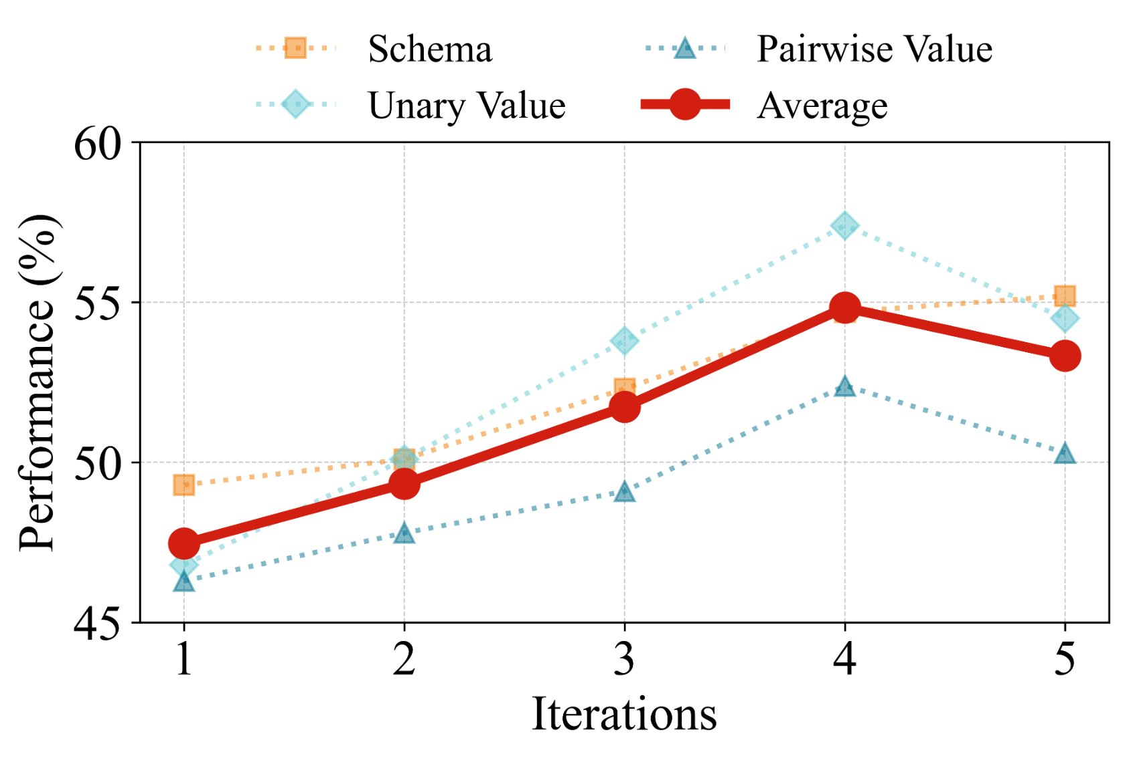
Evaluation vs Number of Iterations
With more iterations, all aspects of the generated tables improves
(up to iter ~4).

Slide 24
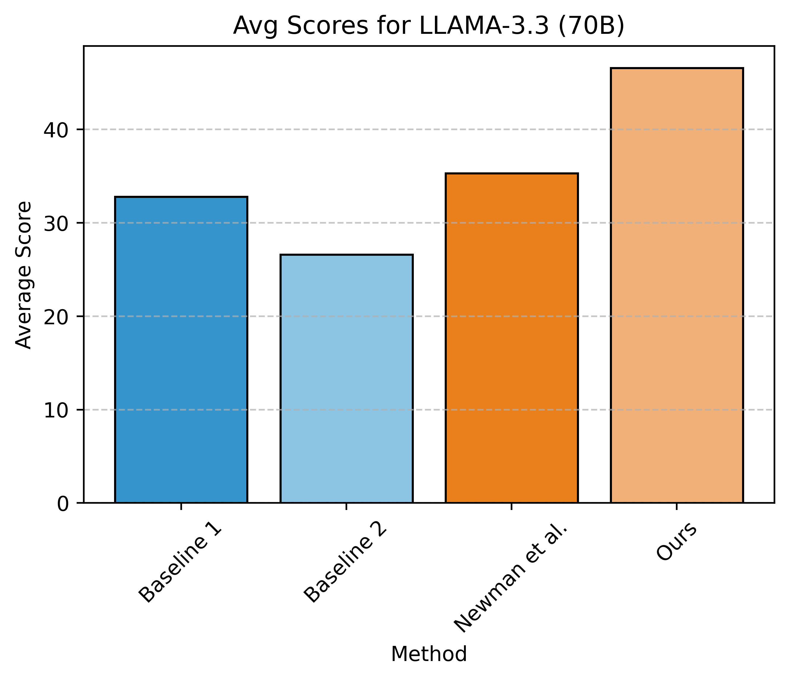
Evaluation of the end-to-end pipeline
Model: Llama 3.3 (70B)
Baseline 1: Read all papers
in one go and write a table.
Baseline 2: Read one paper
at a time and incrementally
form a table.
Newman et al.: Two stages;
define schema in the first round,
then fill in the values.
Our proposed approach outperforms existing results.

Slide 25
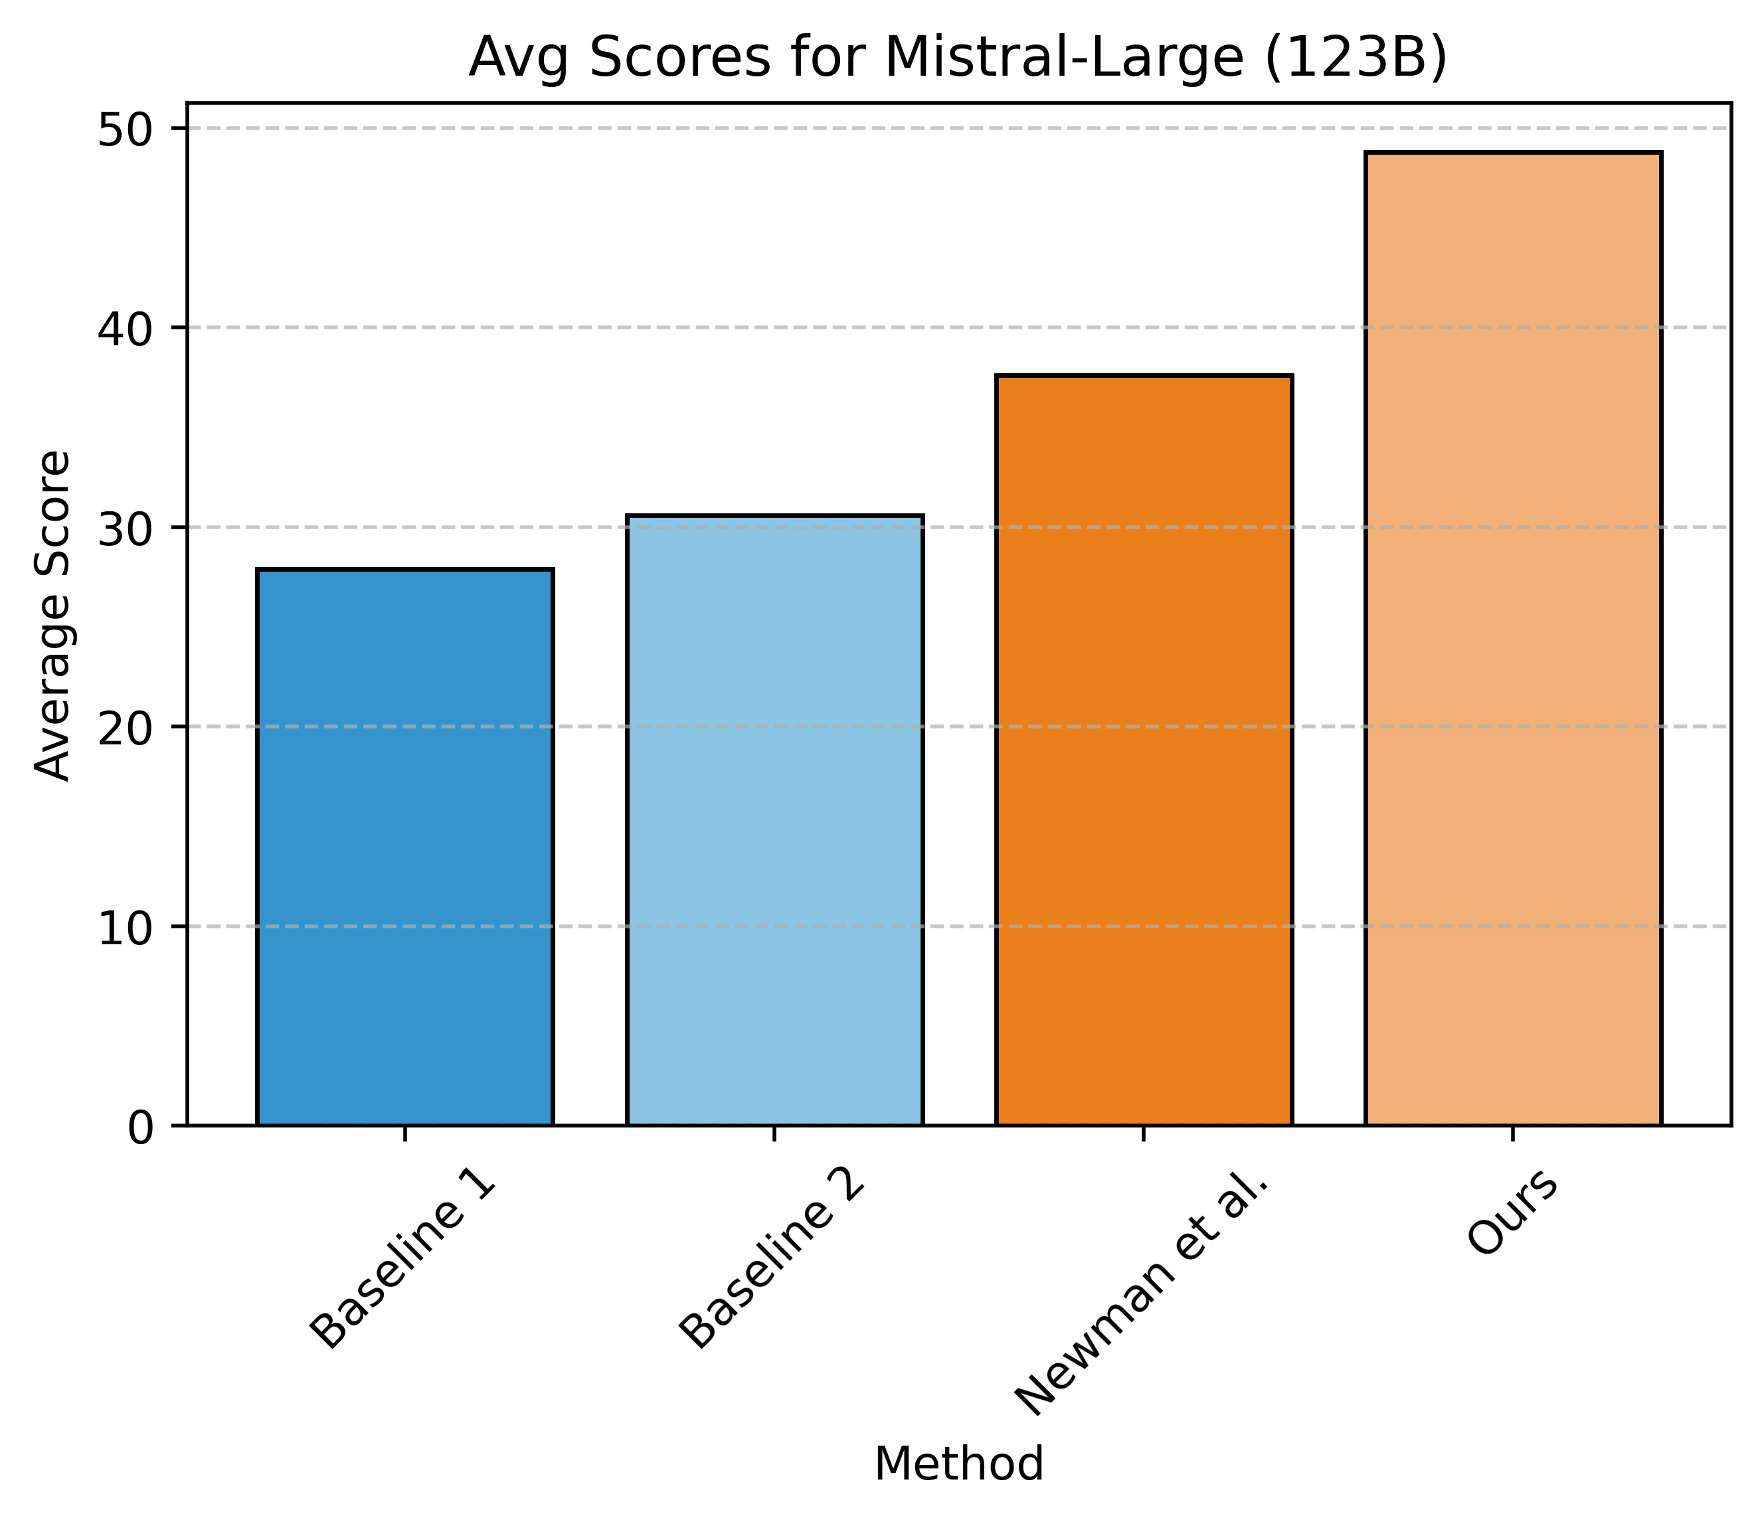
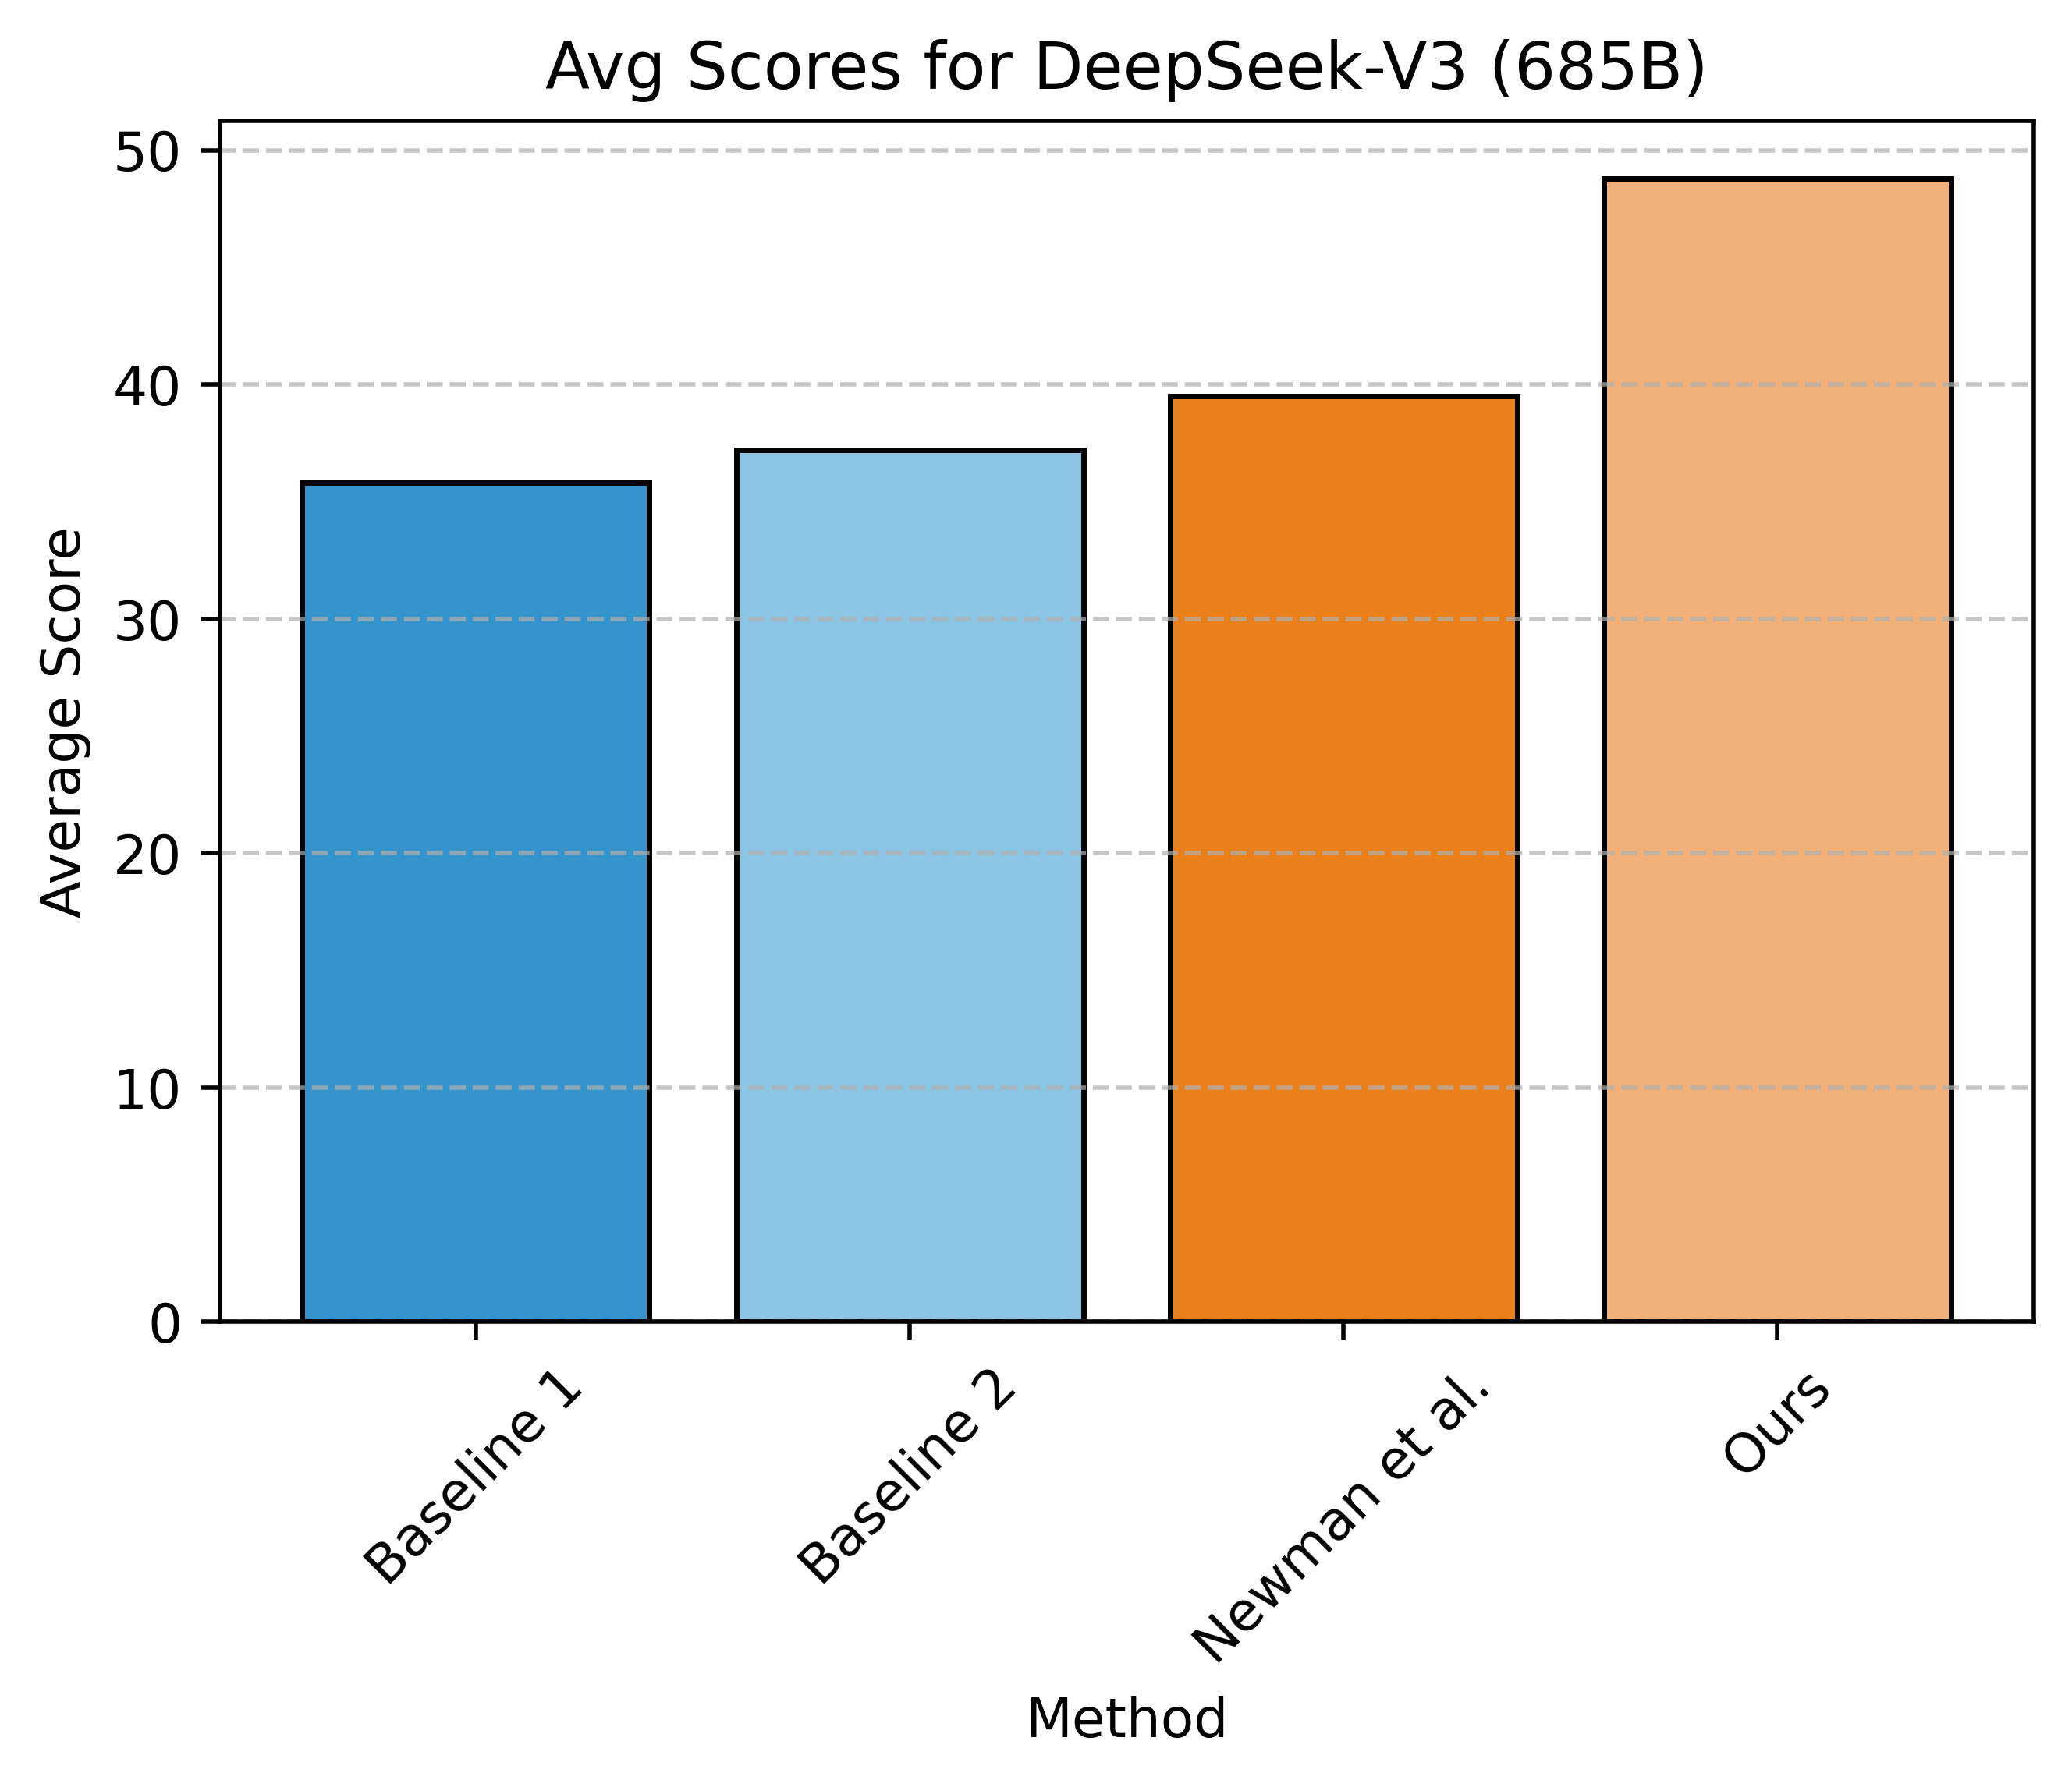
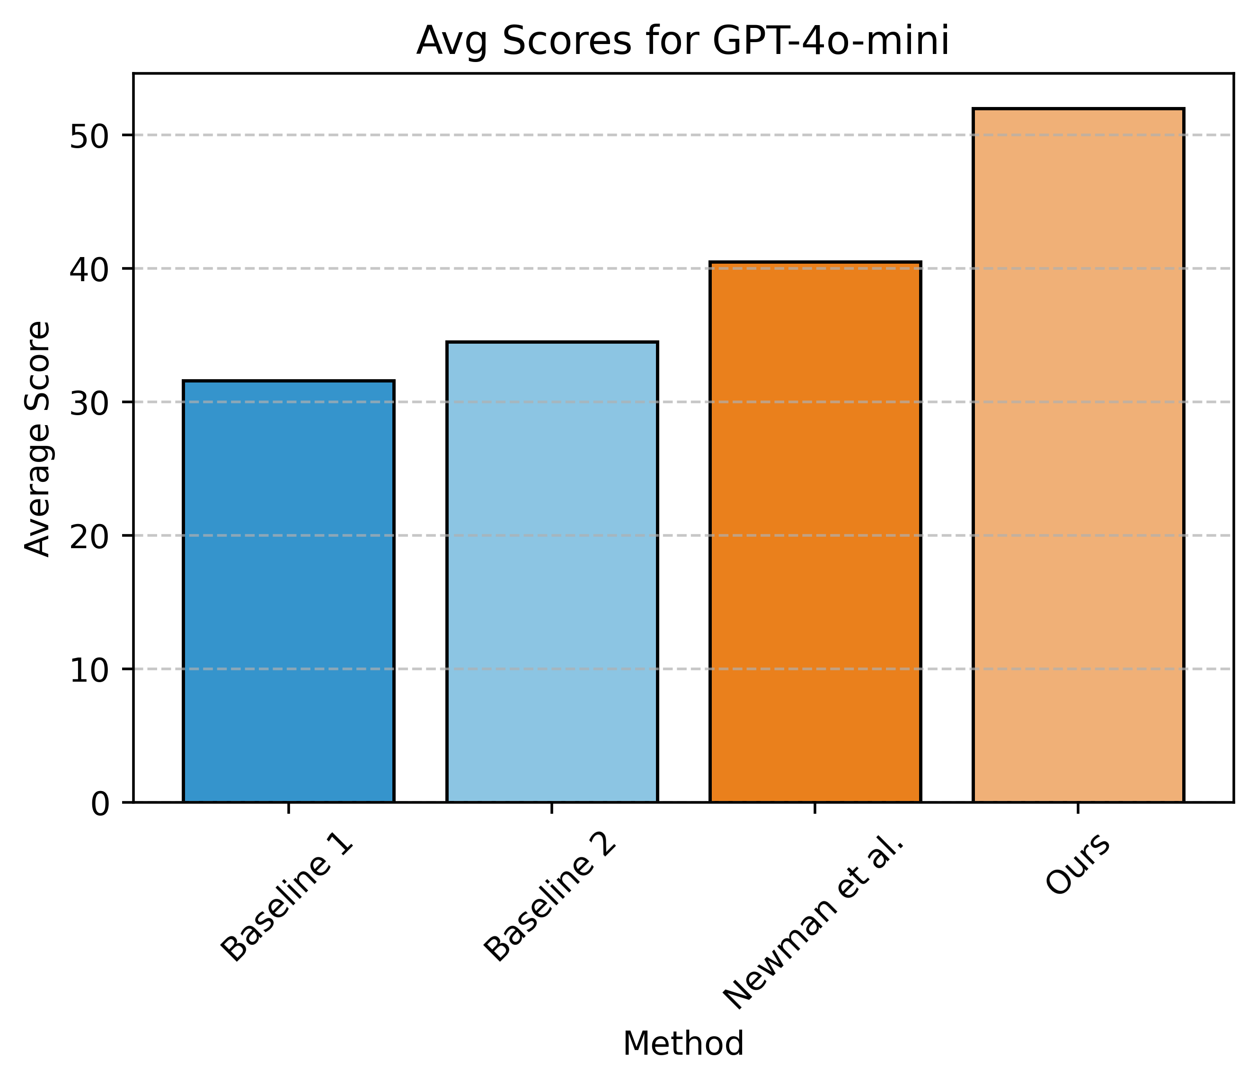
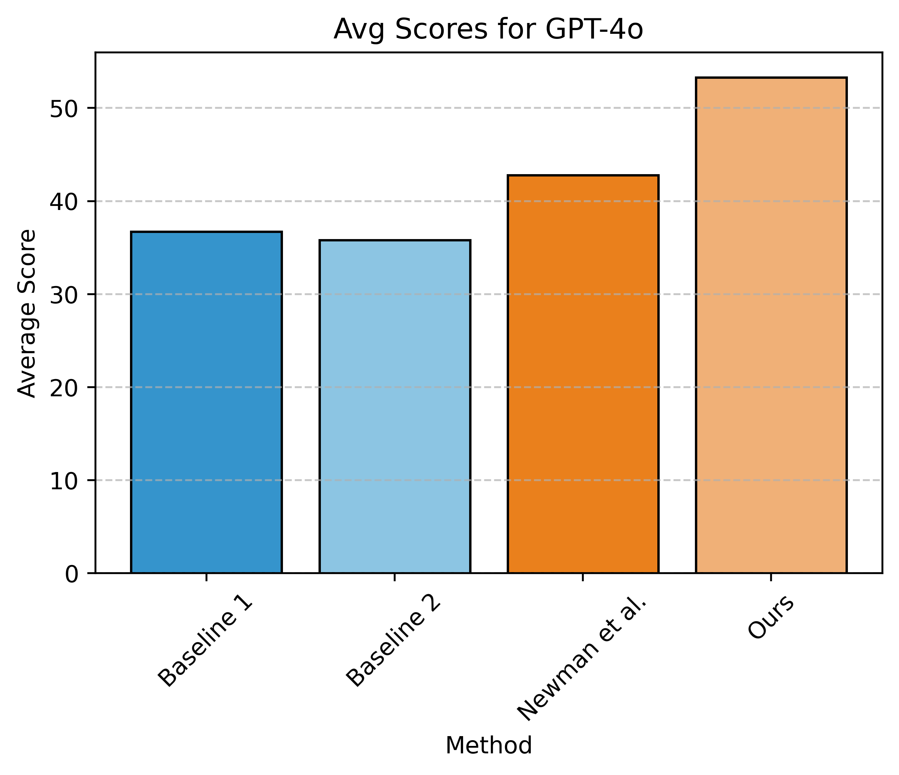
Evaluation of the end-to-end pipeline (other models)
The gains of our approach is consistent across different models.
The task remains challenging for all these approaches.

Slide 26
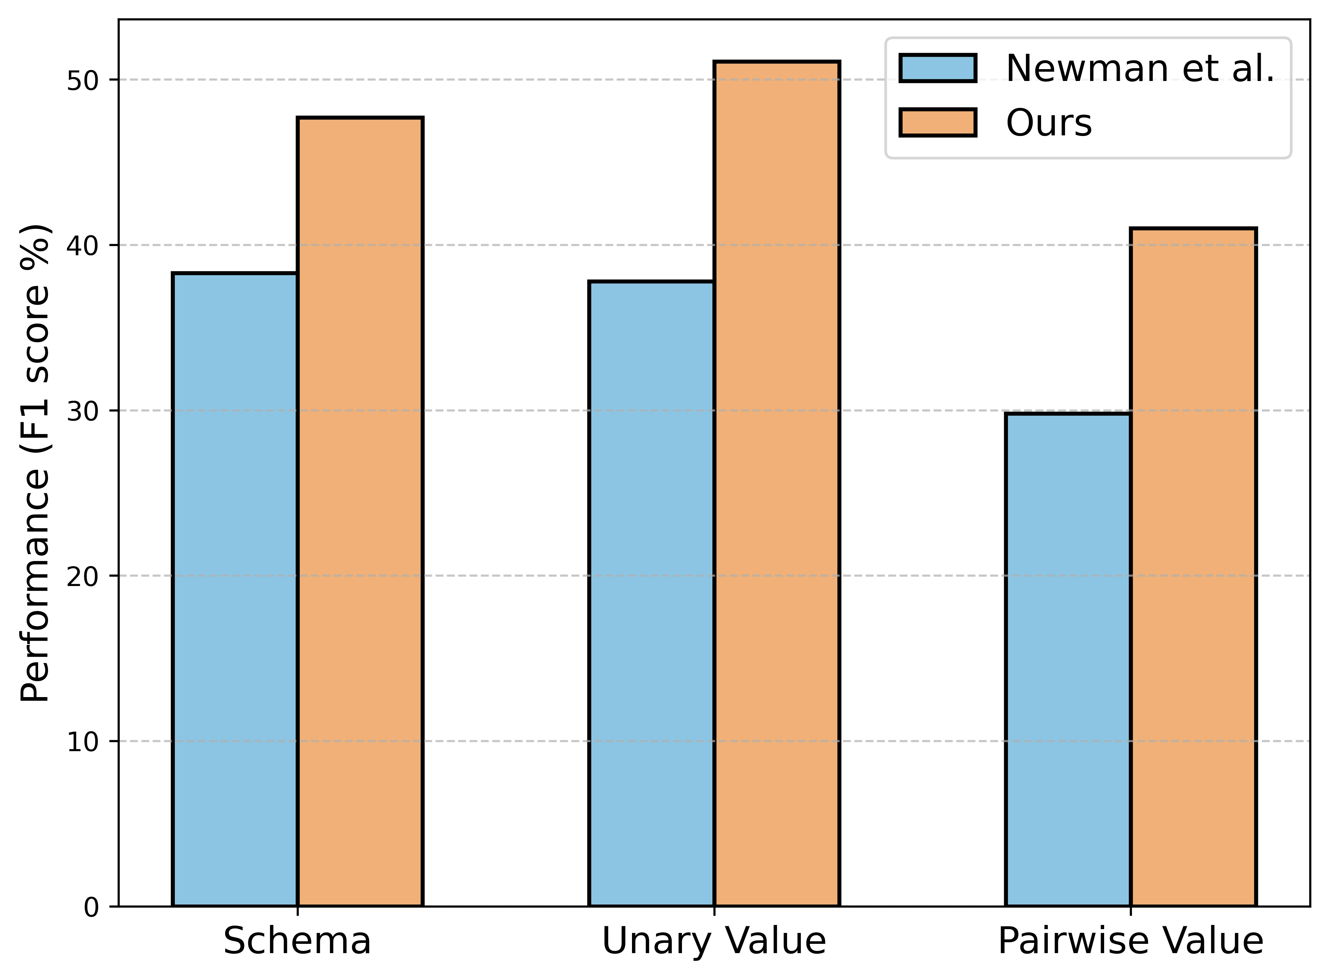
Evaluation of Different Aspects
Different aspects:
  Schema: whether we got the
  right table headings.
  Unary: whether we got the
  cell values.
  Pairwise: whether comparison
  between the cells are found.
Pairwise value comparisons is a more challenging metric than unary values.

Slide 27
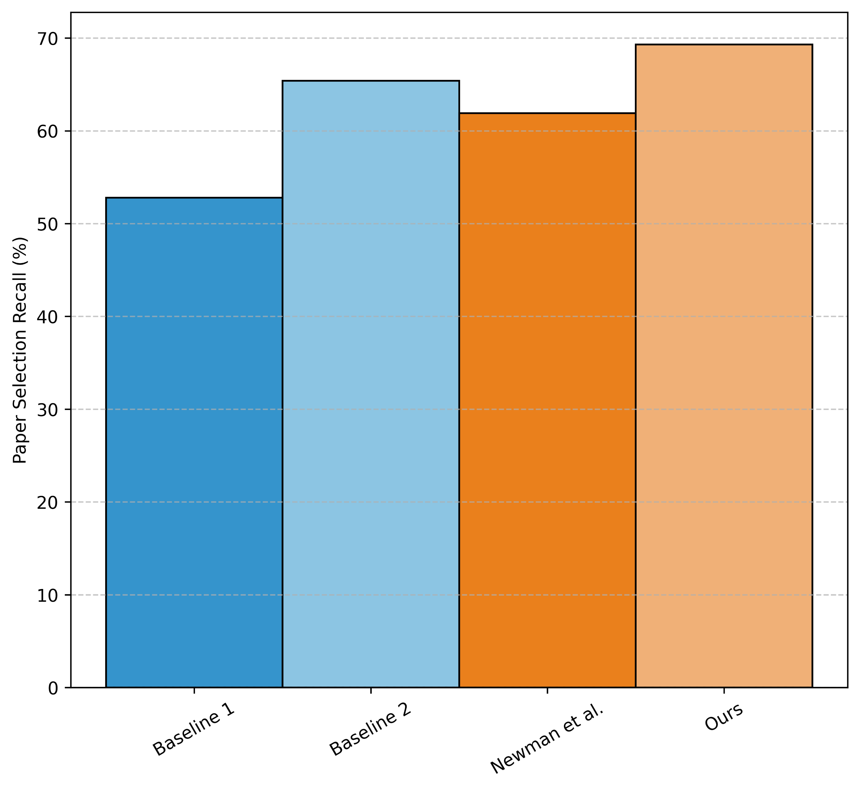
Evaluation of Paper Selection
Selecting relevant papers is difficult for all methods.
Our method is slightly stronger than the best baseline.

Slide 28
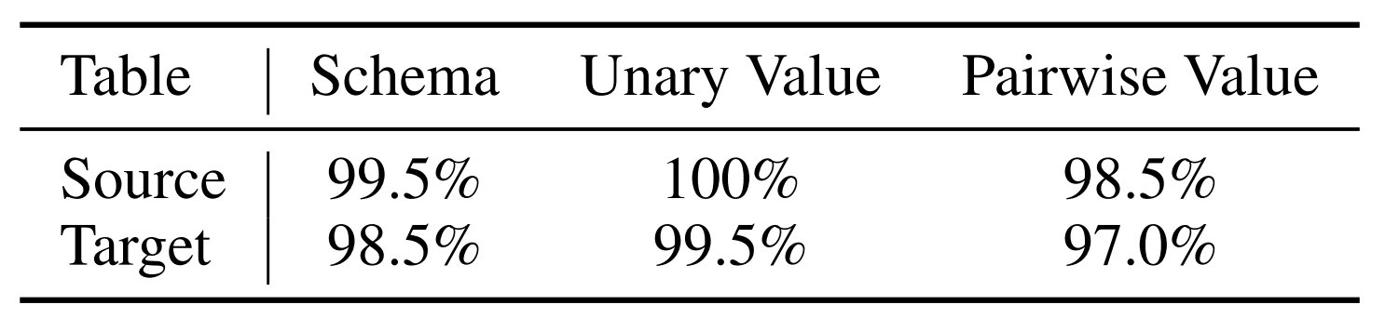
Expert Verification of Our Automatic Evaluation
We annotate a sample of 200 QA pairs to verify that:
  Source: the QA pairs are synthesized correctly from the source table.
  Target: the QA pairs are correctly answered based on the target table.
Our LLM-based evaluation is robust.

Slide 29
Summary and Conclusion
Motivation: A more realistic pipeline for evaluating tabular summarization of science literature.
  Why? Tabular summaries are crucial framework for quickly aggregating and understanding the progress in science.
We introduce arXiv2Table, a framework for evaluating systems for tabular summarization.
We also develop a system to address the challenge posed.
Our benchmark is challenging! Give it a try!! 🚀

