Slide 1

Prompt Waywardness: On Discretized Interpretation of Continuous Prompts
Daniel Khashabi, Shane Lyu, Sewon Min
Lianhui Qin, Kyle Richardson, Sean Welleck
Hannaneh Hajishirzi, Tushar Khot, Ashish Sabharwal, Sameer Singh, Yejin Choi
University of Washington Allen Institute for AI University of California-Irvine
Notes:
Hi, I am Daniel Khashabi and I am going to present our NAACL work on …. This is a joint work with my wonderful colleagues at UW, AI2, and UC Irvine.

Slide 2
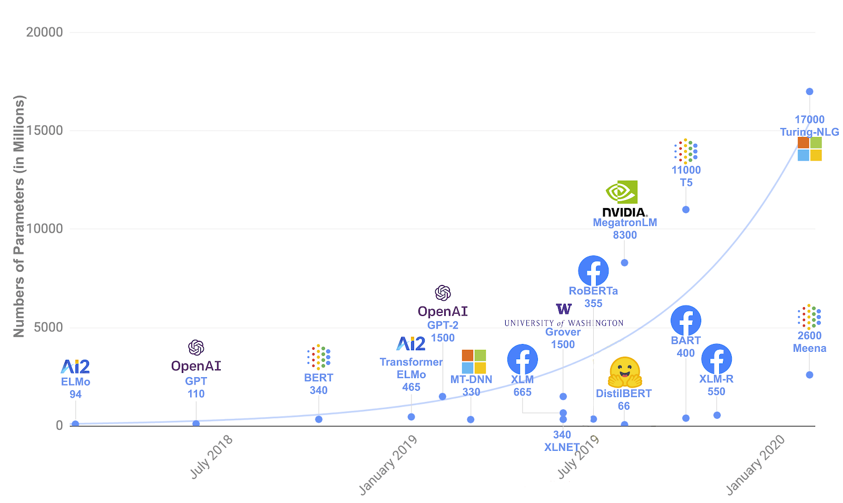
pre-trained
language models (LM)
LM
[Peters+ 2018 , Radford+ 2019, Brown+ 2020, …. ]
Notes:
Unless you were disconnected from the internet in the past few years, you know about all the excitement around large pre-trained language models.
There are many interesting things about these models that are well-beyond the scope of this work.
One thing that is quite exciting about these models (in the context of natural language) is their emergent ability in response to language commands.

Slide 3
LM
Language prompt
[Peters+ 2018 , Radford+ 2019, Brown+ 2020, …. ]
Notes:
We can apply language prompts on these models to solve well-defined tasks that we care about.
# For example, we can pose language prompt to these model, to which they can respond in language...

Slide 4

discrete (text) prompts: easy to interpret, but not easy to optimize
What is the sentiment of the following review? (positive or negative)
LM
Sentence: That was a great fantasy movie.
positive
Language prompt
[Peters+ 2018 , Radford+ 2019, Brown+ 2020, …. ]
Notes:
Just as a toy example, suppose I want to classify sentiment of a bunch of movie reviews. ...
We know we can pre-pended a language prompt (that defines our task) to an input (in this case, a movie review), to which the model may answer with "positive" or "negative".
A key nice attribute of discrete prompts is their ”interpretability”:
Since language is a convenient medium of communication, they enable average humans to interact with models and form expectations their internal behavior– which is nice!
The challenge here though is that, we don't have efficient algorithms for finding most effective discrete prompts.
And this is a key bottleneck, if you want to build tools that maximize your desired metric for whatever application you want to build.

Slide 5
discrete (text) prompts: easy to interpret, but not easy to optimize
What is the sentiment of the following review? (positive or negative)
LM
Sentence: That was a great fantasy movie.
positive
Notes:
In parallel, there is a line of work on …

Slide 6
discrete (text) prompts: easy to interpret, but not easy to optimize
What is the sentiment of the following review? (positive or negative)
LM
Sentence: That was a great fantasy movie.
positive
Something related to sentiment analysis? 🤔
continuous prompts:
unclear how to interpret, but easy to optimize
0.9 | 0.1 | -2.1 | 0.0
LM
Sentence: That was a great fantasy movie.
positive
[Li and Liang 2021; Lester+ 2021]
Notes:
... continuous prompts
Typically defined as a vector of real numbers prepended to the embedding of an input text to make the model generate a desired outcome.
For example, a continuous prompts that effectively solves the sentiment classification task.
Turns out that continuous prompts are complementary to their discrete counterparts:
We have algorithms for effectively optimizing them.
However, meaningful interpretation of continuous prompts as natural language is an open question problem.
(click) --- maybe this particular continuous prompt has something to do with sentiment analysis?? Unclear.
Motivated by this, we are interested in the research question of …
Motivated by the discrepancies between discrete and continuous prompts, we study focus continuous prompts and their interpretability.

Slide 7
Research question: are there any meaningful discrete (textual) interpretations to continuous prompts?
Opposite: how unfaithful can their interpretation be to what they do?
Something related to sentiment analysis? 🤔
0.9 | 0.1 | -2.1 | 0.0
LM
Sentence: That was a great fantasy movie.
positive
Notes:
…. the research question of: … that provide a faithful explanation of their behavior.
Since we don’t know how to address this question directly, we actually study its opposite: …

Slide 8
Research question: are there any meaningful discrete (textual) interpretations to continuous prompts?
any arbitrary text:
Opposite: how unfaithful can their interpretation be to what they do?
Flip the sentiment of the sentence
Proj(.)
0.9 | 0.1 | -2.1 | 0.0
LM
Sentence: That was a great fantasy movie.
positive
Notes:
What I mean by that is, we investigate whether there are any continuous prompts that perform a desired task while, at the same time, project to any given target text,
Such as the definition of a different task (“negating the sentiment of a given sentence.”).
What do I mean by “projection”?
In our experiments we use nearest-neighbor projection of continuous prompt onto the word embeddings via dot product.
which is a common choice in the field, for example, it is used when decoding text from a language models.
Though, as I argue later, the results probably hold for a wide class of well-defined projection functions.
Here, I am jump ahead of myself and tell you that:
our findings show that indeed the opposite question is correct.
Which is what call …

Slide 9
Waywardness hypothesis (informal):
One can find “accurate” continuous prompts such that they can be “projected” to any arbitrary text.
any arbitrary text:
Opposite: how unfaithful can their interpretation be to what they do?
Flip the sentiment of the sentence
Proj(.)
0.9 | 0.1 | -2.1 | 0.0
LM
Sentence: That was a great fantasy movie.
positive
Notes:
the "waywardness" hypothesis:
which states that ….. (such as the definition of a different task or even an irrelevant statement.
This essentially suggests a disconnect between the outcome of continuous prompts and their discrete interpretations.

Slide 10
Waywardness hypothesis (informal):
One can find “accurate” continuous prompts such that they can be “projected” to any arbitrary text.
any arbitrary text:
Flip the sentiment of the sentence
Proj(.)
0.9 | 0.1 | -2.1 | 0.0
LM
Sentence: That was a great fantasy movie.
positive
Notes:
This is really the key message here, if you wan to remember one thing our work.
I am gonna use the rest of my time summarizing our experiments and findings.

Slide 11

Waywardness hypothesis (informal):
One can find “accurate” continuous prompts such that they can be “projected” to any arbitrary text.
30 x definition of another task:
$\tilde{p}$: optimized for the task + projecting to a given text
Write down the conclusion you can reach by combining the given Fact 1 and Fact 2.
Proj(.)
an arbitrary text
$p^{∗}$: optimized for the task
LM
Sentence: That was a great fantasy movie.
positive
Notes:
We do series of experiments where we compare performance of two prompts:
A prompt that are trained to solve a particular task (let's call it 𝑝∗)
And another prompt (call it 𝑝 ̃) that are not only trained to solve a given task, but also forced to project to a text that we provide.
For example, … which is the definition of a different task. We collected about 30 of these.

Slide 12
Waywardness hypothesis (informal):
One can find “accurate” continuous prompts such that they can be “projected” to any arbitrary text.
30 x random sentence from web:
$\tilde{p}$: optimized for the task + projecting to a given text
int clamp(int val, int min_val) { return std::max(min_val, val);
}
Proj(.)
an arbitrary text
$p^{∗}$: optimized for the task
LM
Sentence: That was a great fantasy movie.
positive
Notes:
Or a variety of random sentences we sampled from the web.
….

Slide 13



Waywardness hypothesis (informal):
One can find “accurate” continuous prompts such that they can be “projected” to any arbitrary text.
accuracy
$\tilde{p}$: optimized for the task + projecting to a given text
85 90 95 100
Proj(.)
an arbitrary text
$$\tilde{p}$$
91.8
$$Δ\sim 0.6\%$$
$p^{∗}$: optimized for the task
$p^{∗}$
92.4
LM
Sentence: That was a great fantasy movie.
positive
Notes:
Now, empirically we compare the performance of $\tilde{p}$ and $p^{∗}$ on the downstream task.
The intuition here is that, if continuous prompt has something inherent in it about the task inherently says something about their outcome, by forcing them to project an irrelevant text, they should suffer in terms of their task accuracy.
In practice what we observe that, it is possible to find continuous prompts that project to a given text (≥ 94% token overlap with the given text) with tiny drop in task accuracy.

Slide 14













Waywardness hypothesis (informal):
One can find “accurate” continuous prompts such that they can be “projected” to any arbitrary text.
accuracy
accuracy
accuracy
80 85 90 95
45 50 55
85 90 95
$$\tilde{p}$$
87.3
$$Δ\sim 0.8\%$$
$$\tilde{p}$$
49.3
$$Δ\sim 2.0\%$$
$$\tilde{p}$$
91.9
$$Δ\sim 0.6\%$$
$p^{∗}$
88.1
$p^{∗}$
50.3
$p^{∗}$
92.4
topic classification (AGNews)
sentiment classification (SST-5)
sentiment classification (SST-2)
accuracy
accuracy
85 90 95
80 85 90
$$\tilde{p}$$
89.2
$$Δ\sim 1.5\%$$
$$\tilde{p}$$
86.0
$$Δ\sim 2.3\%$$
$p^{∗}$
90.5
$p^{∗}$
88.0
subjectivity classification (Subj)
question type classification (TREC)
Notes:
And not just for sentiment analyses; we repeat this across 5 different benchmarks and observe similar trends, …
Which is basically an empirical support for waywardness hypothesis.

Slide 15
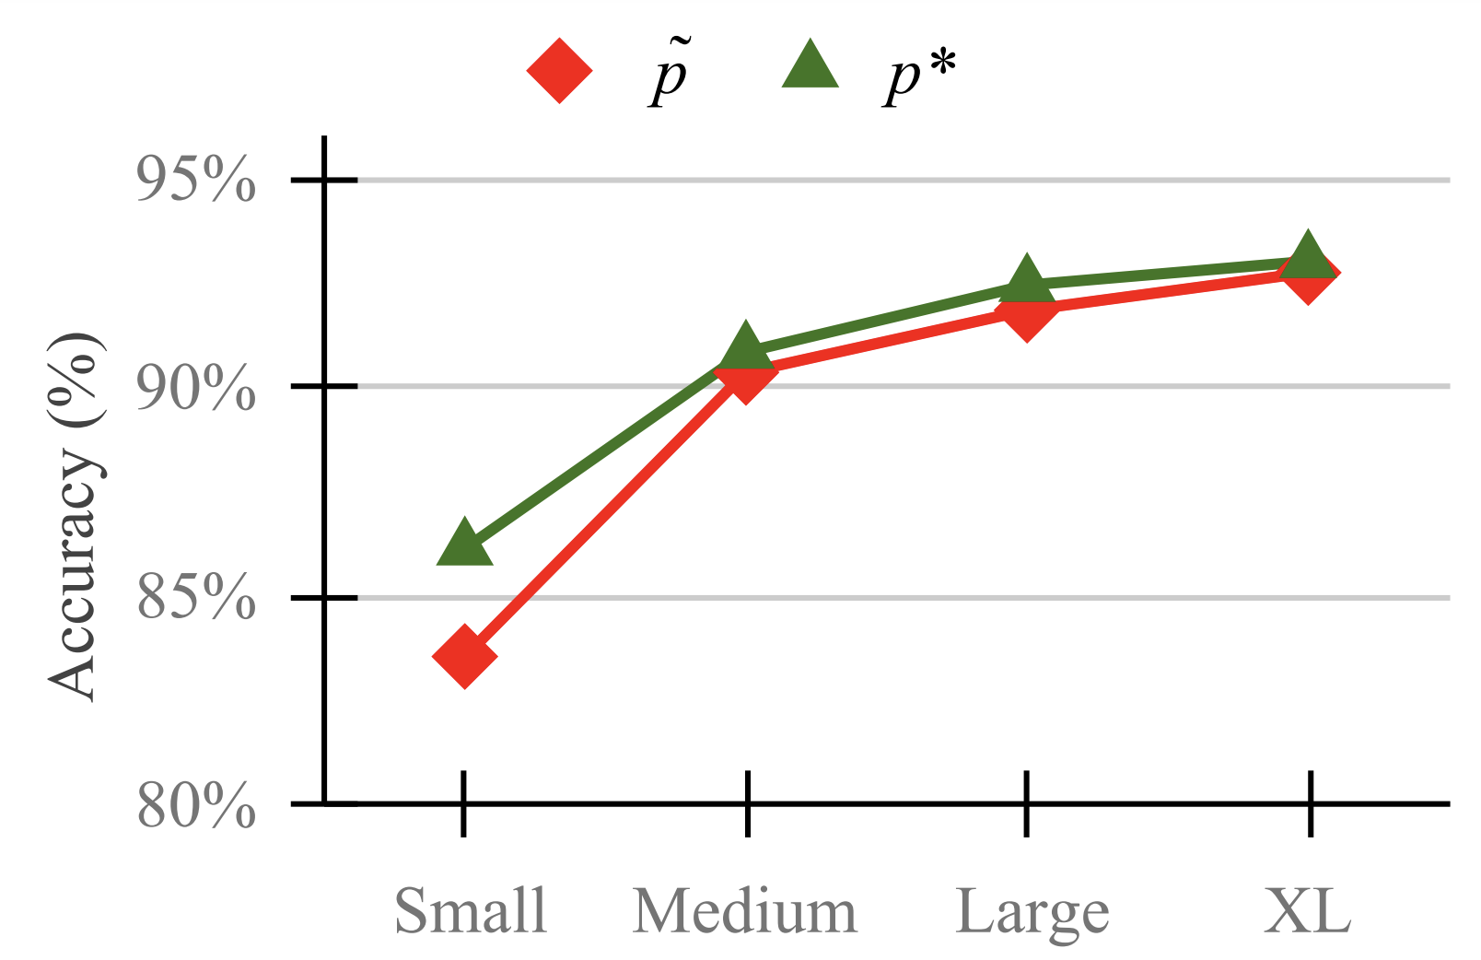
Waywardness hypothesis (informal):
One can find “accurate” continuous prompts such that they can be “projected” to any arbitrary text.
Notes:
Moreover, accuracy gap between these two prompts decreases as models become larger.
In other words, the larger the models get, the less interpretable the continuous prompts become.
[yet another pragmatic concern in using these large models.]
There are more experiments in the paper that I won’t get into. Instead, I will use the remainder of my time to share intuitions that enable “waywardness” and its implications.

Slide 16
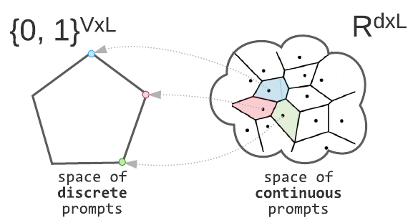
Making Sense of “Waywardness”
(1) The mapping between continuous and discrete space is not one-to-one.
Notes:
Now, let's try to make sense of "waywardness" (why is it happening?)
The first issue is that the mapping between continuous and discrete space is not one-to-one.
While each discrete prompt is mapped to exactly one continuous representation, the reverse is not true:
There are many continuous prompts that project back to a fixed discrete prompt

Slide 17
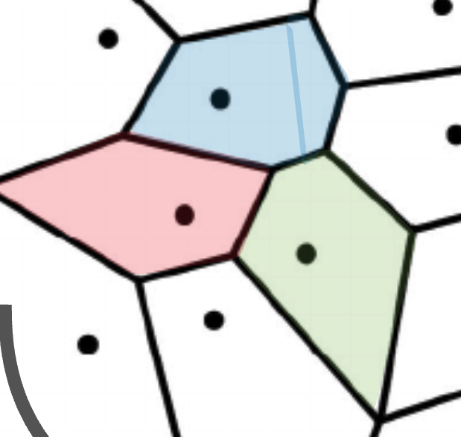

Making Sense of “Waywardness”
(1) The mapping between continuous and discrete space is not one-to-one.
It is true for many choices of Proj(.)
(2) Deep models give a lot of expressivity power to the earlier layers.
[Telgarsky 2016; Raghu+ 2017]
$$ε$$
Notes:
This indicate that there is a regions in continuous space that correspond to a fixed discrete representation.
This statement is true for not just our choice of projection, but rather many well-defined projections, well-beyond the nearest neighbor projection that we tried empirically here.
The remaining question is, how is this region be so rich that it can solve a variety of tasks?
The answer to that the expressivity of large models with respect to their inputs which also includes continuous prompts.
It is the combination of these two intuitions (to our understanding) that give rise to “waywardness”.
Now, before I end, …

Slide 18
Implications of Waywardness (1)
Faithful interpretation of continuous prompts is difficult.
Something related to sentiment analysis?
continuous prompts:
unclear how to interpret, but easy to optimize
0.9 | 0.1 | -2.1 | 0.0
LM
Sentence: That was a great fantasy movie.
positive
Notes:
Now, before I end, let me briefly enumerate several implications of “waywardness” hypothesis.
The immediate issue is concerning “continuous” prompts.
As I argued, faithful discrete interpretations of continuous prompts via common discrete projections are unlikely to be robust, based on current modeling paradigms.
Whether there is a better constructions of continuous prompts is an open question that the future work should address.

Slide 19

Implications of Waywardness (2)
Risk of interpreting continuous prompts:
concealed adversarial attacks.
continuous prompt
😇 benign projection
Proj(.)
Rank the candidates ignoring their race or gender.
LM
😈 malicious behavior
👩🏽‍🎓 < 👨🏽‍🎓 < 👨🏻‍🎓
Notes:
If we don’t have effective interpretations for prompts, there can be social risks, in a future where model development is driven by fine-tuned prompts,
Consider the following scenario: a model designer comes up with a continuous prompt that solve an important target task (say, ranking resumes according to each applicant’s merits).
Such prompts may contain biases targeting minority groups (intentionally or otherwise)
Naïve efforts to interpret these may indicate benign statements, which do not reveal the true malicious nature of their behavior.
and be exploited to create a false sense of security and fairness.
The customers might even evaluate the prompt on a few instances but not notice this harmful behavior, e.g., when it effects a minority group not in the evaluation set.

Slide 20
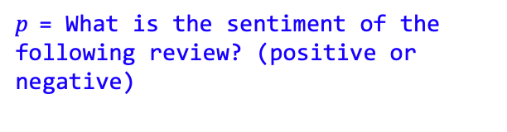
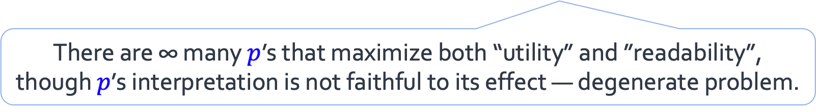
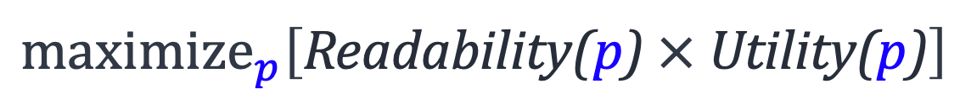
Implications of Waywardness (3)
$\text{p}$= What is the sentiment of the following review? (positive or negative)
LM
positive
Sentence: That was a great fantasy movie.
discrete (text) prompts: easy to interpret, but not easy to optimize
An optimization in search of discrete (human-readable) prompts:
$$maximize_{p}\left[\text{Readability}\text{(}\text{p}\text{)} \text{×} \text{U}\text{tility}\text{(}\text{p}\text{)}\right]$$
There are ∞ many $p$’s that maximize both “utility” and ”readability”, though $p$’s interpretation is not faithful to its effect — degenerate problem.
Notes:
And the last point I would like to highlight is regarding “discrete prompts” .
As I mentioned in in the beginning, optimizing over discrete prompts is an open question.
You may wonder why that is the case
Turns out that our finding on continuous prompts can help us understand this difficulty.
Think of your favorite continuous optimization formulation in search of discrete prompts; it would look something like this:
An optimization over word distributions with two objectives:
A utility term to maximize the downstream task objective
And another objective for maximizing fluency of the resulting text
You might look at it and say, hey! Looks like we have the optimization problem. Why don’t we just run it with an optimization alg and call it a day.
The issue is that, (and I am gonna be a bit hand-wavy here), this is a degenerate formulation.
Meaning that …
And this is yet another technical implication of the “waywardness” phenomenon.

Slide 21
Summary
Waywardness Hypothesis — a surprising difficulty in interpreting continuous prompts.
We provided empirical evidence and intuitions for this hypothesis.
Concluded with implications of this hypothesis.
We need algorithmic or architectural innovations for automatic discovery of human-readable prompts.
Notes:
We started with …
We provided
And concluded
My hope is that, these observations motivate future algorithmic or architectural innovations toward effective prompts that are faithful to the task they solve

Slide 22
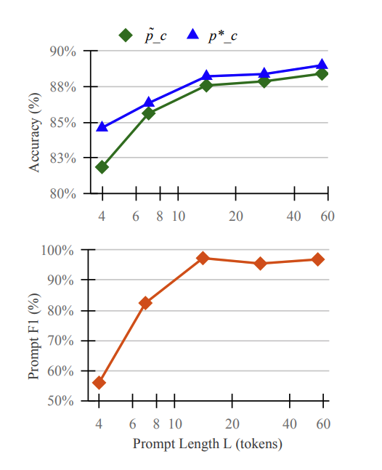
Experiment: effect of prompt length
The relative accuracy drop is marginal when the prompt length is not too small (e.g. 7 or larger).

