Slide 1
Mapping of Suicide Attacks in Pakistan
Group Members
Moeez Abdullah
Danyal Bin Taufiq Tahir
Mukarrama Anwar
Muhammad Ibrahim Khan

Slide 2
Contents
Motivation
Introduction
Methodology
Output
Recommendations

Slide 3
Motivation
Terrorism in Pakistan has become a major and highly destructive phenomenon in recent years.
A total of fatalities around 60,000+ have been recorded as a result of terrorist attacks from years 2000-2018.
The war against terror has caused a loss of more than $60 billion through years.
Suicide attacks are the most common way of terrorism used by terrorists around the world.

Slide 4
Introduction
A plug-in developed which maps suicide attacks in Pakistan, using data obtained from Kaggle.
Demographic mapping is a way of using GIS mapping to show data on population characteristics by region.
The data has attributes of blast’s location, date, target, deaths and injured etc.

Slide 5
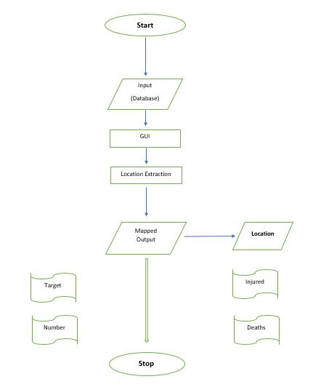
Methodology

Slide 6
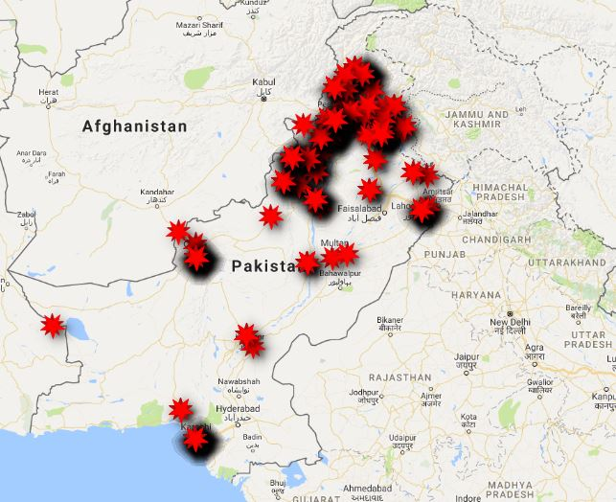
Output

Slide 7
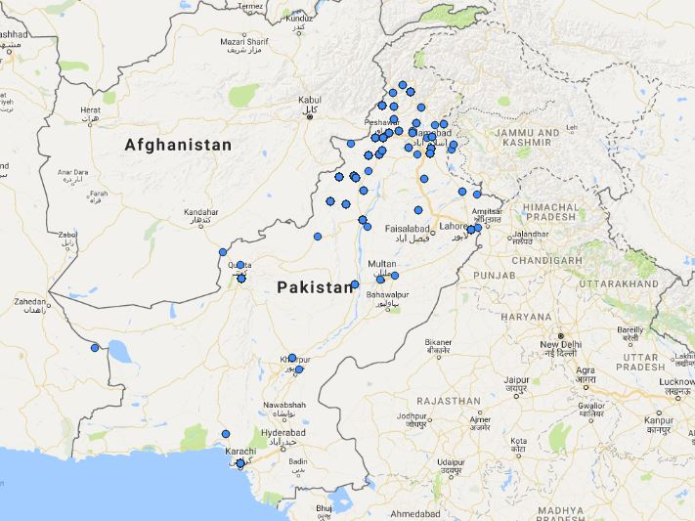

Slide 8
Recommendations
The plug-in can be used for further development of the project, for better safety measures.
The results can be provided to national institutions as an information for policy making in war against terrorism.
Moreover, these results can be further developed into a suicide attacks prediction algorithm to identify the next probable suicide attack’s location.
That can help make better rules and more focus on expected targets and locations.
These recommendations followed can result into a Government level Policy to counter terrorism.

Slide 9
Thank you.

Slide 10
References
http://www.satp.org/satporgtp/countries/pakistan/database/casualties.htm
https://www.betterevaluation.org/en/evaluation-options/DemographicMapping

