Slide 1
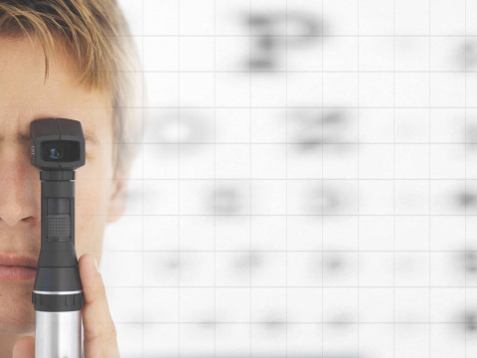
Diabetic Retinopathy
Classifiation
Presented by-
Ayush Goel
Apoorv Gaurav Agarwal
CSE-IV

Slide 2
INTRODUCTION

Slide 3
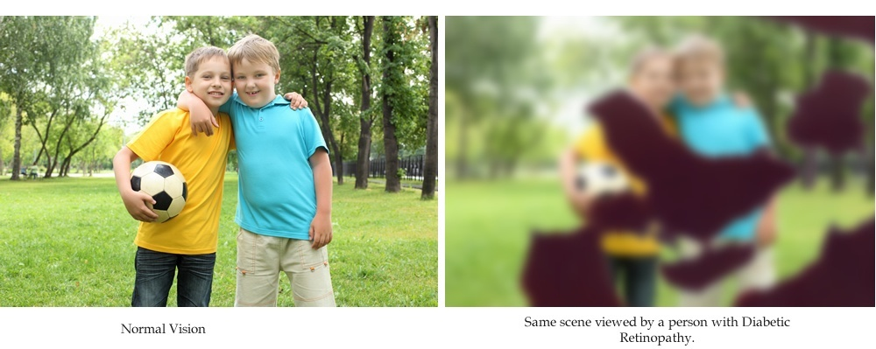

Slide 4
DR Detection

Slide 5
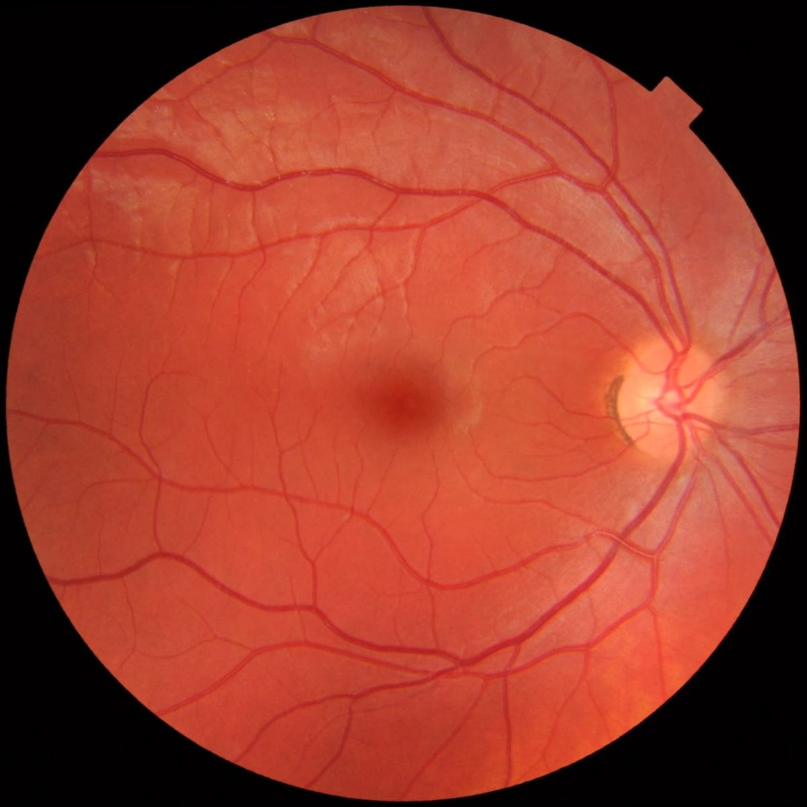
Digital Color Fundus Image of Retina

Slide 6
Machine Learning
vs
Normal Programming

Slide 7
Past works-
Accurate upto 86-88%

Slide 8
Dataset

Slide 9
Machine Learning
Model

Slide 10
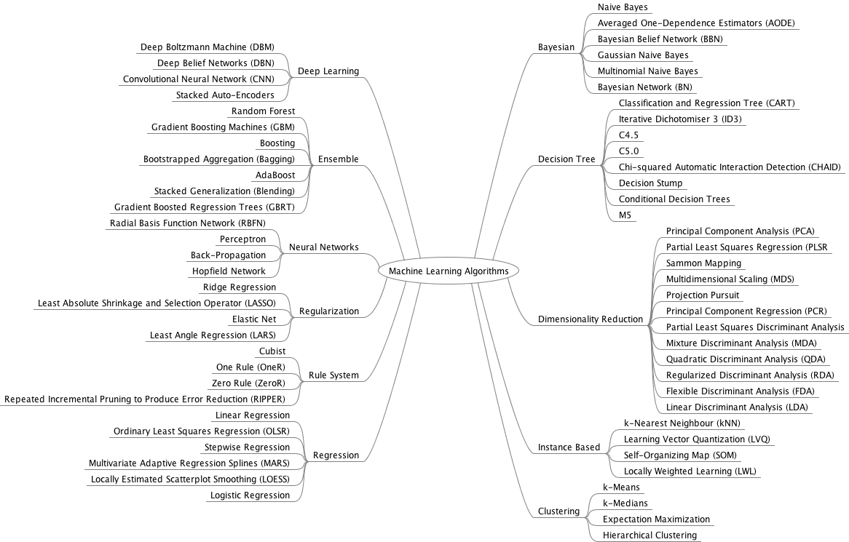

Slide 11
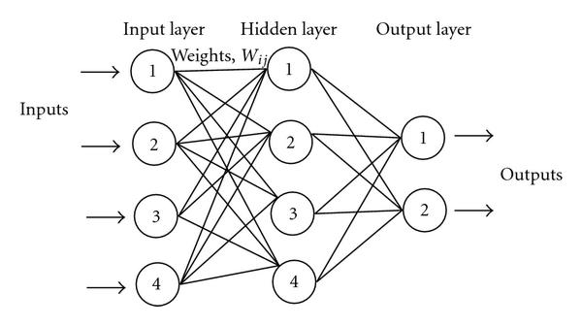
Neural Network

Slide 12
Neural Network
Architecture

Slide 13
No. of Layers and Nodes

Slide 14
Backpropagation Algorithm
Feed-forward computation
Back propagation to outer layer
Back propagation to hidden layer
Weight updates

Slide 15
Setting up of Weights

Slide 16
Learning Rate

Slide 17
Activation Function
Sigmoidal
Linear

Slide 18
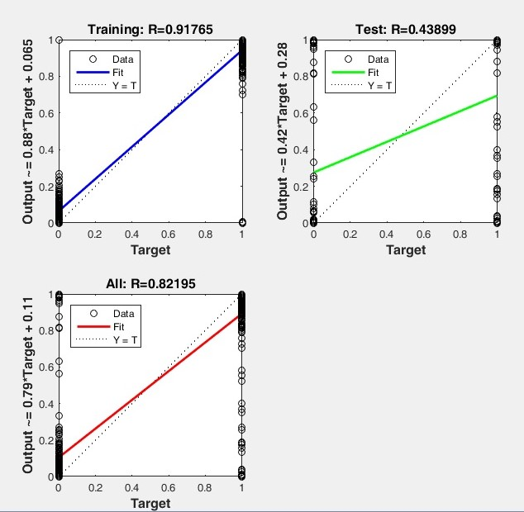
Result

Slide 19
Conclusion

