Slide 1
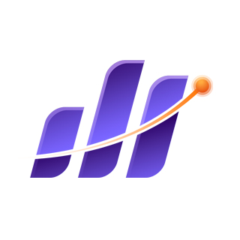
Bluestock Mutual Fund Analytics Platform
Final Capstone Project Presentation
Empowering Data Driven Investment Decisions
Bluestock Fintech

Slide 2
The Challenge
Fragmented mutual fund data across disparate sources.
Difficulty in calculating complex risk adjusted metrics at scale.
Lack of centralized, interactive reporting for stakeholders.
Need for deeper insights into investor behavior and risk exposure.

Slide 3
Project Objectives
Data Engineering: Build a robust, automated ETL pipeline.
Data Warehousing: Design an optimized SQLite Star Schema.
Analytics: Calculate advanced KPIs (Sharpe, Alpha, VaR).
Visualization: Deliver an interactive Power BI dashboard.

Slide 4
Comprehensive Data Integration
Market Data: NAV history, AUM, Benchmark indices.
Fund Metadata: Fund master, Scheme categorizations.
Inflows: Monthly SIP data, Category wise inflows.
Behavioural Data: Investor transactions, Folio counts.

Slide 5
System Architecture
Extract: Pandas used for reading CSV/Excel.
Transform: Cleaning, forward filling weekend NAVs, outlier detection.
Load: SQLAlchemy into SQLite (`dim_fund`, `fact_nav`, etc.).
Automated Execution: Single entry point via `run_pipeline.py`.

Slide 6
Exploratory Data Analysis
Exponential growth in monthly SIP contributions.
Equity funds dominate Total AUM.
Significant rise in Tier 2 city folio creation.
Market volatility directly impacts lump sum inflows, while SIPs remain stable.

Slide 7
Measuring Returns
CAGR: Calculated for 1Y, 3Y, 5Y horizons.
Sharpe & Sortino Ratios: Evaluating risk adjusted performance.
Alpha & Beta: Measuring benchmark outperformance and market volatility.
Results exported to `alpha_beta.csv` and `fund_scorecard.csv`.

Slide 8
Risk & Behavioral Modeling
Value at Risk (VaR) & CVaR: Quantifying tail risk and potential downside.
Portfolio Concentration: HHI analysis (`sector_hhi.csv`).
Cohort Analysis: Tracking investor retention (`cohort_analysis.csv`).
Recommendation Engine: Content based fund matching system.

Slide 9
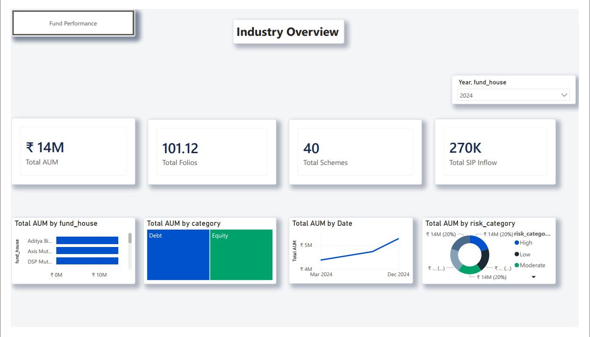
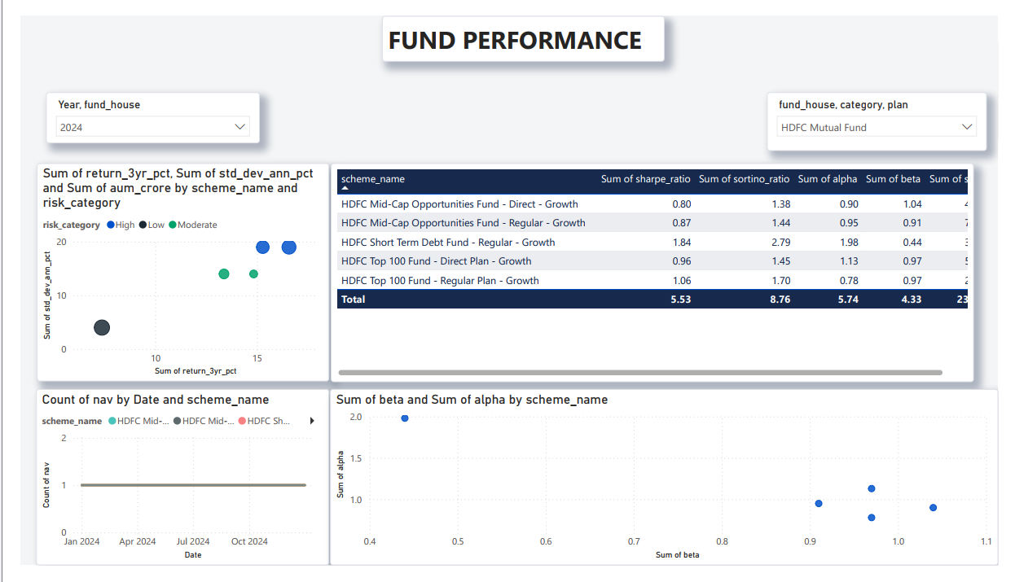
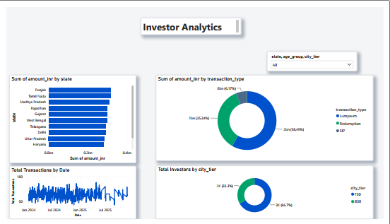
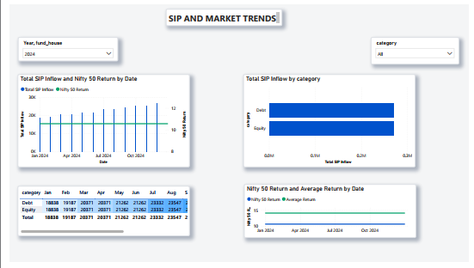
Interactive Power BI Dashboard

Slide 10
Page 1: Industry Overview (Macro trends, AUM).
Page 2: Fund Performance (Drill down into specific schemes).
Page 3: Investor Analytics (Demographics and transaction behaviors).
Page 4: SIP & Market Trends (Inflow consistency).

Slide 11
Insights & Strategy
Finding: Mid cap funds show high Alpha but severe CVaR tail risk.
Recommendation: Utilize hybrid funds for better downside protection.
Finding: High HHI scores in thematic funds indicate concentration risk.
Recommendation: Monitor portfolio diversification actively.

Slide 12
Conclusion
Project delivered on time, meeting all requirements.
Thank you for your time. The platform is fully operational and sets the foundation for future expansions like real-time data integration.

