Slide 1
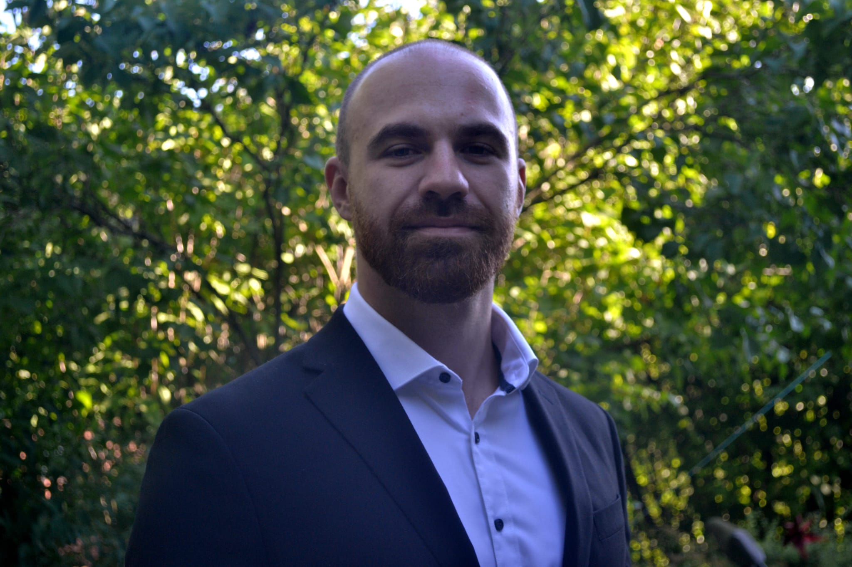

Kandidat dummy1
ML Engineering Specialist
H&PS company, DWH Project / ML Project (Jun 2022 – now) – Frontend Lead
DWH:
Coordination and performing frontend activities over multiple Tableau topics
Project estimations, time & cost planning
ML:
Building Tableau & Kibana dashboards: live monitoring input events / log monitoring
Analyzing python code / testing ML use cases
Project documentation: test cases, client requirements, system design etc.
H&PS company, DWH Project (Jan 2020 – Jun 2022) – Frontend Lead
Finding effective frontend solutions / concept & design
Leading Tableau development teams, agile working
H&PS company, DWH Project (Jul 2018 – Jan 2020) – Frontend Developer
Developing and maintaining Tableau dashboards
Tableau Server user management
Kandidat dummy1
Düsseldorf, Germany
Kandidat_dummy1@accenture.com
Kandidat dummy1 is employed as a ML engineering specialist by Accenture Data & AI Department.
She joined Accenture in February 2018. After successful completion of the big data jump start training, she focused primarily on visual data analytics with Tableau based on Teradata & Oracle databases.
Prior to Accenture, She gained experience in mathematical programming and advanced statistics, working as a scientific assistant at the University.
She holds a Master’s degree in Mathematics specialized in optimization from HHU Düsseldorf.
  Certified Tableau Consultant
  Teradata, Oracle, SQL, GitLab
  Elastic, Kibana, Splunk, Linux, JIRA
  MATLAB, R, Python
  Scrum Master (PSMI), PRINCE2
  Help and Public Services
  Research & Development
  German
  English
  Russian

