Slide 1

UNIVERSITY OF BOLOGNA
Physics-Informed Neural Networks
for Classical PDEs and ODEs
Damped Oscillator · Burgers' Equation · Fisher–KPP Equation
Three PINN case studies — forward & inverse problems, extrapolation, and hyperparameter tuning — with primary focus on the Fisher–KPP reaction-diffusion equation
Presented by
Danyial Munir
Submitted to Professor — University of Bologna
1

Slide 2







Agenda
01
02
Repository Overview
Damped Oscillator
Three PINN projects, one shared codebase pattern
Linear 2nd-order ODE — mass-spring-damper system
03
04
Burgers' Equation
Fisher–KPP Equation
Nonlinear advection-diffusion & shock formation
Reaction-diffusion traveling wave (main focus)
05
06
Fisher–KPP Inverse Problem
Fisher–KPP Extended Experiments
Recovering D and r from noisy observations
Ablation, D/r sweep, blind extrapolation, Optuna
07
08
Cross-Project Comparison
Conclusion
Shared PINN methodology across all three equations
Key findings and takeaways
PINN Solutions to Classical PDEs & ODEs — Damped Oscillator · Burgers' Equation · Fisher–KPP
2

Slide 3
Repository Overview
Three independent PINN projects sharing one architectural pattern
Damped Oscillator
Burgers' Equation
Fisher–KPP Equation
m y'' + c y' + k y = 0
u_t + u u_x = ν u_xx
u_t = D u_xx + r u(1−u)
Linear 2nd-order ODE — under/over/critically damped regimes
Nonlinear advection-diffusion PDE — shockwave formation
Reaction-diffusion PDE — traveling wave front (this talk's focus)
Shared structure across all three: config.py · model.py · losses.py · trainer.py · plot.py · analytic.py · scripts/ · tests/
PINN Solutions to Classical PDEs & ODEs — Damped Oscillator · Burgers' Equation · Fisher–KPP
3

Slide 4
Setup & Method
Project 1
Default parameters
m=1.0, c=0.5, k=4.0 (ζ=0.125, underdamped)
Damped Oscillator
Initial conditions
y(0)=1.0, y'(0)=0.0
Network
5 hidden layers × 64 units, Tanh, input = t only
m y'' + c y' + k y = 0
Physics loss
residual = m y'' + c y' + k y (2nd-order autograd)
Domain split
t_dom=6s (training) → t_extrap=10s (extrapolation)
Classical linear 2nd-order ODE for a mass-spring-damper system.
Damping ratio ζ = c / (2√(mk)) sets the regime: underdamped, critically damped, or overdamped.
Data
15 noisy observations, σ=0.05, 500 collocation points
Optimizer
Adam, lr=5e-3, StepLR, 30000 epochs, early stop
PINN Solutions to Classical PDEs & ODEs — Damped Oscillator · Burgers' Equation · Fisher–KPP
4

Slide 5
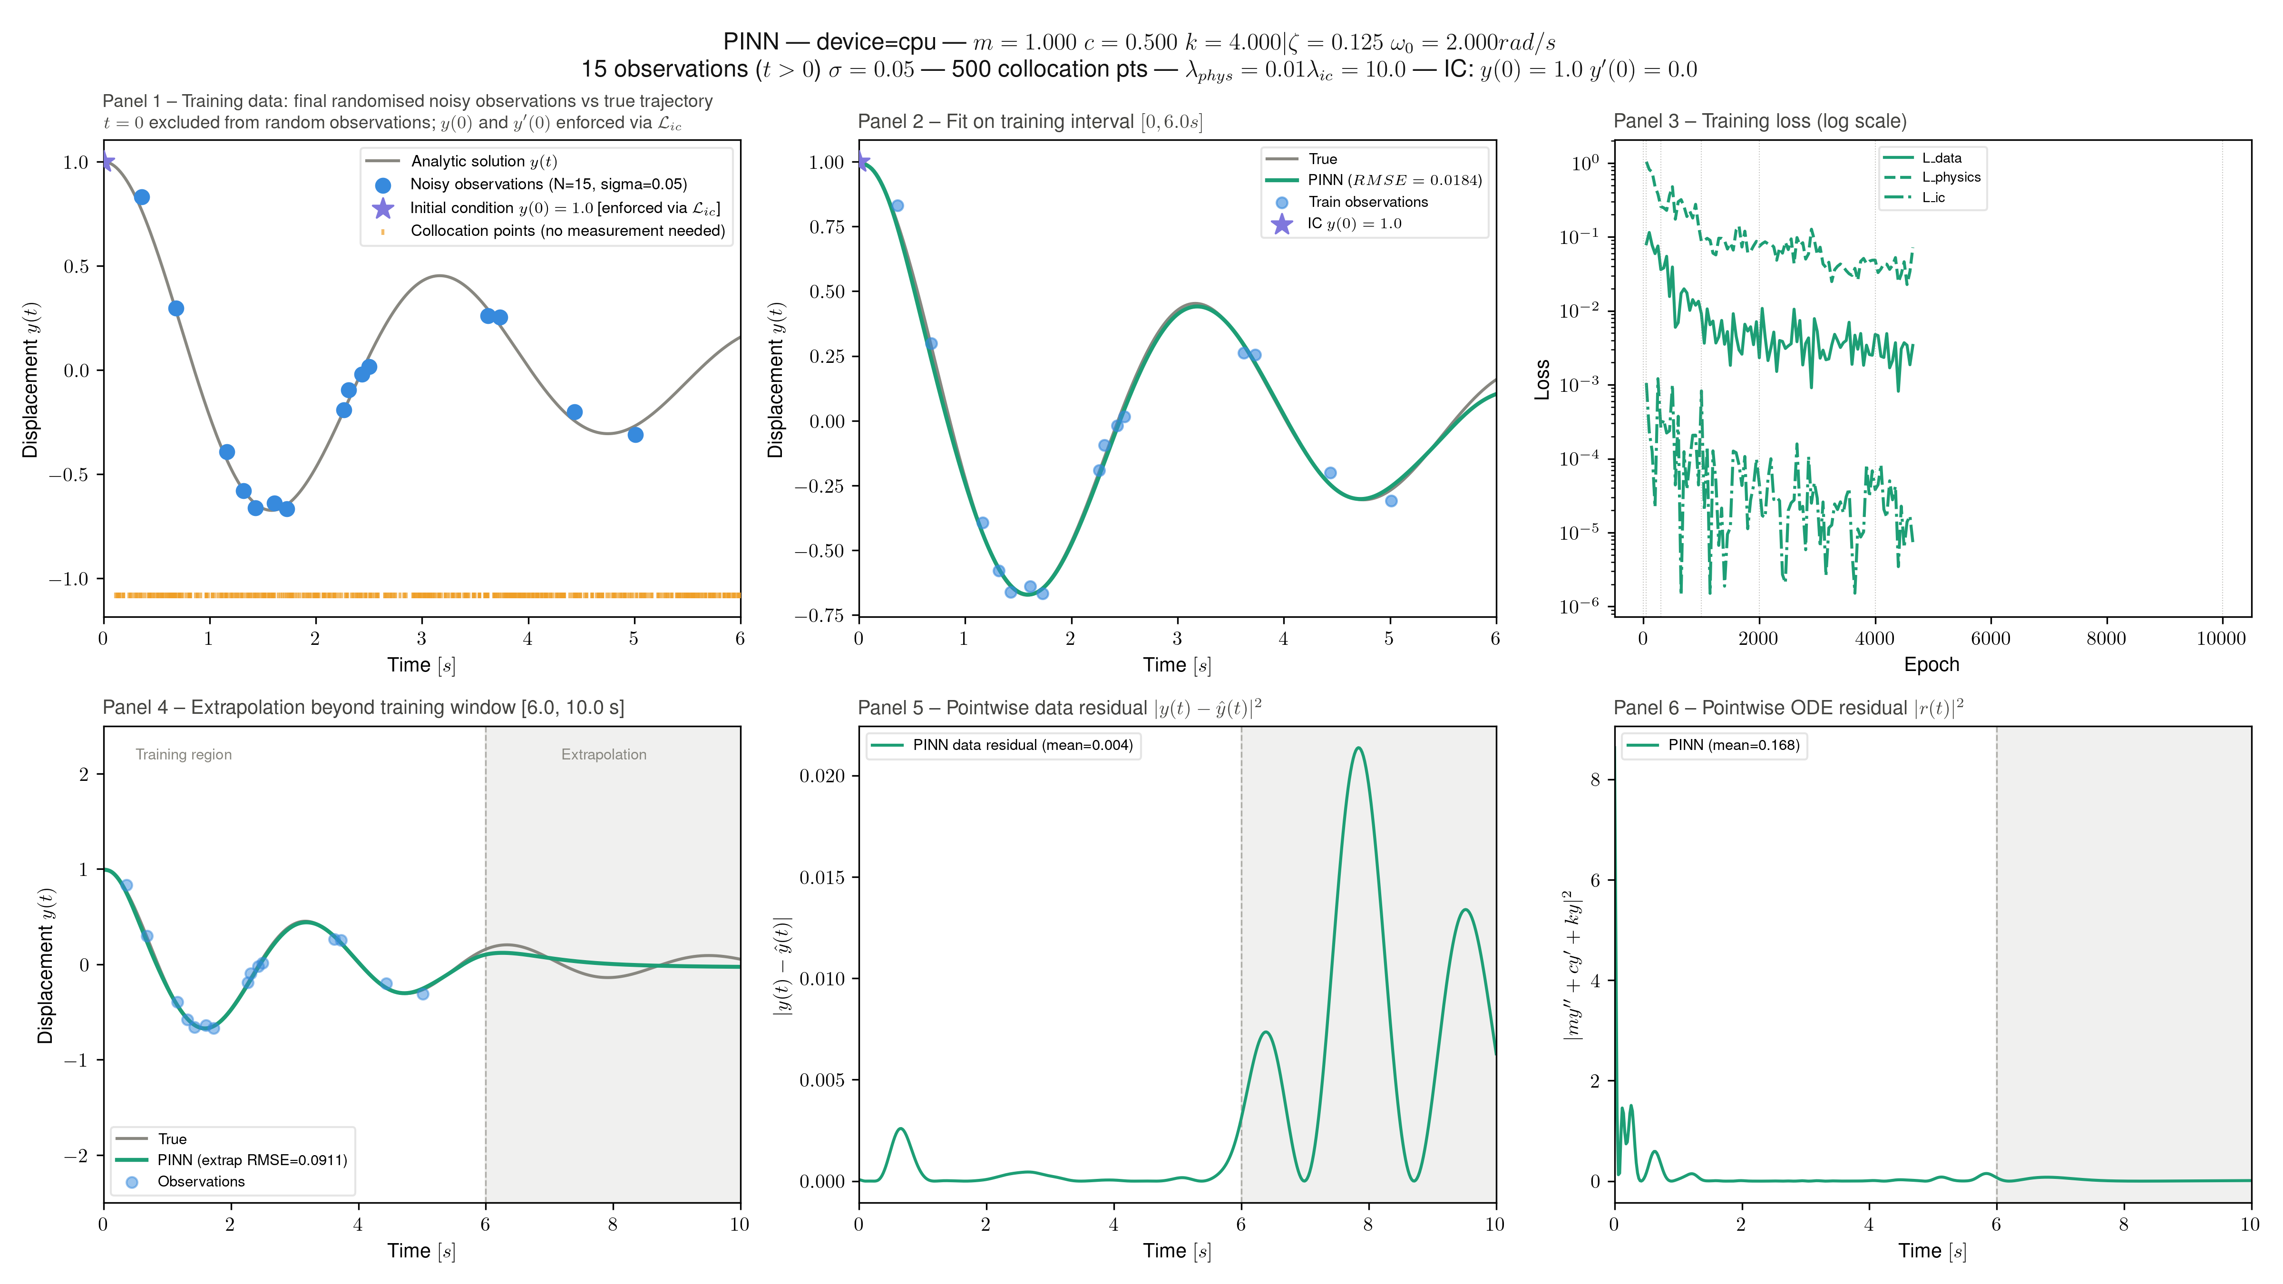
Damped Oscillator: PINN Fit & Extrapolation
Underdamped case — fit on [0, 6s], blind extrapolation to [6, 10s]
PINN Solutions to Classical PDEs & ODEs — Damped Oscillator · Burgers' Equation · Fisher–KPP
5

Slide 6
Setup & Method
Project 2
Default parameters
ν=0.05, IC=Gauss, L=15, n_x=1000
Burgers' Equation
Network
8 hidden layers × 96 units, Tanh, input = (t,x)
Physics loss
residual = u_t + u·u_x − ν·u_xx (autograd u_x, u_xx)
u_t + u·u_x = ν·u_xx
Domain split
t_dom=5s (training) → t_extrap=7s (extrapolation)
Inverse mode
InverseFCNet learns ν̂ via softplus reparam.
Nonlinear advection-diffusion PDE; viscosity ν controls shock smoothing.
Five initial-condition presets: Gauss, N-wave, N-wave-chop, Step-up/down, Slope.
Boundary conditions
Dirichlet, IC-dependent left/right values
Optimizer
Adam, lr=2e-3, StepLR, 30000 epochs, early stop
PINN Solutions to Classical PDEs & ODEs — Damped Oscillator · Burgers' Equation · Fisher–KPP
6

Slide 7
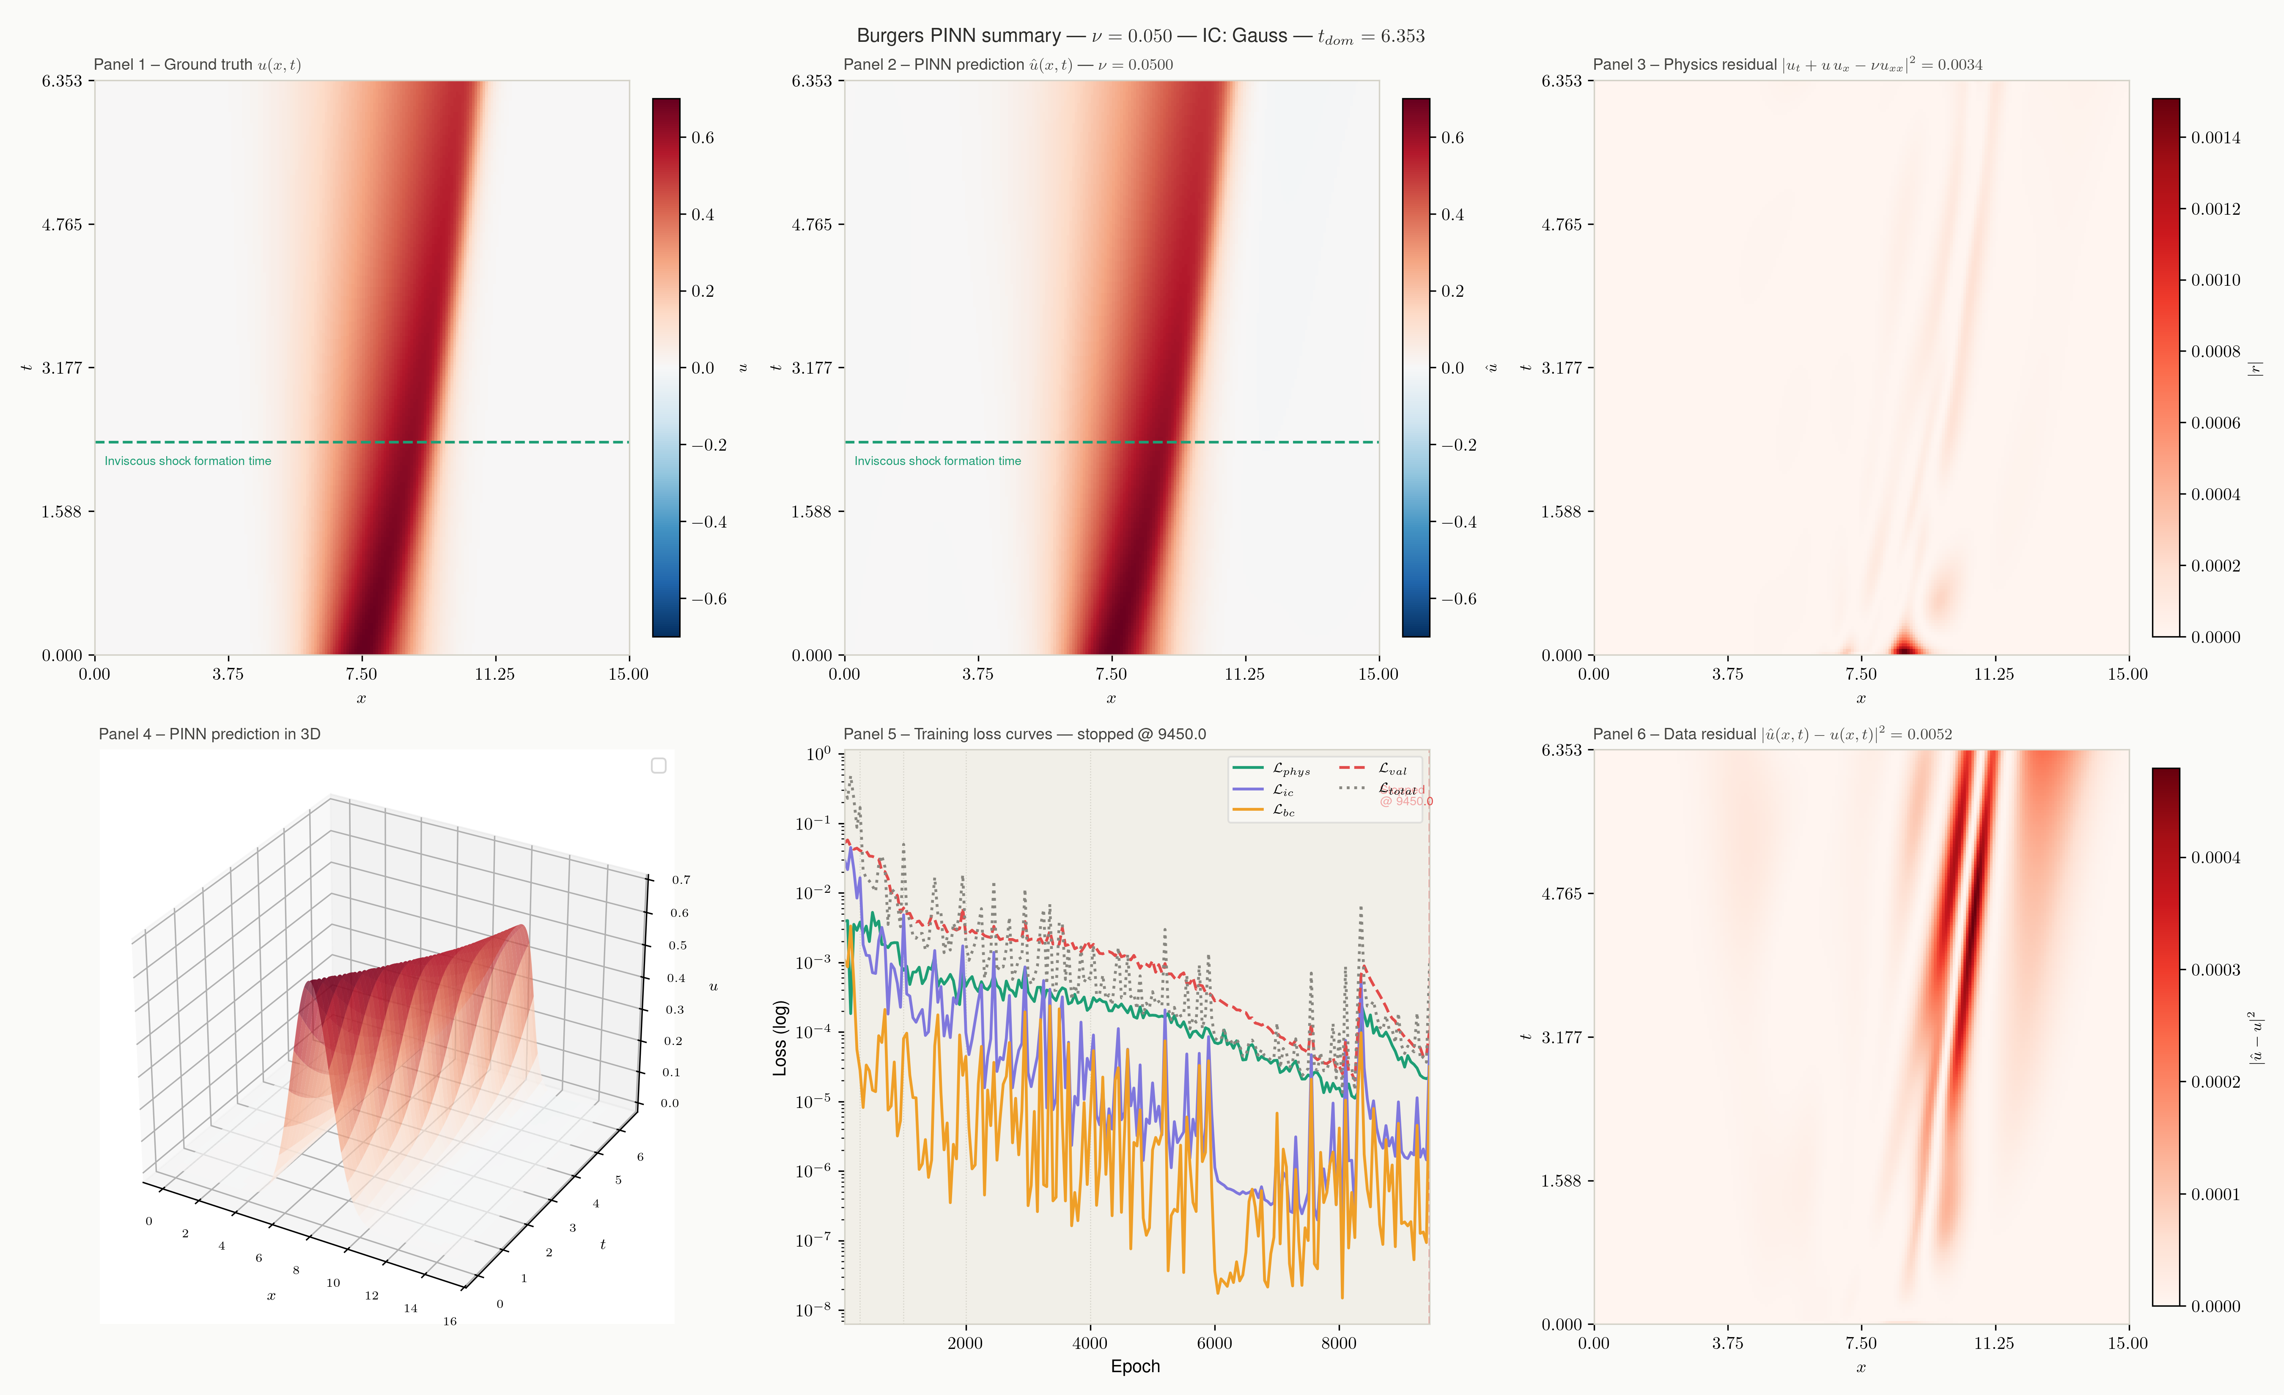
Burgers' Equation: PINN vs. Ground Truth
ν = 0.05, Gaussian initial condition — shock formation captured by the PINN
PINN Solutions to Classical PDEs & ODEs — Damped Oscillator · Burgers' Equation · Fisher–KPP
7

Slide 8

Traveling Wave Front
Project 3 — Main Focus
Analytic wave speed
Minimum speed at which a monotone
traveling-wave solution exists.
Fisher–KPP
c = 2√(r·D)
Initial condition
u_t = D·u_xx + r·u(1−u)
Smoothed step: u(x,0) = 0.5(1 − tanh(x/ε))
Boundary conditions
Proposed independently by Fisher and Kolmogorov–Petrovsky–Piskunov (1937).
Models logistic population growth (rate r) coupled with spatial diffusion (coefficient D).
Dirichlet: u(−L,t)=1, u(L,t)=0
Behaviour
Front connecting u=1 (invaded) to u=0 (uninvaded), moving at speed c
Applications
Population genetics, epidemic spread, combustion, ecology
PINN Solutions to Classical PDEs & ODEs — Damped Oscillator · Burgers' Equation · Fisher–KPP
8

Slide 9

Fisher–KPP: PINN Methodology
Fully-Connected Network
Composite Loss Function
L = λ_phys·L_phys + λ_ic·L_ic + λ_bc·L_bc ( + L_data )
L_phys
u_t − D·u_xx − r·u(1−u) = 0
PDE residual at random collocation points
L_ic
u(0,x) = 0.5(1−tanh(x/ε))
Initial-condition mismatch
t, x
hidden
×6
hidden
u(t,x)
L_bc
u(−L,t)=1, u(L,t)=0
Boundary mismatch (Dirichlet)
Tanh activations — twice-differentiable, required since the physics loss needs ∂²u/∂x² via autograd (ReLU has zero second derivative).
Inverse variant adds learnable D̂, r̂ reparameterized through softplus to stay positive.
L_data
MSE vs. noisy FD samples
Used in inverse / hybrid training
PINN Solutions to Classical PDEs & ODEs — Damped Oscillator · Burgers' Equation · Fisher–KPP
9

Slide 10


Fisher–KPP: Reference Solver & Training Setup
Finite-Difference Reference
Default Configuration
Explicit central-difference scheme for u_xx, explicit reaction term.
CFL-stable time step: dt ≤ cfl·dx²/D (von Neumann diffusion limit).
Reaction term |r·u(1−u)| ≤ r/4 for u∈[0,1] — bounded, does not tighten stability.
Used to generate noisy observations & the validation grid for the PINN.
Domain
L = 20, T = 6, n_x = 400
Diffusion / growth
D = 1.0, r = 1.0
Network
6 hidden layers × 64 units, Tanh
Loss weights
λ_phys=1, λ_ic=10, λ_bc=10
Collocation points
2000 PDE, 100 BC
Optimizer
Adam, lr=2e-3, StepLR schedule
Training
20000 epochs, early stop (patience)
PINN Solutions to Classical PDEs & ODEs — Damped Oscillator · Burgers' Equation · Fisher–KPP
10

Slide 11
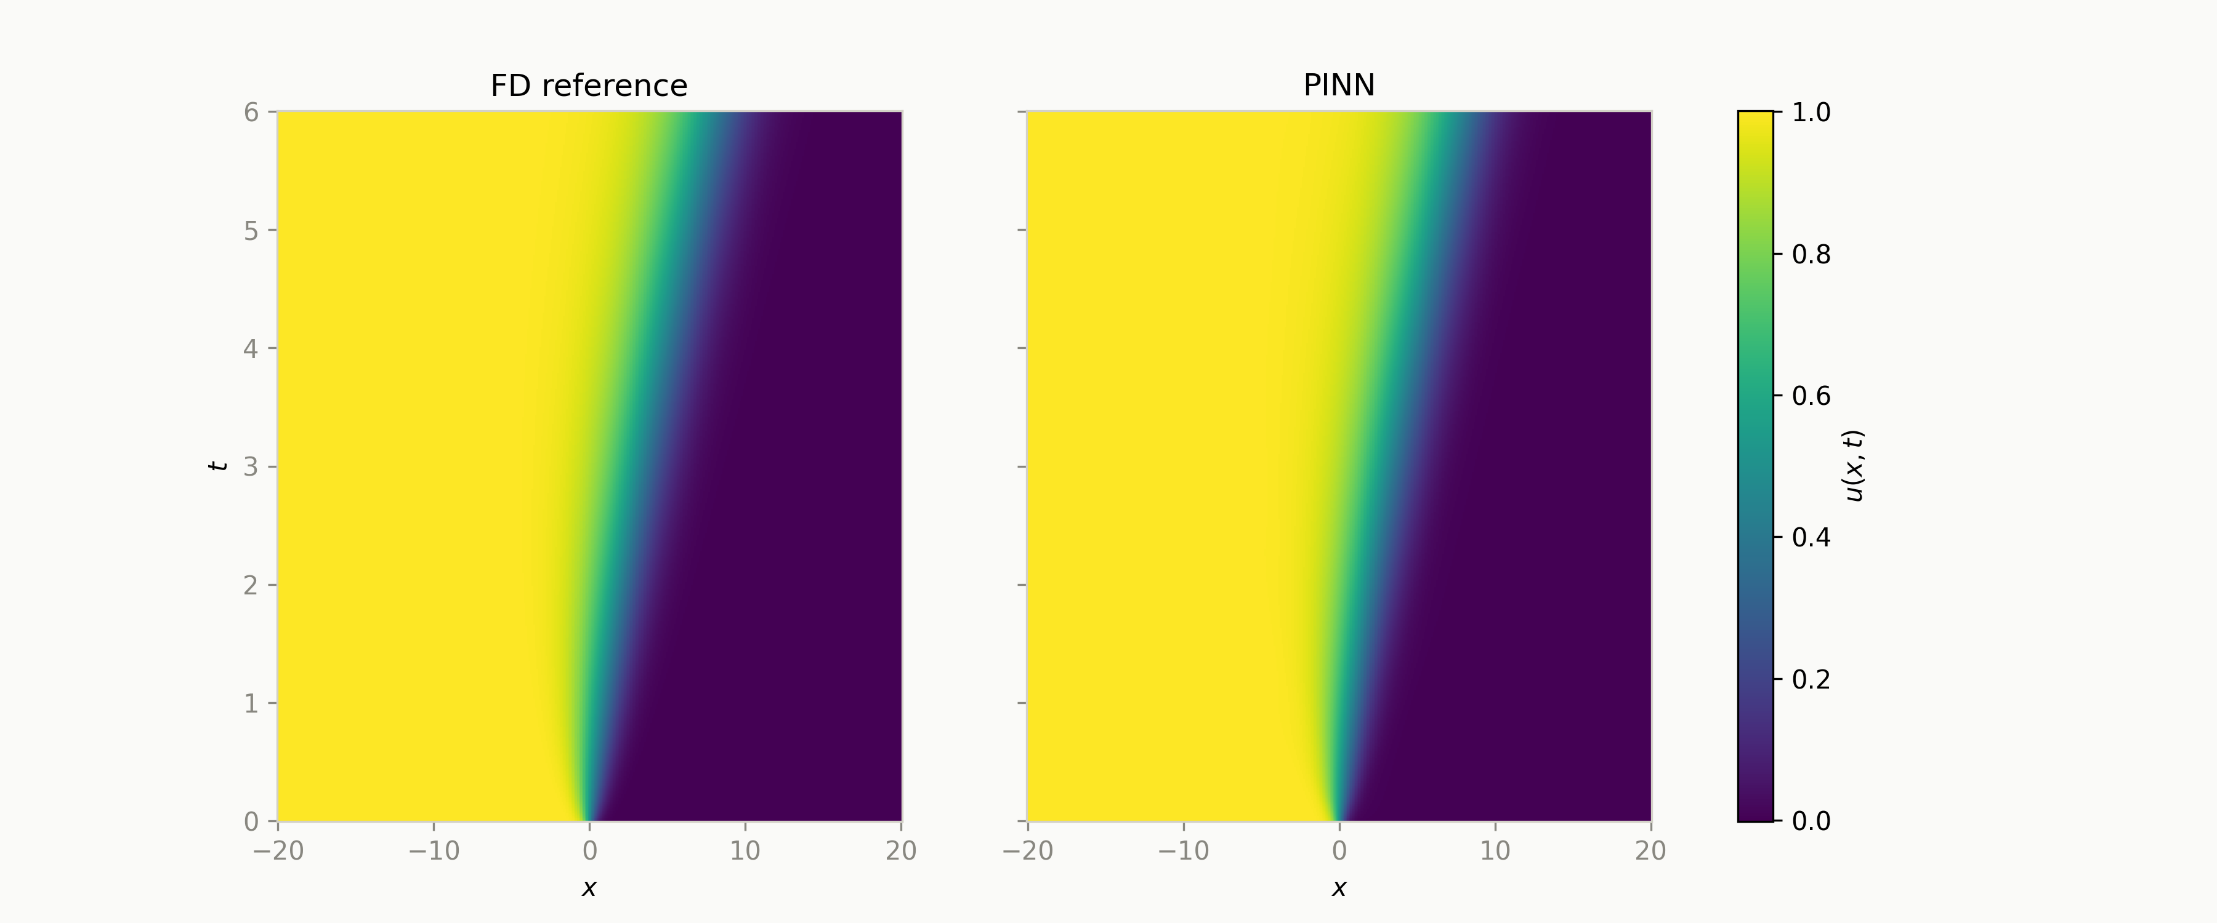
Fisher–KPP Forward Problem: Solution Field
D = 1.0, r = 1.0 — PINN vs. finite-difference reference
Traveling front from u=1 to u=0 propagates at the predicted speed; the PINN heatmap is visually indistinguishable from the FD reference.
PINN Solutions to Classical PDEs & ODEs — Damped Oscillator · Burgers' Equation · Fisher–KPP
11

Slide 12
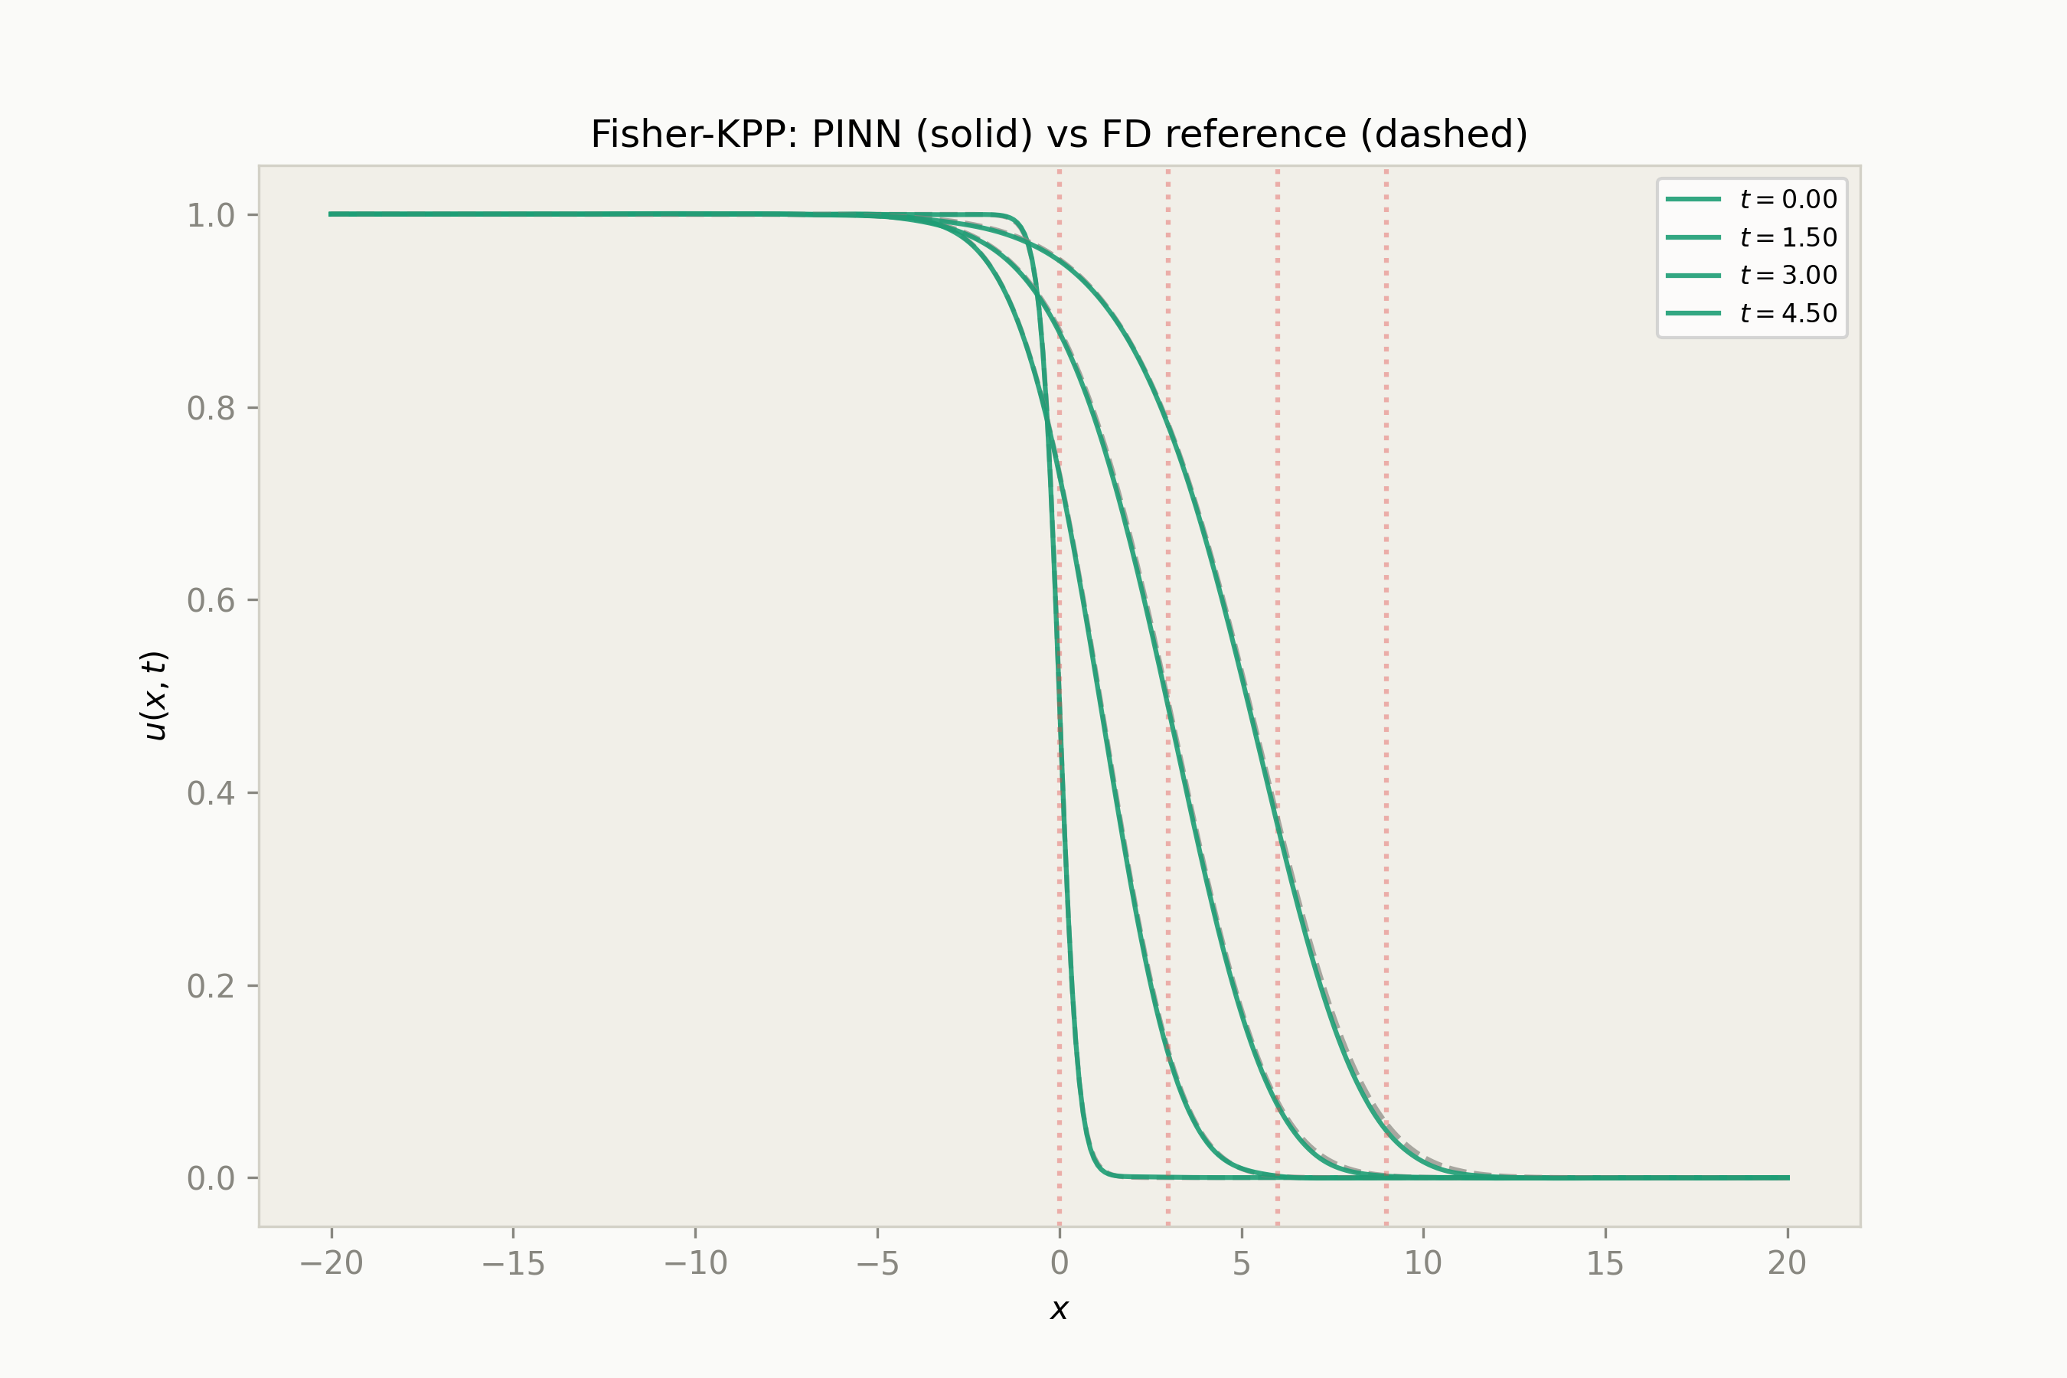
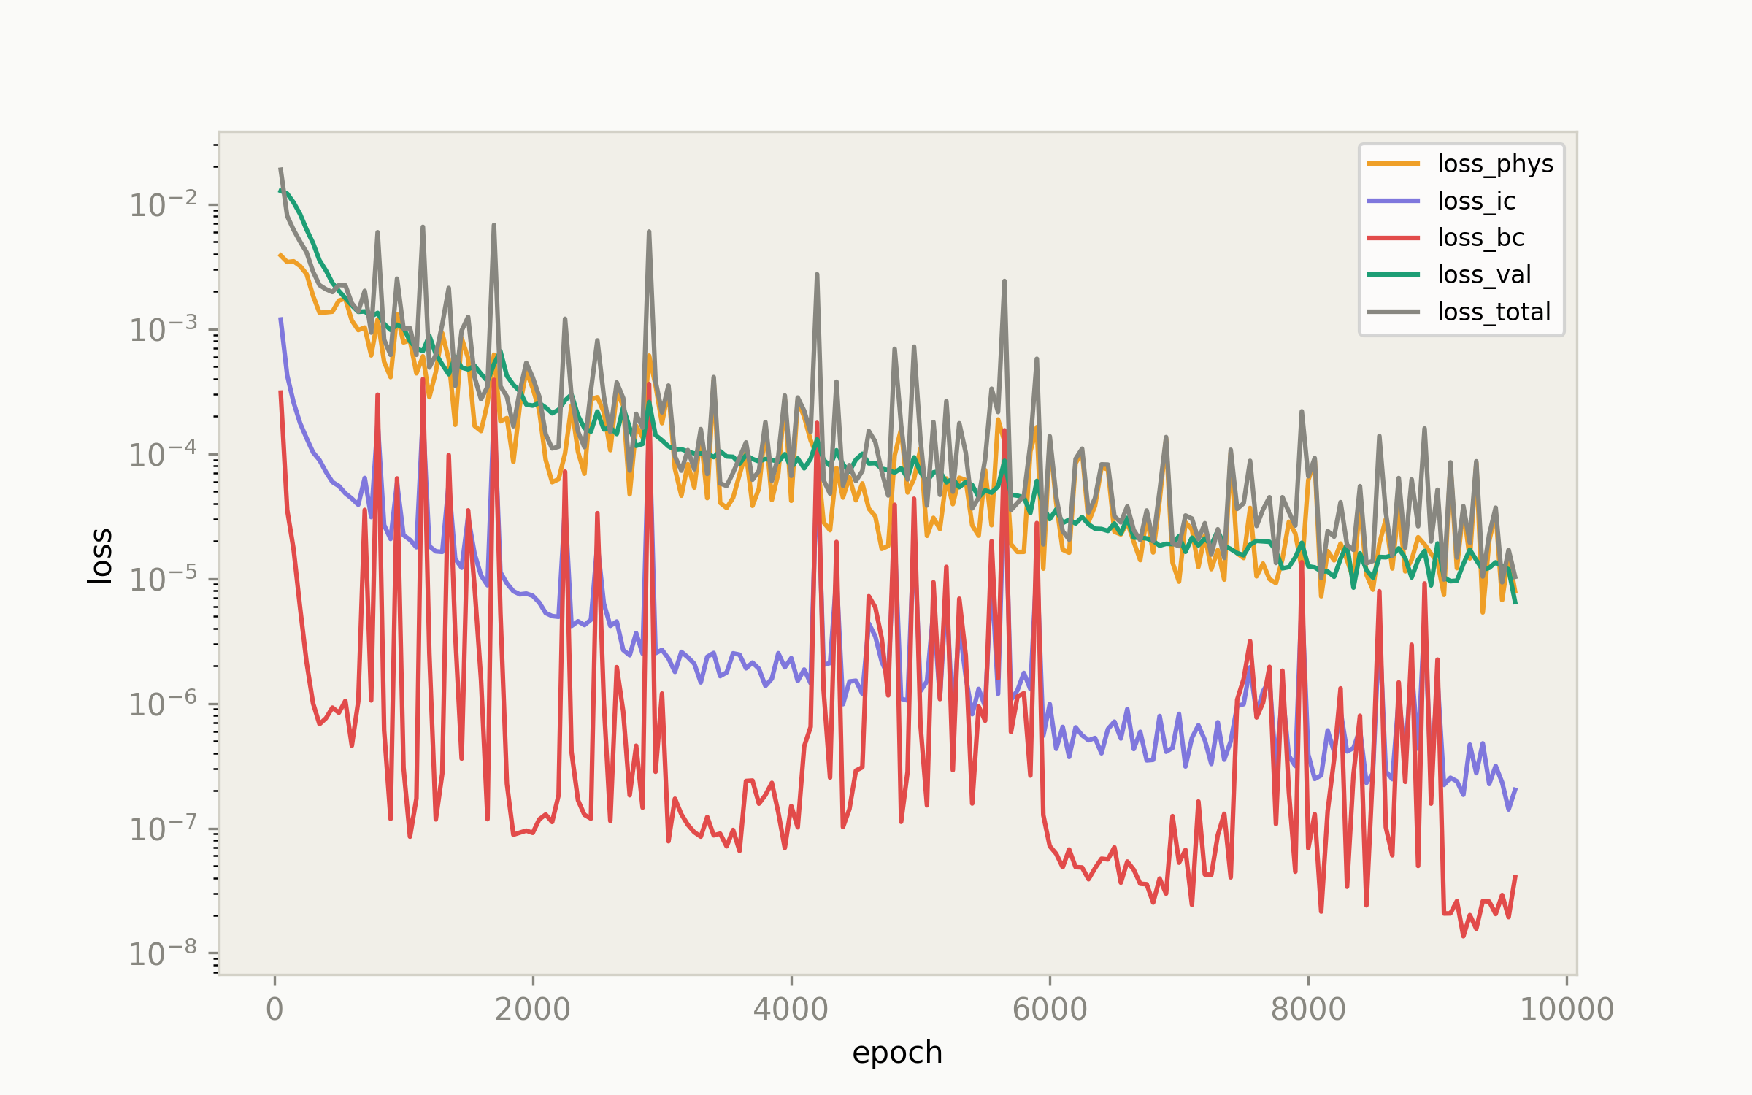
Fisher–KPP Forward Problem: Snapshots & Convergence
Wave profile at fixed times
Loss curves (log scale)
PINN Solutions to Classical PDEs & ODEs — Damped Oscillator · Burgers' Equation · Fisher–KPP
12

Slide 13
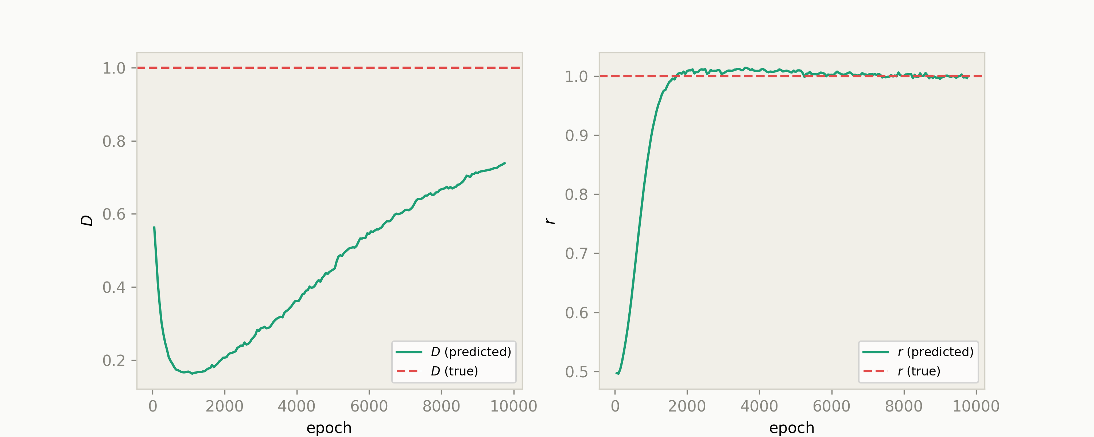
Fisher–KPP Inverse Problem: Parameter Recovery
Parameter convergence during training
Setup
InverseFCNet learns D̂, r̂ jointly with u(t,x).
Parameters reparameterized via softplus — guarantees positivity.
Random init in U(0.5, 2.0); trained against noisy synthetic observations.
True values: D = 1.0, r = 1.0
PINN Solutions to Classical PDEs & ODEs — Damped Oscillator · Burgers' Equation · Fisher–KPP
13

Slide 14
Fisher–KPP Extended Experiments
No-Physics Ablation
D / r Parameter Sweep
Train with data loss only (λ_phys=0) to isolate the contribution of the PDE residual term.
Systematic grid over D, r ∈ {0.5, 1.0, 2.0} — 9 combinations — to test generalisation across physical regimes.
D=1, r=1 → outputs/D1_r1_ML
outputs/D{D}_r{r}
Blind Extrapolation
Optuna Hyperparameter Search
Collocation points restricted to [0, t_train]; PINN must extrapolate the wave front beyond its training window.
TPE-based tuning over network width/depth, loss weights, learning rate, and scheduler — with median pruning.
t_train=3, T=6 → outputs/D1_r1_extrapblind
outputs/optuna_tuning
PINN Solutions to Classical PDEs & ODEs — Damped Oscillator · Burgers' Equation · Fisher–KPP
14

Slide 15
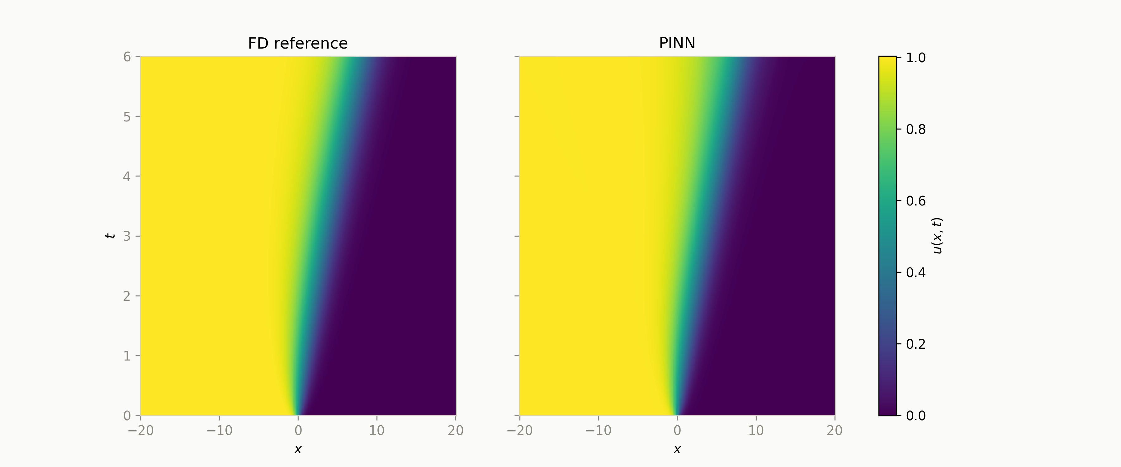
Fisher–KPP Blind Extrapolation Result
Trained only on t ∈ [0, 3], evaluated on the full domain t ∈ [0, 6]
Physics loss extends the front correctly past t=3 — the wave's constant propagation speed (c = 2√(rD)) is baked into the residual, so the network extrapolates without ever seeing labeled data there.
PINN Solutions to Classical PDEs & ODEs — Damped Oscillator · Burgers' Equation · Fisher–KPP
15

Slide 16
Cross-Project Comparison
One PINN methodology, three different physical behaviours
Damped Oscillator
Burgers' Equation
Fisher–KPP
Equation type
Linear ODE
Nonlinear PDE
Nonlinear PDE
Inputs → output
t → y
(t,x) → u
(t,x) → u
Key nonlinearity
none (linear)
u·u_x (advection)
r·u(1−u) (reaction)
Characteristic feature
Oscillatory decay
Shockwave formation
Traveling wave front
Inverse target
m, c, k
ν (viscosity)
D, r
Extrapolation test
t_dom→t_extrap
t_dom→t_extrap
t_train / train_extrap
Hyperparameter search
Optuna (TPE)
Optuna (TPE)
Optuna (TPE)
PINN Solutions to Classical PDEs & ODEs — Damped Oscillator · Burgers' Equation · Fisher–KPP
16

Slide 17
Conclusion
All three PINNs — one linear ODE, two nonlinear PDEs — are solved by the same recipe: a Tanh-MLP trained on autograd-derived residual, IC, and BC losses, with no interior labeled data required.
For Fisher–KPP specifically, the network reproduces the traveling wave to FD-reference accuracy, and its inverse variant recovers D and r from noisy data via a softplus-constrained parameterization.
The physics term is what enables extrapolation: blind training on t∈[0,3] still predicts the correct Fisher–KPP front position at t=6.
Optuna tuning and the D/r sweep confirm the architecture generalises across the parameter space — the same pattern validated earlier on the Damped Oscillator and Burgers' Equation projects.
Danyial Munir — University of Bologna
17

