Slide 1
Automated fundamental analysis in quant
MCM QUANT - Danyil

Slide 2

Setting the Stage: Purpose & Strategy Snapshot
Idea of the strategy is to find undervalued stocks and trade on their fair value doing all of it AUTOMATICALLY .

Slide 3


How it works?
Algorithm takes data about companies from Yahoo finance API.
Calculates DCF of the company using multiple EBITDA methodology.
Returns a fair value of the stock.
This information goes to QC, where it is being processed and backtested

Slide 4
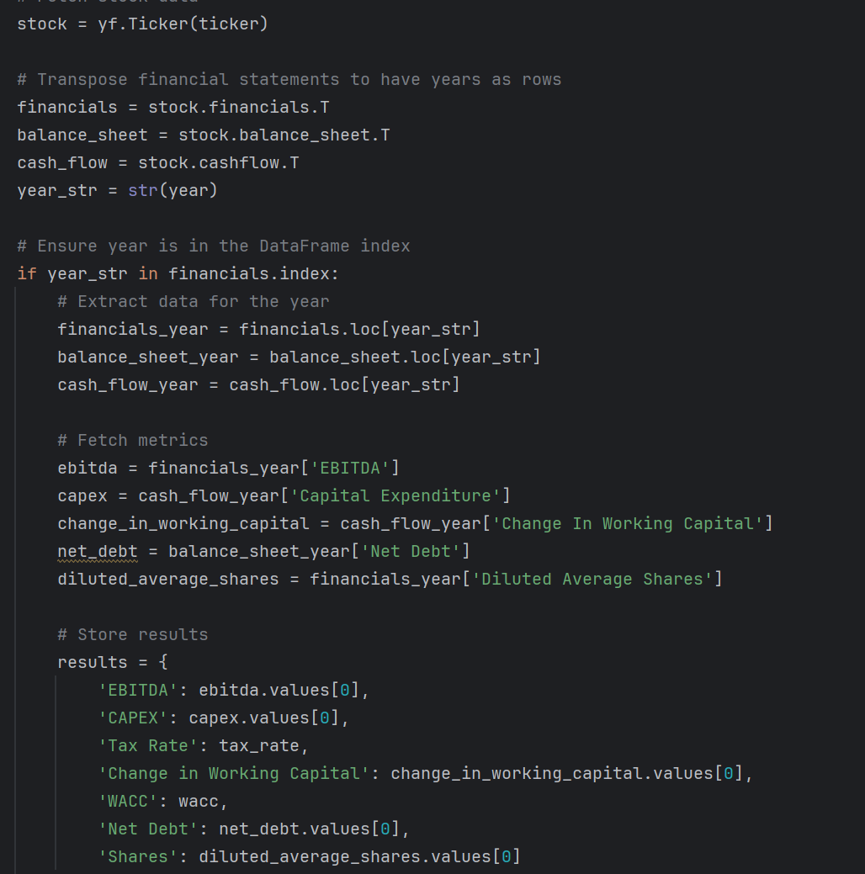
Practice 1:
Getting the data

Slide 5
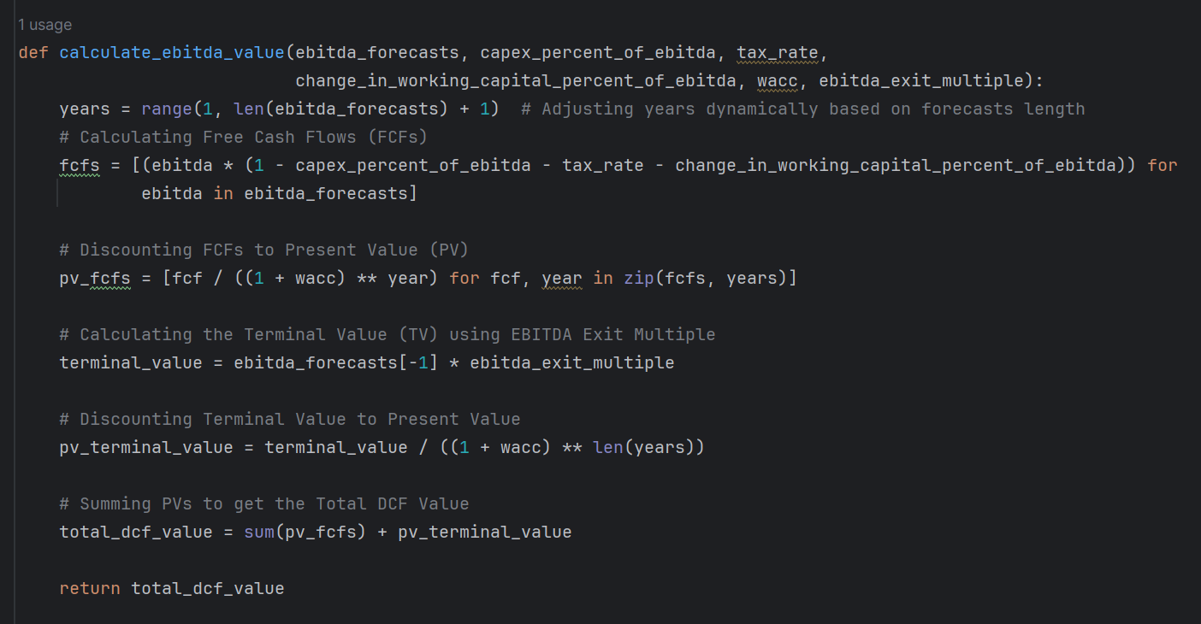
Practice 2:
Calculating the data

Slide 6
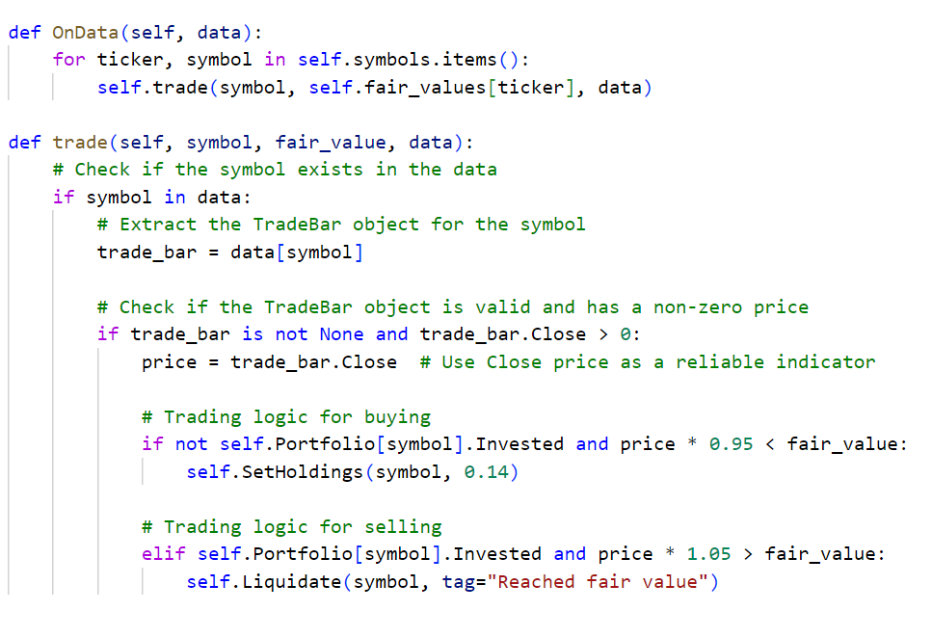
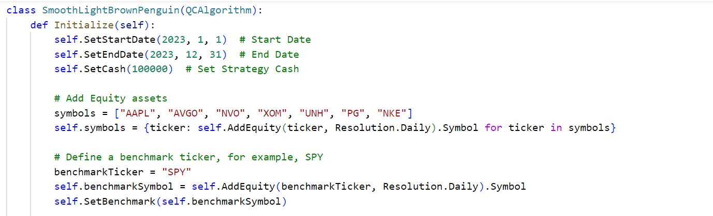
Practice 3:
Trading

Slide 7
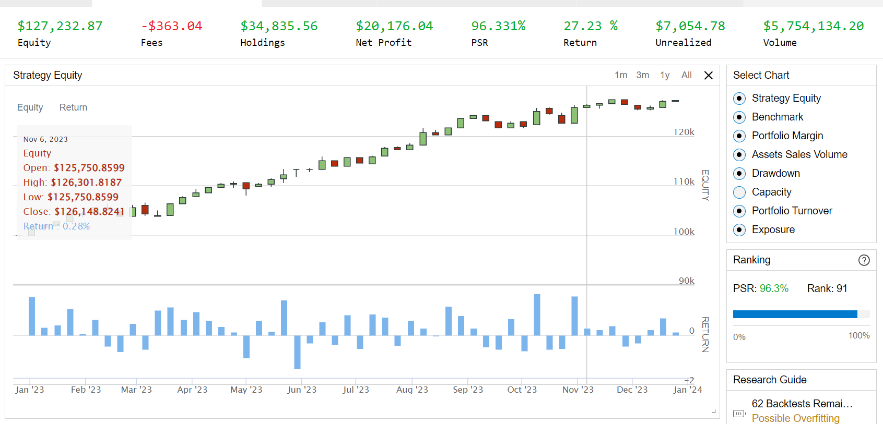
Results

Slide 8

Why do we still do it manually?
Firstly, Yahoo Finance API is a powerful tool but sometimes it doesn’t have needed data for some stocks to be able to calculate DCF accurately.
As a result, lots of ASSUMPTIONS is being made.
Secondly, relevance of the data from the API. Currently it allows to access data only for the last 3 years and only annually.

Slide 9

Future considerations
Potentially if more powerful tool will be used. You would be able to input the name of the stock, push the button and have fair value.

