Slide 1

Statistical Arbitrage in Rank Space
Quant Team: Danyil (Head)

Slide 2
Ranked Space vs Name Space​
How is it different?
Name space should be familiar, it is a list of stocks by name from which one would choose what and how to trade
Rank space on the other hand is not concerned with the names of the companies or movements in the shares
Why rank?
Rank space is focused on the relative position of one company to another in terms of its market capitalization, which simplifies the analyses by moving it into number/rank space​
​The rank space is intrinsically more stable due to its relativity
the arbitrage in rank space isolates the individual performance of the companies and allows us to identify the firms that are going well above market trends
Ranked Space vs Name Space​
Intraday ReBalancing​
Parametrics Model
CNN model
Limitations & Challenges​

Slide 3
Intraday ReBalancing​
Purpose ​
Keeps algorithm responsive to price changes throughout the day by updating market caps, portfolio weights, and portfolio value.​
​
Steps​
Updates market caps using live intraday prices, re-ranks securities to focus on the top 50 by market cap​
Calculates returns based on price movements and historical data then updates portfolio weights accordingly​
Uses a mathematical process to spot mean regression in data, then bets that prices will move back to their expected values​
This is practical as it keeps the portfolio optimized whilst minimizing risk and costs.​
Ranked Space vs Name Space​
Intraday ReBalancing​
Parametrics Model
CNN model
Limitations & Challenges​

Slide 4
Parametrics Model
Calculating Returns and Isolating Individual Behavior
  Calculating Daily Returns: We compute the daily returns of these stocks to understand their recent movements.
  Removing Market Noise with PCA: We use Principal Component Analysis (PCA) to separate overall market trends from individual stock behaviors, isolating the unique price movements of each stock.
Ranked Space vs Name Space​
Intraday ReBalancing​
Parametrics Model
CNN model
Limitations & Challenges​

Slide 5
Parametrics Model
  Generate Signals:
  Modeling Mean Reversion:
    In rank space, we apply the Ornstein-Uhlenbeck (OU) model to understand how each stock's price tends to revert to its own average level.
  Estimating Key Parameters:
    Mean (μμ): The typical price level the stock returns to.
    Volatility (σσ): How much the stock's price fluctuates around the mean.
    Reversion Speed (θθ): How quickly the price moves back to the mean after a deviation.
  Output:
    Trading Signals: Instructions on whether to buy, sell, or hold each stock.
Ranked Space vs Name Space​
Intraday ReBalancing​
Parametrics Model
CNN model
Limitations & Challenges​

Slide 6
Parametrics Model Limitations
Issue:
  Frequent Trading: OU model can generate signals often due to sensitivity to small deviations.
  High Transaction Costs: Each trade incurs fees, reducing net profitability.
Impact on Strategy:
  Erosion of Profits: Accumulated fees can outweigh gains from mean reversion.
  Negative Returns: Excessive fees may lead to overall losses.
Ranked Space vs Name Space​
Intraday ReBalancing​
Parametrics Model
CNN model
Limitations & Challenges​

Slide 7
Convolutional neural network model
Ranked Space vs Name Space​
Intraday ReBalancing​
Parametrics Model
CNN model
Limitations & Challenges​

Slide 8
CNN model : Data Gathering
Get the data from a list of stocks for 2015-2016 sorted by the market cap
1
Gather the market caps on daily basis for 30 stocks
2
At the start of every day get the number of shares outstanding by dividing market cap by the last closing price
3
Use that value to calculate the changes in market cap on a minute-by-minute basis throughout the day
4
Get the percentage change on that frequency
5
Use the PCA analysis to make the data dollar-neutral, hence a lot more balanced in terms of long-short positions in later implementation
6
Ranked Space vs Name Space​
Intraday ReBalancing​
Parametrics Model
CNN model
Limitations & Challenges​

Slide 9
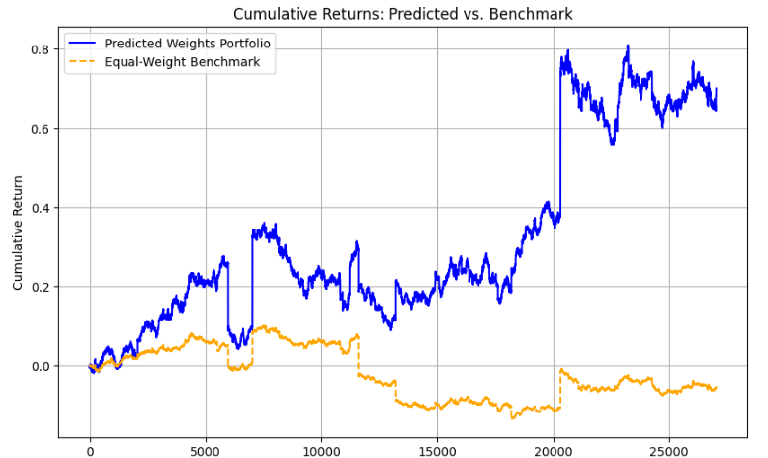
CNN model : Training
Split the data into training / test data sets
Implement a neural network with 2 convolution layers which is different from the paper due to the complexity
Implement a custom loss function which would optimize the neural network to find a balance between returns and the variance in the portfolio by reducing the mean loss on a trade
Train and test and network
Export into the main function
Ranked Space vs Name Space​
Intraday ReBalancing​
Parametrics Model
CNN model
Limitations & Challenges​

Slide 10
CNN model : Implementation
Calculate the shares outstanding at the start of the trading day
Calculate the market cap on the minute-by-minute basis, record the data for the lookback window of 225 minutes
Find the residual returns on the stock, creating a dollar-neutral view of the market
Compile the returns into a dataset that is fed into the neural network
Profit
Estimate the weights(proportions of the portfolio) that should be allocated to each stock
Ranked Space vs Name Space​
Intraday ReBalancing​
Parametrics Model
CNN model
Limitations & Challenges​

Slide 11
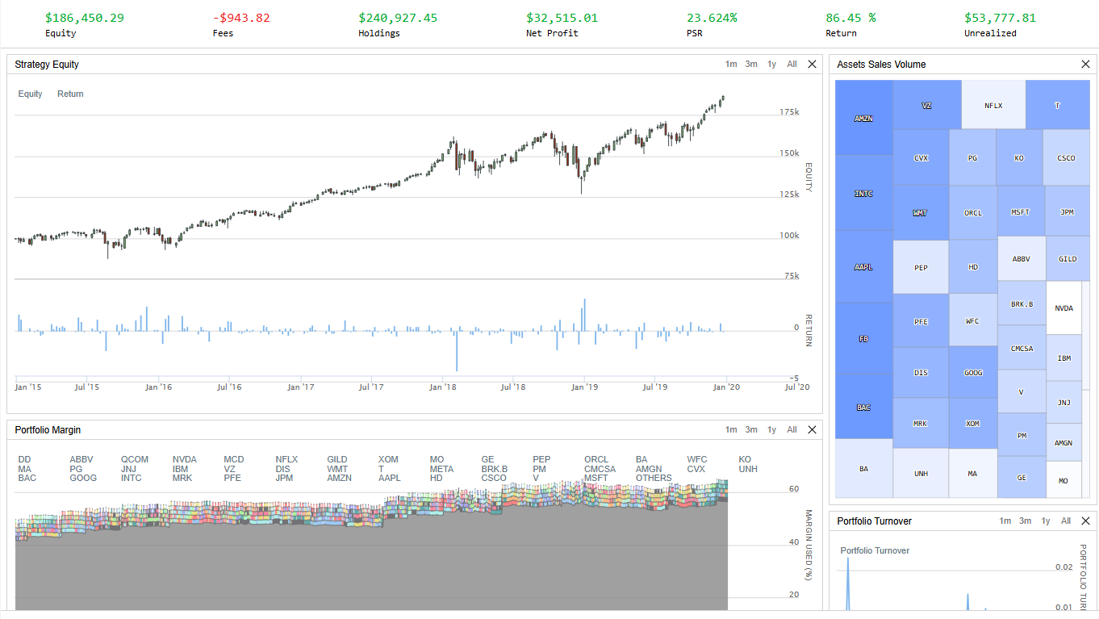
CNN model : Results
Data backtested over the period 2015 – 2020 trading top 50 stocks sorted by market capitalization
Total returns: 86%
Win rate on trades: 89%
Compound returns: 14%
Annual variance: 0,017
Sharpe ratio: 0.7
Ranked Space vs Name Space​
Intraday ReBalancing​
Parametrics Model
CNN model
Limitations & Challenges​

Slide 12
Limitations & Challenges​
Data for market cap is extrapolated, hence imprecise, which impacts the quality of the neural network predictions
Quantconnect does not allow for tracking of 10y bond yield, forcing you to use a constant risk-free rate undermining the quality of the model
The processing power of QuantConnect cloud is severely limited for free users (please buy us subscription), hence the amount of data that neural network can be trained on is severely restricted (1 year of data for 30 stocks)
if those to be resolved, the returns would not just be higher, but also less volatile, making for a much better strategy
Ranked Space vs Name Space​
Intraday ReBalancing​
Parametrics Model
CNN model
Limitations & Challenges​

