Slide 1
Double EMA + ATR
FX Strategy
Backtest Analysis
EURUSD · USDJPY · Daily · H4
IS + OoS Split
Monte Carlo
Walk-Forward
70 / 30
1 000 paths
Rolling windows
Quantitative Research | Strategy Validation

Slide 2
Strategy Introduction
Double EMA + ATR
How It Works
Tested Configurations
Signal
Pair / TF | Fast | Slow | SL | TP
EURUSD Daily | 7 | 25 | 0.6% | 1.0%
USDJPY Daily | 18 | 40 | 2.0% | 5.0%
EURUSD H4 | 8 | 60 | 0.4% | 0.4%
USDJPY H4 | 7 | 21 | 0.5% | 1.0%
Fast EMA crosses Slow EMA — crossover direction sets long/short bias.
Filter
ATR must exceed a minimum threshold to confirm sufficient volatility before entry is allowed.
Risk
Validation Framework
Fixed Stop-Loss and Take-Profit defined as % of entry price, giving a constant R:R per trade.
SL / TP Grid
Sensitivity
Out-of-Sample
Exit
Walk-Forward
Monte Carlo
Trade closes at SL hit, TP hit, or opposing EMA crossover signal.

Slide 3
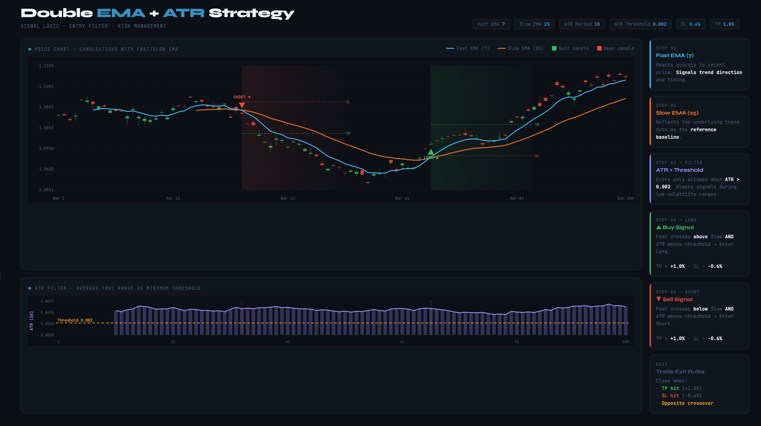
Strategy Introduction
Double EMA + ATR

Slide 4
1
SL / TP Optimization
Simple grid search across stop-loss and take-profit levels
Brute-force grid: SL ∈ [0.3%, 2%] × TP ∈ [0.4%, 5%]
Objective: maximise total return over full in-sample period
Four datasets tested independently: EURUSD Daily / H4, USDJPY Daily / H4
Optimal parameters then frozen for all subsequent tests

Slide 5
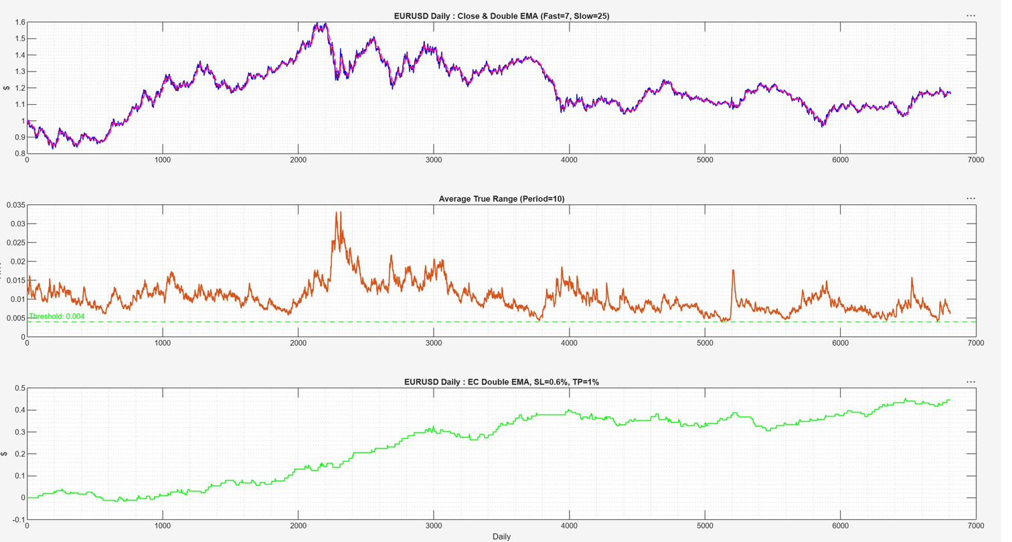
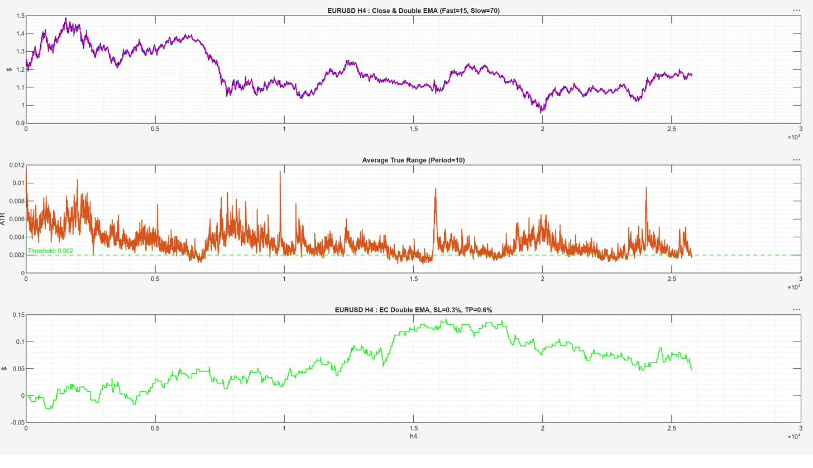
SL / TP Optimization — EURUSD
Daily & H4
EURUSD Daily
EURUSD H4
Daily — Equity curve at optimal SL=0.6%, TP=1.0%
H4 — Equity curve at optimal SL=0.4%, TP=0.4%
Daily: wider TP (1%) captures multi-day swings · H4: tight symmetric SL/TP suits intraday mean-reversion pockets

Slide 6
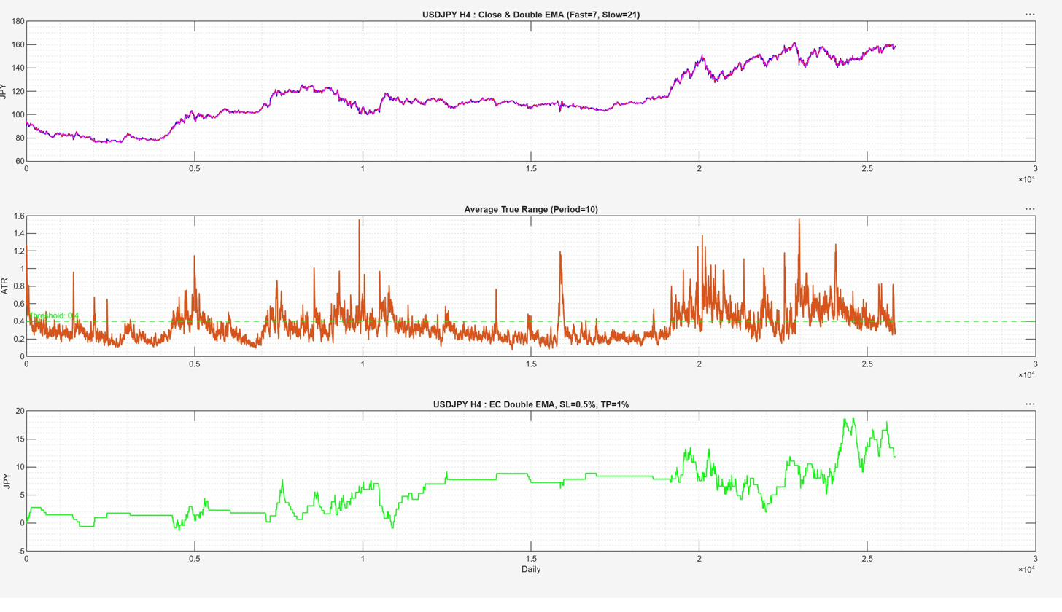
SL / TP Optimization — USDJPY
Both IS and OoS curves trend upward — strongest confirmation of edge generalization in the entire study
USDJPY H4 — IS (left) vs OoS (right) equity curves in full detail

Slide 7
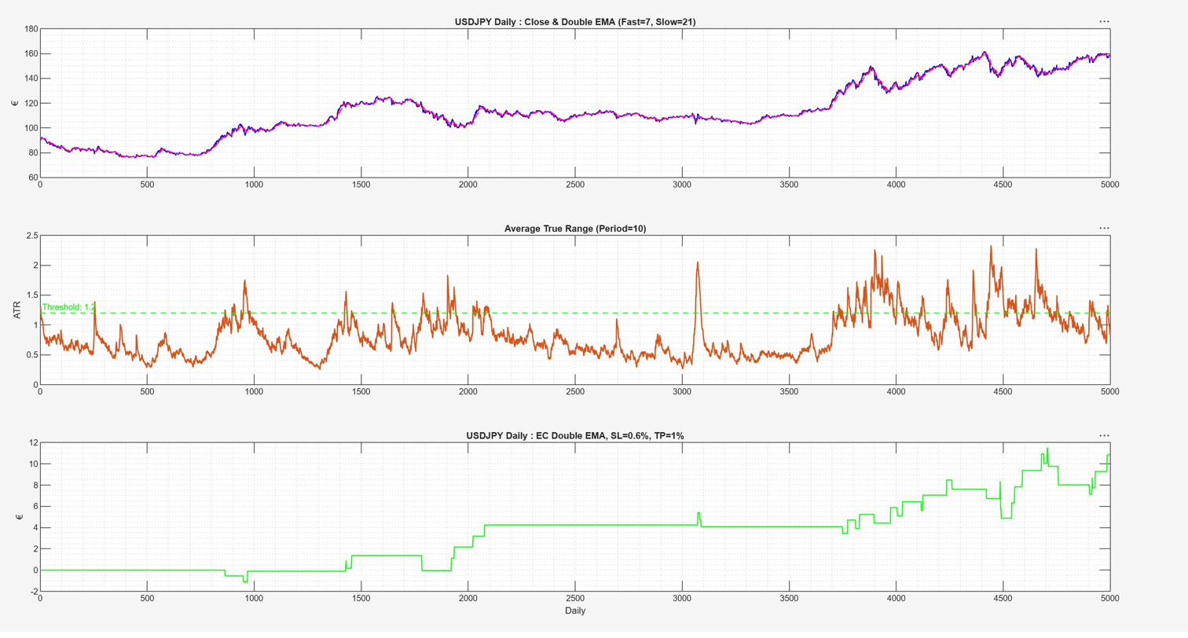
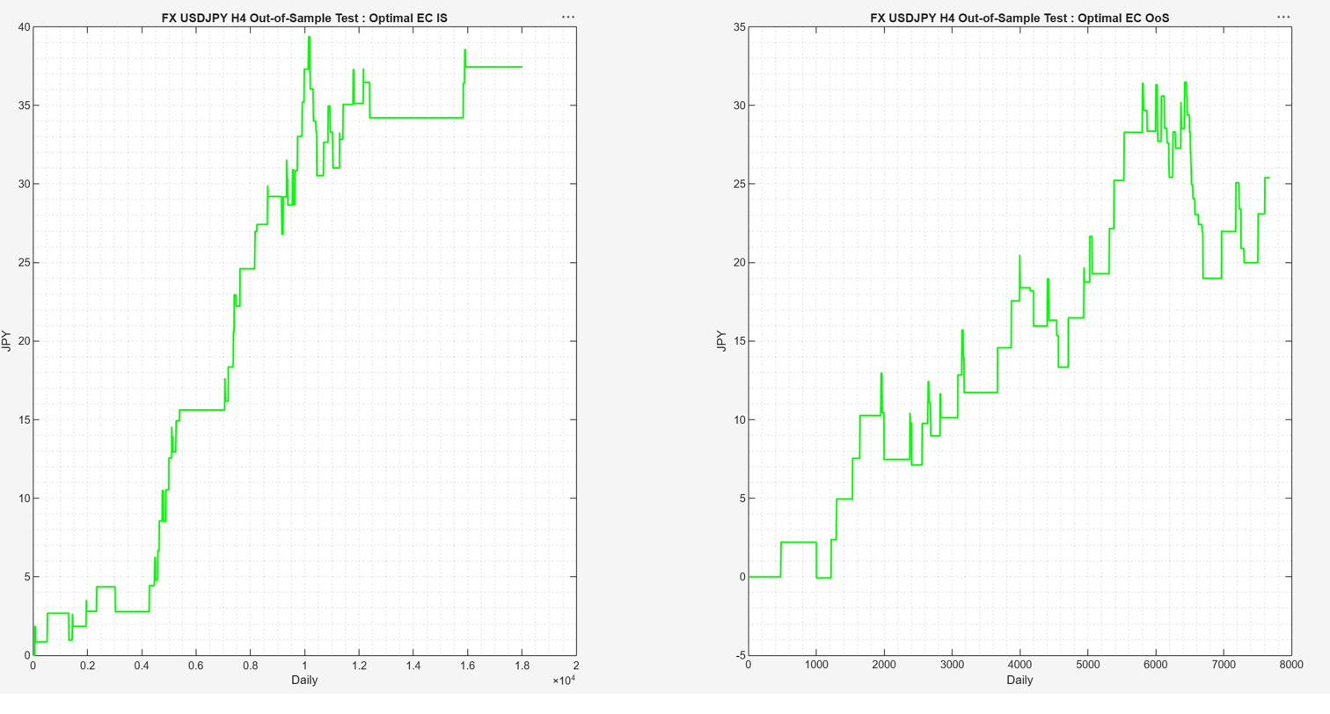
SL / TP Optimization — USDJPY
Daily & H4
USDJPY Daily
USDJPY H4
Daily — Optimal SL=2%, TP=5% (trend-riding config)
H4 — Optimal SL=0.5%, TP=1.0%
USDJPY Daily demands wide SL/TP to ride JPY depreciation trends · H4 benefits from tighter 1:2 R:R

Slide 8
2
Sensitivity Analysis
Parameter robustness across EMA period neighbourhoods
Fast EMA and Slow EMA varied ±50% around optimal values
Heat-map of total return across the full 2-D parameter grid
Wide, flat peak → robust | Sharp, narrow peak → fragile
All four datasets compared side-by-side

Slide 9
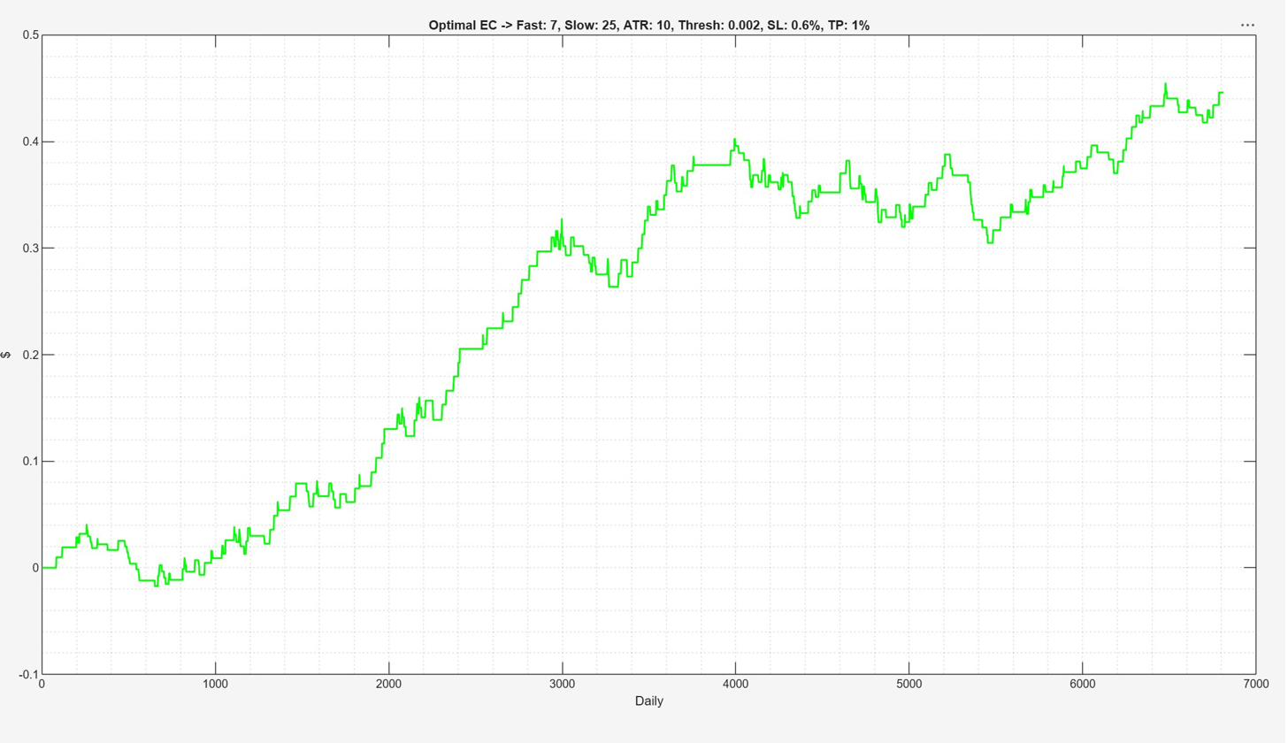
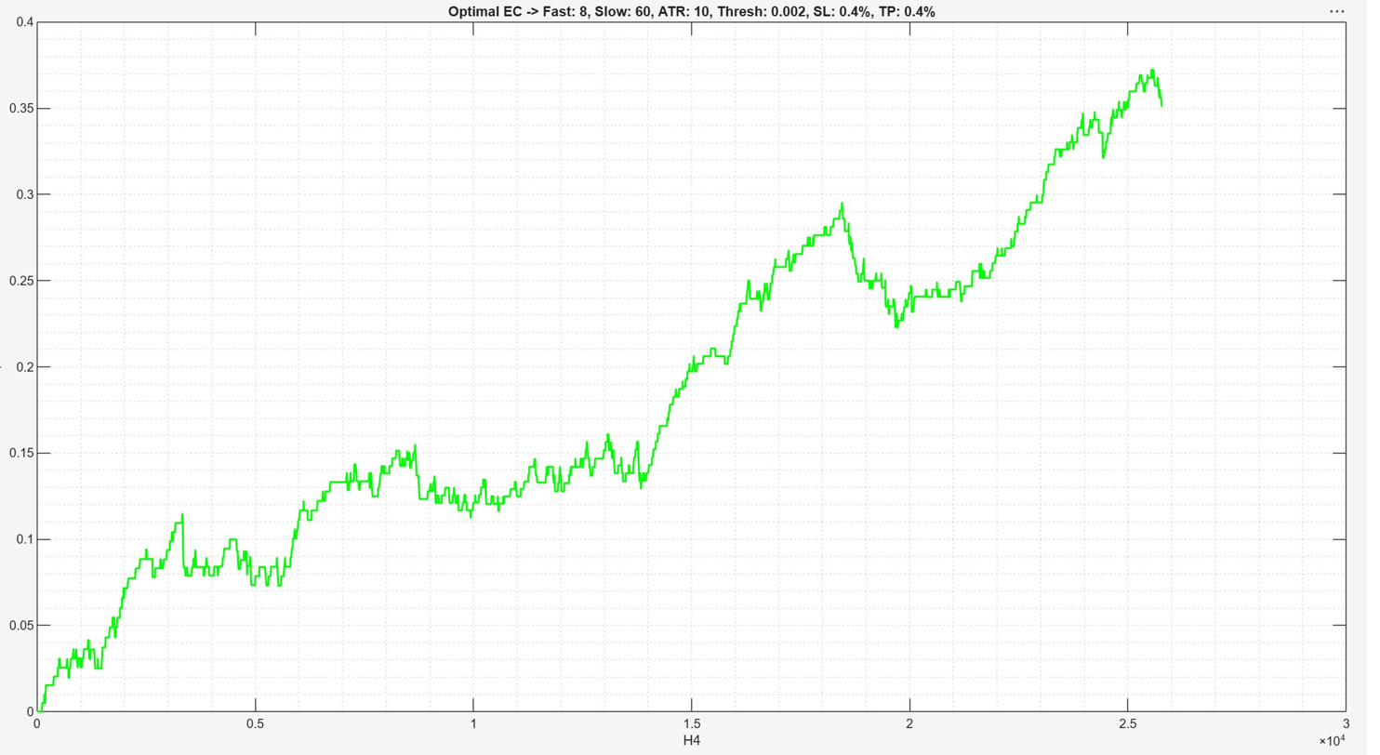
Sensitivity Analysis — EURUSD
Daily & H4
EURUSD Daily
EURUSD H4
Daily — moderate peak, acceptable neighbourhood
H4 — flatter plateau, stronger robustness
H4 sensitivity surface is notably flatter → parameter choices are less critical on the H4 timeframe

Slide 10
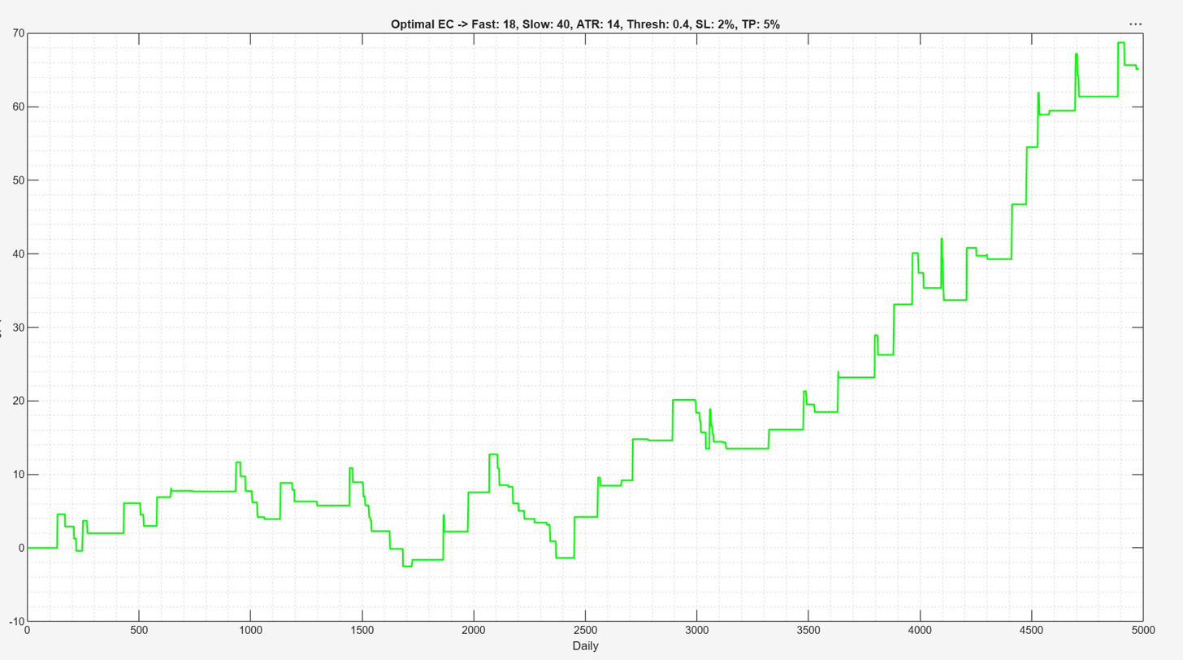
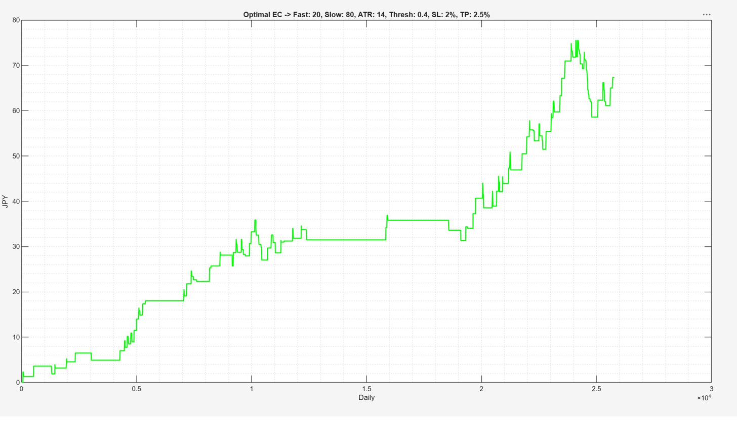
Sensitivity Analysis — USDJPY
Daily & H4
USDJPY Daily
USDJPY H4
Daily — sharper peak, moderate fragility risk
H4 — wide positive region, most robust profile
USDJPY H4 shows the widest positive sensitivity region across all datasets — strongest robustness score

Slide 11
3
Out-of-Sample Testing
IS parameters applied to unseen data (30% holdout)
IS window: first 70% of data — parameters optimised here
OoS window: last 30% of data — parameters locked, no look-ahead
Both IS and OoS equity curves displayed side-by-side
Key metric: OoS curve must be positive and not drastically below IS slope

Slide 12
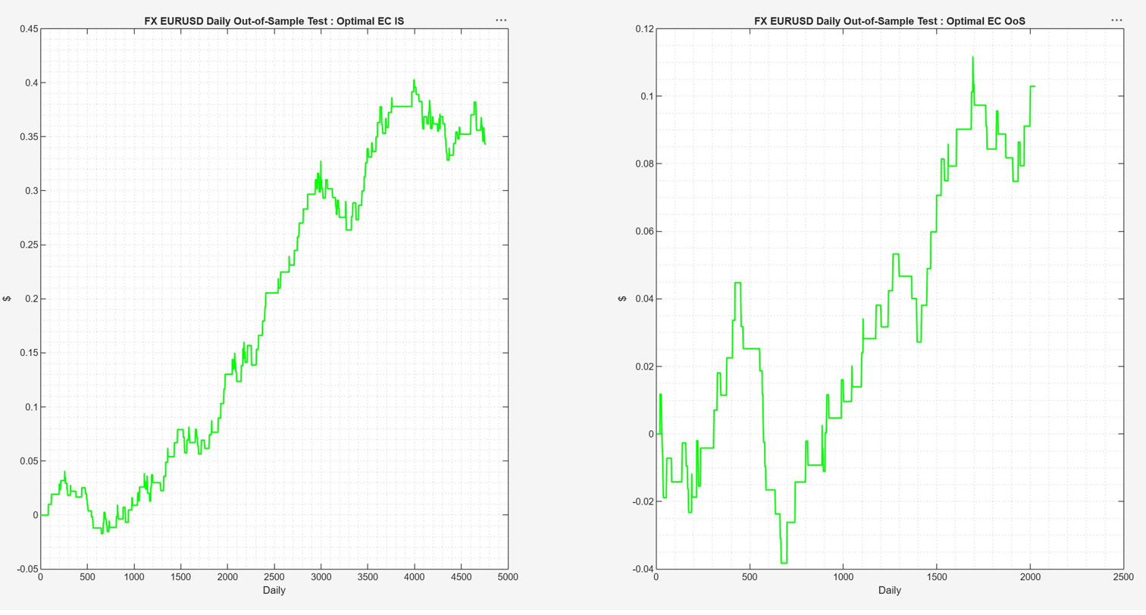
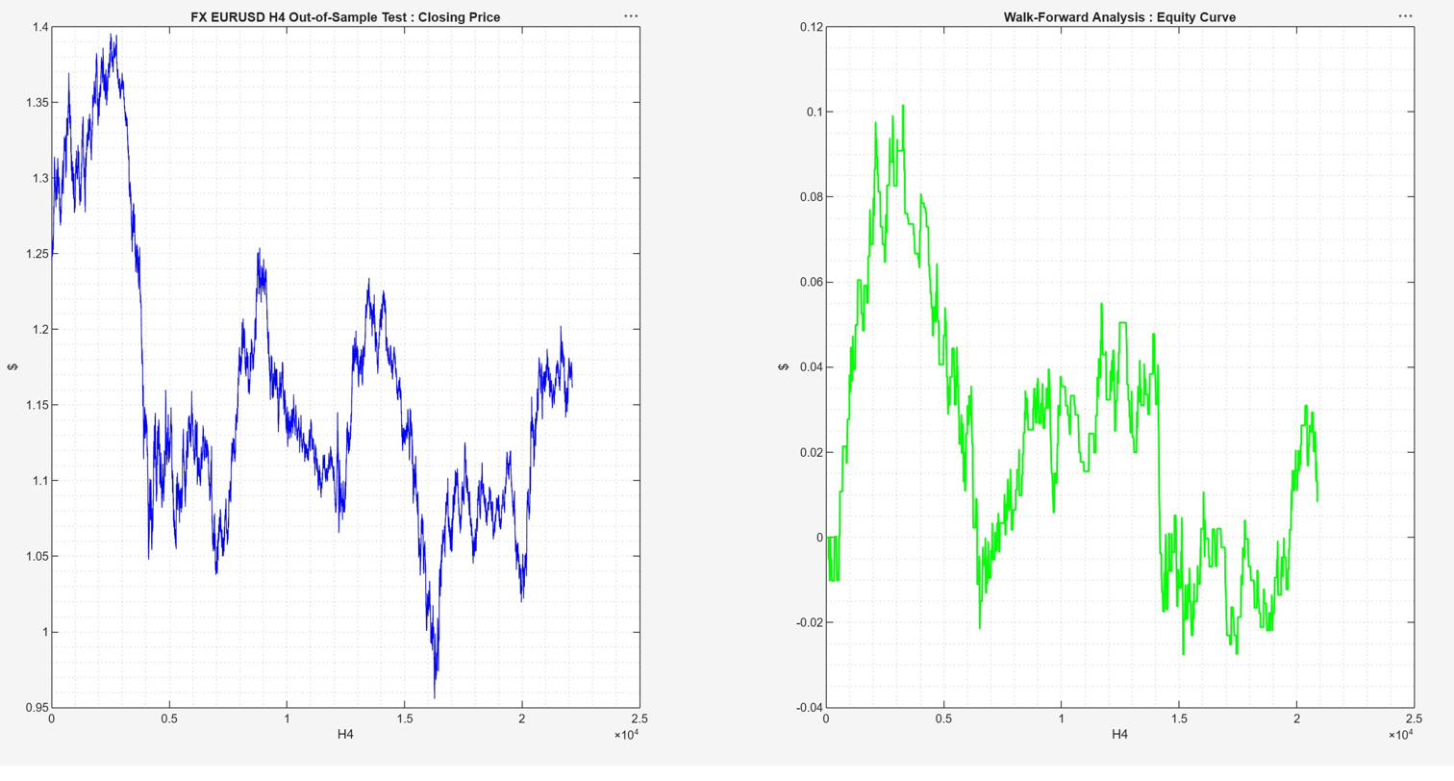
Out-of-Sample — EURUSD
Daily & H4
EURUSD Daily
EURUSD H4
Daily — IS strong, OoS positive (ends ~+$0.11)
H4 — OoS shows initial dip, partial recovery
Daily OoS: genuine edge confirmed · H4 OoS: weaker — ranging EURUSD regime adversely affects trend-following

Slide 13
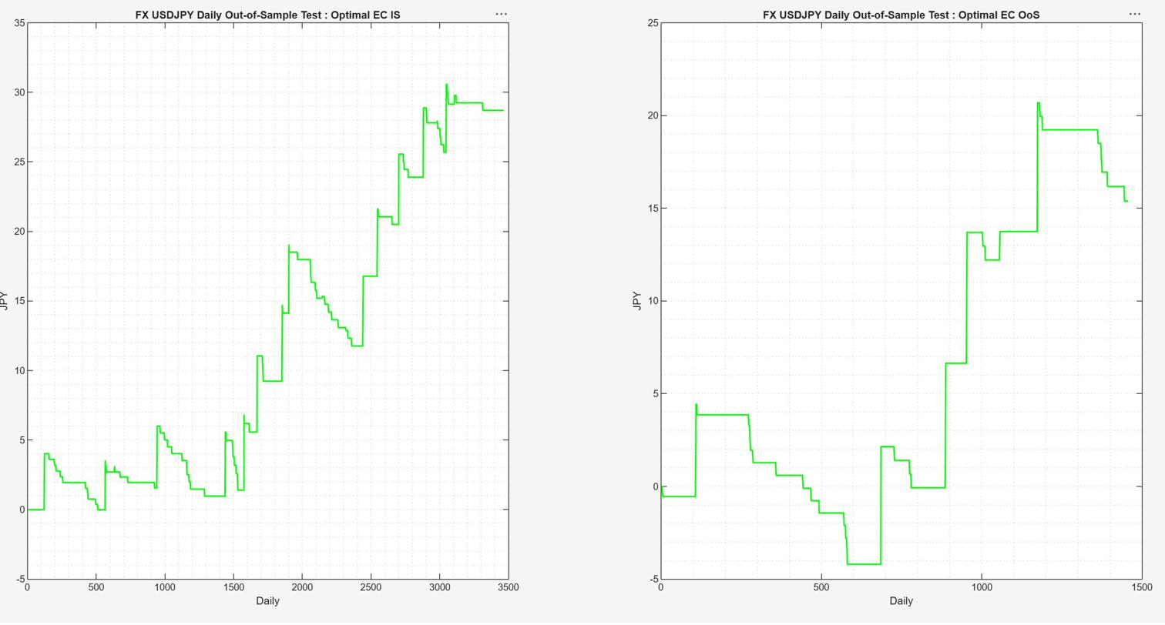
Out-of-Sample — USDJPY
Daily & H4
USDJPY Daily
USDJPY H4
Daily — IS strong; OoS dips then recovers to +20 JPY
H4 — OoS strong: rises to +31 JPY, IS:OoS ratio ≈ 1.2
USDJPY H4 OoS is the standout result — IS:OoS return ratio ≈ 1.2:1, minimal performance degradation

Slide 14
4
Walk-Forward Analysis
Rolling re-optimisation across time windows
Data split into overlapping IS/OoS windows rolled forward in time
Parameters re-optimised at each IS window; applied to the next OoS window
Stitched OoS segments form the WFA equity curve
Tests whether the strategy generalises across different market regimes

Slide 15
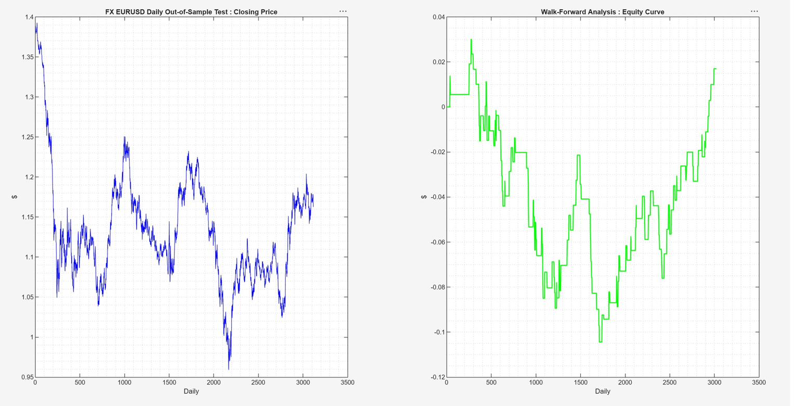
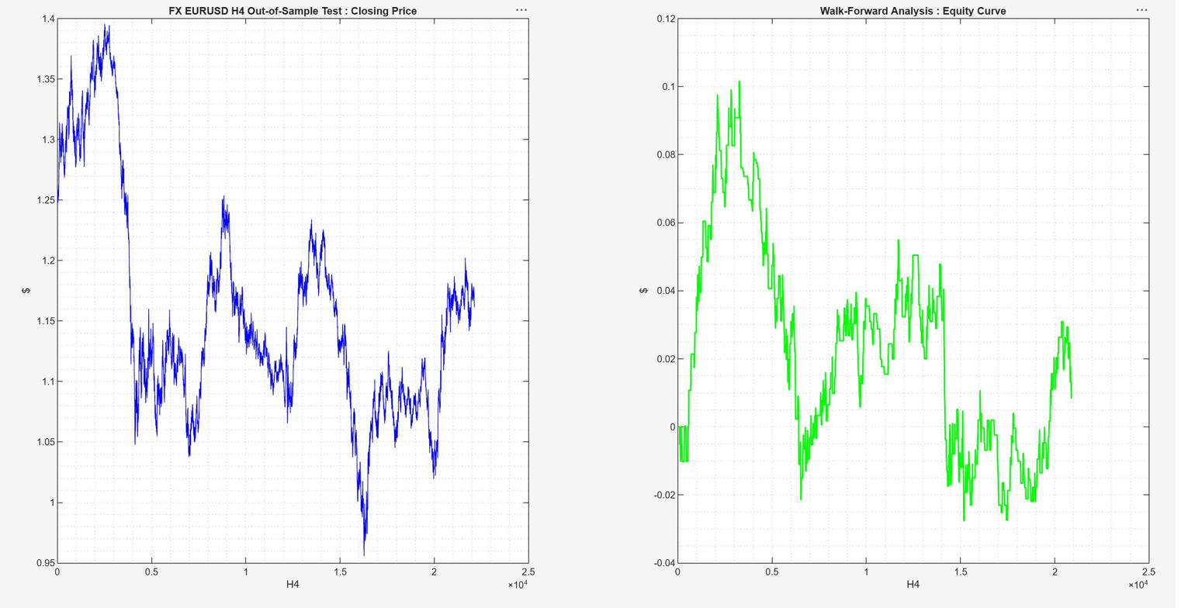
Walk-Forward Analysis — EURUSD
Daily & H4
EURUSD Daily
EURUSD H4
Daily — WFA equity curve (price + WFA P&L)
H4 — WFA: gains early, erosion in ranging period
⚠ EURUSD H4 WFA shows structural weakness — equity curve fails to recover after the 2014–2020 ranging regime

Slide 16
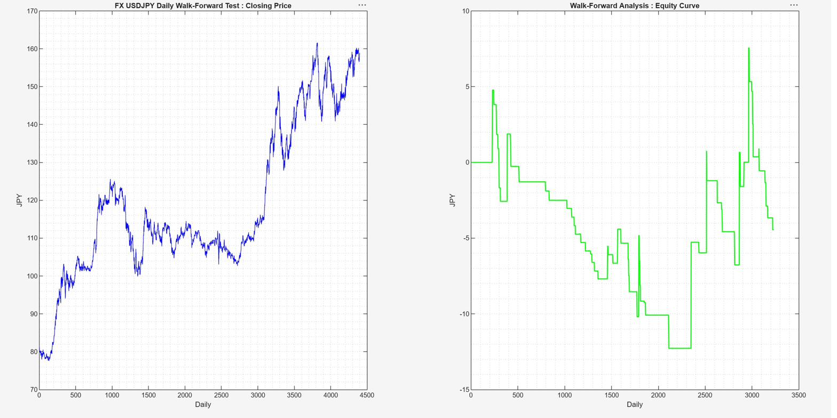
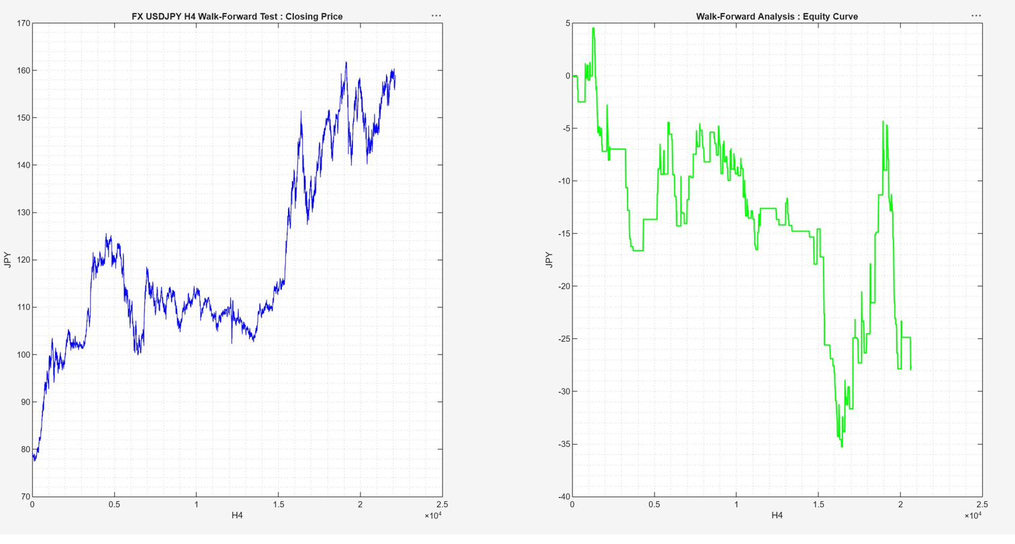
Walk-Forward Analysis — USDJPY
Daily & H4
USDJPY Daily
USDJPY H4
Daily — WFA equity curve negative overall
H4 — WFA: worst result, -35 JPY drawdown
⚠ WFA fails across both USDJPY timeframes — regime shifts between windows cause severe parameter instability

Slide 17
5
Monte Carlo Simulation
Statistical robustness via trade-sequence shuffling
1 000 random reshufflings of the historical trade sequence
Grey fan = distribution of all MC paths · Cyan = mean path · Dashed = ±1σ band
Green = IS actual equity · Blue = OoS actual (post decision point)
Decision gate: if OoS actual falls below lower band → review strategy
Four separate MC analyses: EURUSD Daily / H4, USDJPY Daily / H4

Slide 18
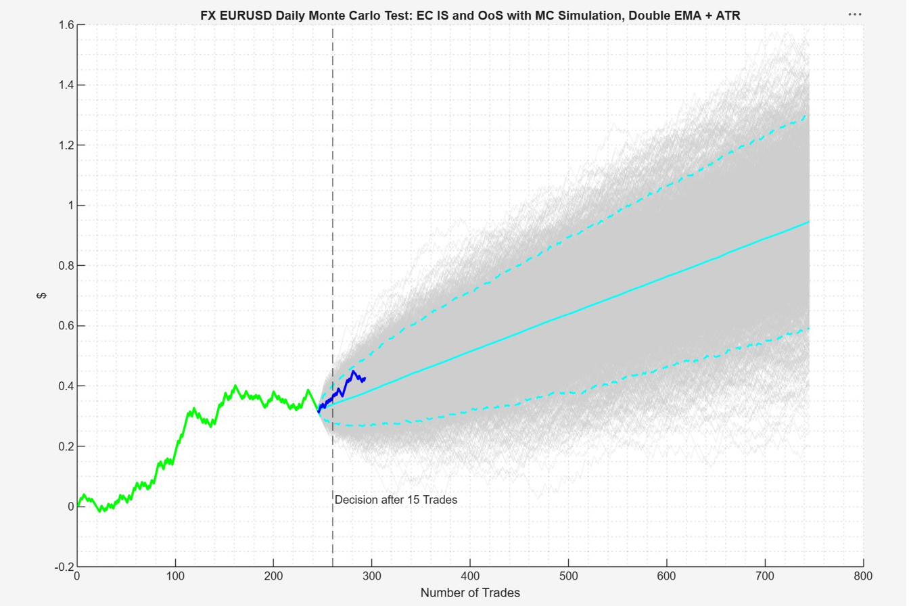
Monte Carlo — EURUSD Daily (1/4)
Full simulation fan
OoS actual (blue) sits above MC median at the 15-trade decision gate — positive early signal
1 000 MC paths | Decision after 15 OoS trades | Blue (OoS actual) tracks above MC mean

Slide 19
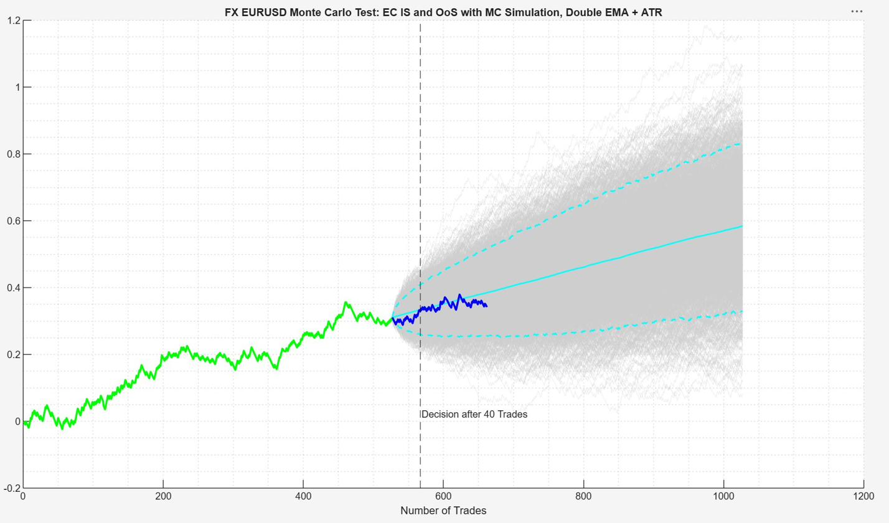
Monte Carlo — EURUSD H4 (1/4)
Full simulation fan
OoS actual marginally below MC mean — passes decision gate but lacks conviction
1 000 MC paths | Decision after 40 OoS trades | OoS actual tracks near MC median

Slide 20
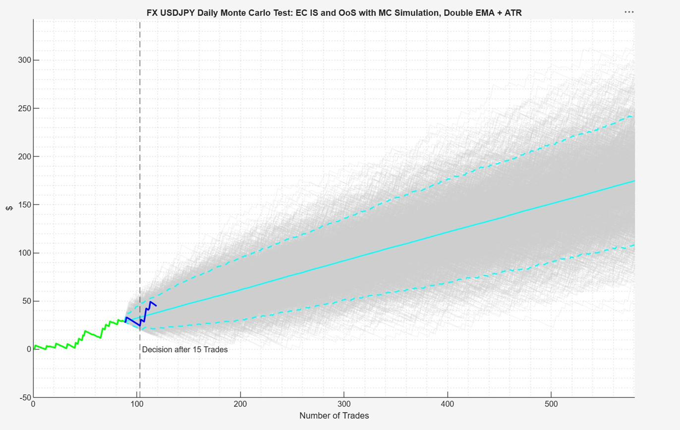
Monte Carlo — USDJPY Daily (1/4)
Full simulation fan
OoS actual within distribution — passes 15-trade MC gate but tracks the lower bound; warrants monitoring
1 000 MC paths | Decision after 15 OoS trades | OoS actual near lower MC confidence band

Slide 21
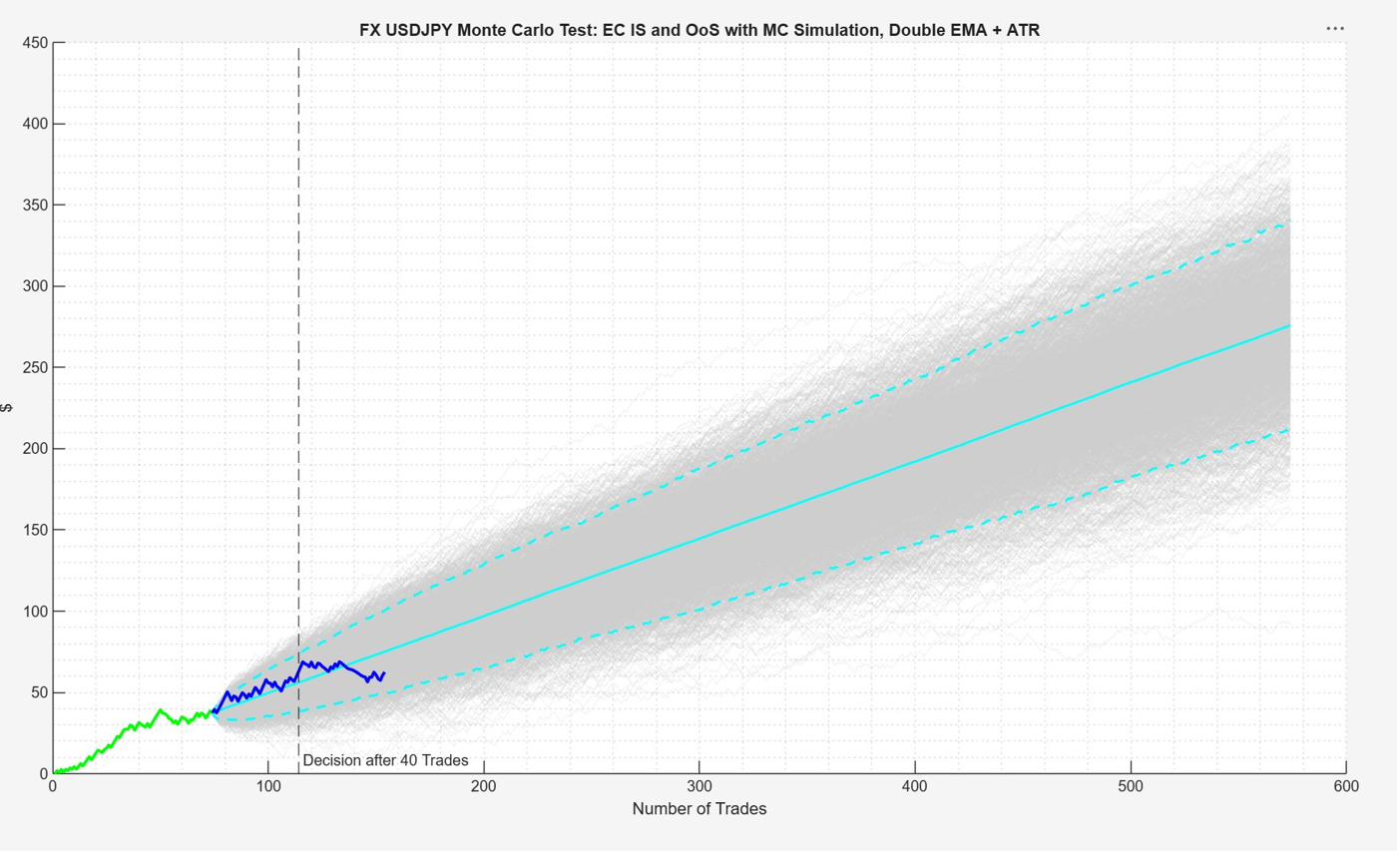
Monte Carlo — USDJPY H4 (1/4)
Full simulation fan
★ OoS actual (blue) tracks above MC mean at 40-trade gate — exceptionally strong MC result
1 000 MC paths | Decision after 40 OoS trades | OoS actual ABOVE MC mean — strongest result

