Slide 1
Construction Management Software
(everything open to discussion)

Slide 2
Major Tasks to Complete
Front-end – website [Jeepal, Dipali]
Back-end – machine learning algorithm, python code [Danylo]
API software – connectivity program/software/code
Hosting platform – Google Cloud Platform?
Database – GCS? SQL database?

Slide 3
Solution (Website) Characteristics
Inputs
Outputs
Mandatory: 1 of 2 (or both)
Transformation Type – dropdown menu of transformations
Additional info – text (transformation and activity description)
Optional: (0, 1, or both)
a) Start Date
b) # of units required
Completion rate: units per day (and error)
Completion time: days per unit (and error)
Optional:
If optional input none: empty
If optional input a: empty
If optional input b: days required to complete
If optional input a+b: predicted end date.

Slide 4
Types of Output
Quantity – yes or no
Time start – yes or no
Time end – yes or no
1. Prediction
2. Error, minimum search
3. Error, maximum search

Slide 5
Quantity
Time Start
Time End
Output 1
Time Start
Time End
Output 2
Time End
Time End
Out 3
Out 4
Out 5
Out 6
Out 7
Out8
Yes
No
Yes
No
Yes
Yes
No
Yes
No
No
Yes
No
Yes
No

Slide 6
Sample Output 1
========== Prediction for Activity 1 ==========
Completion Rate, Days per Unit: ??? (min: ???, max: ???)
Completion Rate, Units per Day: ??? (min: ???, max: ???)
Units: ???
Quantity: ???
Start Date: ????-??-??
End Date: ????-??-??
→ Sufficient Time Allocated to Project OR Insufficient Time Allocated to Project
Predicted Activity End Date:

Slide 7
Sample Output 2
========== Prediction for Activity 1 ==========
Completion Rate, Days per Unit: ??? (min: ???, max: ???)
Completion Rate, Units per Day: ??? (min: ???, max: ???)
Units: ???
Quantity: ???
Start Date: ????-??-??
→ End Date Predicted to be: ????-??-??

Slide 8
Sample Output 3
========== Prediction for Activity 1 ==========
Completion Rate, Days per Unit: ??? (min: ???, max: ???)
Completion Rate, Units per Day: ??? (min: ???, max: ???)
Units: ???
Quantity: ???
End Date: ????-??-??
→ To Complete on Time, Start By: ????-??-??

Slide 9
Sample Output 4
========== Prediction for Activity 1 ==========
Completion Rate, Days per Unit: ??? (min: ???, max: ???)
Completion Rate, Units per Day: ??? (min: ???, max: ???)
Units: ???
Quantity: ???
→ Total Predicted Completion Time: ??? days

Slide 10
Sample Output 5
========== Prediction for Activity 1 ==========
Completion Rate, Days per Unit: ??? (min: ???, max: ???)
Completion Rate, Units per Day: ??? (min: ???, max: ???)
Units: ???
Start Date: ????-??-??
End Date: ????-??-??
→ Number of Units completed in timeframe: ???

Slide 11
Sample Output 6, 7 and 8
========== Prediction for Activity 1 ==========
Completion Rate, Days per Unit: ??? (min: ???, max: ???)
Completion Rate, Units per Day: ??? (min: ???, max: ???)
Units: ???

Slide 12
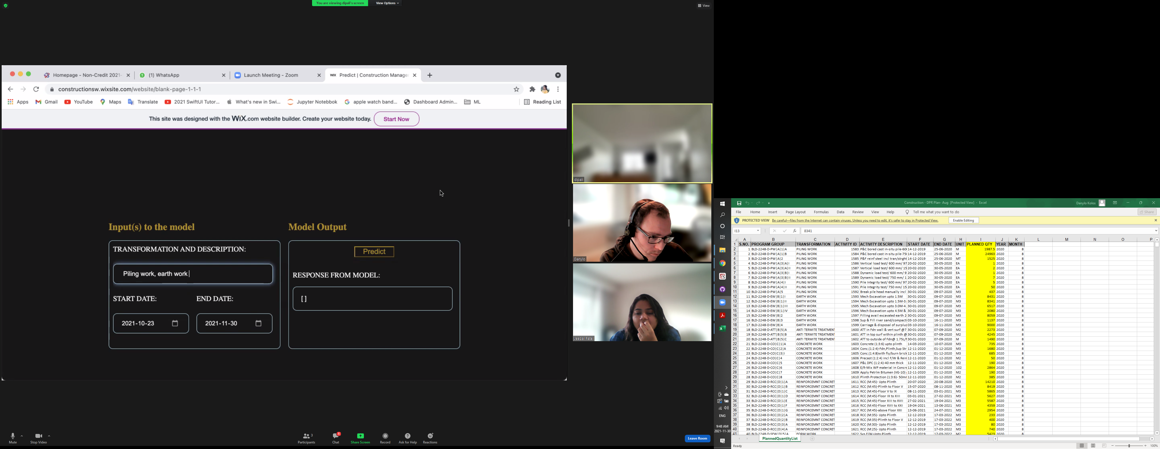

Slide 15
Input = Blue, Output = Red
Units
Transformation
Description
Output
199
Drop-down
Flooring 1.5mm
Start Date
End Date

Slide 16
Construction Management – Back-End Code
Data after Feature Engineering
Tasks
With a user input of a transformation type and a description:
Predict rate at which tasks can be completed.
Predict type of units

