Slide 1
Construction Management Software
(everything open to discussion)

Slide 2
Major Tasks to Complete
Front-end – website [Jeepal, Dipali]
Back-end – machine learning algorithm, python code [Danylo]
API software – connectivity program/software/code
Hosting platform – Google Cloud Platform?
Database – GCS? SQL database?

Slide 3
Solution (Website) Characteristics
Inputs
Outputs
Mandatory: 1 of 2 (or both)
Transformation Type – dropdown menu of transformations
Additional info – text (transformation and activity description)
Optional: (0, 1, or both)
a) Start Date
b) # of units required
Completion rate: units per day (and error)
Completion time: days per unit (and error)
Optional:
If optional input none: empty
If optional input a: empty
If optional input b: days required to complete
If optional input a+b: predicted end date.

Slide 4
Types of Output
Quantity – yes or no
Time start – yes or no
Time end – yes or no
1. Prediction
2. Error, minimum search
3. Error, maximum search

Slide 5
Quantity
Time Start
Time End
Output 1
Time Start
Time End
Output 2
Time End
Time End
Out 3
Out 4
Out 5
Out 6
Out 7
Out8
Yes
No
Yes
No
Yes
Yes
No
Yes
No
No
Yes
No
Yes
No

Slide 6
Sample Output 1
========== Prediction for Activity 1 ==========
Completion Rate, Days per Unit: ??? (min: ???, max: ???)
Completion Rate, Units per Day: ??? (min: ???, max: ???)
Units: ???
Quantity: ???
Start Date: ????-??-??
End Date: ????-??-??
→ Sufficient Time Allocated to Project OR Insufficient Time Allocated to Project
Predicted Activity End Date:

Slide 7
Sample Output 2
========== Prediction for Activity 1 ==========
Completion Rate, Days per Unit: ??? (min: ???, max: ???)
Completion Rate, Units per Day: ??? (min: ???, max: ???)
Units: ???
Quantity: ???
Start Date: ????-??-??
→ End Date Predicted to be: ????-??-??

Slide 8
Sample Output 3
========== Prediction for Activity 1 ==========
Completion Rate, Days per Unit: ??? (min: ???, max: ???)
Completion Rate, Units per Day: ??? (min: ???, max: ???)
Units: ???
Quantity: ???
End Date: ????-??-??
→ To Complete on Time, Start By: ????-??-??

Slide 9
Sample Output 4
========== Prediction for Activity 1 ==========
Completion Rate, Days per Unit: ??? (min: ???, max: ???)
Completion Rate, Units per Day: ??? (min: ???, max: ???)
Units: ???
Quantity: ???
→ Total Predicted Completion Time: ??? days

Slide 10
Sample Output 5
========== Prediction for Activity 1 ==========
Completion Rate, Days per Unit: ??? (min: ???, max: ???)
Completion Rate, Units per Day: ??? (min: ???, max: ???)
Units: ???
Start Date: ????-??-??
End Date: ????-??-??
→ Number of Units completed in timeframe: ???

Slide 11
Sample Output 6, 7 and 8
========== Prediction for Activity 1 ==========
Completion Rate, Days per Unit: ??? (min: ???, max: ???)
Completion Rate, Units per Day: ??? (min: ???, max: ???)
Units: ???

Slide 12
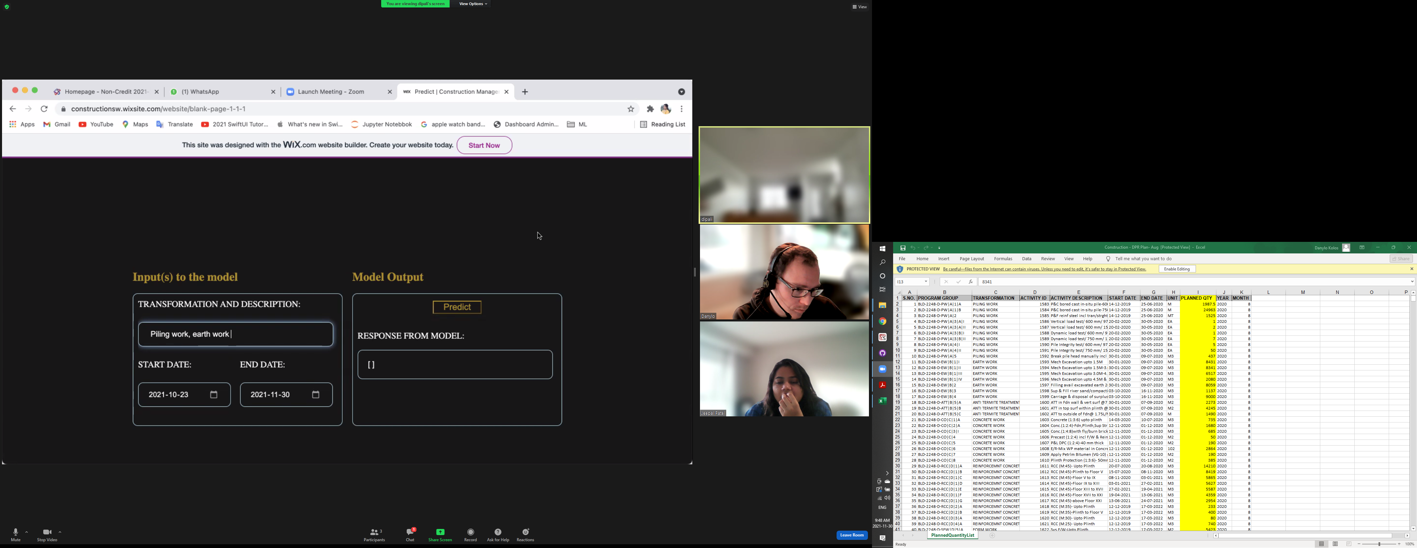

Slide 15
Input = Blue, Output = Red
Units
Transformation
Description
Output
199
Drop-down
Flooring 1.5mm
Start Date
End Date

Slide 16
Construction Management Back-End Code

Slide 17
Input Data and Tasks
Data after Feature Engineering
Tasks
With a user input of a transformation type and a description:
Predict rate at which tasks can be completed.
Predict type of units

Slide 18
How does the code do it?
Read in data
Data Wrangling – remove unwanted columns, zero values, calculate new features
Split data
Text Vectorization – convert each word to unique columns in dataset
Build machine learning model for predicting completion rate and unit type
Analyze results

Slide 19
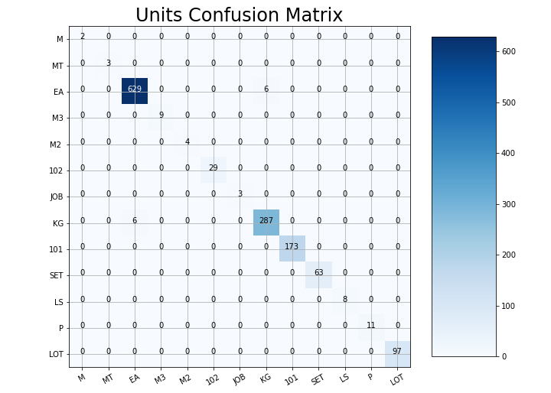
Model Performance
Completion Rate
Unit Type
Range of data: from 0.002 to 826 days per unit
Median Absolute Error: 47.1 days per unit
Mean Absolute Error: 126 days per unit
Mean Absolute Percentage Error: 537%
Accuracy Score: 99%

Slide 20
Extra features
Spelling correction
Uses English dictionary and construction dataset to identify misspelled words and find a replacement
Direct search of text string to find matches
Returns min/max completion rate values to be able to compare with machine learning model prediction.

