Slide 1
SmartStickers
Zemlianyi Danylo
Klobudskyi Dmytro
Kryhina Olena

Slide 2

Key Partners
NFC tag manufacturers
Customer support services
Technical support

Slide 3
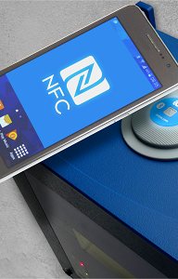
Key Activities
Equipment management
Access control
Activities statistics

Slide 4
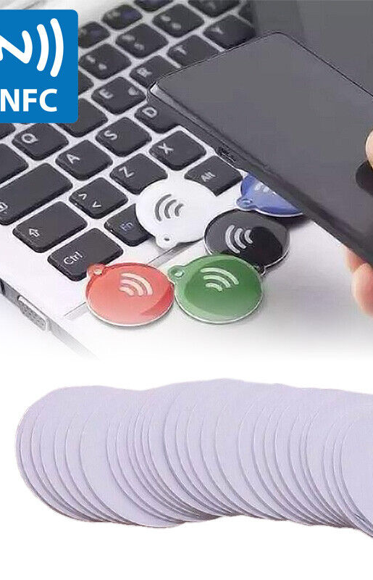

Key Resources
Trained specialists
NFC equipment
Reliable server

Slide 5
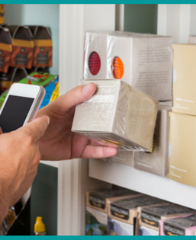
Value Propositions
Security
Comfortable access to equipment
Easy management

Slide 6

Customer Relationships
Automation (if possible)
24/7 access to application
Technical support

Slide 7
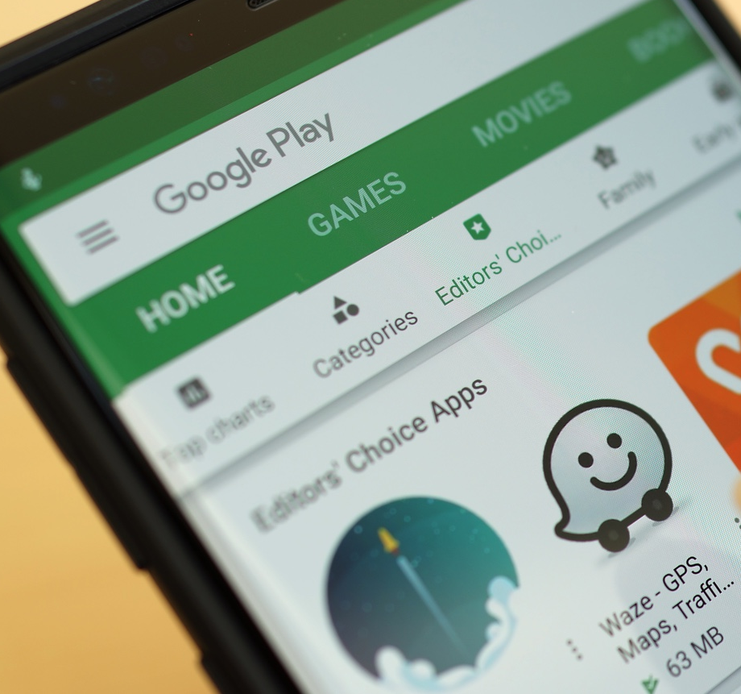
Channels
Application
Technical support

Slide 8

Customer Segments
Manufacturers
Hotel owners
Enterprises
Smart-Home enthusiasts

Slide 9

Cost Structure
NFC tags
Product development
Salaries
Equipment cost
Rent

Slide 10

Revenue Streams
Subscriptions
Enterprise product sale

