Slide 1

Locaiton based Taxi Aggregator and Selector
Developed By,

Slide 2
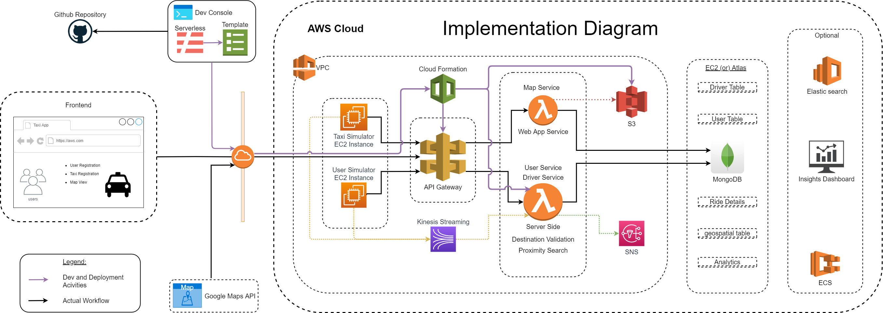

Slide 3
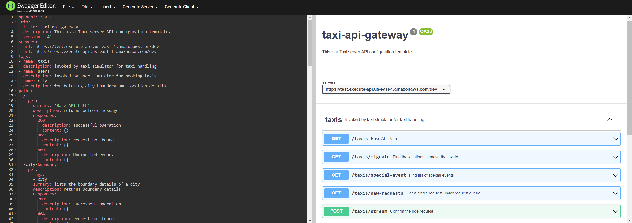
API Diagram

Slide 4
Technology Highlights
Flutter - Dart
AWS Lambda & API gateway
Mongodb & Aggregation framework
NodeJS, Python
Serverless framework, google API
Matplotlib, Seaborn

Slide 5
Frontend Highlights
Description : Flutter Web application that use google maps to display the transaction regarding booking a cab, it also integrated with Payment system, free movement of taxis on the map.
Purpose
Steps to execute
Scenarios supported

Slide 6
Simulators Highlights (Taxi, User)
Purpose
Description
Steps to execute
Scenarios supported

Slide 7
Insights Highlights
Purpose
Description
Steps to execute
Scenarios supported

Slide 8
References

