Slide 1

Locaiton based Taxi Aggregator and Selector
Developed By,

Slide 2
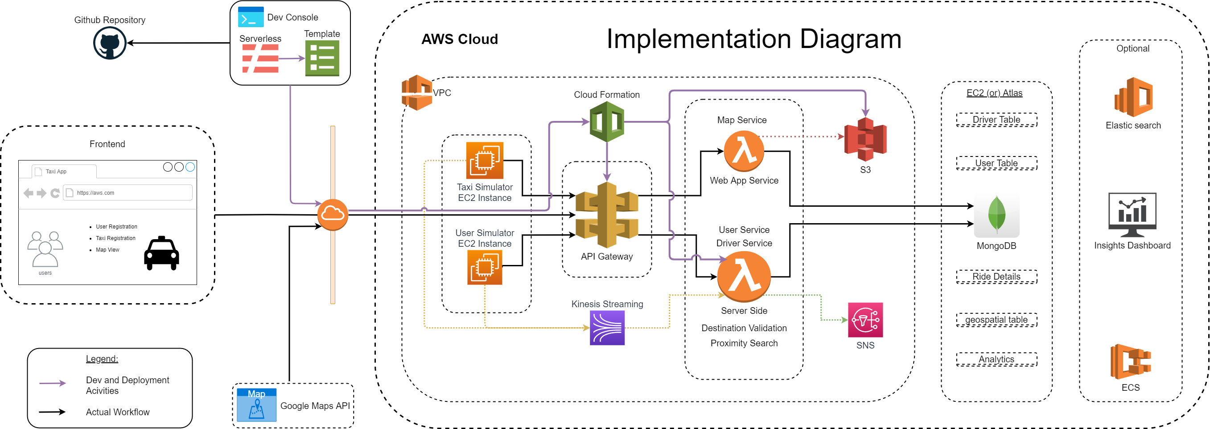

Slide 3
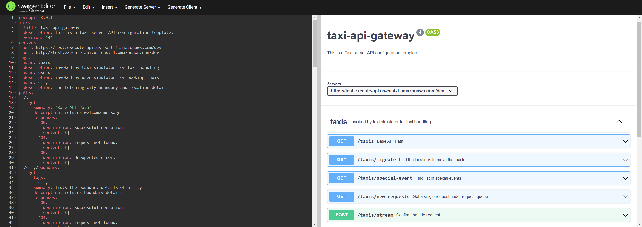
API Diagram

Slide 4
Technology Highlights
Flutter - Dart
AWS Lambda & API gateway
Mongodb & Aggregation framework
NodeJS, Python
Serverless framework, google API
Matplotlib, Seaborn

Slide 5
Frontend Highlights
Description :
Flutter Web App using Google Maps and making REST API calls to AWS API Gateway storing data into Mongo DB.
Purpose :
Users can do the following:
(Taxi/Passenger) ->uses front end to SignUp, Login.
(Passenger) ->Book taxi, View Rides on map, Give feedback, Pay for ride.
(Taxi) -> View location of passenger, View route.
Tech Stack
Flutter with dart in Android Studio to code the front end (flutter and dart packages include google-maps for flutter web)
AWS API Gateway, AWS Lambda, AWS SNS
Mongo DB Atlas Free tier

Slide 6
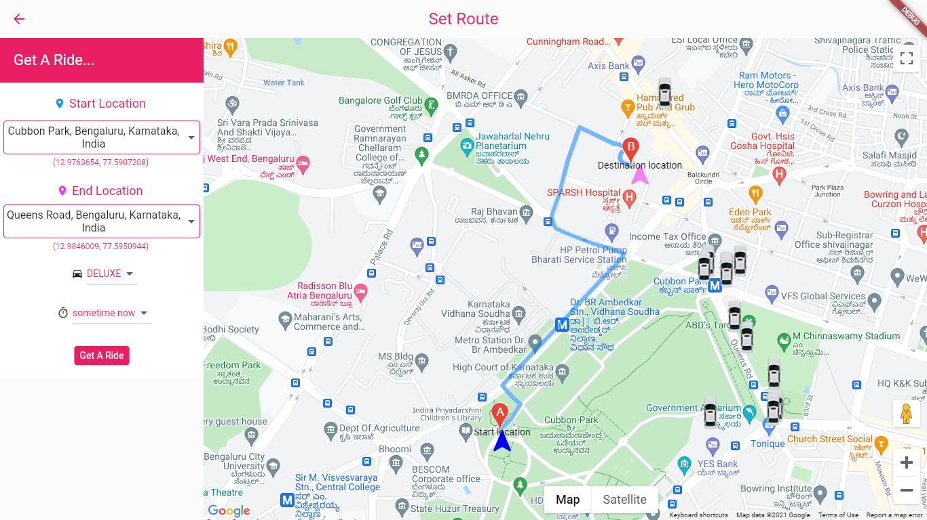
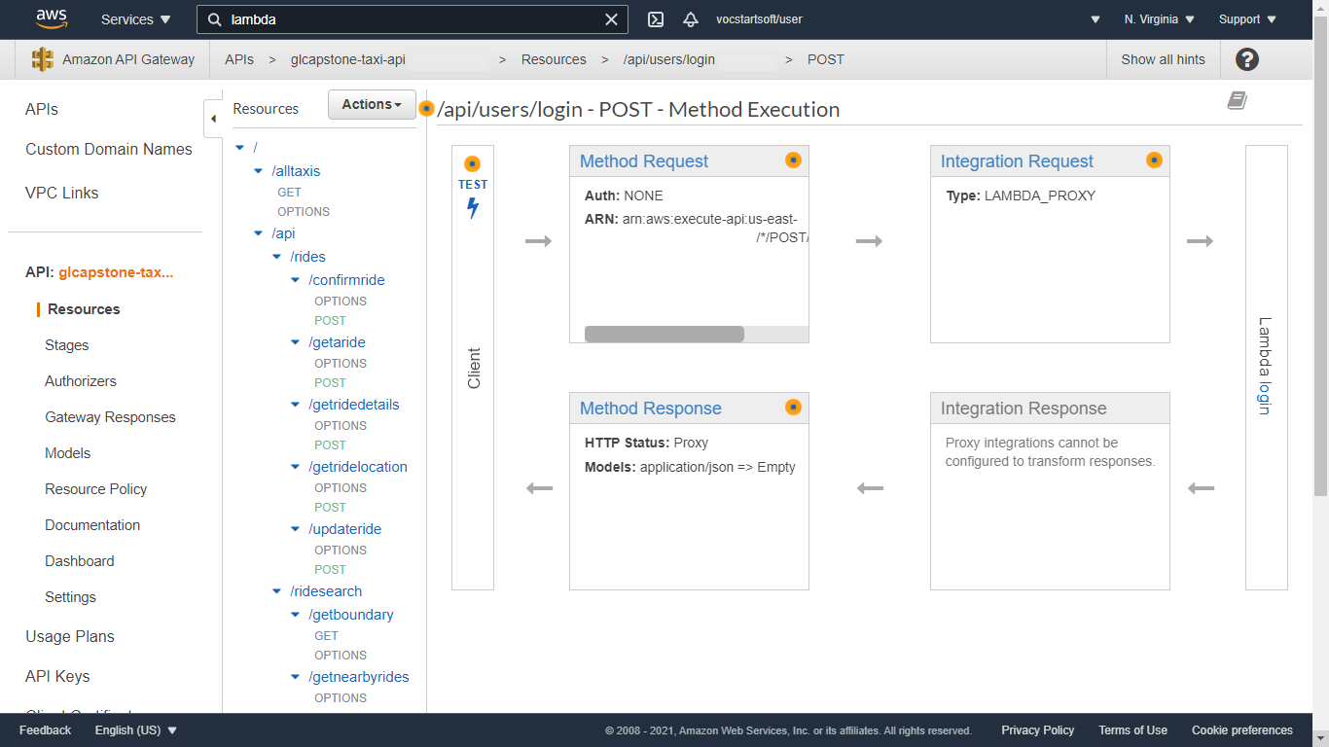
Frontend UI

Slide 7
Simulators Highlights (Taxi, User)
Purpose
Description
Steps to execute
Scenarios supported

Slide 8
Insights Highlights
Purpose
Description
Steps to execute
Scenarios supported

Slide 9
References

