Slide 1
Are you a resident of Bangalore ?
Tired of booking cabs ?
Frustrated with long waiting time and poor Interface ?
{{{{{TAXI}}}}}}
Introducing
The most advanced cloud-based system in the market
A one stop solution for all your struggles ;)
Now available in Beta ……………

Slide 2

CAPSTONE PROJECT
Location based Taxi Aggregator and Selector
Designed and Developed By,
ANKITA SHREYA | ANDLIBMEHNDI NAQVI |  | HARSHIV VIKRAM SHA
SREENATH KIZHEMADAM |  | NISCHITA SHETTY
VIGNESH KUMAR

Slide 3
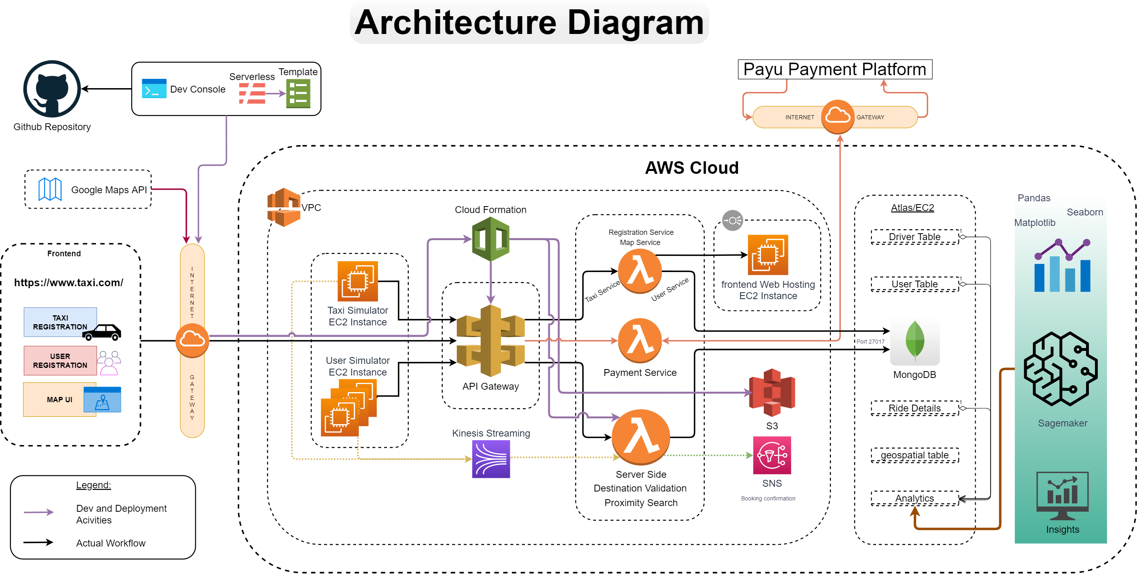

Slide 4
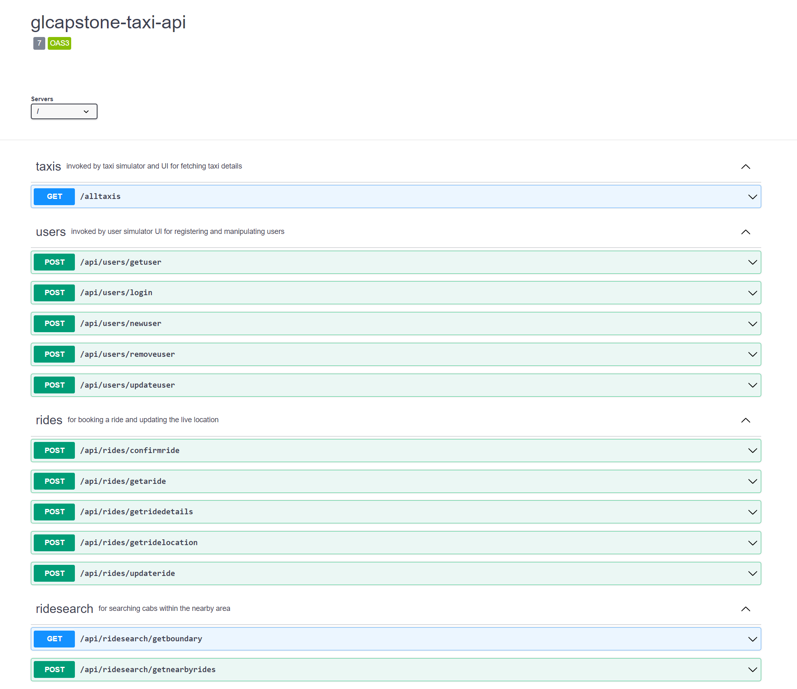
API Diagram

Slide 5

Tools, Language and Framework Highlights
Flutter - Dart
AWS Lambda & API gateway
MongoDB & Aggregation framework
NodeJS, Python
Serverless Framework, Google API
Matplotlib, Seaborn

Slide 6
Frontend Highlights
Description :
Flutter Web App using Google Maps and making REST API calls to AWS API Gateway storing data into Mongo DB.
Purpose :
Users can do the following:
(Taxi/Passenger) ->uses front end to SignUp, Login.
(Passenger) ->Book taxi, View Rides on map, Give feedback, Pay for ride.
(Taxi) -> View location of passenger, View route.
Tech Stack
Flutter with dart in Android Studio to code the front end (flutter and dart packages include google-maps for flutter web)
AWS API Gateway, AWS Lambda, AWS SNS
Mongo DB Atlas Free tier

Slide 7
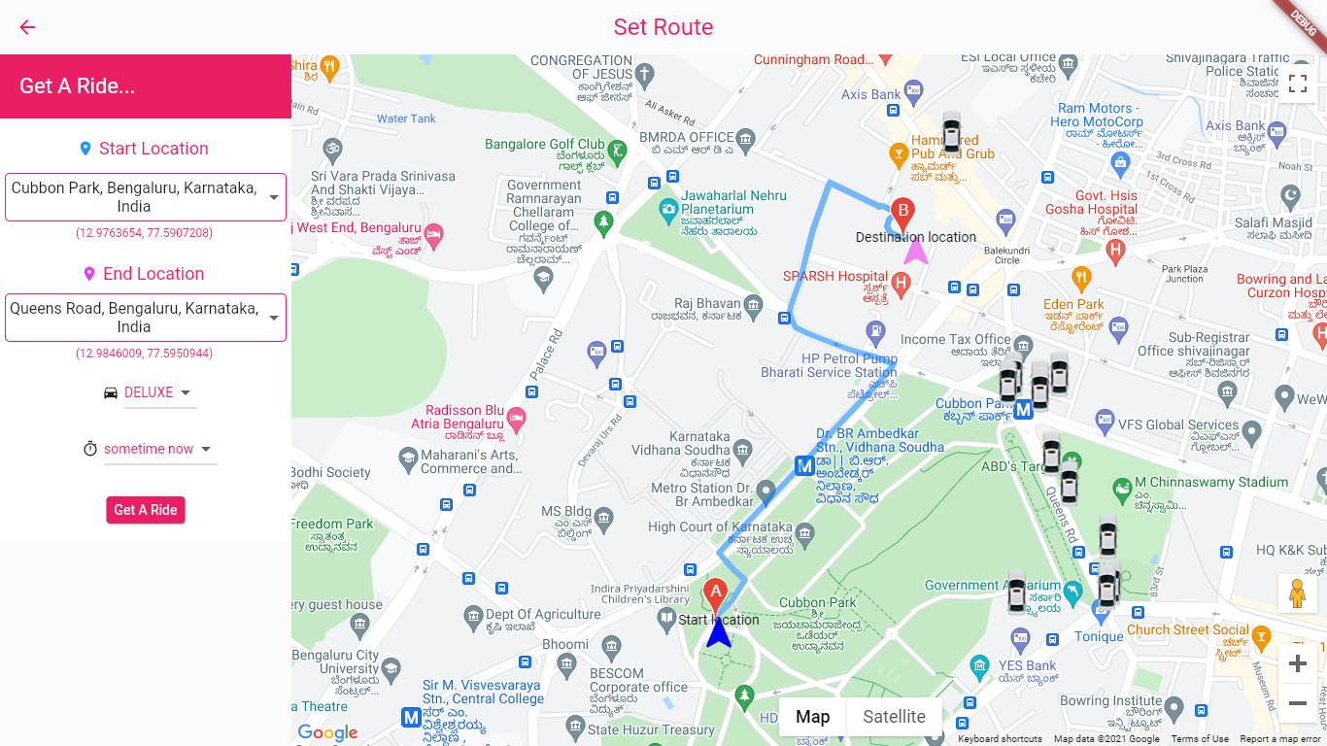
Map UI

Slide 8
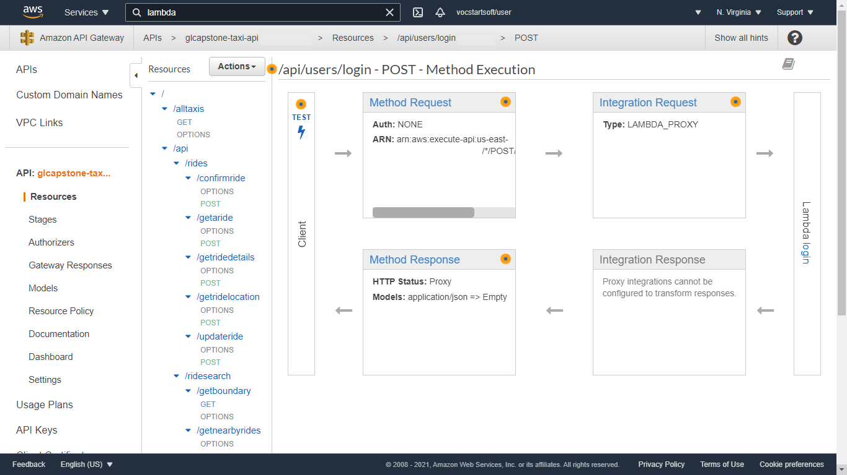
API Gateway

Slide 9
Simulators Highlights (Taxi)
Purpose - Generate initial random coordinates and then move taxi free in given boundary.
Description - First we need to fetch all taxi list from the database and then generate initial coordinates for all taxi and after that start free movement of taxi at every 1 minute at 500 m distance. Simulator will also assign new coordinates to each taxi by calculating distance given above from previous coordinates. Simulator also keep an eye that taxi will not be able to go outside define boundary. All data will push to kinesis and from there it will trigger lambda function which insert data in database.
Steps to execute - All code reside in EC2 instance, and you just need to run main.py file to start execution of taxi simulator. Give appropriate rights to EC2 (i.e.- Kinesis role) and install external libraries used in simulator.
Scenarios supported -
Taxi initial random location generation within boundary
Move taxi at every 1 min
Generate new coordinates from old coordinates
Validate coordinates within boundary or not
Push data to kinesis
Placeholder INSERT CONSOLE LOGS HERE

Slide 10
Simulators Highlights (User)
Purpose- To simulate Taxi movement and User actions to showcase taxi movement and booking scenarios
Description- Taxi Simulator and User Simulators majorly used to simulate Taxi driver and User actions and movements in order to provide user interface like behavior
Steps to execute- Both Taxi Simulators and User simulators are placed in AWS EC machines.
Scenarios supported-
Taxi Simulator supports:
Taxi generation
Taxi Tracking
Taxi movement
User Simulator Supports
User Signup
User Signin
Taxi Booking
Placeholder INSERT CONSOLE LOGS HERE

Slide 11

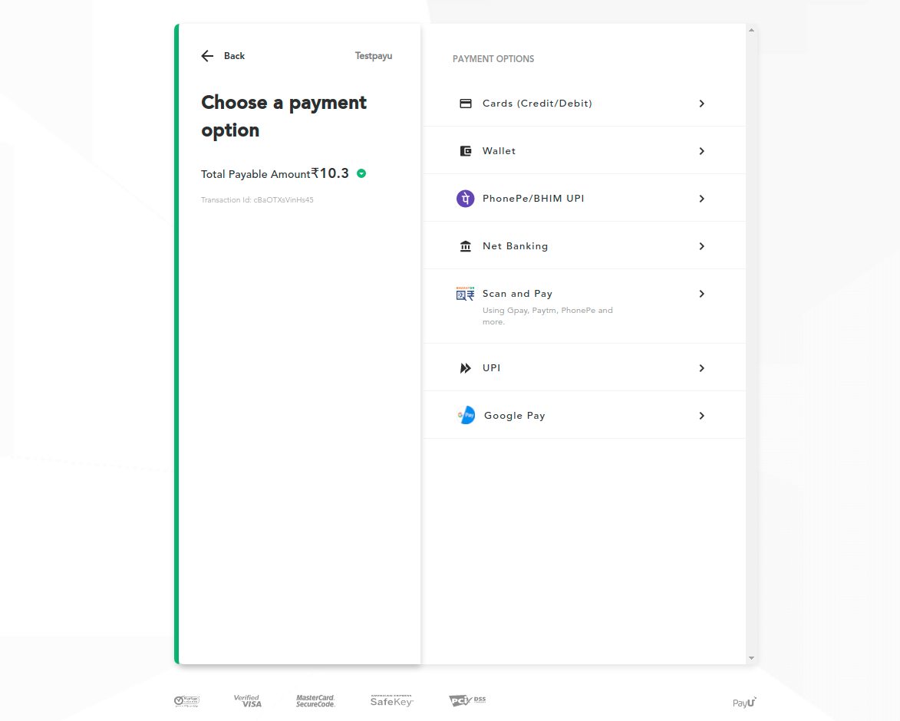
Payments
Purpose- Initiates the transaction for the customers availing TravelCare services.
Description – Provides a lot of payment methods letting the customer choose as per their convenience.
Methods: Using Pre-built in Checkout supported by PayU

Slide 12
Insights Highlights
Purpose
Description
Steps to execute
Scenarios supported

Slide 13
References
https://flutter.dev/docs
https://flask.palletsprojects.com/en/2.0.x/
https://nodejs.org/api/
https://docs.aws.amazon.com/lambda/index.html
https://docs.mongodb.com/manual/
https://www.practical-mongodb-aggregations.com/
https://seaborn.pydata.org/api.html
https://pandas.pydata.org/docs/reference/index.html

Slide 14


Our sincere thanks to the faculties of IIT-Madras and Great Learning

Slide 15
Thank You

