Slide 1
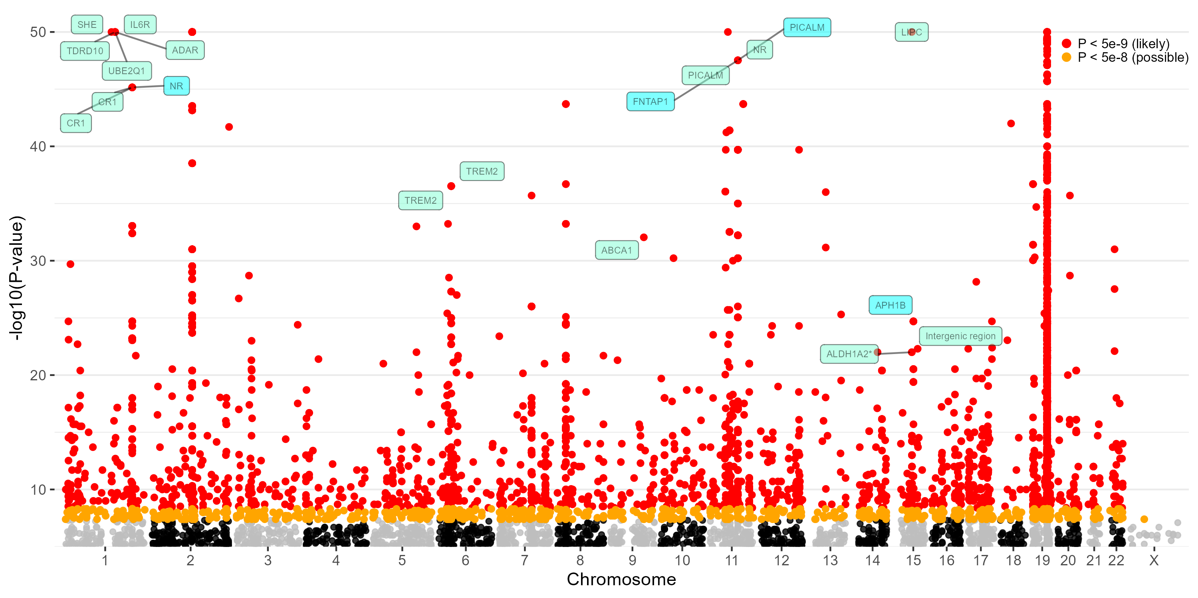
Manhattan plot

Slide 2
