Slide 1

Towards resolution invariant face recognition in uncontrolled scenarios
Dan Zeng, Hu Chen, Qijun Zhao
College of Computer Science
Sichuan University, China
Poster Session : II
Date: Thu 16 June 2016, 11:30-13:00
International Conference
on Biometrics, 2016
Notes:
Please amend the template as follows:
1- Title slide: please fill in the spotlight session number (from the program), the date of the presentation, the title and the authors of the paper. Please underline the name of the person giving the spotlight talk.
2- The second slide should give a brief summary of the approach taken in the paper and the most interesting results obtained by the approach. Feel free to include pictures. However, do not include any videos in the slides. Do NOT change fonts or font sizes.
.
3- There is a strict limit of two slides per presentation (title + content) - If multiple slides are submitted, only the first content one will be included in the program. There will also be a hard limit of 2 minutes per talk, so please prepare the content accordingly.
4- Submit the .ppt file containing the presentation through CMT: https://cmt.research.microsoft.com/ICB2015/
The slides will be put together into a single file for each session, which necessitates a single format. Thus submit the presentation in the Powerpoint format (as the given template). Please test the presentation before submitting.
Additional Details:
Presenters will NOT have access to the computer on which the presentations will run. All spotlights in the same session will be compiled into a single presentation, and slides will automatically advance.
The first (title) slide of each presentation will be shown for exactly 10 seconds during which the microphone will be handed over to the presenter and the presenter will introduce himself/herself, the authors and the title of the paper.
The second slide will be shown for exactly 110 seconds. This timing is strict and you are kindly asked to leave the podium for the next presenter after the 110seconds are up.
Clickable animations are NOT accepted and will be removed if found during the process of compiling the session's presentation.
We thank you for your cooperation! See you at ICB!

Slide 2
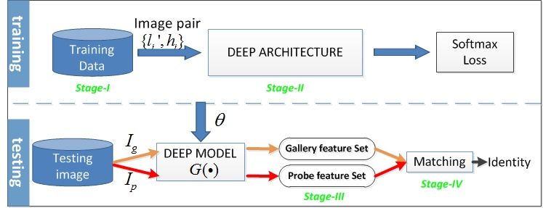
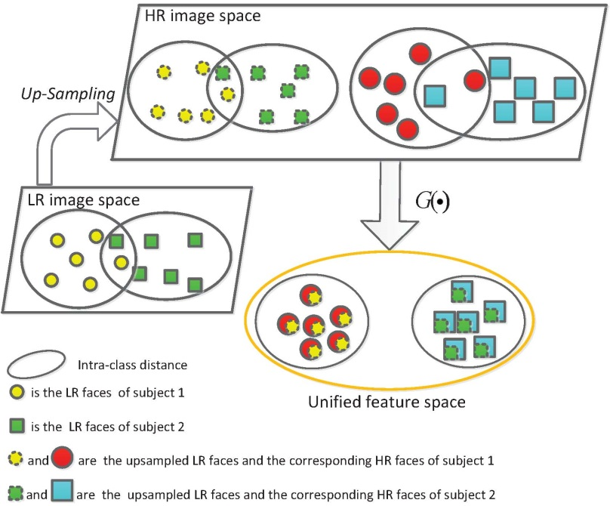
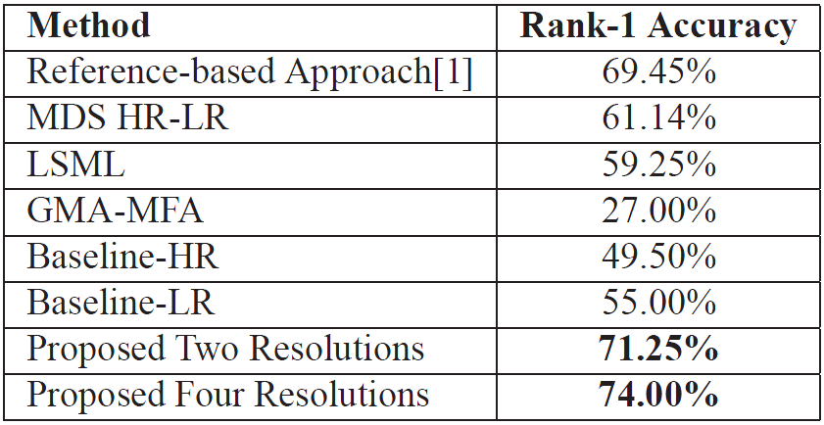
Towards resolution invariant face recognition in uncontrolled scenarios
Proposed approach
Key Results
International Conference
on Biometrics, 2016
[1] S. Mudunuri and S. Biswas. Low resolution face recognition across variations in pose and illumination. Pattern Analysis and Machine Intelligence, IEEE Transactions on, PP(99):1–1, 2015.
Notes:
Please amend the template as follows:
1- Title slide: please fill in the spotlight session number (from the program), the date of the presentation, the title and the authors of the paper. Please underline the name of the person giving the spotlight talk.
2- The second slide should give a brief summary of the approach taken in the paper and the most interesting results obtained by the approach. Feel free to include pictures. However, do not include any videos in the slides. Do NOT change fonts or font sizes.
.
3- There is a strict limit of two slides per presentation (title + content) - If multiple slides are submitted, only the first content one will be included in the program. There will also be a hard limit of 2 minutes per talk, so please prepare the content accordingly.
4- Submit the .ppt file containing the presentation through CMT: https://cmt.research.microsoft.com/ICB2015/
The slides will be put together into a single file for each session, which necessitates a single format. Thus submit the presentation in the Powerpoint format (as the given template). Please test the presentation before submitting.
Additional Details:
Presenters will NOT have access to the computer on which the presentations will run. All spotlights in the same session will be compiled into a single presentation, and slides will automatically advance.
The first (title) slide of each presentation will be shown for exactly 10 seconds during which the microphone will be handed over to the presenter and the presenter will introduce himself/herself, the authors and the title of the paper.
The second slide will be shown for exactly 110 seconds. This timing is strict and you are kindly asked to leave the podium for the next presenter after the 110seconds are up.
Clickable animations are NOT accepted and will be removed if found during the process of compiling the session's presentation.
We thank you for your cooperation! See you at ICB!

