Slide 1

Likelihood Ratio based Loss to finetune CNNs for Very Low Resolution Face Verification
Dan Zeng, Raymond Veldhuis, Luuk Spreeuwers, Qijun Zhao
2019-06-05
Notes:
Hello, everyone. Thank you for being here. My name is Dan Zeng.
Today, I will introduce our work:
Likelihood ratio based loss to finetune CNNs for very low resolution face verification
This is a collaborative /kə'læbərətɪ/
work by University of twente and Sichuan University

Slide 2
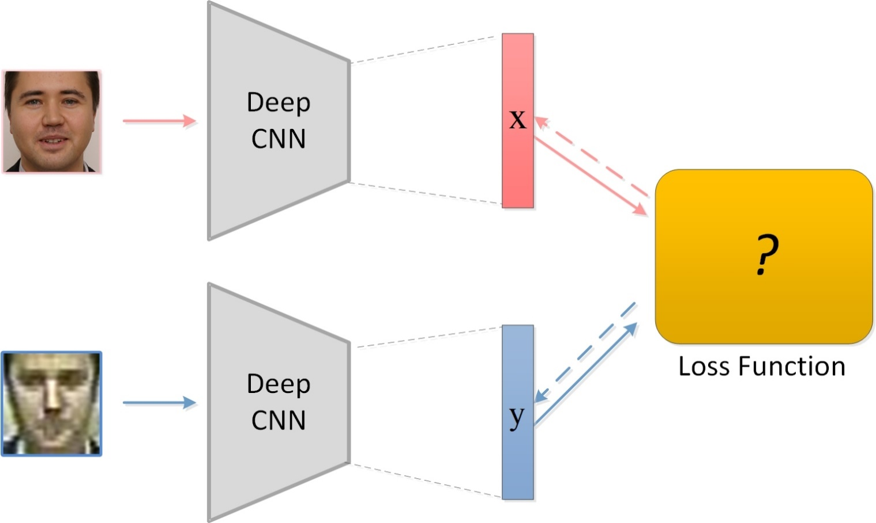
CNNs for Face Verification
2
Notes:
In recent years, the development of deep learning has brought renovation and boosted the performance in many application domains. (click)
As for deep CNNs, the network architecture and the loss functions are two main parts. This is one of the most widely used CNNs framework for face verification. We focus on the loss design and take the very low resolution face verification as a casestudy .

Slide 3
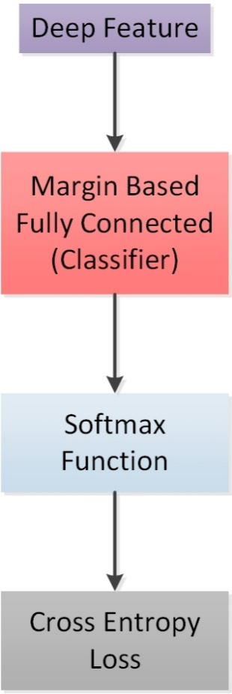
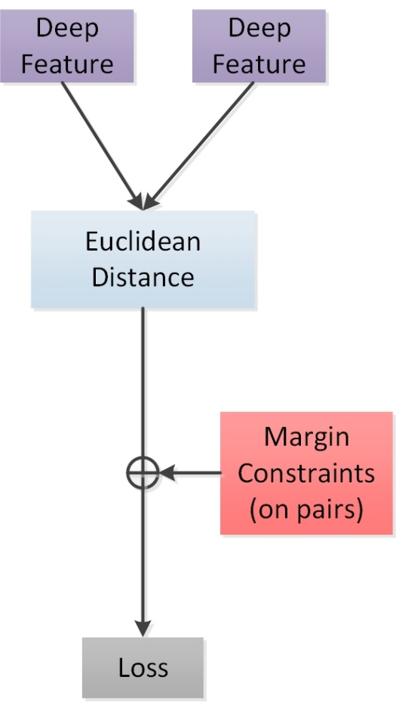
Loss Functions
Identification loss
Verification loss
3
Notes:
Loss functions can be classified into two categories.
Some loss functions improve the softmax loss, to learn large-margin embedded features. They are usually called ‘margin-based softmax loss’ or ‘identification loss’.（click）This category intends to improve the classifier part by imposing margin constraints on features(click）
The other loss functions impose Euclidean margin constraints between features of image pairs, which classified as the ‘metric learning loss or ‘verification loss’. (click)The use of image pairs instead of single image for training is an intuitive way for biometric verification.However, these existing loss functions fail to guarantee the best discriminative ability of embedded features.

Slide 4
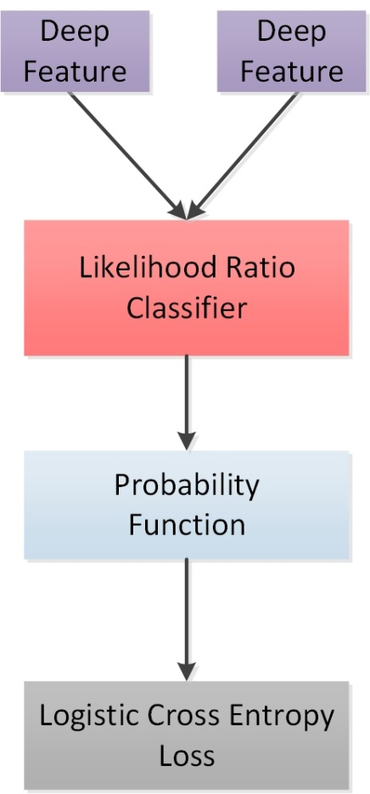
Motivation
Better classifier, better loss function
Identification losses
Intuitive way for
face verification
Verification losses
Optimal classifier
Likelihood ratio
classifier
4
Notes:
There are three stuff motivate our work.(click)
From the identification losses, which improve the classifier part (i.e., fully connect layer) to strength the loss function, in other words, the improvement of loss functions heavily relies on how good THE classifier part is! To sum up, better classifier induces more powerful loss function; (click)
2）The existing verification losses provide an intuitive way for face verification task which determines whether a pair of face belongs to the same identity. (click)
3）Likelihood ratio classifier which is an optimal classifier in Neyman-Peason sense, to give the highest verification rate at a given false accept rate, WHEN the data obey the Gaussian distribution.
(click)
Combine with these three aspects, we propose our loss function. The proposed loss function directly optimizes the constraints between image pairs which is quite intuitive as well as effective because of the use of likelihood ratio classifier.

Slide 5
Contributions
A likelihood ratio based loss function
A training procedure to fine tune CNNs trained on arbitrary losses with limited data
State of the art results on VLR Scface dataset
5
Notes:
Here are the lists of our contributions,
First, we propose a likelihood ratio based loss function to take advantage of an optimal classifier to help supervise network training? (click)
Second, since collecting large amount of data for specific scenario is not an easy task. we design training procedure for deep CNNs fine-tune with very limited data available, and these CNNs can be trained by arbitrary losses ahead.(click)
Third, we apply the proposed method on very low resolution face recognition and obtain the SOTA results on Scface dataset.(click)
The rest of the presentation will follow these three contributions. First, introduce the proposed loss function. Then describe the training procedure. Finally we demonstrate our results.

Slide 6
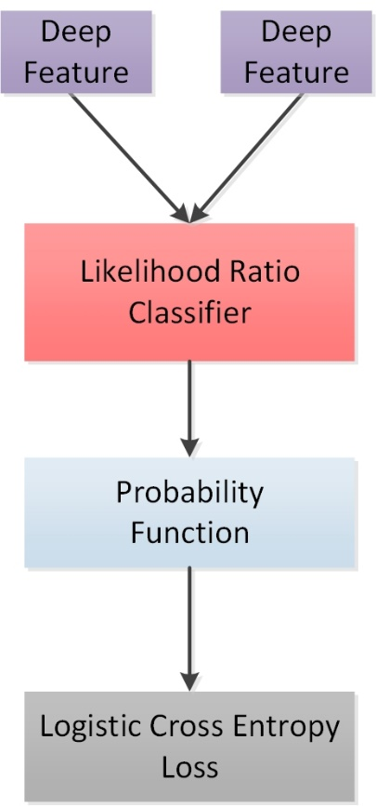
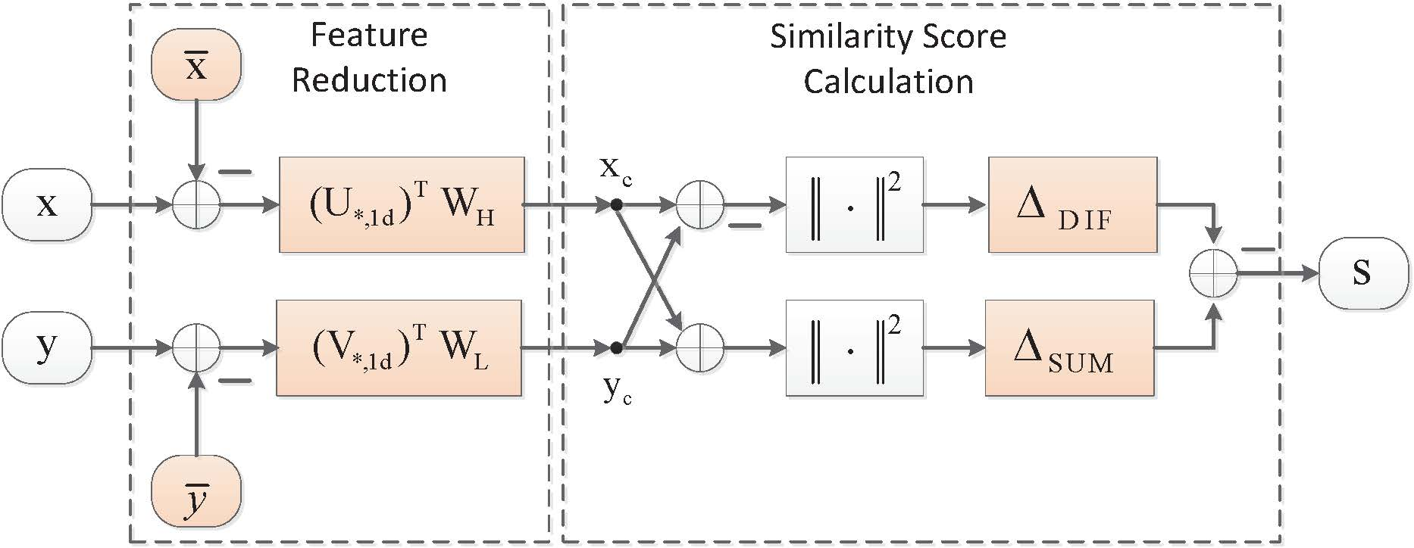
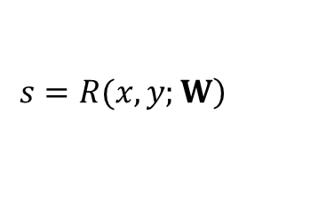
Likelihood ratio based loss
Likelihood ratio classifier
Likelihood ratio score obtained by the classifier is denoted as,
$$\left.s=R(x,y;W\right)$$
6
Notes:
Likelihood ratio based loss is shown here. Once the deep features are already, then we can get the likelihood ratio score based on the formula. We hold the assumption that the deep features obey the Gaussian distribution. The initial deep features of image pairs are represented by x and y, respectively. Where parameter W is the covariance and cross-covariance matrices that needs to be estimated during the classifier training.(click)
The detail of the classifier for very low resolution face verification can be seen in this figure.
It consists of two parts, feature reduction part decreases the dimensionality of features to a more compact feature space. W_h and W_l are the transformation matrices for HR feature and VLR features, respectively. Then similarity score is calculated in the second calculation box.
Here the similarity score can be seen as the approximate /ə'prɒksɪmət/ value of log likelihood ratio.

Slide 7
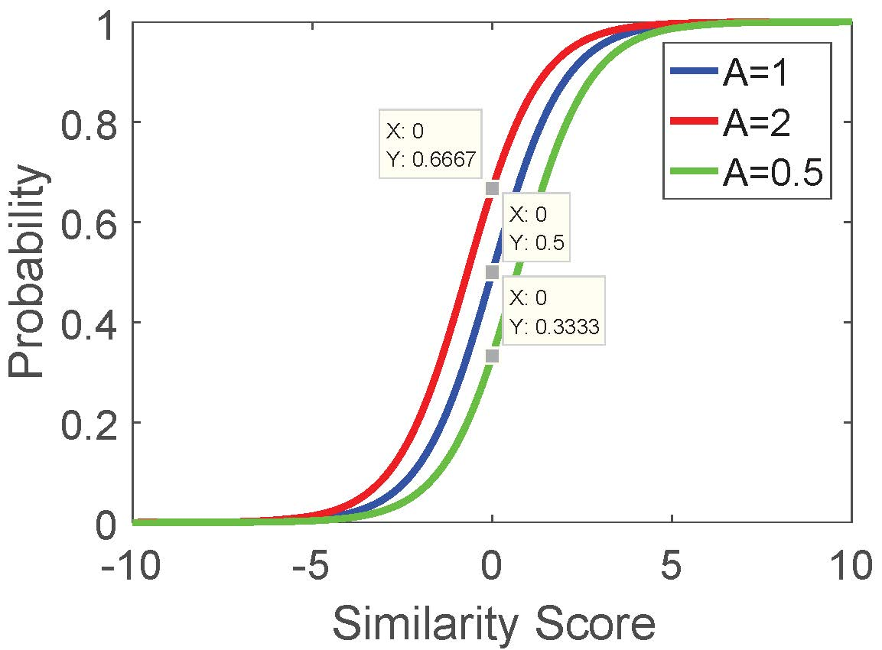
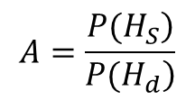
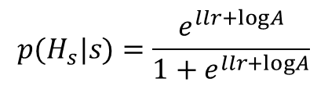
Likelihood ratio based loss
Probability Function
Given the log likelihood ratio (llr), the probability of features originate from the same identity can be derived as
$$p(H_{s}|s)=\frac{e^{llr+logA}}{1+e^{llr+logA}}$$
$$A=\frac{\left.P(H_{S}\right)}{\left.P(H_{d}\right)}$$
7
Notes:
Given the similarity score or log likelihood ratio, we can derive the probability of features originate from the same identity based on the posterior probability. It can be shown in this formula. （click）
Where A is the presence of genuine pairs and impostor pairs regarding the training set, we called it situation-specific prior odds. We play with it as a hyperparameter, which can be set on our own. When changing it, we can see a small effect there.
(click)
The figure shows how prior odds affects the predicted probability. The x axis /'æksɪs/
is the similarity score we can get from the classifier. The y axis is the probability of the feature pair belongs to the same identity.
when A equals to 1, this function will degrade (become) to sigmoid function. With the increase of A, high confidence will be allocated on genuine pairs and vice versa/,vaisi'və:sə/ .

Slide 8

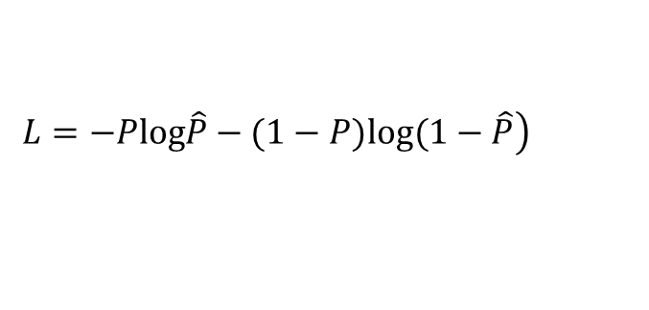
Likelihood ratio based loss
Logistic Cross Entropy Loss
Calculate the loss using logistic cross entropy loss, denoted as,
$$\left.L=−Plog\hat{P}−(1−P)log(1−\hat{P}\right)$$
$$\hat{P}$$
is the predicted probability of features belong to the same individual.
8
Notes:
Finally, when we obtain the predicted probability, we can use logistic cross entropy loss to tell how good the whole deep learning system is. （click）
The formula is shown here, P_hat indicates the predicted probability and P is the ground truth label.
In the next few slides, we will introduce the training procedure /prə'siːdʒə/.

Slide 9
Training procedure
For very low resolution verification
Training the deep CNN
Training the likelihood ratio classifier
Apply the likelihood ratio loss to finetune the deep CNN
9
Notes:
The steps of training procedure for very low resolution face verification are ,
First, we train the deep CNN
Second, training the likelihood ratio classifier
Third, we apply the likelihood ratio loss to finetune the deep Cnn

Slide 10
Training procedure
For very low resolution verification
Training the deep CNN
Existing RIDN[1] deep model
RIDN dataset: public face datasets, 13671 subjects, 438139 face images
Training the likelihood ratio classifier
First 100 subjects of SCface datasets for offline training
Apply the likelihood ratio loss to finetune the deep CNN
Generate image pairs from training set of SCface
[1] Zeng, Dan, Hu Chen, and Qijun Zhao. "Towards resolution invariant face recognition in uncontrolled scenarios." International Conference on Biometrics (ICB). IEEE, 2016.
10
Notes:
We give detail about training procedure.
As for deep Cnns, we take the RIDN deep model for use which is training on about half million faces from public datasets.
When train the likelihood ratio classifier, we use the first 100 subjects of Scface for training. There are about 1600 faces in total.
Regarding the finetune process by the proposed loss, we generate genuine pairs and impostor pairs from the training set of Scface.
To sum up, no additional faces are needed for the third step.

Slide 11
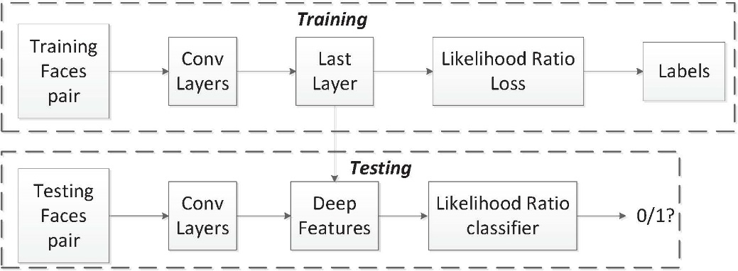

VLR Faces Verification
VLR face verification diagram
Very low resolution faces need to be recognized shown as,
11
Notes:
Once we obtained new feature embeddings, we apply them for testing. During testing phase， the likelihood ratio classifier is used as a metric for face verification. It makes sense because we optimized the deep CNNs based on the likelihood ratio loss during training.
The faces with resolution lower than 16 by 16 can be defined as VLR faces. Here show the very low resolution faces in Scface dataset. Faces originate from the same person are in a green box. It is quite challenge and prone-to-error for human eyes to recognize them. (16 by 16)
We take the very low resolution face recognition as an example because usually there are quite limited VLR faces at hand, and it is also challenge and often encountered in surveillance scenario.

Slide 12
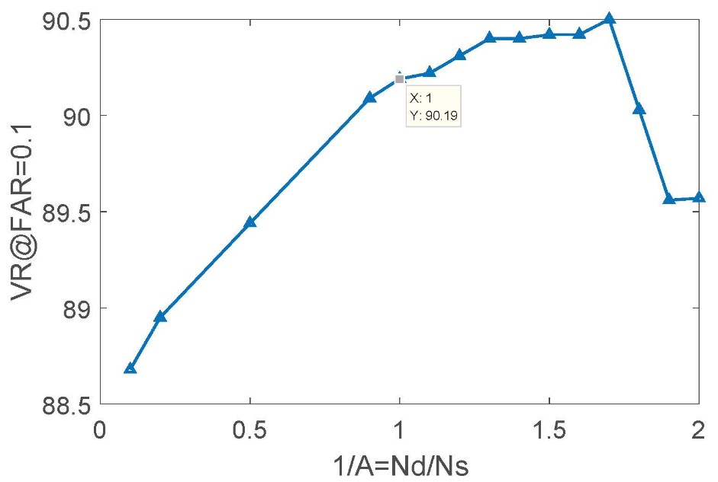
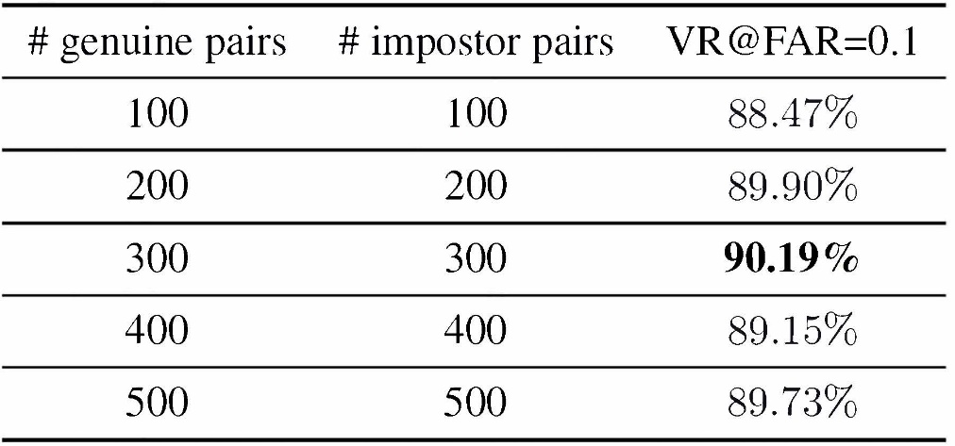
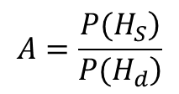
Exploratory experiments
Effects of prior odds (hyperparameter)
Effects of number of training image pairs
Baseline:87.65%
$$A=\frac{\left.P(H_{S}\right)}{\left.P(H_{d}\right)}$$
12
Notes:
Here we arrive at the experiment part. (click)
Effect of prior odds on performance is shown in the figure.
X axis is the inverse of prior odds.
//Ns denotes the number of image pairs from the same person; Nd is the number of image pairs from the different individuals.
From the curve, we investigate that around x=1.7, the verification rate reaches the peak value. (click)
We tune this hyperparamter to optimize the performance. (click)
We also conduct the experiments to know how the number of training image pairs affect the performance. We set the prior odds to 1, and vary the number of image pairs.
Regarding the effects of number of training image pairs，we find that the use of loss function can always improve the performance compared with the baseline performance which is obtained by the same architecture without the use of loss function. The table shows the use of few hundred of pairs have positive effect on results.

Slide 13
Comparison Results on SCface
Methods | VR@FAR=0.1 (%)
RIDN [1] | 70 (3)
MRC [2] | 73 (6)
Proposed Baseline | 87.65
Proposed Loss | 90.50
Hyper-parameters:
1/A=1.7
# of genuine pair = 300
# of impostor pair = 300
[1] Zeng, Dan, Hu Chen, and Qijun Zhao. "Towards resolution invariant face recognition in uncontrolled scenarios." International Conference on Biometrics (ICB). IEEE, 2016.
[2] Peng, Yuxi, Luuk Spreeuwers, and Raymond Veldhuis. "Low-resolution face alignment and recognition using mixed-resolution classifiers." IET biometrics 6.6 (2017): 418-428.
13
Notes:
Finally, When compare our results with other SOTA methods on VLR face verification, our proposed loss function get the best performance.

Slide 14
Wrapping up
Question?
14
Notes:
This is the architecture we pose in the beginning.

Slide 15
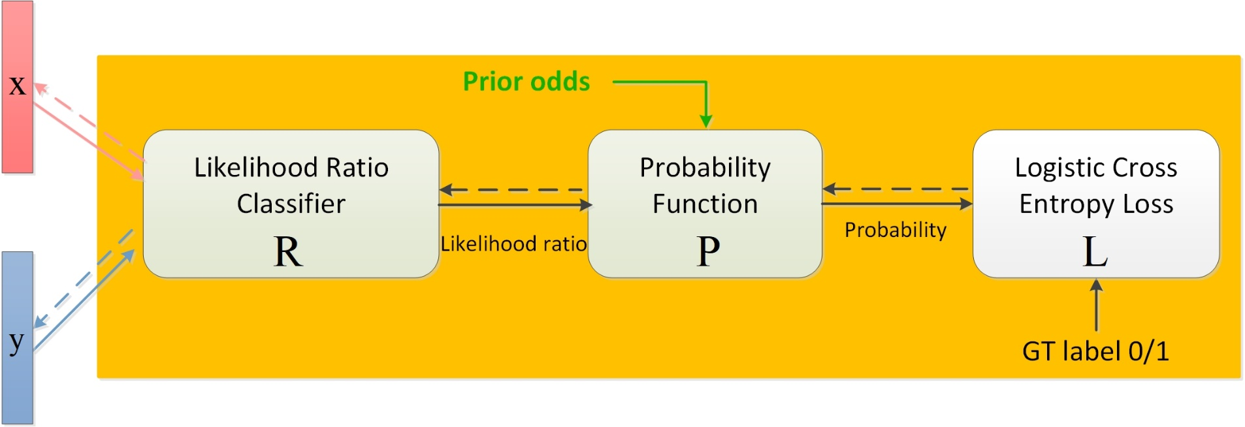
Wrapping up
Our Solution
15
Notes:
Here are our solution. There are three components that constitute the proposed loss.
To sum up, Likelihood ratio classifier takes the deep feature pair as input and outputs its likelihood ratio.Probability function takes the likelihood ratio as input and explores the prior odds to obtain the probability of the pair belongs to the same person. Finally, logistic cross entropy loss calculates the difference between the predicted probability and the ground truth label to guide the CNNs training.

Slide 16
Conclusion
Explore the likelihood ratio classifier into loss design
Improve the performance of very low resolution face recognition with limited data
16
Notes:
Here’s what you should take away from our work. (click)
We are the first to explore the likelihood ratio classifier into loss design and introduce the proposed loss function to improve the performance of very low resolution face recognition with limited data available

Slide 17
Thank you!
Any questions?
Notes:
That’s all, thanks for listening

