Slide 1
Grades 2-6
US Education
Highlanders Breaking Belief Barriers
Product Deep Dive #9

Slide 2
US Education
Current Climate of Education in US
Different Types of Schools in the US
Advantage Products for Different Types of HS Diplomas

Slide 3
US Education
Education Standards
Parent Concerns
Current Climate of Education in US

Slide 4
Education Standards
2001 No Child Left Behind law required testing of “basic facts”
→ No national achievement standard … many other issues
→ States created their own standards
→ Huge gaps from state to state ...
→ Research: US failing in students who are ready for careers and college
→ Research: Jobs going overseas to better educated people
2009 Common Core Expectations supported by council of state governors, not a required law
→ A career/college-ready education, no matter where you live.
→ An outline of learning “expectations” for each grade. Up to each state to figure out how to get there.
→ In practice, many states did not have the budget to fund new teaching & testing materials to rise up.
→ In politics, this became a “hot button.”
States that left the Common Core created their own “new” standards → in name only; still modeled on Common Core

Slide 5
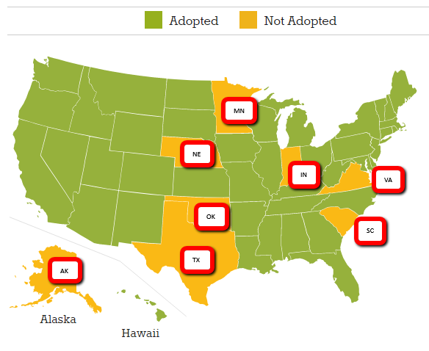
Education Standards

Slide 6
Parent Concerns
Universal Concerns:
Want the best education for their kids – without frustration
Want their kids to be safe at school – no bullying, no guns
Want their kids to thrive – special interests, special needs
Want reliable options

Slide 7
US Education
Public school
Magnet school
Charter school
Private school
Homeschool
Different Types of Schools in US

Slide 8



Public School
88% of US Students are enrolled in public school
Generally divided into elementary school (K-5), middle school (6-8), high school (9-12)
Free education funded by
est 31% local taxpayers (primarily property taxes—residential & commercial)
est 46% state govt
est 13% federal govt
Managed by elected citizens on a school board
Required to meet minimum state learning standards
Students are assigned to neighborhood schools

Slide 9
Magnet School
As much as 12% (varies by state) US Students enrolled in magnet schools
A highly selective type of free public school
Specialize in a particular academic area—such as science or the arts—while still meeting state standards
Highly competitive. Students usually must pass rigorous testing & application process
Available to students within school district, not necessarily near student’s neighborhood.
Transportation options: take public school bus or parents drive

Slide 10
Charter School
Small but growing School Option in over 40 states
Independently operated public schools – must adhere to state standards but no oversight from school boards or gov’t authorities.
Type #1 Free to families. Operated by parents using tax dollars.
Type #2 Charge tuition. Operated by for-profit companies with private funding.
Some charter schools specifically target gifted or high-risk kids.
Smaller classes & more individual attention than public schools.

Slide 11
Private School
10% of US Students enrolled in private schools
K-12 schools that rely on tuitions and funds from nonpublic sources (religious orgs, endowments).
Students must apply. Private schools can pick & choose the students they admit.
Type #1 Parochial. Operated by religious orgs, churches.
Type #2 Day School (or boarding school). Operated by for-profit companies with private funding. $$$$
Most private schools are accredited by National Association of Independent Schools

Slide 12
Homeschool
2% (and growing) of US Students enrolled in homeschool.
Intentional homeschooling → Do not agree with public school curriculum for religious reasons
→ Concerned about public school safety
→ Unhappy with quality of public school teaching
“Accidental” homeschooling → Did not intend to homeschool, but tried it & like the personal freedom
Requirements vary by state. Some states require homeschools meet state standards through testing, others not.
Homeschool learning options:
Join a homeschooling co-op to share teaching materials
Create their own teaching materials
Use online teaching resources

Slide 13
US Education
Graduation diploma → Core learning track
Honors diploma → Challenging track (includes AP)
International Baccalaureate (IB) diploma → Most demanding track
Different Types of HS Programs in US

Slide 14
Graduation Diploma
Requirements for core learning diploma vary by state. In general, students must:
Maintain a minimum “satisfactory” grade point average
Complete a specific number of classes according to required state standards.
Achieve acceptable passing grade on state exit exam
HS students with a graduation diploma go on to careers or college.
advantage4teens.com!
Advantage core textbooks!
Topic Source!
College Entrance Advantage!

Slide 15
Honors Diploma
Requirements for an honors diploma vary by state. In general, students must:
Maintain a minimum 3.0 grade point average
Complete a specific number of classes at honors or AP level. Typically includes:
world history
calculus
physics and/or chemistry
literature & composition
foreign language
Graduate with more than the minimum number of credits.
Selective colleges & universities prefer students who challenge themselves.
They view honors graduates as better prepared & more likely to be successful in college.
Honors Advantage!
College Entrance Advantage!
Topic Source!
advantage4teens.com!

Slide 16
International Baccalaureate Diploma (IB)
Created in Switzerland in 1968 for students in international schools.
A Geneva-based program with ties to the United Nations.
IB offered in 1,370 public and private schools (and increasing) in the U.S.
Emphasizes:
creative & critical thinking
taking initiative
individual & group projects
intensive research
extensive writing
community service
intercultural understanding & respect
IB can be school-wide @ elementary schools, middle schools, & even some HS.
In many cases, IB is an optional 1-year or 2-year program at HS level.
IB coursework & IB final exam are even more demanding & time-intensive than AP
more focus on applying ideas in new ways.
Colleges & Universities view IB students as ambitious, well-prepared for college, & highly successful in life beyond college.
These are IDEAL students for
Southwestern’s Summer Internship!

