Slide 1
Lab 11 Single and Double Slits
Dana Zhumabekova Makpal Yeles
Ademi anzhan

Slide 2
Abstract

Slide 3
Outline
Single and Double Slits Interference
Simulation
Experimental setup and experiment
Results
Conclusion

Slide 4
Introduction

Slide 5
Introduction

Slide 6
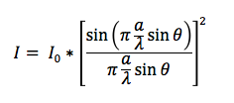
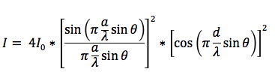
Simulation Part1. Parameters
Chosen parameters:
Slit width for both slits a = 0.08mm
Separation between slits for double slit d = 0.05mm
Wavelength for the semiconductor laser λ= 650nm
(this is typical value for red lasers used in physics labs)
Parameters are substituted into formulas to predict the intensity
Single Slit Intensity
Double Slit Intensity

Slide 7
Simulation Part 2. Single slit

Slide 8
Simulation Part 2. double slit

Slide 9
Experimental setup

Slide 10
Single Slit experiment

Slide 11
Double slit experiment

Slide 12
results

Slide 13
Conclusion

Slide 14
references

