Slide 1
Vietnamese Legal Documents Classification with Machine Learning Models
Ngoc-Anh Dao
Faculty of Information Technology Hung Yen University of Technology and Education
Instructor: Assoc. Prof. Minh-Tien Nguyen
7nd October 2024

Slide 2
Table of Contents
Introduction
Related Works
Methods
Experiment
Results and Discussion
Demo
Conclusion

Slide 3
Introduction
Concept of Legal Document Classification:
Legal document classification is the process of categorizing legal documents based on their content, structure, and purpose, helping to organize, manage, and retrieve legal information efficiently.
This is a significant task in Natural Language Processing (NLP).
Applications of Legal Document Classification:
Supports legal research: quickly retrieves relevant case laws, statutes, and precedents.
E-discovery: filters and organizes vast amounts of data, identifying pertinent documents for litigation and compliance.
Contract management: categorizes agreements by type, date, and parties involved, facilitating easier access and monitoring.
Regulatory compliance systems: ensures documents meet legal standards, aiding in risk management and audit readiness.
Current Research Situation:
Many studies have been conducted on legal document classification, but few have addressed the larger challenge of optimizing legal document classification in general.
Most studies focus only on English legal document.

Slide 4
Introduction
Objective of This Study:
Focuses on the classification of Vietnamese legal documents.
Investigates the effectiveness of various machine learning and deep learning algorithms such as Naive Bayes, SVM, Neural Networks, and Transformer-based models.
Discusses the impact of different preprocessing steps, feature extraction methods, and data augmentation techniques on the performance of these models.
Contributions of the Study:
Provides a comprehensive evaluation of these approaches for Vietnamese text classification.
Offers practical insights for researchers and practitioners working with Vietnamese text data.
Highlights the potential of state-of-the-art models in improving the accuracy and efficiency of Vietnamese text classification, paving the way for future developments in this field.

Slide 5
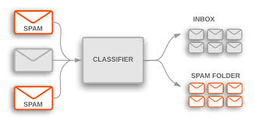
Related Works
What’s classification?
Definition: Text Classification involves using machine learning algorithms to automatically categorize text into different groups, classes, or categories based on content.
Goal: The aim is to determine the "topic" or "label" of each document based on its content.
Techniques: Utilizes methods from Machine Learning and Natural Language Processing (NLP).
Process: Involves training machine learning models on pre-labeled datasets and then predicting the labels of new documents based on the learned information.

Slide 6


Methods $−>$ Problem Statement
Definition: Vietnamese Legal Document Classification involves categorizing legal documents to indicate which set of laws they pertain to.
Task Type: This is a classification problem, where the input is a legal document and the output is its classification under a predefined category.
Formal Definition:
4. Supervised Learning: Requires an initial labeled dataset for training.
5. Scope: While documents can be assigned to multiple categories (Ranking Classification), this paper focuses on Hard Categorization, where each document is assigned a single category.

Slide 7
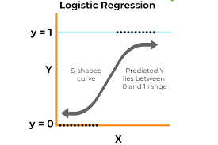

Methods $−>$ Logistic Regression
Purpose: Classify data into two or more classes based on probability.
Principle: Uses the logistic (sigmoid) function to predict the probability that a sample belongs to a specific class.
Advantages: Easy to implement, simple to interpret, effective for linear classification problems.
Disadvantages: Performs poorly on non-linear problems or data that is not linearly separable.

Slide 8

Methods $−>$ Naïve Bayes
Purpose: Classify based on Bayes' theorem with the assumption of feature independence.
Principle: Calculates the probability of each class based on features and selects the class with the highest probability.
Advantages: Fast, effective for text classification, requires less training data.
Disadvantages: Assumes feature independence, which is often unrealistic and can lead to lower performance if this assumption is violated.

Slide 9
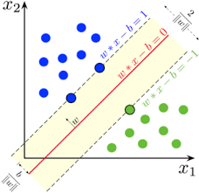

Methods $−>$ SVM
Purpose: Classify data by finding the optimal hyperplane that separates classes.
Principle: Finds the hyperplane that maximizes the margin between classes.
Advantages: High performance for complex classification tasks, handles non-linear data well with kernel tricks.
Disadvantages: Computationally expensive with large datasets, requires choosing the right kernel and parameters for optimal performance.

Slide 10
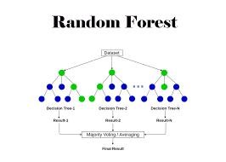

Methods $−>$ Random Forest
Purpose: Classify based on the consensus of multiple decision trees.
Principle: Builds multiple decision trees on random subsets of the data and averages the results.
Advantages: High performance, reduces overfitting, handles complex and non-linear data well.
Disadvantages: Can be computationally expensive and memory-intensive, difficult to interpret.

Slide 11

Methods $−>$ Neural Network
Purpose: Classify based on deep learning models with multiple layers of neurons.
Principle: Learns features from data through multiple connected layers, each layer adjusting weights during training.
Advantages: Capable of handling complex data, learns non-linear patterns, effective with large datasets.
Disadvantages: Requires a lot of data and computational resources, can overfit, difficult to interpret.

Slide 12

Experiments $−>$ Dataset
ViLegal Dataset is a collection of Vietnamese legal documents.
Supports research and applications in natural language processing (NLP) and machine learning.
Includes documents from various sources.
Categorized by topics and fields of law such as criminal, civil, administrative, commercial, labor, and many other fields.

Slide 13
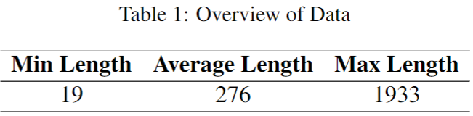
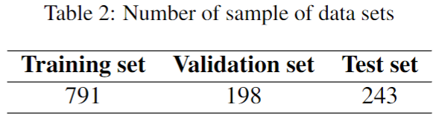

Experiments $−>$ Dataset

Slide 14

Experiments $−>$ Dataset
Tokenizing
Lower-casing
Data Processing
Stop-word removing
Numeric removing

Slide 15
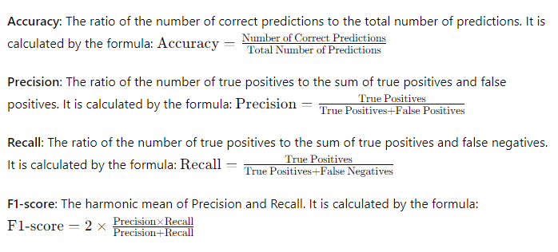

Experiments $−>$ Evaluation Matric

Slide 16
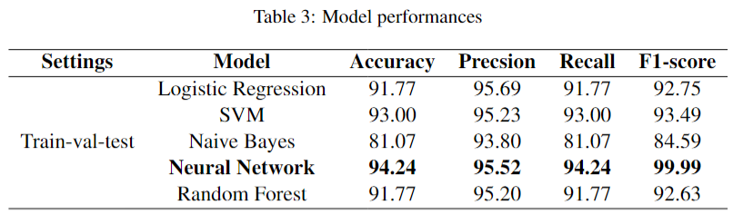
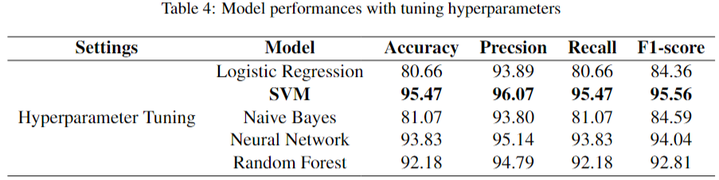
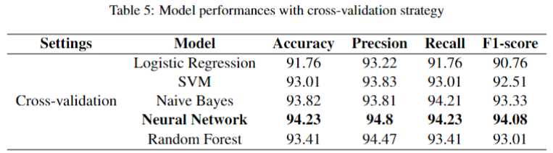
Result & Disscusion

Slide 17
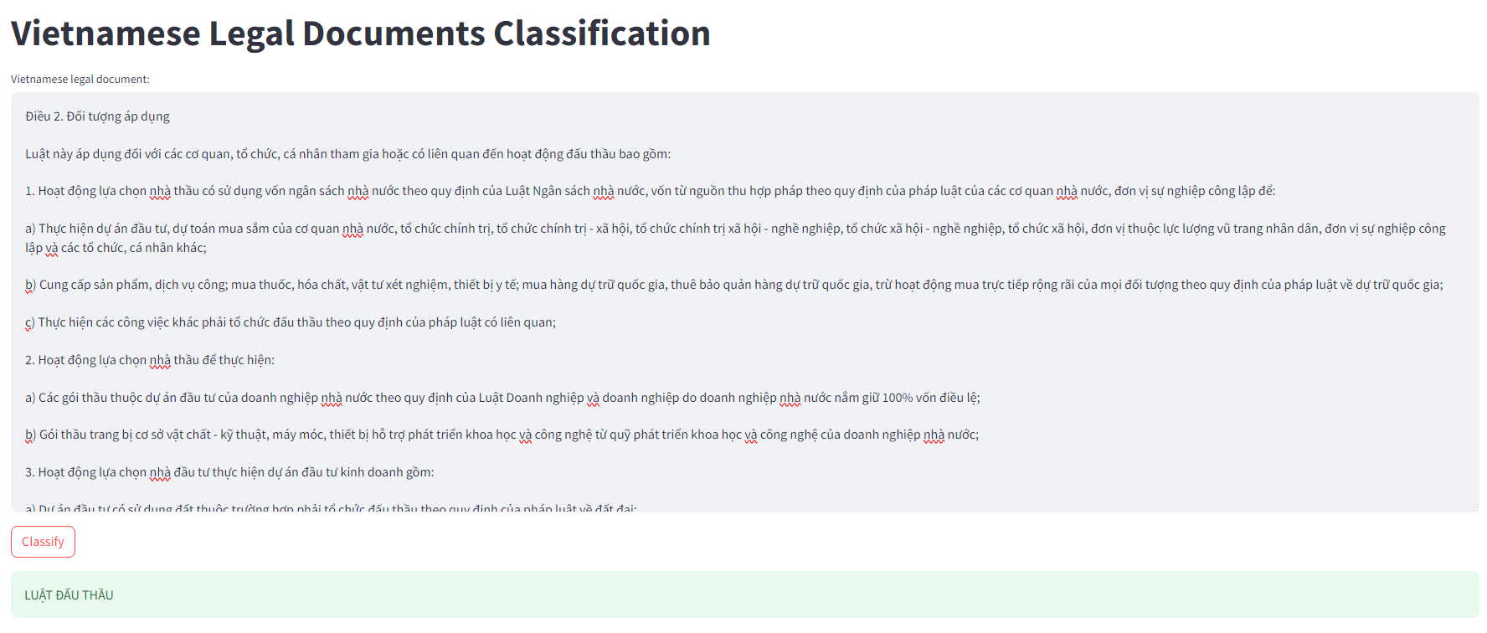
Demo

Slide 18
Conclusion
Innovative Approach: The study addressed Vietnamese Legal Document Classification using
pre-trained machine learning models fine-tuned on Vietnam’s legal corpus.
Database Creation: Successfully established a diverse and extensive database of various
Vietnamese legal documents, including legislative texts.
Advanced Techniques: Employed advanced machine learning techniques, achieving impressive
results in categorizing Vietnamese legal documents.

Slide 19
THANK
FOR LISTENING !

