Slide 1
RabbitMQ
channel_1
channel_n
queue_bind
channel_1
exchange
queue
channel_n
connection
connection
routing_key
connection: adaptor, parameter,…
channel:…
exchange: callback, name, type
queue: callback, queue, durable, exclusive
queue_bind:

Slide 2
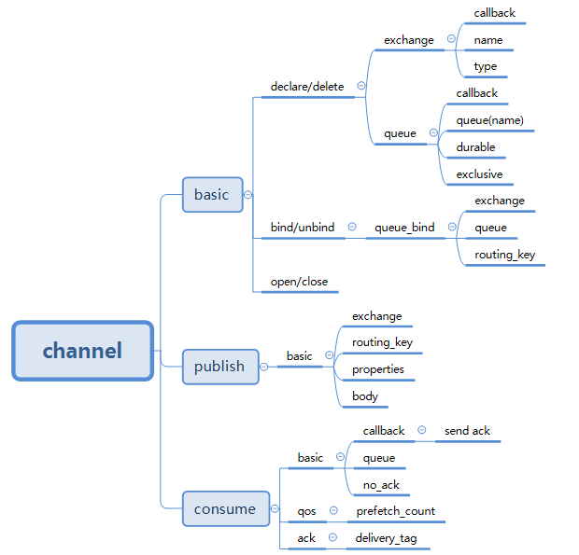
connection → channel → …

