Slide 1
Scorecard Construction using Credit Card data
Group 4: Cai Yuxin, Dao Duy Hung, Li Xuan, Sumedha Bansal, Vineeta Dawar

Slide 2
Outline
1) Abstract
3) Business
Problem
5) Methodology
2) Motivation
4) Describe Data
And Features
6) Conclusion
7) References

Slide 3

Introduction
Dao Duy Hung

Slide 4
Abstract
Credit card usage on the rise: Fintech advancements have made buying on credit common.
Easy credit availability brings default risk: Customers can make purchases without sufficient funds, but it increases the risk of default.
Creating a reliable credit scorecard model: Our project uses machine learning algorithms to develop a dependable credit scorecard model.
Credit scorecards assess creditworthiness: They consider factors such as payment history, delinquencies, and credit records for customers.
Model evaluation: Logistic regression, Random Forest, SVC, KNN, Gaussian Naive Bayes, and Bagged Decision Tree were assessed.
Preferred model: Logistic regression is easy to apply and yields good results. While SVC and Gaussian Naive Bayes can be helpful in improving reliability and accuracy of scorecard as they show better performance.

Slide 5
Verification
High Risk Evaluation
04
01
Decision Making
Applicable for companies
02
05
Credit Card Default Analysis
Credit Rating
03
06
Motivation
Evaluating classification algorithms on the current problem of default prediction. With availability of sophisticated ML techniques, it seems like an interesting problem to tackle.
The credit scoring system can also be utilized by SPV vehicles selling ABS to investors, ensuring that risky underlying assets are allocated to customers with a greater risk tolerance.
With our effective model, we assist companies in identifying profitable customers and avoiding risky ones.
This model can also be used on companies that frequently rely on debt or overdraft services from banks for financing. We can create a scorecard specifically tailored for them. Like Moody’s, Fitch’s ratings.
Credit card default analysis is vital for lenders dealing with uncollateralized loans. It enables risk identification, allowing lenders to mitigate their own risk and seek protection. Credit scoring systems assist in identifying high-risk customers, aiding investors in assessing risks in asset-backed securities like credit card portfolios.
Credit rating agencies such as Moody's and Fitch develop their own internal models to assess companies. Similarly, customers have credit scores compiled by country-specific agencies like CIBIL in India.
But how do they work? We explore here!!

Slide 6
Business Problem
A reliable credit scorecard system can solve various challenges for companies, including:
Evaluating existing customers' eligibility: Determine if current customers qualify for balance transfer offers or lifetime no annual fee credit cards based on their credit scores.
Offering benefits to high-value customers: Determine if customers with credible credit histories or stable high incomes are eligible for premium benefits or discounts on selected brands and products.
Managing risk: Predict and address the likelihood of existing customers defaulting within specific timeframes (e.g., 30, 60, or 90 days).
By building a reliable scorecard, companies can effectively assess the creditworthiness of their customers. Our project specifically focuses on evaluating whether existing customers should receive transfer offers, which involve transferring their credit balance to a loan or a new credit card with lower fees or enhanced benefits. Offering these deals to good customers can be perceived as a great opportunity, while extending them to bad customers may lead to non-payment of both old and new balances, loss of potential interest payments, additional costs and even ruining the company’s image.

Slide 7
Methodology
Scorecard Building and Testing
Feature Selection
WOE Transformation
Data Preprocessing
Feature Binning
Performance of ML algorithms
1
2
3
4
5
6

Slide 8

Step 1: Data Pre-Processing
Vineeta Dawar

Slide 9
Data Description
The dataset used in this analysis, obtained from Kaggle, includes credit card client information from Taiwan between April 2005 and September 2005. It encompasses default payments, demographics, credit data, payment history, and bill statements. The first column represents customer IDs, with subsequent IDs indicating the addition of new customers in ascending order(An assumption we make). This impacts the train-test split methodology, which will be explained later.
Some concepts, that have been studied in this project and explained later are:
Weight of Evidence (WOE)
Information value (IV)
Population Stability Index (PSI)
Feature Binning
Class Imbalance techniques

Slide 10
Features and Label
Columns | Description
EDUCATION | Educational background of the client (1 = graduate school, 2 = university, 3 = high school, 4 = others)
LIMIT_BAL | Amount of credit limited granted to clients
AGE | Age of the client in years
PAY_0 to PAY_6 | Repayment status from September 2005 to April 2005, respectively
BILL_AMT1 to BILL_AMT6 | Amount of bill statement from September 2005 to April 2005, respectively
PAY_AMT1 to PAY_AMT6 | Amount paid in each period from September 2005 to April 2005, respectively
default.payment.next.month | The target variable indicating whether the client defaulted on their credit card payment

Slide 11
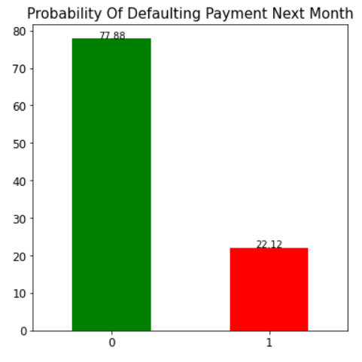
Target Distribution
In this dataset, there are no missing values. Class imbalance is clearly present. Customer IDs are in increasing order which we assume that higher the ID, the more recently that client became that company’s credit card user.
The train-test split (75-25) has been done at this juncture in order to get feature binning using the WOE, Information value. The characteristics of training data are used to bin the test data. The train-test split is done assuming that customer IDs indicate the time they joined the company.
This is similar to the standard scaler but this is feature binning. Some benefits of feature binning are it can handle outliers well, null data and reduces the risk of overfitting.
The figure illustrates the clear class imbalance issue present. Also, it shows that without any modeling, there is 22.12% chance a customer will default next month.

Slide 12
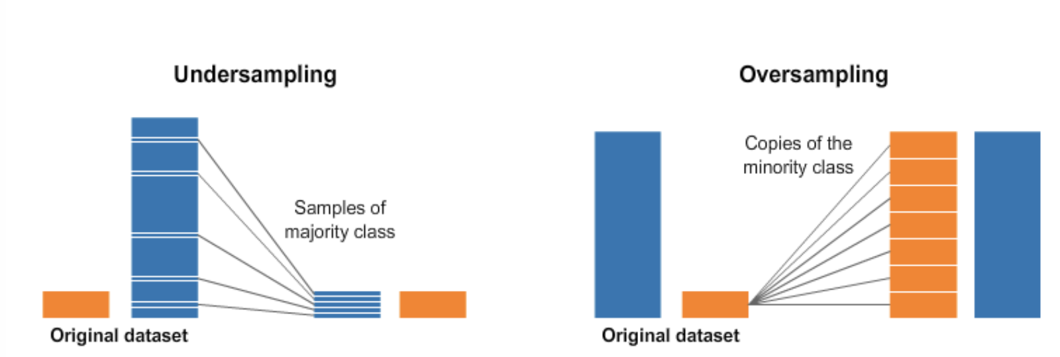
What is Class Imbalance?
Class imbalance an issue where the class of interest the analyst want to model/predict has less observations. This can implications on the model development. A mix of undersampling and oversampling should be done for the data. That is because if we:
Only Undersample the data then it will remove useful information because it might remove many important records. It might choose only one type of data eg, all from top or bottom.
Only Oversample then there can be overfitting problem because we duplicate minority class observations
So, our approach is that we will be doing undersampling (60%) and oversampling (80%) to handle this class imbalance. But different combinations can also be tried.

Slide 13
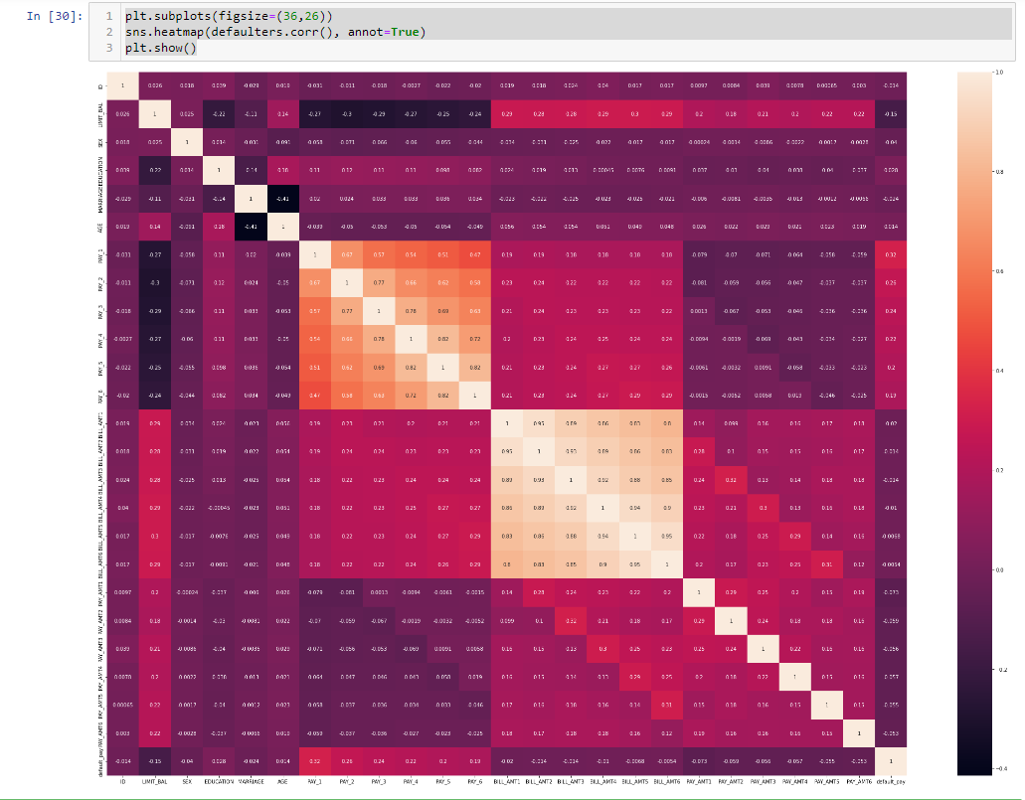
Pairwise Correlation Between Features
This figure clearly shows the presence of high pairwise correlation between Pay_0-Pay_6 (Repayment status in different months). Also, it is higher in case of Bill_AMT1-Bill_AMT6 (Bill statement).

Slide 14

Step 2: Feature Selection
Vineeta Dawar

Slide 15
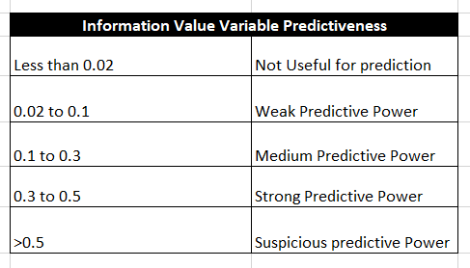
Information Value
IV provides a measure of the variable's ability to differentiate between the target categories. Higher IV values indicate stronger predictive power, while lower values suggest that the variable has less influence on the outcome.
Formula of IV
Information Value = WOE * (% of non-events - % of events)
In our project, we drop the features which have an IV of less than 2%.

Slide 16
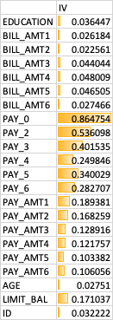
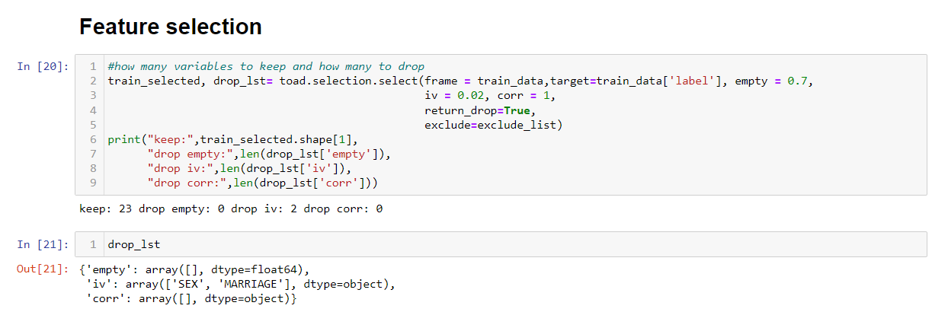
Step 2: Feature Selection
Features which have more 70% missing values, have less than 2% information value, and have perfect correlation of 1 are removed.

Slide 17

Step 3: Feature Binning
Cai Yuxin

Slide 18
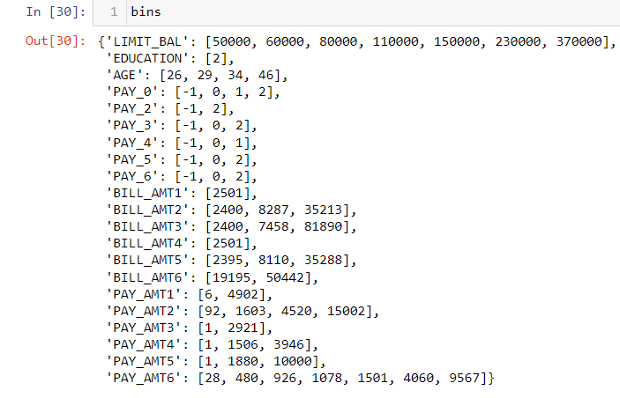
Step 3: Feature Binning
For feature binning, we have used Chi square method with the restriction that each bin should contain 5% of the samples. This binning is first fitted on train data and then applied to test data.
One example of how these features are binned:
Limit Balance
S.NO | Bins | Value assigned
1 | [-inf ~ 50000) | 0
2 | [50000 ~ 60000) | 1
3 | [60000 ~ 80000) | 2
4 | [80000 ~ 110000) | 3
5 | [110000 ~ 150000) | 4
6 | [150000 ~ 230000) | 5
7 | [230000 ~ 370000) | 6
8 | [370000 ~ inf) | 7

Slide 19
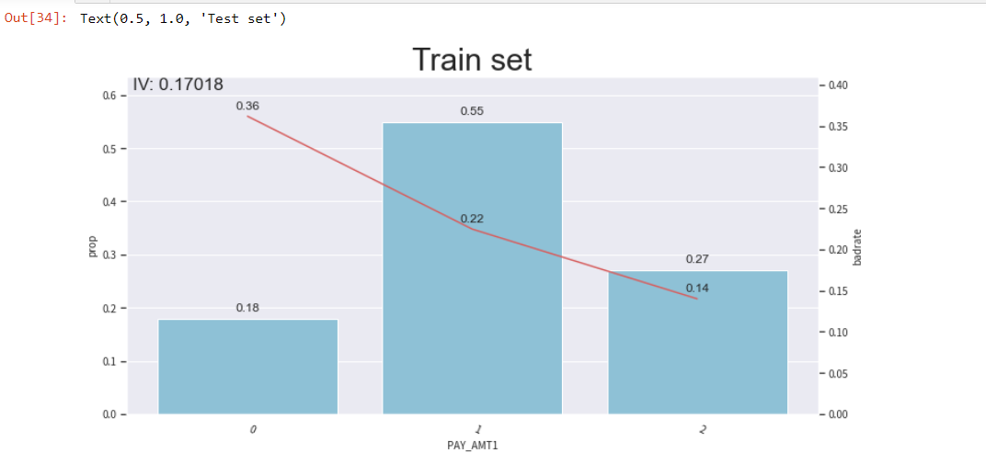
An example of Binning: PAY_AMT1 has been given 3 bins. The bin is [6,4902]
Bin No. | Bin | Value assigned
1 | [-inf,6) | 0
2 | [6,4902) | 1
3 | [4902,inf) | 2
0.18 represents the proportion of customers in bin 1 who have a higher probability of defaulting on payment next month.
0.36 represents the number people in bin 0 who are likely to default (have a label 1).

Slide 20

Step 4: WOE Transformation
Cai Yuxin

Slide 21
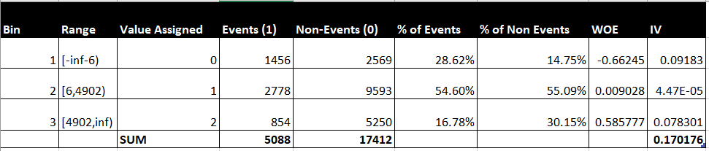
The weight of evidence tells the predictive power of an independent variable in relation to the dependent variable. Since it evolved from credit scoring world, it is generally described as a measure of the separation of good and bad customers.
"Bad Customers"refers to the customers who defaulted on a loan,
"Good Customers" refers to the customers who paid back loan. WOE is calculated as follows:
WOE = In(% of non-events ➗ % of events)
Weight of Evidence (WOE) helps to transform a continuous independent variable into a set of groups or bins based on similarity of dependent variable distribution i.e. number of events and non-events. In general, 10 or 20 bins are taken. Ideally, each bin should contain at least 5% cases. The number of bins determines the amount of smoothing - the fewer bins, the more smoothing.
Weight of Evidence
An example of WOE for the feature PAY_AMT1

Slide 22
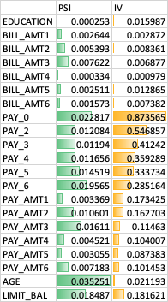
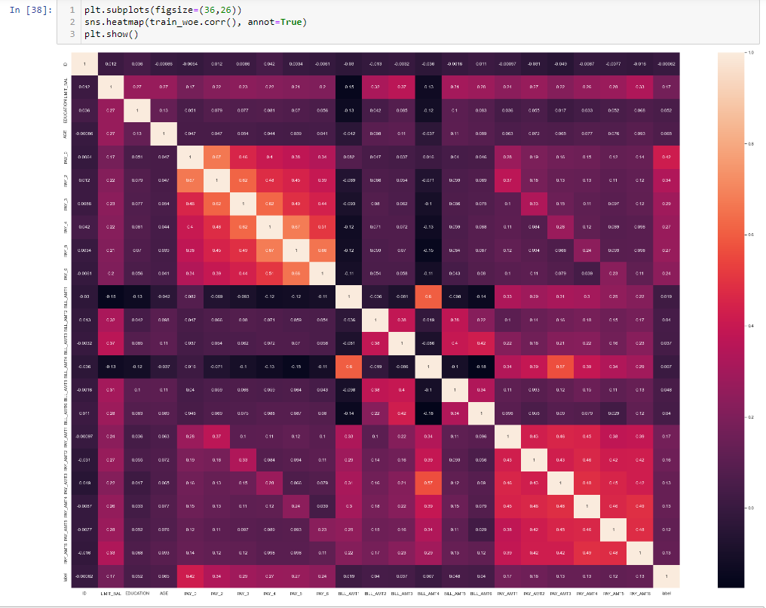
Step 4: WOE transformation
If we were more strict about the correlation coefficient, then there would be less orange cells present in the correlation matrix. But considering that all features corresponds to the history of the client and are important from the domain knowledge perspective, we took the correlation threshold=1.0

Slide 23
PSI: Population Stability Index
Population Stability Index (PSI) compares distribution of a scoring variable(predicted probability) in scoring data set to a training data set that was used to develop a model
PSI=(% of records based on scoring variable in Scoring Sample (A)- % of records based on scoring variable in Training sample (B)) * ln(A/B)
PSI < 0.1 | No change | You can continue using existing model
PSI >=0.1 but < 0.2 | Slight change is required. | Can use the model after few changes.
PSI >=0.2 | Significant change is required. | Ideally, you should not use this model anymore, retraining is required.

Slide 24

Step 5:
Performance of ML Algorithms
Li Xuan

Slide 25
Logistic Regression
KNN
04
01
Random Forest
Naive Bayes
02
05
SVC
Bagged Decision Trees
03
06
Algorithms
Simplicity and interpretability.
Efficient computation.
Handles both categorical and continuous features
Ability to handle multi-class problems
Simplicity and ease of implementation
Robust to outliers
Simplicity and efficiency
Handling high-dimensional data
Fast training
High predictive accuracy
Nonlinear relationships
Feature importance
Effective in high-dimensional spaces
Ability to handle non-linear relationships
Robustness to noise
Reduction of overfitting
Improved predictive accuracy
Robustness to outliers and noisy data

Slide 26
Performance Metrics
Performance Metrics | Formula | Value Range | In Imbalanced Datasets
Accuracy | Accuracy = (TP + TN) / (TP + TN + FP + FN) | 0 to 1 | In an imbalanced dataset, balanced accuracy is a reliable metric to evaluate the overall performance of a classifier as it considers the recall for each class and mitigates the impact of data imbalance. On the other hand, metrics such as AUC, Cohen's Kappa, Matthews correlation coefficient, and AUC PR curve provide more comprehensive evaluations by considering different aspects of predictions for different classes. These metrics offer a more detailed understanding of the classifier's performance in imbalanced datasets.
AUC-ROC | AUC = Area under the ROC curve | 0 to 1
Recall | Recall = TP / (TP + FN) | 0 to 1
Precision | Precision = TP / (TP + FP) | 0 to 1
F1 Score | F1 Score = 2 * (Precision * Recall) / (Precision + Recall) | 0 to 1
Balanced Accuracy | Balanced Accuracy = (Sensitivity + Specificity) / 2 | 0 to 1
Cohen's Kappa | Cohen's Kappa = (Accuracy - Expected Accuracy) / (1 - Expected Accuracy) | -1 to 1
Matthews Correlation Coefficient | Matthews Correlation Coefficient = (TP * TN - FP * FN) / sqrt((TP + FP) * (TP + FN) * (TN + FP) * (TN + FN)) | -1 to 1
AUC PR Curve | AUC PR Curve = Area under the precision-recall curve | 0 to 1
PS: The higher the value, the better the performance of the metric

Slide 27
No Tuning and No Balancing (Base Models)
ML Algorithms | Accuracy | AUC - ROC | Recall | Precision | F1 Score | Balanced Accuracy | Cohen’s Kappa | Matthews corr_coef | AUC PR curve
Logistic Regression | 83.48% | 78.02% | 0.33 | 0.71 | 0.46 | 64.98% | 0.373 | 0.41 | 54.75%
Random Forest | 81.20% | 73.96% | 0.35 | 0.57 | 0.43 | 64.11% | 0.33 | 0.344 | 48.52%
Gaussian Naive Bayes | 80.24% | 77.42% | 0.49 | 0.52 | 0.51 | 68.79% | 0.384 | 0.384 | 52.52%
SVC | 83.57% | 71.45% | 0.35 | 0.7 | 0.47 | 65.66% | 0.384 | 0.417 | 50.38%
KNN | 80.47% | 66.05% | 0.23 | 0.57 | 0.32 | 59.04% | 0.233 | 0.267 | 45.08%
Bagged Decision Tree | 80.17% | 71.32% | 0.33 | 0.53 | 0.4 | 62.61% | 0.294 | 0.307 | 45.35%
Result 1: Hyperparameter Tuning has improved Recall, Balanced Accuracy, Cohen’s Kappa, Mathews corr_coef and AUC-PR curve. The model accuracy does not improve that much.
Tuned with no Balancing (Raw Models tuned)
ML Algorithms | Accuracy | AUC - ROC | Recall | Precision | F1 Score | Balanced Accuracy | Cohen’s Kappa | Matthews corr_coef | AUC PR curve
Logistic Regression | 80.49% | 78.22% | 0.52 | 0.53 | 0.53 | 70.07% | 0.403 | 0.403 | 54.72%
Random Forest | 81.49% | 74.10% | 0.36 | 0.59 | 0.44 | 64.49% | 0.339 | 0.354 | 49.26%
Gaussian Naive Bayes | 80.24% | 77.42% | 0.49 | 0.52 | 0.51 | 68.79% | 0.384 | 0.384 | 52.52%
SVC | 79.40% | 76.92% | 0.56 | 0.5 | 0.53 | 70.70% | 0.397 | 0.398 | 49.26%
KNN | 82.75% | 75.07% | 0.36 | 0.65 | 0.46 | 65.49% | 0.37 | 0.393 | 52.09%
Bagged Decision Tree | 81.00% | 73.20% | 0.36 | 0.56 | 0.44 | 64.35% | 0.331 | 0.343 | 47.71%

Slide 28
No Tuning and Balancing (Base Models)
ML Algorithms | Accuracy | AUC - ROC | Recall | Precision | F1 Score | Balanced Accuracy | Cohen’s Kappa | Matthews corr_coef | AUC PR curve
Logistic Regression | 83.48% | 78.02% | 0.33 | 0.71 | 0.46 | 64.98% | 0.373 | 0.41 | 54.75%
Random Forest | 81.20% | 73.96% | 0.35 | 0.57 | 0.43 | 64.11% | 0.33 | 0.344 | 48.52%
Gaussian Naive Bayes | 80.24% | 77.42% | 0.49 | 0.52 | 0.51 | 68.79% | 0.384 | 0.384 | 52.52%
SVC | 83.57% | 71.45% | 0.35 | 0.7 | 0.47 | 65.66% | 0.384 | 0.417 | 50.38%
KNN | 80.47% | 66.05% | 0.23 | 0.57 | 0.32 | 59.04% | 0.233 | 0.267 | 45.08%
Bagged Decision Tree | 80.17% | 71.32% | 0.33 | 0.53 | 0.4 | 62.61% | 0.294 | 0.307 | 45.35%
Result 2: Using undersampling and oversampling reduces test set accuracy and precision for most of the algorithms but it improves all the classification metrics by only a small extent. Recall has improved a lot.
Tuned with no Balancing (Raw Models tuned)
ML Algorithms | Accuracy | AUC - ROC | Recall | Precision | F1 Score | Balanced Accuracy | Cohen’s Kappa | Matthews corr_coef | AUC PR curve
Logistic Regression | 80.49% | 78.22% | 0.52 | 0.53 | 0.53 | 70.07% | 0.403 | 0.403 | 54.72%
Random Forest | 81.49% | 74.10% | 0.36 | 0.59 | 0.44 | 64.49% | 0.339 | 0.354 | 49.26%
Gaussian Naive Bayes | 80.24% | 77.42% | 0.49 | 0.52 | 0.51 | 68.79% | 0.384 | 0.384 | 52.52%
SVC | 79.40% | 76.92% | 0.56 | 0.5 | 0.53 | 70.70% | 0.397 | 0.398 | 49.26%
KNN | 82.75% | 75.07% | 0.36 | 0.65 | 0.46 | 65.49% | 0.37 | 0.393 | 52.09%
Bagged Decision Tree | 81.00% | 73.20% | 0.36 | 0.56 | 0.44 | 64.35% | 0.331 | 0.343 | 47.71%

Slide 29
No Tuning but with Balancing (Balanced models)
ML Algorithms | Accuracy | AUC - ROC | Recall | Precision | F1 Score | Balanced Accuracy | Cohen’s Kappa | Matthews corr_coef | AUC PR curve
Logistic Regression | 83.45% | 77.82% | 0.33 | 0.71 | 0.45 | 64.82% | 0.37 | 0.408 | 54.73%
Random Forest | 78.37% | 74.50% | 0.5 | 0.48 | 0.5 | 68.74% | 0.362 | 0.363 | 49.35%
Gaussian Naive Bayes | 79.53% | 77.41% | 0.53 | 0.5 | 0.52 | 69.78% | 0.388 | 0.388 | 52.51%
SVC | 80.21% | 76.25% | 0.54 | 0.52 | 0.53 | 70.47% | 0.404 | 0.404 | 49.23%
KNN | 77.43% | 66.81% | 0.36 | 0.44 | 0.4 | 62.26% | 0.262 | 0.264 | 46.15%
Bagged Decision Tree | 76.19% | 71.84% | 0.49 | 0.43 | 0.46 | 66.14% | 0.308 | 0.309 | 45.76%
Result 3: With tuning the balanced models, recall and F1 score improves a lot. While other classification metrics like Balanced Accuracy and Cohen’s Kappa has also seen tremendous improvement.
TUNED and Balanced (Final Models)
ML Algorithms | Accuracy | AUC - ROC | Recall | Precision | F1 Score | Balanced Accuracy | Cohen’s Kappa | Matthews corr_coef | AUC PR curve
Logistic Regression | 80.52% | 78.16% | 0.52 | 0.53 | 0.53 | 70.09% | 0.403 | 0.403 | 54.68%
Random Forest | 78.21% | 74.38% | 0.52 | 0.47 | 0.5 | 68.44% | 0.357 | 0.357 | 49.23%
Gaussian Naive Bayes | 79.53% | 77.41% | 0.53 | 0.5 | 0.52 | 69.78% | 0.388 | 0.388 | 52.51%
SVC | 81.09% | 76.54% | 0.52 | 0.54 | 0.53 | 70.21% | 0.412 | 0.412 | 50.28%
KNN | 74.84% | 70.91% | 0.54 | 0.42 | 0.47 | 67.30% | 0.311 | 0.315 | 47.94%
Bagged Decision Tree | 77.05% | 73.52% | 0.52 | 0.45 | 0.48 | 67.69% | 0.336 | 0.337 | 47.64%

Slide 30
Result 4: Most important !!!!
TUNED and Balanced
ML Algorithms | Accuracy | AUC - ROC | Recall | Precision | F1 Score | Balanced Accuracy | Cohen’s Kappa | Matthews corr_coef | AUC PR curve
Logistic Regression | 80.52% | 78.16% | 0.52 | 0.53 | 0.53 | 70.09% | 0.403 | 0.403 | 54.68%
Random Forest | 78.21% | 74.38% | 0.52 | 0.47 | 0.5 | 68.44% | 0.357 | 0.357 | 49.23%
Gaussian Naive Bayes | 79.53% | 77.41% | 0.53 | 0.5 | 0.52 | 69.78% | 0.388 | 0.388 | 52.51%
SVC | 81.09% | 76.54% | 0.52 | 0.54 | 0.53 | 70.21% | 0.412 | 0.412 | 50.28%
KNN | 74.84% | 70.91% | 0.54 | 0.42 | 0.47 | 67.30% | 0.311 | 0.315 | 47.94%
Bagged Decision Tree | 77.05% | 73.52% | 0.52 | 0.45 | 0.48 | 67.69% | 0.336 | 0.337 | 47.64%
It is evident from the above table that Logistic regression works the best in almost every performance metric category. Thus, we choose Logistic Regression for scorecard construction.

Slide 31

Verdict in favor of Logistic Regression
Accuracy, Precision and AUC-ROC for Logistic regression is higher than most of the other ML algorithms. Special statistics like Cohen’s Kappa, Matthews Correlation Coefficient, AUC-PR also show good results. Again, F1 score is highest for Logistic but KNN gives a higher recall rate.
The coefficients of the LR equation represent the log-odds or logit of the target variable probability. These coefficients can be easily transformed into odds ratios, which provide insights into the impact of different predictor variables on the probability of the target event. This interpretability is crucial in scorecard construction to understand and communicate the factors influencing the creditworthiness or risk of an individual.
LR provides a well-established and interpretable framework for scorecard construction in credit scoring. Its ability to estimate probabilities, interpret coefficients, handle variable selection, and facilitate model evaluation makes it a popular choice in the field. Hence, LR becomes the model of choice.
Gaussian Naive and SVC are also giving good results. So, they are the runner-up models on which scorecard can be constructed.

Slide 32
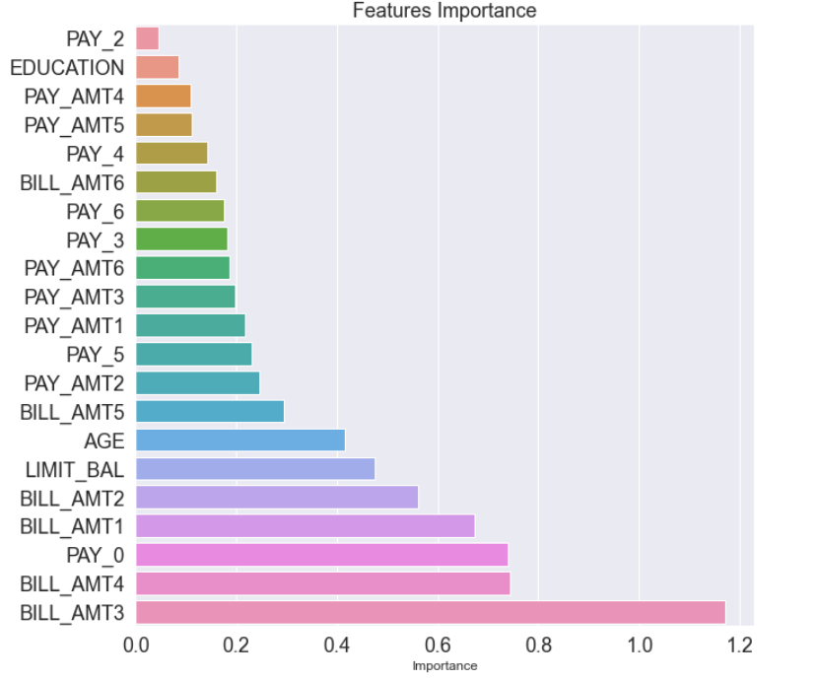
Feature Importance
We will use the Logistic regression as our base estimator as the performance is equivalent to other ML algorithms and plus it is easy to deploy considering that all libraries have inbuilt function for this particular estimator.
Feature Importance
The table shows the feature importance when LR is employed to build the scorecard model.
PAY_0 (repayment status in September,2005) is as expected. It should be high in explaining predicting the state of the customer.
BILL_AMT3 and BILL_AMT4 are also showing expected results as when the bill amounts are higher in the middle of the period under study, it is highly likely that the customer might not pay the dues if they does not have sufficient funds to cover the bill payments. The higher the bill statement in the past, the higher is the chance that the customer will default on dues due to the higher burden and increasing interest costs.
In case of repayment status (PAY_0/2/3/4/5/6), it is higher in case of repayment made in the most recent month (September 2005), which is might reduce the chance of a classifying a customer in the default category.
Amount of previous payments (PAY_AMT1/2/3/4/5) show low importance as compared to other features. This is unexpected as making previous payments should show how a diligently the customer made his past payments. This might be due to the fact that the economic status of the customer can change any time making him more likely to be either delinquent or become a good customer. So, maybe that's why predictive ability is low for this one. As it works both ways.

Slide 33

Step 6: Scorecard Building and Testing
Sumedha Bansal

Slide 34
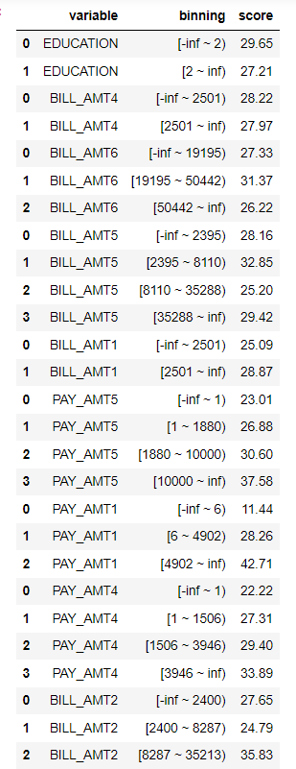
Building Steps
We take the transformed train and test data from step 4 and pass that in the scorecard function of the Toad Library with base score 1000, base_odds=35, and pdo=80(points to double the odds). We use C=0.1 and class_weight=balanced as parameters for LR.
Basically, we fit the scorecard function on the train data as we would have done for any ML algorithm. The only difference is that this Library takes the base estimator to be LR. We can change base estimators but that requires some changes in the library codes which can be complex at this level.
Once this fitting is done, the model gives us the credit scores for each of bin as shown in the table on the RHS.
Now if we want to see the score of a random client in our model, we will just use the predict function of the scorecard and get the credit score for that person. All we have to do here is pass the information of the client in original format (w/o WOE transformation) to this predict function and we will get the credit score for that customer.

Slide 35
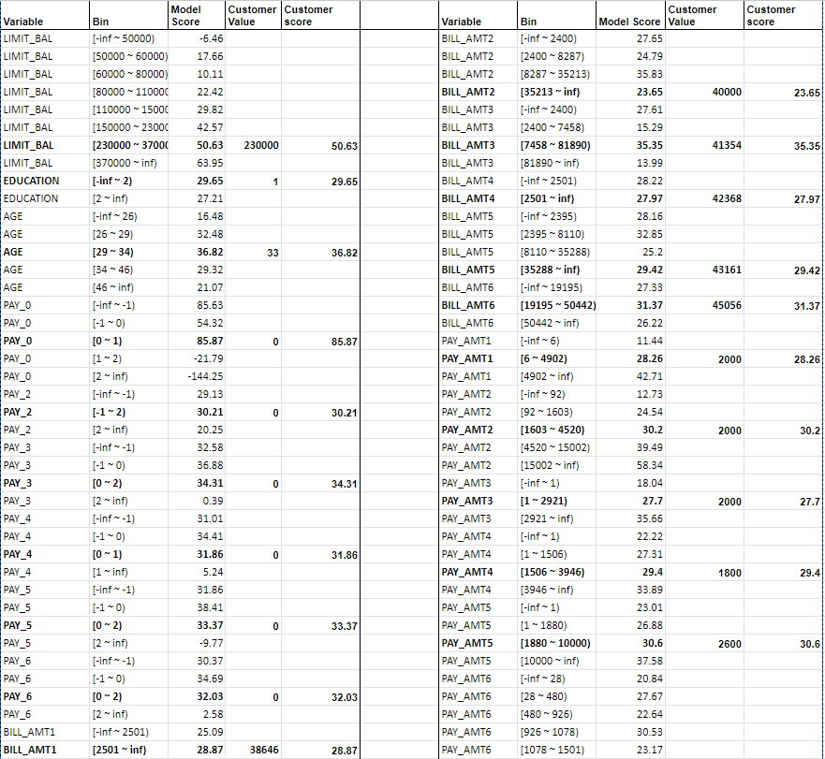


A manually- calculated Scorecard
717.3

Slide 36
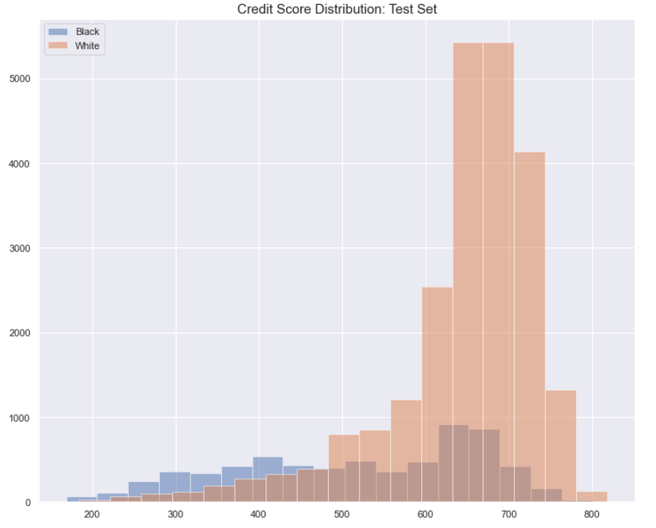
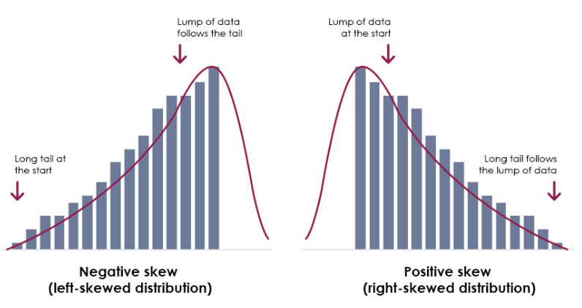
Scorecard Distribution
The graph shows credit score distribution for good and bad customers. The desired pattern should be a distinguishable smile shape, with good customers skewed left and bad customers skewed right. However, our graph lacks clear distinction, indicating the need to look explore more features to increase the predictive power of the model or tune the scorecard further to develop a benchmarking model.
Does not look very intuitive, huh?
Should be more like this!!!

Slide 37
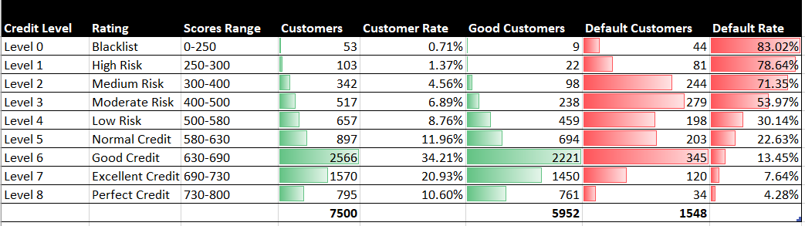
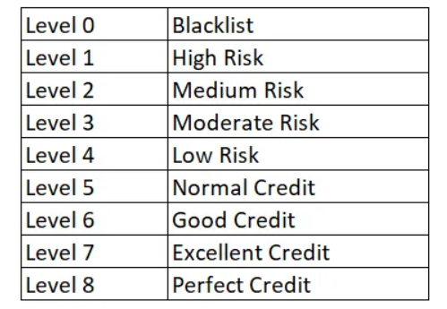
Tuning Results
Benchmark Table
The benchmark table is a general table taken from one of the references. We built the credit scores of the clients in the test set on the basis of this table.
The table presents customer distribution in the 7500-test set, showing that as credit rating level increases, default rates tend to decrease. Accurate assessment requires analysis using the Loss-Coverage tradeoff table.

Slide 38
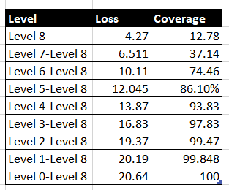
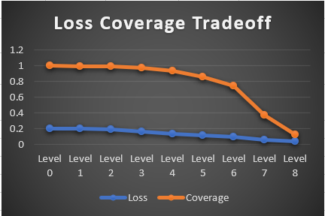
Give the Balance transfer offer or not?
This loss coverage table shows the tradeoff across different levels. For instance, if I give the balance transfer option to customers who are categorised at level 8, then I might incur a loss of around 4.3%. This is due to the fact that there might be some people at that level who will default. Though it’s rare in practice, so we can attribute this loss percentage to the limitations of our model. Coverage on the other hand shows that number of customers that are given that respective rating in the test set.
So, now what's the benefit of such a table? It boils down to the objective of the company. If the company wants to reward its good customers and identify the ones who are more likely to default, then it has to set up a loss level which aligns with the loss bearing appetite of the firm. At the same time, it has to identify how many customers they want to cover. There is clearly a tradeoff between loss and coverage. For example, if I offer transfer offer to people from level 5 and above, then I will incur a loss of 12% but the coverage will be higher(87%). If above level 4, then loss increases but coverage also increases.
Assuming that the company’s objective is to cover 75% of the customers with a loss level of 10%, then in that situation, the firm will offer transfer benefits to customers who are given a level 6 rating and above.

Slide 39

Conclusion
Sumedha Bansal

Slide 40
CONCLUSION
WHY IS CREDIT SCORE MODEL IMPORTANT?
It's important to have credit score model in place for banks and financial institutions who are the main participants in the credit market. They give out loans and credit cards to various retail customers.
These scores help in better risk management for such firms, especially in case of credit cards where no collateral is pledged and recourse can becomes a cumbersome process.

Slide 41
CONCLUSION
LIMITATIONS
In our model, we have only utilized the base estimator i.e. logistic regression in the toad library for scorecard building process. Other non-Linear models were also giving good results.
Usage of Different class imbalance techniques and ratios
FUTURE SCOPE
One can make use of Artificial Neural networks.
Usage of other scorecard generation libraries such as scorecardpy, OptBinning,etc
Create their own library with the best algorithm by making changes in Toad Library main code blocks to change the base estimator and tune it according to the desired algorithm.

Slide 42

Thank you Very Much for Listening. Questions and Feedbacks Are Warmly Welcome!

Slide 43
References
https://machinelearningmastery.com/hyperparameters-for-classification-machine-learning-algorithms/
https://towardsdatascience.com/end-to-end-guide-to-building-a-credit-scorecard-using-machine-learning-6502d8bb765a
https://machinelearningmastery.com/hyperparameter-optimization-with-random-search-and-grid-search/
https://towardsdatascience.com/feature-engineering-deep-dive-into-encoding-and-binning-techniques-5618d55a6b38
https://toad.readthedocs.io/en/0.0.59/tutorial.html
https://www.kaggle.com/datasets/uciml/default-of-credit-card-clients-dataset
https://www.listendata.com/2015/03/weight-of-evidence-woe-and-information.html
https://medium.com/codex/do-i-need-to-tune-logistic-regression-hyperparameters-1cb2b81fca69
https://machinelearningmastery.com/smote-oversampling-for-imbalanced-classification/
https://www.analyticsvidhya.com/blog/2019/08/11-important-model-evaluation-error-metrics/
https://scikit-learn.org/stable/modules/model_evaluation.html
https://www.intellspot.com/machine-learning-classification/
Template from: Slidesgo https://slidesgo.com/theme/cyber-security-business-plan#search-cyber+security+plan&position-1&results-1&rs=search&rs=search
Icons From: https://www.flaticon.com/
Photos Link:
https://www.vecteezy.com/vector-art/4940875-artificial-intelligence-machine-learning-ai-data-deep-learning-for-future-technology-artwork-mining-isometric-neural-network-machine-programming-and-responsive-web-banner-vector-illustration
https://www.unite.ai/machine-learning-vs-artificial-intelligence-key-differences/
https://www.freepik.com/free-photos-vectors/machine-learning-background
https://www.genengnews.com/insights/machine-learning-to-optimize-product-quality-measurement/
https://www.marktechpost.com/2022/05/06/in-the-latest-research-hpe-employs-blockchain-infrastructure-for-distributed-machine-learning-models/
https://www.vecteezy.com/free-vector/tech-background
https://www.cambridgemaths.org/blogs/skewed-usage-skewed-distribution/

