Slide 1
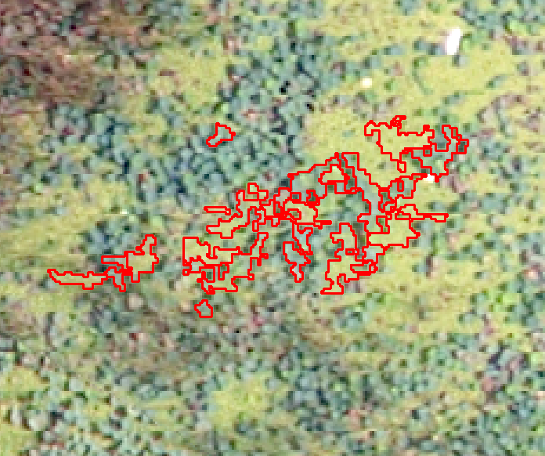
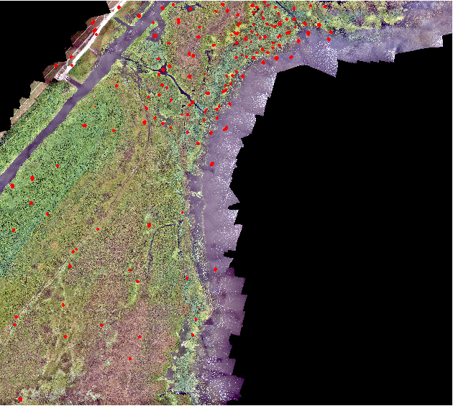
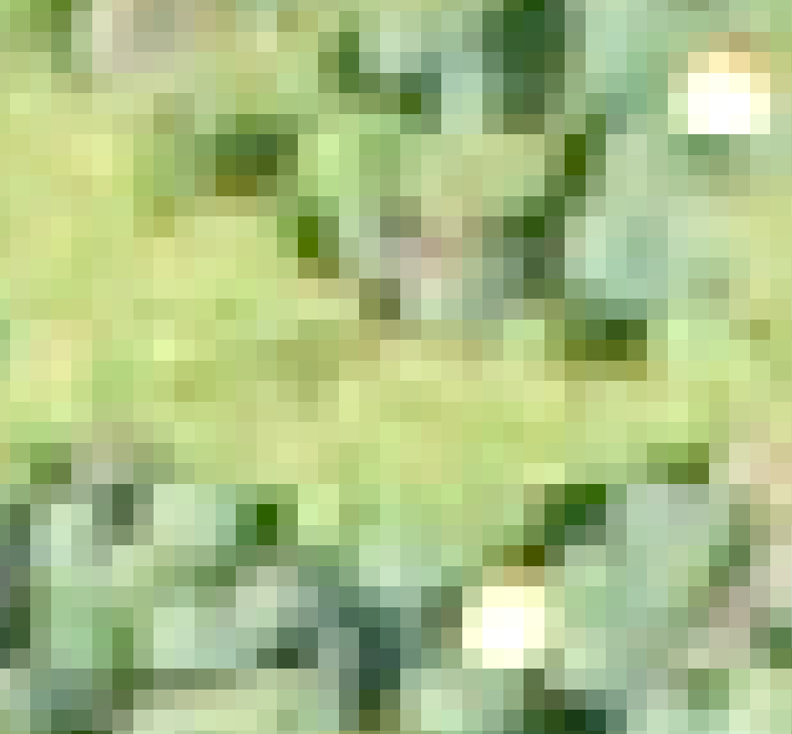
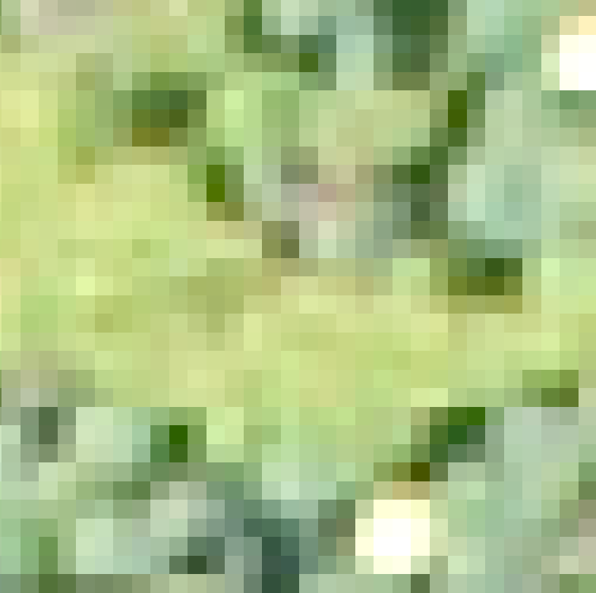
Extract training data
Notes:
The training data are extracted on the image with 8cm resolution. 32*32 window size pactches were extracted from each training polygon of object based approaches. The label of the object is used to assign to the label of each patch within that polygon.

Slide 2

One data item
Lettuce
X
Y
One data item
Notes:
For each data item, X is the 3*32*32 pixel value, Y is the label for vegetation type. This is one example of lettuce item.

Slide 3
TRAIN, VALIDATION AND TEST
X
Y
X
Y
Testing 6000 (First testing set)
X
Y
X
Y
Total
930366
Systematically select 60000
Validation 4000
…………………….
…………………….
…………………….
Shuffle
…………………….
Training 50000
X
Y
X
Y
Notes:
Totally, we extracted 930366 patches samples from the training polygons. From these patches, 60000 were systematically selected and then shuffled. These 60000 patches is split into three parts: 6000 were used for testing, 4000 for validation and 50000 for training. The 6000 testing items are called the first testing dataset. In addition to the 6000 testing data items, we also have another set of data for testing. We call it the second test dataset. The second test dataset is the same as that used for testing of object based approaches and it contains 373 random points.

Slide 4
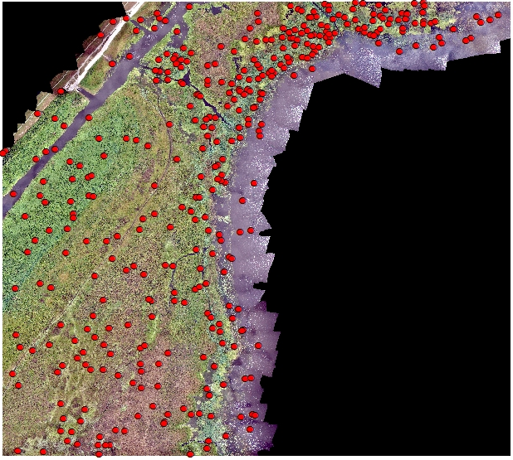
Second Testing Set
Notes:
373 random points used as the second testing set

Slide 5
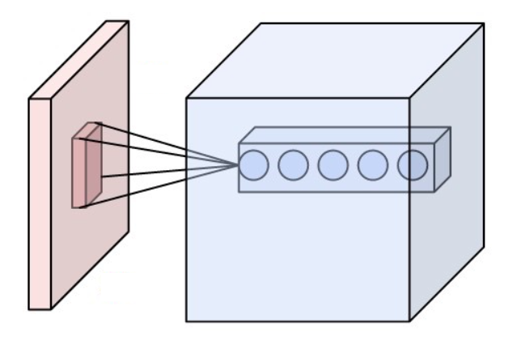
Convolutional Neural Network(CNN)
One type of feed-forward artificial neural network
Workhorse for a lot of recording-breaking deep learning frameworks for computer vision tasks
Distinguish features:
3D volumes of neurons
One single layer can be extended to multiple
layers
Local connectivity
Allow locally learned features to combine together to represent global feature
Shared weights
Each filter is applied to the entire image to create one layer
Notes:
Picture in the slide is the building block of neural network, which shows filtering operation on one layer can create 3D neurons. The 3D neurons contains multiple layers. Reference https://en.wikipedia.org/wiki/Convolutional_neural_network

Slide 6
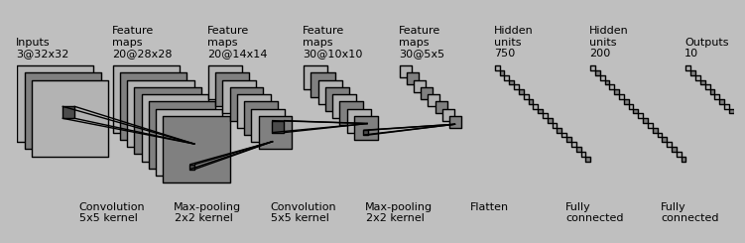
Architecture
Notes:
Our network architecture includes two convolutional layers and one fully connected layer. It is implemented using Theano package(http://deeplearning.net/software/theano/).

Slide 7
Result
Table 1 Accuracy of CNN result of first testing set
Method | Overall Accuracy
CNN approach based on the first testing data set | 79.88%
Best accuracy of object approach on the second testing data set | 70.78%
Notes:
Using the first testing data set, the convolutional neural network achieves 79.88%, higher than the best accuracy of object approach result on the second testing data set. However to make the comparison more fair, we also run the CNN model on the second testing data set.

Slide 8
Result
Table 1 Testing result based on the second testing data set
 | lettuce | brown | Willo-Smartweed | hyac | lily | lotus | moonvine | water | road | other | Total | Producer Accuracy (100%)
lettuce | 18 | 0 | 2 | 5 | 7 | 15 | 0 | 1 | 0 | 0 | 48 | 37.50
brown | 4 | 36 | 4 | 0 | 3 | 4 | 0 | 1 | 0 | 0 | 52 | 69.23
Willo-Smartweed | 2 | 12 | 30 | 9 | 0 | 2 | 0 | 0 | 0 | 0 | 55 | 54.55
hyac | 6 | 0 | 8 | 7 | 1 | 5 | 0 | 0 | 0 | 0 | 27 | 25.93
lily | 1 | 7 | 5 | 3 | 5 | 2 | 0 | 2 | 0 | 0 | 25 | 20.00
lotus | 4 | 0 | 3 | 0 | 2 | 43 | 1 | 4 | 0 | 0 | 57 | 75.44
moonvine | 0 | 0 | 1 | 0 | 0 | 1 | 19 | 0 | 0 | 0 | 21 | 90.48
water | 0 | 4 | 3 | 1 | 0 | 14 | 0 | 53 | 4 | 0 | 79 | 67.09
road | 0 | 0 | 0 | 0 | 0 | 0 | 0 | 0 | 1 | 0 | 1 | 100.00
other | 0 | 8 | 0 | 0 | 0 | 0 | 0 | 0 | 0 | 0 | 8 | 0.00
Total | 35 | 67 | 56 | 25 | 18 | 86 | 20 | 61 | 5 | 0 | 373
User accuracy(100%) | 51.43 | 53.73 | 53.57 | 28.00 | 27.78 | 50.00 | 95.00 | 86.89 | 20.00 | 100.00 | Overall Accuracy | 56.84
Notes:
The overall accuracy is 56.84%, much lower than the accuracy on the first testing set and also lower than the best accuracy achieved by object based methods. Surprisingly, 56.84% is exactly the same as the accuracy achieved by SVM, the best pixel based methods when also using 8cm resolution image. This makes us to think that extracting patches this may not be the best way to apply CNN, since it did not use the context information effectively. It’s also noted that only 0.06% (60000
/93066) of training data was used to train the CNN network, achieve the same accuracy as the SVM, which however used all the training data to train the model. The implies the potential CNN for classification tasks in this research. Find the best way to apply the deep learning techniques for classification task of this kind is still on going. In the future, we will develop other types of framework for application of CNN.

Slide 9
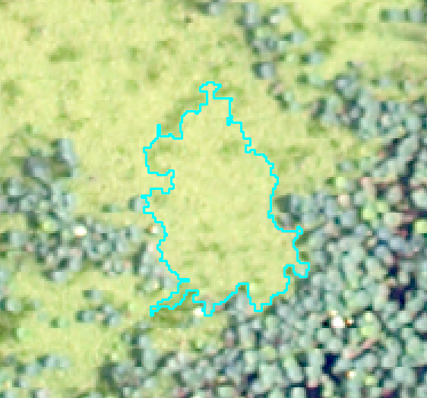
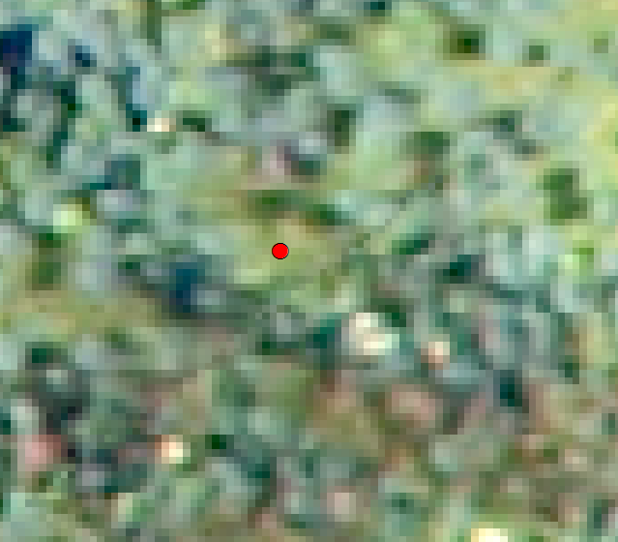
One reason for accuracy mismatch
A. Homogeneous context within training polygon
B. Complex context surrounding test point
Notes:
We expect the accuracy from two testing data set should match, however the accuracy from the second testing data set is much lower from the accuracy of first dataset. One possible reason is that within the training objects, the context is homogeneous. However, for test point, its surrounding context may be complicated. Remember training patches are only extracted within the training objects, so we are short of training sample, whose surrounding is complex.

