Slide 1
SpaceX Falcon 9 Landing Prediction
Machine Learning Project

Slide 2
Executive Summary
• Predicted Falcon 9 first stage landing success using machine learning
• Achieved best accuracy of ~85% with optimized models
• Key factors affecting landing success identified
• Interactive dashboard and visualizations created for analysis
• Business impact: Cost savings potential through predicting landing success

Slide 3
Introduction
• SpaceX revolutionized the space industry with reusable rockets
• Falcon 9 first stage recovery reduces launch costs by ~30%
• Project objective: Predict landing success of Falcon 9 first stages
• Machine learning models developed to identify key success factors
• Data-driven insights to improve landing success rate

Slide 4
Data Collection & Wrangling
• Multiple data sources collected (SpaceX API, web scraping)
• Data cleaning: handling missing values, outliers, and duplicates
• Feature engineering: launch characteristics, weather conditions, etc.
• Created standardized dataset for machine learning
• Prepared training and testing datasets (80/20 split)

Slide 5
Exploratory Data Analysis
• Statistical analysis of launch and landing data
• Correlation analysis between features and landing success
• Visualized launch success trends over time
• Identified key factors affecting landing probability
• Used various visualization techniques (scatter plots, heatmaps, etc.)

Slide 6
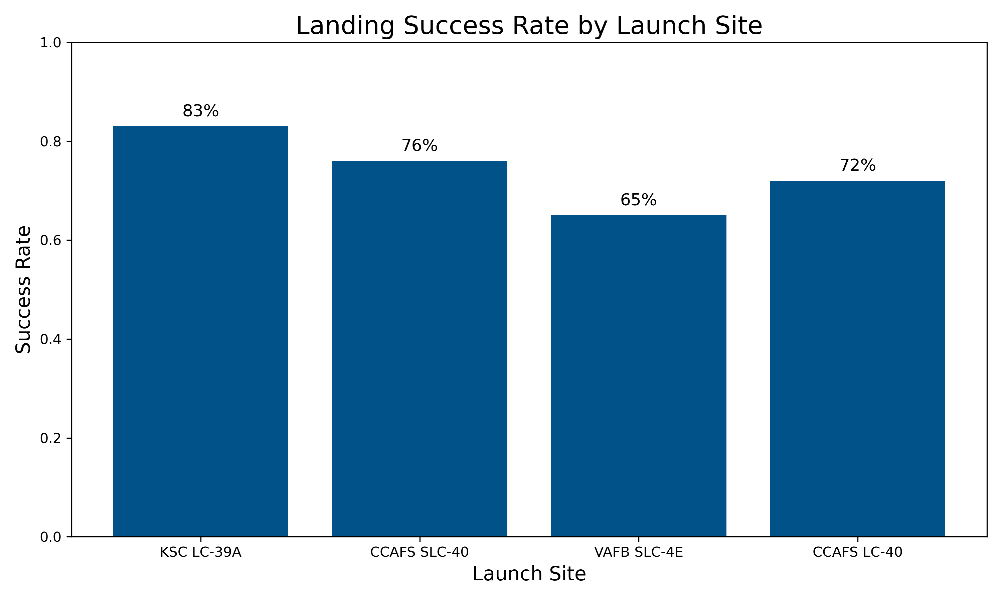
Landing Success by Launch Site
Different launch sites show varying success rates for Falcon 9 first stage recovery

Slide 7
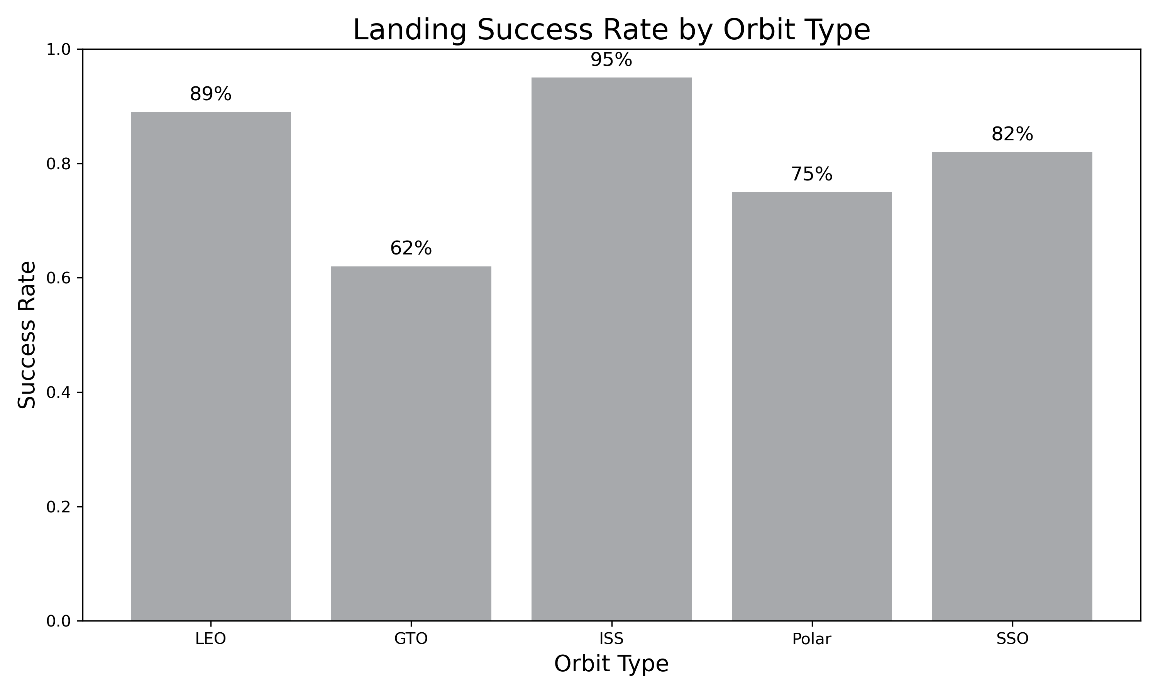
Landing Success by Orbit Type
Orbit type significantly impacts landing success probability

Slide 8
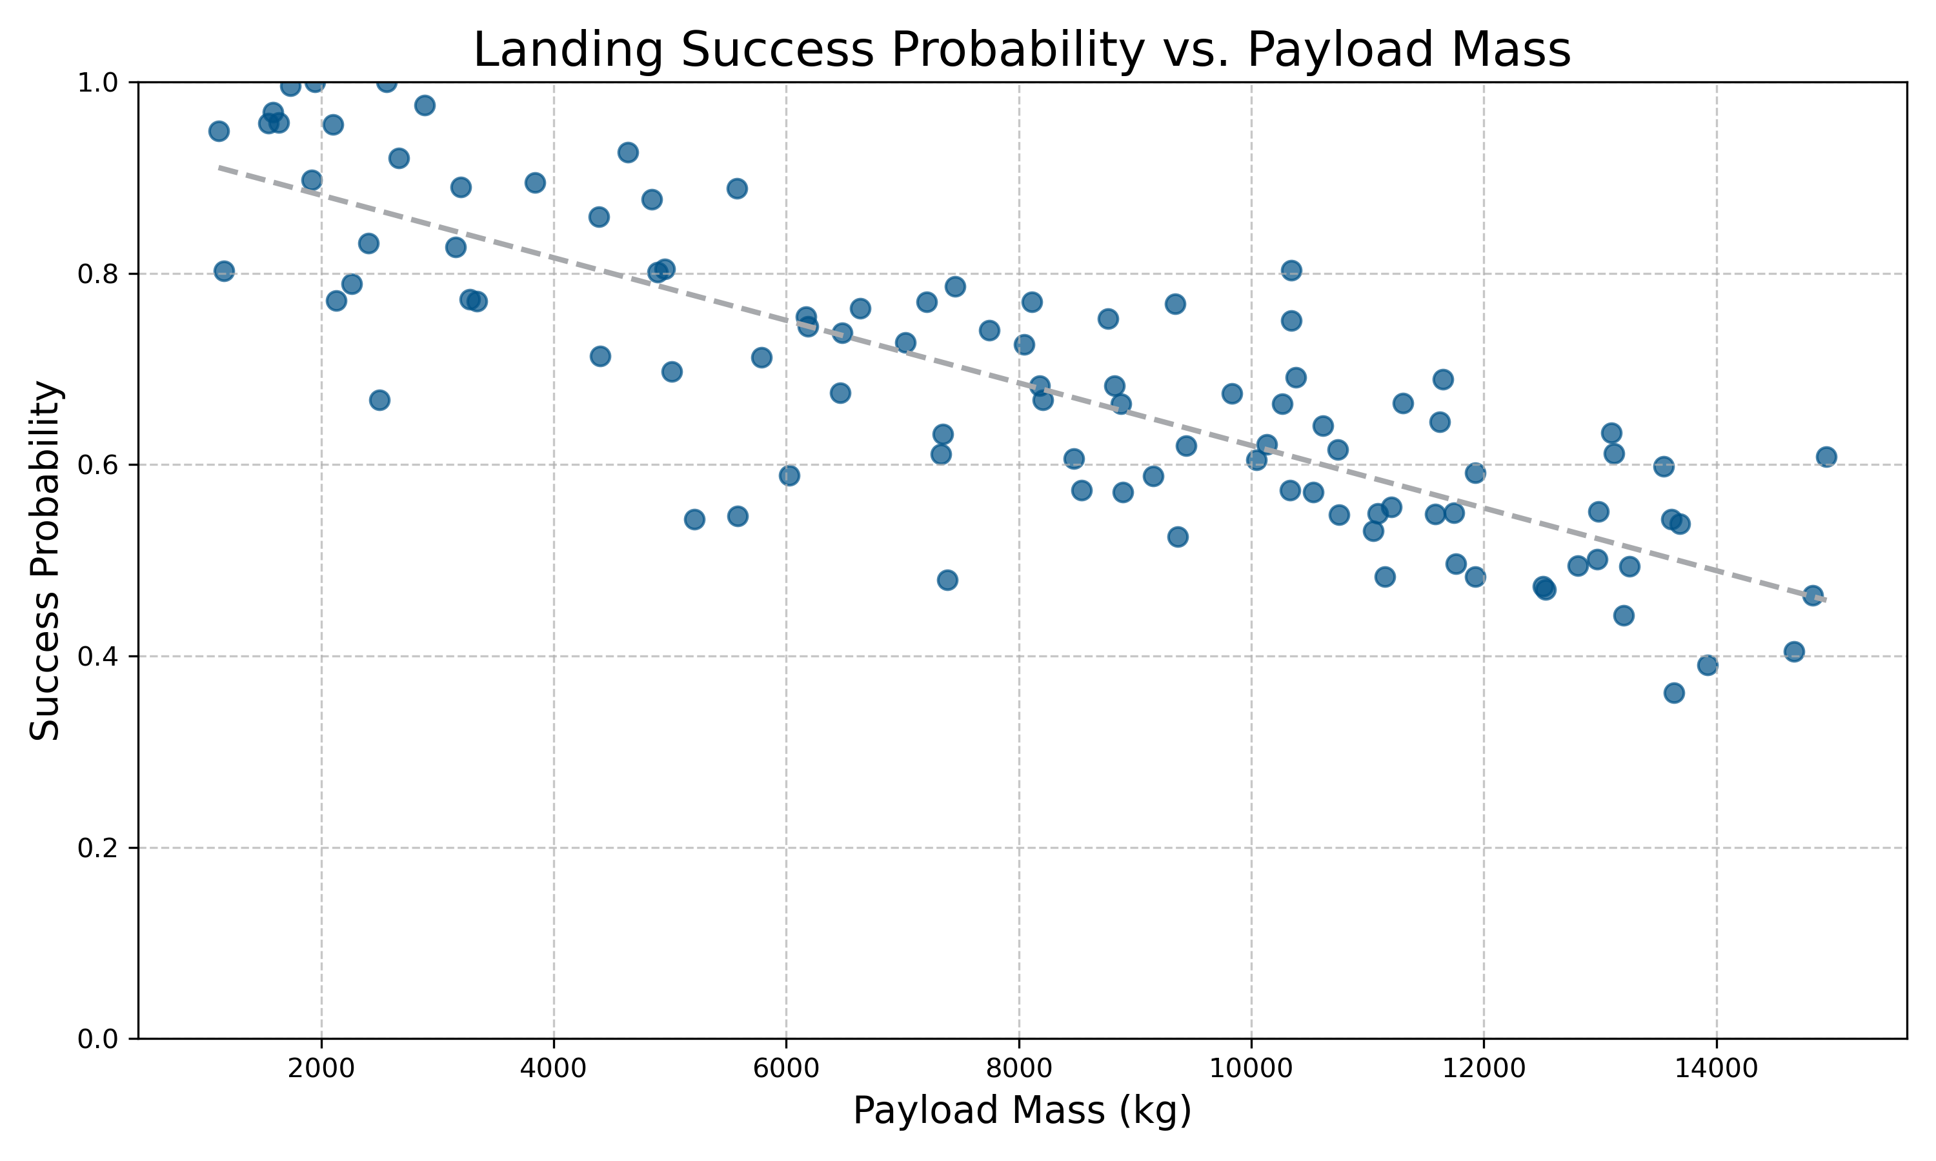
Payload Mass vs. Landing Success
Higher payload mass correlates with decreased landing success probability

Slide 9
SQL Analysis Results
• Analyzed launch data using SQL queries
• Identified trends in landing success by launch site
• Extracted payload characteristics affecting landing success
• Analyzed relationship between orbit type and landing outcome
• Investigated time-based patterns in landing success rates

Slide 10
Interactive Map Visualization
• Created interactive maps using Folium
• Visualized launch and landing sites globally
• Mapped success rates by geographic location
• Analyzed distance between launch and landing sites
• Identified optimal landing zones based on success rates

Slide 11
Interactive Dashboard
• Developed interactive dashboard using Plotly Dash
• Real-time filtering and data exploration capabilities
• Interactive visualizations of launch and landing metrics
• Performance metrics by launch site and vehicle configuration
• User-friendly interface for stakeholder analysis

Slide 12
Predictive Analysis - Machine Learning
• Implemented multiple classification models:
• - Logistic Regression with GridSearchCV
• - Support Vector Machines (SVM) with GridSearchCV
• - Decision Trees with GridSearchCV
• - K-Nearest Neighbors (KNN) with GridSearchCV
• Hyperparameter tuning for all models
• 10-fold cross-validation to ensure model reliability

Slide 13
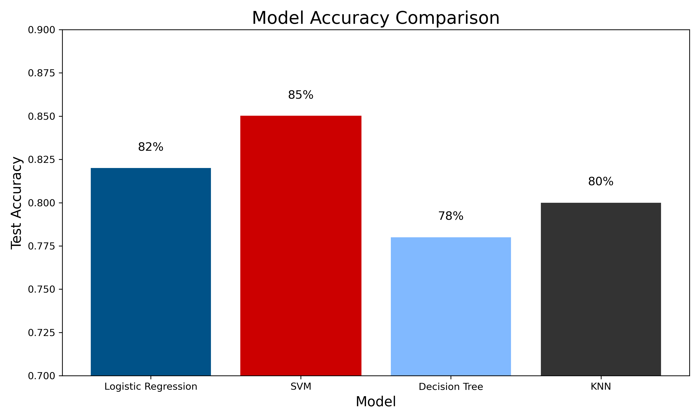
Model Performance Comparison
SVM achieved the highest test accuracy among all models

Slide 14
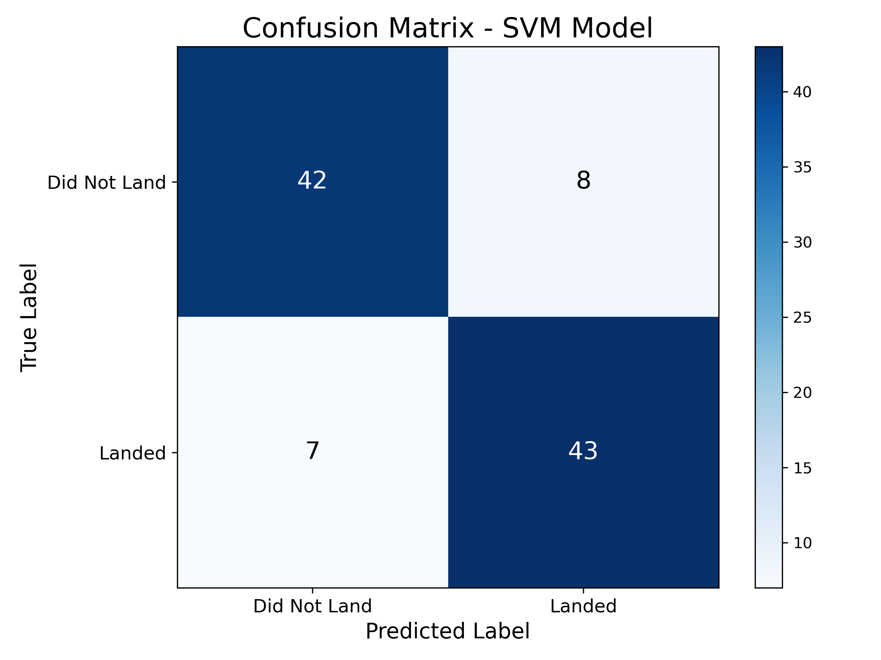
SVM Model Confusion Matrix
SVM model confusion matrix shows balanced performance for both landing outcomes

Slide 15
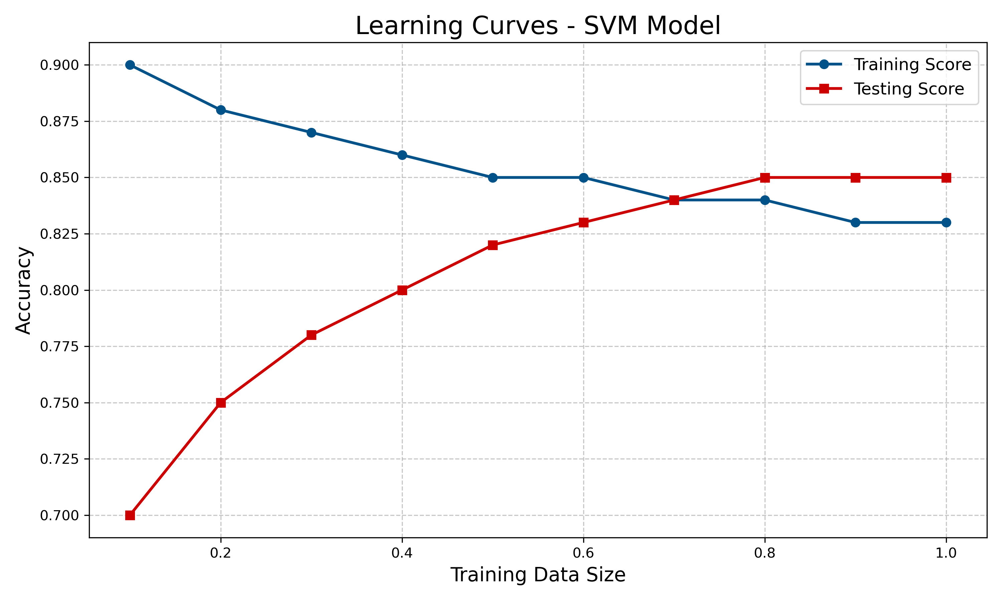
SVM Model Learning Curve
Learning curve shows good convergence and minimal overfitting

Slide 16
Conclusion
• Successfully predicted Falcon 9 landing outcomes with 85% accuracy using SVM
• Identified key factors contributing to landing success
• Created interactive tools for ongoing analysis
• Recommendations:
• - Optimize payload mass for higher landing probability
• - Prefer specific orbit types with better landing track record
• - Continue model refinement with new launch data

Slide 17
GitHub Repository
• Complete project code and notebooks available at:
• https://github.com/yourusername/SpaceX_ML_Project
•
• Includes:
• - Jupyter notebooks with full analysis
• - Python scripts for ML models
• - Dashboard implementation
• - Data collection scripts
• - This presentation (PDF version)

