Slide 1
My Fifty (50) Stocks

Slide 2
My Fifty (50) Stocks for the Group Project
Group 2
ATVI | BXP | BDX | CDW
AVB | C | BEN | CE
AVGO | CAG | BF/B | CERN
AVY | CAH | BIIB | CF
AWK | CAT | BK | CFG
AXP | CB | BKNG | CHD
AZO | CBOE | BKR | CHRW
BA | CBRE | BLK | CHTR
BAC | CCI | BLL | CI
BAX | CCL | BMY | CINF
BBY | CDNS | BR | CL
BWA | CMCSA | BRK/B | CLX
BSX | CMA

Slide 3
Market Impact Model

Slide 4
Market Impact Description:
To include in this slide:
Describe the analyses you performed in this step.
For example, briefly describe (in a few sentences max) what you did in each model. You can use my wording below for this slide, but please add you own words where you feel appropriate.
Log-Regression
We performed a log-transformation of the I-Star impact model. We set the temporary impact parameter b1=1. We solved for the model parameters using ordinary least squares (OLS) regression analysis.
Non-Linear Regression
We performed non-linear least squares regression analysis to determine the parameters of the I-Star Market Impact Model.
Non-Linear Regression with Sampling
We estimated the parameters of the I-Star Market Impact Model using non-linear least squares regression analysis and a sampling process with replacement. The sampling with replacement technique provides the parameters standard errors. This is used to determine if the factor in a non-linear model is statistically significant via a T-Test.

Slide 5
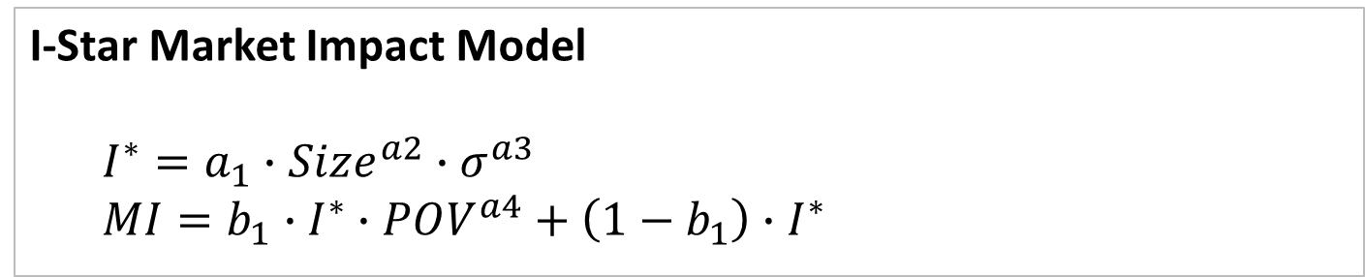
I-Star Market Impact Model:

Slide 6
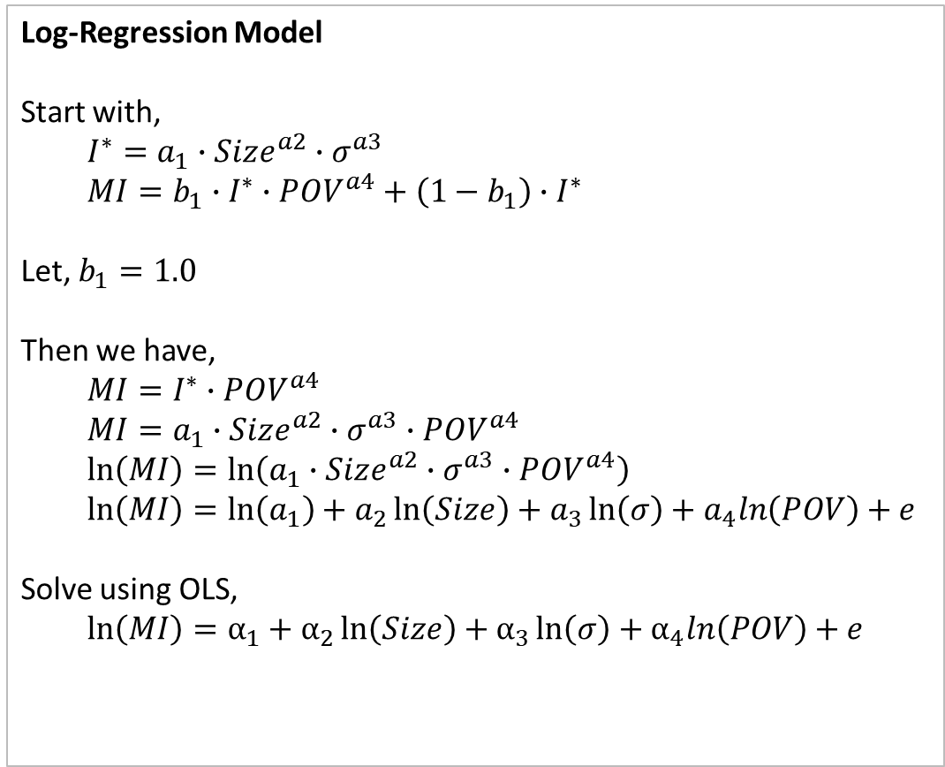
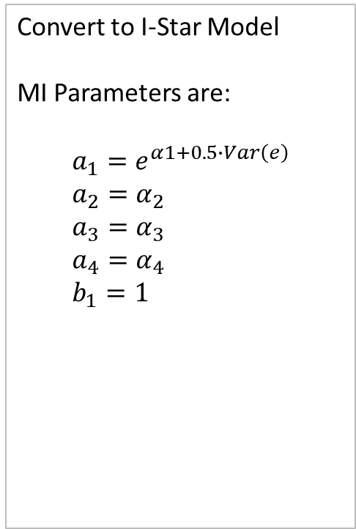
Log-Transformed I-Star Market Impact Model:

Slide 7
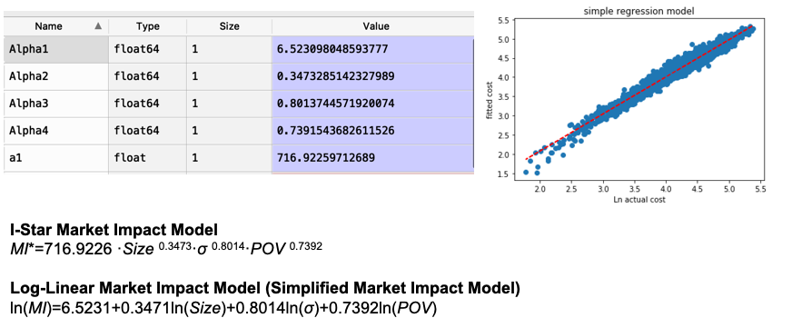
Log-Transformed Regression Results:

Slide 8
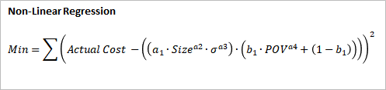
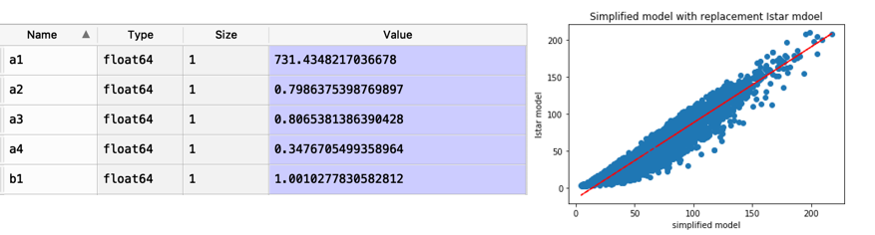
I-Star Model: Non-Linear Regression Results

Slide 9
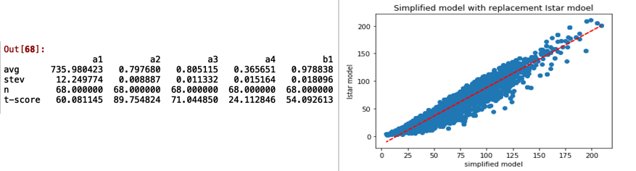
I-Star Model: Non-Linear Regression with Sampling Results

Slide 10
CAPM Regression

Slide 11
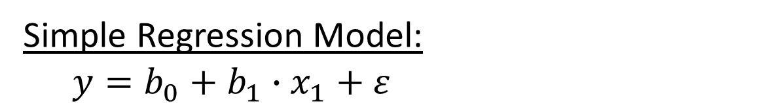
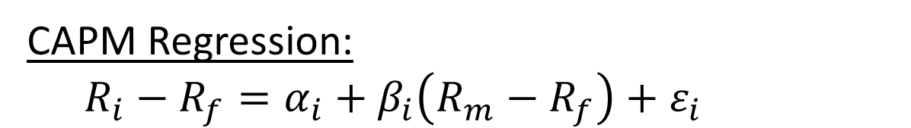
CAPM Regression Model

Slide 12
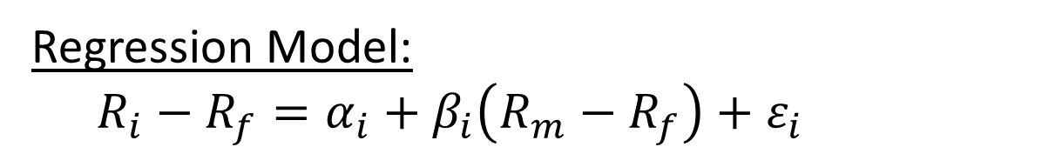
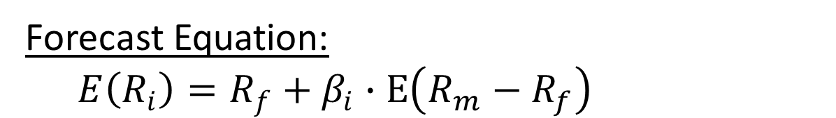
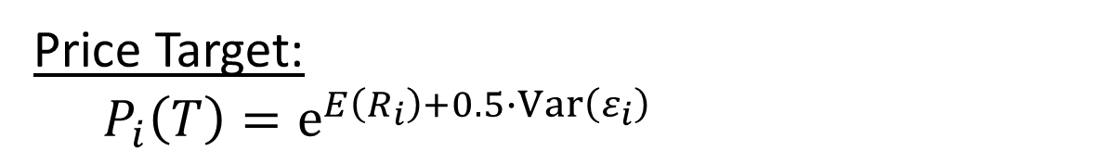
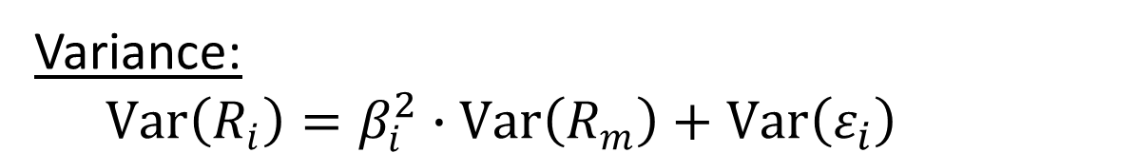
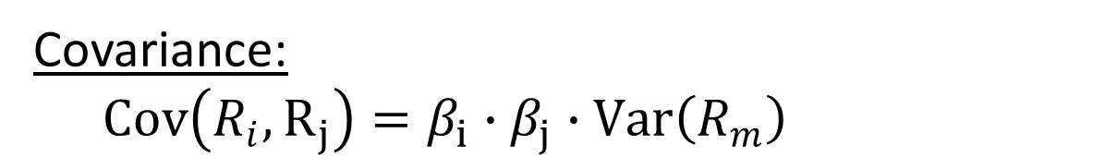
CAPM Regression Model

Slide 13
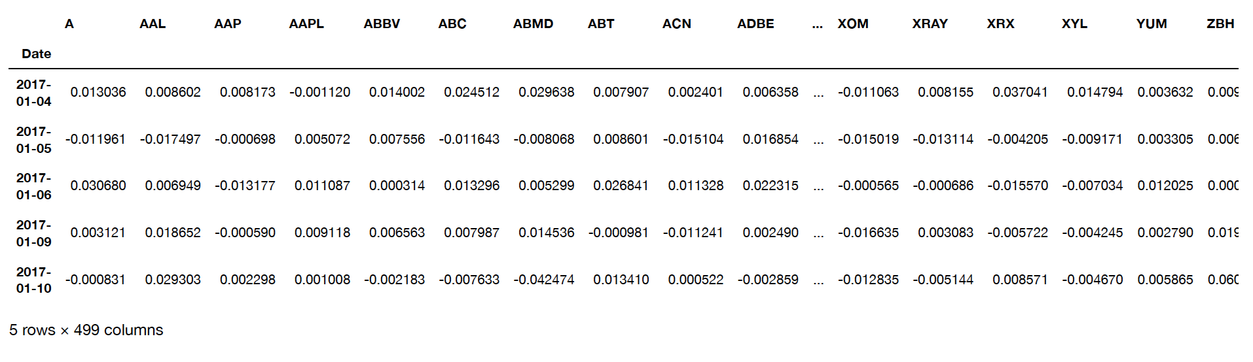
CAPM Regression Model
Get historical cumulative return of ~500 stocks and SP500; market premium, and risk free rate.

Slide 14
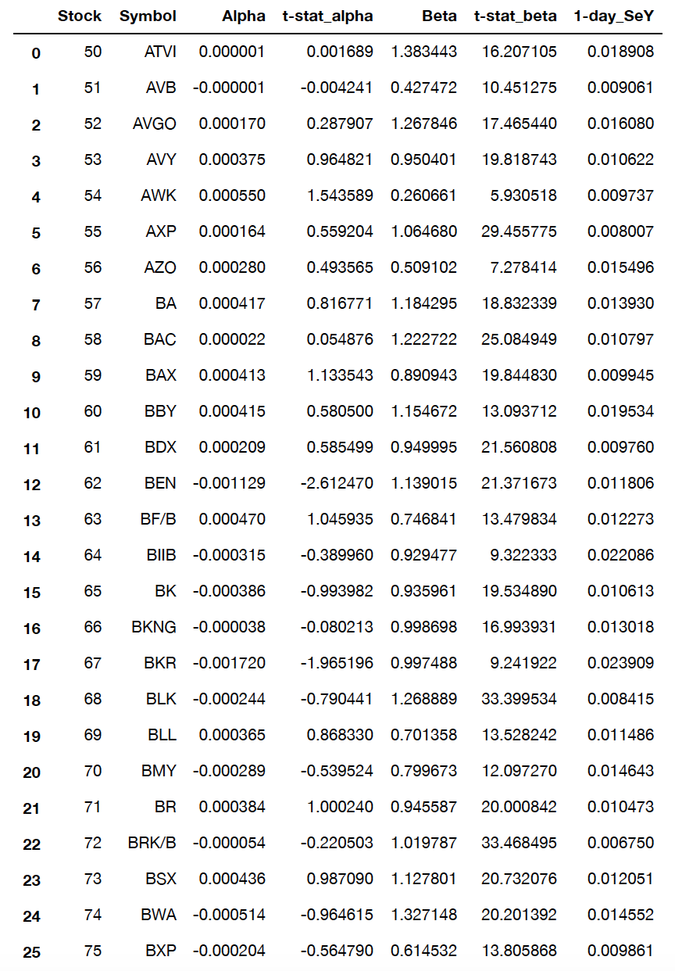
CAPM: Regression Results for My 50 Stocks (Stock #1 – Stock #25)
Set up selected stock range
Get betas, alphas, t-stats and 1-day SeY for each selected stock

Slide 15
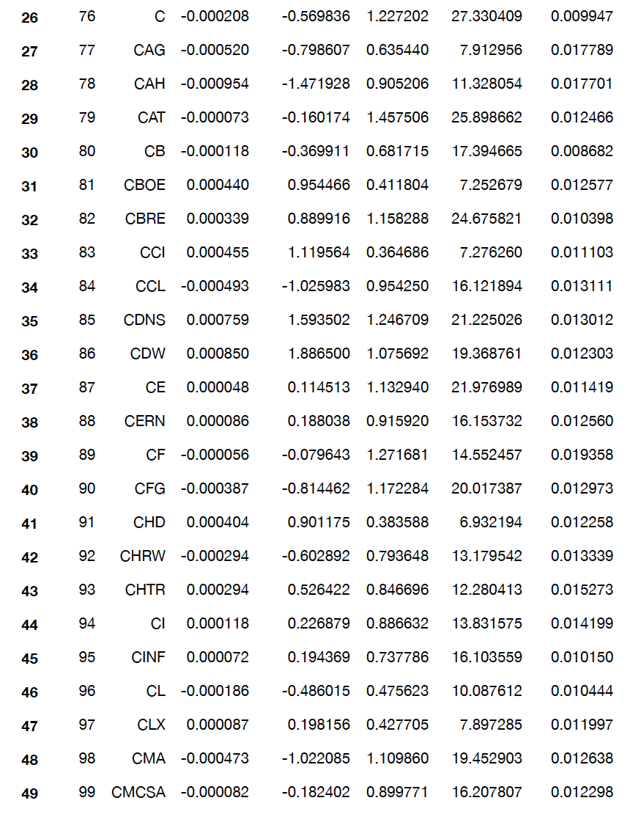
CAPM: Regression Results for My 50 Stocks (Stock #26 – Stock #50)

Slide 16
Portfolio Optimization

Slide 17
First Five Optimizations to Run:
Run optimization on following scenarios:
min var
min ret
max ret
max sharpe_ratio
min var s.t. ret
Return
Stdev
min var - ret: 0.038522682682492336 std: 0.0760920226345196
min ret - ret: 0.022438391800092643 std: 0.11184050830974332
max ret - ret: 0.147224170437794 std: 0.30399658024732323
max spr - ret: 0.0908682546352963 std: 0.1591619304748163
min var st ret - ret: 0.07999999999999999 std: 0.13536444471478723

Slide 18
Efficient Frontier

Slide 19
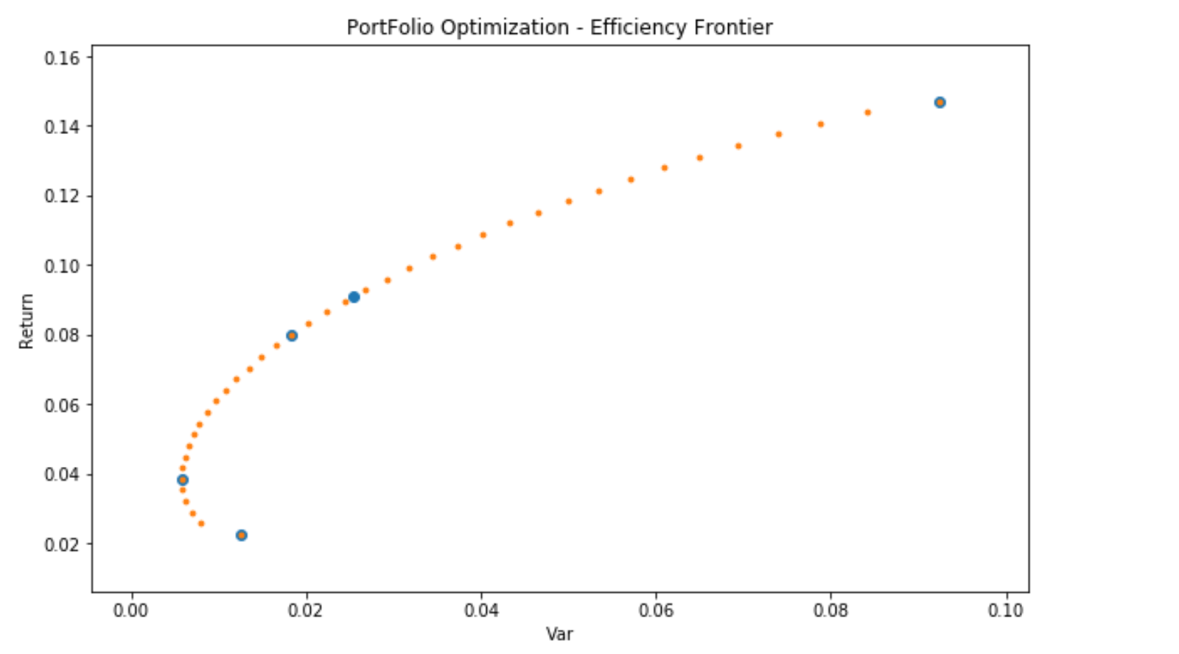
Efficient Frontier with All Points

Slide 20
Traditional QP Portfolio Optimization

Slide 21
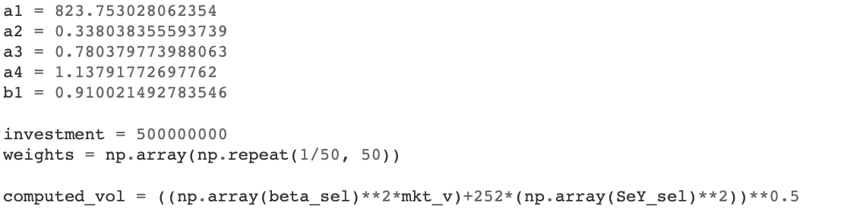
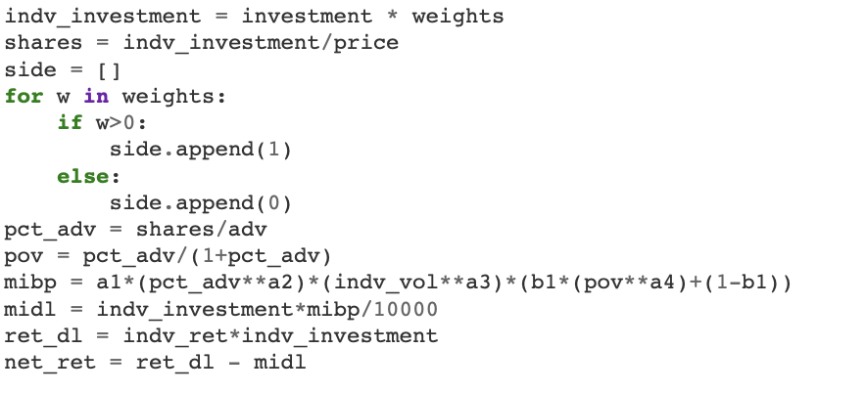
Traditional QP Portfolio Optimization

Slide 22
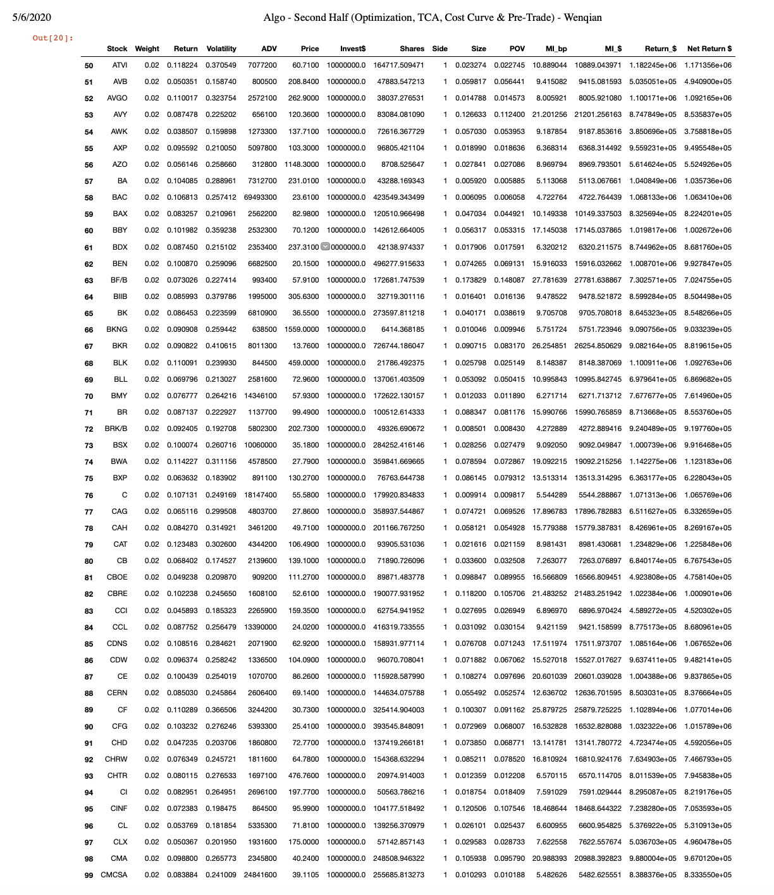
Traditional QP Portfolio Optimization

Slide 23
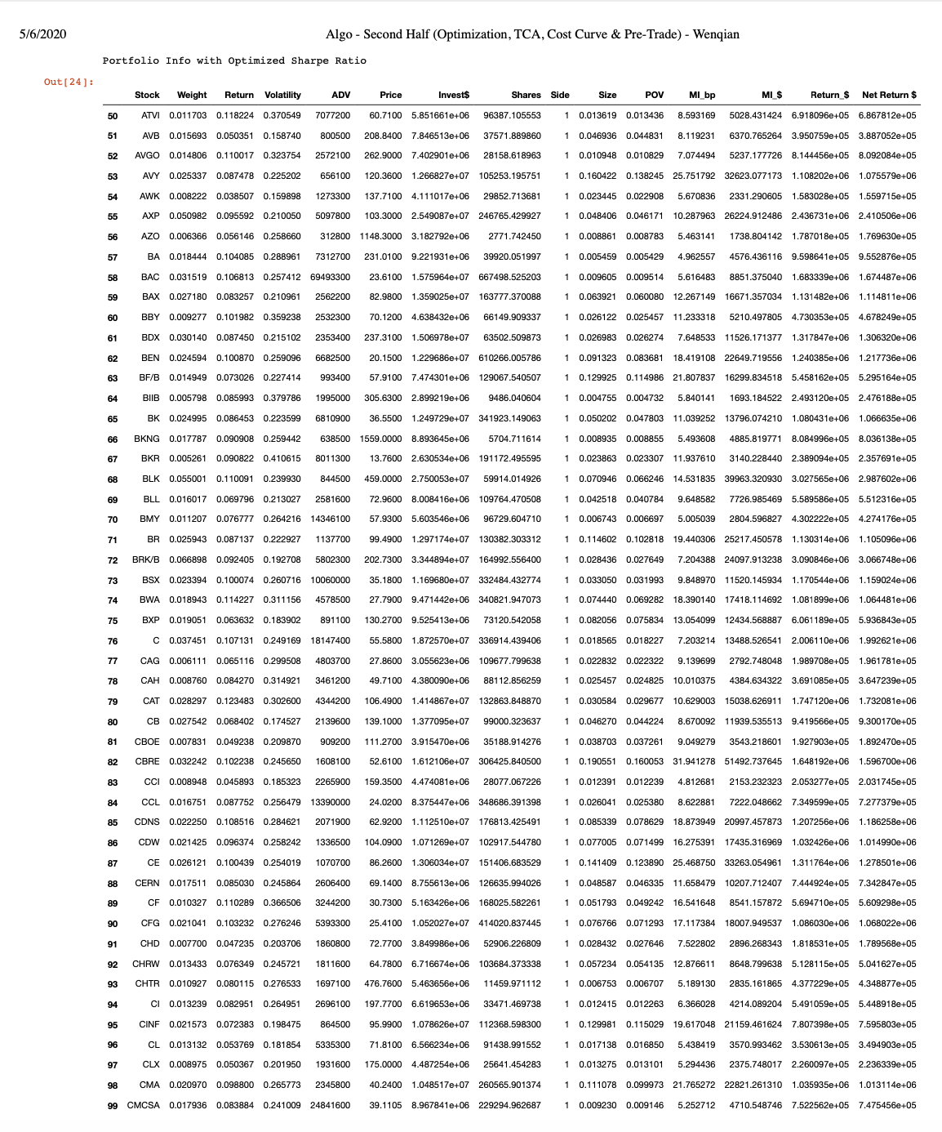
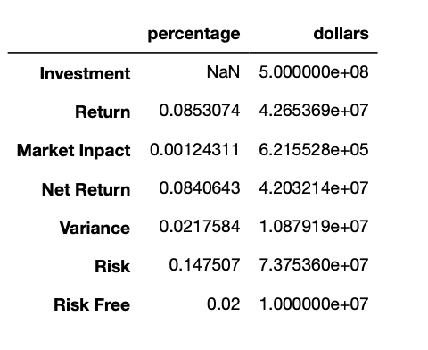

Slide 24
TCA Portfolio Optimization

Slide 25
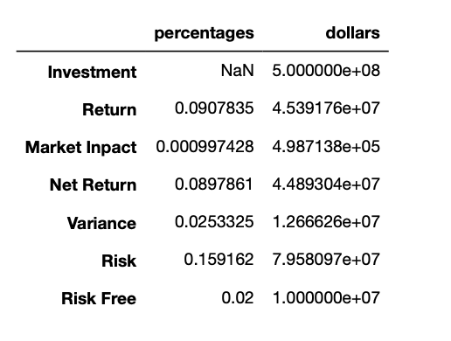
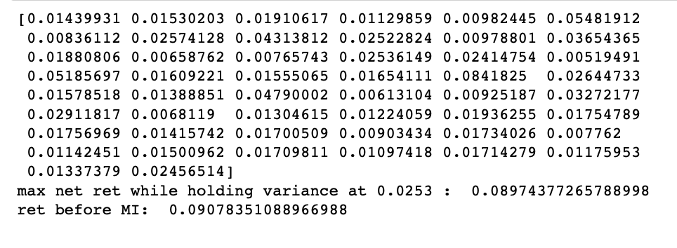
TCA Portfolio Optimization

Slide 26
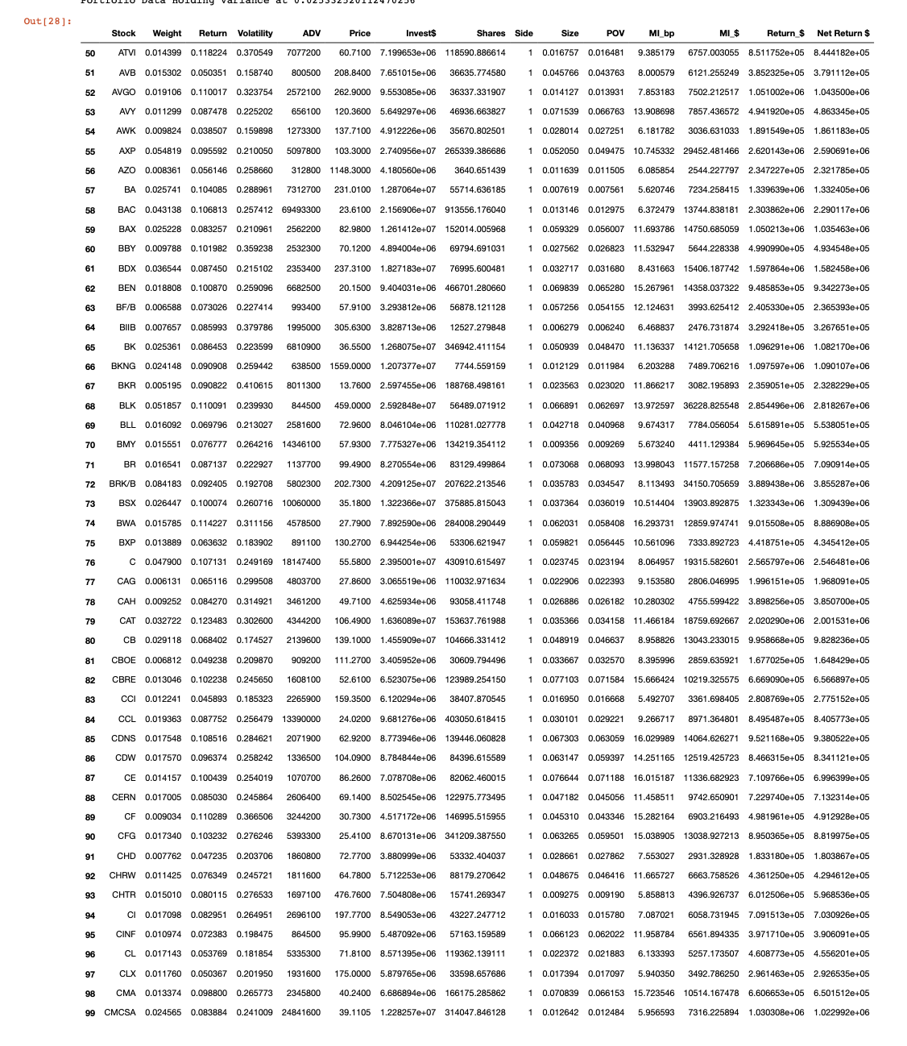

Slide 27
Comparison of Portfolio Optimization Approaches

Slide 28
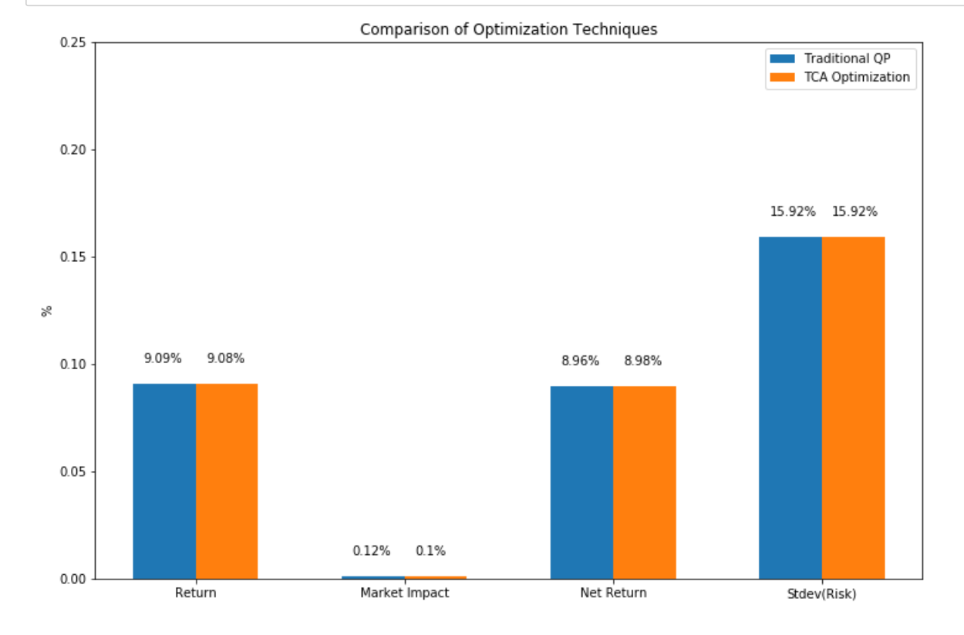
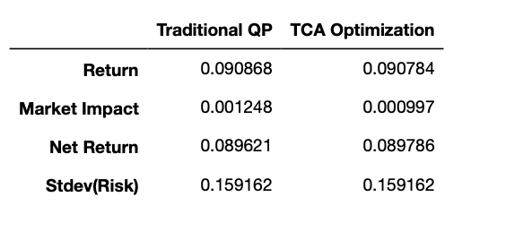
Comparison of Portfolio Optimization Approaches

Slide 29
Pre-Trade Analysis

Slide 30
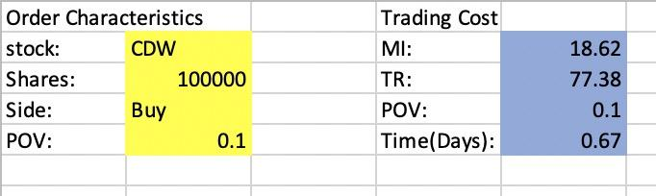
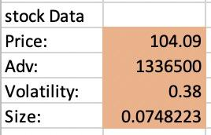
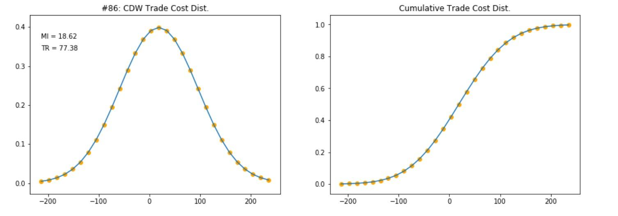
Pre-Trade Analysis

Slide 31
Cost Curves

Slide 32
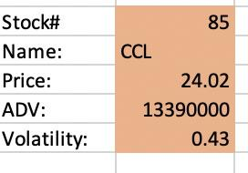
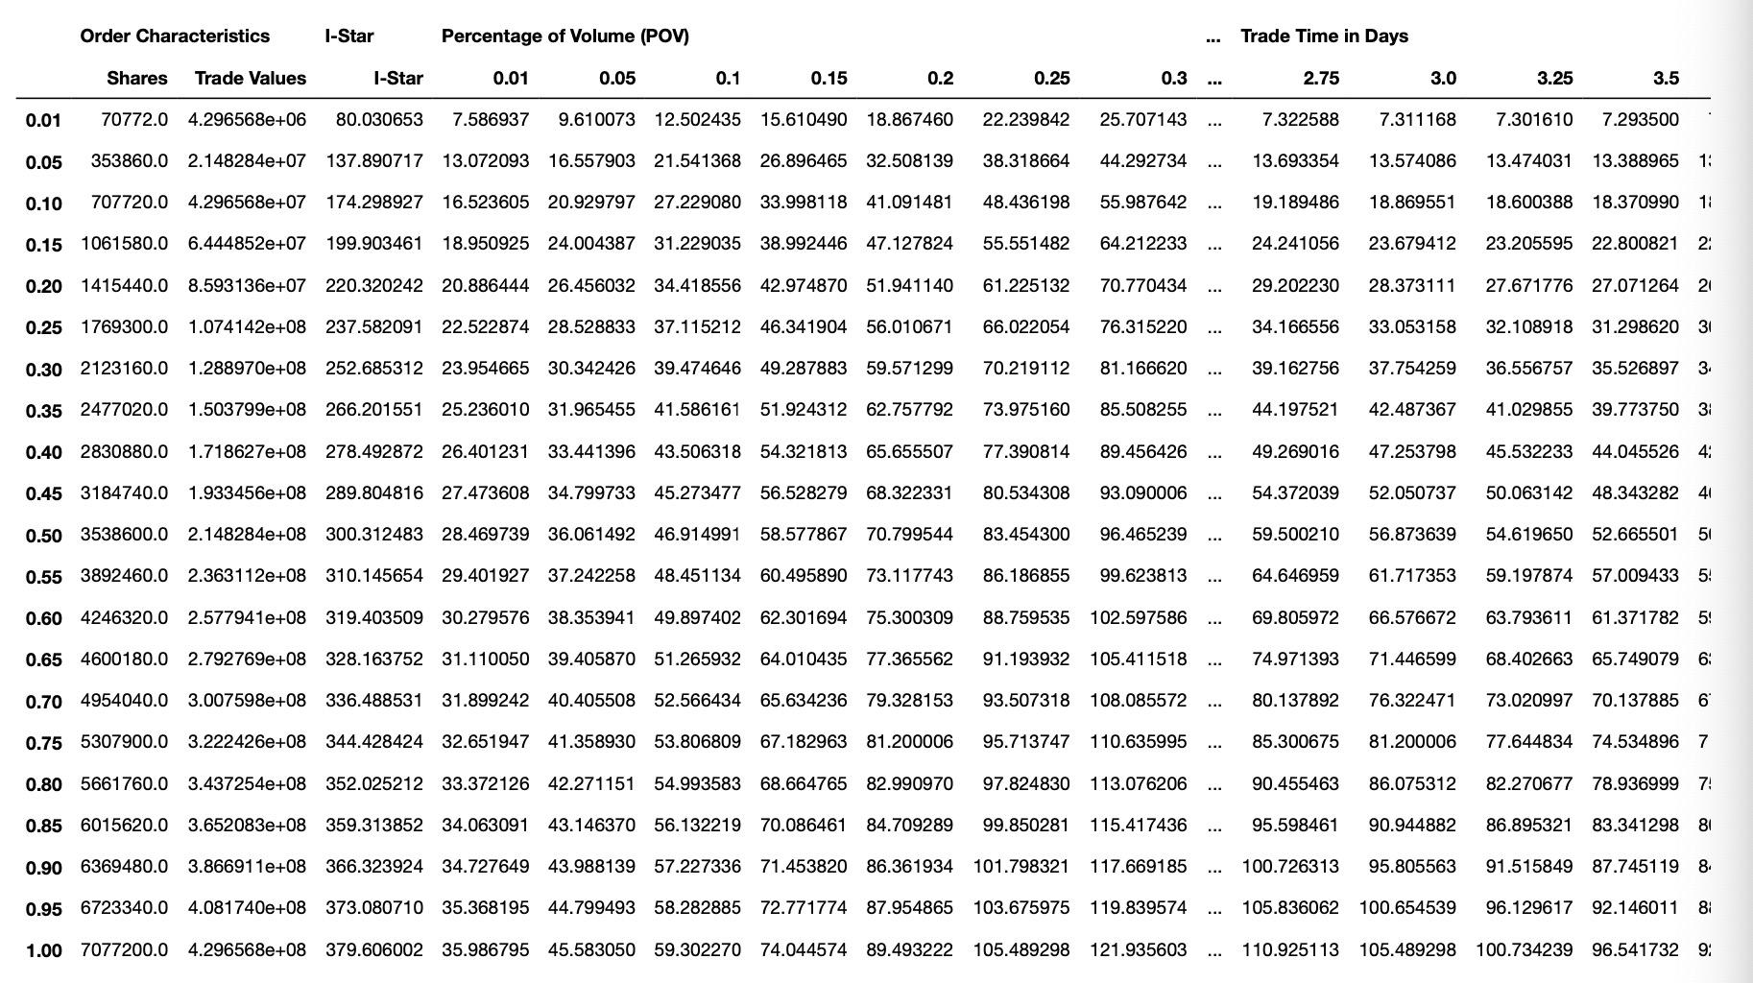
Cost Curves: Trade Time

Slide 33
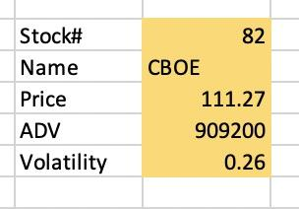
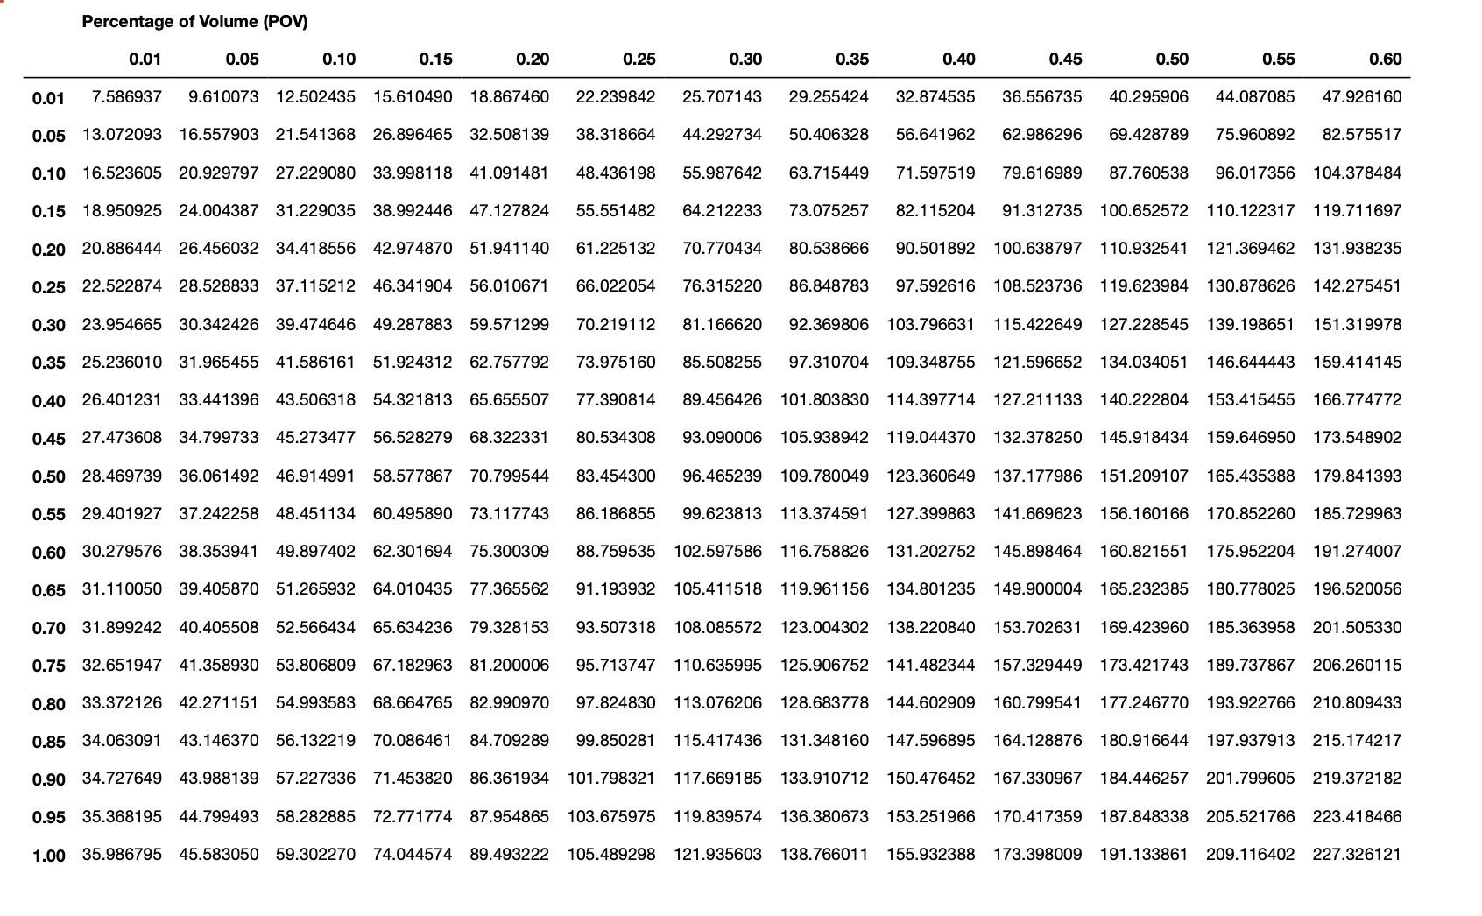
Cost Curves: Percentage of Volume

