Slide 1
Tips & Trick with Selenium
Dima Kovalenko
@dimacus

Slide 2


Slide 3

Resume
Worked with Selenium for 5 years
Currently working at Groupon
Blog: www.agilesoftwaretesting.com

Slide 4
Why I am here?
I enjoy finding new ways to test complicated things with Selenium
I want to share somethings I had to learn the hard way myself
I want to start a small "Selenium Examples" project

Slide 5
Source Code
github.com/dimacus/SeleniumTipsAndTricks

Slide 6

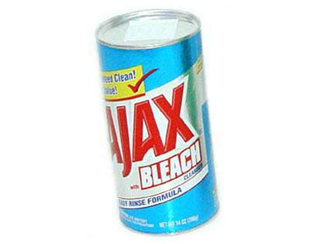
Wait For AJAX

Slide 7
Wait For AJAX
More web applications use AJAX to load content
Selenium is not very smart about AJAX
You need to add your own wait for AJAX method

Slide 8
Methods used
Selenium 1
Ruby
wait_for_condition
Java
waitForCondition
Selenium 2
Ruby
execute_script
Java
executeScript

Slide 9
Selenium 1
wait_for_condition method waits for JS condition to be true
To get to current window DOM
selenium.browserbot.getCurrentWindow()
Condition example for jQuery
selenium.browserbot.getCurrentWindow().jQuery.active == 0

Slide 10
Selenium 2
execute_script method executes JS method
Example
selenium.execute_script("return jQuery.active”)
Returns integer
0 no longer active

Slide 11
Non jQuery examples to check
jQuery
jQuery.active
Prototype
Ajax.activeRequestCount
Dojo
dojo.io.XMLHTTPTransport.inFlight.length

Slide 12
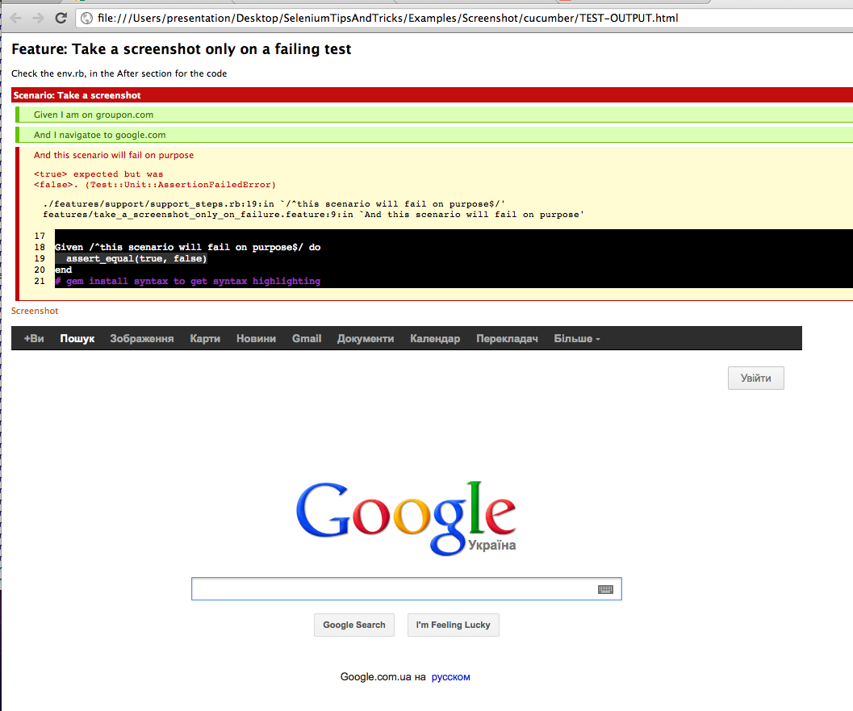
Screenshots

Slide 13
Screenshot
Selenium allows you to take screenshots of the whole web-page
Does not care if multiple windows are open
Ruby
save_screenshot
Java
getScreenshotAs

Slide 14
Take a screenshot on failure in Cucumber
Cucumber has HTML reports
You can attach screenshots into report
Example
embed(“screenshot.png”, "image/png")

Slide 15


Video capture of tests

Slide 16

Video capture of test
Only on Linux for now
Working on windows/mac
I’m looking for a good free screen capture program.
Possibly VLC

Slide 17
Video capture of test
Record the test
If test passes, delete the video
If test fails, publish video into CI

Slide 18
Video capture of test
Using “headless” gem
Actual work:
Start XVFB
xvfb :1 –screen 1280x1024x24
Start ffmpeg
ffmpeg -f x11grab –i :1...
Write to /tmp/video.mov
Delete movie if test passes
Copy movie to project if fails

Slide 19
Video capture of parallel tests
Use different DISPLAY
Start XVFB for every test instance

Slide 20
Firefox profiles Selenium 1
Can use existing firefox profile
Set everything up once, and have it in the test
Extensions
SSL certificates
Passwords

Slide 21
Firefox profiles Selenium 2
Setup profile on the fly in code
Settings
Extensions

Slide 22
Selenium 2 profile
profile = Selenium::WebDriver::Firefox::Profile.new
profile[“some_setting“] = 1
selenium = Selenium::WebDriver.for :firefox, {:profile => profile}

Slide 23
In URL Basic Auth Firefox
Selenium 1
Modfy
network.http.phishy-userpass-length = 255
Selenium 2
Already supported in webdriver 2.14+

Slide 24

Auto download files

Slide 25
Auto download files
browser.helperApps.neverAsk.saveToDisk
List of MIME types to always save
application/pdf
application/zip
browser.download.dir
Default folder to save files to
browser.download.lastDir
Last save directory
browser.download.folderList
Set 2, to auto save to the default folder

Slide 26
Parsing PDF
Ruby
pdf-reader gem
Java
Apache PDFBox

Slide 27

Headless Tests

Slide 28
Headless Tests
HTMLUnit
Built into Selenium2 stand alone jar
Runs 2x faster for simple page loads
Emulates browsers
IE
Firefox
etc..
capybara-webkit gem
Uses Nokia's QT framework
https://github.com/thoughtbot/capybara-webkit

Slide 29
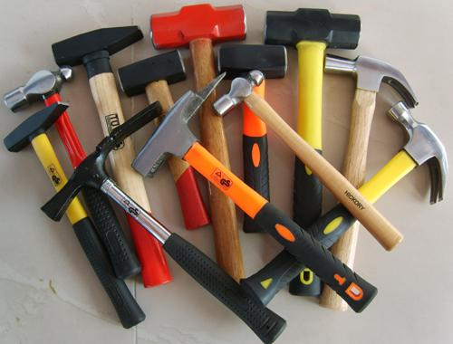
Tests in parallel

Slide 30
Tests in parallel
Using fork in linux based systems
Windows does not have fork support ☹
Ruby
parallel_tests gem
or parallel gem
or Unix fork

Slide 31
Parallel Tips
Use separate databases for each test run
Tests SHOULD NOT depend on each other
Run in separate DISPLAYs on linux boxes

Slide 32
Sauce
Run selenium on
Multiple browsers
Operating systems
In parallel
EC2 cloud
Selenium 1 & 2 support
Screenshots of every step
Movie of every test
www.saucelabs.com

Slide 33
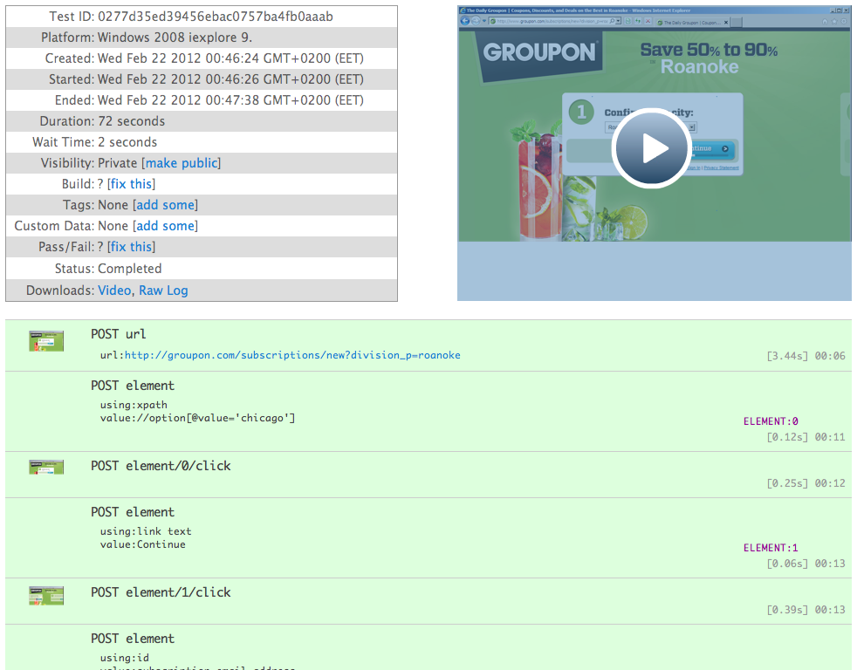
SauceLabs

Slide 34
Sauce connect
Small Java application
Sets up SSH tunnel between local computer and EC2
Allows Selenium tests to run against internal “Staging” servers

Slide 35
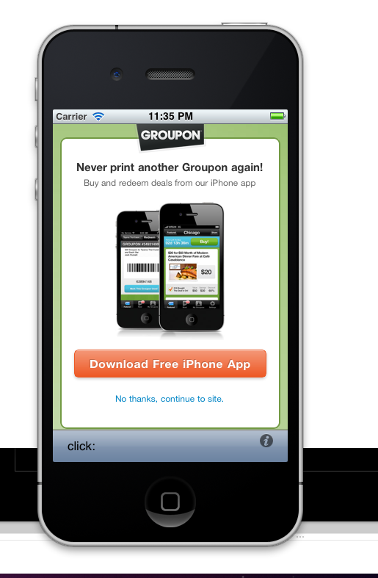
Selenium & iPhone

Slide 36
iPhone
Use iPhone Simulator’s Safari Browser
Need Xcode, developer account to compile app for simulator
No parallel support ☹
JS alert support is not always good ☹

Slide 37
iPhone application testing
Not selenium per se…
You can test applications using Frank project
http://www.testingwithfrank.com/
http://vimeo.com/21860134

