Slide 1
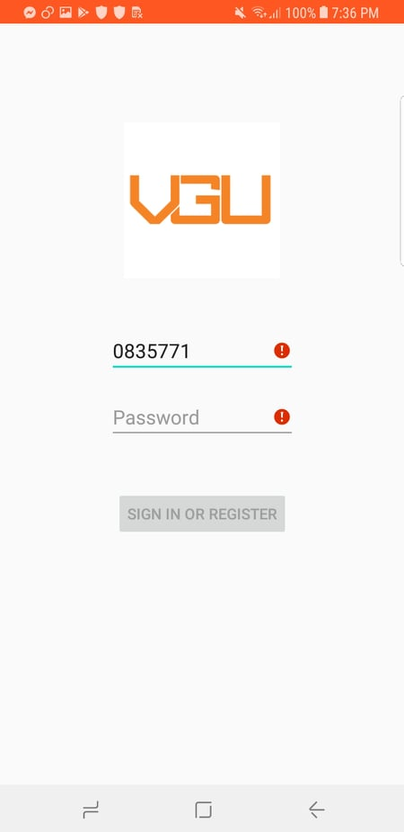
Phone number Edit Text
Password Edit Text
Login/Signup Button

Slide 2
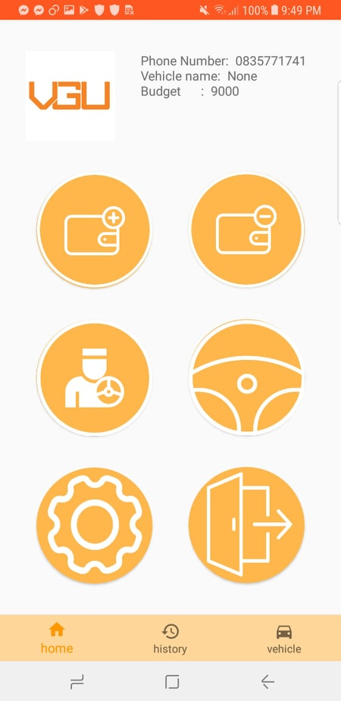
User information
Text view
Add Credit
Button
Retrieve Money
Button
Driver registration
Button
Vehicle registration
Button
Log out
Button
Debug Button
Navigation bar

Slide 3
Start TCP connection
Start connection
Search existence key with corresponding IP address
No key exist of given IP address
Send temporarily key request
Generate a temporarily secrete key
Encrypt the log in request with temporarily key
Wait for request
Send encrypted log in request
Decrypt the request with temporarily key
If log in success ,stored long term key with IP address
Send positive encrypted log in response
Encrypt log in positive response
Store long term key
Close connection
…
…
…
TCP connection
handler
Database
handler
Mobile device
Central server

Slide 4
TCP connection
handler
Database
handler
Mobile device
Central server
…
…
…
Start TCP connection
Start connection
Search existence key with corresponding IP address
Long term key exist of given IP address
Wait for request
Encrypt the request with long term key
Send encrypted request
Decrypt the request with long term key
Execute the request and generate response
Send positive encrypted response
Encrypt positive response
…
…
…
Close connection

Slide 5
TCP connection
handler
Database
handler
Mobile device
Central server
…
…
…
Start TCP connection
Start connection
Search existence key with corresponding IP address
Long term key exist of given IP address
Encrypt the log out request with long term key
Wait for request
Send encrypted log out request
Decrypt the request with long term key
If log out success, delete long term key with regard IP address
Send positive encrypted response
Encrypt log out positive response
Close connection

Slide 6
Message structure
JSON Header
Byte order: little
Content type: text/json
Content encoding: UTF-8
Content length: (Body length)
Client JSON Body
Server JSON Body
Action
Action
Info 1
Result: good/bad
Info 2
Info 1
….
…

Slide 7
Waiting for driver registered
Registration not done
Set old 2nd coordinate as new 1st coordinate
Positive response
Registration successful
Waiting for pay fee response
No response
Set up GPS connection
Send request to central server
Waiting for GPS event
No event
Negative response
New event
Generated pay fee request
Update last GPS position
Convert to street name
Update 1st coordinate
Name check
Right after driver registration
Same street name
Update 2nd coordinate as last position
Get street name
Different street name

