Slide 1

DriverPass System Analysis
David Greene
Notes:
"Good day, everyone! Today, we delve into the analysis of the DriverPass system. This comprehensive examination is aimed at enhancing students' preparation for driving tests, improving satisfaction, and optimizing the management of reservations. Let's explore the various aspects of our system analysis."

Slide 2

System Requirements
Capabilities the system must have, such as creating and managing user accounts
Nonfunctional requirements focus on aspects like security, scalability.
Notes:
"In understanding DriverPass's needs, we've identified two key types of requirements: functional and nonfunctional. On the functional side, we've outlined the capabilities the system must have, such as creating and managing user accounts, registering for driving lessons, taking practice exams, and more. Nonfunctional requirements focus on aspects like security, scalability, and accessibility, ensuring the system is secure, reliable, and accessible from anywhere."

Slide 3
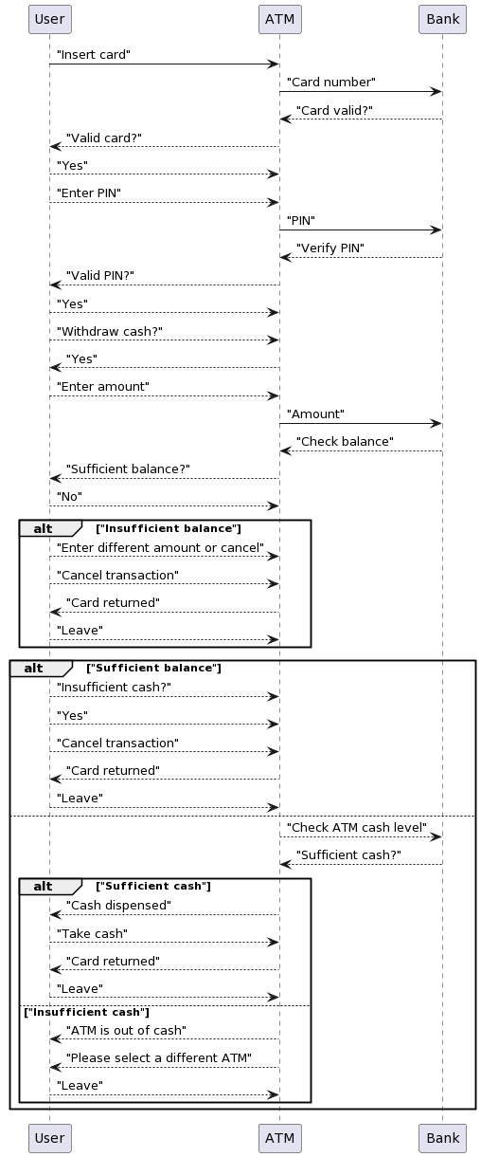
Use Case Diagram
Notes:
"Now, let's dive into the use case diagram. We've identified various actors in our system, including users and the ATM. Use cases represent the functionalities users can perform, like 'Insert Card' and 'Withdraw Cash.' This design ensures that DriverPass's needs are seamlessly integrated into the system, providing a user-friendly experience without using technical jargon."

Slide 4
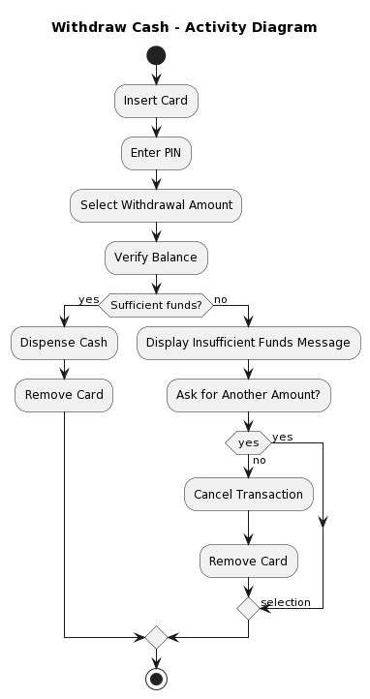
Activity Diagram
Notes:
"This activity diagram breaks down the 'Withdraw Cash' use case. Users start by inserting a card and go through the steps of entering a PIN, selecting withdrawal options, and verifying the balance. By breaking down this use case, we've ensured a clear and intuitive process for users, aligning with DriverPass's emphasis on simplicity and efficiency."

Slide 5
Security
Data encryption: All sensitive data will be encrypted at rest and in transit.
User authentication: Two-factor authentication will be implemented for enhanced security.
Vulnerability management: Regular system scans and updates will be conducted to mitigate security risks.
Secure coding practices: Developers will follow secure coding practices to avoid vulnerabilities.
Notes:
"Security is a top priority in our design. We've implemented measures to protect user data, secure communication, and authenticate users without delving into technical jargon. The focus is on ensuring a secure environment for all DriverPass users without overwhelming them with technical details."

Slide 6
System Limitations
Limitations
The following limitations have been identified for the DriverPass system:
The system will not be able to provide real-time feedback on driving lessons.
The system will not be able to predict whether a student will pass their driving test.
Notes:
"Every design has its limitations, and ours is no exception. We've identified that real-time feedback on driving lessons and predicting test outcomes aren't within the system's scope. It's crucial to recognize these limitations to set clear expectations, and we've done so with our audience in mind, avoiding technical terms for clarity."

