Slide 1
Advanced Programming
CO2039
Chapter 1: Object Oriented Programming Revision - Encapsulation
TP.HCM, 03/01/2025

Slide 2
CONTENT
01
02
03
04
05
INTRODUCTION TO ENCAPSULATION
KEY CONCEPTS OF ENCAPSULATION
BEST PRACTICES
CONCLUSION
EXTENSION: CLASS DIAGRAM

Slide 3
01
INTRODUCTION TO ENCAPSULATION

Slide 4
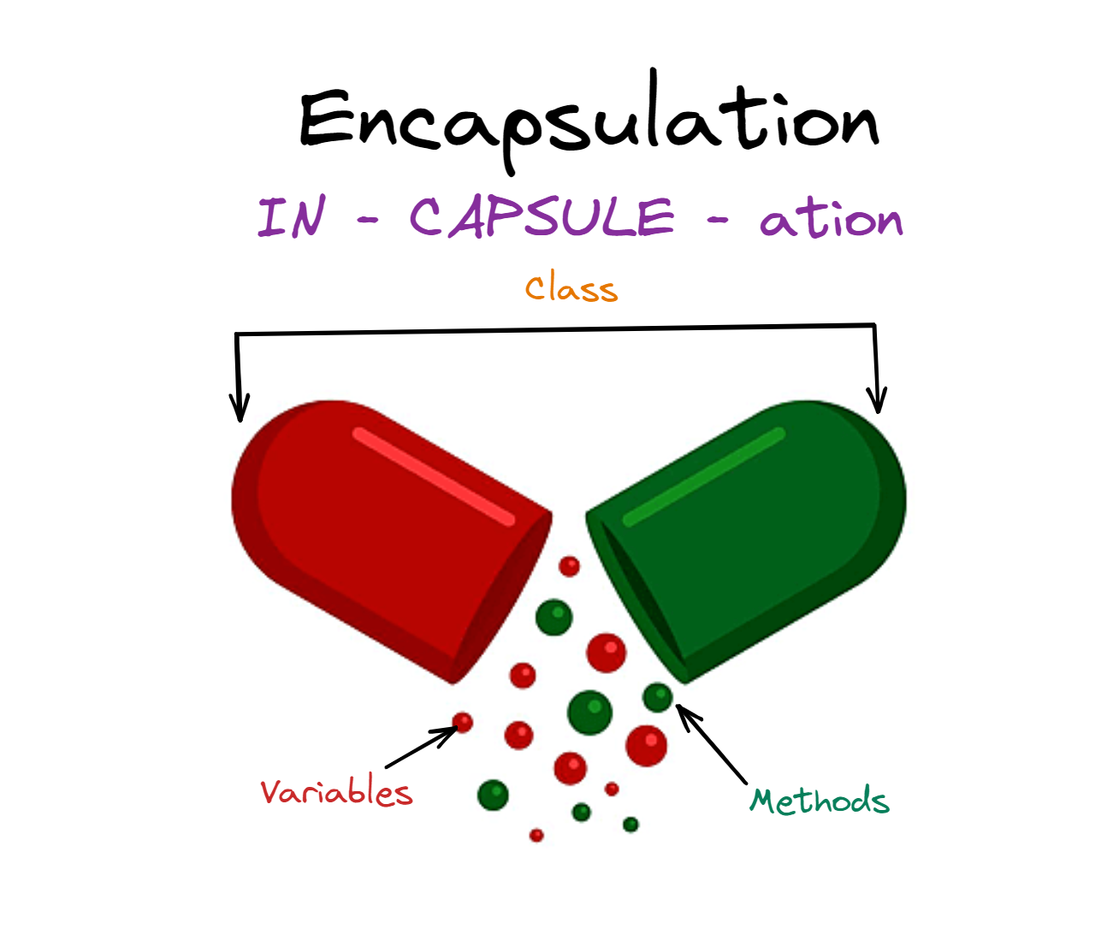
What is Encapsulation?
When creating new data types (classes) the details of the actual data and the way operations work is hidden from the other programmers who will use those new data types.

Slide 5

Why is Encapsulation important?
By controlling how data and methods are accessed or modified, encapsulation ensures:
Data Integrity: Prevents unauthorized or accidental changes to data.
Security: Sensitive data is hidden from unauthorized access.
Ease of Use: Users of the class do not need to understand its internal complexities.
Code Maintenance: Internal implementation can change without impacting external usage.

Slide 6
02
KEY CONCEPTS OF ENCAPSULATION

Slide 7
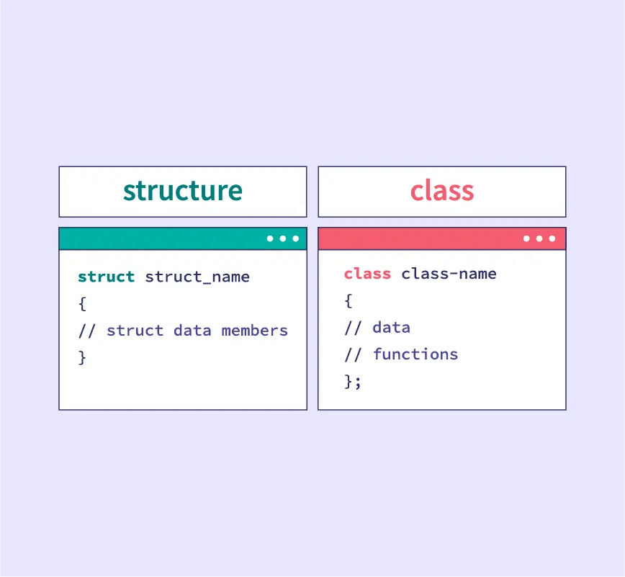
How Encapsulation works?
Defining Classes and Objects
⇒ Can I use Struct instead of Class?
Using Getters and Setters for Data Access
Default:
public
private

Slide 8
Core principles of Encapsulation
Data Hiding: The internal state of an object is kept private and can only be accessed through public methods (getters and setters).
Access Control: Access specifiers are used to control the visibility of class members:
private: members (attributes & methods) cannot be accessed (or viewed) from outside the class ⇒ Default.
protected: members cannot be accessed from outside the class, but can be accessed in inherited classes. Learn more about Chap 2 - Inheritance.
public: members are accessible from outside the class.

Slide 9
How to write in Java & Python?
class BankAccount {
private:
double balance; string password;
public:
BankAccount(double initBalance, string pwd) : balance(initBalance), password(pwd) {}
double getBalance(string pwd) { return (pwd == password) ? balance : -1; }
void deposit(double amount) { balance += amount; }
void withdraw(double amount, string pwd) {
if (pwd == password && amount <= balance) balance -= amount;
}
};

Slide 10
Constructor characteristics
A constructor is a special function in a class:
Same name as the class.
Not have a return value.
It is automatically called when an object is created (the programmer does not call it directly).
If no constructor is declared, the program automatically provides a default empty constructor.
⇒ What is the access modifier for the default constructor?
⇒ Can we create a private constructor? (Singleton Pattern)

Slide 11
Setters & Getters
WHY we need? Data hiding / Controlled access / Flexibility
HOW they work?
Private Data Members: Data members of the class are declared private to restrict direct access.
Public Methods:
  Getter: Provides controlled access to retrieve the value of a private data member.
  Setter: Provides controlled access to modify the value of a private data member.

Slide 12
03
BEST PRACTICES

Slide 13
Exercise 1 - Multiple constructor
Create a Car class with the following private attributes:
brand (string)
model (string)
year (int)
Add the following:
A default constructor that sets default values.
A parameterized constructor to initialize all attributes.
Setters and getters for all attributes.
Write a main function to:
Create an object using the default constructor and display its details.
Create another object using the parameterized constructor and display its details.

Slide 14
Exercise 2 - Constructor chaining
Create a Laptop class with attributes:
brand (string)
model (string)
price (double)
Add the following:
A default constructor.
A parameterized constructor to initialize all attributes.
Use constructor chaining to call one constructor from another.
Write a main function to test the class.

Slide 15
Exercise 3 (Bonus)
Create a Library system using encapsulation and constructors.
Create a Book class with attributes: title, author, ISBN, price, and stock.
Create a Library class with:
  An array of Book objects.
  Methods to:
    Add new books.
    Search for books by title or author.
    Borrow books (reduce stock).
Write a main function to simulate library operations.

Slide 16
04
CONCLUSION

Slide 17
Conclusion
Encapsulation is the foundation of OOP, focusing on bundling data and functions within a class.
The main difference between a class and a struct lies in the level of data security (private/public).
A constructor is a special mechanism in OOP that automatically executes when an object is created and can cause errors if not properly designed.

Slide 18
05
EXTENSION:
CLASS DIAGRAM

Slide 19
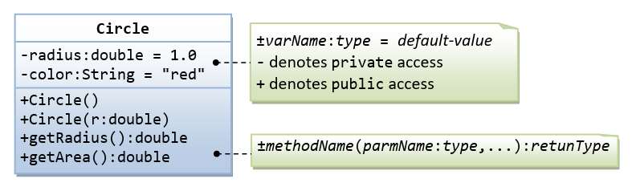
Class diagram
Can you write a program based on the above class diagram?
Notes:
A class called Circle is designed as shown in the following class diagram. It contains:
Two private instance variables: radius (of the type double) and color (of the type String), with default value of 1.0 and "red", respectively.
Two overloaded constructors - a default constructor with no argument, and a constructor which takes a double argument for radius.
Two public methods: getRadius() and getArea(), which return the radius and area of this instance, respectively.

Slide 20
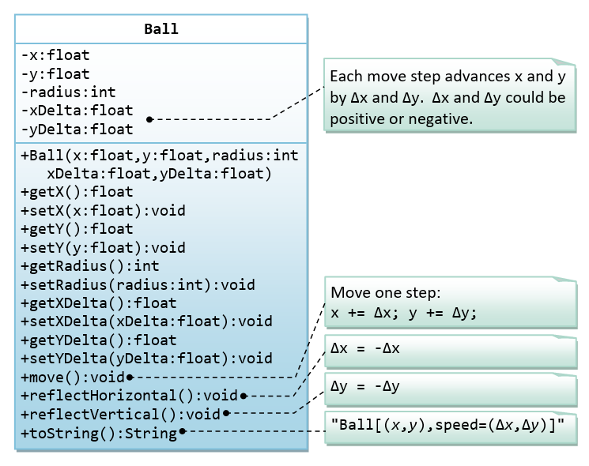
Hands-on exercise
A class called Ball, which models a bouncing ball, is designed as shown in the following class diagram.
It contains its radius, x and y position. Each move-step advances the x and y by delta-x and delta-y, respectively. delta-x and delta-y could be positive or negative.
The reflectHorizontal() and reflectVertical() methods could be used to bounce the ball off the walls. Write the Ball class. Study the main() on how the ball bounces.
https://www.programiz.com/online-compiler/5VrKcTuK0GRr6
Notes:
A class called Circle is designed as shown in the following class diagram. It contains:
Two private instance variables: radius (of the type double) and color (of the type String), with default value of 1.0 and "red", respectively.
Two overloaded constructors - a default constructor with no argument, and a constructor which takes a double argument for radius.
Two public methods: getRadius() and getArea(), which return the radius and area of this instance, respectively.

Slide 21
Thank you for your attention!
https://www.cse.hcmut.edu.vn

