Slide 1
SOFTWARE PROCESS & QUALITY MANAGEMENT GROUP PROJET ISO 9000

Slide 2

ISO 9000 is a series of standards, developed and published by the International Organization for Standardization(ISO)

Slide 3
ISO ensures that products and services meet international quality standards, which can improve customer satisfaction and help businesses gain a competitive edge.
7 key quality management principles—customer focus, leadership, engagement of people, process approach, improvement, evidence-based decision making and relationship management.

Slide 4
Assign work
Nguyen Ba Phu Quy
SCOPE OF ISO 9000
FUNDAMENTAL CONCEPT
QUALITY MANAGEMENT PRINCIPLES
DEVELOPING THE QMS USING FUNDAMENTAL CONCEPTS AND PRINCIPLES

Slide 5
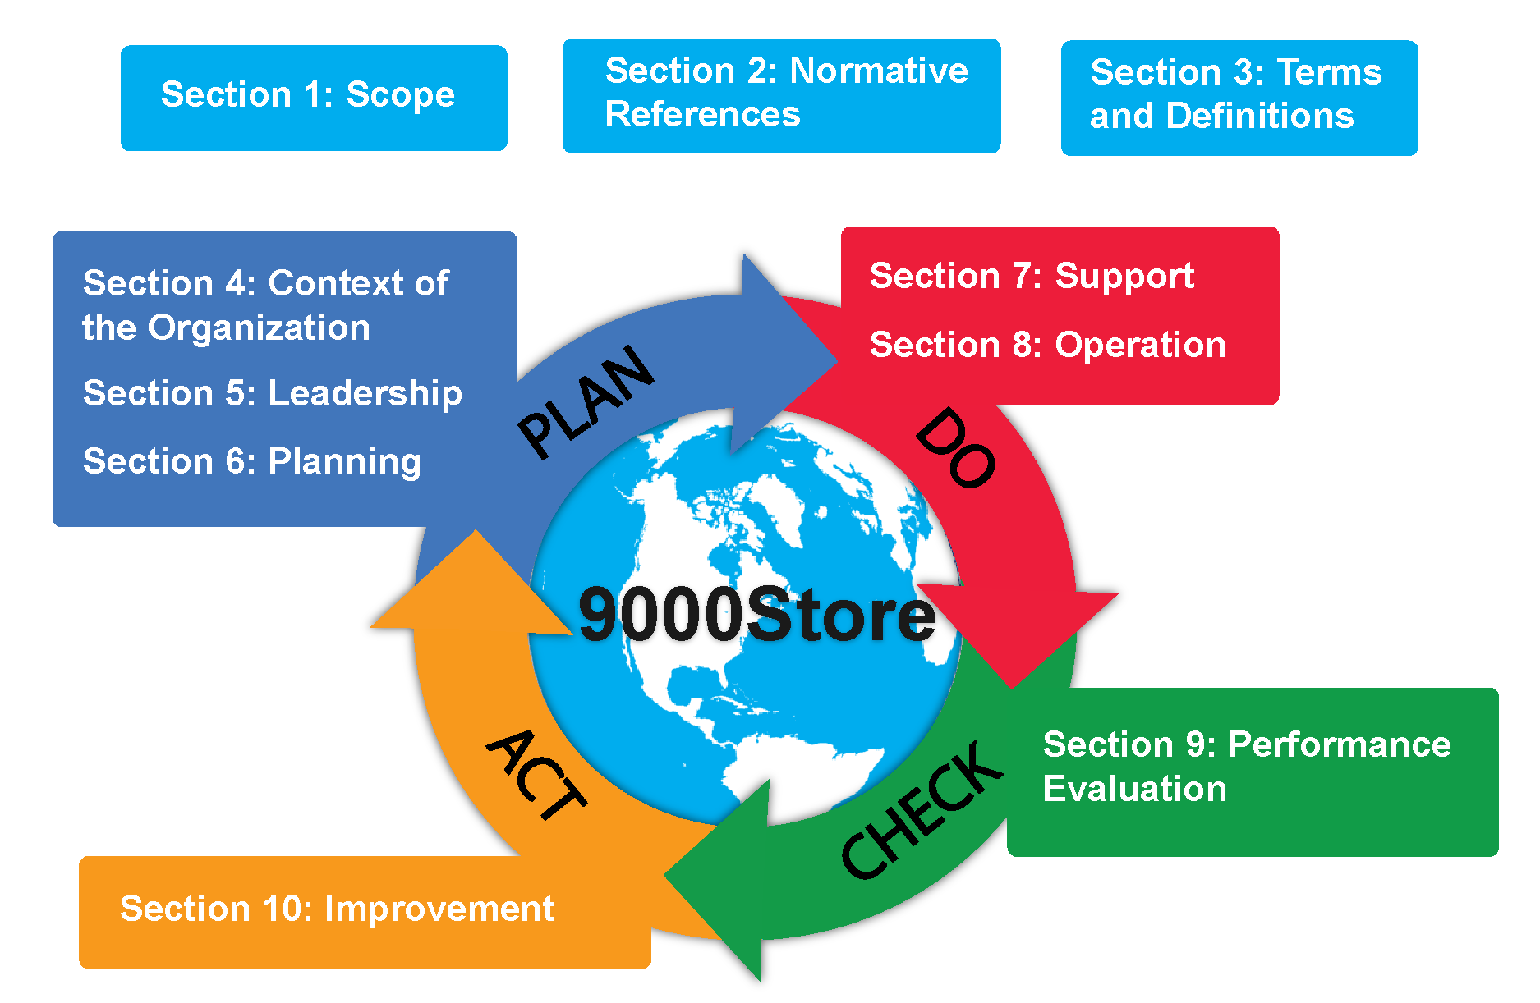
1. SCOPE OF ISO 9000
Organizations seeking success through quality management.
Assuring customer confidence in product and service consistency.
Ensuring supply chain reliability.
Facilitating effective communication.
Conformity assessments to ISO 9001.
Quality management services.
Related standard development.

Slide 6

2. FUNDAMENTAL CONCEPT
Quality
Quality management system
Context of an organization
Interested parties
Support

Slide 7
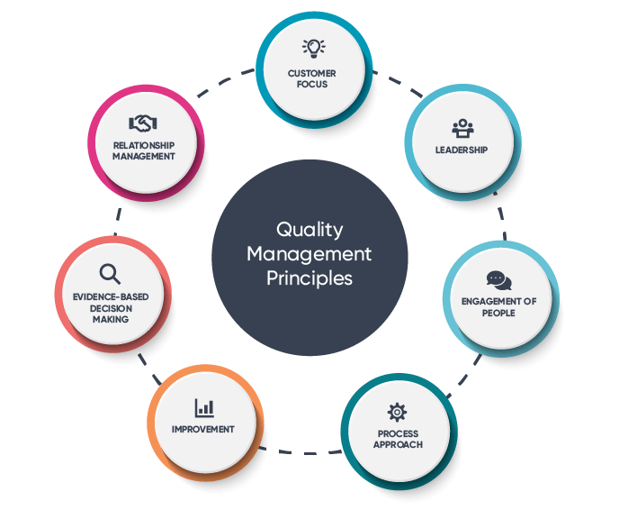
3. QUALITY MANAGEMENT PRINCIPLES
Customer focus
Leadership
Process approach
Improvement
Relationship management

Slide 8
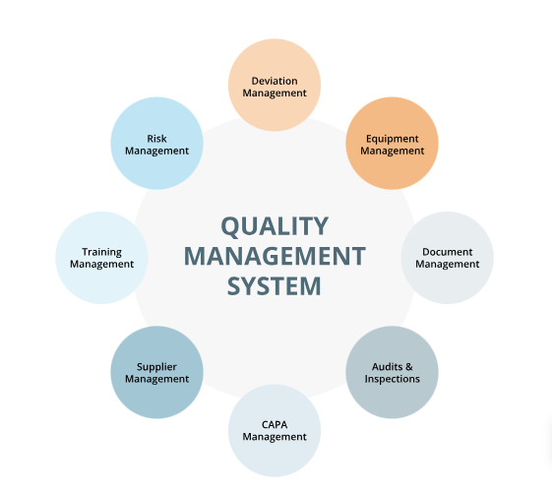
3. DEVELOPING THE QMS USING FUNDAMENTAL CONCEPTS AND PRINCIPLES
QMS model:
Process-based approach.
Customer focus.
Continuous improvement.
Leadership commitment.
Employee engagement.
Evidence-based decision making.
Relationship management.

Slide 9
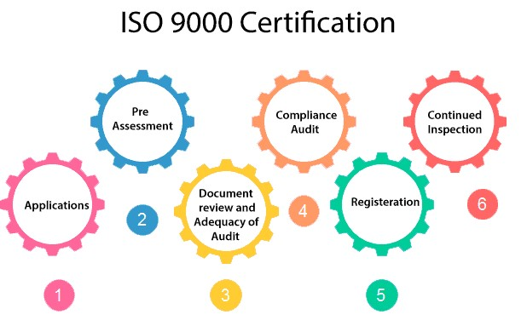
Assign work
Dao Nhat Duong
TERMS RELATED TO PERSON OR PEOPLE
TERMS RELATED TO ORGANIZATION
TERMS RELATED TO ACTIVITY
TERMS RELATED TO PROCESS

Slide 10
1. TERMS RELATED TO PERSON OR PEOPLE
1 Top management
3 Involvement
4 Engagement
2 Quality management system consultant
5 Configuration authority
6 Dispute resolver

Slide 11
2. TERMS RELATED TO ORGANIZATION
1 Organization
2 Context of the organization
7 DRP-provider
3 Interested party
8 Association
4 Customer
9 Metrological function
5 Provider/ Supplier
6 External provider /External supplier

Slide 12
3. TERMS RELATED TO ACTIVITY
1 Improvement
3.3.6 Quality assurance
3.3.7 Quality control
3.3.8 Quality improvement
3 Management
4 Quality management
5 Quality planning

Slide 13
3. TERMS RELATED TO ACTIVITY
9 Configuration management
10 Change control
11 Activity
12 Project management
13 Configuration object

Slide 14
4. TERMS RELATED TO PROCESS
1 Process
7 Contract
2 Project
8 Design and development
3 Quality management system realization
4 Competence acquisition
5 Procedure
6 Outsource (verb)

Slide 15
Assign work
Nguyen Duc Thien
TERMS RELATED TO SYSTEM
TERMS RELATED TO REQUIREMENT
TERMS RELATED TO RESULT
TERMS RELATED TO DATA, INFORMATION AND DOCUMENT

Slide 16
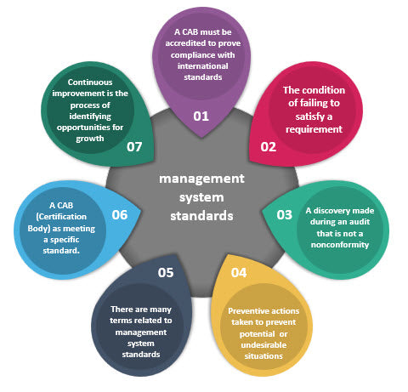
1.TERMS RELATED TO SYSTEM
System
Infrastructure
Management system
Quality management system
Work environment
Metrological confirmation
Measurement management system
Policy
Quality policy
Vision
Strategy

Slide 17
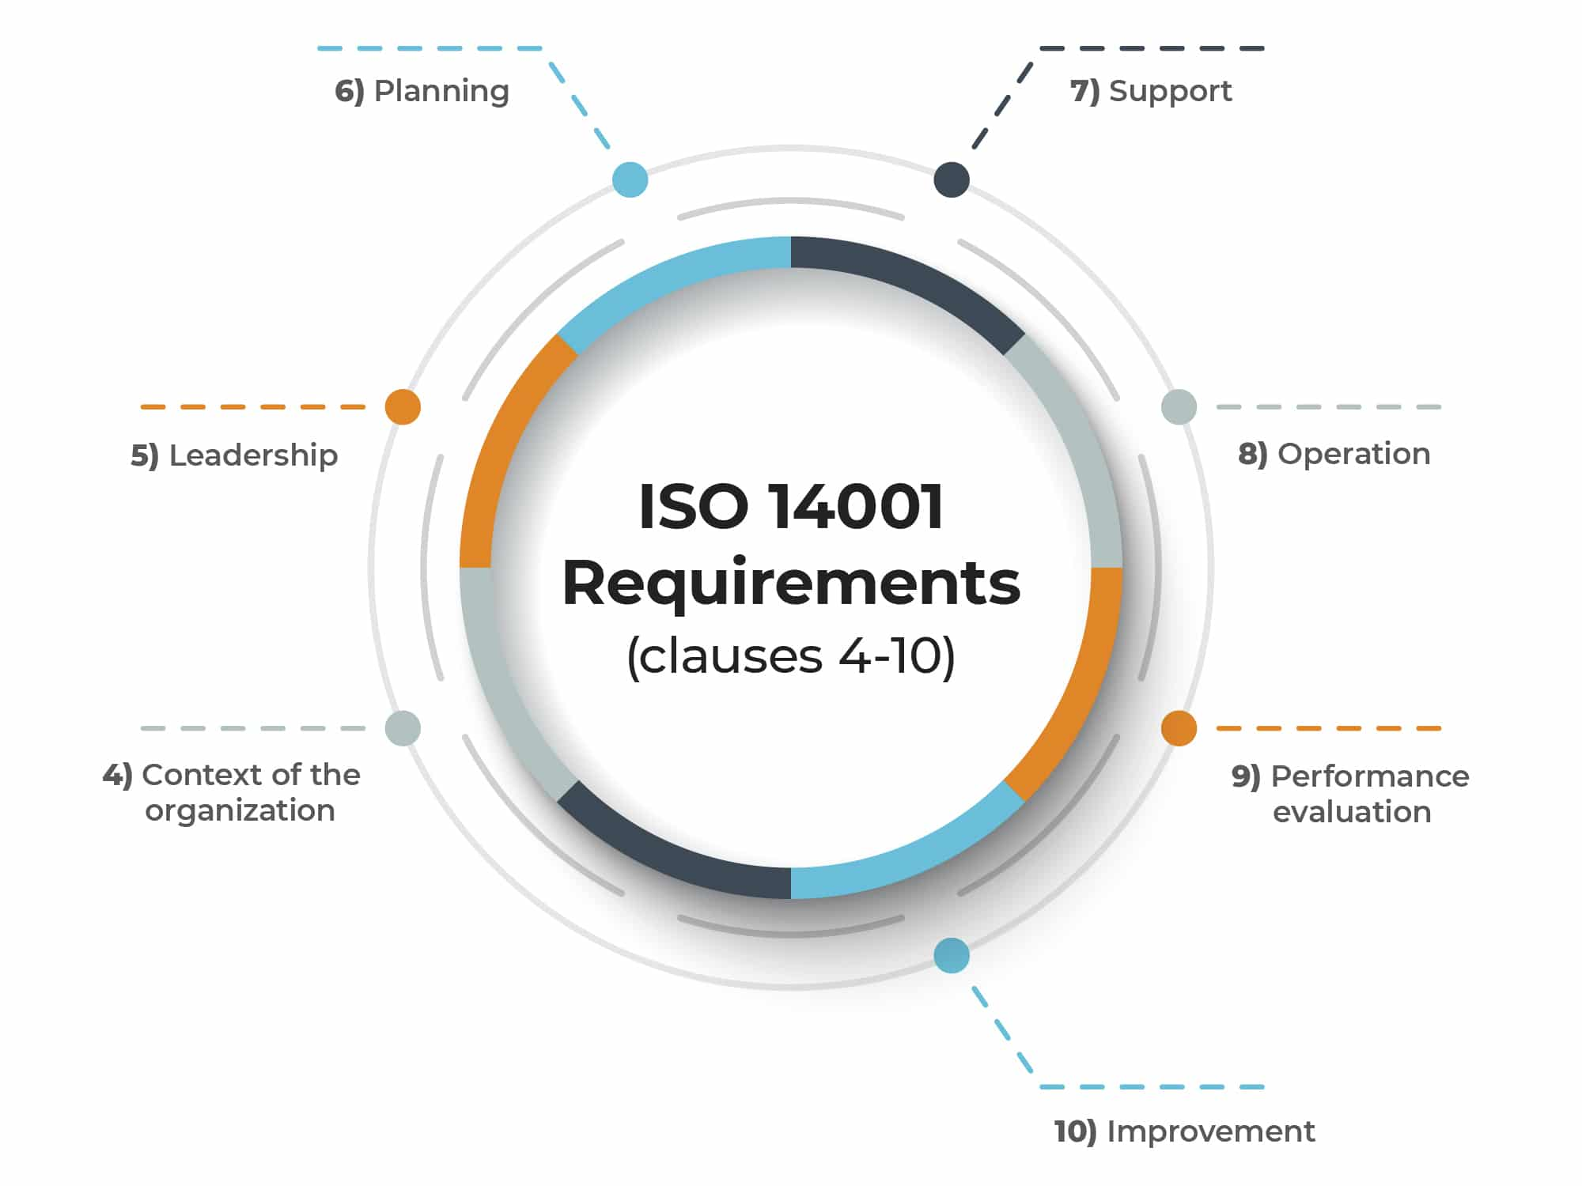

2.TERMS RELATED TO REQUIREMENT
Object
Quality
Grade
Requirement
Quality requirement
Statutory requirement

Slide 18

3.TERMS RELATED TO RESULT
Service
Performance
Rick
Objective
Quality objective
Success
Sustained success
Output
product

Slide 19

4.TERMS RELATED TO DATA, INFORMATION AND DOCUMENT
Data
Information
Objective evidence
Document information
Specification
Quality manual
Quality plan

Slide 20
Assign work
Le Thi Thao
TERMS RELATED TO CHARACTERISTIC
TERMS RELATED TO DETERMINATION
TERMS RELATED TO ACTION
TERMS RELATED TO AUDIT

Slide 21

1. TERMS RELATED TO CHARACTERISTIC
CHARACTERISTIC
QUALITY CHARACTERISTIC
HUMAN FACTOR
COMPETENCE
METROLOGICAL CHARACTERISTIC
CONFIGURATION
CONFIGURATION BASELINE

Slide 22
CHARACTERISTIC
Characteristic: In the context of ISO 9000, a characteristic refers to a specific attribute or property of a product or process that is subject to measurement or evaluation.

Slide 23
QUALITY CHARACTERISTIC
Quality Characteristic: Quality characteristics are those attributes of a product or service that are used to assess its quality. ISO 9000 standards emphasize the importance of identifying and monitoring quality characteristics to ensure product or service quality.

Slide 24
HUMAN FACTOR
Human Factor: ISO 9000 standards acknowledge the significance of the human factor in quality management. This relates to the role of people in processes and their impact on quality outcomes.

Slide 25
COMPETENCE
Competence: Competence in ISO 9000 standards refers to the knowledge, skills, and abilities of individuals involved in an organization's processes. Ensuring that personnel possess the necessary competence is crucial for maintaining quality standards.

Slide 26
METROLOGICAL CHARACTERISTIC
Metrological Characteristic: ISO 9000 may involve metrological characteristics, which pertain to measurements and their accuracy. This is particularly important in industries where precise measurements are critical, such as manufacturing or scientific research.

Slide 27
CONFIGURATION
Configuration: Configuration refers to the specific arrangement or settings of components or software. In ISO 9000, understanding and controlling the configuration of products or systems is important to maintain consistency and quality.

Slide 28
CONFIGURATION BASELINE
Configuration Baseline: A configuration baseline, in the context of ISO 9000, typically represents a specific version or state of a configuration at a particular point in time. It serves as a reference point for comparison and may be used for quality control and change management

Slide 29
3. TERMS RELATED TO ACTION
PREVENTIVE ACTION
CORRECTIVE ACTION
REGRADE
CONCESSION
DEVIATION PERMIT
RELEASE

Slide 30
3. TERMS RELATED TO ACTION
PREVENTIVE ACTION
CORRECTIVE ACTION
REGRADE
CONCESSION
DEVIATION PERMIT
RELEASE

Slide 31
THANK
YOU !

