Slide 1
People Network Knowledge Graph using Neo4j
Karthik Vegi Chaitanya Sagar Pullabhotla

Slide 2
1.
Knowledge Graph and Neo4j

Slide 3
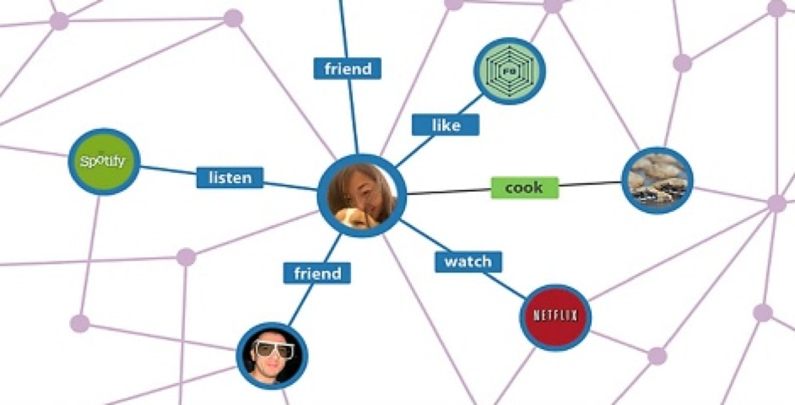
Knowledge Graph
Graphical representation of data
Easier retrieval of complex relationships
Highly popular among social networking sites like Facebook, Google, Twitter, etc.
Open Link Virtuoso, Neo4j, Allegro Graph

Slide 4

Neo4j
Graph Database
Built from ground up using connections first approach
Semantic Family
Semantic Web and Neo4j are siblings from the same family with different implementation details
Open Source
Neo technology and open source database
Labelled Property Graph
Implemented using labelled property graphs with rich internal structure
Agile
- Highly agile
- Blazingly fast
- Can be distributed across a cluster
Use Cases
- Social networks
- Fraud detection
- Manage network infrastructure

Slide 5
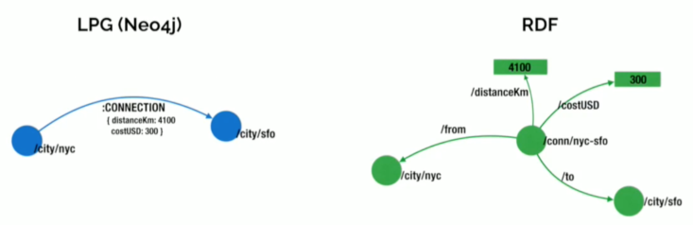
Neo4j
Entities stored as Nodes and Edges
Designed for increased storage and faster querying
Unlike RDF have entities internal structure

Slide 6
Nodes and Relationships
Nodes
People
Places
Relationships
Birthplaces
Friendships

Slide 7
Cypher Query Language
Graph Query Language developed for Neo4j
Structure borrowed from SQL
Pattern matching expressions from SPARQL
MATCH (john {name: 'John'})-[:friend]->()-[:friend]->(fof)
RETURN john.name, fof.name

Slide 8
2.
People Network

Slide 9
Application Stack
UI
HTML
JavaScript
Bootstrap
Graph Database
Neo4j
Server
Node.js

Slide 10
Node.js
Open source server framework based on JavaScript
Uses asynchronous programming
Node.js application integrates with the graph database
Uses Neo4j driver to connect and modify the graph connections
Events trigger the search queries on the knowledge graph

Slide 11
Node modules
Body Parser: to parse form data from UI elements
Express: web framework to handle routes
EJS: template engine to manage dynamic variables in HTML
Morgan: logger
Neo4j driver: to communicate with the graph database

Slide 12
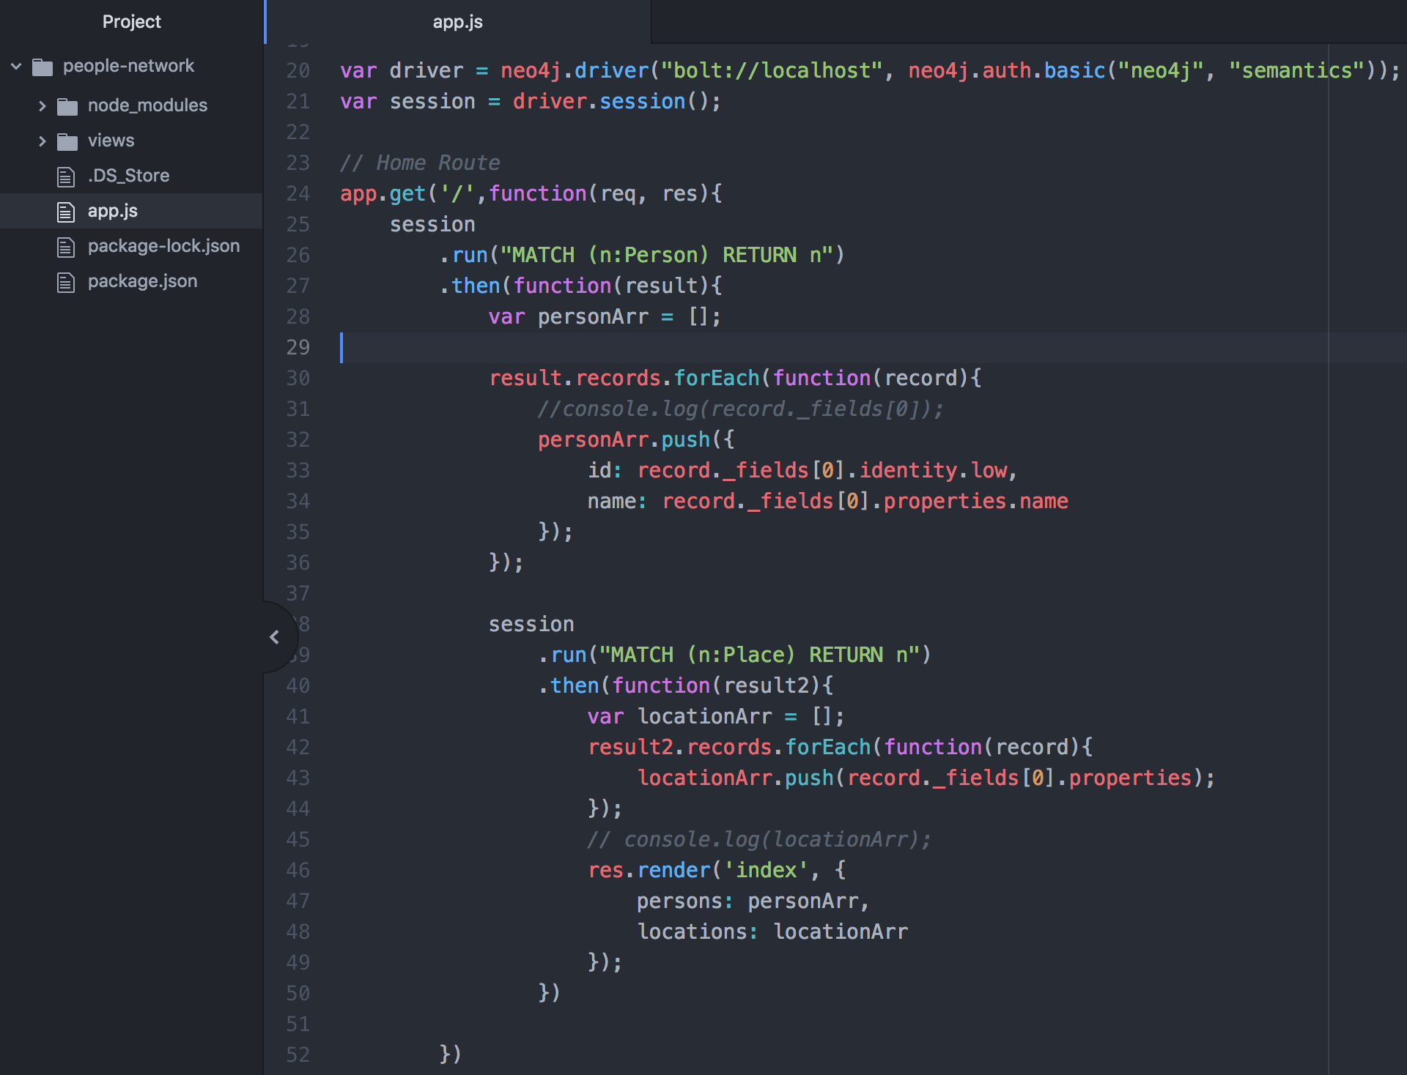
Integration using Neo4j Driver
Uses bolt protocol to connect to Neo4j
Use session object to fire query and fetch data

Slide 13
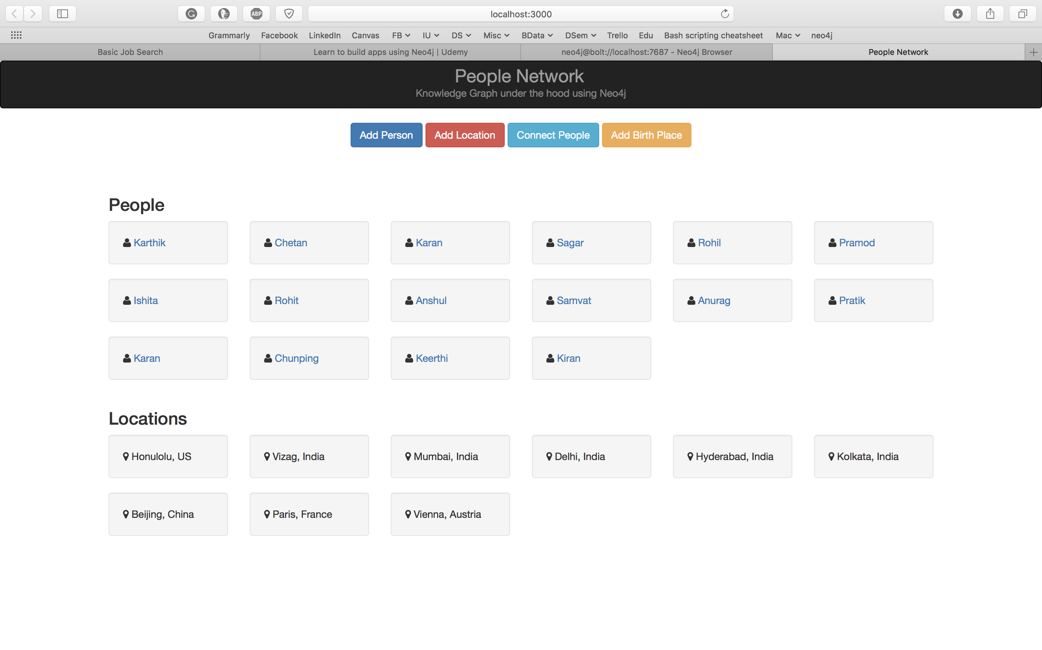
Application Demo

Slide 14
Sample Queries
Create: create(p:Person {name: “John”}) return p
Match: match(p:Person) return p
Relationship: match(a:Person {name: ‘Karthik’}) , (b:Person {name: ‘Sagar}) merge(a)-[:friends]->(b)
Distinct Relationships: match(a)-[r]->() return distinct type(r)
Query1: match(p)-[:BORN_IN]->(l:Place {city:"Delhi"}) return p
Query2: match(a:Person {name:"Sagar"})-[r1:FRIENDS]-()-[r2:FRIENDS]-(fof) return fof.name as fofName

Slide 15
Thank You!

