Slide 1
A CPAN Author's Power Tools
Part – I:
Building a CPAN distribution

Slide 2
“Only wimps use tape backup: real men just upload their important stuff on ftp, and let the rest of the world mirror it ;)”
Torvalds, Linus (1996-07-20). Post. linux.dev.kernel newsgroup. Google Groups. Retrieved on 2006-08-28.

Slide 3

CPAN hadn't been invented...yet.

Slide 4
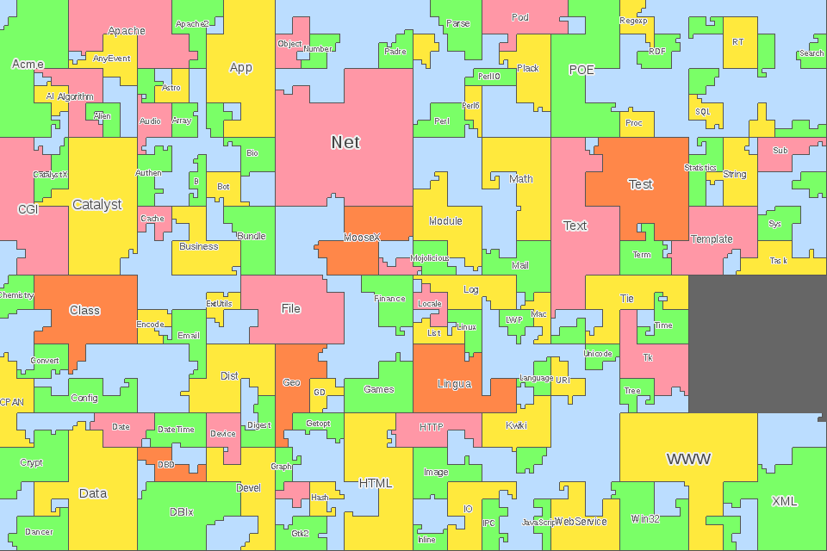
App::cpanminus
http://mapofcpan.org/#/
App::Prove
TAP::Harness
Module::Install
Module::Build
Test::More
Module::Starter
ExtUtils::MakeMaker
CPAN::Meta::Spec
h2xs
CPANPLUS
Dist::Zilla
CPAN
“Recalculating... Please Drive to Highlighted Route.”

Slide 5

There are many forks in the road to
producing a CPAN module. We will
follow one of them, and mention a few
of the other notables.

Slide 6
Step one: An idea.
“Necessity, who is the mother of invention.”
Plato, The Republic
Greek author & philosopher in Athens (427 BC - 347 BC)

Slide 7
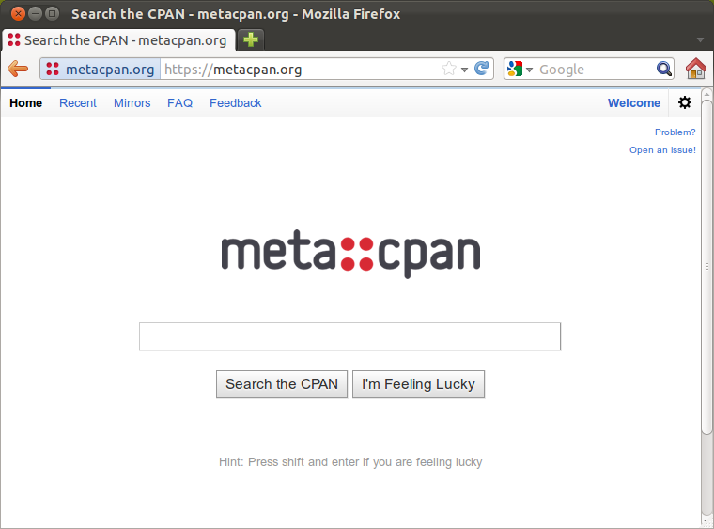
Step two: Search

Slide 8
Existing solutions:
Is there a module that already does it? Done.
Is there an old (possibly abandoned) module that would be perfect if it just were brought up to date? Submit patch, co-maintain, or take over.
Would an existing module be perfect if it just had a frobcinate accessor? Discuss with author or on module's mailing list.
Subclass, Extend, Compose, Start over? Design Decisions.
Refine the idea: What differentiates your idea from MIYAGAWA's? Product differentiation.

Slide 9
On The Naming of Modules
“Choose a good module name”
– The PAUSE documentation
http://pause.perl.org/pause/query?ACTION=pause_namingmodules
A module name must accomplish quite a bit in a few characters, and, once chosen, you rarely have the opportunity to change it after people start using it.
Don't fall into the “Help newbie” trap. (ie, meaningless subject lines, or in this case, module names.)

Slide 10
Create a distribution framework.
The old way: h2xs
  h2xs -AX --skip-exporter --use-new-tests -n Foo::Bar
Module::Starter
  module-starter --module=Foo::Bar \
  --author="Your Name" \
  --email=yourname@cpan.org
Hmm.... 'yourname@cpan.org'...???...

Slide 11
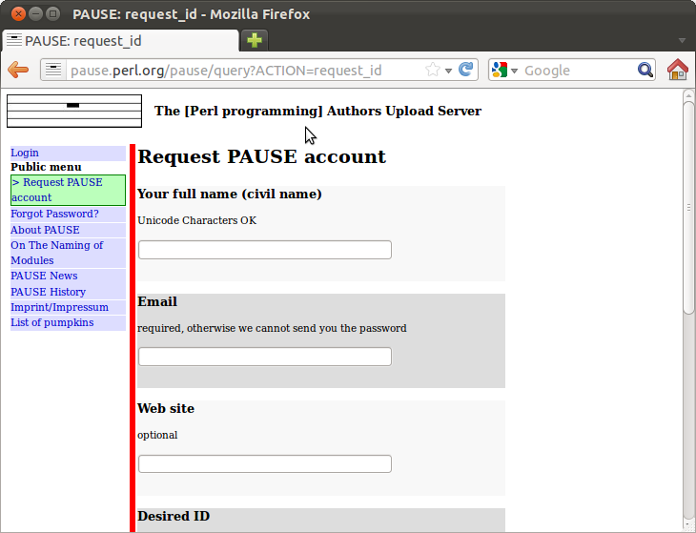
Get started with PAUSE
The Perl Authors Upload Server
  Yes, I really did use bold, underline, and colors to highlight the acronym. Yes, I know you would have figured it out yourself. I just wanted the slide to be prettier.
  Expect no such frills on the PAUSE website.
Request PAUSE account
  http://pause.perl.org/pause/query?ACTION=request_id

Slide 12
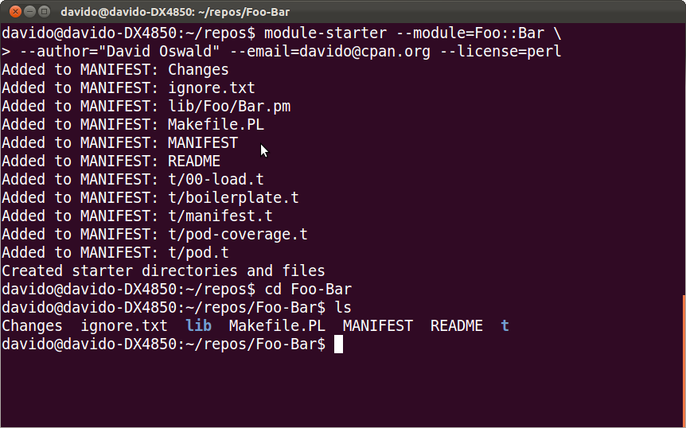
A Closer Look at the Framework

Slide 13
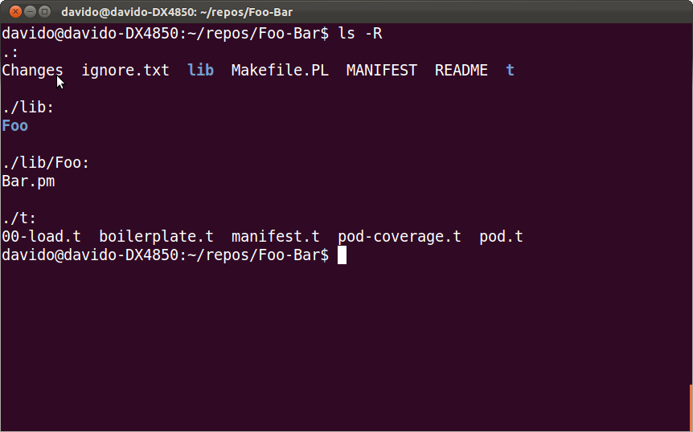
Here's what it created

Slide 14
What are the components for?
lib/
  Your distribution's module(s) reside here.
t/
  Your distribution's test suite.
Changes
  The change-log users will see.
MANIFEST
  A list of all the components of your distribution.
README
  A few words describing your module.
Makefile.PL
  A Perl script that creates your distribution's Makefile.
ignore.txt
  A version control ignore template. Rename it to .gitignore, for example.

Slide 15
Other components
META.yml and META.json
  Metadata used by PAUSE and CPAN to index your module.
  Also used by cpan.pm, cpanm, and cpanp to determine what dependencies need to be installed, and when.
  Also used by ExtUtils::MakeMaker to determine configuration dependencies when the author creates a distribution.
  Automatically generated, when the time comes.
    More on that later.

Slide 16
Other components
MANIFEST.SKIP
  Usually not necessary; default behavior often is fine. Sometimes 'make distcheck', 'make manifest', and other EU::MM tools find files that you don't want in your distribution. MANIFEST.SKIP keeps them out.
  If you need a MANIFEST.SKIP file, you also need to read the documentation for ExtUtils::Manifest to understand what defaults you need to specify.
You may safely ignore for now:
  blib/ (This is where a pre-install build of your module resides for testing)
  pm_to_blib (...yeah, just ignore it...)
  MYMETA.yml, MYMETA.json (user-specific copies of META.*)
  Makefile (Makefile.PL uses ExtUtils::MakeMaker to create it for you)

Slide 17
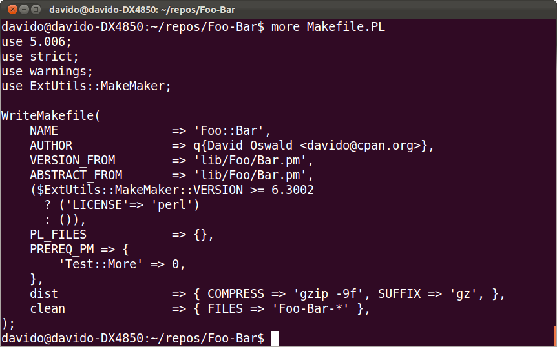
Makefile.PL
Module prerequisites: Module::Name => Minimum Version

Slide 18
Useful Makefile.PL components
Write_Makefile() responds to a number of convenient directives.
CONFIGURE_REQUIRES
  A hash-ref of modules and version numbers required to run Makefile.PL itself
    Author uses this to build effective META.* files.
BUILD_REQUIRES
  A hash-ref of module names and minimum version numbers required to build (but not run) your module. Test modules, configuration modules, etc.
PREREQ_PM
  A hash-ref of module names and minimum version numbers required to run your module.
See the POD for ExtUtils::MakeMaker for the (many) additional options.

Slide 19
The roles of the META.* files

