Slide 1
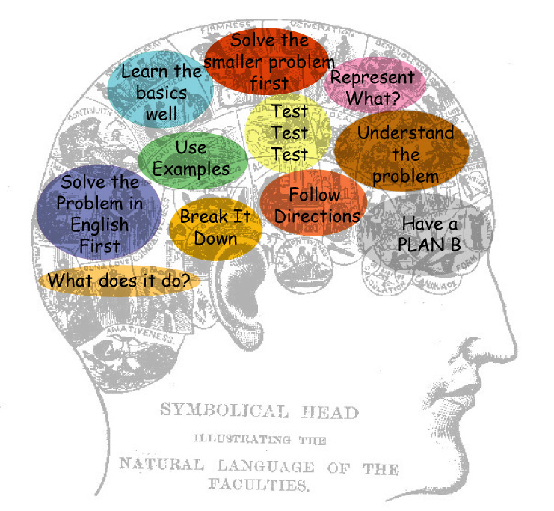
Add Perl To Your Toolbelt
David Oswald
daoswald@gmail.com
Salt Lake Perl Mongers
http://saltlake.pm.org

Slide 2
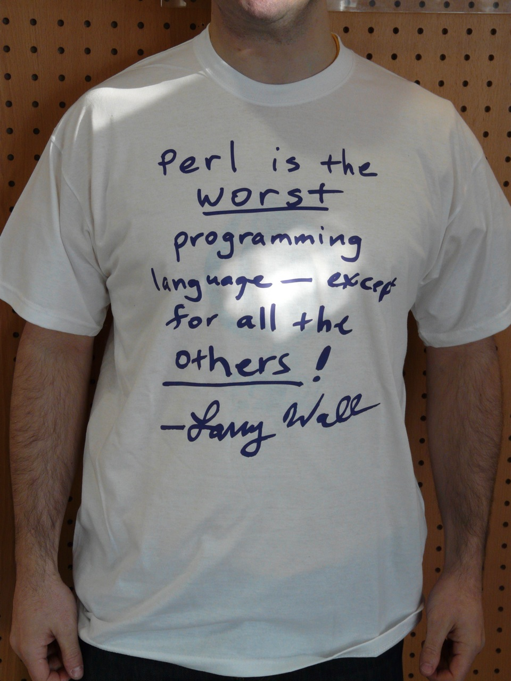
Add Perl To Your Toolbelt
David Oswald
daoswald@gmail.com
Salt Lake Perl Mongers
http://saltlake.pm.org

Slide 3
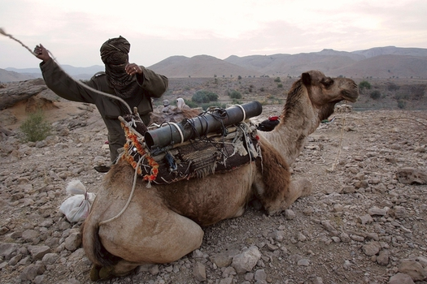
Add Perl To Your Toolbelt
David Oswald
daoswald@gmail.com
Salt Lake Perl Mongers
http://saltlake.pm.org

Slide 4
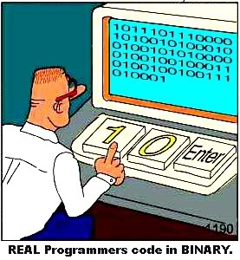

Twitter
#openwest
#perltoolbelt

Slide 5
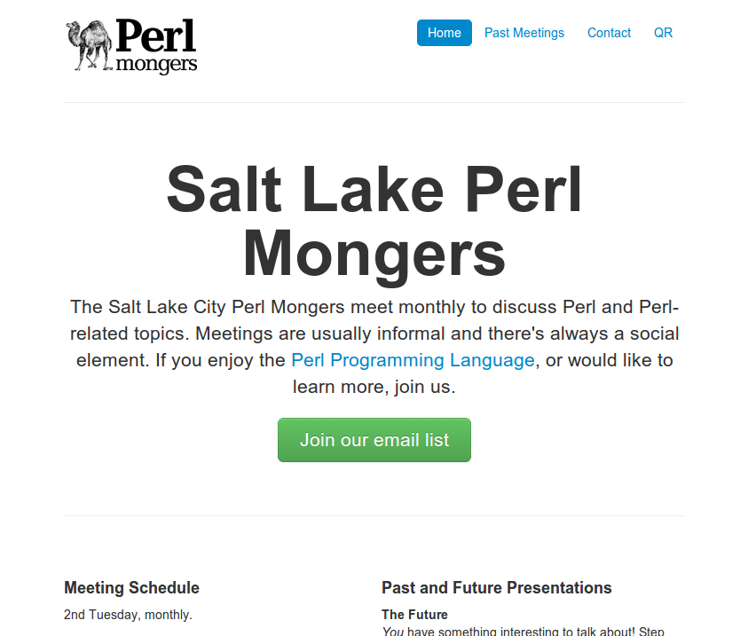
Salt Lake Perl Mongers
The local “Perl Community”
  Monthly meetings.
  Partnership discounts.
  Job announcements.
  Everyone learns and grows.
  For the love of Perl!
http://saltlake.pm.org

Slide 6

Who am I?
Dave Oswald – A Propetual Hobbiest.
Studied Economics and Computer Science at U of U.
  Also CS in High School, SLCC, LAVC, and self-guided.
Independent software developer, trainer, and consultant.
  Focus on Perl, C++, and server-side development.
Solving problems programatically is my hobby. Gratifyingly, it's also my job.
daoswald@gmail.com
Salt Lake Perl Mongers
  http://saltlake.pm.org

Slide 7
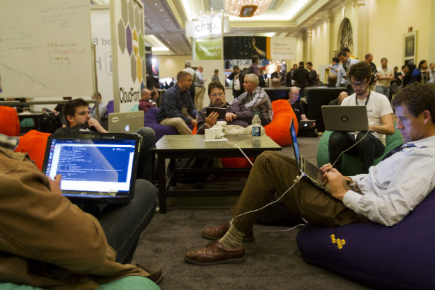
Our Goal
Learn how (and why) to get started with Perl...
...in about two days.

Slide 8
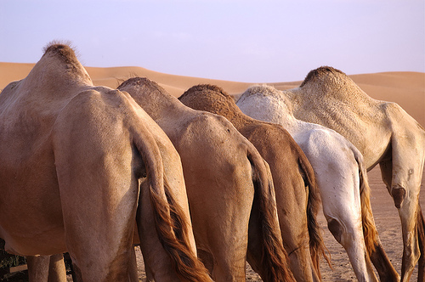
But...

Slide 9
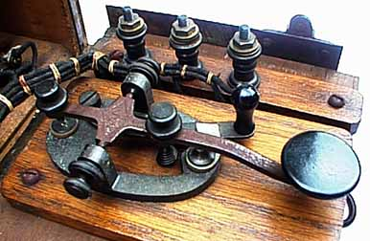
“It's an old language.”

Slide 10
 | First Appeared | Most Recent | Standard / Version
C | 1972 | 2011 | C11
Java | 1995 | 2014 | JSE8
Objective-C | 1983 | 2007 | 2.0
C++ | 1983 | 2011 | C++11
Visual Basic | 1991 | 1998 | 6.0
C# | 2000 | 2012 | 5.0
PHP | 1995 | 2014 | 5.5.12
Python | 1991
Python 2 |  | 2013 | 2.7.6
Python 3 |  | 2014 | 3.4.1
JavaScript | 1995 | 2011 | 1.8.5
ECMAScript | 1997 | 2011 | 5.1
Perl | 1987 | 2014 | 5.20.0
Perl 5 | 1994 | 2014 | 5.20.0

Slide 11
Conclusion
We can't draw useful conclusions based on a programming language's age.

Slide 12
“The syntax is ugly.”

Slide 13
Quotes:
“I'm supposed to learn ____ _____ for work ... it's really bugging me. I don't think I've ever seen such an ugly programming language.

Slide 14

Quotes:
“I'm supposed to learn Objective-C for work ... it's really bugging me. I don't think I've ever seen such an ugly programming language.

Slide 15
Quotes:
The Homoiconic nature of ____ means that one cannot tell by looking at the code alone whether something is a data structure or a function. You have to read and understand the context. Other languages make it pretty clear because they use different symbols and syntax for each.

Slide 16
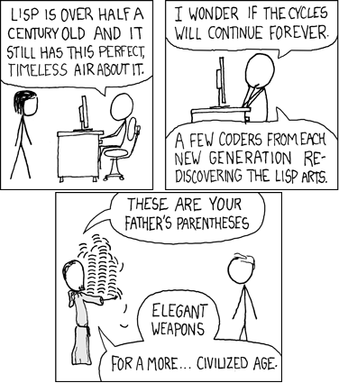
Quotes:
The Homoiconic nature of Lisp means that one cannot tell by looking at the code alone whether something is a data structure or a function. You have to read and understand the context. Other languages make it pretty clear because they use different symbols and syntax for each.

Slide 17
Do we need to talk about C++ and C syntax?

Slide 18
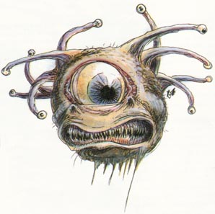
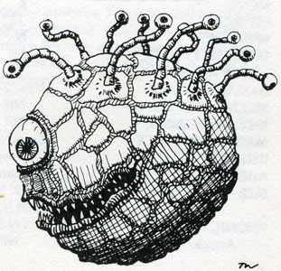

We can't draw conclusions based on perceived syntactic beauty.

Slide 19
“Perl lacks subroutine signatures, or named parameters.”

Slide 20

my( $who, $cares ) = @_;

Slide 21
...besides...
use v5.20;
use feature 'signatures';
sub foo ($left, $right) {
return $left + $right;
}

Slide 22
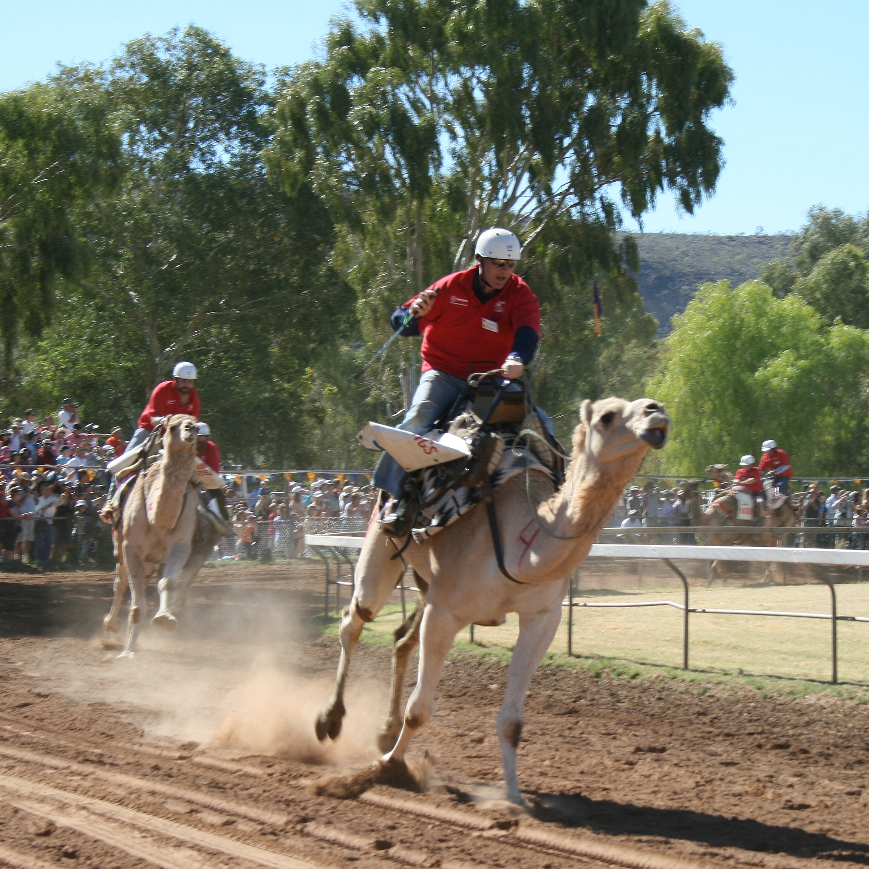
So, why Perl?

Slide 23
The Three Virtues

Slide 24
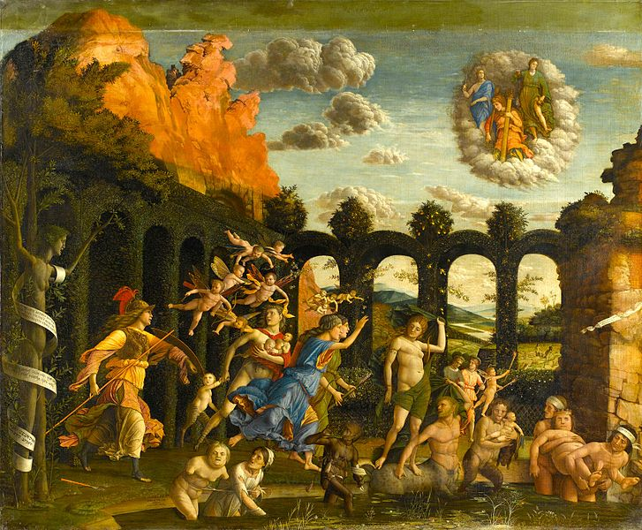
The Three Virtues...
“The Triumph of the Virtues”
  Andrea Mantegna, 1497
Justice!
Temperance!
Fortitude!

Slide 25


Slide 26
The Three Virtues...
“The Triumph of the Virtues”
  Andrea Mantegna, 1497
Justice!
Temperance!
Fortitude!

Slide 27
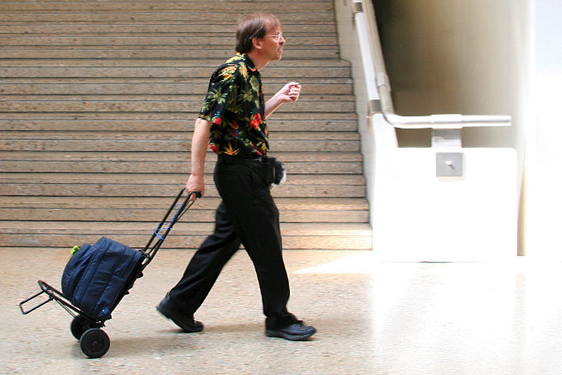
The Three Virtues...of Programmers

Slide 28
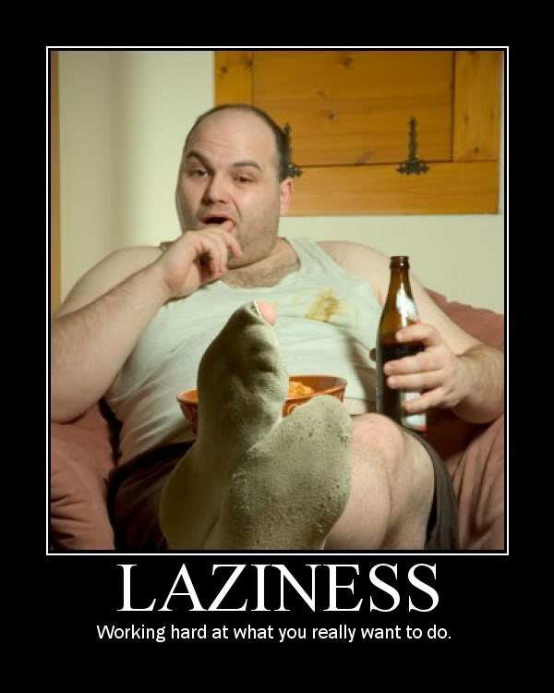
The Three Virtues...of Programmers
Laziness

Slide 29

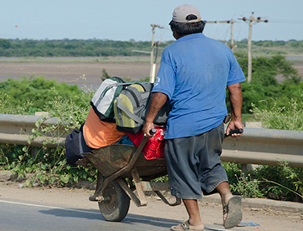
The Three Virtues...of Programmers
Laziness
  The quality that makes you go to great effort to reduce overall energy expenditure.

Slide 30
Impatience!

Slide 31
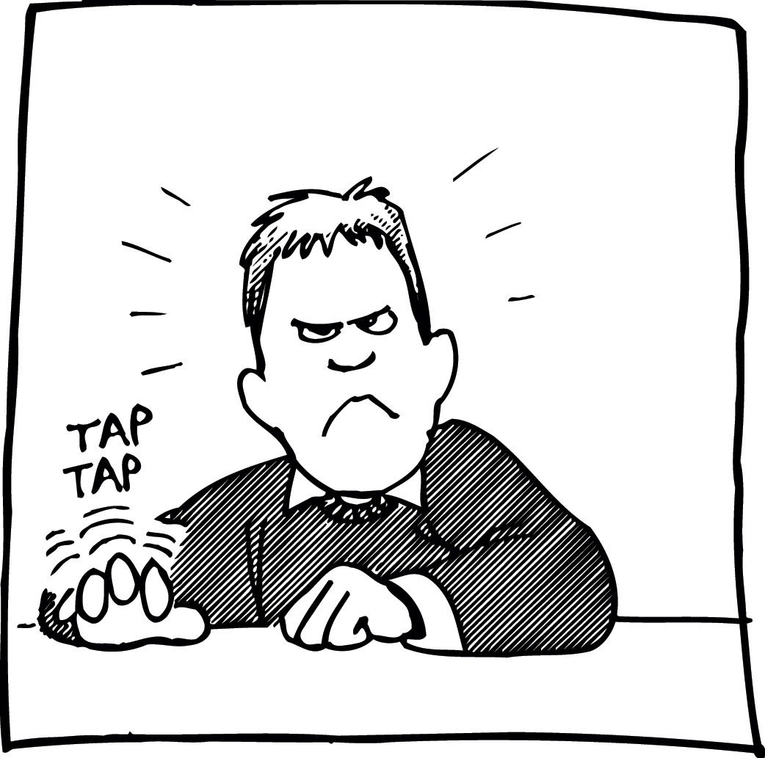
The Three Virtues...of Programmers
Laziness
Impatience

Slide 32

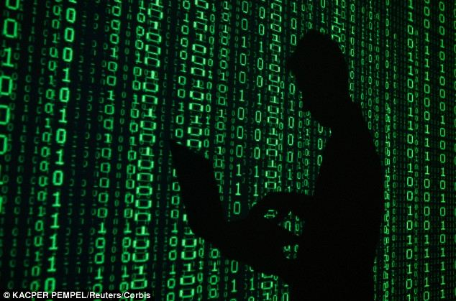
The Three Virtues...of Programmers
Laziness
Impatience
  The anger you feel when the computer is being lazy, which happens when another programmer is not lazy.

Slide 33
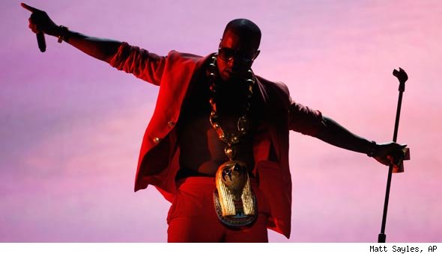
The Three Virtues...of Programmers
Laziness
Impatience
Hubris

Slide 34
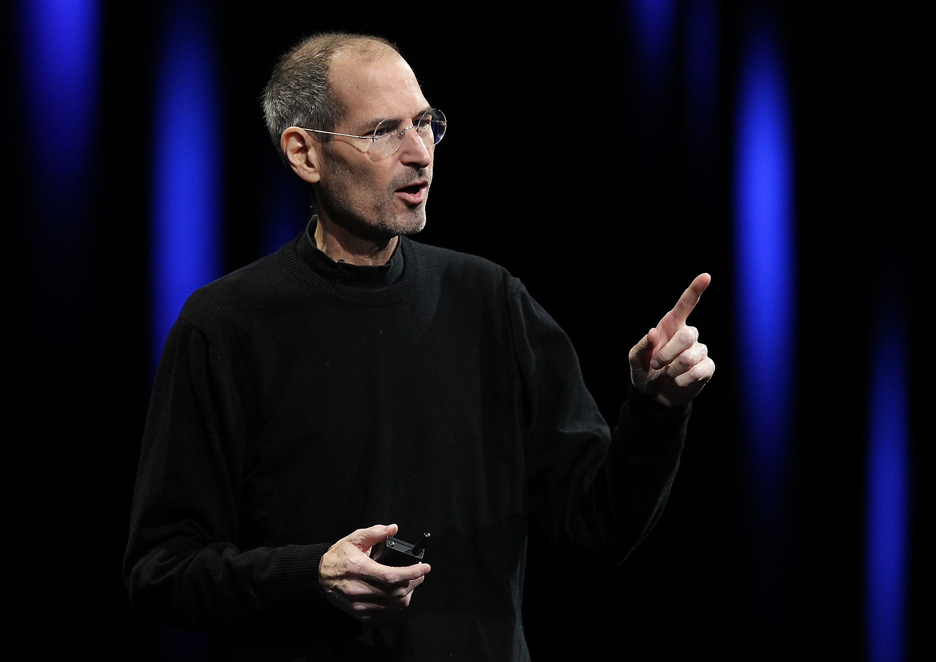
The Three Virtues...of Programmers
Laziness
Impatience
Hubris
  The pride that makes you write and maintain programs that you can be proud of, and that your peers will admire.

Slide 35
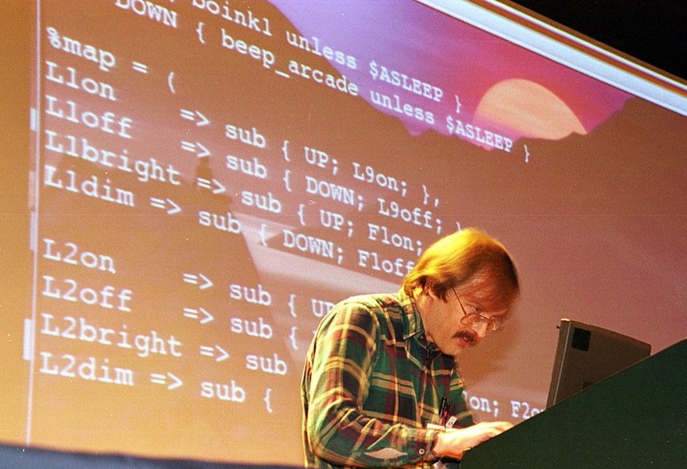
The Three Virtues...of Programmers
Laziness
  ...makes you go to great effort to reduce your overall energy expenditure.
  …makes you write robust, modular, well-documented programs so you can reuse [the effort].
Impatience
  ...anger you feel when the computer is being lazy, which happens when another programmer is not lazy.
  ...makes you write programs that use minimal code so they’re fast, efficient, and anticipate what needs to be done.
Hubris
  ...pride that makes you write and maintain programs that you and your peers will admire.
  ...uncontrolled or undeserved, it can also get you in trouble.

Slide 36
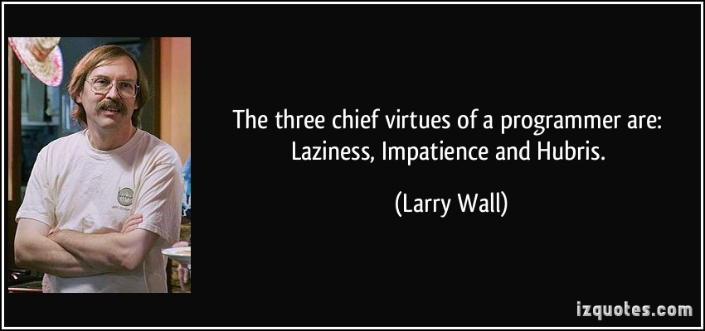

Slide 37
So... Who am I?
Dave Oswald – Hobbiest.
Studied Economics and Computer Science at U of U.
  Also CS in High School, SLCC, LAVC, Independent.
Independent developer and consultant.
  Focus on Perl, C++, and server-side development.
Solving problems programatically is my hobby. Gratifyingly, it's also my job.
daoswald@gmail.com
Salt Lake Perl Mongers
  http://saltlake.pm.org

Slide 38
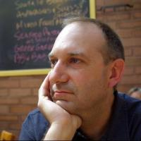
I am...
Dave Oswald – Hobbiest.
Studied Economics and Computer Science at U of U.
  Also CS in High School, SLCC, LAVC, Independent.
Independent developer and consultant.
  Focus on Perl, C++, and server-side development.
Solving problems programatically is my hobby. Gratifyingly, it's also my job.
daoswald@gmail.com
Salt Lake Perl Mongers
  http://saltlake.pm.org
Aspiring to be:
  Lazy
  Impatient
  Hubristic

Slide 39
So, why Perl?

Slide 40
Because...

Slide 41
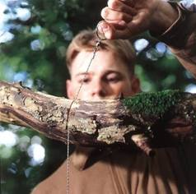
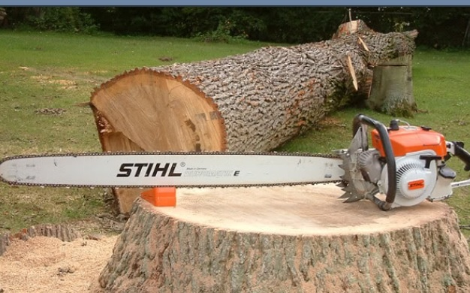
With Perl you can...
...get the job done quickly.

Slide 42
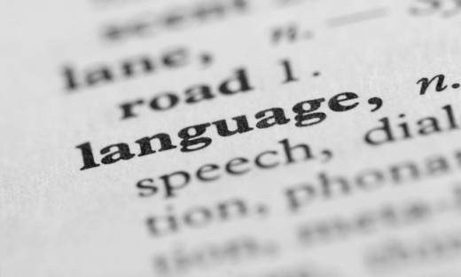

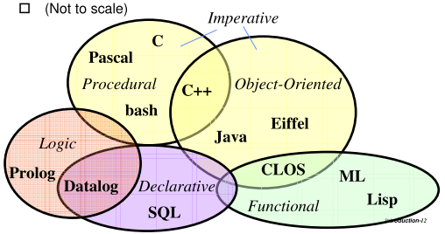
With Perl you can...
Be Expressive.

Slide 43
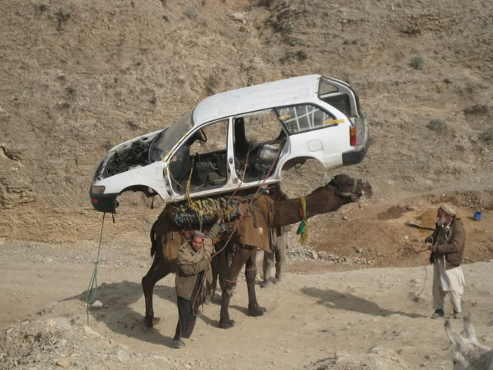
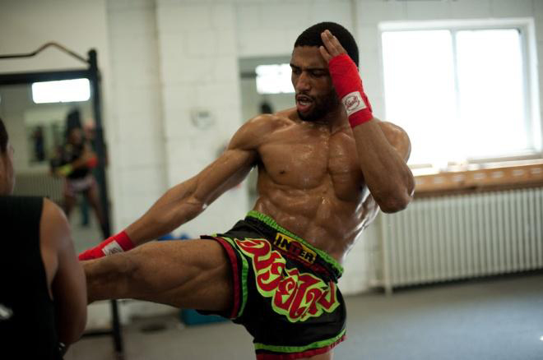
Perl is...
Powerful, with finesse.

Slide 44

Perl is
FUN!

Slide 45
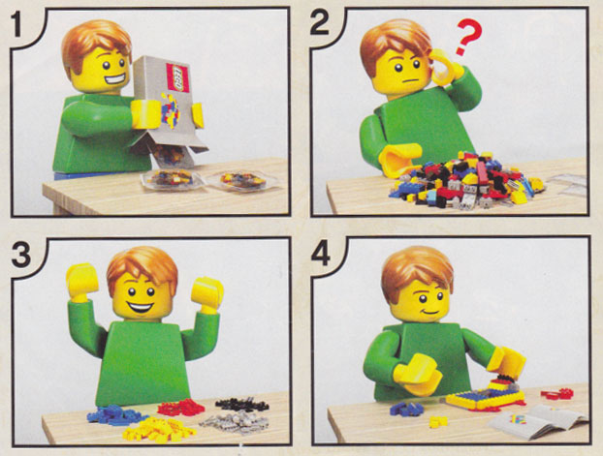
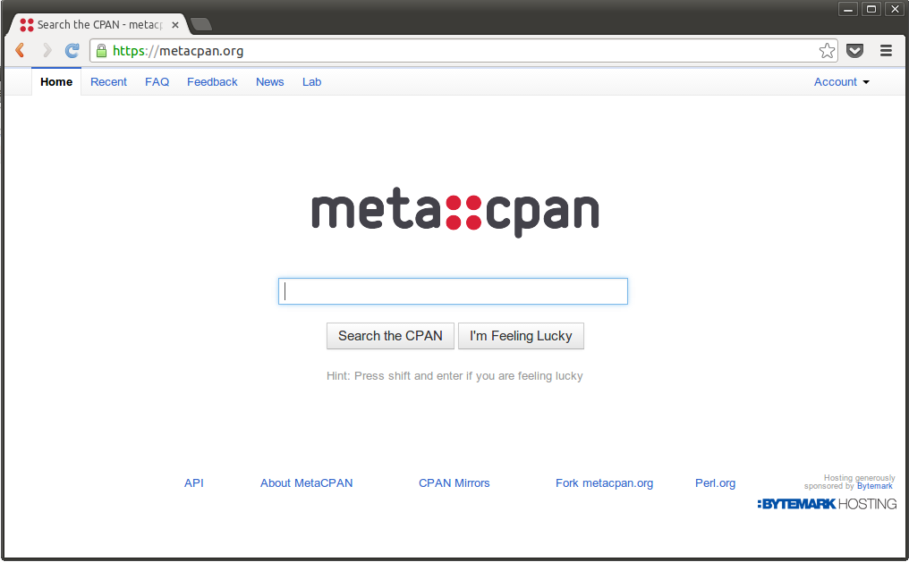
Why Perl?
It will get the job done quickly.
It's expressive.
It's powerful.
It's fun.
CPAN.

Slide 46
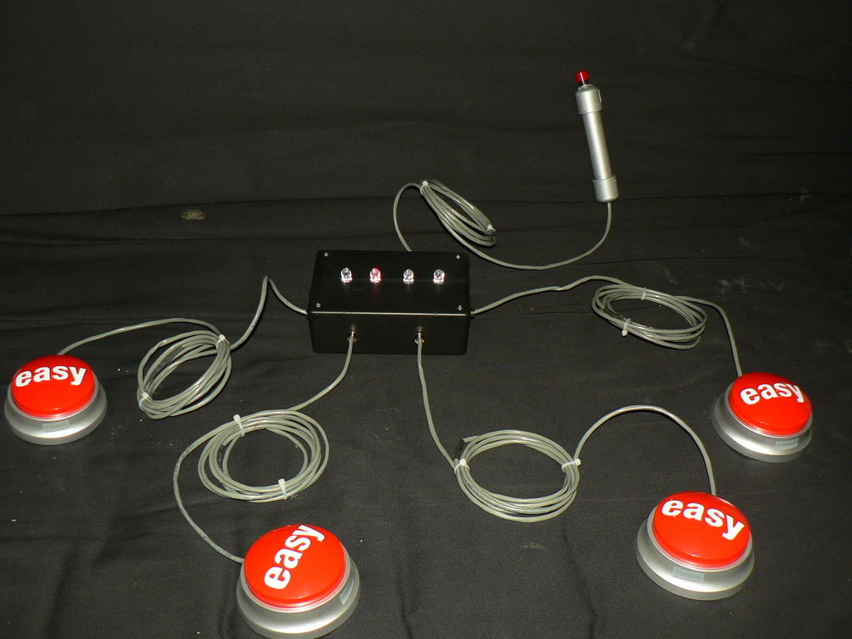
“...easy things should be easy, and hard things should be possible.”
– Programming Perl, 4th ed.

Slide 47
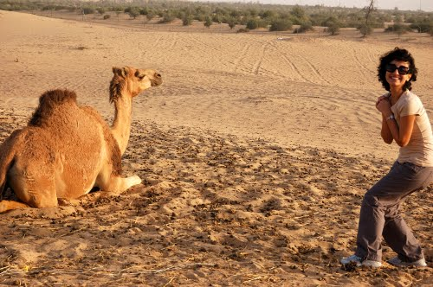
Obtaining Perl

Slide 48
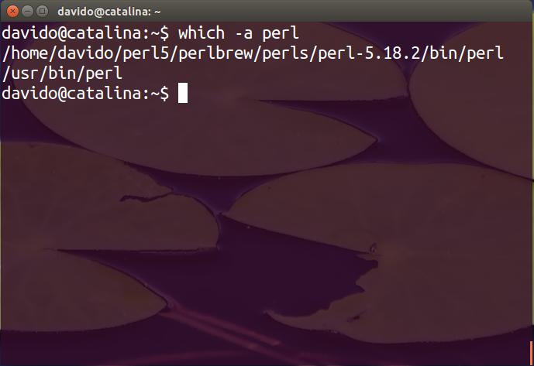
Obtaining Perl
Often it's already installed
  Your “System Perl”

Slide 49
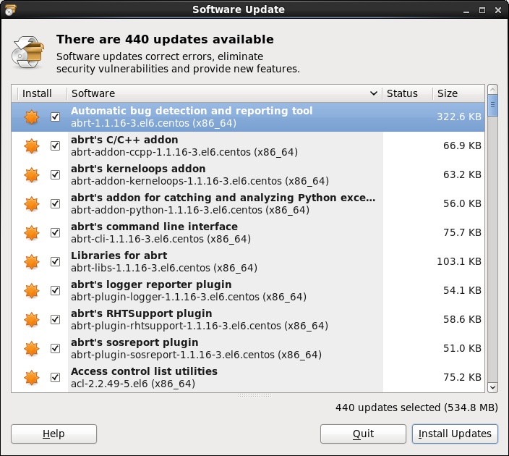
Obtaining Perl
Often it's already installed
  Your “System Perl”
Package managers
  .rpm's, .deb's

Slide 50
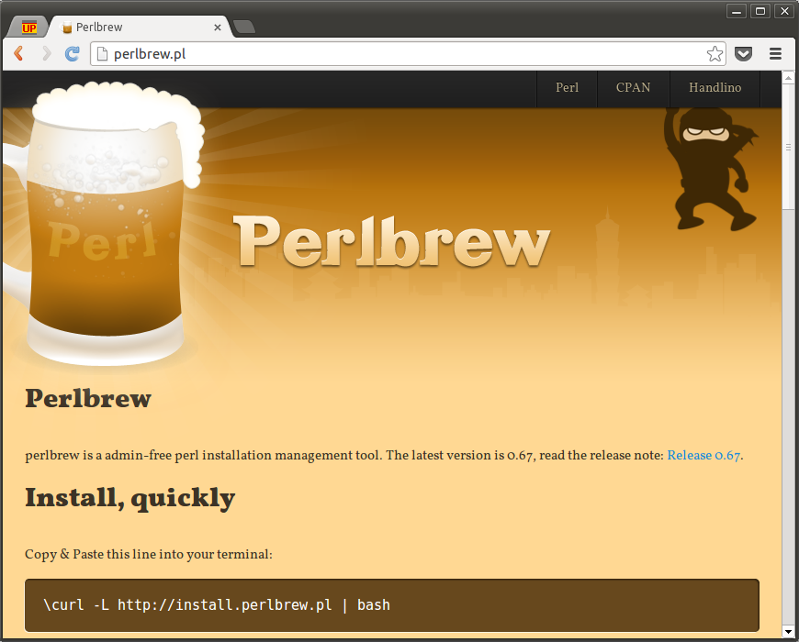
Obtaining Perl
Often it's already installed
  Your “System Perl”
Package managers
  .rpm's, .deb's
Perlbrew
  http://perlbrew.pl

Slide 51
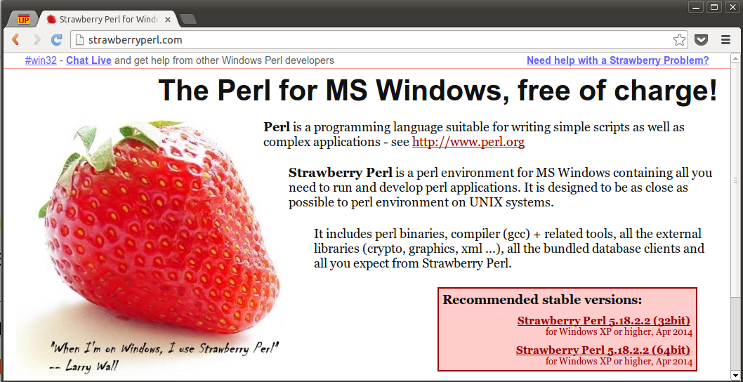
Obtaining Perl
Often it's already installed
  Your “System Perl”
Package managers
  .rpm's, .deb's
Perlbrew
  http://perlbrew.pl
Strawberry Perl
  MS Windows
  http://strawberryperl.com

Slide 52

Obtaining Perl
Often it's already installed
  Your “System Perl”
Package managers
  .rpm's, .deb's
Perlbrew
  http://perlbrew.pl
Strawberry Perl
  MS Windows
  http://strawberryperl.com
Active State
  Windows
  Support

Slide 53
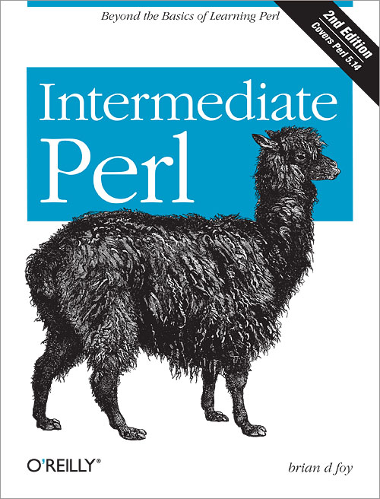
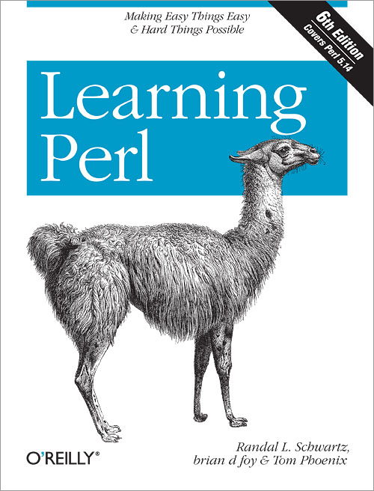

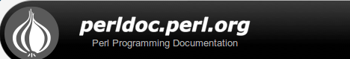
Becoming Productive
with Perl

Slide 54
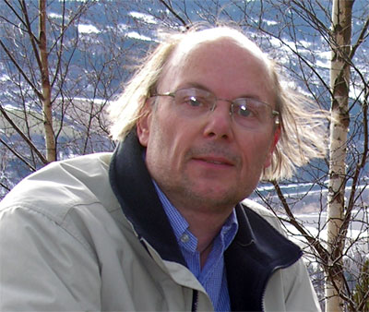
“What you must do - in any language - is to pick a subset, get working writing code, and gradually learn more of the language, its libraries, and its tools.”
– Bjarne Stroustrup
http://www.stroustrup.com/bs_faq.html#big

Slide 55
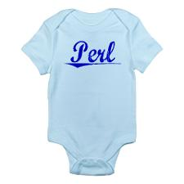
Our Subset
Structure
Data types
Operators
Lexical variables
Loops
Conditionals
Subroutines
Files and Basic IO
Using objects
Using CPAN

Slide 56
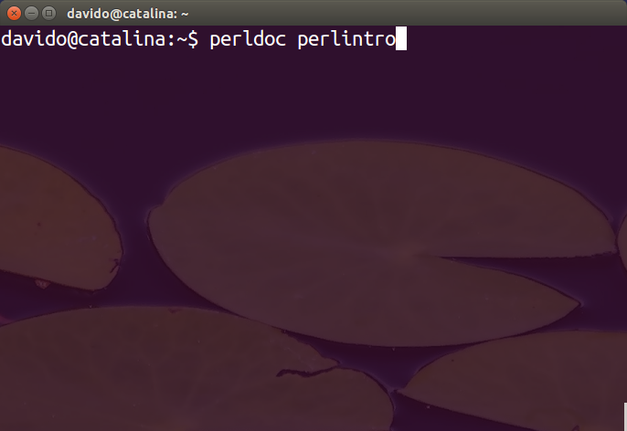
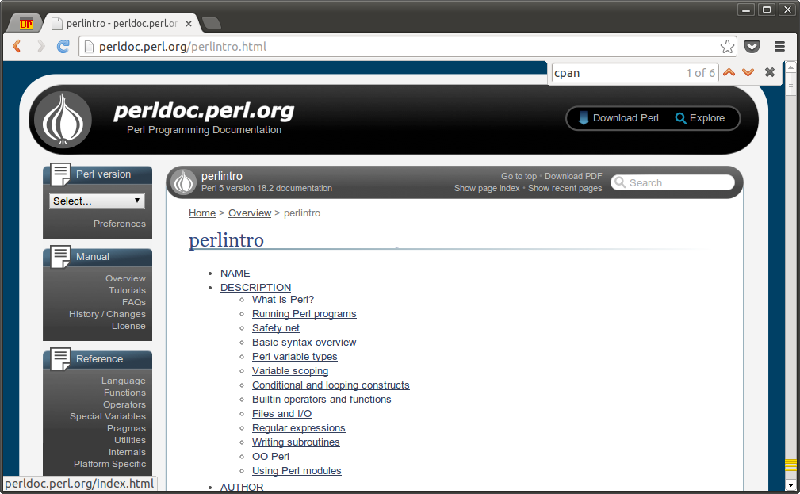
But first, perlintro

Slide 57
The Format
A simple text file
  Whitespace is mostly insignificant, but encouraged.
#!/usr/bin/env perl
# comments
use Quantum::Superpositions 'eigenstates';
use constant PI => 3.141592654;
# Your app for world domination goes here.

Slide 58

The obligatory Hello World!
  #!/usr/bin/perl
  print “Hello world!\n”;
  Save as 'hello', set executable, and invoke as: ./hello
or...
  perl -e 'print “Hello world!\n”'
  perl -E 'say “Hello world!”'
  perl -e 'printf “%s\n”, “Hello world!”'

Slide 59
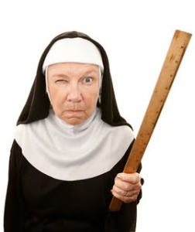
Be Strict!
#!/usr/bin/env perl
use strict;
use warnings;
use autodie;
use diagnostics;

Slide 60
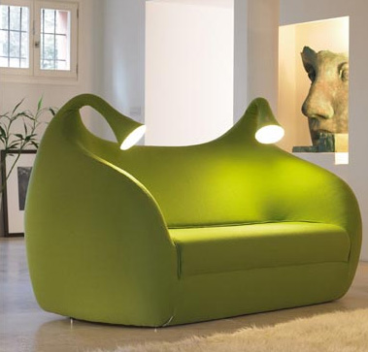
Be Modern!
#!/usr/bin/env perl
use strict;
use warnings;
use diagnostics;
use autodie;
use feature ':5.18'; # or use 5.018;

Slide 61
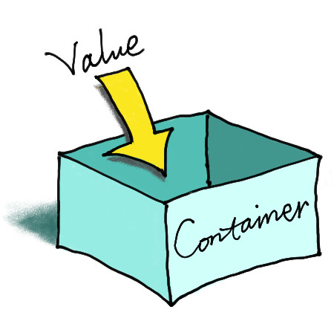
Containers
Scalar containers start with $, and hold one thing.
  my $num = 1;
  my $string = “Hello”
  my $ref = \$num;

Slide 62
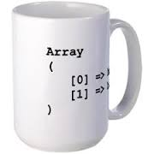
Containers
Scalars
Array containers start with @, and hold zero or more scalars, indexed by integers.
  my @things = qw( this that and the other );
  my @refs = ( \$x, \$y, [@z] );
  print “$things[0]\n”; # this
  print “$things[-1]\n; # other

Slide 63
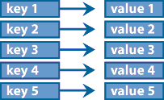
Containers
Scalars
Arrays
Hashes start with %, and hold zero or more values, indexed by keys.
my %set = ( seat => 5, hp => 250, fuel => 'reg' );
print “The car has $set{hp} horsepower.\n”;
print “There are “, scalar keys %set, “ elements.\n”;
my @keynames = keys %set;
my @vals = values %set;
if( exists $set{fuel} ) { ... }

Slide 64

Containers
Scalars
  Single items.
Arrays
  Lists of items.
Hashes
  Collections of values indexed by keys.

Slide 65
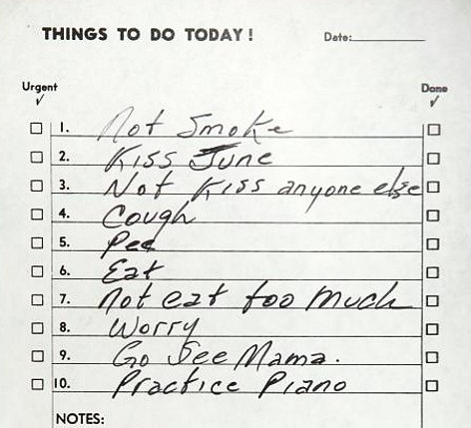


Aggregate vs Scalar
Aggregate types: @, %
Scalar types: $

Slide 66
The Sigil expresses the container type
$scalar # Scalar containers start with $
@array # Array containers start with @
$array[5] # Array elements are scalar containers: $
%hash # Hashes start with %
$hash{key} # Hash elements are scalar containers: $

Slide 67
Containers can hold references
@structure = (
  [ 'a', 'b', 'c' ],
  [ 'd', 'e', 'f' ],
  { 'g' => 42 },
);
print “$lol[2]{g}\n”; # 42

Slide 68
Hash of arrays
%hash = (
  names => [ qw/ bob frank joe / ],
  ages => [ 34, 26, 46 ],
);
print $hash{names}[0], “\n”; # bob
print $hash{ages}[0], “\n”; # 34

Slide 69
Array of hashes
@array = (
  { Name => joe, Age => 34 },
  { Name => pete, Age => 26 }
);
print $array[0]{name}, “\n”; # joe

Slide 70
Hash of hashes
%hash = (
  bob => { age => 34, sex => 'm' },
  joe => { age => 26, sex => 'm' },
  jane => { age => 30, sex => 'f' },
);
print $hash{bob}{age}, “\n”; # 34
print $hash{joe}{sex}, “\n”; # f

Slide 71
Scalar references to an arrays
my $aref =
[ qw/ a b c / ];
print “$aref->[1]\n”;
# b
$aref = \@array;
print “$aref->[1]\n”;
# b

Slide 72

Reference Constructors
\
  Takes a reference to some entity.
[ … ]
  Constructs a reference to an anonymous array.
{ … }
  Constructs a reference to an anonymous hash.

Slide 73
Topic containers
$_ : The “it” or “topic” variable.
  for( 1 .. 100 ) { print “$_\n”; }
@_ : The “subroutine parameters” variable.
  sub sum {
    my $acc;
    $acc += shift @_ while @_;
    return $acc;
  }

Slide 74
Many functions operate on $_ by default
print $_ for 1 .. 10 #12345678910
print for 1 .. 10 # 12345678910
while(<>) { chomp; print; }
print if m/pattern/

Slide 75
Data Types

Slide 76
Perl Data Types
Strings
  “Hello world!\n”
  'Good morning Starshine...'
  '42'
Numbers
  42
  3.141592654
  2.9979e+08
  0xFF
  0655

Slide 77
A few others
References
  Created with \, [...], or {...}
  Dereferenced with ${...}, @{...}, %{...}, or ->
File handles
  Internally implemented as Typeglobs.
Typeglobs
  Mostly for when we want to deal with the man behind the curtain.

Slide 78
Perl Data Types DWYM
(Do What You Mean)
  Duck Typing
say substr(42,0,1)
4
say 'oops' if '0';
  (String '0' is Boolean false)
say '42' – 42;
0

Slide 79
Booleans: What is the truth?
0 : (Numeric 0) False
“0” : (String 0) False
“” : (Empty string) False
undef : (Undefined values) False
Everything that is not false is true.
  Including the string “0E0”

Slide 80

Structure

Slide 81
Subroutines
sub add {
  my @param = @_;
  return $param[0] + $param[1];
}
sub fact {
my $n = shift;
return ( $n <= 1 ) ? 1 : $n * fact( $n - 1 );
}

Slide 82
Namespaces
package Foo;
sub bar { return 1; }
our $baz = “Hello.”;
package main;
print $Foo::baz, “ “, Foo::bar();
# Hello. 1

Slide 83
Package Globals
Variables that aren't lexical (my) are package globals.
  Declare with 'our'.
    our @family = qw( Dave Aileen Nathaniel Noelle );
  Available within the same package.
    print “@family\n”;
  Available globally via fully qualified name.
    print “@main::family\n”;

Slide 84

Looping

Slide 85
Loops (foreach and for)
foreach my $item ( @list ) { print “$item\n”; }
for ( my $i=0; $i!=10; ++$i ) { print “$i\n”; }
say for 1 .. 10;

Slide 86
Loops (while and until)
while( rand(5) > 3 ) { print “Unlucky.\n”; }
print while <>;
do { print “Greetings.\n” } while ( guests() );
print “42\n” until end_of_time();

Slide 87

Breakout!
for( 1 .. 10 ) {
  next if $_ == 5;
  print $_, “\n”;
  last if $_ == 8;
}
1 2 3 4 6 7 8

Slide 88
Files
open my $in_fh, '<', 'myfile.txt' or die $!;
while( my $line = <in_fh> ) {
  chomp $line;
  print “$line\n” if $line eq 'Hello!';
}

Slide 89

Conditionals (if)
if( alive() ) {
  live_life();
}
elsif ( dead() ) {
  haunt();
}
else {
  drink_blood();
}

Slide 90
Conditionals
unless ( dead() ) { stay_alive() }
snore() if $sleeping;
sleep() unless $time > $wakeup_time;
$continue and live(); # Logical short circuit
live() or die “trying.”; # Log. Short circuit

Slide 91
String vs Numeric Relational Operators
3 < 5 # true
6.7 == 42 # false
“abcd” lt “bcde” #true
“abcd” eq “abcd” # true
Numeric:
  ==, <, >, <=, >=, !=, <=>
Stringwise:
  eq, lt, gt, le, ge, ne, cmp

Slide 92

Context: Scalar, or List
my $quantity = @camels; # Scalar context.
my @elements = @array; # List context.
my $item = qw/ a b c /; # c (Scalar context.)
my ($item) = qw/ a b c /; # a (List context.)
foreach( @array ) {…
while( $condition ) { …

Slide 93
Context
@array: List of elements, or element count.
%hash: List of keys=>values, or Boolean “populated/empty”
(1,2,3): List: (1,2,3), Scalar: 3
foreach( list )...
while( scalar )...
Most operators impose scalar context on operands.
Comma doesn't.

Slide 94
Scope
my $foo = 10;
{
  my $foo = 100;
  print $foo, “\n”;
  sub closure { return $foo }
}
print $foo, “\n”;
print closure(), “\n”;

Slide 95
Functional loops
my @times_five = map { $_ * 5 } @numbers;
my @filtered = grep { $_ =~ /^Y/i } @strings;
my @sorted = sort { $b <=> $a } @unsorted;

Slide 96
Decorate, sort, undecorate
my @sorted =
  map { $_->[0] }
  sort { $a->[1] cmp $b->[1] }
  map { [ $_ => lc $_ ] }
  @unsorted;

Slide 97

Regular Expressions

Slide 98
Regular Expressions
$string =~ m/pattern/ #matching
$_ =~ m/pattern/
m/pattern/
/pattern/
$string =~ s/pattern/replacement/ #substitution
$_ =~ s/pattern/replacement/
s/pattern/replacement/

Slide 99
It's the “It” variable again: $_
m/pattern/ matches against $_ by default.
s/pattern/replacement/ substitutes within $_ by default.

Slide 100
Binding other variables: =~
$string =~ m/pattern/
$string =~ /pattern/ # “m” is usually optional.
$string =~ s/pattern/replacement/

Slide 101
In scalar context: Boolean
if( $string =~ m/^Hello/ ) {
  print “Hello to you to!\n”;
}

Slide 102
Captures returned in list context
say for “abcde” =~ m/(.)(.)(.)/;
a
b
c

Slide 103
Captures also populate $1, $2 ...
my $string = “abcde”;
if( $string =~ m/(.)(.)(.)/ ) {
  print “$1$2$3\n”;
}
abc

Slide 104
/g modifier
while( “abcde” =~ m/(.)/g ) {
  print “$1\n”;
}
a
b
c
d
e

Slide 105

Using Core Modules
use strict;
use warnings;
use feature qw(say);
use List::Util 'reduce';
say reduce { $a + $b } ( 1, 2, 3, 4, 5 ); # 15

Slide 106

CPAN

Slide 107


Search CPAN

Slide 108
Using CPAN
$ cpan install Mojolicious;
#!/usr/bin/env perl
use Mojolicous::Lite;
get '/' => { text => 'Hello world!' };
app->start;

Slide 109


Reading
Learning Perl
Intermediate Perl
Programming Perl
Modern Perl
perldoc

Slide 110

“You can sometimes write faster code in C, but you can always write code faster in Perl.”
– perldoc perlembed
Slides available on Slide Share: http://www.slideshare.net/daoswald/toolbelt
David Oswald: daoswald@gmail.com

Slide 111


Slide 112


