Slide 1
Slides:

Slide 2

Regular Expressions
The Little Engine That Could(n't)?

Slide 3

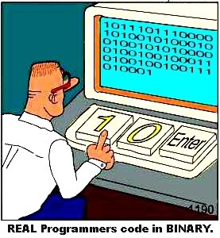
Twitter
#openwest
#perlreintro

Slide 4

Salt Lake Perl Mongers
The local “Perl Community”
  Monthly meetings.
  Partnership discounts.
  Job announcements.
  Everyone learns and grows.
  For the love of Perl!
http://saltlake.pm.org

Slide 5

Who am I?
Aspiring to be Lazy, Impatient, and Hubristic.
Dave Oswald – A Propetual Hobbiest.
Studied Economics and Computer Science at U of U.
  Also CS in High School, SLCC, LAVC, and self-guided.
Independent software developer and consultant.
  Focus on Perl, C++, and server-side development.
Solving problems is my hobby. Surprisingly (often enough), people pay me to do it.
daoswald@gmail.com
Salt Lake Perl Mongers
  http://saltlake.pm.org

Slide 6
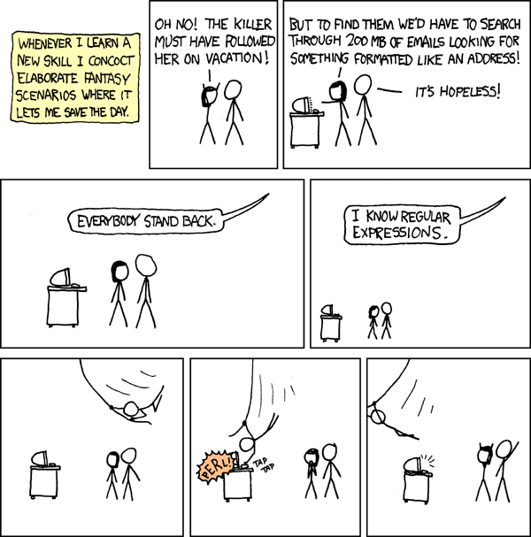
This Is Our Goal Today
https://xkcd.com/208/

Slide 7
oO(um...) This Is ^H^H^H^H^H^H^H^H^H^H^H^H^H^H

Slide 8
This Is NOT Our Goal Today

Slide 9
Reference Materials
perlrequick
perlretut
perlreref
perlre
perlrecharclass
perlrebackslash
perlfaq6
perluniprops

Slide 10

Examples will be in Perl
$_ = 'Just another Perl hacker,';
s/Perl/$your_preference/;
Because this is a Perl course.

Slide 11
Examples will be in Perl
$_ = 'Just another Perl hacker,';
s/Perl/$your_preference/;
Because this is a Perl course.
  Regexes are an integral part of Perl's syntax.
  There are some cool tools unique to Perl.
  PCRE is nearly ubiquitous.
  Perl's regexes are Unicode enabled in modern Perls.

Slide 12
Some Definitions
Literal Characters
  abcdefghijklmnopqrstuvwxyz ABCDEFGJIHKLMNOP...
  1234567890
Metacharacters
  \ | ( ) [ { ^ $ * + ? .
Operators
  m// (match)
  s/// (substitute)
  tr/// (transliterate)
  =~ or !~ (bind)
Metasymbols
  \b \D \t \3 \s \n
  ...and many others

Slide 13
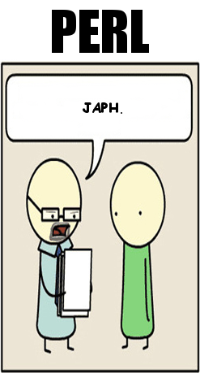
A trivial example
$string = “Just another Perl hacker,”;
# (Target) (Bound to) (Pattern)
say “Match!” if $string =~ m/Perl/;
Match!

Slide 14
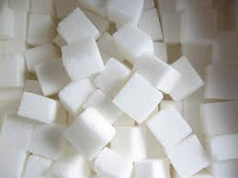
Syntactic Shortcuts
$_ = “Just another Perl hacker,”;
# (Target) (Bound to) (Pattern)
say “Match!” if /Perl/;
Match!

Slide 15
NFA?
DFA?
Hybrid?

Slide 16
/(non)?deterministic finite automation/
Deterministic Finite Automation
  Text-directed match
  No backtracking, more limited semantics.
  awk, egrep, flex, lex, MySQL, Procmail
Non-deterministic Finite Automation
  Regex-directed match
  Backtracking, more flexible semantics
  GNU Emacs, Java, grep, less, more, .NET, PCRE library, Perl, PHP, Python, Ruby, sed, vi, C++11

Slide 17
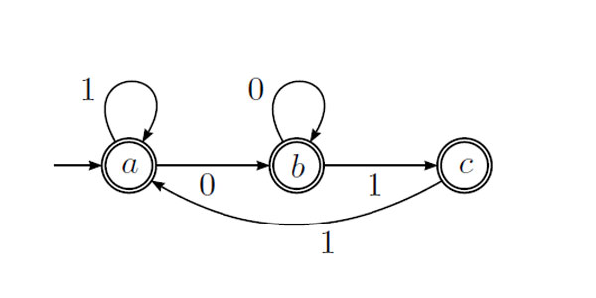
Our focus...
NFA – Nondeterministic Finite Automata
  It's more interesting.
  We tend to use it in more places.
  Perl's regular expression engine is based on NFA.

Slide 18
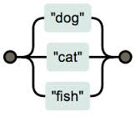
Some Basics
Literals match literals
“Hello world!” =~ m/Hello/; # true.
Alternation
“Hello world!” =~ m/earth|world/; # true (world)

Slide 19
Metasymbols
Some metasymboles match classes of characters.
“Hello world” =~ m/\w\s/\w/; # true: (o w)
Common symbols
  \w (an “identifier” character)
  \s (a “space” character)
  . (anything except newline – and sometimes newline too)
  \d (a numeric digit)
See perldoc perlrebackslash, perlrecharclass

Slide 20
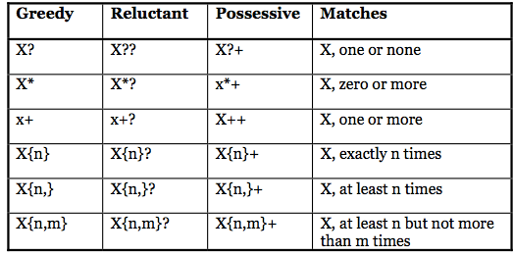
Quantifiers
Quantifiers allow for atoms to match repeatedly.
“Loooong day” =~ m/o+/; # true (oooo)
Common quantifiers
  + (One or more): /o+/
  * (Zero or more): /Lo*/
  {2} (Exactly 2): /o{2}/
  {2,6} (2 to 6 times): /o{2,4}/
  {2,} (2 or more times): /o{2,}/
  ? (0 or 1 times): /o?/

Slide 21

Controlling Greed
Greedy is the default.
“looong” =~ m/o+/; # ooo
? after a quantifier makes it lazy, or non-greedy.
“looong” =~ m/o+?/; # o

Slide 22
Greedy and Non-greedy Quantifiers
Greedy
  *, +, {…}, {… , …}, ?
  'aaaaa' =~ /\w+a/ # aaaaa
Non-Greedy
  *?, +?, {…}?, {… , …}?, ??
  'aaaaa' =~ /\w+?a/ # aa

Slide 23
Anchors / Zero-width assertions.
“Hello world” =~ /^world/; # false.
“Hello world =~ /world$/; # true.
Common anchoring assertions
  ^ (Beginning of string or line – /m dependent)
  $ (End of string or line – /m dependent)
  \A (Beginning of string, always.)
  \z (End of string, always.)
  \b (Boundary between \w\W): “Apple+” =~ /\w\b/

Slide 24


Grouping
(?: … ) – Non-capturing.
“Daniel” =~ m/^(?:Dan|Nathan)iel$/; #true
“Daniel” =~ m/^Dan|Nathaniel$/; # false
( … ) – Group and capture.
“Daniel” =~ m/^(Dan|Nathan)iel$/;
  # Captures “Dan” into $1.

Slide 25
Captures
( … ) captures populate $1, $2, $3...
Also \1, \2, \3 within regexp.
Named captures: (?<name> … )
  Populates $+{name}
  Also \g{name} within regexp.

Slide 26
Capturing
while(
'abc def ghi' =~ m/(?<trio>\w{3})/g
) { print “$+{trio}\n”; }

Slide 27
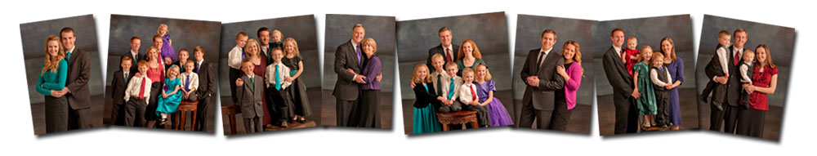
Grouping creates composite atoms
“eieio” =~ /(?:ei)+/; # Matches “eiei”

Slide 28
Custom character classes
[ … ] (An affirmitive characer class)
“Hello” =~ m/[el]+/; # ell
[^ … ] (A negated character class)
“Hello” =~ m/[^el]+/; # H

Slide 29
Character Class Ranges
- (hyphen) is special within character classes.
“12345” =~ m/[2-4]+/; # 234
A literal hyphen must be at the end:
“123-5” =~ m/[345-]/; # 3-5
A literal ^ (carat) must not be at the beginning.
“12^7” =~ m/[0-9^]+/; # 12^7
“12^7” =~ m/[^0-9]+/; # ^

Slide 30

Character Class Ranges in 2014
Unicode means this is probably wrong
m/\A[a-z]*\z/i
  # Contains only English letters (wrong)
  # 52 possibilities.
This is probably better
m/\A\p{Alpha}*\z/
  # Contains only Alphabetic characters.
  # 102,159 possibilities.

Slide 31
Character classes may contain most metasymbols
“1, 2, 3 Clap your hands for me”
=~ m/^[\w\d\s,]{12}/ # 1, 2, 3 Clap
Metasymbols that represent two or more code points are usually illegal inside character classes:
  \X, \R, for example.
Dot (.) is literal in character classes.
Quantifiers and alternation don't exist in character classes.

Slide 32
Escape “special characters”
Literal [ must be escaped with \
“John [Brown]” =~ m/\[(\w+)\]/;
  Captures “Brown”
Adding a \ escapes any special character:
  \\w
  \^
  \{2}
  \(...)

Slide 33
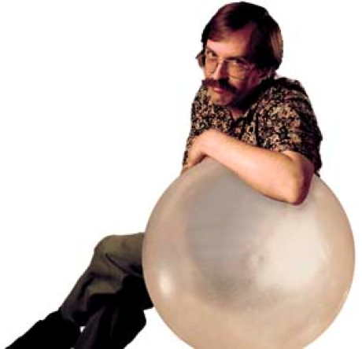
Quotemeta
\Q and \E escape special characters between.
“O(n^2)” =~ m/\Q(n^\E/; # (n^

Slide 34
Zero-width Assertions
\b Match a word boundary
  m/\w\b\W/
(?= … ), (?! … ), (?<= … ), (?<! … )
  '%a' =~ m/(?<!%)\w/; # false

Slide 35

Avoiding Leaning Toothpick Syndrome

Slide 36
Avoid leaning toothpicks
Alternate delimiters
“/usr/bin/perl” =~ m#^/([^/]+)/#;
  Captures usr
  Most non-identifier characters are fine as delimiters.
A bad example
“/usr/bin/perl” =~ m/^\/([^/])\//;
  Still captures usr, but ugly and prone to mistakes.

Slide 37
The next step...

Slide 38
Two big rules
The Match That Begins Earliest Wins
  'The dragging belly indicates your cat is too fat'
  /fat|cat|belly|your/
The Standard Quantifiers Are Greedy
  'to be, or not to be'
  /(to.*)(or not to be)*/
  $1 == 'to be, or not to be'
  $2 == ''

Slide 39
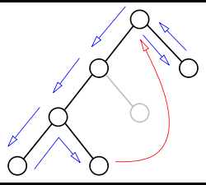
Backtracking
'hot tonic tonight!'
/to(nite|knight|night)/
$1 == 'night'
Matched “tonight”
First tries to match “tonic” with “nite|knight|night”
Then backtracked, advanced the position, attempted at 'o'

Slide 40
Forcing greedy quantifiers to give up ground
'to be, or not to be'
/(to.*)(or not to be)/
$1 == 'to be, '
$2 == 'or not to be'
Watch the backtracking happen...
  ...twelve times.

Slide 41
Backtracking...
'aaaaaab'
/(a*)*[^Bb]$/

Slide 42
Backtracking out of control
'aaaaaab'
/(a*)*[^Bb]$/
“Regex failed to match after 213 steps”

Slide 43
Backtracking under control
'aaaaaab'
/(a*)*+[^Bb]$/
“Regex failed to match after 79 steps”
*+, ++, ?+, {n,m}+: possessive quantifiers.

Slide 44
An extreme example
'a' x 64
/a*a*a*a*a*a*a*a*a*a*a*a*a*a*a*a*a*a*a*a*a*a*a*a*a*a*a*a*a*a*a*a*[Bb]/
This will run for septillions of septillions of years (or until you kill the process).
'a' x 64
/(?>
a*a*a*a*a*a*a*a*a*a*a*a*a*a*a*a*a*a*a*a*a*a*a*a*a*a*a*a*a*a*a*a*
)[Bb]/x
This will not (4550 iterations).
  (?> … ) is another possessive construct.

Slide 45
Leftmost Longest
Not necessarily...
'oneselfsufficient'
/one(self)?(selfsufficient)?/
Matches
  oneself
Captures
  self
Greedy quantifiers only give up if forced.

Slide 46
Greedy, Lazy
'I said foo'
/.*foo/ # Greedy; backtracks backwards.
/.*?foo/ # Lazy; backtracks forward.
'CamelCase' # (TwoWord example)
/([A-Z].*?)([A-Z].*)?/ # $1:'C' GOTCHA!
/([A-Z].*)([A-Z].*)?/ # $1:'CamelCase' GOTCHA!
/([A-Z][^A-Z]*)([A-Z][^A-Z]*)?/ # ok (kinda)

Slide 47
Six more NFA rules
Matches occur as far left as possible.
Alternation has left-to-right precedence.
Any alternative matches if every item listed in the alternative matches squentially such that the entire regexp is satisfied.
If an assertion doesn't match, backtracking occurs to try higher-pecking-order assertions with different choices (such as quantifier values, or alternatives).
Quantifiers must be satisfied within their permissible range.
Each atom matches according to its designated semantics. If it fails, the engine backtracks and twiddles the atom's quantifier within the quantifier's permissible range.

Slide 48
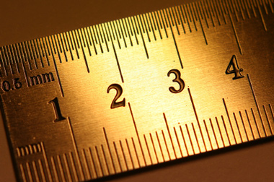
The golden rule of programming
Break the problem into manageable (smaller) problems.

Slide 49
Shorter segments are often easier
'Brian and John attended'
if( /Brian/ && /John/ ) { … }
...is much better than...
if( /Brian.*John|John.*Brian/ ) { … }

Slide 50
Short-circuiting may be more runtime efficient.
if( m/(guillermo|john)/i ) …
if( m/john/ || m/guillermo/ ) …
The former has trie optimization.
The latter still wins if you live in North America.

Slide 51
Modifiers
/g (Match iteratively, or repeatedly)
/m (Alters semantics of ^ and $)
  This is why we often use \A and \z.
/s (Alters semantics of . (dot) )
/x (Allow freeform whitespace)

Slide 52
Unicode semantic modifiers
ASCII Semantics: \a
ASCII Really Really only: \a\a
Dual personality: \d
  The Pre-5.14 standard.
Unicode Semantics: \u
  use v5.14 or newer.

Slide 53
Freeform modifer
/x ignores most whitespace.
m/(Now)\s # Comments
(is)\s # are good
(the)\s # in regexes!
(time.+)\z
/x

Slide 54
/g modifier
while( “string” =~ m/(.)/g ) {
  print “$1\n”;
}
s
t
r
...

Slide 55
Progressive matching
xxo
oxo
oox
# Forward Diagonal:
if(
/ ^ (.).. /gx
&& / \G .($1). /gx
&& / \G ..($1) /gx
) {
print “$1 wins!\n”;
}
$_ = 'xxooxooox'

Slide 56
Extended Bracketed Character Classes
/(?[ \p{Thai} & \p{Digit} ])/x
/(?[ ( \p{Thai} + \p{Lao} ) & \p{Digit} ])/x
/(?[ [a-z] – [aeiou] ])/x
Character classes can now have set semantics:
  & intersections
  + unions
  - subtraction
  ^ symmetric difference
  ! complement

Slide 57
Some people, when confronted with a problem, think "I know, I'll use regular expressions." Now they have two problems.
– Jamie Zawinski

Slide 58
Perl's nature encourages the use of regular expressions almost to the exclusion of all other techniques; they are far and away the most "obvious" (at least, to people who don't know any better) way to get from point A to point B.
– Jamie Zawinski

Slide 59
This issue is not unique to Perl anymore.

Slide 60
Regexes were a big reason why Perl was accused of looking like line noise from a teletype.
But everyone uses regexes now.

Slide 61
Know your problem.
(And know when not to use regexes.)

Slide 62
RegExes are for matcing patterns
This should be obvious, but...
  HTML? (Probably not...)
    Tom Christiansen wrote an HTML parser
      He recommends against it.

Slide 63
RegExes are for matcing patterns
This should be obvious, but...
  HTML? (Probably not...)
  JSON? (Um, no...)
    Merlyn wrote a regex JSON parser.
      It's complicated, not compliant with latest spec, and hard to modify for compliance.
    JSON or JSON::XS provide feature-full correct solutions.
    JSON::Tiny provides a robust solution, yet dependency free, and still small enough for embedding.

Slide 64
RegExes are for matcing patterns
This should be obvious, but...
  HTML? (Probably not...)
  JSON? (Um, no...)
  Email Addresses? (Don't waste your time...)
    Mastering Regular Expressions, 1st Edition demonstrates a regular expression for matching email addresses.
      It was two pages long, not fully compliant, and was omitted from the 2nd and 3rd editions.
    RFC::RFC822::Address parses the email address grammatically.
    Email::Valid applies regex and heuristic tests.

Slide 65
“Regexes optimal for small HTML parsing problems, pessimal for large ones”
“...it is much, much, much harder than almost anyone ever thinks it is.”
“...you will eventually reach a point where you have to work harder to effect a solution that uses regexes than you would have to using a parsing class.”
– Tom Christiansen

Slide 66
You can't parse [X]HTML with regex. Because HTML can't be parsed by regex. Regex is not a tool that can be used to correctly parse HTML. As I have answered in HTML-and-regex questions here so many times before, the use of regex will not allow you to consume HTML. Regular expressions are a tool that is insufficiently sophisticated to understand the constructs employed by HTML. HTML is not a regular language and hence cannot be parsed by regular expressions. Regex queries are not equipped to break down HTML into its meaningful parts. so many times but it is not getting to me. Even enhanced irregular regular expressions as used by Perl are not up to the task of parsing HTML. You will never make me crack. HTML is a language of sufficient complexity that it cannot be parsed by regular expressions. Even Jon Skeet cannot parse HTML using regular expressions. Every time you attempt to parse HTML with regular expressions, the unholy child weeps the blood of virgins, and Russian hackers pwn your webapp. Parsing HTML with regex summons tainted souls into the realm of the living. HTML and regex go together like love, marriage, and ritual infanticide. The <center> cannot hold it is too late. The force of regex and HTML together in the same conceptual space will destroy your mind like so much watery putty. If you parse HTML with regex you are giving in to Them and their blasphemous ways which doom us all to inhuman toil for the One whose Name cannot be expressed in the Basic Multilingual Plane, he comes. HTML-plus-regexp will liquify the n​erves of the sentient whilst you observe, your psyche withering in the onslaught of horror. Rege̿̔̉x-based HTML parsers are the cancer that is killing StackOverflow it is too late it is too late we cannot be saved the trangession of a chi͡ld ensures regex will consume all living tissue (except for HTML which it cannot, as previously prophesied) dear lord help us how can anyone survive this scourge using regex to parse HTML has doomed humanity to an eternity of dread torture and security holes using regex as a tool to process HTML establishes a breach between this world and the dread realm of c͒ͪo͛ͫrrupt entities (like SGML entities, but more corrupt) a mere glimpse of the world of reg​ex parsers for HTML will ins​tantly transport a programmer's consciousness into a world of ceaseless screaming, he comes, the pestilent slithy regex-infection wil​l devour your HT​ML parser, application and existence for all time like Visual Basic only worse he comes he comes do not fi​ght he com̡e̶s, ̕h̵i​s un̨ho͞ly radiańcé destro҉ying all enli̍̈́̂̈́ghtenment, HTML tags lea͠ki̧n͘g fr̶ǫm ̡yo​͟ur eye͢s̸ ̛l̕ik͏e liq​uid pain, the song of re̸gular exp​ression parsing will exti​nguish the voices of mor​tal man from the sp​here I can see it can you see ̲͚̖͔̙î̩́t̲͎̩̱͔́̋̀ it is beautiful t​he final snuffing of the lie​s of Man ALL IS LOŚ͖̩͇̗̪̏̈́T ALL I​S LOST the pon̷y he comes he c̶̮omes he comes the ich​or permeates all MY FACE MY FACE ᵒh god no NO NOO̼O​O NΘ stop the an​*̶͑̾̾​̅ͫ͏̙̤g͇̫͛͆̾ͫ̑͆l͖͉̗̩̳̟̍ͫͥͨe̠̅s͎a̧͈͖r̽̾̈́͒͑e n​ot rè̑ͧ̌aͨl̘̝̙̃ͤ͂̾̆ ZA̡͊͠͝LGΌ ISͮ̂҉̯͈͕̹̘̱ TO͇̹̺ͅƝ̴ȳ̳ TH̘Ë͖́̉ ͠P̯͍̭O̚​N̐Y̡ H̸̡̪̯ͨ͊̽̅̾̎Ȩ̬̩̾͛ͪ̈́̀́͘ ̶̧̨̱̹̭̯ͧ̾ͬC̷̙̲̝͖ͭ̏ͥͮ͟Oͮ͏̮̪̝͍M̲̖͊̒ͪͩͬ̚̚͜Ȇ̴̟̟͙̞ͩ͌͝S̨̥̫͎̭ͯ̿̔̀ͅ
Have you tried using an XML parser instead?
-- Famous StackOverflow Rant

Slide 67
Appropriate Alternatives
Complex grammars
  Parsing classes.
Fixed-width fields
  unpack, substr.
Comma Separated Values
  CSV libraries.
Uncomplicated, predictably patterned data.
  Regular Expressions!

Slide 68
Abuse!
Check if a number is prime:
% perl -E 'say "Prime" if (1 x shift) !~ /^1?$|^(11+?)\1+$/' 1234567
  Attributed to Abigail:
    http://www.cpan.org/misc/japh
  brian d foy (Author of Mastering Perl) dissects it:
    http://www.masteringperl.org/2013/06/how-abigails-prime-number-checker-works/

Slide 69
“Driving home last night, I started realizing that the problem is solvable with pure regexes.”
N Queens Problem: A pure-regexp solution.
  Abigail, again: http://perlmonks.org/?node=297616

Slide 70
#!/usr/bin/perl
use strict;
use warnings 'all';
use Getopt::Long;
Getopt::Long::Configure ("bundling");
GetOptions ('p|print' => \my $print,
'P|Print' => \my $Print,
'n|number=i' => \(my $nr_of_queens = 8)
);
my $nr_of_rows = $nr_of_queens;
my $nr_of_cols = $nr_of_queens;
my @rows = (1 .. $nr_of_rows);
my @cols = map {chr ($_ - 1 + ord 'a')} 1 .. $nr_of_cols;
# Return positions not attacked by a certain other position.
sub free {
my $pos = shift;
my ($col, $row) = $pos =~ /(\D+)(\d+)/;
$col = ord ($col) - ord ('a') + 1;
map {my $c = chr ($_ -> [0] - 1 + ord 'a'); "$c$_->[1]"}
grep {$_ -> [0] != $col && $_ -> [1] != $row &&
abs ($_ -> [0] - $col) != abs ($_ -> [1] - $row)}
map {my $c = ord ($_) - ord ('a') + 1; map {[$c, $_]} @rows} @cols;
}
my $str = join "\n" => map {my $c = $_;
my $l = join "," => map {"$c$_"} @rows;
",$l,"} @cols;
$str .= "\n;\n";
map {$str .= "$_:" . join ("," => free $_) . ",\n"}
map {my $c = $_; map {"$c$_"} @rows} @cols;
my $re = join "\n" => (".*,(\\w+),.*") x $nr_of_queens;
$re .= "\n";
map {my $q = $_;
$re .= "[\\x00-\\xFF]*\\n\\$q:";
map {$re .= ".*\\$_,"} grep {$_ ne $q} 1 .. $nr_of_queens;
$re .= ".*\n"} 1 .. $nr_of_queens;
if ($print || $Print) {
print "'$str' =~ \n/^$re/\n";
exit if $Print;
}
if (my @a = $str =~ /^$re/) {
print "[@a]\n";
}
__END__

Slide 71
Regardless of the language, if it uses PCRE, the Perl POD is the most complete documentation anywhere.

Slide 72
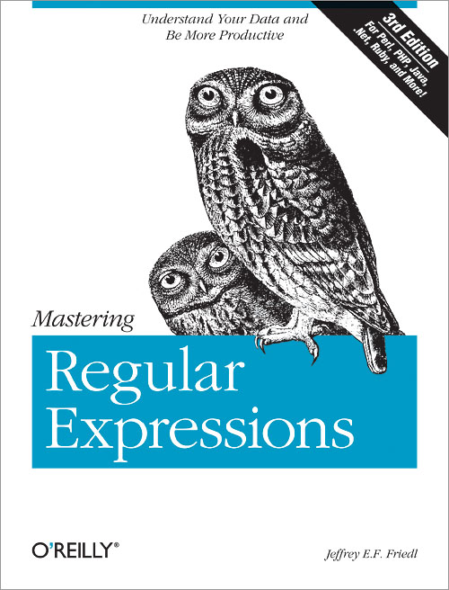
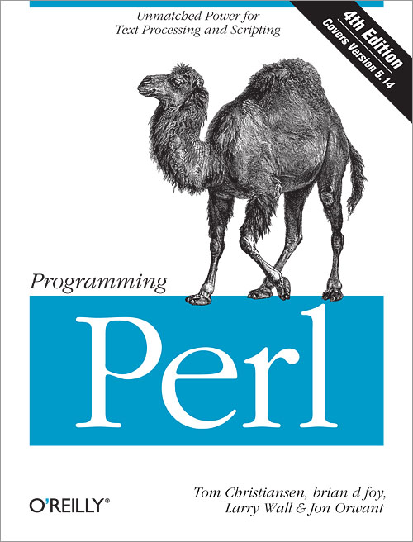
References
Programming Perl, 4th Edition (OReilly)
Mastering Regular Expressions, 3rd Edition (OReilly)
Mastering Perl, 2nd Edition (OReilly)
Regexp::Debugger – Damian Conway
perlre, perlretut, perlrecharclass
perlrequick, perlreref, perlrebackslash
perlfaq6, perluniprops.

Slide 73


Dave Oswald
daoswald@gmail.com
http://saltlake.pm.org (PerlMongers)
http://www.slideshare.net/daoswald/regex-talk-30408635 (SlideShare)

